Slide 1



RF-Diffusion: Radio Signal Generation via Time-Frequency Diffusion
Guoxuan Chi¹, Zheng Yang¹, Chenshu Wu², Jingao Xu¹, Yuchong Gao¹,
Yunhao Liu³, Tony Xiao Han⁴
¹ School of Software and BNRist, Tsinghua University
² Department of Computer Science, The University of Hong Kong
³ Global Innovation Exchange, Tsinghua University
⁴ Wireless Technology Lab, Huawei Technologies Co., Ltd.
https://Guoxuan-Chi.github.io
ACM MobiCom’24
Notes:
Hello everyone, I’m Guoxuan Chi from Tsinghua University. Today, I’ll present our recent work, "RF-Diffusion: Radio Signal Generation via Time-Frequency Diffusion." This research was done in collaboration with my colleagues, supervised by Prof. Zheng Yang and Prof. Yunhao Liu.

Slide 2




Background – AIGC Era
The AIGC era has arrived, encompassing various modalities.
Text: ChatGPT, LLaMA, ChatGLM, Claude, …
Image: Stable Diffusion, DALL·E, Midjourney, …
Video: Sora, Imagen Video, CogVideo, …
Audio: Suno AI, AudioCraft, WaveNet, …
Generative AI has mastered almost all data modalities.
…Except for the RF Signal
Notes:
We are now in the AIGC era, where generative AI models like ChatGPT, Stable Diffusion, and Suno AI are creating impressive results across text, images, video, and audio. However, one modality—RF signals—has not been fully explored. This gap is what we aim to address with RF-Diffusion.
我们都知道生成式AI是近期最热门的一个话题，而且短短两三年，AIGC大模型就已经掌握了大多数我们人类能够感知到的数据模态。
比如我们常提到的大语言模型（LLM），比如ChatGPT，LLaMA等，就是生成式模型在文本数据上的成功应用；比如以Stable Diffusion为代表的一系列AI作画的应用；OpenAI还发布了Sora和Suno，这两个模型分别针对视频和音频生成。
看起来生成式AI已经很好地掌握了我们日常生活中常见的各种模态——除了RF信号。

Slide 3
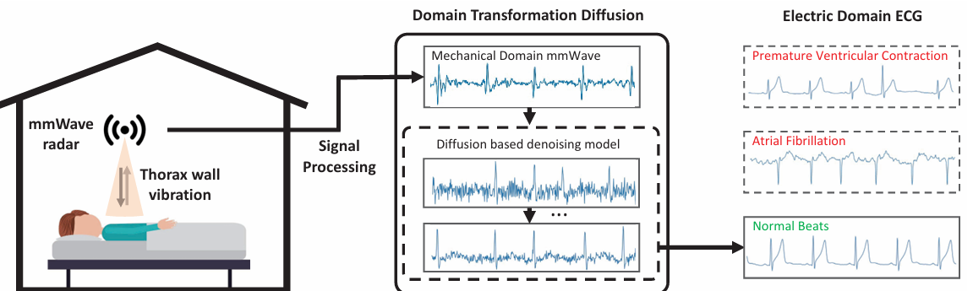
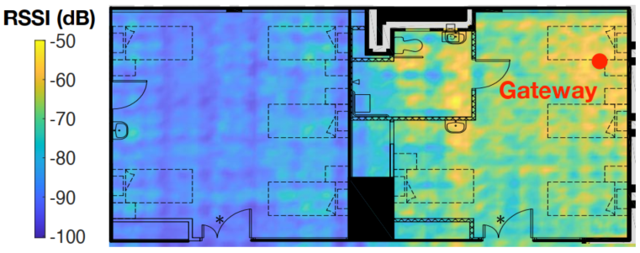

Background – RF Generative Models
The RF-oriented generative models are important for various applications:
Sensing: data augmentation, solve regression problems, …
Communication: signal denoising, heatmap reconstruction, …
mmWave-ECG regression
RF Generative Models contribute to various aspects of the wireless system.
Heatmap Reconstruction
Notes:
RF generative models are important for many applications, including wireless sensing and communication. They can generate synthetic data to augment training dataset. They can also solve regression problems, like constructing ECG from mmWave Radar signal. In communication system, generative models can help signal denoising and heatmap reconstruction, playing a critical role in enhancing the performance of wireless systems.
那么，为什么要去生成射频信号呢？
生成的信号对于无线系统具有重要意义，对于感知和通信任务都是。
一方面，基于生成模型合成的数据，进行训练数据的增广就有助于增强下游任务的鲁棒性和泛化性；
另一方面，这类生成式模型也可以被直接用于解决一些回归问题。 比如右上角这张图，就是使用diffusion model，在给定mmWave Radar信号的条件下，生成ECG的一个例子。
面向通信任务，生成模型也可以完成信号去噪，信号热力图生成等一系列任务。 可以说，生成模型对于无线系统至关重要。

Slide 4
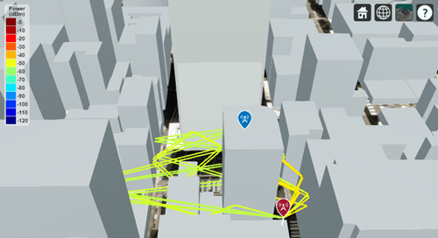
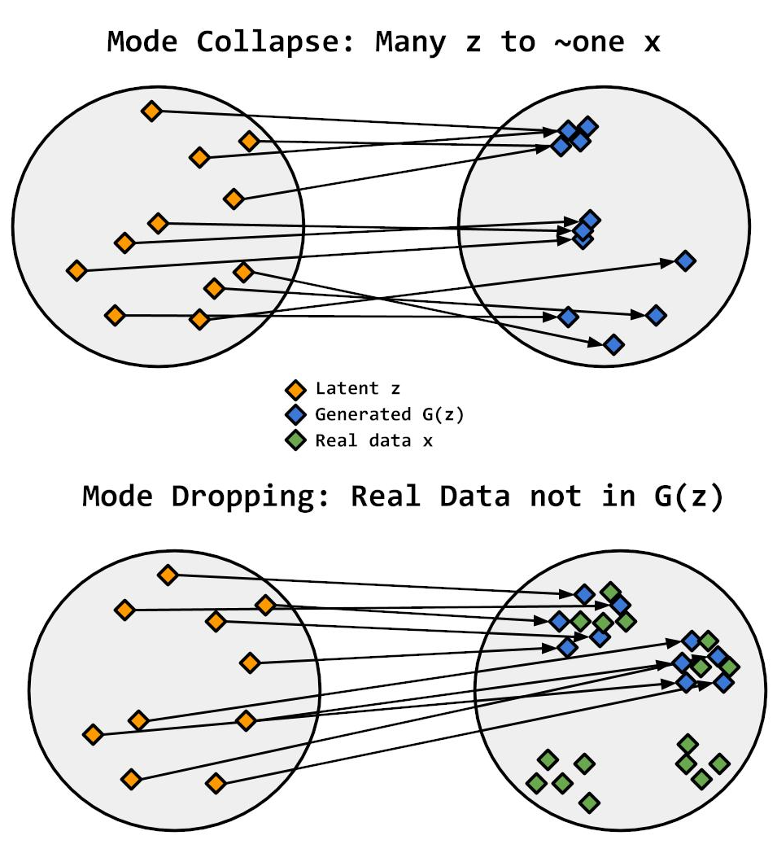

Motivation
Existing RF generation solutions:
Modeling-based: ray-tracing algorithm requires precise 3D model of the environment.
Data-driven:
GAN: low diversity caused by mode collapse;
VAE: low quality caused by mode dropping;
Diffusion has been recognized for its ability to generate high-fidelity and diverse data.
Modelling-based Approach
RF synthesis based on Diffusion Model is promising.
Data-driven Approach
Notes:
Nowadays, existing RF generation methods can be divided into two categories: modeling-based and data-driven approach. Modeling-based methods, like ray tracing, need precise 3D models, which are sometimes impractical. Data-driven methods, such as GANs, face challenges like mode collapse, and VAEs often produce low-quality results.
The Generative Diffusion model, however, offer high fidelity and diversity, making it a promising approach for RF synthesis.
然而，现有的生成方案仍然存在一定的局限性。
对于modeling-based方案，比如ray tracing仿真来说，我们需要提供环境的精确3D模型，甚至需要包括环境的反射系数等材料特性。
对于data-driven的方案，基于GAN的方案通常面临模式坍塌的问题。GAN生成的结果往往会几乎完全地“模仿”训练集中的样例，导致生成结果缺乏多样性；基于VAE的方案，则往往面临mode dropping的问题，导致生成的数据分布和真实数据分布偏移较大，导致生成保真度下降。
近年来，Diffusion Model成为了最火热的一类生成模型，现有研究表明Diffusion模型同时兼顾了高质量和多样性的数据生成，因此我们认为“RF synthesis based on Diffusion Model is promising”。

Slide 5
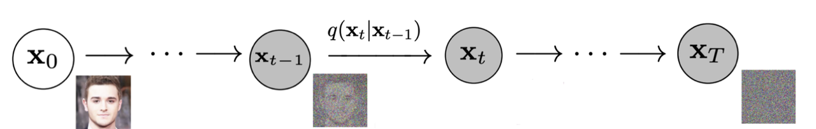
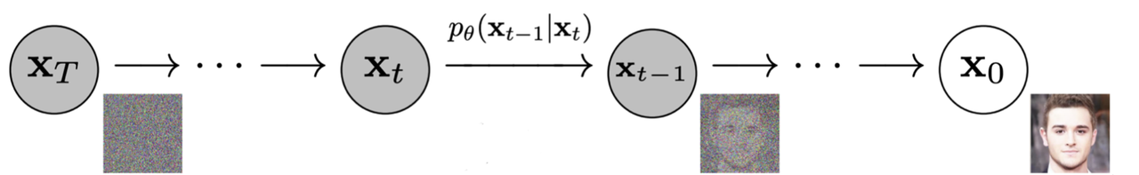
Preliminary
A Traditional Diffusion model performs the following two steps:
Forward Process: gradually inject noise to destruct the original data.
Reverse Process: reconstruct the original data from a noise step by step.
Therefore, Diffusion model can generate data from random noise.
Diffusion model focuses on the feature destructed during the forward process.
Notes:
Before introducing our model design, let's briefly revisit the classic diffusion process which are typically used for image generation. It involves two main steps:
In the forward process, Gaussian noise is gradually added to the original data until the data distribution is almost entirely degraded into random noise.
The second step is the reverse process, where we train a neural network to learn the reverse of the forward process. This allows the model to progressively reconstruct the original data from the noise, step by step.
In simple terms, the diffusion model focuses on reversing the destructive effects of the forward process, enabling it to reconstruct original data distribution from pure noise. This principle forms the foundation of our approach for RF signal generation.
在我们介绍我们设计前，先简单回顾一下经典的面向图像生成的diffusion process，他包含两步：
第一个步骤是逐步向原始数据中添加高斯噪声，直到原始数据分布几乎完全退化为一个高斯噪声；
第二个步骤则是通过训练一个神经网络，使其能够学习到inverse of the forward process，从而能够从被破坏的噪声数据中，逐步还原出前一步的数据；
简单来说，diffusion model致力于恢复forward process的破坏性结果，从而能够从噪声中恢复数据。

Slide 6

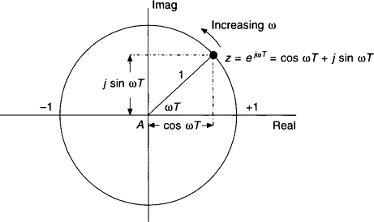
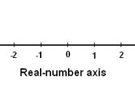
Challenges
RF data are different from the image data:
Time-series: RF signal captures dynamic details over time, unlike static snapshot.
Frequency domain: essential features (e.g., doppler shift) are embedded in the frequency domain.
Complex-Valued: both amplitude and phase carry critical information.
Dynamic signal vs. Static Image
Complex-valued vs. Real-valued
Notes:
The challenge of applying existing diffusion models to RF signals lies in the fundamental differences between RF data and image data.
RF signals are time-frequency signals, which means the critical features are often hidden within dynamic details over time. Additionally, RF signals are complex-valued, meaning both amplitude and phase information are crucial for accurate representation.
These aspects make RF signals fundamentally different from static image data, which are typically represented as real-valued, single snapshots.

Slide 7
Challenges
RF data are different from the image data:
Time-series: RF signal captures dynamic details over time, unlike static snapshot.
Frequency domain: essential features (e.g., doppler shift) are embedded in the frequency domain.
Complex-Valued: both amplitude and phase carry critical information.
1. Capture time-frequency features
with time-frequency diffusion theory.
Dynamic signal vs. Static Image
Complex-valued vs. Real-valued
2. Handle complex-valued inputs, with a complex-valued network design.
Notes:
So, Diffusion model for Radio data should be able to do the following things:
It should be able to Capture time-frequency features within time-series data.
It should be able to Handle complex-valued inputs.

Slide 8
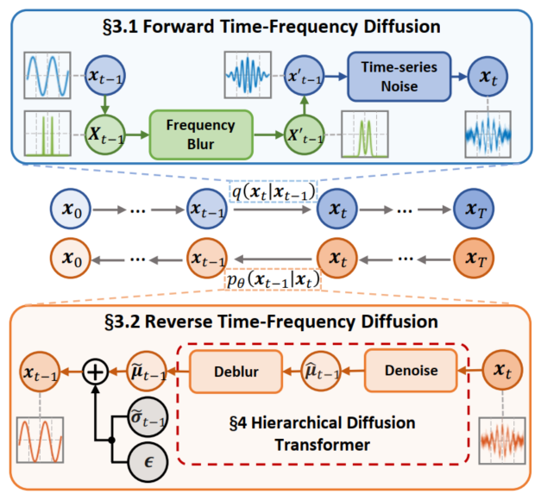
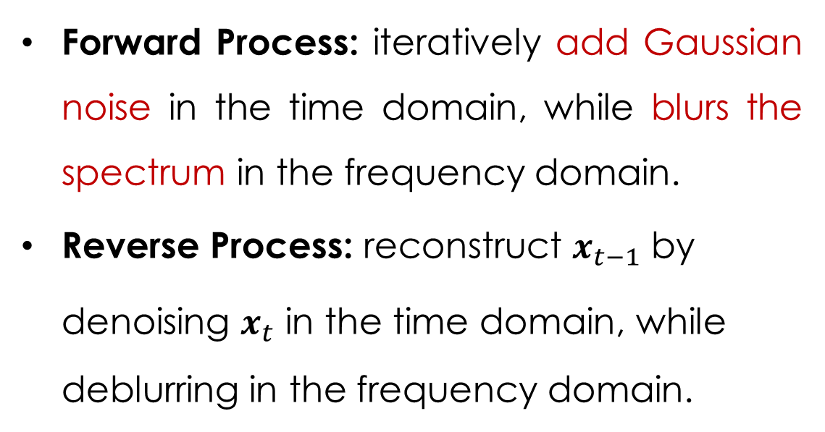
Theory: Time-Frequency Diffusion
Forward Process: iteratively add Gaussian noise in the time domain, while blurs the spectrum in the frequency domain.
Reverse Process: reconstruct $x_{t−1}$ by denoising $x_{t}$ in the time domain, while deblurring in the frequency domain.
Diffusion model focuses on the feature destructed during the forward process.
Notes:
To fully explore the time-frequency feature within RF signals, we propose the time-frequency diffusion theory, which employs a hybrid approach in the forward process. At each step of the forward process, we first 1. blur the spectrum in the frequency domain. 2. add Gaussian noise in the time domain.
[CLICK] The reason behind this design, as I mentioned earlier, is that "the diffusion model focuses on the features destructed during the forward process.“
为了充分探索RF信号中的时频特性，RF-Diffusion的前向过程中交叉使用了两种方法，添加时域高斯噪声，以及对频谱进行模糊。
我们这样做的原因是，正如我之前提到的“Diffusion model focuses on the feature destructed during the forward process“。
[CLICK] 因此我们期望这样能够使训练的神经网络能够同时关注到到信号在时域的幅度特征，以及在频域的频谱连续性特征，使模型能够从两个“正交的视角”理解到信号的分布，从而提升模型的学习效率。
Time-frequency Diffusion模型和传统的Diffusion模型一样，它不仅仅是一项应用技术，同样也具有相对完善的理论支撑。大家如果感兴趣的话可以去查阅原文，我们最后会放一个链接，这里就不再赘述了。

Slide 9
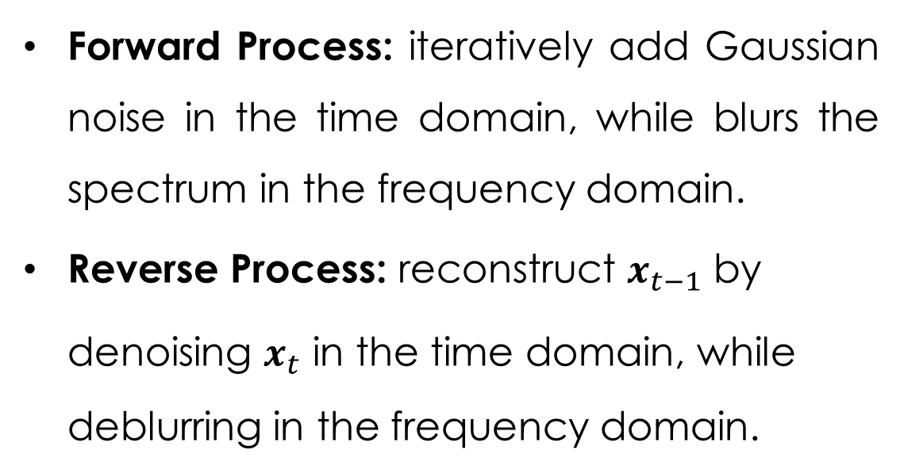
Theory: Time-Frequency Diffusion
Forward Process: iteratively add Gaussian noise in the time domain, while blurs the spectrum in the frequency domain.
Reverse Process: reconstruct $x_{t−1}$ by denoising $x_{t}$ in the time domain, while deblurring in the frequency domain.
Time-Frequency Diffusion emphasizes the time-domain amplitude accuracy and the frequency-domain continuity.
Notes:
[CLICK] Therefore, by incorporating both time-domain noise and frequency-domain blurring, we aim to train the neural network which can simultaneously capture amplitude features in the time domain and continuity features in the frequency domain.
This approach allows the model to understand the signal distribution from both time and frequency perspective, and ultimately improving learning efficiency.
For more theoretical details, please refer to our paper if you're interested. 为了充分探索RF信号中的时频特性，RF-Diffusion的前向过程中交叉使用了两种方法，添加时域高斯噪声，以及对频谱进行模糊。
我们这样做的原因是，正如我之前提到的“Diffusion model focuses on the feature destructed during the forward process“。
[CLICK] 因此我们期望这样能够使训练的神经网络能够同时关注到到信号在时域的幅度特征，以及在频域的频谱连续性特征，使模型能够从两个“正交的视角”理解到信号的分布，从而提升模型的学习效率。
更多详细的证明，以及有关合理性的解释，您可以参考我们的paper。

Slide 10
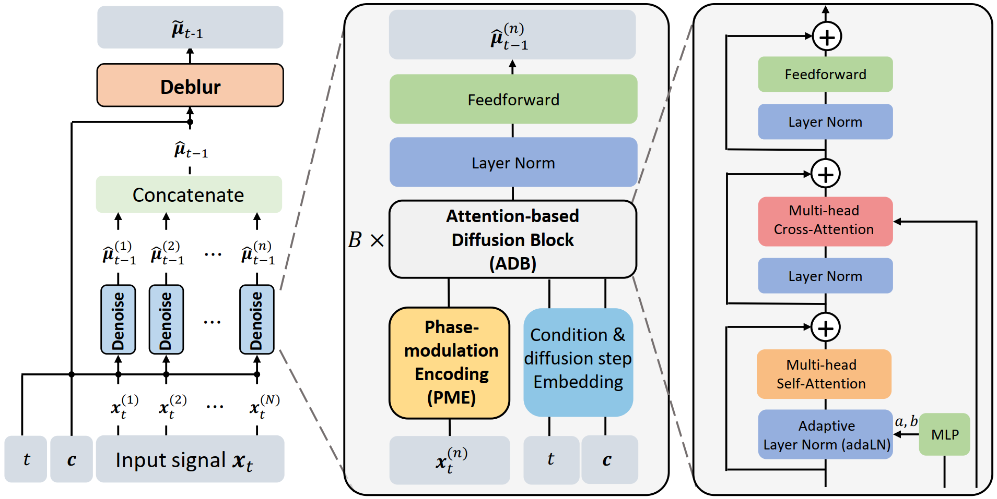
Design: Hierarchical Diffusion Transformer
Hierarchicy: HDT is divided into 2 stages, the denoising and deblurring stages.
Complex-valued: propose the complex-valued attention and feed-forward module to adapt to complex signals.
Phase modulation: a positional encoding scheme tailed for complex-valued signals.
HDT adopts a hierarchical architecture to decouple noise and spectrum blur.
Along with a complex-valued design to adapt to complex-valued signals.
Notes:
To incorporate with our proposed Time-Frequency Diffusion theory, we developed a Hierarchical Diffusion Transformer (HDT) framework.
The HDT adopts a hierarchical architecture that decouples Gaussian noise and spectral blurring into 2 stages. First, each sample is independently denoised, and then all samples are concatenated into a series for deblurring. The entire model is implemented using a complex-valued neural network structure, …
[CLICK] with complex-valued module designs like complex-valued attention, complex-valued feed-forward network,
[CLICK] and a novel phase modulation encoding module.
which further enhances the model's learning efficiency.
为了适配我们提出的时频扩散理论，我们设计了一种Hierarchical Diffusion Transformer，它采用了一种层级式架构来解耦并分别消除高斯噪声和频谱模糊。模型整体上采用了复数域神经网络架构实现，with我们提出的复数域attention模块和FFN模块，以及一种独特的复数域Transformer位置编码算法，提升模型的学习效率。

Slide 11
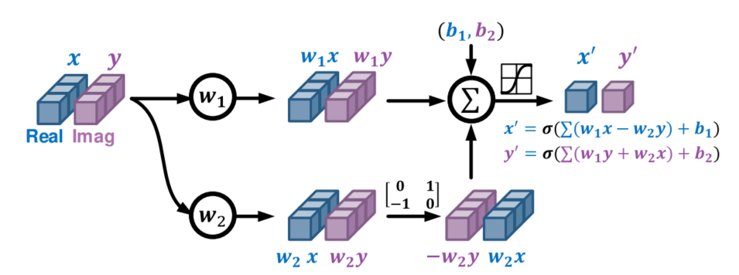
Design: Hierarchical Diffusion Transformer
Hierarchicy: HDT is divided into 2 stages, the denoising and deblurring stages.
Complex-valued: propose the complex-valued attention and feed-forward module to adapt to complex signals.
Phase modulation: a positional encoding scheme tailed for complex-valued signals.
Complex-valued NN module
HDT adopts a hierarchical architecture to decouple noise and spectrum blur.
Along with a complex-valued design to adapt to complex-valued signals.
Notes:
To incorporate with our proposed Time-Frequency Diffusion theory, we developed a Hierarchical Diffusion Transformer (HDT) framework.
The HDT adopts a hierarchical architecture that decouples Gaussian noise and spectral blurring into 2 stages. First, each sample is independently denoised, and then all samples are concatenated into a series for deblurring. The entire model is implemented using a complex-valued neural network structure, …
[CLICK] with complex-valued module designs like complex-valued attention, complex-valued feed-forward network,
[CLICK] and a novel phase modulation encoding module.
which further enhances the model's learning efficiency.
为了适配我们提出的时频扩散理论，我们设计了一种Hierarchical Diffusion Transformer，它采用了一种层级式架构来解耦并分别消除高斯噪声和频谱模糊。模型整体上采用了复数域神经网络架构实现，with我们提出的复数域attention模块和FFN模块，以及一种独特的复数域Transformer位置编码算法，提升模型的学习效率。

Slide 12
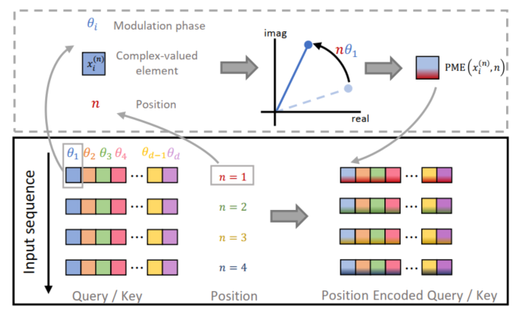
Design: Hierarchical Diffusion Transformer
Hierarchicy: HDT is divided into 2 stages, the denoising and deblurring stages.
Complex-valued: propose the complex-valued attention and feed-forward module to adapt to complex signals.
Phase modulation: a positional encoding scheme tailed for complex-valued signals.
Phase modulation encoding
HDT adopts a hierarchical architecture to decouple noise and spectrum blur.
Along with a complex-valued design to adapt to complex-valued signals.
Notes:
To incorporate with our proposed Time-Frequency Diffusion theory, we developed a Hierarchical Diffusion Transformer (HDT) framework.
The HDT adopts a hierarchical architecture that decouples Gaussian noise and spectral blurring into 2 stages. First, each sample is independently denoised, and then all samples are concatenated into a series for deblurring. The entire model is implemented using a complex-valued neural network structure, …
[CLICK] with complex-valued module designs like complex-valued attention, complex-valued feed-forward network,
[CLICK] and a novel phase modulation encoding module.
which further enhances the model's learning efficiency.
为了适配我们提出的时频扩散理论，我们设计了一种Hierarchical Diffusion Transformer，它采用了一种层级式架构来解耦并分别消除高斯噪声和频谱模糊。模型整体上采用了复数域神经网络架构实现，with我们提出的复数域attention模块和FFN模块，以及一种独特的复数域Transformer位置编码算法，提升模型的学习效率。

Slide 13
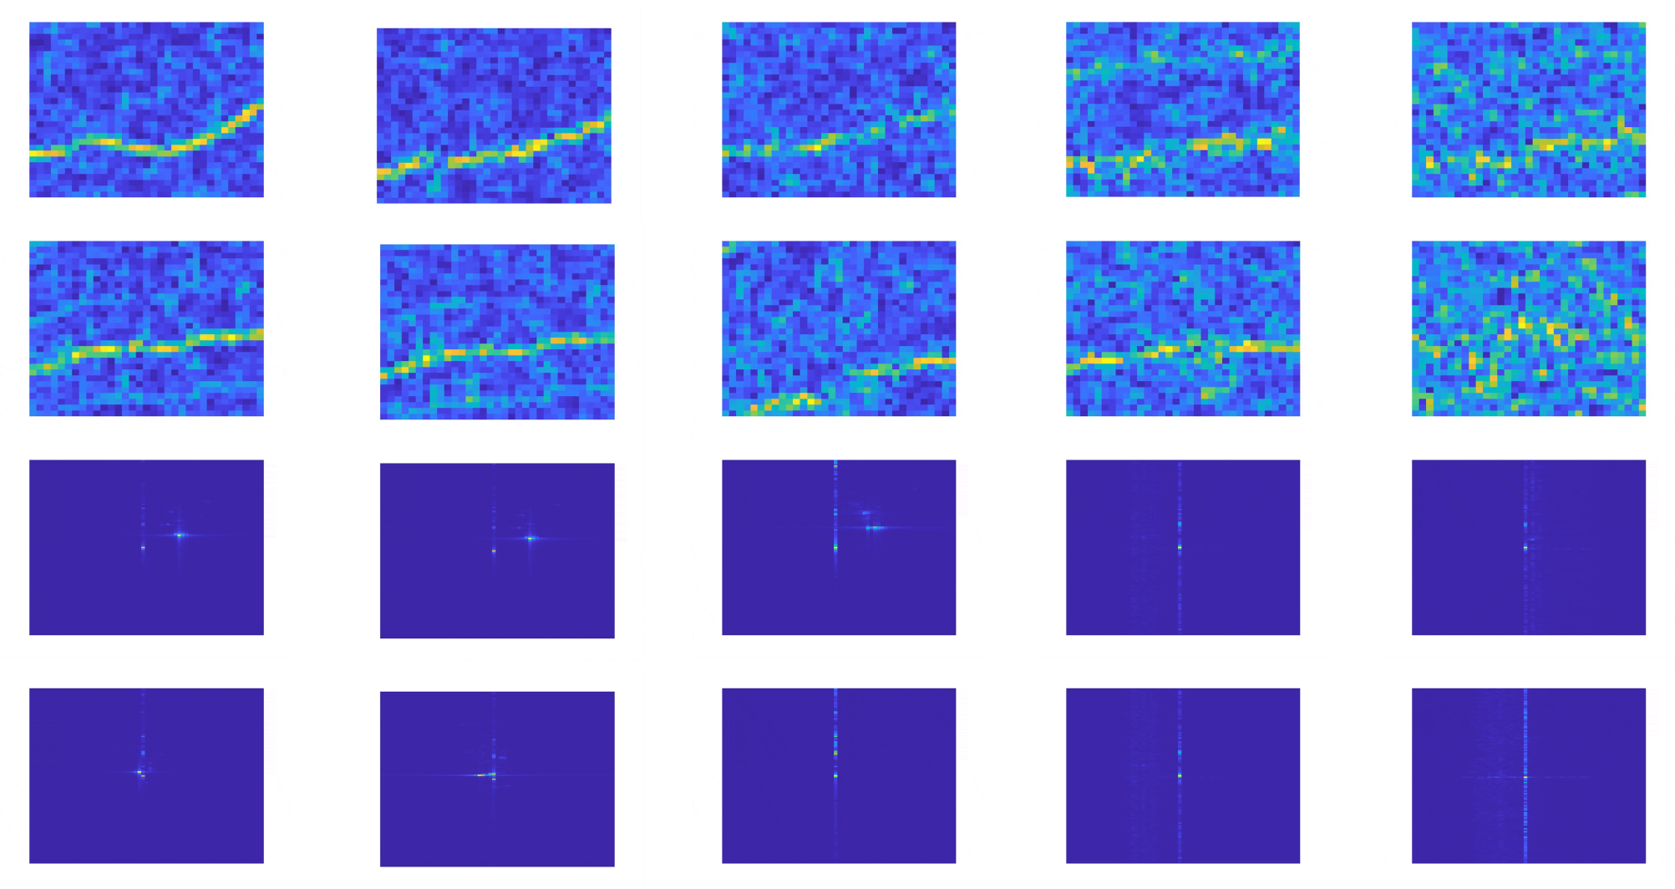
Visualization
 |  | Authentic | RF-Diffusion | DDPM | DCGAN | CVAE
Wi-Fi CSI (Doppler Frequency Spectrum) | Sample ①
 | Sample ②
FMCW (Range-Velocity Doppler) | Sample ①
 | Sample ②
Notes:
We tested RF-Diffusion on Wi-Fi CSI and FMCW radar signals. And we use feature spectrograms to visualize the results. Our model generates much clearer and more accurate spectrograms compared to traditional denoising diffusion model, GAN, and VAE methods.

Slide 14
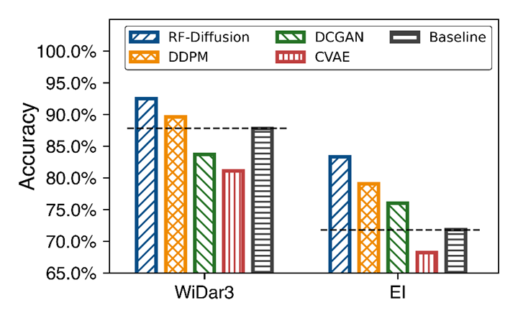
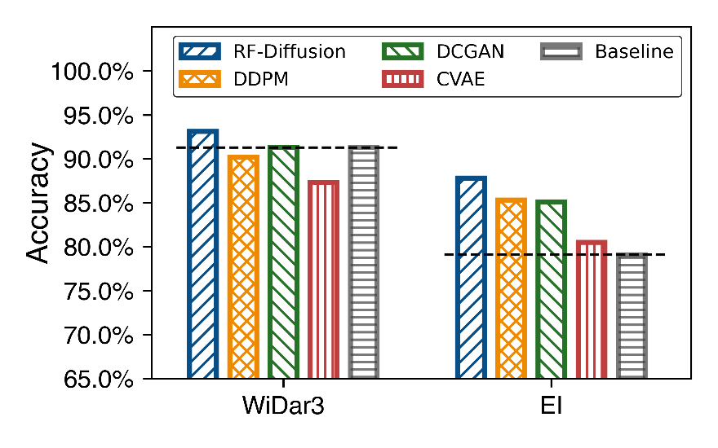
Case Study: Sensing data augmentation
Mixing synthesized wireless data with the original training set to jointly train Wi-Fi gesture recognition models results in performance improvements:
In cross-domain scenarios, Widar and EI saw increases of 4.7% and 11.5%, respectively;
In in-domain situations, Widar and EI experienced gains of 1.8% and 7.5%, respectively;
Cross-domain Performance
In-domain Performance
Notes:
We also used RF-Diffusion for data augmentation in wireless sensing. By generating synthetic samples and mixing them with the original training dataset, we saw improved performance in Wi-Fi gesture recognition tasks. We observed that high-quality generative data increased accuracy, while low-quality models, like VAE, may even degrade the original performance.
我们进一步地尝试用生成模型进行无线感知数据增广。具体来说，我们先用给定的训练集训练一个生成扩散模型，然后让这个生成模型合成一部分样本，混到原始的训练集里面。然后真实的和合成的数据一起训练无线感知模型。
我们在基于Wi-Fi的手势识别这个任务上进行了测试，选择了Widar3和EI两种类型的系统。最后的结论是，引入高质量的生成模型，能够通过增加训练数据的多样性，提升模型的性能表现。
当然了，如果模型本身的生成质量较差，比如VAE，反而会让感知系统的性能下降。

Slide 15
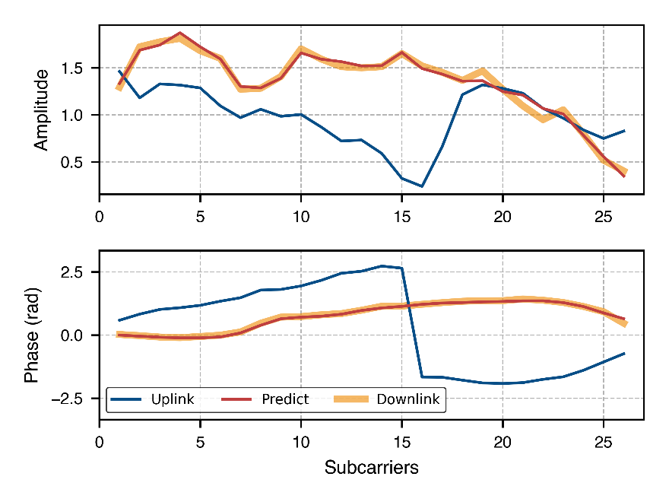
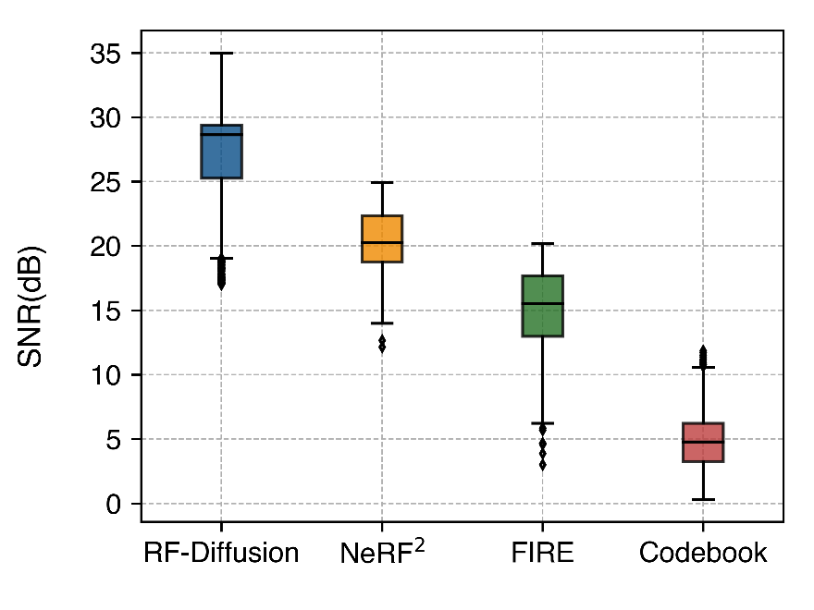
Case Study: FDD Channel Prediction
Taking channel uplink CSI as a condition, RF-Diffusion can generate the downlink CSI:
Compared to the SOTAs, RF-Diffusion achieved over 5.9 dB performance gain;
The MSE of channel estimation has been reduced by about 70%;
Predicted CSI amplitude and phase
SNR Performance
Notes:
We further applied our model to a classic wireless communication problem: channel estimation. Specifically, given the uplink CSI, we aim to estimate the corresponding downlink CSI.
By encoding the uplink Channel State Information (CSI) as a conditional vector, we were able to guide the RF-Diffusion model to generate the downlink CSI effectively.
In the left figure, the blue line represents the amplitude and phase of the uplink CSI, which serves as the input. The orange line is the actual downlink CSI that we want to predict. Our estimation, shown by the red line, almost perfectly overlaps with the orange line.
When evaluated using the SNR metric, our generative approach improved prediction accuracy by 5.9 dB compared to prior channel estimation methods. This translates to an approximate 70% reduction in estimation error.
我们还将时频扩散模型应用在无线通信领域的一个经典的信道估计问题中。也就是已知上行信道的CSI，希望能够估计出对应下行信道的CSI。
我们发现，如果我们把上行信道状态信息编码成条件向量输入。完全可以引导RF-Diffusion模型生成下行链路的CSI。
可以看到，蓝色的是上行链路CSI的幅度和相位，我们把它作为输入，橙色的是实际的下行链路的CSI幅度和相位，是我们要拟合的数值。我们的估计结果是这条红线，几乎完全和橙色重合了，没有误差。
当使用预测SNR指标评估时，我们的基于生成式的方案相比于先前的信道估计方案提升了5.9dB的预测准确度。这等同于估计的误差降低了大概70%。

Slide 16
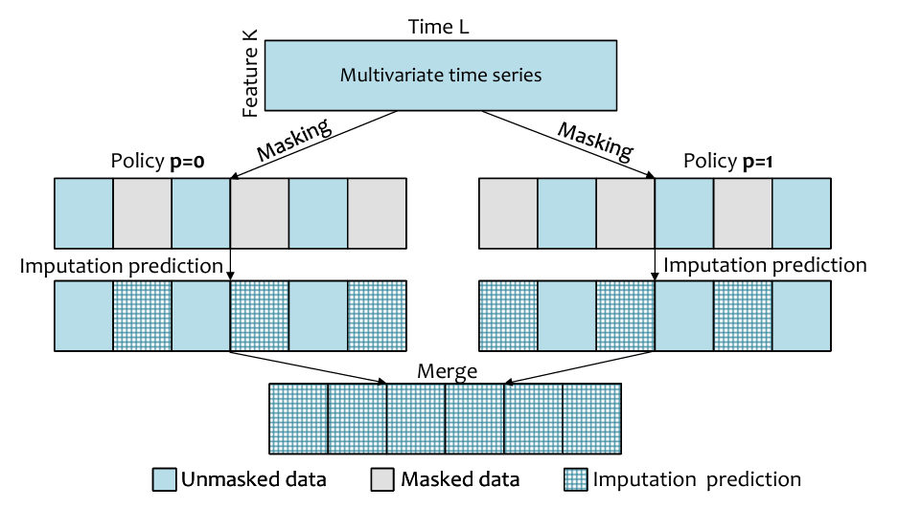
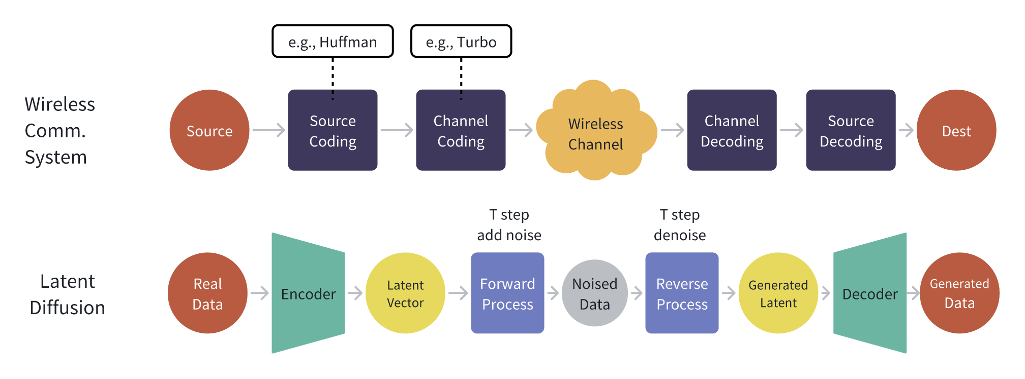
Future Work
RF-Diffusion benefits future wireless researches:
New paradigm for wireless sensing：
Data augmentation for localization and sensing.
Generative approach for regression:
AirECG: From mmWave to ECG;
AnoSense: Anomaly activity detection;
Improve wireless communication systems:
Channel prediction with CSI feedback;
Wireless signal denoise;
Beamform generation;
Inference mitigation;
Imputation-based anomaly detection
Diffusion for signal denoise
Notes:
Beyond these results, our ongoing projects focus on expanding this approach. This includes anomaly activity detection and signal denoising using diffusion models. We believe RF-Diffusion holds have great potential for a wide range of future applications.
除此之外，我们的on going project都是围绕它展开，基于diffusion的异常活动检测，以及使用diffusion model提升无线通信系统性能，等等。

Slide 17

Takeaways
We propose RF-Diffusion:
The first generative diffusion model tailored for RF signals.
Can be applied to different types of RF signal and wireless tasks.
From the theoretical perspective:
Propose the Time-Frequency Diffusion Theory.
Evolution beyond traditional denoising-based diffusion model (DDPM).
From the implementation perspective:
Propose the Hierarchical Diffusion Transformer.
Introduce many complex-valued NN modules.
Our implementation is open-sourced on GitHub.
Notes:
In summary, our contributions are as follows:
We introduced the first generative diffusion model specifically for RF signals, which can be applied for various types of signals and wireless tasks.
We developed the Time-Frequency Diffusion theory, extending traditional denoising diffusion approaches, and implemented it using complex-valued neural networks.
Finally, our project, including the code, pretrained small models, and test data, is publicly available on GitHub.
简单总结一下贡献：
我们提出了首个面向RF信号的生成式扩散模型，面向不同类型的信号和无线任务，都有着优越性。
我们提出的时频扩散理论有效拓展了传统的去噪扩散理论，并基于复数域神经网络进行了实现。
我们的工作，包括代码、预训练模型、测试数据都已经在Github上公开。

Slide 18

RF-Diffusion: Radio Signal Generation via Time-Frequency Diffusion
Q&A
Guoxuan Chi
Tsinghua University
Notes:
I'm pleased to share that our work received all four badges in Artifact Evaluation. You can scan the QR code on the right side to visit our GitHub project and explore more potential applications.
That’s the end of my presentation. Thank you for listening. 我感到很开心，我们的工作在Artifact Evaluation环节获得了全部四枚徽章，大家可以扫描右侧的QR code访问我们的GitHub项目，探索更多可能的应用。

