Slide 1
Tool wear monitoring with 𝜷-variational-autoencoder
IE7374 Sensor Analytics for Eng. Sys. Course Project
12/07/2022
Guoyan Li

Slide 2
Outline
1.Project Introduction
2.Dataset collection and design of experiments
3.Project objective
4.Framework Details
5.Performance evaluation
6.Insights and Summary

Slide 3
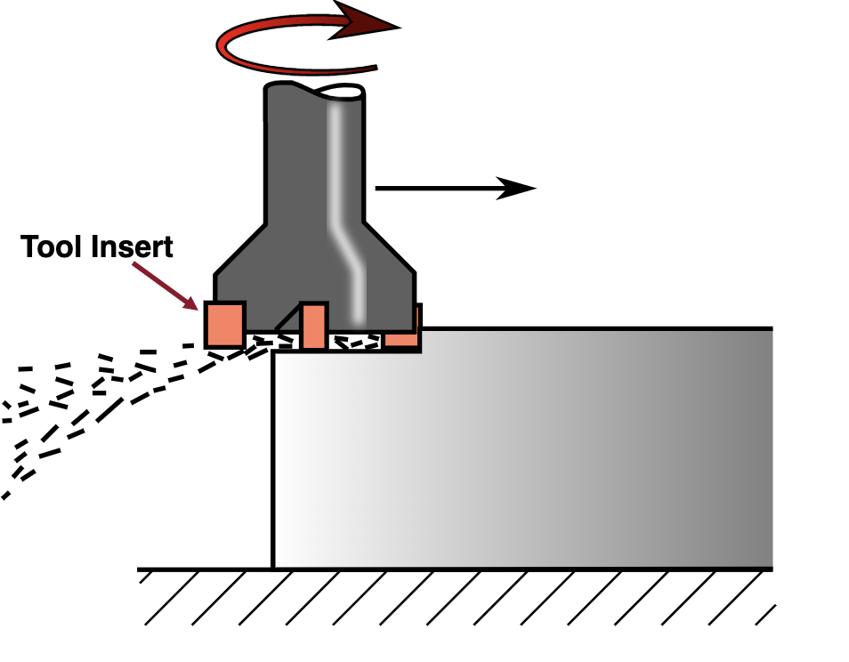
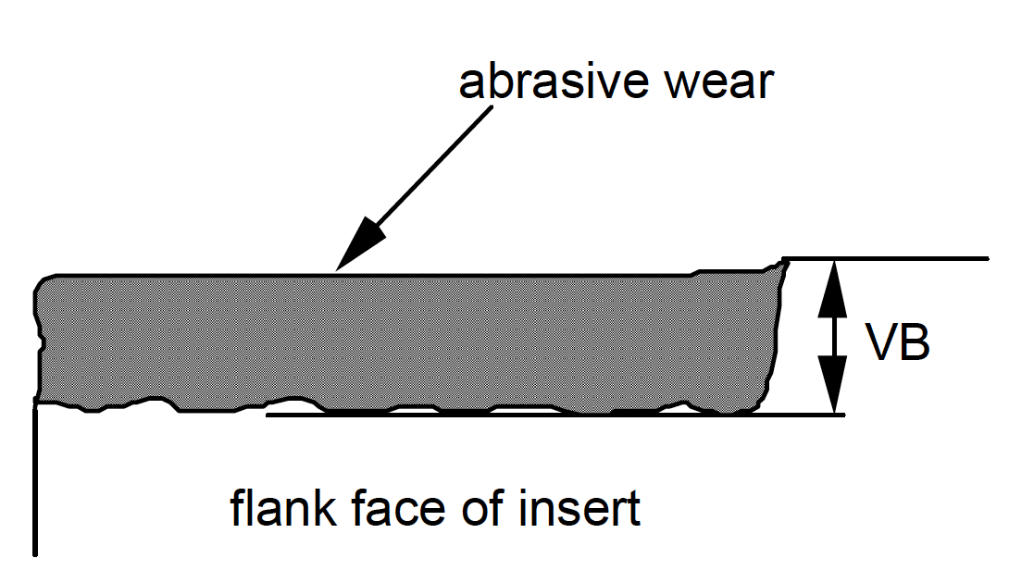
Project Introduction
This project explores the use of deep learning in the context of tool wear monitoring for metal machining process.
Fig.1 Milling Process
Fig.2 Tool wear VB as it is seen on the insert.
A milling tool has several tool inserts on it. As the tool rotates, and is pushed forward, the inserts cut into the metal.
(Pictures citied from https://commons.wikimedia.org/wiki/File:Fraisage_surfacage.svg#/media/File:Fraisage_surfacage.svg)

Slide 4
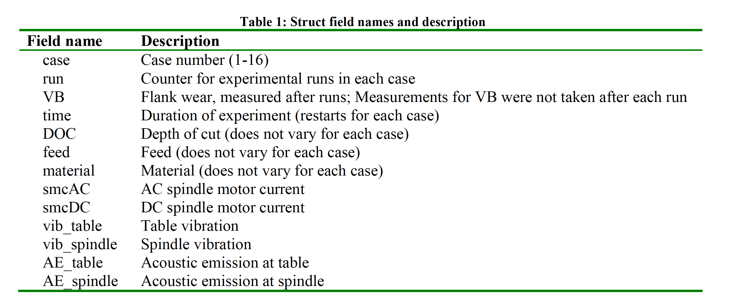
Dataset collection and Design of Experiments
Dataset: UC Berkeley milling data set
Sensor Type: 1) Acoustic emission sensor, 2) Vibration sensor, 3) Current sensor.
Experimental Conditions: There are 16 cases with varying numbers of runs.
Experimental parameters
Sensor signal data

Slide 5
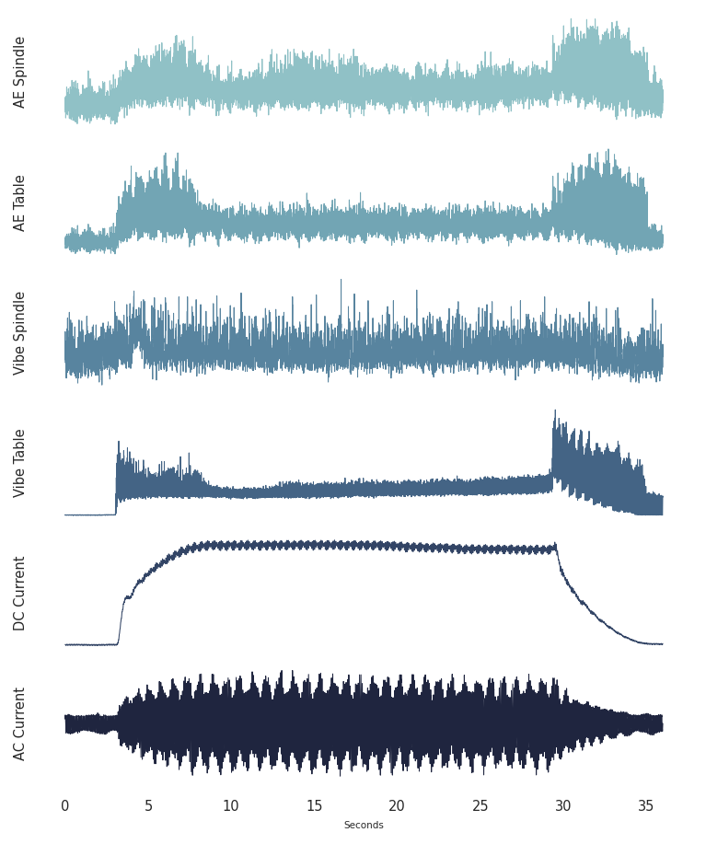
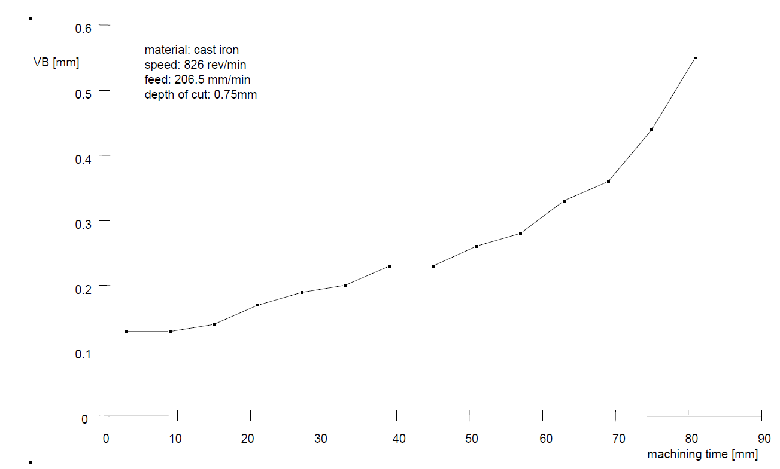
Project objective
Anomaly detection: Use raw sensor data as input to detect failed tool conditions.
Input features: Six signals in time domain
Output feature: Tool condition labeled from flank wear.(Health: VB ≤0.7mm or Failed state: VB> 0.7mm)
Fig.4 Tool wear VB over time
Fig.3 Signal visualization for Cut #145

Slide 6
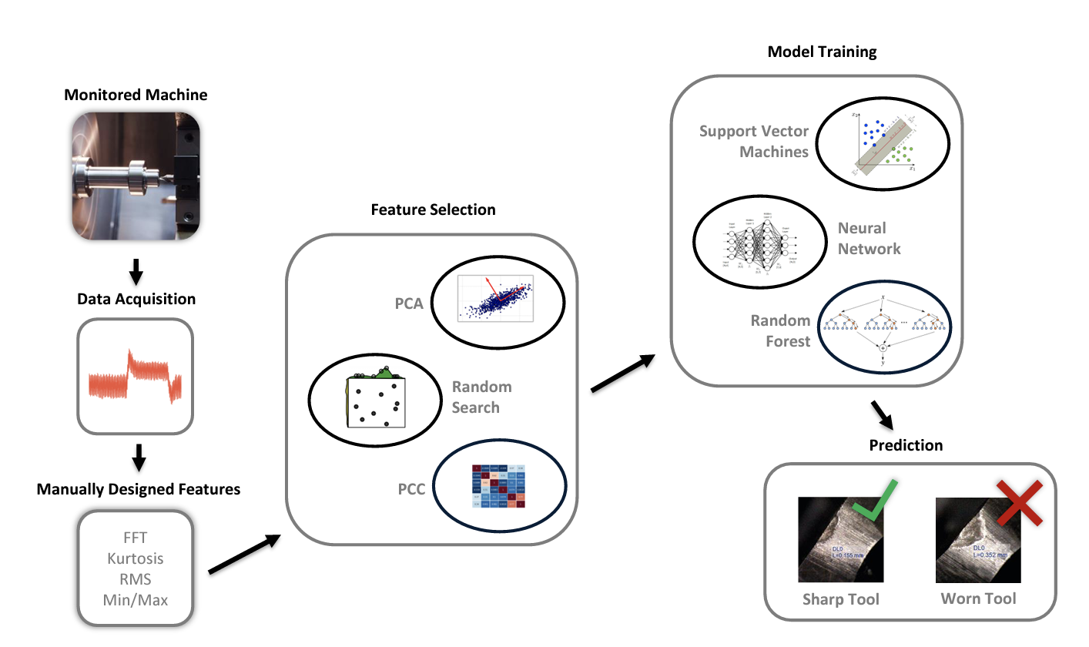
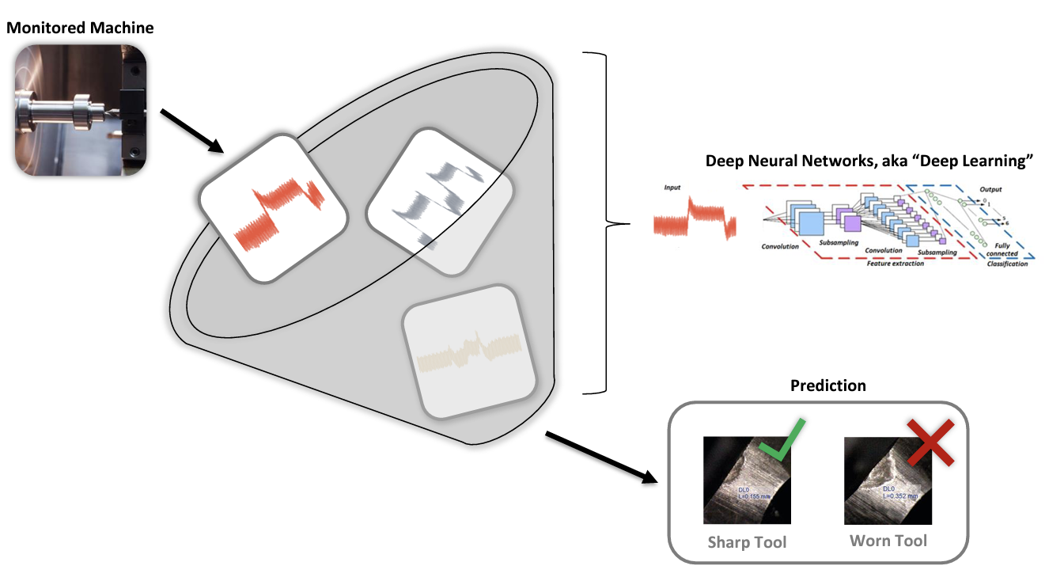
Data driven approaches in tool condition monitoring
Fig5. Traditional data-driven methods: signal processing or statistical features (Manually abstracted)
Fig6. Deep Learning methods: Deep learning networks can work effectively on raw signals
Hahn, Tim Von, and Chris K. Mechefske. "Self-supervised learning for tool wear monitoring with a disentangled-variational-autoencoder." International Journal of Hydromechatronics 4.1 (2021): 69-98.

Slide 7
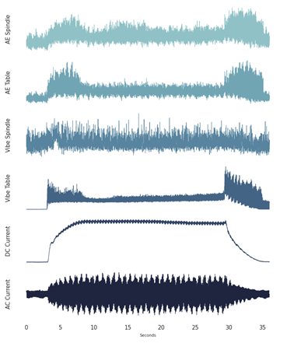
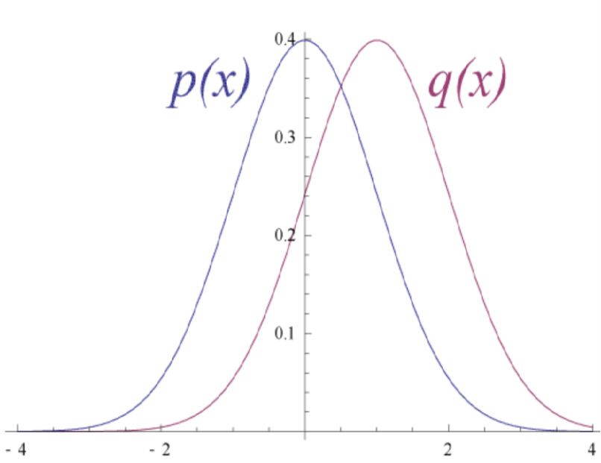


Model: Variational Autoencoder based Anomaly detection
Convolutional layers
Reconstruction layers
Healthy data
Latent Space Representation
Input layer 1
Feature map
Reconstructed input 1
…
Latent space
…
…
…
$$μ$$
…
Feature map
$$σ$$
Input layer N
Reconstructed input N
Data preprocessing
Two methods:
Reconstruction error-based detection
Latent space-based detection

Slide 8
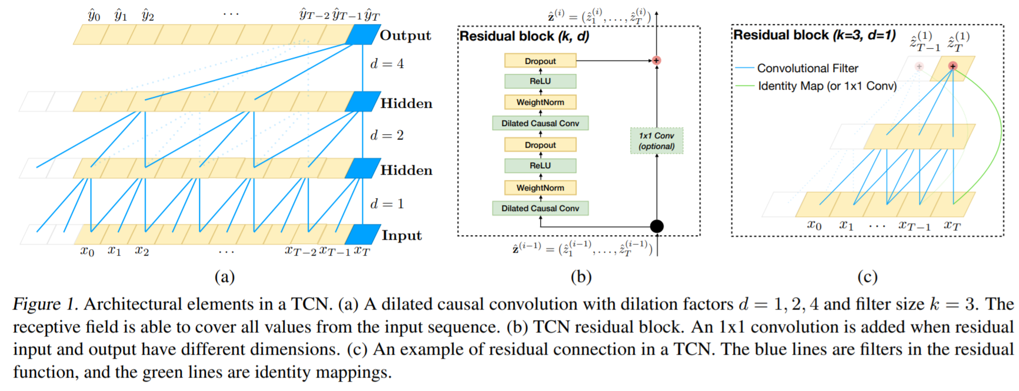
VAE with temporal convolutional neural network(TCN)
The objective of TCN:
TCN framework allows VAE model to consider a larger portion of the input waveform and thus avoid the loss of time-independent information earlier in the signal.
Three hyperparameters:
Filter (Kernel) size
Dilation factor
Number of residual blocks
Bai, Shaojie, J. Zico Kolter, and Vladlen Koltun. "An empirical evaluation of generic convolutional and recurrent networks for sequence modeling." arXiv preprint arXiv:1803.01271 (2018). GitHub link: https://github.com/locuslab/TCN

Slide 9
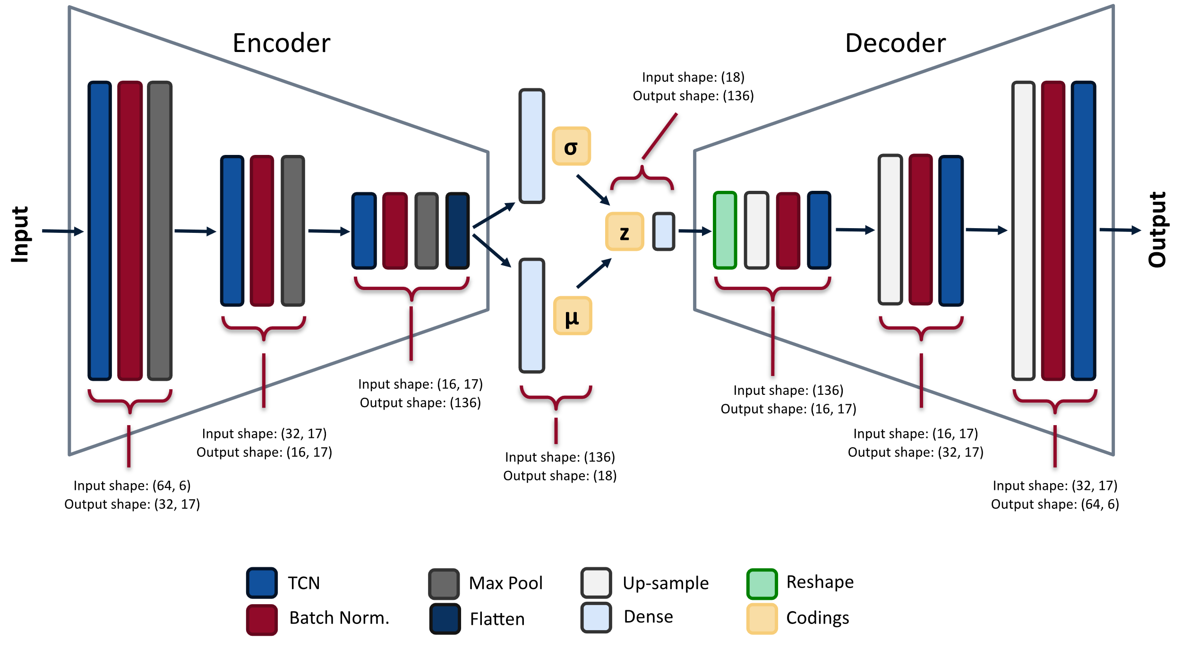
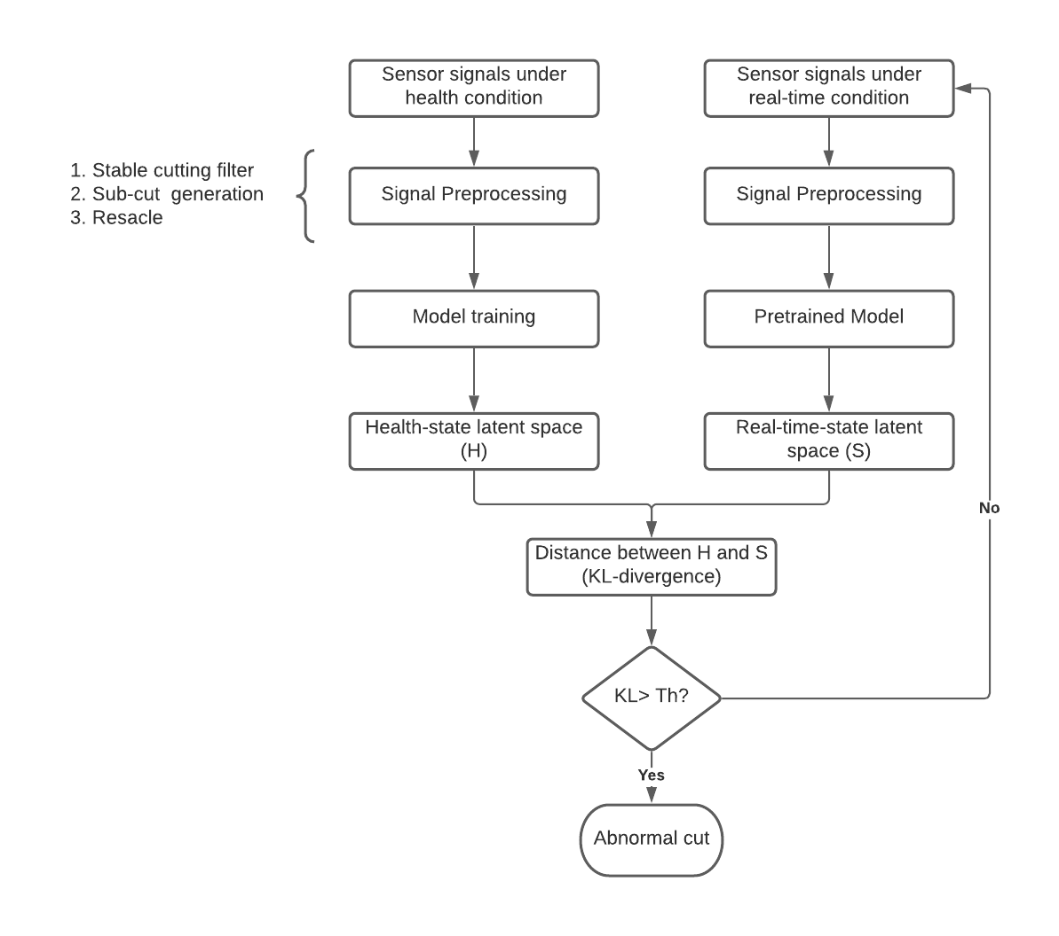
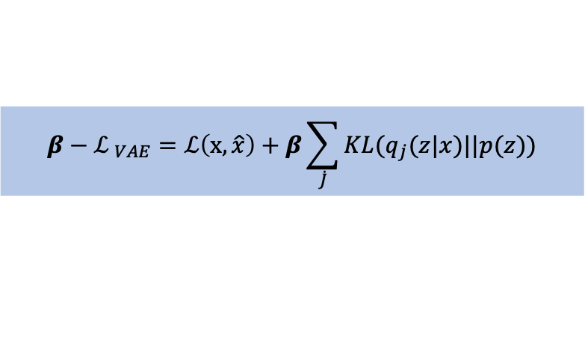
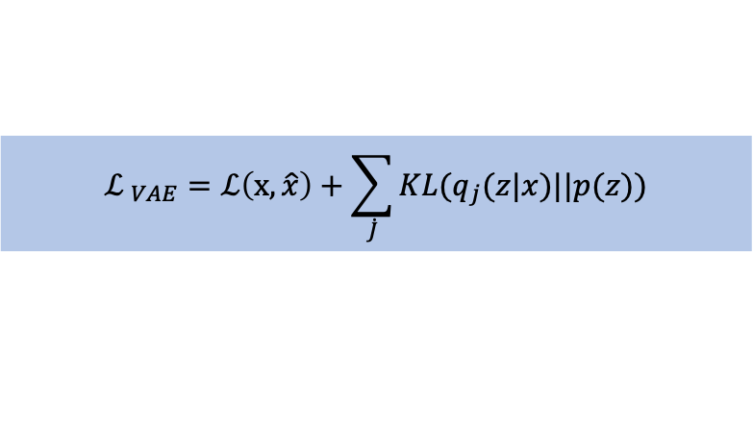
Overall framework
Fig.8 Model pipeline for 𝞫-VAE with TCN
$${ℒ }_{VAE}=ℒ\left(x,\hat{x}\right)+\sum_{\dot{J}}{KL(q_{j}(z|x)||p(z))}$$
Loss function:
$${β−ℒ }_{VAE}=ℒ\left(x,\hat{x}\right)+β\sum_{\dot{J}}{KL(q_{j}(z|x)||p(z))}$$
Fig.7 Flow diagram of the anomaly detection method
Fig 8 resourse: https://www.tvhahn.com/posts/building-vae/

Slide 10
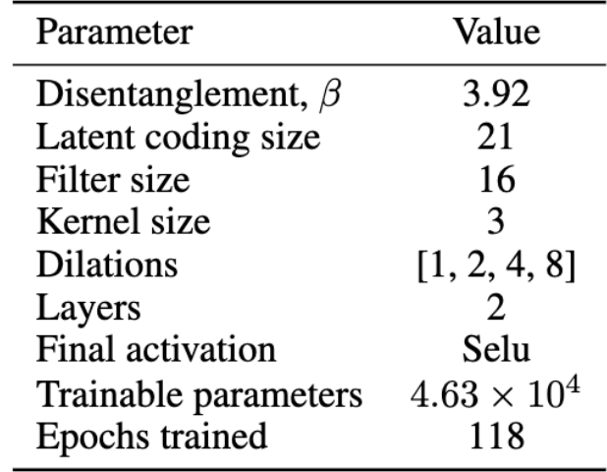
Model training
Data splits:
The milling data is made up of 167 cuts. Each cut was processed using a window size of 64 and a stride 64, producing a larger dataset. All sub-cuts were labeled either 0 or 1(healthy and failed).
Model training:
1) Hyperparameter setting cited from paper[1]
2) The model training process use the Adam optimizer to manage the learning process. A batch size of 32 was used when training the model.
 | Total number | Healthy | Failed
Training data | 2831 | 100% | 0
Validation data | 1909 | 100% | 0
Testing data | 1910 | 92.7% | 7.3%
Hahn, Tim Von, and Chris K. Mechefske. "Self-supervised learning for tool wear monitoring with a disentangled-variational-autoencoder." International Journal of Hydromechatronics 4.1 (2021): 69-98.

Slide 11
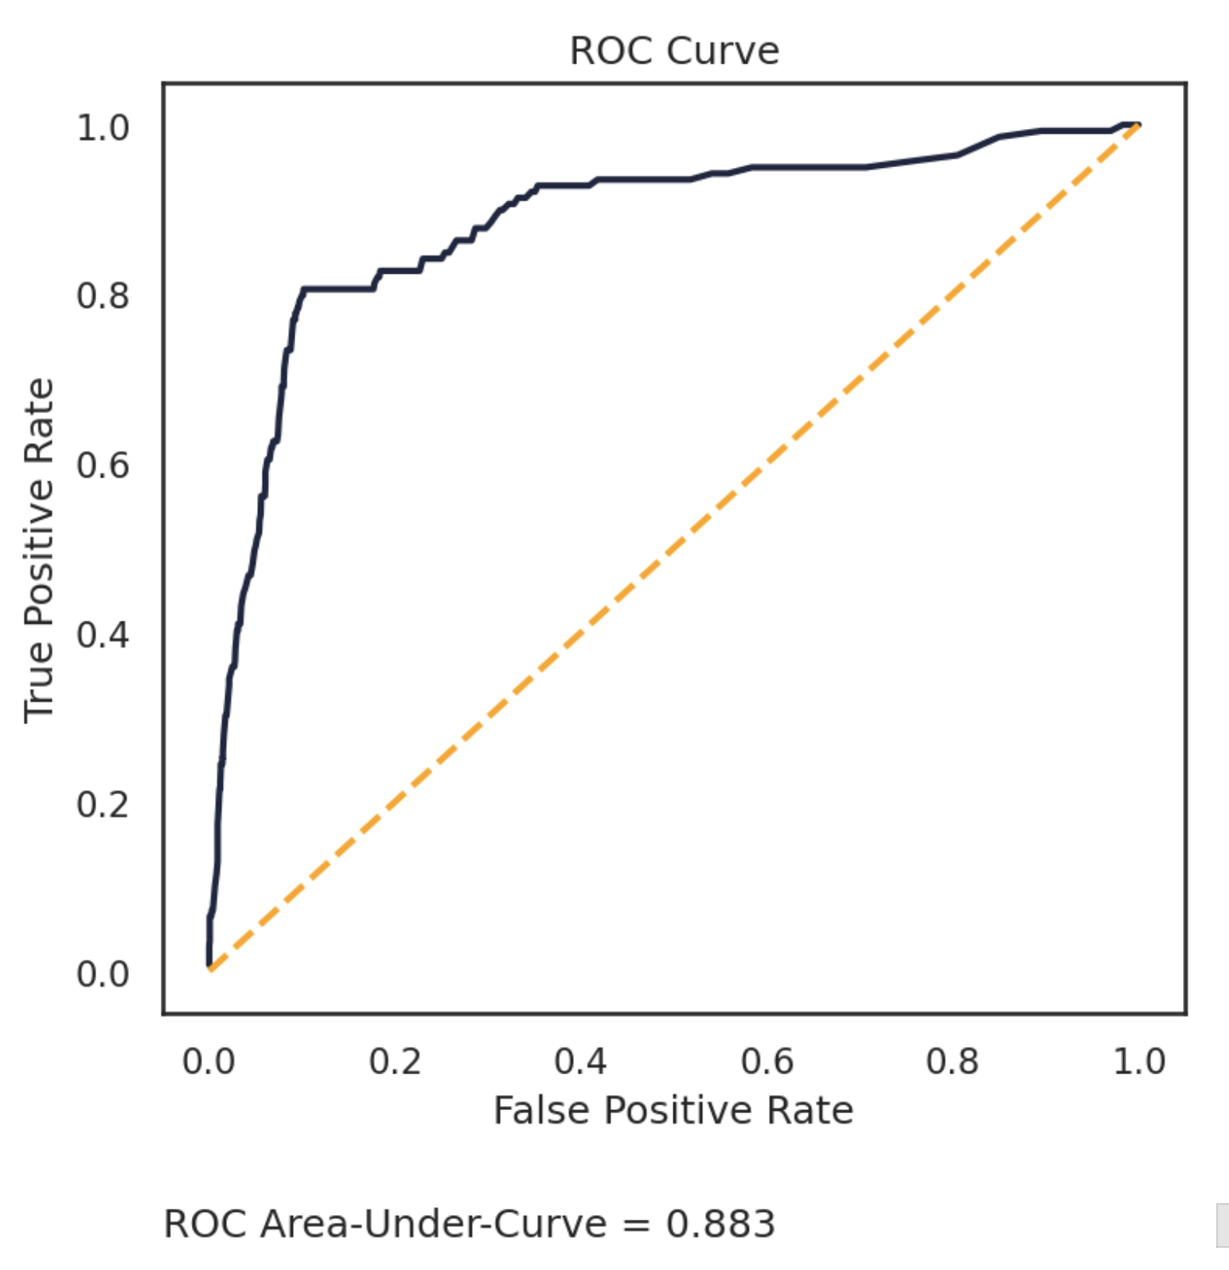
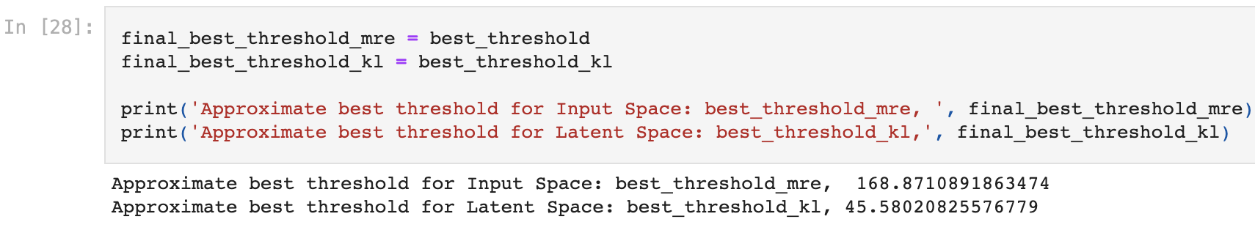
Performance evaluation
2. ROC-Curve
Precision-recall area-under-curve(PR-AUC)
 | Input feature method | Latent space method
PR-AUC (Test set) | 0.432424 | 0.449931
Best thresholds
Saito, Takaya, and Marc Rehmsmeier. "The precision-recall plot is more informative than the ROC plot when evaluating binary classifiers on imbalanced datasets." PloS one 10.3 (2015): e0118432.

Slide 12
Summary and Further work
The merits of latent space based anomaly detection:
1) Probabilistic formulation of latent space enhance the interpretability of deep learning model.
2) Compared with the anomaly detection in the input Anomaly detection in latent space is more efficient in computation.
Further work:
1) How to solve the data imbalance?
2) Further exploration of the latent space to identify the impact of the experimental parameters.

