Slide 1
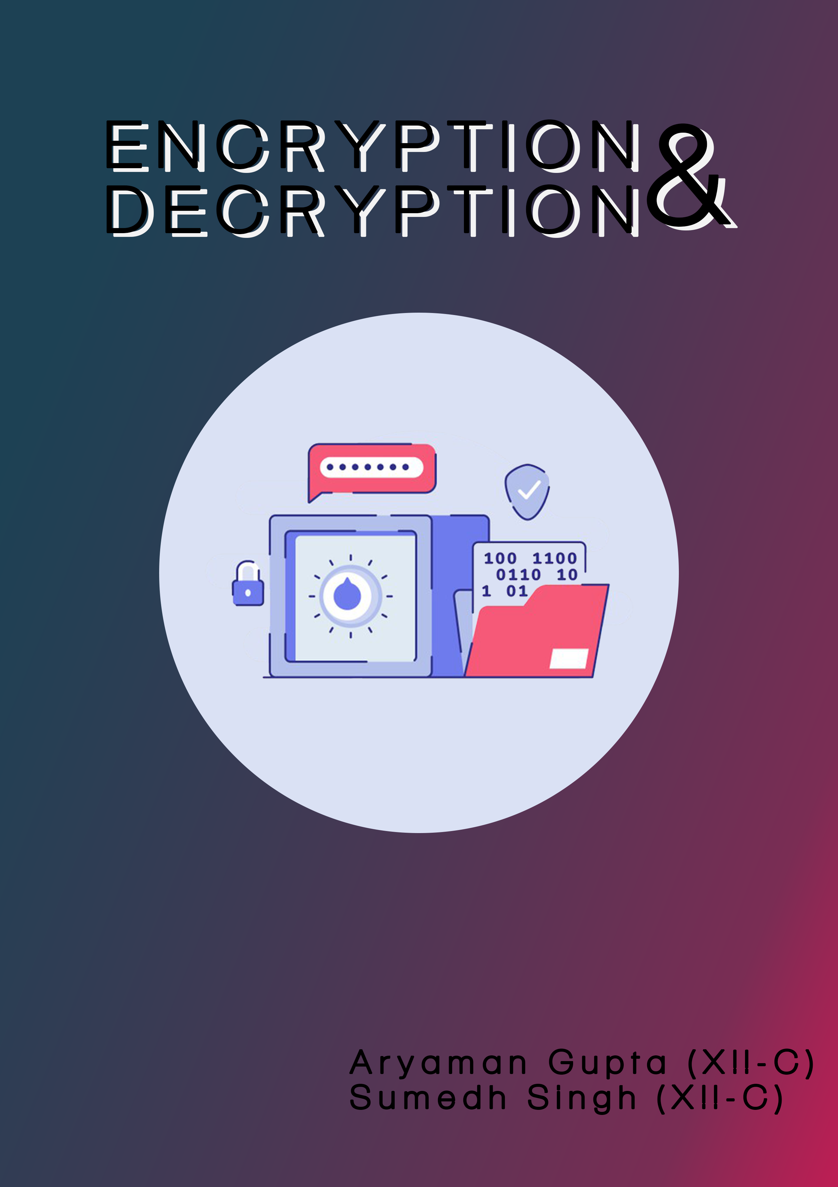

Slide 2

2
“Encryption threatens to lead all of us to a very dark place.”
~ James Comey

Slide 3

INTRODUCTION
5
This project implements encryption and decryption of files. It allows the user to protect their data from being stolen or leaked.
The user must import the file which has to be encrypted and generate a unique key which is the only way it can be decrypted.
The user can encrypt as many files as they wish to without decrypting the previous ones.
The unique keys for each individual file will be generated automatically and save in the user’s system.
When the user wishes to decrypt their file, they can do so by importing the file they wish to decrypt and the unique key which was generated along with the encryption of the file.
All the details of the operation such as the username, file path, action and date-time etc. are stored in an SQL table as a record

Slide 4

SPECIFICATIONS
6
Modules Used:
1) tkinter
Used for creating Graphical User Interface.
2) tkinter.font
Used for creating better fonts on buttons and dropdown lists.
3) mysql.connector
Used for linking the database with Python in order to store records.
4) os
Used for renaming key files to avoid replacement.
5) cryptography.fernet
Used for generating and assigning unique key to a file.

Slide 5
User Defined Functions:
1) BrowseFiles()
Imports the files from the user’s system for
encryption/decryption.
2) Decrypt()
Used for decrypting the encrypted file.
3) Browsekey()
Imports the key for decrypting the file which needs to be decrypted.
4) Extractkey()
Downloads the unique key in the user’s system while encrypting.
5) ValidateLogin()
Records the username and stores it in the SQL table.
7

Slide 6

SOURCE CODE
from tkinter import Tk, Menu, Menubutton, Frame, LEFT, W, X, RAISED, IntVar,
StringVar, DISABLED import tkinter as tk from tkinter import *
from tkinter import font as tkfont from tkinter import filedialog from functools import partial
from cryptography.fernet import Fernet
import mysql.connector as mc
import os
# Window Properties window = Tk() window.geometry('600x900')
window.title('Encryption & Decryption')
bitmap = PhotoImage(file=r"C:\Users\Aryaman.Gupta\cbseboards2020project\final compilation\bitmap_image.png")
window.iconphoto(False, bitmap)
# Defined Global Variables
key2 = b'' encry_decry = '' filepath = "" data_list = [] filename = '' filepath_key = "" filepath_decrypt = '' extracted_key = b''
# Use to prevent duplication of windows BUTTON_PRESSED_encrypt = False BUTTON_PRESSED_decrypt = False
# SQL Database connectivity
conn = mc.connect(host="localhost", user="root",
passwd="d.p.snoida", database="encryptionproj") mycur = conn.cursor()
# Main Encryption UDF
def encryption():
global BUTTON_PRESSED_encrypt
global frame1
frame1.pack_forget() # To hide the login dialogue box upon initiation of encryption window
if not BUTTON_PRESSED_encrypt:
def browseFiles(): global filepath global data_list
# Opens Windows dialogue box to browse the desired file
filename = filedialog.askopenfilename(initialdir="/",
title="Select a File", filetypes=(("Text files",
"*.txt*"),
("all files", "*.*")))
8

Slide 7
# Change label contents
label_file_explorer.configure(text="File Opened: " + filename)
filepath = str(filename) # Changes the extracted filepath to string
data_list.append(
filepath) # Appends the extracted filepath into a list(later used to flush contents inside sql table)
class page2:
def write_key():
global key2
key1 = Fernet.generate_key() # Generating Key (binary)
with open("key.key", "wb") as key_file: # Writing the key into a
file 'key.key'
key_file.write(key1)
key2 = open("key.key", "rb").read() # Loads the key from the current directory named `key.key`
# Changing the name of the file 'key.key' ,in which the key is saved, to a unique name to prevent overwriting of file and hence loss of data
serial_number = []
w12 = "select S_No from user_details ORDER BY S_No DESC LIMIT 1;"
mycur.execute(w12) serial_number = mycur.fetchone() serial = serial_number[0] serial += 1
name = "key.key" + str(serial)
os.rename("key.key", name) # Renaming the 'key.key' file
label_keyname.configure(text="Generated Keyname: " + name) #
Change label contents
def encrypt(filename, key):
"""
Given a filename (str) and key (bytes), it encrypts the file and
write it
"""
global encry_decry
global data_list
f = Fernet(key)
with open(filename, "rb") as file:
file_data = file.read() # Read all file data
encrypted_data = f.encrypt(
file_data) # Encrypting data and Assigning the key generated earlier to the encrypted file
with open(filename, "wb") as file: file.write(encrypted_data) # Write the encrypted file
encry_decry = 'Encryption'
data_list.append(
encry_decry) # Appends the Action (encryption/decryption) into a list(later used to flush contents inside sql table)
9

Slide 8
table
# Inserting the values from the list created earlier to the SQL
10
com = "insert into user_details (username,file_path,action) values
(%s,%s,%s)"
data1 = data_list[0], data_list[1], data_list[2] mycur.execute(com, data1)
conn.commit()
# Clearing last 2 elements of the list, which is used to enter data in SQL table, and allowing first element to stay to prevent requirement of re-entering username
data_list.pop(2) data_list.pop(1)
button_encrypt.configure(bg="green4") # Changes button color to green upon completion of encryption
# Encryption frame
encrypt = LabelFrame(window, text="Encryption", bd=10, bg='light cyan') encrypt.pack(fill="both", expand="yes")
label_file_explorer = Label(encrypt,
text="Safely Transfer Your Data", width=1000, height=4, fg="white",
bg="slategray4", bd=3, font='arial')
label_file_explorer.pack()
label_space1 = Label(encrypt, bg="light cyan", height="1") label_space1.pack()
button_explore = Button(encrypt,
text="Browse Files",
width=20, height=2, bg="lavender", command=lambda: browseFiles())
button_explore.pack()
label_space1 = Label(encrypt, bg="light cyan") label_space1.pack()
label_keyname = Label(encrypt,
text="Key Name:", width=200, height=2, fg="white", bg="slategray4", bd=3,
font='arial')
label_keyname.pack()
label_space1 = Label(encrypt, bg="light cyan", height="1") label_space1.pack()
button_writekey = Button(encrypt,
text='Generate Key',
width=20, height=2, bg="lavender", command=page2.write_key)
button_writekey.pack()

Slide 9
label_space2 = Label(encrypt, bg="light cyan", height="3") label_space2.pack()
button_encrypt = Button(encrypt,
text='Encrypt',
width=30, height=4, bg="orangered2", command=lambda: page2.encrypt(filepath, key2))
button_encrypt.pack()
BUTTON_PRESSED_encrypt = True
# Main Decryption UDF
def decryption():
global BUTTON_PRESSED_decrypt
global frame1
frame1.pack_forget() # To hide the login dialogue box upon initiation of decryption window
if not BUTTON_PRESSED_decrypt:
def decrypt(filename, key1):
"""
Given a filename (str) and key (bytes), it decrypts the file and write
it
"""
global encry_decry
global data_list
f = Fernet(key1)
with open(filename, "rb") as file:
encrypted_data = file.read() # Read the encrypted data
decrypted_data = f.decrypt(encrypted_data) # Decrypt data using the assigned key
with open(filename, "wb") as file: # Overwriting the original file
file.write(decrypted_data)
encry_decry = "Decryption"
data_list.append(
encry_decry) # Appends the Action (encryption/decryption) into a list(later used to flush contents inside sql table)
# Inserting the values from the list created earlier to the SQL table
com = "insert into user_details (username,file_path,action) values
(%s,%s,%s)"
data1 = data_list[0], data_list[1], data_list[2] mycur.execute(com, data1)
conn.commit()
# Clearing last 2 elements of the list, which is used to enter data in SQL table, and allowing first element to stay to prevent requirement of re- entering username
data_list.pop(2)
data_list.pop(1)
button_decrypt.configure(bg="green4") # Changes button color to green
11

Slide 10
upon completion of decryption
def browsekey():
global filepath_key
# Opens Windows dialogue box to browse the desired file
filename = filedialog.askopenfilename(initialdir="/",
title="Select a File", filetypes=(("Text files",
"*.txt*"),
("all files", "*.*")))
label_file_explorer_key.configure(text="File Opened: " + filename)
#Change label contents
filepath_key = str(filename) # Changes the extracted filepath to
string
def browse_encrypted_file(): global filepath_decrypt global data_list
# Opens Windows dialogue box to browse the desired file
filename = filedialog.askopenfilename(initialdir="/",
title="Select a File", filetypes=(("Text files",
"*.txt*"),
("all files", "*.*")))
label_file_explorer_decrypt.configure(text="Encrypted File Opened: " + filename) # Change label contents
filepath_decrypt = str(filename) # Changes the extracted filepath to
string
data_list.append(filepath_decrypt) # Appends the extracted filepath into a list(later used to flush contents inside sql table)
def extract_key(filename):
global extracted_key
extracted_key = open(filename, "rb").read() # Reads the binary key from the file
# Decryption frame
decrypt_ = LabelFrame(window, text="Decryption", bd=10, bg='light blue') decrypt_.pack(fill="both", expand="yes")
label_file_explorer_decrypt = Label(decrypt_,
text="Decrypt Your Data", width=1000, height=4, fg="white", bg="slategray4",
bd=3, font='arial')
label_file_explorer_decrypt.pack()
12

Slide 11
label_space1 = Label(decrypt_, bg="light blue") label_space1.pack()
button_explore_decrypt = Button(decrypt_,
text="Browse Encrypted File", width=20, height=2, bg="lavender", command=browse_encrypted_file)
button_explore_decrypt.pack()
label_space1 = Label(decrypt_, bg="light blue") label_space1.pack()
label_file_explorer_key = Label(decrypt_,
text="Browse Key", width=200, height=2, fg="white", bg="slategray4", bd=3,
font='arial')
label_file_explorer_key.pack()
label_space1 = Label(decrypt_, bg="light blue") label_space1.pack()
button_explore_key = Button(decrypt_,
text="Browse Key",
width=20, height=2, bg="lavender", command=browsekey)
button_explore_key.pack()
label_space1 = Label(decrypt_, bg="light blue") label_space1.pack()
button_loadkey = Button(decrypt_,
text='Load Key',
width=20, height=2, bg="lavender", command=lambda: extract_key(filepath_key))
button_loadkey.pack()
label_space1 = Label(decrypt_, bg="light blue", height="3") label_space1.pack()
button_decrypt = Button(decrypt_,
text='Decrypt',
width=30, height=4, bg='OrangeRed2', command=lambda: decrypt(filepath_decrypt,
extracted_key))
button_decrypt.pack()
BUTTON_PRESSED_decrypt = True
def validateLogin(username):
global data_list
print("username entered :", username.get()) data_list.append(
username.get()) # Gets the name of the user and appends the data into
list which late is recorded in SQL table
13

Slide 12
success_label = Label(frame1,
text="Username recorded! \n Go to 'Action' dropdown list
to Encrypt/Decrypt your file",
bg="powderblue") # Prints when username gets recorded
successfully
success_label.pack()
return
# Menu Bar
frame = Frame(window, relief=RAISED, borderwidth=1) frame.pack(fill=X)
# First Menu
first_menu = Menubutton(frame, text="Action") first_menu.pack(padx=3, pady=3, side=LEFT) first_menu.menu = Menu(first_menu, tearoff=False)
button1 = first_menu.menu.add_command(label="Encryption", command=encryption)
first_menu.menu.add_command(label="Decryption", command=decryption) first_menu['menu'] = first_menu.menu
# second Menu
second_menu = Menubutton(frame, text="Exit") second_menu.pack(padx=3, pady=3, side=LEFT) second_menu.menu = Menu(second_menu, tearoff=False) second_menu.menu.add_command(label="Confirm?", command=exit) second_menu['menu'] = second_menu.menu
# login block
frame1 = LabelFrame(window, padx=100, pady=100, bd=3, bg="powderblue") frame1.pack(fill="none", expand=True)
# username label and text entry box
usernameLabel = Label(frame1, text="Enter Username", bg="powderblue") usernameLabel.pack()
username = StringVar()
usernameEntry = Entry(frame1, textvariable=username) usernameEntry.pack()
validateLogin = partial(validateLogin, username)
label_space1 = Label(frame1, bg="powderblue", height="1") label_space1.pack()
# login button
loginButton = Button(frame1, text="Login", bg="lavender", command=validateLogin) loginButton.pack()
window.mainloop()
14

Slide 13

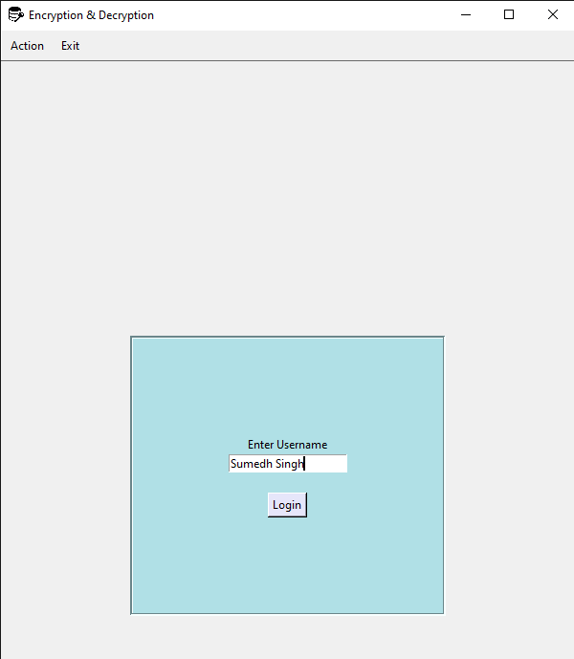
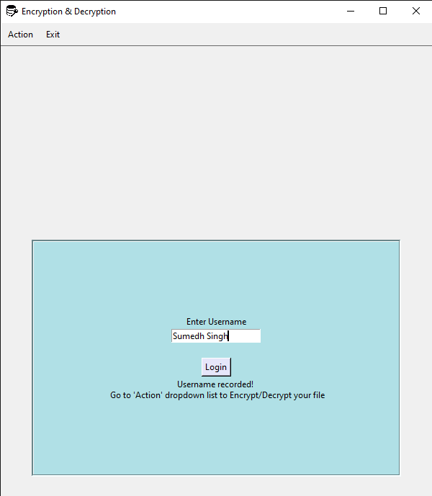
GRAPHICAL USER INTERFACE
15

Slide 14
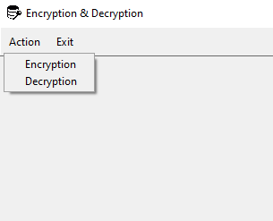
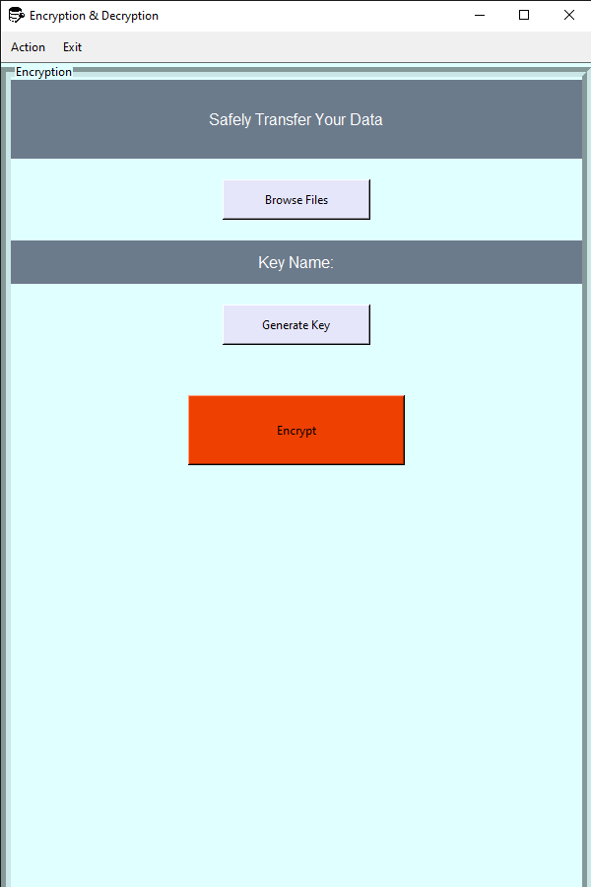
16
Encryption Block

Slide 15
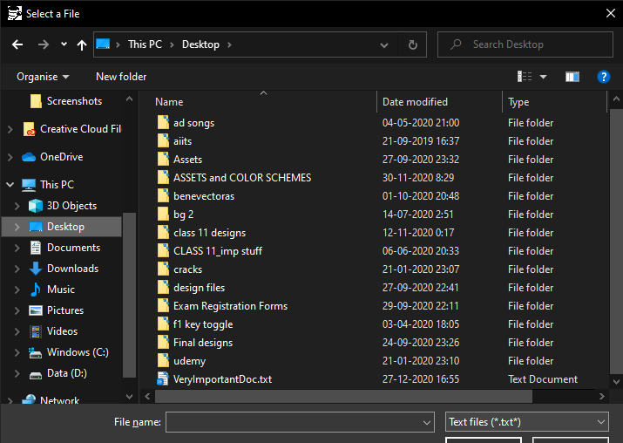
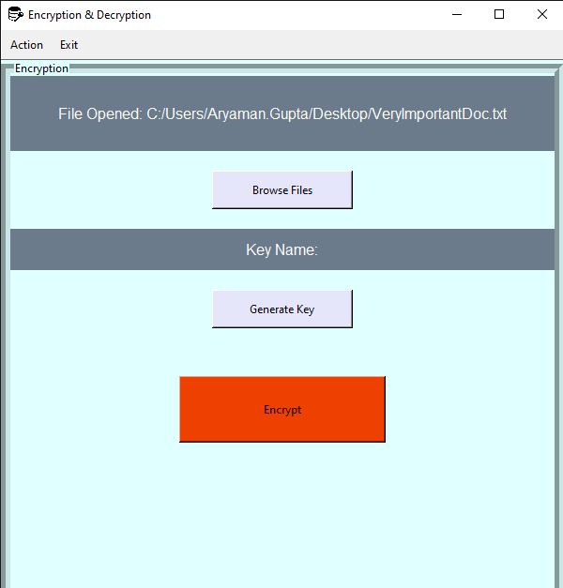
17
Dialog Box for browsing files is opened

Slide 16
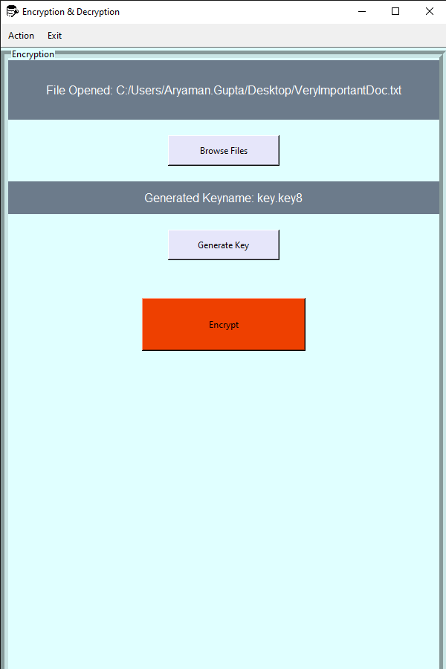
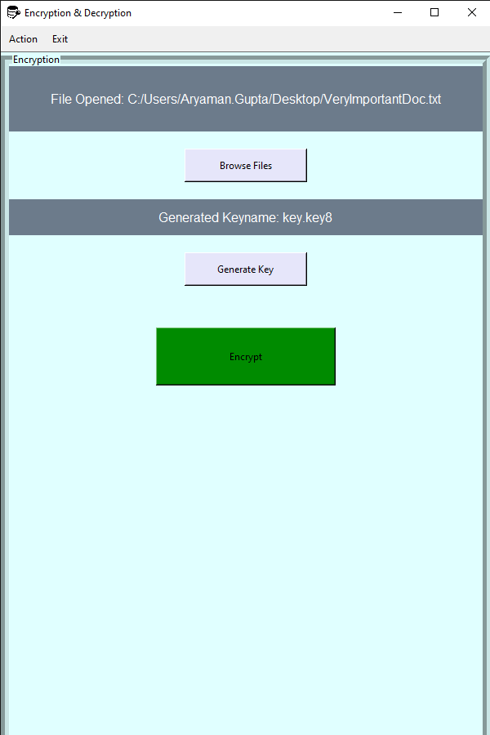
18
File has been encrypted and stored

Slide 17
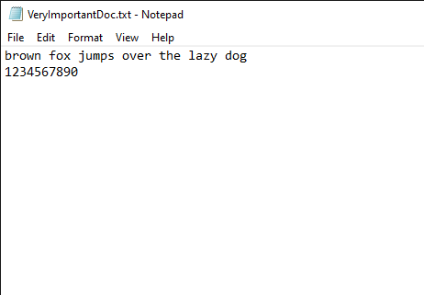
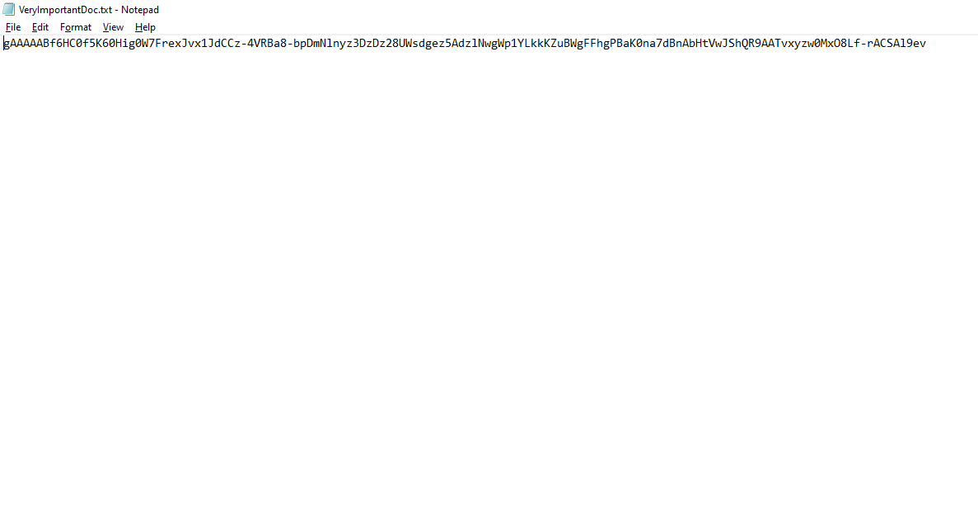
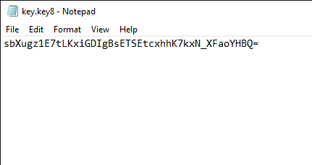
19
Normal File
Encrypted File
Generated Key

Slide 18
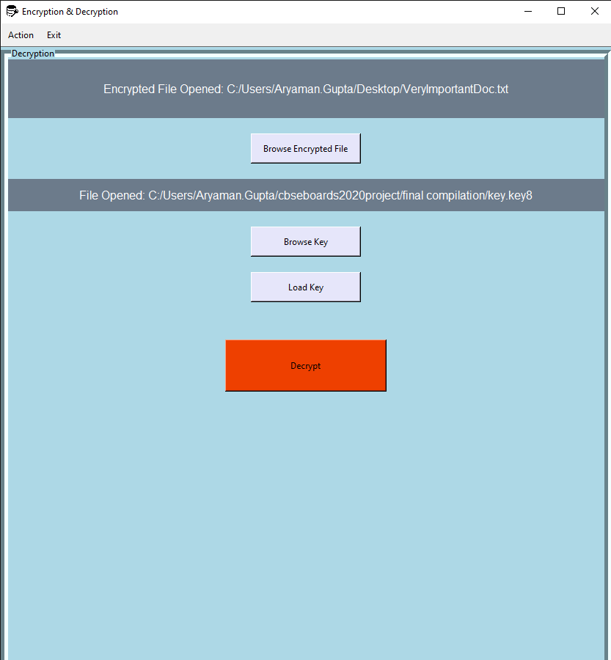
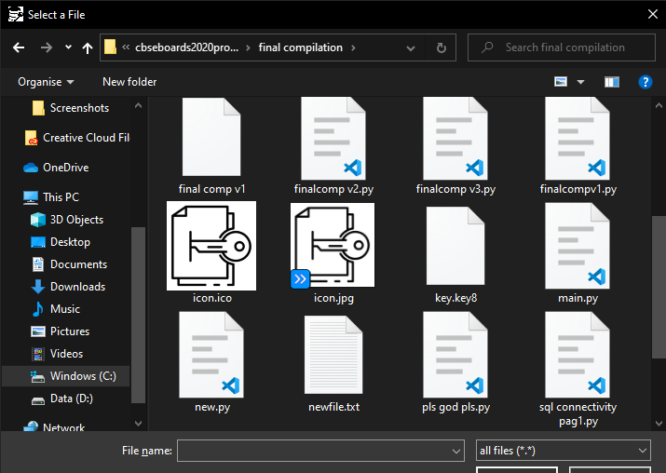
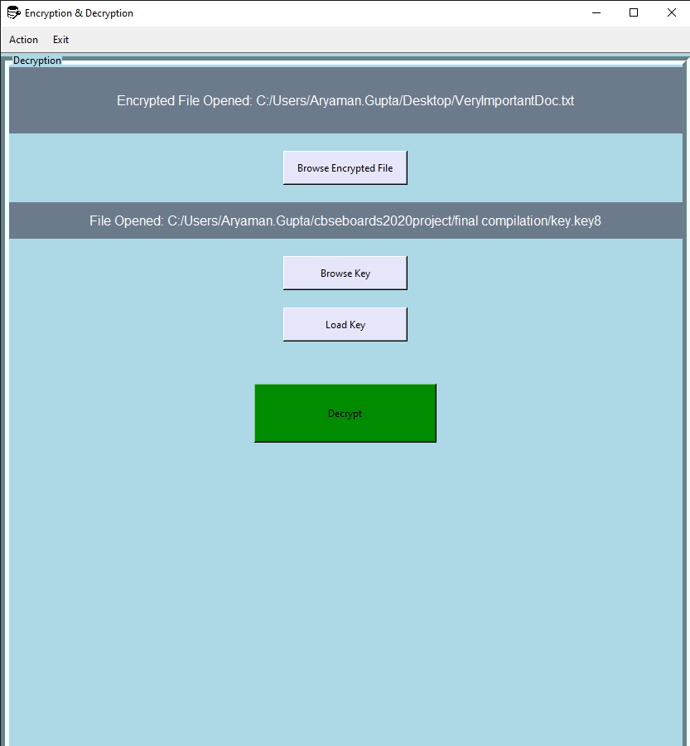
For Decryption
Encrypted file and
key have to be
searched
20
Decryption Block
File has been decrypted and stored

Slide 19
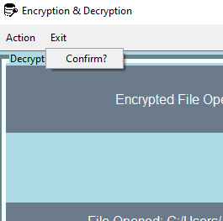
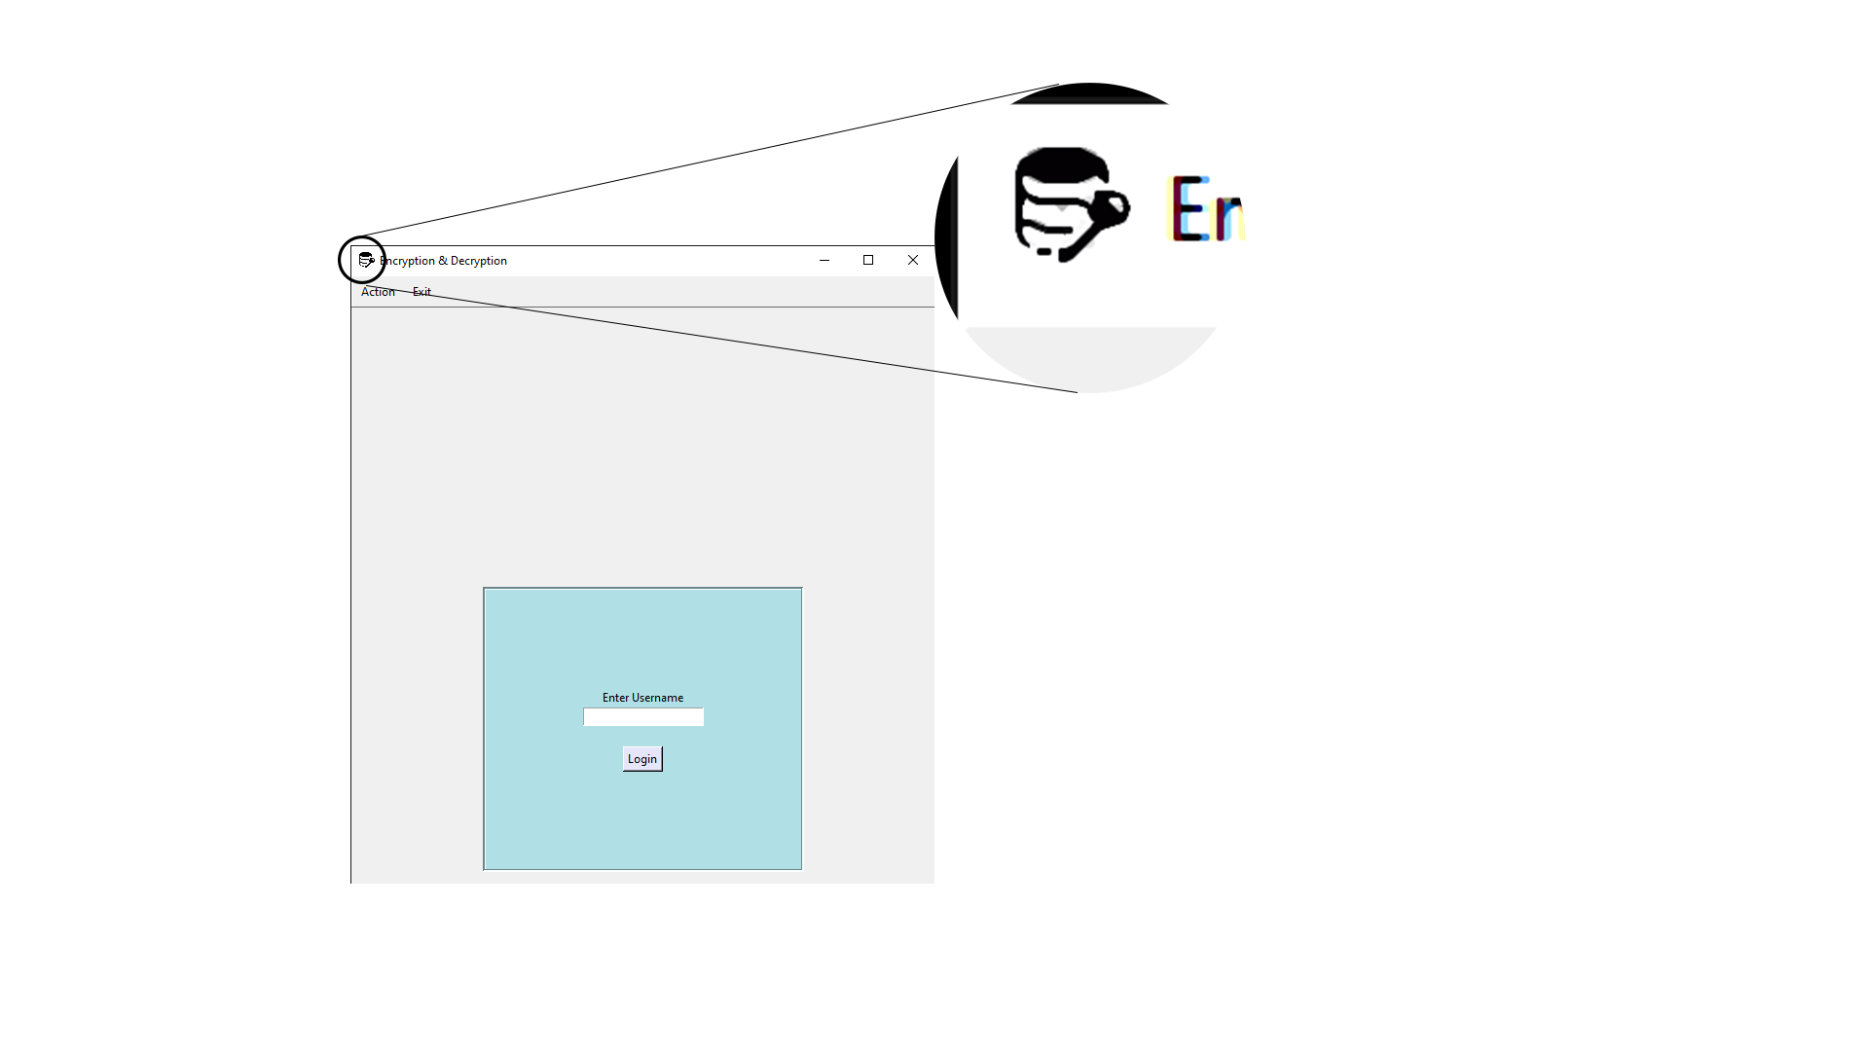
21
Bitmap Image

Slide 20
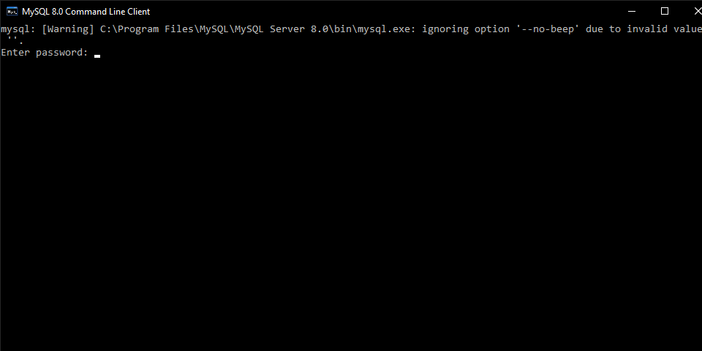
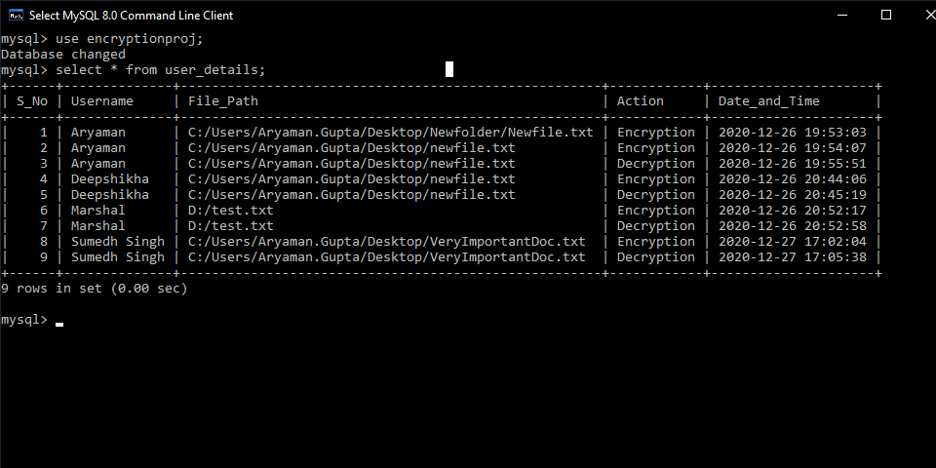
SQL DATABASE
22
Record of Operations done by user added in table user_details

Slide 21
BIBLIOGRAPHY
23
Websites
stackoverflow.com
w3schools.com
geeksforgeeks.org
python-forum.io
pythonexamples.org
tutorialspoint.com
delftstack.com
codemy.com
Books
O’Reilly Python
tkinter Documentation
pyinstaller Documentation

