Slide 1
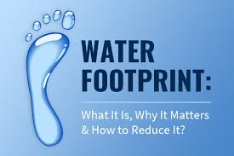
Water Footprint Calculation App
The impact of water footprint varies based on the source and scarcity of water. With increasing pollution and declining groundwater levels, communities and individuals face elevated water footprints, directly impacting health and future sustainability. Addressing severe droughts in water-stressed areas necessitates efficient water usage, which can only be achieved with accessible water footprint data.
Guide Name: Prof. Vivek Kumar Sharma
Project Members:
1.Shikha Kushwaha
2.Sumit Tiwari
3.Suraj Jain
4.Shivanshu Srivastava

Slide 2
Project Abstract
Overview
Key Objectives
Approach
The Water Footprint Project focuses on calculating and analyzing water usage across various sectors, such as agriculture, industry, and households. It provides insights into total water consumption and identifies areas for conservation.
Develop a user-friendly interface for accessing water footprint data.
Integrate AI, Big Data, Blockchain, and other digital tools for accurate and efficient data processing.
Ensure compatibility with mobile devices and support local languages for pan-India usage.
Raise awareness about water footprint implications and encourage sustainable consumption practices.
We are focusing on developing a user-friendly app or website may be developed which can provide the water footprints of different items/ final products, we use in daily life by feeding little inputs or just by scanning through the camera like Google lens.

Slide 3
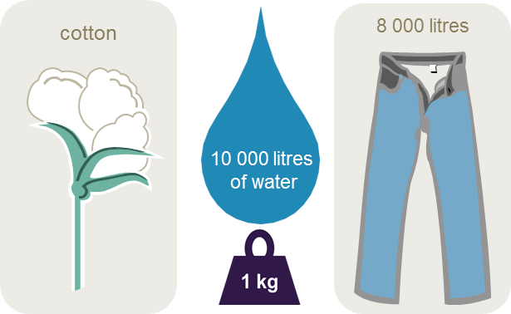

Project Goals and Objectives
Raise Awareness
1
Educate individuals and organizations about the importance of tracking and reducing their water footprint.
2
Measure Water Usage
Develop tools and methodologies to calculate water consumption across sectors like agriculture, industry, and households.
Support Policy and SDG Alignment
3
Contribute to global efforts in achieving UN Sustainable Development Goals, particularly Goals 6 (Clean Water), 12 (Responsible Consumption), and 13 (Climate Action).

Slide 4
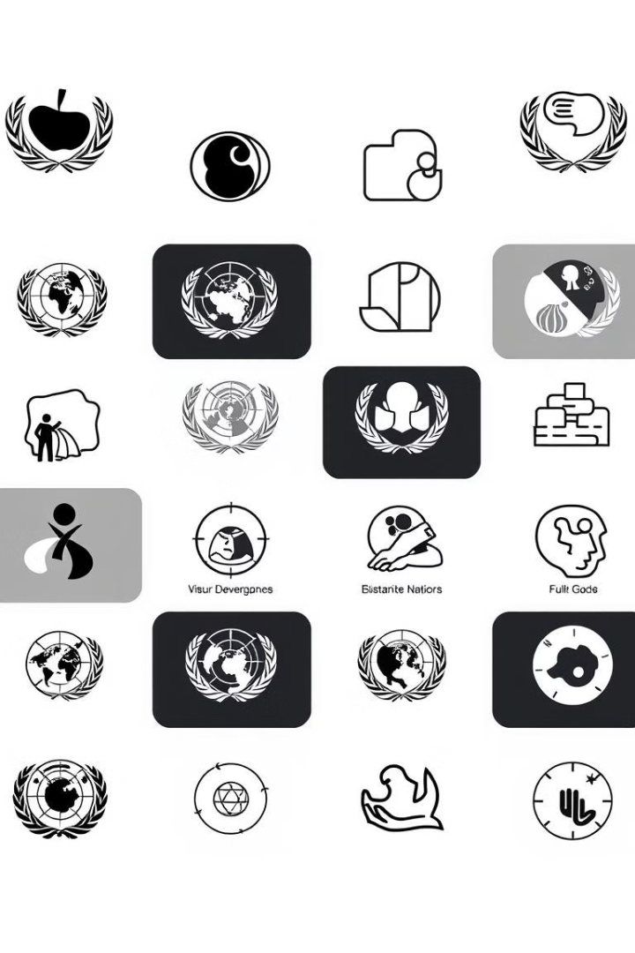
Alignment with UN Sustainable Development Goals (SDGs)
SDG 6: Clean Water and Sanitation
SDG 13: Climate Action
Promoting efficient water use and awareness directly supports sustainable water management.
Highlighting water's role in sustainability contributes to climate resilience strategies.
SDG 15: Life on Land
SDG 17: Partnerships for the Goals
Conservation of freshwater ecosystems and reducing overuse supports biodiversity and land sustainability.
Collaboration with organizations, industries, and communities ensures widespread impact.

Slide 5
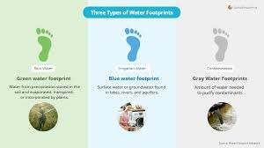



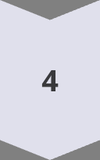
Methodology and Approach
Data Collection
Gather data from users or sources, such as water usage in households, industries, and agriculture, via surveys, IoT sensors, or databases.
Categorization and Analysis
Segment water consumption into categories (e.g., direct usage, virtual water in products) and analyze patterns using algorithms or statistical methods.
Calculation
Use established models, such as the Water Footprint Network’s methodologies, to compute the total and sector-specific water footprints.
Visualization
Present results using intuitive dashboards, charts, and breakdowns to enhance user understanding and engagement.

Slide 6
Expected Outcomes and Impact
Enhanced Awareness
Environmental Impact
Reduction
Policy and Substainability
Alignment
Increase public and organizational understanding of water consumption patterns and the importance of sustainable water use.
Minimize the overall ecological footprint by promoting sustainable water usage and protecting water-dependent ecosystems.
Support the creation of policies that align with water conservation goals and the UN Sustainable Development Goals (SDGs).

Slide 7
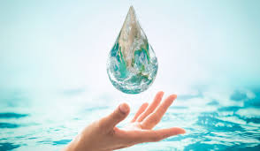
Key Project Deliverables
Water Footprint Calculation Tool
A digital platform or app that allows users to calculate their water footprint based on consumption.
Data Visualization Dashboard
Interactive charts and graphs to present water usage breakdown, comparisons, and trends for better understanding and decision-making.
Reports and Analytics
Automated generation of detailed water usage reports for users, industries, and policymakers, highlighting key areas for improvement.

Slide 8
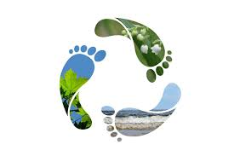
Next Steps and Conclusion
1
Public Awareness
Campaign
2
Deployment and Testing
Launch a pilot version to test the system with real users, gather feedback, and optimize the interface and calculations.
Roll out educational initiatives to raise awareness about water conservation and the benefits of monitoring water footprints.
3
Scaling and Updates
Expand the project to include more regions, sectors, and features like predictive analytics and real-time monitoring.

