Slide 1

Accenture
Innovation Challenge
Innovate to create
360° value
Let there be change

Slide 2
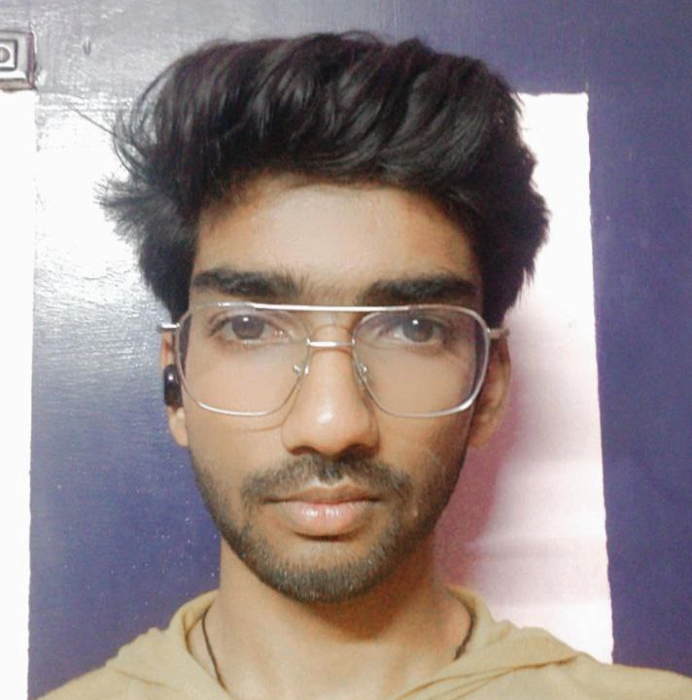
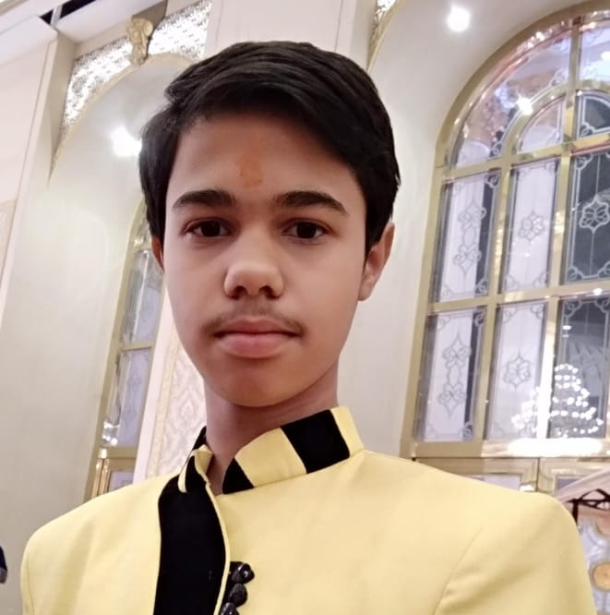
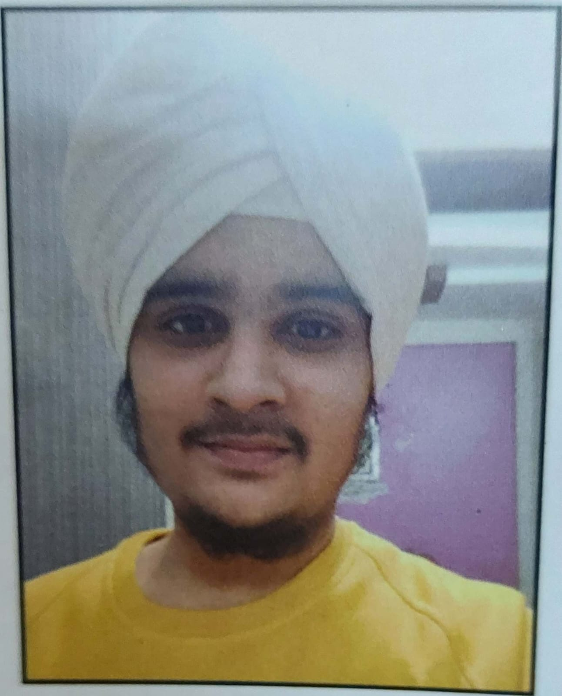
Team details
TEAM NAME: PROTOTYPES
Shashwat Gupta
Divyansh Singhal
College: Amity University, Lucknow, UP
Stream: B. Tech. CSE
Year of graduation: 2025
College: Amity University, Lucknow, UP
Stream: B. Tech. CSE
Year of graduation: 2025
Naman Chawla
College: Amity University, Lucknow, UP
Stream: B. Tech. CSE
Year of graduation: 2025

Slide 3

Theme
one and highlight it)
Innovate For Business
Develop innovative business solutions, offering or a business model that disrupts the competition in the given industry space
Innovate for Business
Innovate for Society
Innovate For Society
Apply technology in innovative ways to help improve the way we work and live, and create value for our society
Innovate for a Sustainable World
Innovate for a Sustainable World
Develop innovative business to tackle some of the world’s greatest ‘environmental challenges’

Slide 4
Problem Statement:
Part 1: Social Connections –
According to surveys conducted it was found that 25 to 40% of the world population find it hard to connect to people as they are either shy or feel discomfort while connecting to people.
People find it hard to find people with same interest as them.
Many people find it difficult to ask someone about their social handles.
People are too lazy to ask others to connect to them in person and struggle without anyone’s assistance.
Part 2: Availability of quality answers to general questions –
Most of the general answers are already available online, but those which do not exist online are the hardest to find answers to.
If we post a new question, it takes years to get a relevant answer most of the time. (or at least it takes just enough time that we don’t even need the answer anymore)
It’s a lot of hassle to find a suitable senior or mentor in colleges with same domain specialties as we require.
Part 3: Bringing the students within an institute together–
The students in an institute limit their connections within their classroom or batch only which leaves them with less options for a collaborating partner or just a guide.
Keeping in mind the present Industry scenario, it is of utmost value for the students to find a best fit team to work with so that they can learn and grow together.

Slide 5
Proposed solution / Our big Idea
Our app includes the following features to solve the above-mentioned problems:
We have three places where we can ask questions –
Public: Where all people can see our questions and posts.
Community: Where we can ask a particular group of people to search for a solution.
Institute: Where we can ask the solutions for our problems in our own institute page.
Bonus: We can ask a particular person with whom we are friends with. It is different from asking them in their personal chats because in this mode, the questions will appear in their personal question bank with a priority notification… not in their DM where it lies unanswered for eternity.
Also, it is easier to find communities where people are working on the same topic as the community admins will have the flexibility to invite other users to their community after checking their posts and answers.
The problem of being introvert is not a problem anymore with “go anonymous” feature where we can chat, post and answer anonymously. We will use profanity filters to avoid any abuse and keep users in check.
Technologies Used:
We will build this app using Android Studio for app creation and MySQL for Database Management.
We will use Java as the main language in android studio.
Profanity filtering APIs will be used to avoid any abusing in the app.
In anonymous mode, we will send encrypted data in order to prevent any data breach.

Slide 6
How does our innovation create 360° value?
Our solution provides 360-degree value by working in favor of all types of college students.
It helps extroverts in making connections outside of college and introverts to just start making connections.
Students who like making connections can go all out by joining multiple communities with people who have same interests. They can also search other institute pages and search for a particular person from a particular institute.
Those who are not so good at making connections can start by practicing some anonymous communications and can even join anonymous communities.
There is no loss of people in using our app whatsoever. Even if someone can’t answer questions of people,
He/she will be able to get solutions to their answers from the person they want.
The control is in the user’s hand as we do not require any personal information (if the user does not wish to reveal it) and there is instant anonymous ID blocking system which will help to keep people in check.
There is no restriction to how many people we can connect or chat with and we will also provide the history of questions that any user visited.
Our app provides college students with all their basic needs… from connections to question / answers to groups and communities and has its own chatting system.
Hence, providing 360-degree value.

Slide 7
How is our solution different/unique from other solutions in market
Our solution is different from any other doubt solving application in the market as it uses different communities as a source for answers. People can ask others anonymously as well if they don’t feel like asking others with their personal IDs. Moreover, one can completely trust the answers when they come from their own acquaintances and peers.
People are classified based on their institutes, so it is much easier to make connections with people of other colleges on our app than any other app.
Also, no other application provides us to make connections while being anonymous and doesn’t let us chat without involving our personal info.
Anonymous browsing of the app is being given the same amount of priority as the normal browsing.
In anonymous mode, no one will be able to know each other’s identity or profile so there is no room for taking revenge on a particular someone. Upon encountering any unruly behavior or breach of personal space the person responsible will have their anonymous privileges barred and the respective university will take necessary actions.(Note that the university will only be provided the data in case of grave miscreance)
PATENT FILED: No
Do we have a working model/prototype: No
Will we be able to show working prototype during finale. Yes

Slide 8
Elevator pitch video (1 minute) Share the public link
https://drive.google.com/drive/folders/1_AidMEW5owlb3AkMbL38CbtY5nVlgWAj?usp=sharing

Slide 9
Thank you!

