Slide 1

Basic Details of the Team and Problem Statement
PSID: KVH-010 Problem Statement Title: RAM dump collection tool Team Name: Local-Host Team Leader Name: Shashwat Gupta Institute Code (AISHE): Institute Name: Amity University Lucknow Campus
Problem Statement Description: Design and develop a technological solution that can collect RAM Dump from any Windows, Linux or Mac based operating system. The solution may be in the form of an Auto-Executable/Lite Version that can be run/executed from any USB storage device without installation at the target computer system.

Slide 2
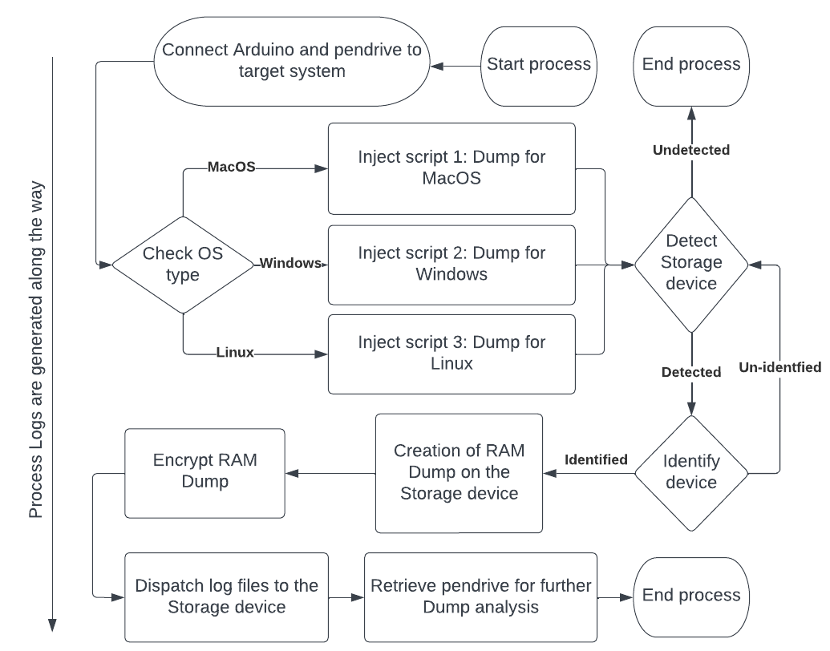
Idea/Approach Details
Our solution can automatically detect the OS of the target system and generate the RAM Dump accordingly.
We have created a fully automated pipeline which does not require any human intervention.
There will be a controlling device (mobile/computer) linked to an Arduino using Wi-Fi functionality of Arduino where a UI will be displayed.
This UI will enable the selection of specific processes for RAM dump collection or full system RAM dump collection. This feature will provide more targeted and efficient RAM dump collection, allowing for quicker analysis and investigation.
The controlling device will also be used to ensure ethical usage of this device.
Our solution ensures the security of the storage medium and target system by preventing file transfers other than the RAM dump and analyzing file signatures post-process.
PROCEDURE:
Our solution involves intelligent usage of an Arduino's digital pins for OS detection and script injection making it highly cost effective.
Based on the HIGH/LOW states of the digital pins, the OS-specific RAM Dump script gets executed.
LED lights indicate the progress of the collection, and a final LED light indicates the completion of the RAM Dump transmission.
The dump is then saved to a pen drive for analysis on another system.
The dump is saved in encrypted and compressed format to prevent unauthorized access.
Process logs are created along the way.
In case of frozen system screen, a LED light will indicate the completion of RAM dump transmission.
Technology Stack:
Programming Languages – C/C++
Bash scripting - For creating bash scripts
Digital Forensic Tools – such as: winpmem and avml for ramdump collection
Ducky Script – For sending keystrokes to system

Slide 3
Idea/Approach Details
Version 2.0
We will develop another version of the same device using an Arduino which has native DMA (Direct Memory Access) functionality, using which we can create RAM dump of any system without admin privileges.
This will include all the features of the first version and can also access the RAM when the system is locked.
Unique use case: Our device provides quick access to RAM in locked systems, saving time for government authorities to hack the system.
Dependencies
Arduino : Used for auto-executing scripts
Any USB Storage device : for the purpose of storing necessary scripts, RAM Dump building software, and the resultant RAM Dump.
A to B-type USB connector : For connecting Arduino to the target system.
Show stopper
Automated and cost-effective solution for RAM Dump collection
Collects RAM dump even from locked systems (version 2.0)
LED lights for progress indication
Process logs for forensic analysis
Encrypted and Compressed RAM Dumps to prevent data breaches
Controlling device can revoke access permissions upon unethical usage
Can collect RAM Dump even in frozen systems
Only allows transfer of RAM dump for added security, blocking all other file types.
Reduces the risk of data loss or alteration
Increases efficiency and accuracy of RAM Dump collection
User-friendly and easy to use
Use Cases
Forensic investigation: Our solution can be used by forensic investigators to collect RAM Dump without human intervention, reducing the risk of data loss or alteration.
Malware Analysis: RAM dump is used in malware analysis to identify the malicious activities and behavior of the malware while it is running in the memory of a compromised system.
Our solution facilitates the collection of RAM dumps from systems where the screen has become unresponsive or frozen
Source Code: Gupta-Shashwat/localhost-KVH-010 (github.com)
Demo Video: localhost - Google Drive

Slide 4
Team Member Details
Sr. No. | Name of Team Member | Branch (Btech/Mtech/PhD etc): | Stream (ECE, CSE etc): | Year | Position in team (Team Leader, Front end Developer, Back end Developer, Full Stack, Data base management etc.)
1 | Shashwat Gupta | B.Tech. | CSE | 2 | Team Leader
2 | Naman Chawla | B.Tech. | CSE | 2 | System Administrator
3 | Ashutosh Verma | B.Tech. | CSE | 2 | Core Developer
4 | Kunal Mishra | B.Tech. | CSE | 2 | Hardware Engineer
5 | Tanish Mishra | B.Tech. | CSE | 1 | DevOps Engineer
6 | Anshika Gupta | B.Tech. | CSE | 2 | Researcher
Team Mentor/s Details
Sr. No. | Name of Mentor | Category (Academic/Industry): | Expertise (AI/ML/Blockchain etc): | Domain Experience (in Years )
1
2

