Slide 1

Basic Details of the Team and Problem Statement
PSID: KVH-010 Problem Statement Title: RAM dump collection tool Team Name: Local-Host Team Leader Name: Shashwat Gupta Institute Code (AISHE): Institute Name: Amity University Lucknow Campus
Problem Statement Description: Design and develop a technological solution that can collect RAM Dump from any Windows, Linux or Mac based operating system. The solution may be in the form of an Auto-Executable/Lite Version that can be run/executed from any USB storage device without installation at the target computer system.

Slide 2
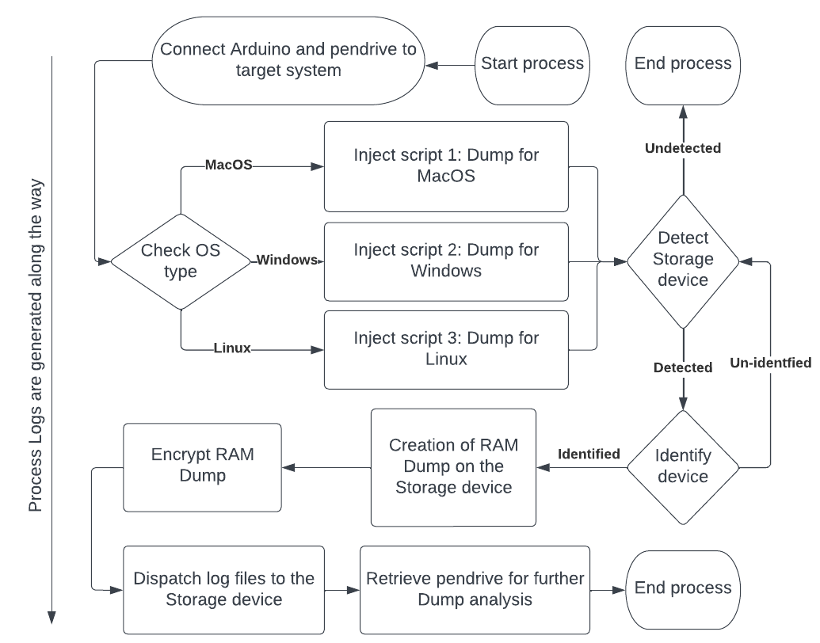
Idea/Approach Details
Problem: Lack of a software solution that can collect RAM Dump from any Windows, Linux or Mac based operating system without human intervention.
Our solution can automatically detect the OS of the target system and generate the RAM Dump accordingly.
We have created a fully automated pipeline which does not require any human intervention.
It runs in the background and can collect the dump even if the system screen is frozen.
It uses an Arduino for auto-running scripts and a pen drive to store the RAM Dump.
Our solution also creates process logs for forensic analysis and encrypts the RAM Dump to prevent data breaches in case the pen drive is lost/stolen.
PROCEDURE:
Most people tend to use Raspberry pi when running the same script on different OSs.
Our solution involves intelligent usage of an Arduino's digital pins for OS detection and script injection making it highly cost effective.
Based on the HIGH/LOW states of the digital pins, the OS-specific RAM Dump script gets executed.
LED lights indicate the progress of the collection, and a final LED light indicates the completion of the RAM Dump transmission.
The dump is then saved to a pen drive for analysis on another system.
The dump is saved in encrypted format to prevent unauthorized access.
Process logs are created along the way.
In case of frozen system screen, a LED light will indicate the completion of RAM dump transmission.
Technology Stack:
Programming Languages – C/C++
Bash scripting - For creating bash scripts
Digital Forensic Tools – such as: winpmem and avml for ramdump collection
Ducky Script – For sending keystrokes to system

Slide 3
Idea/Approach Details
Use Cases
Forensic investigation: Our solution can be used by forensic investigators to collect RAM Dump without human intervention, reducing the risk of data loss or alteration.
System diagnosis: IT professionals can use our solution to diagnose system issues and collect RAM Dump for analysis.
Security testing: Our solution can be used to test the security of a system by collecting RAM Dump for analysis.
Malware Analysis: RAM dump is used in malware analysis to identify the malicious activities and behavior of the malware while it is running in the memory of a compromised system.
Our solution facilitates the collection of RAM dumps from systems where the screen has become unresponsive or frozen
Source Code: Gupta-Shashwat/localhost-KVH-010 (github.com)
Demo Video: localhost - Google Drive
Dependencies
Arduino : Used for auto-executing scripts
Any USB Storage device : for the purpose of storing necessary scripts, RAM Dump building software, and the resultant RAM Dump.
A to B-type USB connector : For connecting Arduino to the target system.
Show stopper
Automated and cost-effective solution for RAM Dump collection
OS detection and script injection using an Arduino
LED lights for progress indication
Process logs for forensic analysis
Encrypted RAM Dump to prevent data breaches
Works on Windows, Linux, and Mac operating systems
Can collect RAM Dump even in frozen systems
Reduces the risk of data loss or alteration
Increases efficiency and accuracy of RAM Dump collection
User-friendly and easy to use

Slide 4
Team Member Details
Sr. No. | Name of Team Member | Branch (Btech/Mtech/PhD etc): | Stream (ECE, CSE etc): | Year | Position in team (Team Leader, Front end Developer, Back end Developer, Full Stack, Data base management etc.)
1 | Shashwat Gupta | B.Tech. | CSE | 2 | Team Leader
2 | Naman Chawla | B.Tech. | CSE | 2 | System Administrator
3 | Ashutosh Verma | B.Tech. | CSE | 2 | Core Developer
4 | Kunal Mishra | B.Tech. | CSE | 2 | Hardware Engineer
5 | Tanish Mishra | B.Tech. | CSE | 1 | DevOps Engineer
6 | Anshika Gupta | B.Tech. | CSE | 2 | Researcher
Team Mentor/s Details
Sr. No. | Name of Mentor | Category (Academic/Industry): | Expertise (AI/ML/Blockchain etc): | Domain Experience (in Years )
1
2

