Slide 1
Task: Prometheus/Grafana Stack
Amardeep Gupta • 02.06.2022

Slide 2
Overview
K8s Cluster setup - Terraform
Prometheus/Grafana setup
Blackbox exporter setup
Dashboard to visualize availability
mail.ionos.com

Slide 3
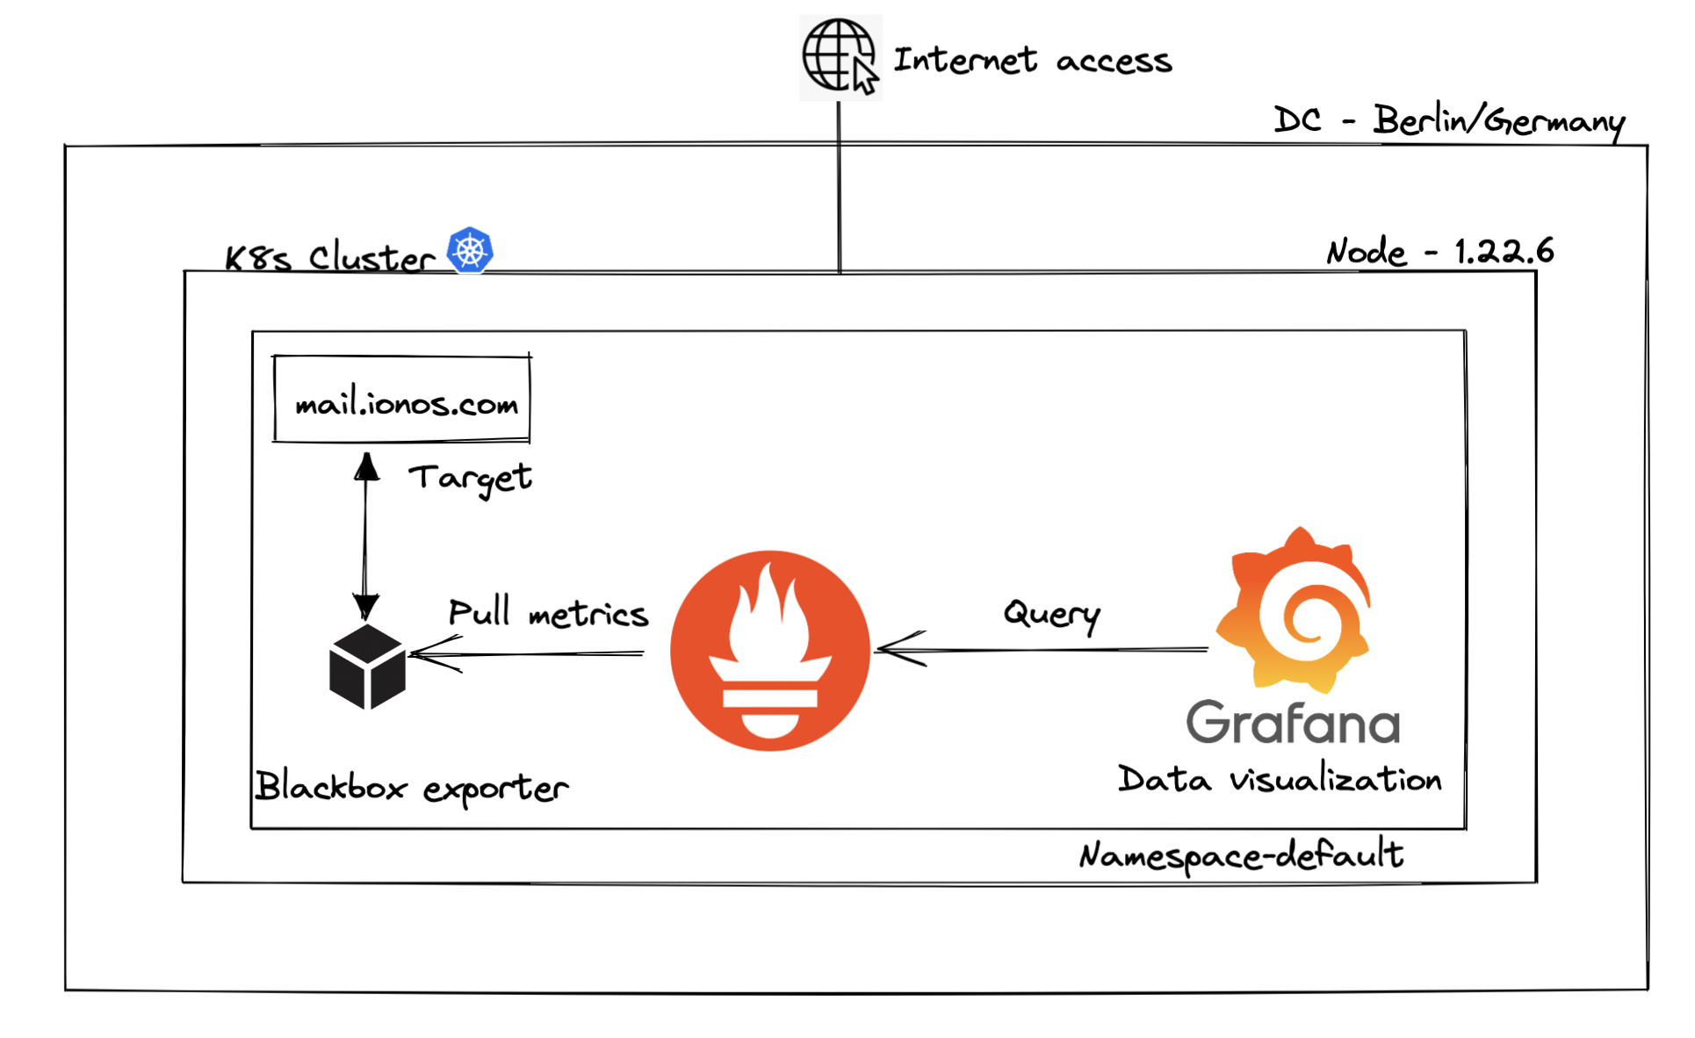
Architecture

Slide 4
Key Decisions:-
Setting up K8s cluster using Terraform
Creating Yaml manifest files to deploy Prometheus, Blackbox and Grafana.
Exposing the Grafana svc to external users via public facing Load Balancer
Creating Grafana dashboard to visualize the availability of mail.ionos.com

Slide 5
Steps taken:-
Refer:-
https://docs.google.com/document/d/1IMjo2prngf8hrPl346pTfm8a4hvYNdisa0nzxlzf_ps/edit

Slide 6
Problems encountered:
Yaml Indentation issue while writing manifest.
Configmap creation for injecting configurations
Grafana admin username and password using env variables
Datasource is passed through configmap so user cannot change it from UI.

Slide 7
Thanks!!
QnA

