Slide 1
Loan-Prediction
By:-Ayushi gupta

Slide 2
Content
Problem Statement
Data Source
Data Preparation
Modelling the machine
Evaluation
Conclusion
Appendices
Dumping and predicting the model

Slide 3
1. Problem Statement
The Goal is use machine learning and predict the data as 0 and 1 so that the loan will provided to the customer .

Slide 4
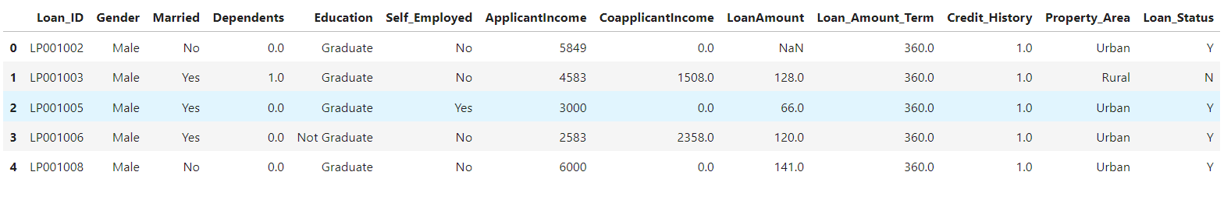
2. Data Source
Data we sourced from Kaggle ourselves .
It includes 597 data which has 12 columns.
The target variable is loan_status.

Slide 5
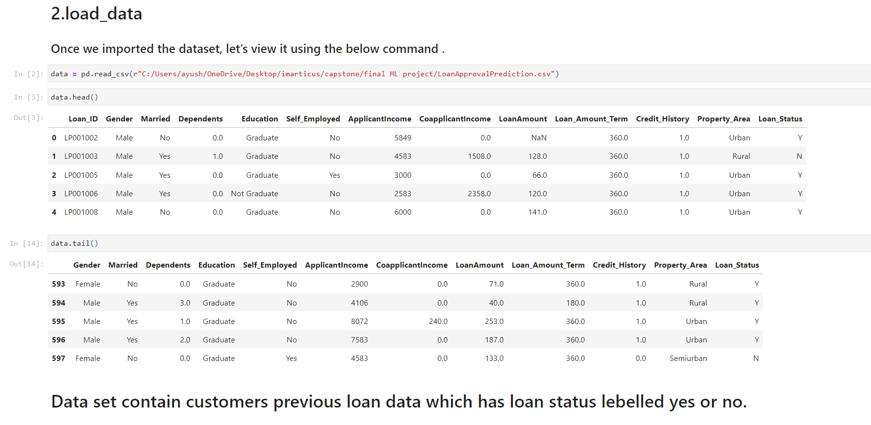
2.1Load Data
Once we imported the dataset, let’s view it using the below command.

Slide 6
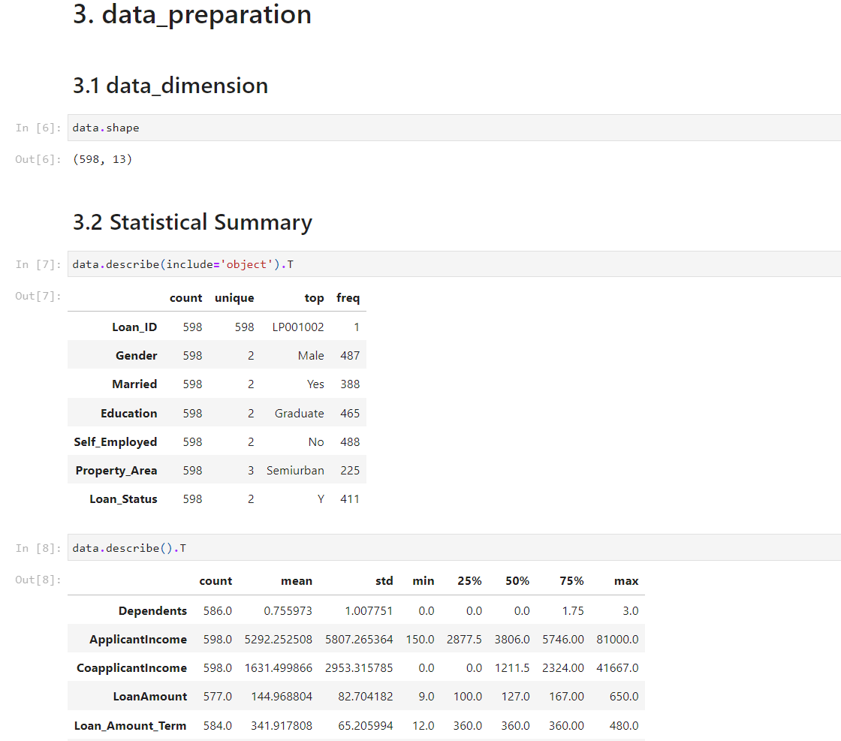
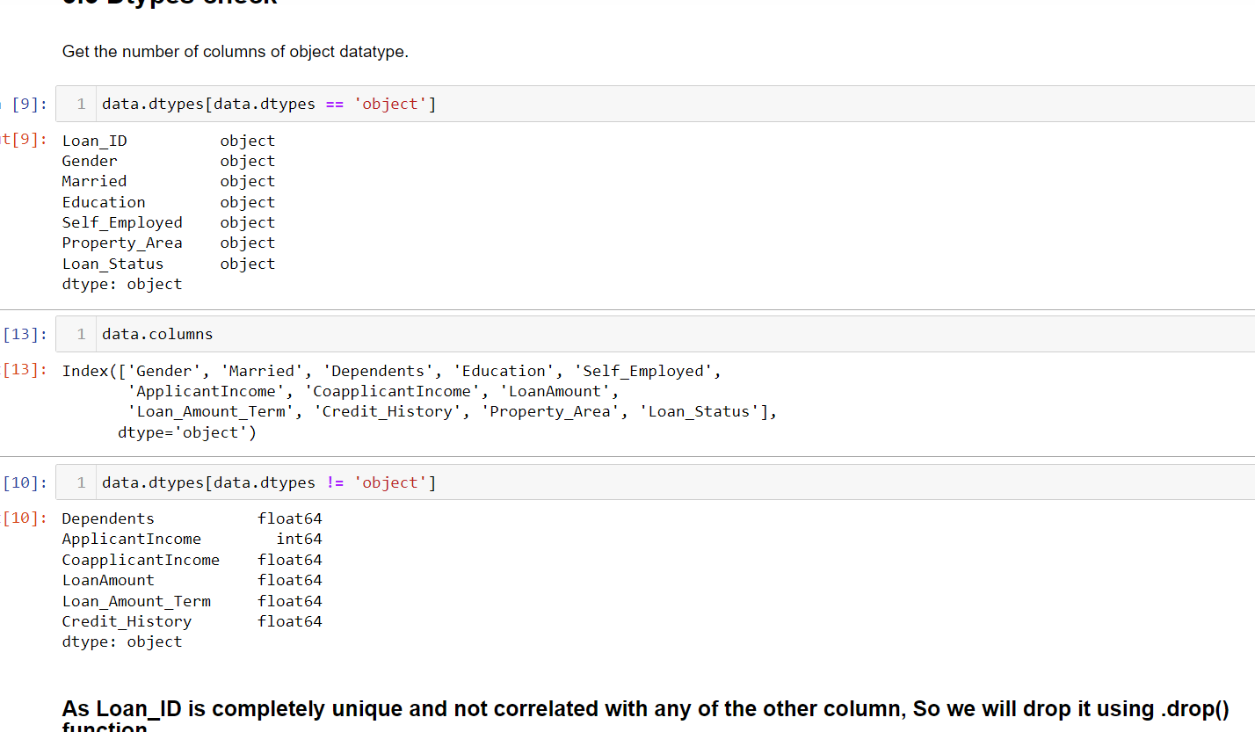
3.Data Preparation
Checking the dimension and shape
Check for the statistical summary for object and numerical variable.

Slide 7
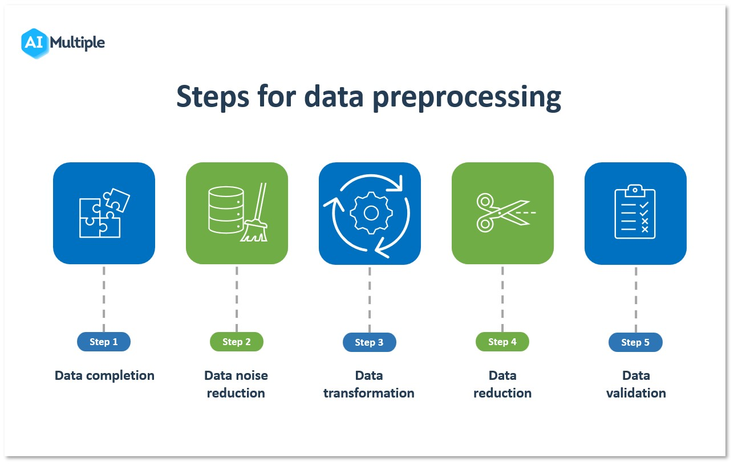

Slide 8
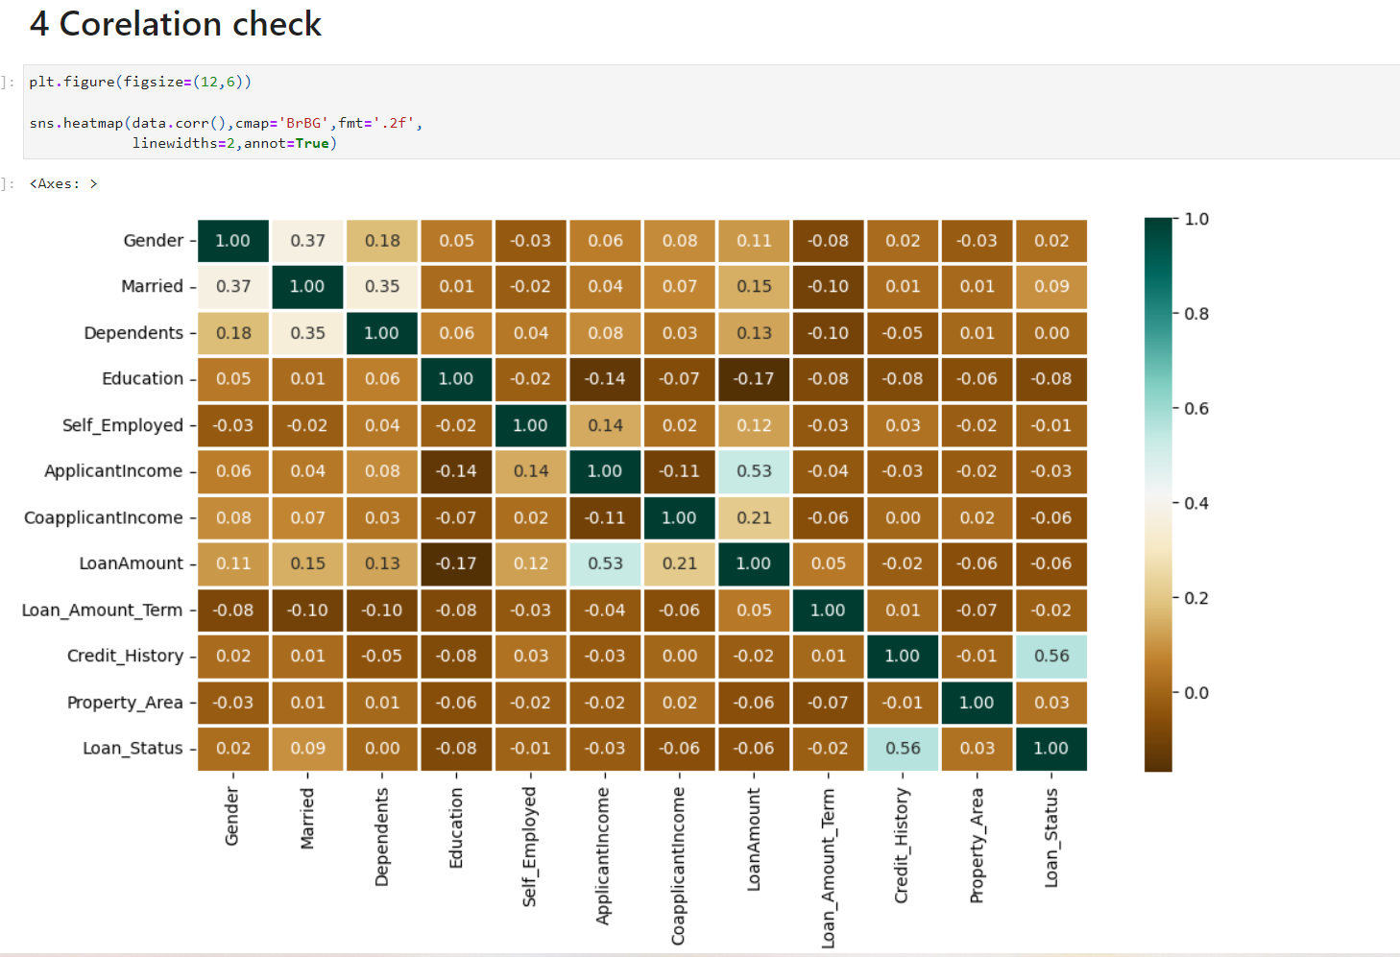
4.Modelling the machine
The above heatmap is showing the correlation between all the columns.
Loan status and credit history
Loan amount and applicant income
The above two features showing stronger relation among them
Credit history showing stronger relation to the loan status.

Slide 9
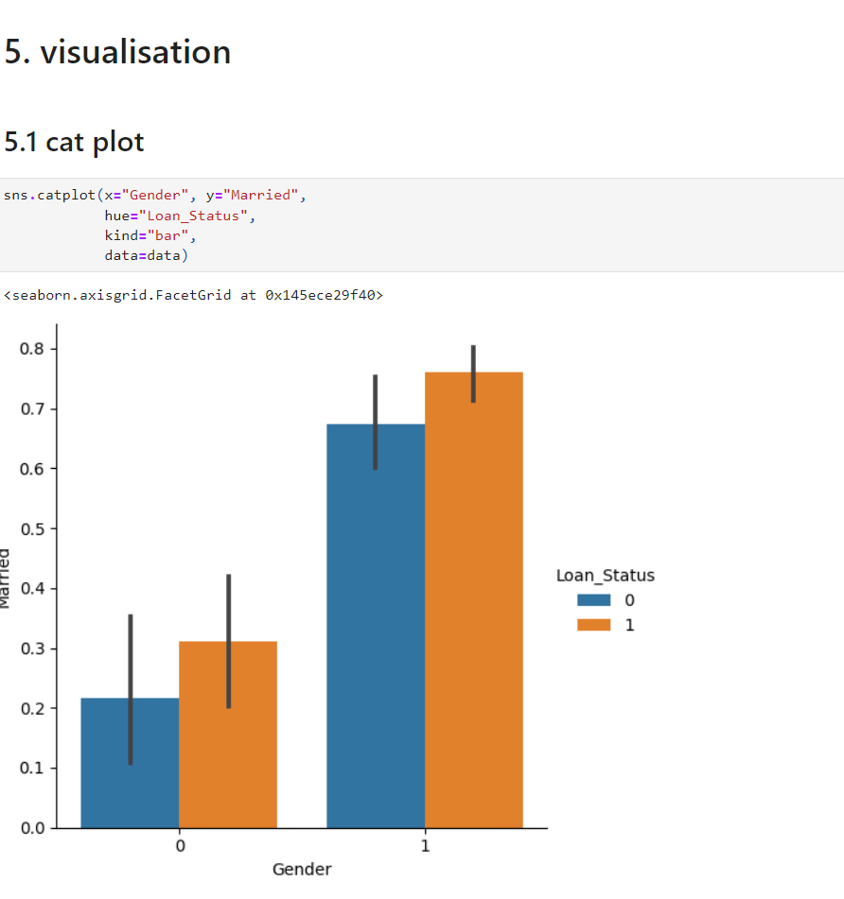
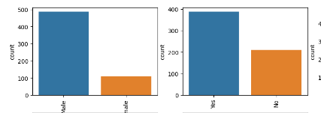
Catplot showing the gender wise loan status viz males are contributing more in the data set rather than other gender.
Its obsereved that the very less females are taking loans

Slide 10
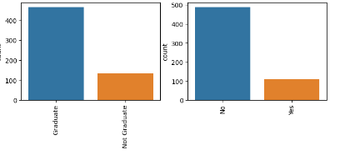
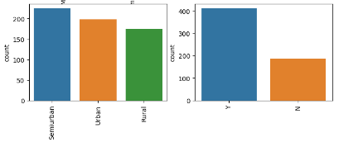
Semi urban people more populated in data set that affect the target variable.
Graduated person influence more in the data set

Slide 11
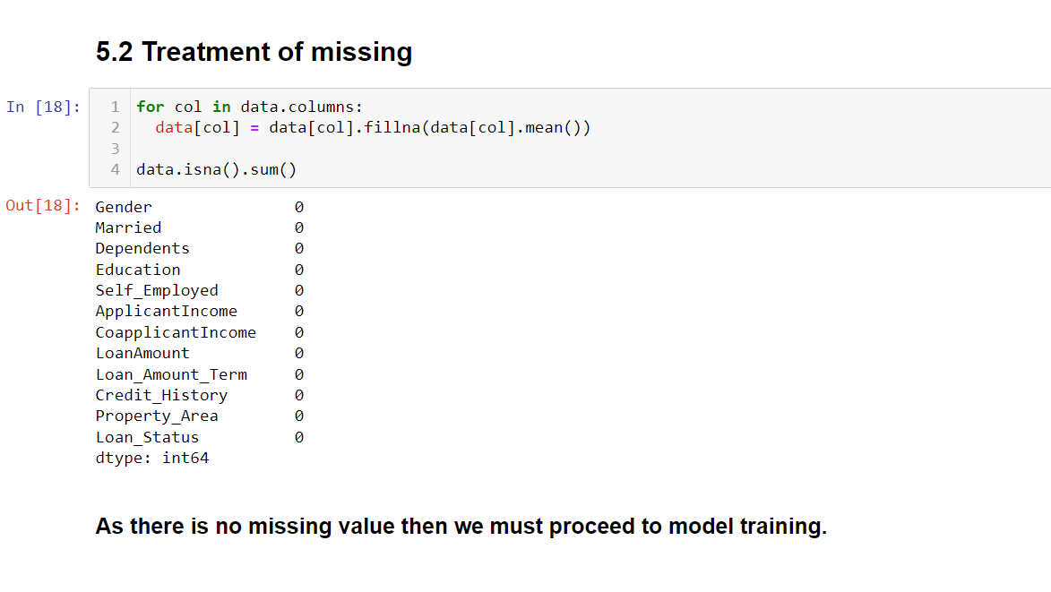
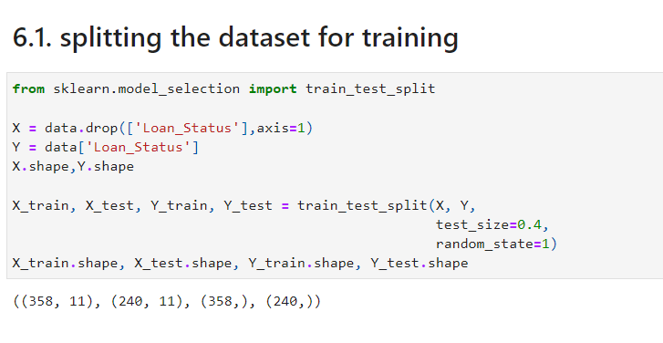
Treatment for the missing values by the mean value where fill in the blank value.
Splitting the dataset for training.

Slide 12
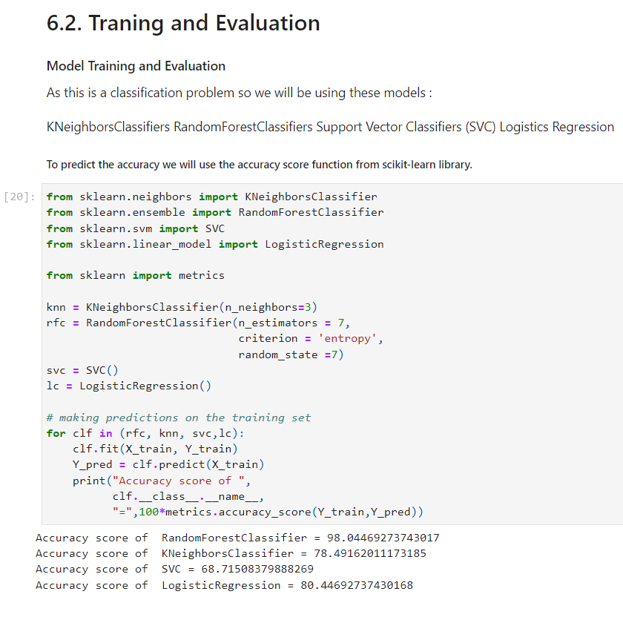
As this is a classification problem so we will be using these models :
Kneighbor sClassifiers ,Random Forest Classifiers Support vector Model Training and Evaluation
As this is a classification problem so we will be using these models :
KNeighborsClassifiers,RandomForestClassifiers Support Vector Classifiers (SVC) Logistics Regression
To predict the accuracy we will use the accuracy score function from scikit-learn library.
Sector Classifiers (SVC) Logistics Regression
To predict the accuracy we will use the accuracy score function from scikit-learn library.

Slide 13
Traning the model in object svc and lc

Slide 14
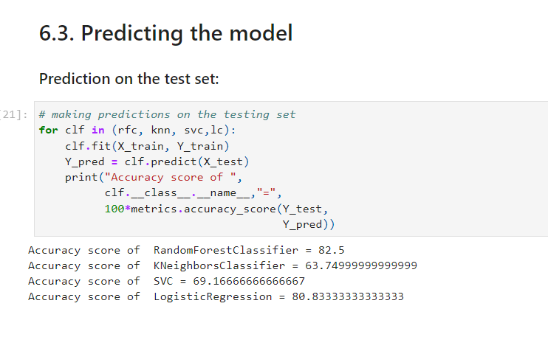
As this is a classification problem I predicted the test dataset to get the accuracy .
it observed that the best accuracy gives at random forest among them
The accuracy is 82.5 percent
5. Evaluation

Slide 15
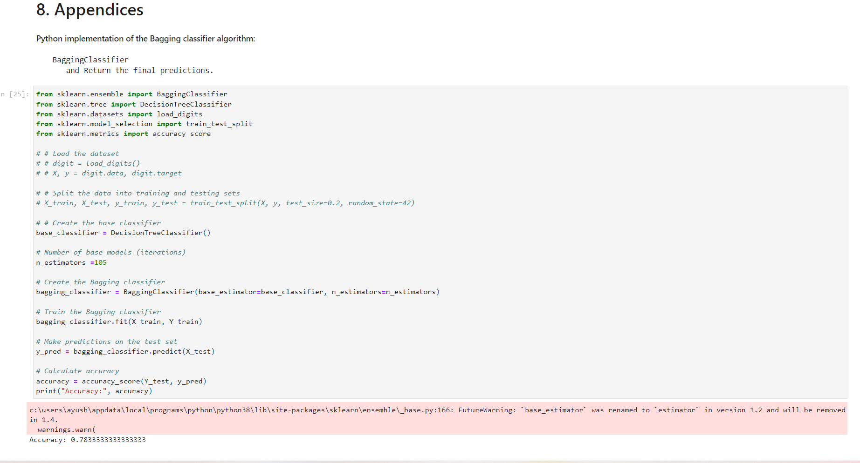
7. Appendices
Python implementation of the Bagging classifier algorithm:
BaggingClassifier and Return the final predictions.
Python implementation of the Bagging classifier algorithm:
BaggingClassifier and Return the final predictions.
BaggingClassifier and Return the final predictions.
After random forest using bagging technique to train the model
It gives me accuracy to test data
That gives me less accuracy than random forest 78.3 percent.
Using n estimater =105

Slide 16
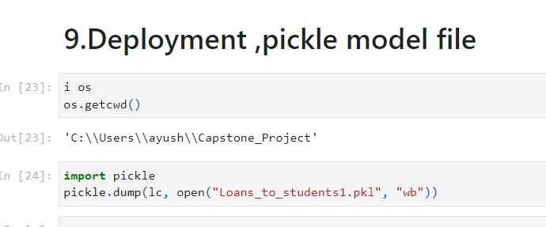
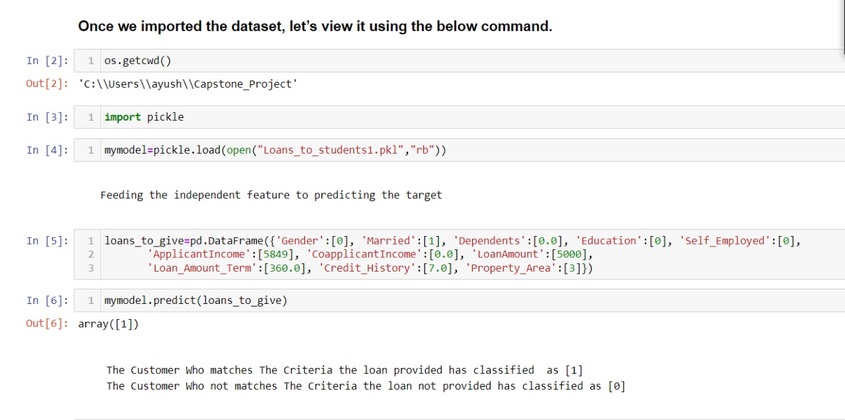
7. Dumping and predicting the model
Python implementation of the Bagging classifier algorithm:
BaggingClassifier and Return the final predictions.
Python implementation of the Bagging classifier algorithm:
BaggingClassifier and Return the final predictions.

Slide 17
8. Conclusion
1.Random Forest Classifier is giving the best accuracy with an accuracy score of 82%for the testing dataset.
2.And to get much better results ensemble learning techniques like Bagging and Boosting can also be used and Dumping the model and use the features and predict the class
3. Predicting the model as labelled as [1,0]
4.If the dumped model gives the output 1 the model says to person is eligible for loan.

Slide 18
#Use Case.
The model is widely used for financial sectors.
Production sector as well used to their customers for buying their goods
After getting the person is in loan we have to get the data prevent them fro overburden and losses.
Due to this we fetch the targeted audiences for making the profit for whom has strongest evidences for getting the loan.

Slide 19
Thank You

