Slide 1
YOLO Evaluation
and
Lane Segmentation Dataset Preparation
Abhinav Gupta

Slide 2
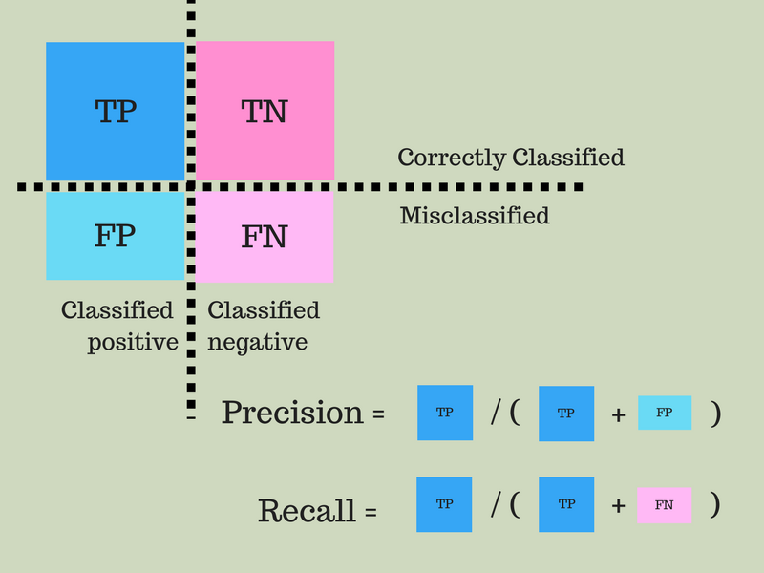
Evaluation Metrics
https://www.youtube.com/watch?v=iIjtgrjgAug

Slide 3
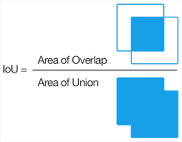
IOU (Intersection over Union)

Slide 4
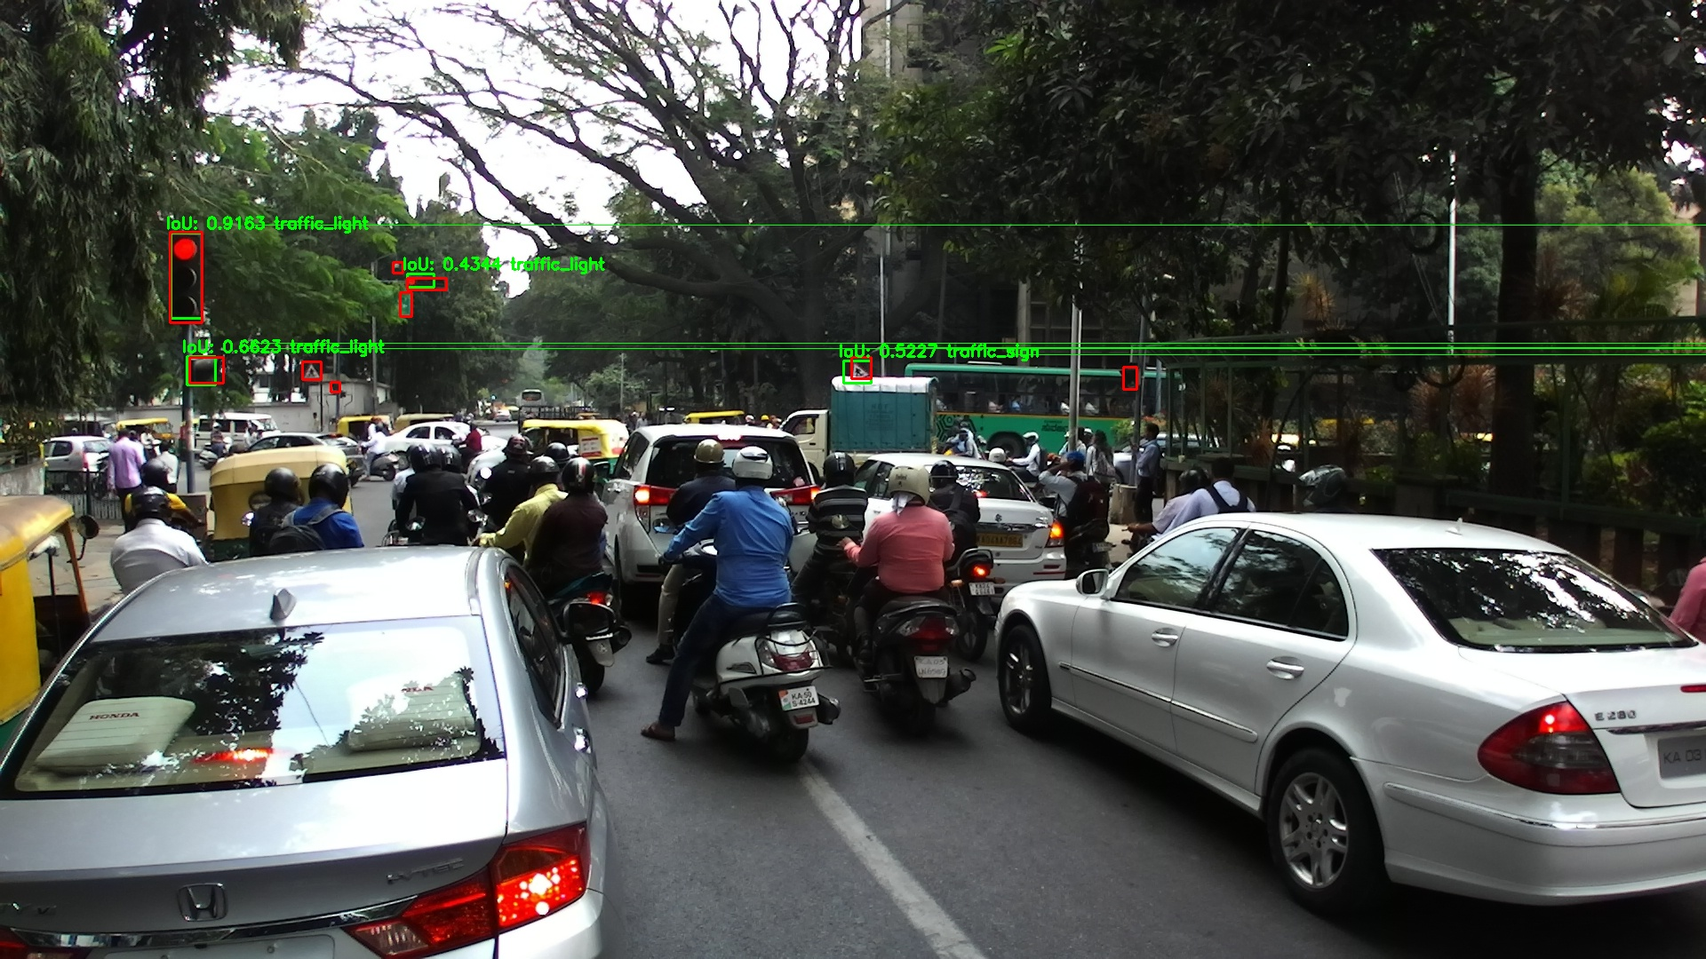

Slide 5
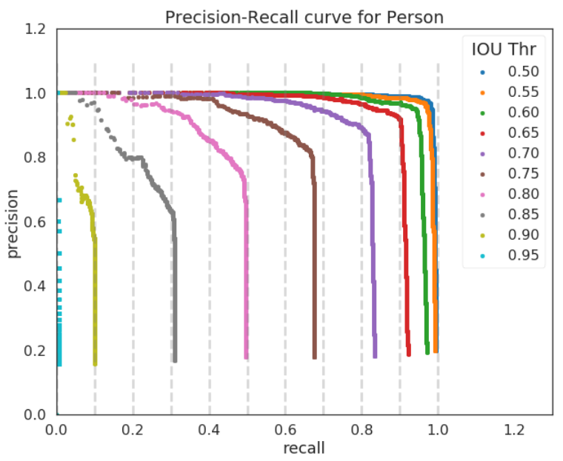
Precision-Recall Curve

Slide 6
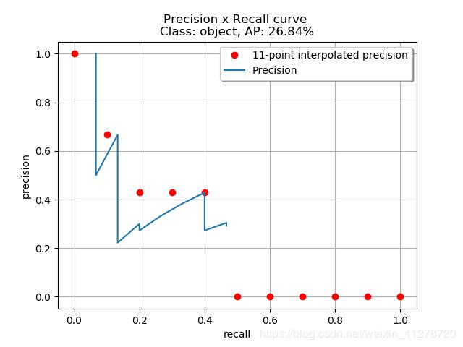
Average Precision
Area under the precision recall curve -
11 point interpolation

Slide 7
Mean Average Precision (mAP)
Mean of Average Precisions calculated over each class.

Slide 8
YOLO stats
1617 training images, each having >3 labels.
Tested on 916 images.
Total no. of classes
At iou 0.5 as threshold,
Precision = 0.825
Recall = 0.119
TP = 749, FP = 158, TP+FN=6257

Slide 9
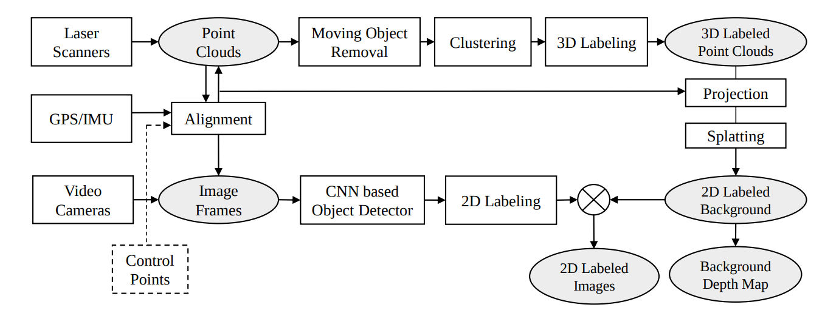
Lane Segmentation Dataset Preparation
The pipeline as in the published paper

Slide 10
Citation-
Other Relevant Publication-
J. Xie, M. Kiefel, M.-T. Sun, and A. Geiger. Semantic instance annotation of street scenes by 3d to 2d label transfer.
http://www.cvlibs.net/publications/Xie2016CVPR.pdf
R. Tylecek, R.-B.Fisher. Consistent Semantic Annotation of Outdoor Datasets via 3D-2D Label Transfer.
https://www.mdpi.com/1424-8220/18/7/2249/htm
GitHub : https://github.com/rtylecek/rosemat

Slide 11
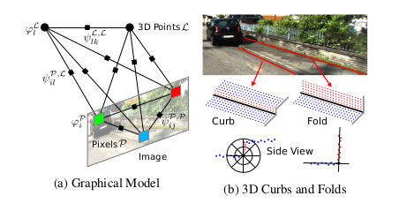
Key Points (Paper -1)
Annotate all objects in 3D using bounding primitives.
Detection of curbs and folds
Transfer this information to 2D by building a CRF jointly over all 3D points and corresponding 2D pixels, to encourage neighbourhood consistency.
3D structures such as folds and curbs are leveraged to improve segmentation boundaries between the categories “Road”, “Sidewalk” and “Wall”.

Slide 12
Key Points (Paper 2)
Inputs
3D point cloud using laser/SFM techniques.
Camera pose information.
Corresponding images to be labeled.
Procedure
3D labeling in point cloud
Transfer labels through projection
Manual Refinement in 2D
Transfer labels from frame-to-frame by using optical flow.

Slide 13
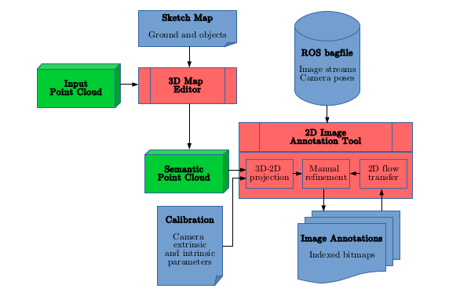
Proposed Pipeline

Slide 14
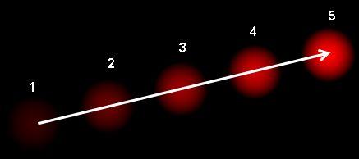
Optical Flow
Optical flow is the pattern of apparent motion of image objects between two consecutive frames caused by the movement of object or camera.
The manually refined results can be transferred to consecutive frames using optical flow.
Optical Flow implementation - EpicFlow, GitHub

Slide 15
Other Optimization Techniques
In order to speed up the 3D labeling process, over-segment point clouds into point clusters based on spatial distances and normal directions.
Pre-segment the point cloud using PointNet++ for better results. (Website)
The splatting techniques in computer graphics are further applied to handle unlabeled pixels that are often caused by missing points or strong reflections.

Slide 16
Thank You

