Slide 1


S. G. R. education FOUNDATION’S G.H. RAISONI COLLEGE OF ENGINEERING AND MANAGEMENT, chas, AHMEDNAGAR
A Project Report on
“Enhancement of performance & emission parameters of hybrid biodiesel blended with diesel fuel & additive in diesel engine”
Under The Guidance of
Prof. Shrikant kathwate
(internal guide)
&
Prof. Supriya Bobade
(external guide)
Sponsored by
Indian Biodiesel Corporation
Presented By
Akshay Deshmukh Ashwin Gupta
Karan Fulare Sahil Pawar

Slide 2
Contents
Introduction.
Objectives.
Scope Of The Project.
Literature Review.
Proposed Research Methodology.
Proposed Test Procedure , Setup Layout.
Scheme of Implementation.
Summary.
References.

Slide 3
Introduction
The availability of energy resource plays a critical role in the progress of a nation. Almost all the human energy needs are currently met from the fast depleting fossil fuels associated with serious environmental consequences.
The rapid increase in the consumption of fossil fuels is resulting into climate change which is considered as the most important environmental problem of the present century.
The recent studies indicates that the emission of green house gases to the atmosphere have contributed to the increase in the global mean temperature by approximately 0.8 °C during the past century.

Slide 4
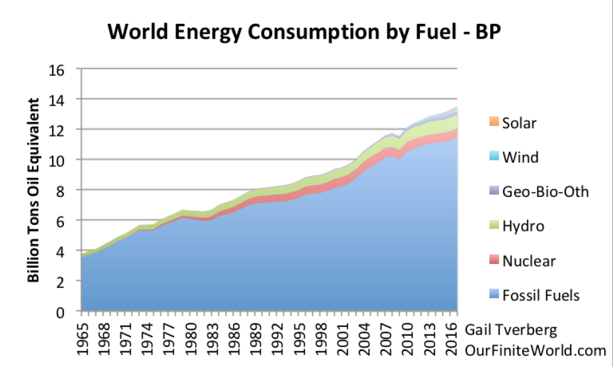

Slide 5
Alternative fuels
The future of alternative fuels for compression-ignition engine has become imperative due to exhaustion of petroleum products and its major contribution in pollution.
In the future, the demand for biodiesel may be predictable to increase due to fast deplition of fossil fuels and improvement of vehicle transportation.
Alternative fuel may be of three types:
(i) Bio Solid fuel from nature (For direct burning).
(ii) Bio Gaseous fuel.
(iii) Bio Liquid fuel (Produced specially for C.I engine).

Slide 6
Comparision of diesel & Biodiesel
Sr.No | Type of emission | B100 | B20
1 | Hydrocarbon (HC) | -67% | -20%
2 | Carbon monoxide (CO) | -48% | -12%
3 | Particulate matter (PM) | -47 | -2%
4 | NOx | +10% | +2%
5 | SO2 | -100% | -20%
6 | PAH | -80% | -13%
Biodiesel shows very less emission and have same performance characteristics as that of diesel when used in engine

Slide 7
Objectives
To obtain different engine performance parameters for the various blends of biodiesel.
To compare engine performance with pure diesel and blended biodiesel(B6,B12,B18,B24,B30,B36) .
To obtain blend with nominal emission parameter at same compression ratio.

Slide 8
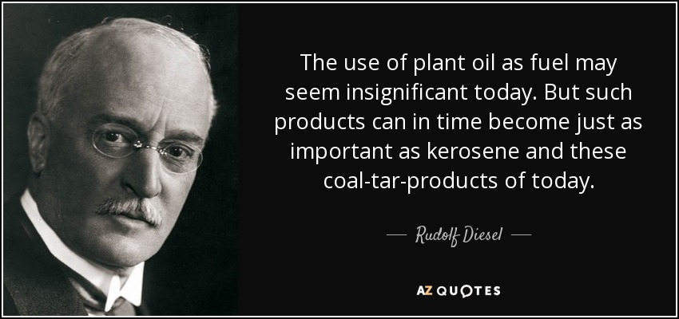
Scope of project

Slide 9
Biodiesel will prove to be an alternative for fossil fuels and will reduce the current demand of diesel.
This will open new employment opportunities to people in rural areas.
Biodiesel will reduce environmental pollution.
New refineries can be set up providing new employment opportunities to the peoples.
Intercrops system can be implemented for earning more profit via farming.
Diesel import can be reduced indirectly affecting the economy.
This will affect the national economy in profitable manner.

Slide 10
Literature Review
Sr. No | Author | Paper Title | Description | Conclusion
1 | Harshad .T Magar | Experimental Investigation Of Undi Oil Methyl Ester And Diesel Blends As A Fuel In Vcr Diesel Engine And Development Of Emission Models. | In this paper the tests has been carried out to investigate the performance characteristics of diesel blended with Undi biodiesel in VCR engine. | The experimental investigation proves that Undi oil has less emission as compare to fossil fuel Hydro carbon, CO, NOx emissions are reduced for blend of Undi oil. It has also been concluded that the esters showed a slight power loss and increased fuel consumption.
2 | Rahul Krishnaji Bawane | Performance Test of CI Engine fueled with Undi Oil Biodiesel under Variation in Blend Proportion, & Engine Load . | In this review an experimental work is conducted to obtain the operating and emission characteristics of Undi Oil Biodiesel on various blends of biodiesel, and load conditions. | Exhaust Gas Temperature, (EGT), for the biodiesel and its blends found lower at all conditions as compared to diesel. The result indicates that the variation in exhaust gas temperature is very minimal and is showing the same trend at full load condition.

Slide 11
Sr. No | Author | Paper Title | Description | Conclusion
3 | S. A. Ransing | Experimental Study on Diesel Engine Performance using undi Oil Biodiesel and Its Blends. | The test has been conducted on single cylinder four stroke constant speed diesel engine using pure diesel, 10%, 20%, 30%, 40% and 100% blends. The engine model has been validated using GT-Power simulation software. Diesel engines emit significant amounts of particulate matter (PM) and oxides of nitrogen (NOx). | The BTE and BSFC graphs show that, among all blends B20 blend follow closely to that of pure diesel. From experimental results, B20 blend shows 2.51% variation in BTE and 7.17% variation in BSFC at maximum power when compared with that of pure diesel.
4 | M. Vijay Kumar | The impacts on combustion, performance and emissions of biodiesel by using additives in direct injection diesel engine. | In this review article there is a comparative study to find out the effects of additives for biodiesel fuel and efforts to recover the combustion and performance and to diminish the emissions. | The review conclude that the uses of additive to the 2nd generation of bio -diesel are the best in improving the combustion performance and emission reduction. Using the biodiesel in CI engines can reduce the hydrocarbons (HC), smoke and carbon monoxide (CO) emissions.

Slide 12
Sr . No | Author | Paper Title | Description | Conclusion
5 | Raahul Krishna & Ashish G | Experimental Investigation of Emission Characteristics of VCR Engine using Calophyllum Inophyllum Bio-Diesel Blends as a Fuel. | This paper presents experimental results on single cylinder vertical diesel engine with Undi biodiesel blends. Experiments were performed using pure diesel, 25%, 50% and 75% blends by varying the compression ratio and the exhaust emissions, namely hydrocarbon (HC), carbon monoxide (CO) and Nox. | The CO emissions are higher at lower compression ratio, and decreased at higher compression ratio. The biodiesel and its blends emits lower percentage of CO2 as compared to diesel at higher compression ratio.
6 | Gaurav Dwivedi | Diesel engine performance and emission analysis using biodiesel from various oil sources. | In this paper has compared various properties of vegetable oils and their esters with diesel fuel. This paper describes the engine performance at various blends (B5,B10,B15,B20). | From the review it is found that the use of biodiesel leads to the substantial reduction in PM, HC and CO emission. It is also concluded that the use of biodiesel favours to reduce carbon deposit and wear of the key engine parts, compared with standard diesel.

Slide 13
Sr .No | Author | Paper Title | Description | Conclusion
7 | Wail M. Adaileh | Performance of Diesel Engine Fuelled by a Biodiesel Extracted From A Waste Cocking Oil | In this study, the combustion characteristics and emissions of compression ignition diesel engine were measured using biodiesel as an alternative fuel. | 1)Waste vegetable oil was found to be safe and efficient alternative fuel and has a low impact on the Environment. 2) As the B20 produced significant reductions in the CO, HC, and smoke emissions compared with standard diesel and B5. 3) It has the major advantages of having high biodegradability, excellent lubricity and no sulfur content.
8 | A. Tamilvann | Effects of nano-copper additive on performance ,combustion and emission characteristics of Calophyllum inophyllum biodiesel in CI engine. | In this paper the effect of additives in biodiesel on engine performance , combustion and emission characteristics has been studied. | This paper aims to investigate the effects of the copper additive nano particles with biodiesel blends on the engine performance, combustion and emission characteristics of single-cylinder direct-injection diesel engine and compared that with diesel fuel.

Slide 14
Methodology
Undi oil
Transesterification
Preparing blends
Testing on VCR diesel engine
Results and comparison

Slide 15
Blending (Phase II)
Each blend contained Diesel + Undi oil + wco + alcohol .
TRANSESTERIFICATION of Undi oil and wco was done before blending .
Alcohol was use as a additive , 05 % in proportion with the blend .

Slide 16
Proportion
For B00 (D100,U00,W00,A00)
For B06 (D094,U03,W03,A05)
For B12 (D088,U06,W06,A05)
For B18 (D082,U09,W09,A05)
For B24 (D076,U12,W12,A05)
For B30 (D070,U15,W15,A05)
For B36 (D064,U18,W18,A05)

Slide 17
1 ltr batch was decided to be blended for each proportion .
For eg . Consider B24 (D076,U12,W12,A05)
for 1 liter 760 ml of diesel +120ml of undi oil +120ml of waste cookin oil + 50 ml of alcohol were used .

Slide 18
BLEND REPORTS
Lab tests were carried out for density, calorific value , cetane no. ,viscosity ,moisture , flash point and fire point by following ASTM Ref.Std. 6751

Slide 19
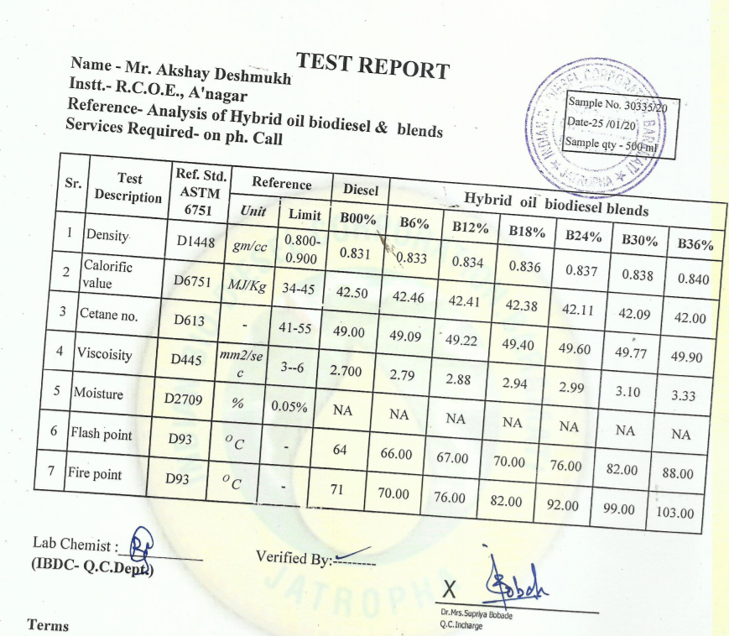

Slide 20
Proposed tests
Engine performance test
( BSFC,BP, FC, BTE , BT , HS ,Torque, Efficiency)
Emission parameters (HC, CO, Nox , Nitrogen, Carbon).

Slide 21
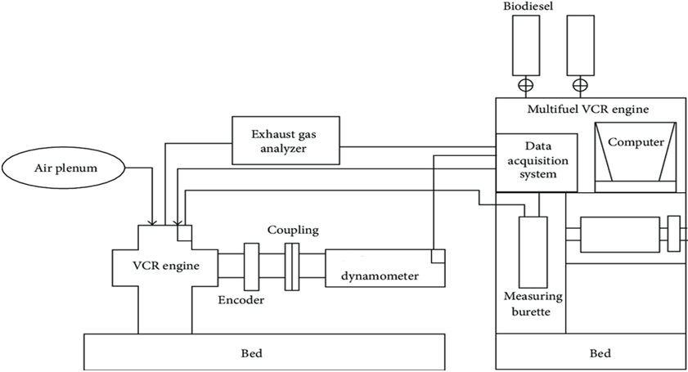
Proposed setup layout

Slide 22
Scheme of Implementation
Month | Topics searching | Literature survey | Detail study | Blendind of biodiesel | Experimentation
June 19
July 19
Aug 19
Sept 19
Oct 19
Nov19
Dec 19
Jan 20

Slide 23
Summary
The literature survey has been done and from that we have concluded that : due to high yield of oil from seeds Undi has a promising source of feedstock for making of biodiesel in India.
The esters obtained clearly indicates that the Undi plant seeds can be used directly without extraction of oil from seeds for the preparation of (Biodiesel) which will be suitable for use as replacement of diesel without any change in engine.
Till now we have selected undi plant for extraction of biodiesel and from that we have found that undi is suitable to use as fuel in engine.

Slide 24
References
Harshad.T.Magar, "Experimental Investigation Of Undi Oil Methyl Ester And Diesel Blends As A Fuel In vcr Diesel Engine And Development Of Emission Models", International Engineering Research Journal (IERJ) Special Issue 2 Page 4741-4745, 2015, ISSN 2395-1621.
Rahul Krishnaji Bawane, "Performance Test of CI Engine fueled with Undi Oil Biodiesel under Variation in Blend Proportion, Compression Ratio & Engine Load International Journal of Science", Engineering and Technology Research (IJSETR), Volume 3, Issue 8, August 2014.
S. A. Ransing, " Experimental Study on Diesel Engine Performance Using Undi Oil Biodiesel and Its Blends", International Engineering Research Journal (IERJ) Special Issue 2 Page 4761-4765, 2015, ISSN 2395-1621.
M. Vijay Kumar, "The impacts on combustion, performance and emissions of biodiesel by using additives in direct injection diesel engine", Alexandria Engineering Journal (2018) 57, 509–51.

Slide 25
Raahul Krishna, "Experimental Investigation of Emission Characteristics of VCR Engine using Calophyllum Inophyllum Bio-Diesel Blends as a Fuel", International Journal on Recent Technologies in Mechanical and Electrical Engineering (IJRMEE) Volume: 2 Issue: 2.
Gaurav Dwivedi,"Diesel engine performance and emission analysis using biodiesel from various oil sources - Review", J. Mater. Environ. Sci. 4 (4) (2013) 434-447 ISSN : 2028-2508.
Wail M. Adaileh ," Performance of Diesel Engine Fuelled by a Biodiesel Extracted From A Waste Cocking Oil ",Elsevier Ltd, Energy Procedia 18 ( 2012 ) 1317 – 1334.
A. Tamilvanan, " Effects of nano-copper additive on performance, combustion and emission characteristics of Calophyllum inophyllum biodiesel in CI engine", Journal of Thermal Analysis and Calorimetry.

Slide 26
Thank You

