Slide 1

Kodekalesh HACKTHON 2025
TITLE PAGE
Problem Statement Title- AI Outbreak Detection System.
Theme – Early warning for public health.
PS Category- Software
Team Name – ALPHA CODERS

Slide 2
Introduction to Virus Outbreaks
Virus outbreaks are sudden increases in the number of cases of a particular disease, beyond what is normally expected in a population. They can range from localized events to global pandemics. Understanding the nature and scope of these outbreaks is the first step in developing effective response strategies.
Understanding virus outbreaks is crucial for protecting public health and preventing widespread illness and death. The ability to quickly identify and respond to these outbreaks can significantly reduce morbidity and mortality rates, safeguarding communities and healthcare systems.
Outbreaks can overwhelm healthcare systems, disrupt economies, and cause significant social disruption globally. The interconnectedness of the modern world means that a localized outbreak can rapidly escalate into a global crisis, underscoring the need for international collaboration and preparedness.

Slide 3
The Reactive Nature of Public Health Agencies
Public health responses often lag behind the actual spread of diseases. This "Lag Time" means that by the time an outbreak is officially confirmed, it has already begun to spread, creating a critical window for uncontrolled transmission.
This "lag time" costs crucial days, allowing the disease to take hold and making it harder to control. The consequences of delayed action can include higher infection rates, increased mortality, and greater strain on healthcare resources, impacting the overall effectiveness of containment efforts.
Traditional public health responses are often reactive, responding to outbreaks as they occur, rather than proactively preventing them. This reactive approach can limit the ability to effectively contain and mitigate the impact of emerging infectious diseases, emphasizing the need for more proactive strategies.

Slide 4
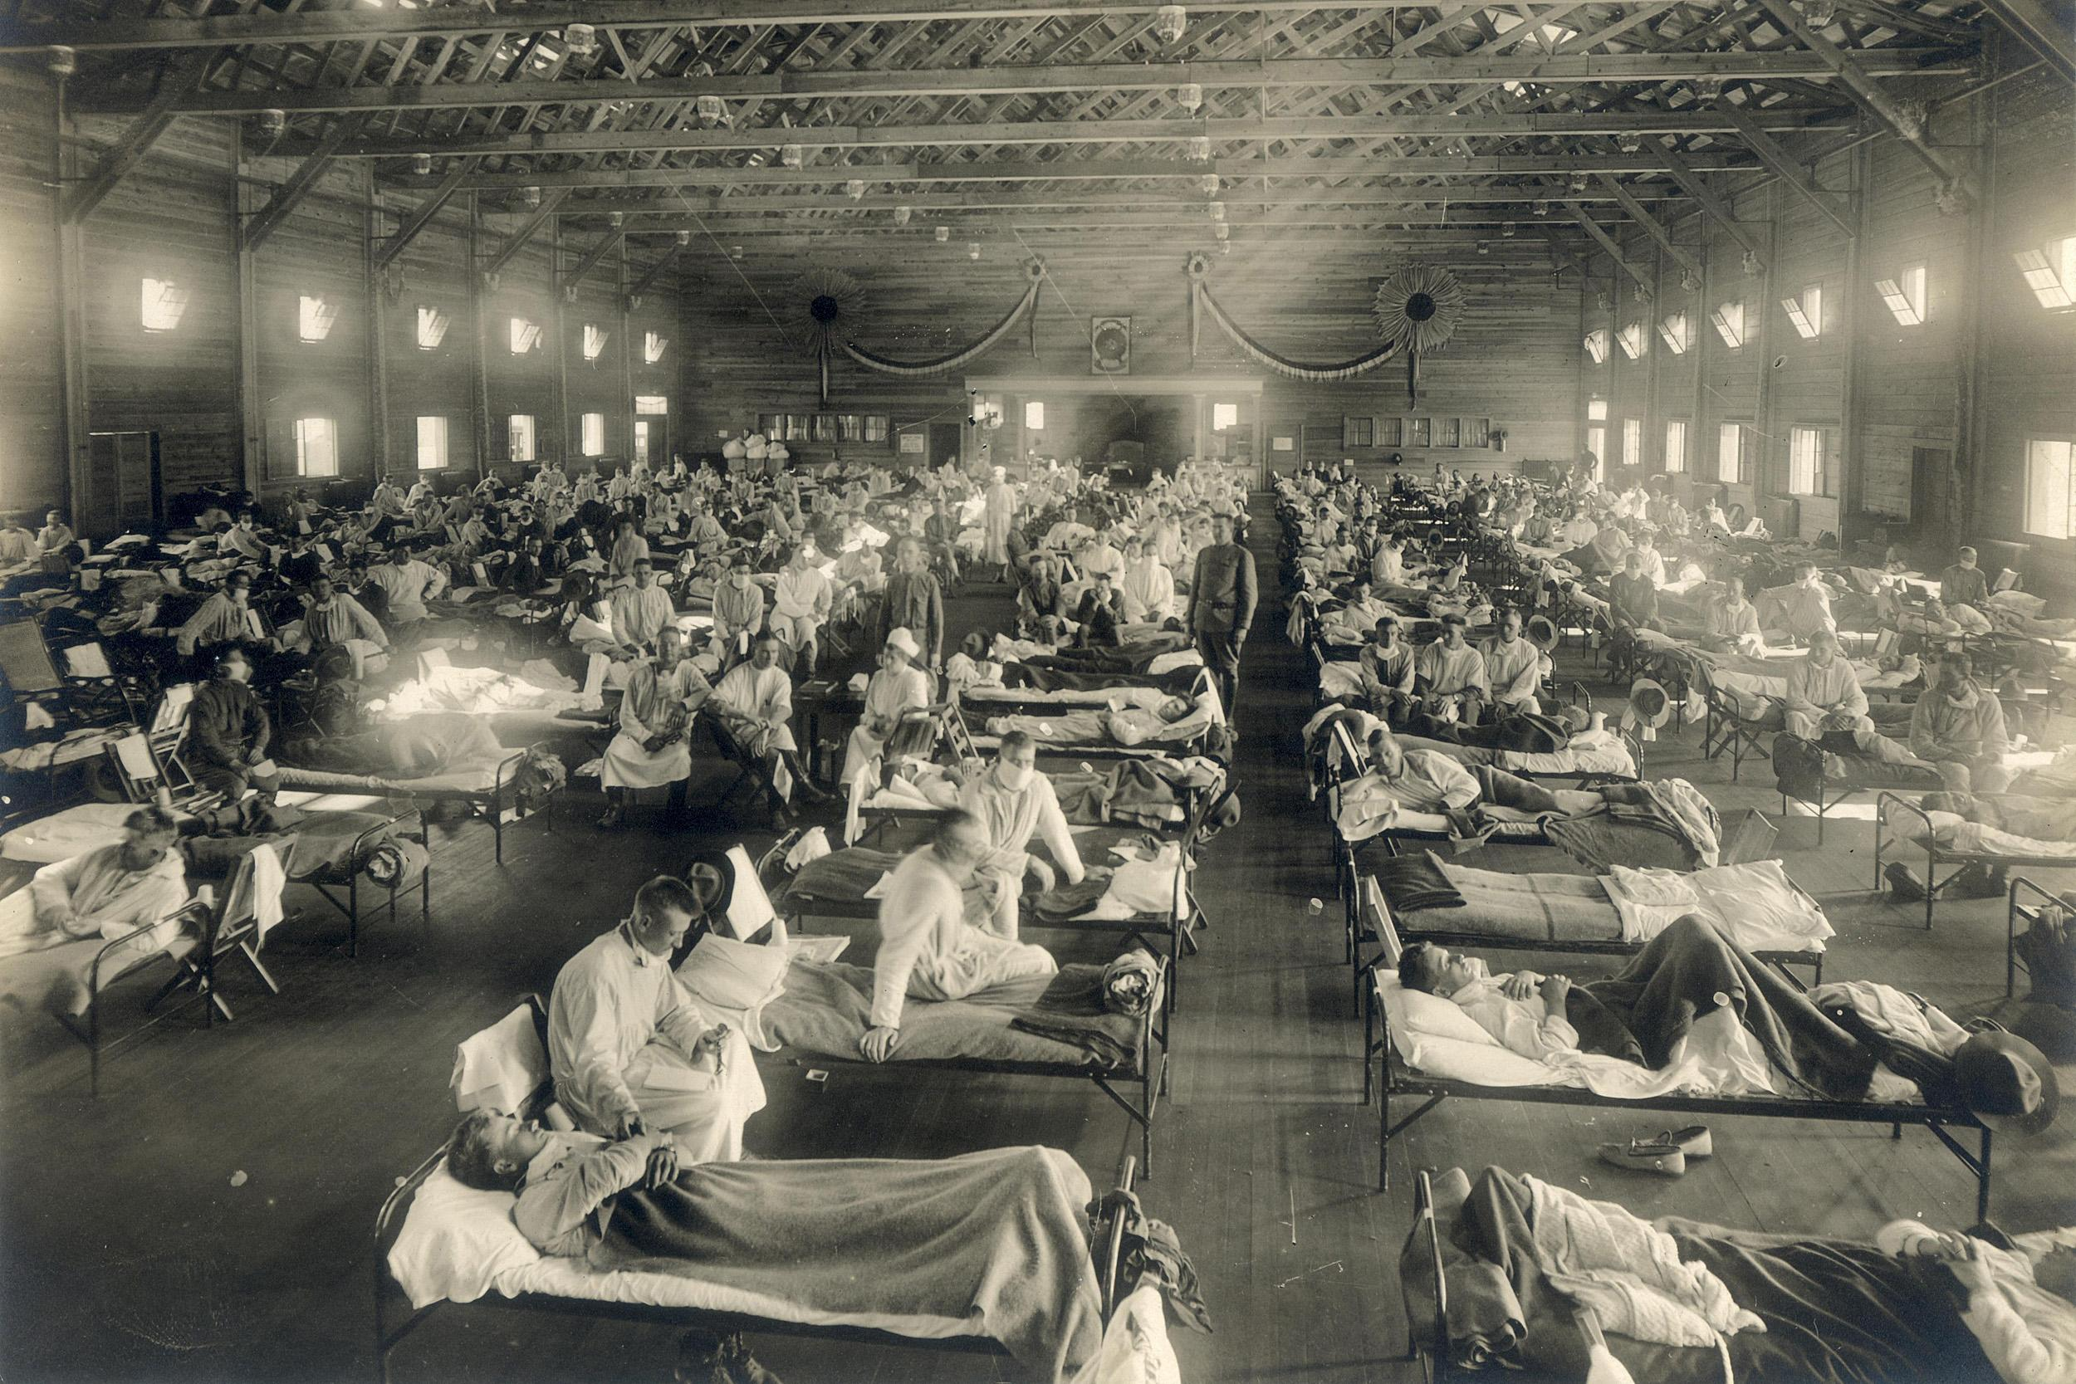
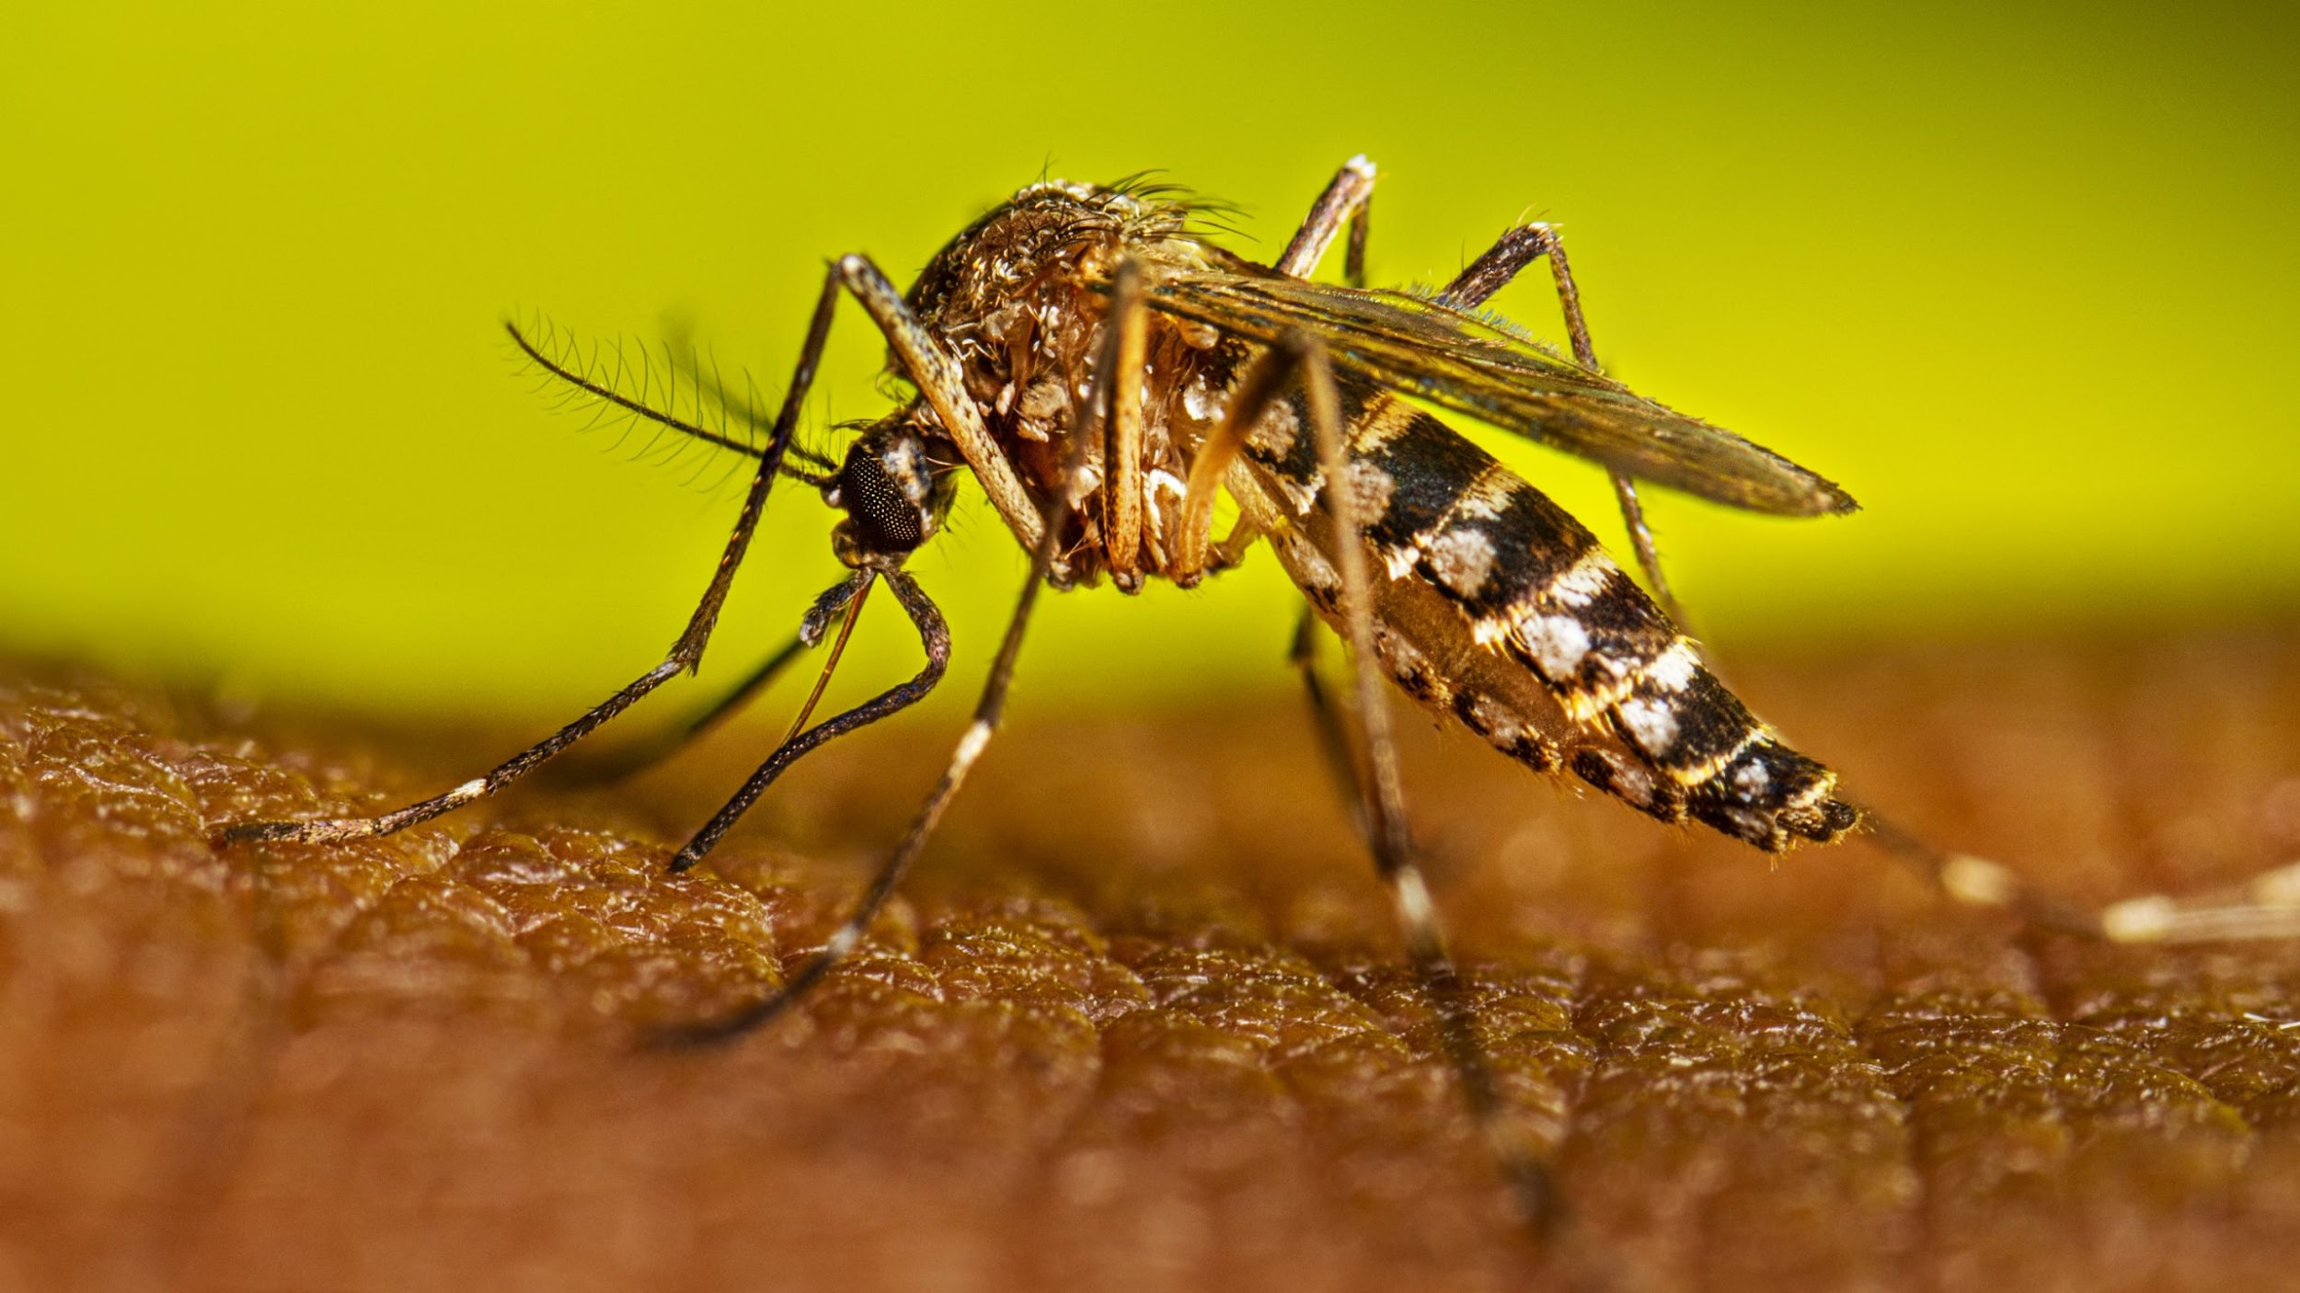
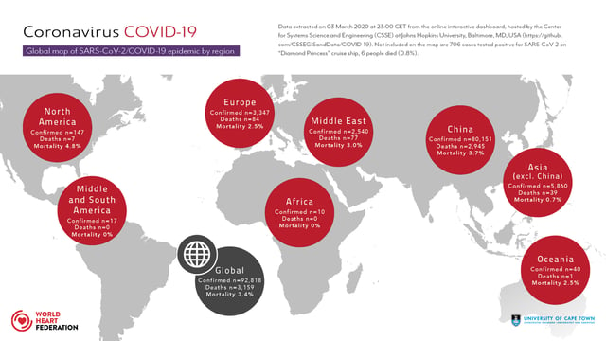
Case Studies of Historical Outbreaks
Influenza: Spanish Flu (1918)
Dengue Fever: Recurring Outbreaks
Novel Viruses: COVID-19
Demonstrated the devastating impact of a highly contagious virus. Lessons Learned: Importance of rapid response and public health measures.
Highlight the challenges of controlling mosquito-borne diseases. Mistakes Made: Insufficient vector control and public awareness.
Showed the rapid global spread and impact of a novel virus. Lessons Learned: The need for early detection, international collaboration, and robust public health infrastructure.

Slide 5
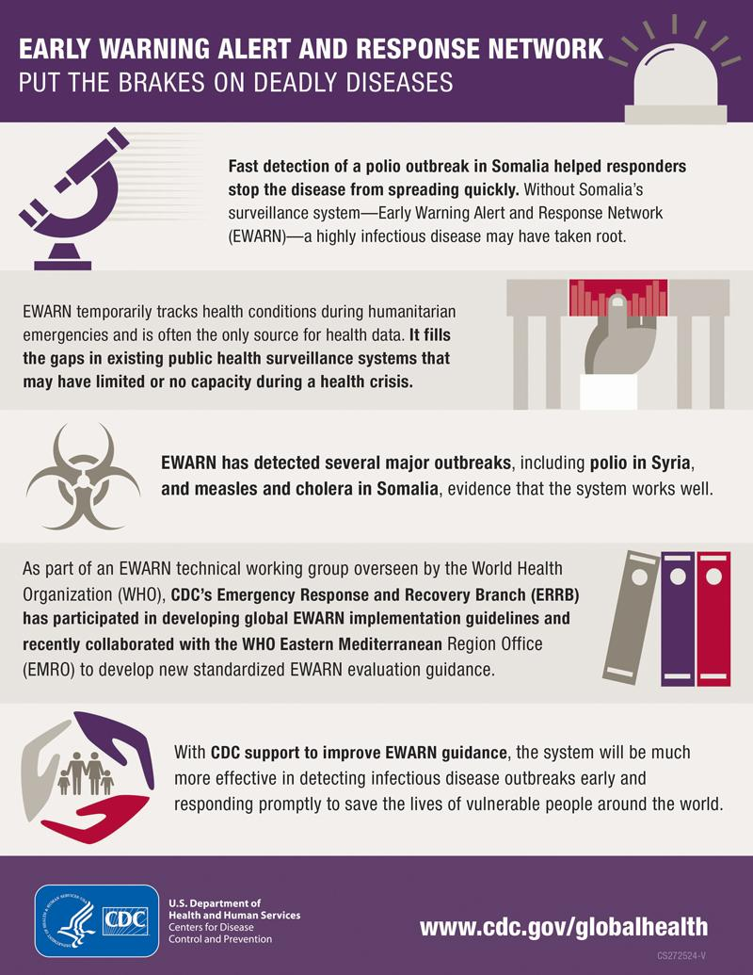
The Importance of Early Detection
Mitigating the Spread: Early warning systems can mitigate the spread of viral diseases by allowing authorities to mobilize resources quickly.
Saving Lives: Early detection can save lives by enabling timely treatment and preventative measures.
Rapid identification of outbreaks
Implementation of targeted interventions
Reduced morbidity and mortality

Slide 6
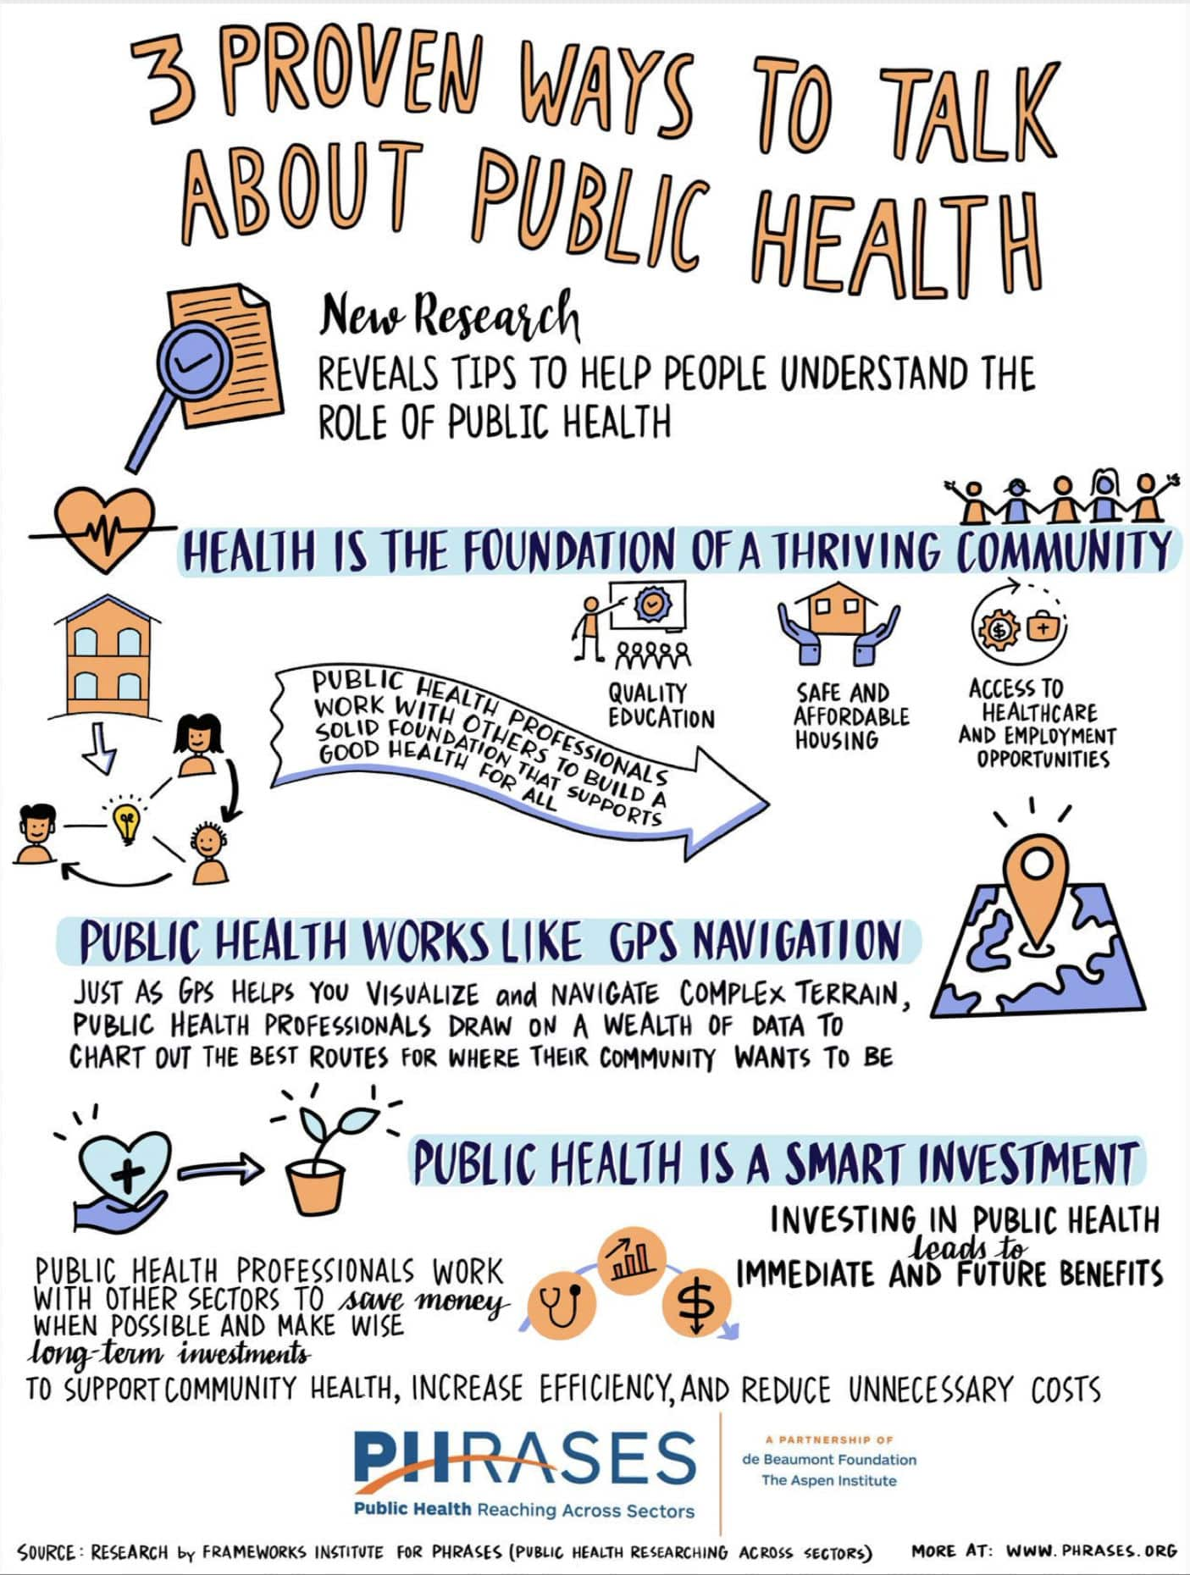
Communicating Risk to the Public
Necessity of Effective Communication: Clear and timely communication is essential during an outbreak to inform the public about preventive actions.
Transparency: Providing honest and accurate information.
Clarity: Using simple and understandable language.
Consistency: Delivering consistent messages across all channels.
Benefits:
Increased public trust
Improved adherence to preventive measures
Reduced panic and misinformation

Slide 7
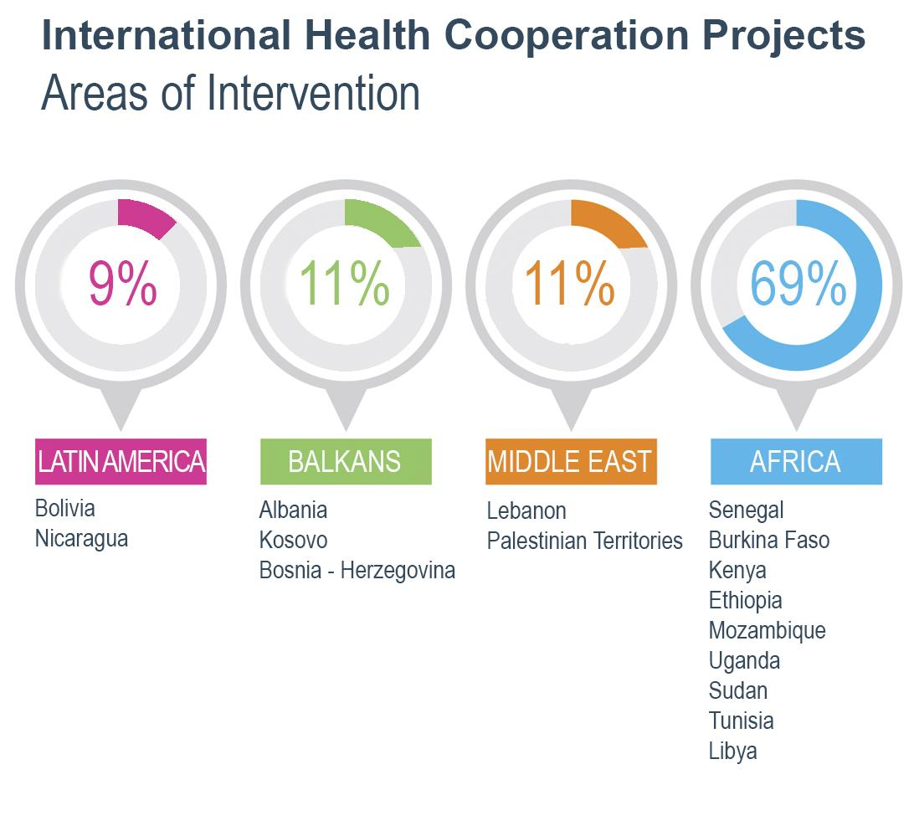
Collaborative Efforts in Public Health
Role of Partnerships: Partnerships between governments, health organizations, and communities are crucial in outbreak prevention and response.
International cooperation: Sharing information and resources.
Public-private partnerships: Developing and distributing vaccines.
Community engagement: Involving local communities in prevention efforts.
Benefits:
Enhanced coordination and resource mobilization
Improved community participation
More effective outbreak control

Slide 8
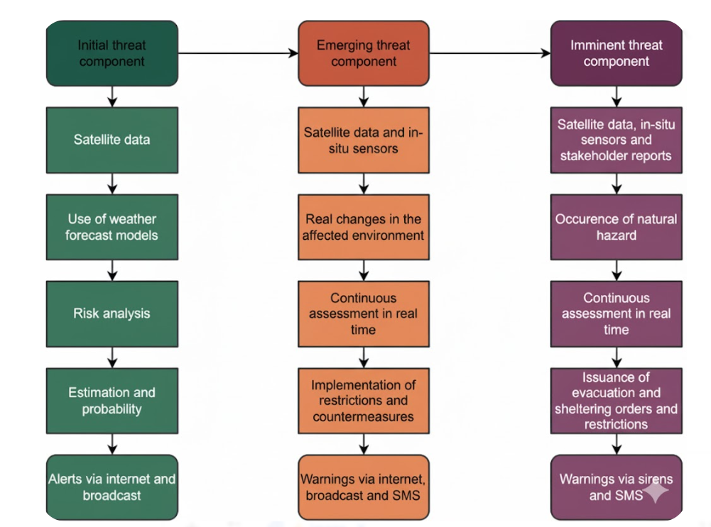
Challenges in Early Warning Systems
Barriers to Establishing Functional Systems:
Data gaps: Lack of reliable data on disease incidence.
Limited resources: Insufficient funding and infrastructure.
Political barriers: Lack of coordination and political will.
Addressing the Challenges:
Investing in data collection and analysis.
Strengthening public health infrastructure.
Promoting international cooperation.

Slide 9

Role of Global Health Organizations
Influence of the WHO: The World Health Organization (WHO) plays a critical role in managing and coordinating responses to virus outbreaks on a global scale.
Key Functions of the WHO:
  Surveillance and monitoring: Tracking disease outbreaks worldwide.
  Technical assistance: Providing guidance and support to countries.
  Coordination: Facilitating international collaboration.
Benefits:
Global coordination of outbreak response
Access to expertise and resources
Improved preparedness and response capacity

Slide 10

Mitigating the Impact of Outbreaks
Approaches to Reduce Impact:
Strengthening healthcare systems: Ensuring adequate capacity to handle surges in cases.
Providing economic support: Assisting individuals and businesses affected by the outbreak.
Addressing social impacts: Mitigating the social disruption caused by the outbreak.
Benefits:
Reduced morbidity and mortality
Minimized economic disruption
Improved social resilience

Slide 11

The Future of Outbreak Preparedness
Overview:
Emerging Technologies:
  AI and machine learning: Predicting and tracking outbreaks
  Rapid diagnostics: Developing faster and more accurate tests
  Vaccine development: Accelerating the development of new vaccines
Strategies and Innovations:
  One Health approach: Recognizing the interconnectedness of human, animal, and environmental health
  Community-based surveillance: Engaging local communities in surveillance efforts
Benefits:
  Enhanced preparedness and response capacity
  Reduced impact of future outbreaks
  Improved global health security

Slide 12
Key Takeaways from the Lecture
Importance of Proactive Measures: Proactive measures are essential in preventing and controlling virus outbreaks.
Key Strategies:
  Early detection and surveillance
  Preventative measures and public awareness
  Collaborative efforts and global coordination
Reinforcing the Message: By implementing these strategies, we can mitigate the impact of virus outbreaks and protect public health.

Slide 13
