Slide 1
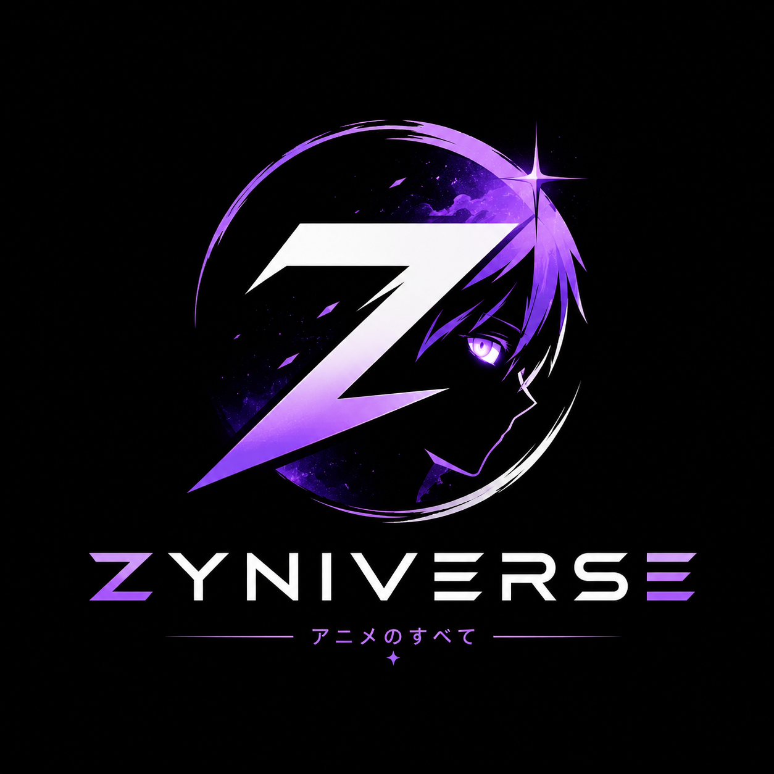
✦
✧
TECHNICAL PRESENTATION · 2026
ZyniVerse × AI
✦ ✧ ✦
A next-gen anime community platform where AI is the engine — built for India
Discover · Track · Discuss · Watch Together
✦
✧
9+ AI FEATURES · 224+ PAGES · 409 API ROUTES · ~190 DB MODELS
Presented by Parth Gupta
Notes:
Introduce yourself. ZyniVerse is a full anime & manga community platform for India. The unique angle for this talk: AI is not a bolted-on tab — it is the engine that powers discovery, search, chat, and social features. 9+ real AI features, built on top of Google's Gemini 2.5 flash, with a custom hybrid recommender running server-side.

Slide 2
Anime Fans Are Scattered
2
✦
✧
The discovery + community problem every Indian anime fan lives with
✖ 4 platforms · 0 synergy
◆ Fragmented Data
✦ Zero India Intelligence
Watchlists live on MAL, AniList, Reddit and Discord — four places, one broken picture.
Hindi / Tamil / Telugu dub schedules, filler lists, where-to-watch — everything is manual Google hunting.
● Manual Discovery
◈ Solo Watching
Finding 'what to watch next' means endless catalog clicking — no personalization, no vibes.
Everyone watches alone. No shared watch parties, no co-watching, no social layer around anime.
ZYNIVERSE × AI
PARTH GUPTA · 2026 · 2 / 12
Notes:
Set up the problem: fans are spread across 3-4 apps; India has almost zero tooling for finding Hindi/Tamil/Telugu dubs or filler episodes; discovery is manual; and watching is a lonely activity. ZyniVerse was built to collapse all of these into one platform — and AI is what makes that possible at scale.

Slide 3
Introducing ZyniVerse
3
✦
✧
An all-in-one anime & manga community platform for India
One platform, four pillars
THE PLATFORM AT A GLANCE
Discover
224+
226+ pages of curated data — Trending, A–Z, Genre, Seasonal, Top, Dub schedules.
App router pages
409
API route handlers
Track
Watchlists, fillers, watch-orders, manga chapters, 30-day activity timeline.
268
React components
Discuss
Posts, forums, clubs, reels, memes, fan-art, character battles & tournaments.
~190
Prisma / Postgres models
Watch Together
4
Surfaces: Web · Chrome Ext · Mobile · Discord bot
Socket.io watch-parties with sync, voice chat & screen-share — HLS playback.
ZYNIVERSE × AI
PARTH GUPTA · 2026 · 3 / 12
Notes:
Position the product: it's a companion & social ecosystem over anime catalogs — content intelligence is pulled live from AniList/MyAnimeList/MangaDex/TMDB. Scale: 224+ pages, 409 API routes, 268 components, ~190 database models, shipped on 4 surfaces (web, Chrome extension, mobile app, Discord bot). Every surface feeds the same AI stack.

Slide 4
The Engineering Foundation
4
✦
✧
One monorepo — Next.js 16 core, 4 client surfaces
▲
▣
▼
▶
Next.js 16
Prisma + PostgreSQL
Stripe
Socket.io + WebRTC
App Router · React 19 · TS 5
~190 models, relation-mode Prisma
Pro subs, UPI, merch, portal + webhooks
Watch-parties, DMs, voice & screen-share
◉
▶
◆
✚
Redis
HLS + R2 / Supabase
NextAuth v5
Ops + QA
Rate-limiting (INCR/PEXPIRE) + in-mem fallback
hls.js streams, S3-presigned uploads
Credentials + Google / GitHub / Discord
Vercel + Node server, Vitest, k6 load tests
CODE — package.json
next ^16.3.2 · react 19.2.4 · prisma ^5.22.0 · socket.io ^4.8.3 · tailwindcss ^4 · typescript 5.9
ZYNIVERSE × AI
PARTH GUPTA · 2026 · 4 / 12
Notes:
Walk through the stack quickly: Next.js 16 App Router + React 19 + TypeScript; Prisma on Postgres with ~190 models; Stripe for Pro + UPI payments; Socket.io for realtime watch-parties with WebRTC voice; Redis rate limiting; HLS streaming; R2 + Supabase storage; NextAuth v5 OAuth. QA via Vitest and k6 load scripts.

Slide 5
One Wrapper, Nine Features
5
✦
✧
A single battle-tested Gemini pipeline powers every AI surface
THE PIPELINE ➜ src/lib/gemini.ts
WHY IT WORKS
SYSTEM PROMPT
Role + constraints per feature
Cost control
SHA-256 caching in AiCache + per-user & global daily quotas — Gemini stays affordable at scale.
QUOTA CHECK
AiUsageDaily — 20/user · 1200/day global
Resilience
CACHE LOOKUP
SHA-256 key → AiCache hit? return instantly
Auto-retry on HTTP 429 / 5xx with exponential backoff; empty-response guard.
geminiGenerate()
Gemini 2.5 flash · JSON mode · retries
Fast + cheap model
gemini-2.5-flash for latency; thinkingBudget: 0 so tokens aren't burned on reasoning.
JSON PARSE
parseGeminiJson with regex fallback
Structured output
CODE — gemini.ts
responseMimeType: application/json + parser that regex-recovers JSON from noisy text.
const PER_USER_DAILY_LIMIT = 20 · GLOBAL_DAILY_LIMIT = 1200 · thinkingBudget: 0 · retry 429 / 5xx · AiCache hit
ZYNIVERSE × AI
PARTH GUPTA · 2026 · 5 / 12
Notes:
The whole AI surface is one wrapper: src/lib/gemini.ts. Every feature — chat, identify, vibe, night planner, theories — runs through the same pipeline: quota check (AiUsageDaily: 20/day per user, 1200/day global), SHA-256 cache lookup in AiCache, then geminiGenerate with JSON output mode, retries on 429/5xx, and a regex-tolerant JSON parser. This is how nine AI features run on one tiny Gemini budget.

Slide 6
Chat & Character Roleplay
6
✦
✧
Conversational AI that thinks inside the anime universe
✧ Zyni AI — Domain Expert
◉ Character Chat — Roleplay
Chat with an anime/manga expert that answers with sources & context.
Talk to your favourite characters — in-character, with their personality & speech style.
Each reply can embed up to 4 recommendations, resolved to real AniList titles + images.
Replies are generated in Hinglish — the perfect tone for Indian anime fans.
Multi-turn conversation with full history in prompts.
Structured JSON reply → typed card UI with dialogue + reaction.
EXAMPLE → User: "kyun main sabke saath binge worthy hoon?" · Zyni AI: "Based on your profile — spend the weekend on this 3 anime lineup: …"
CODE — api/ai/chat/route.ts
system: 'you are a world-class anime & manga expert' · reply JSON + up to 4 recommendations · resolve IDs → AniList titles
ZYNIVERSE × AI
PARTH GUPTA · 2026 · 6 / 12
Notes:
Two personalities: Zyni AI is a domain expert whose chat replies include real, clickable recommendations resolved against AniList — so the chat doesn't just talk, it leads somewhere. Character Chat does in-character roleplay and, uniquely for an Indian audience, replies in Hinglish. Both share the same quota + cache pipeline.

Slide 7
Visual & Semantic Search
7
✦
✧
AI that recognises screenshots and understands vibes
❋ Screenshot Identify
☁ Vibe Search
Upload any screenshot → identify the anime instantly.
Natural language moods become playlists: "something chill for 3 a.m."
Returns title + confidence, guessed episode, and the characters on screen.
LLM maps the vibe → real anime titles via AniList.
Base64 image passed inline to Gemini as a vision input.
Turns 'I don't know what to watch' into one search box.
IDENTIFY → {"title": "One Piece", "confidence": 0.93, "episode": "1164+, Film: Red", "characters": ["Luffy", "Zoro"]}
CODE — gemini.ts → parseGeminiJson
inline_data: { mime_type, base64 } · responseMimeType: application/json · JSON.parse fallback → regex extract
ZYNIVERSE × AI
PARTH GUPTA · 2026 · 7 / 12
Notes:
Two hero AI features. Screenshot Identify sends the image as base64 inline_data and returns structured JSON: title, confidence, guessed episode, characters — this is how users settle 'which anime is this frame?' debates. Vibe Search turns natural-language moods into real catalogue titles. Both are single requests through the same pipeline.

Slide 8
Shared Watching + Social AI
8
✦
✧
Planning, co-watching and debate — all inside one platform
☾ Night Planner
▶ Watch Parties
Blends every friend's taste into a themed lineup of anime, snacks & trivia — then auto-creates the watch party.
Socket.io co-viewing: play / pause / seek sync, WebRTC voice chat + screen-share, HLS playback.
★ Character Tournaments
⚡ AI Lab — Fan Theories
Crowd-ranked character battles, polls and Zyni Awards — community votes drive the results.
AI generates theories per anime; the fandom agrees or disagrees — theories become content.
EXAMPLE → "Sunday Funday" — friends' tastes fused → Jujutsu Kaisen marath + momos + trivia → watch-party room live
CODE — watch-party.ts + ai/night-gen
Socket.io: play/pause/seek sync · WebRTC voice + screen-share · night-gen() → createParty() · tournament polls → ranked results
ZYNIVERSE × AI
PARTH GUPTA · 2026 · 8 / 12
Notes:
Two AIs + two social engines: Night Planner fuses a friend group's taste into a themed lineup then auto-creates a real watch-party. Watch Parties run on Socket.io with synced playback plus WebRTC voice and screen-share. Character Tournaments give the crowd ranked battles. AI Lab generates fan theories the community then votes on.

Slide 9
Practical AI + Content Tools
9
✦
✧
Filler that skips itself, reels and manga that build themselves
▸ Skip Filler
⌕ AI Search + Mixer
AI summarises the filler episode so you skip it guilt-free — plus crowd-voted filler list and 200 guides.
Natural questions + semantic intents layered over the AniList index — 'My Hero Academia but space horror' mixes.
✍ Hinglish Reels Generator
▣ In-app Manga Reader
ffmpeg + impact font + sharp render Hinglish meme reels automatically from source clips (scripts/make-reels.mjs).
Read chapters right in the browser — chapter browser, progress tracking, doujinshi & light-novel support.
PATTERN → content tooling + AI share one stack: import scripts → ffmpeg/typed endpoints → quota → cache → typed UI
CODE — scripts/make-reels.mjs + manga-reader
ffmpeg-static + impact font → Hinglish reels · filler votes + guides · chapter browser with progress sync
ZYNIVERSE × AI
PARTH GUPTA · 2026 · 9 / 12
Notes:
Practical features, not demo-only: Skip Filler sums up filler episodes (supported by crowd-voted filler data and 200 guides); AI search and the Mixer layer semantics over the real AniList index; the Hinglish reels generator automates content creation with an ffmpeg pipeline; and the in-app manga reader covers chapters, doujinshi and light novels.

Slide 10
The AI That Doesn't Need the LLM
10
✦
✧
Behavioral recommendation engine — src/lib/ai-recommender.ts
HOW IT SCORES
ACTION WEIGHTS
Profile build
Last 30 days of UserActivity → genres, viewed IDs, searches.
SIGNAL — USER ACTIVITY
WT
view_anime
3
Cold-start seed
New users get taste seeded from onboarding favoriteGenres.
add_to_list
5
Signal weighting
Actions carry weight: view=3, add-to-list=5, click-rec=4, search=2…
click_recommendation
4
search
2
Time decay
Older events shrink — score ∝ recency (1 − days/30, floor 0.1).
view_filler
2
Rank — recs + Wrapped
Scored recs with reasons; feeds 'My Year in Anime' recap + streaks.
view_character
1.5
CODE — ai-recommender.ts
Decay = max(0.1, 1 − days/30) · genre weights seeded at onboarding · rank = genre · search · similarity · → recs + My-Year-in-Anime recap
ZYNIVERSE × AI
PARTH GUPTA · 2026 · 10 / 12
Notes:
Not all AI here is a language model. This deterministic engine builds a 30-day activity profile, seeds cold-start users from onboarding favorite genres, weights actions (add-to-list=5 vs a plain view=3), applies time-decay so old events fade, and ranks candidates by genre/search/similarity — each rec ships with a human-readable reason. The same profile powers the 'My Year in Anime' Wrapped recap and streaks.

Slide 11
The Ecosystem Nobody Else Ships
11
✦
✧
Software that lives where the fans already are
✦ Chrome Extension (MV3)
▣ JioTV EPG TV Schedule
Filler % + Indian-dub badge injected right on MAL / AniList / Anime-Planet; right-click → 'Search on ZyniVerse'.
Scraped Indian TV anime schedule (EPG cache) — know exactly when an episode airs on your channel.
◉ Discord Bot
◆ Public API v1 + Guides
A fourth surface: notifications + community commands bridge ZyniVerse straight into the fandom.
Developer API — scrobble, dub-status, filler, schedule, webhooks — plus 200 filler guides and 40 watch orders.
STILL HARDENED → 37 scrapers blocked · 3-layer caching · k6 load-tested · Stripe Pro + UPI · ads/merch/affiliate
CODE — manifest.json + server.ts + api/v1
MV3 content-script → filler % + dub badge · JioTV EPG scrape → tv-schedule cache · discord-bot notifications · api/v1: scrobble · dub-status · schedule
ZYNIVERSE × AI
PARTH GUPTA · 2026 · 11 / 12
Notes:
These are the features your class project almost certainly doesn't have: an MV3 Chrome extension that injects filler percentage and Indian dub status directly onto MAL/AniList/Anime-Planet plus right-click search; a JioTV EPG scraper powering the TV schedule; a Discord bot; and a public API v1 with scrobbling, dub status and webhooks. All of it rides production hardening: 37 scrapers blocked, three caching layers, k6 load tests, Stripe Pro with UPI.

Slide 12
AI Isn't the Feature — It's the Engine
12
✦
✧
One pipeline + one behavioral engine = a personal anime universe
LIVE DEMO FLOW
Zyni AI Chat
Screenshot Identify
Vibe Search
Install Extension
Night Planner
Watch Party
▸
▸
▸
▸
▸
ask anything
drop a frame
type a mood
dub badge
invite friends
press play
TAKEAWAY — A real community at 224+ pages and ~190 models, where one cost-controlled Gemini pipeline, a behavioral recommender, a Chrome extension and real-time watch parties give every user a personal anime universe.
THANK YOU · Q & A
zyverse.in · github.com <your-username> · Let's argue about best girl after this
ZYNIVERSE × AI
PARTH GUPTA · 2026 · 12 / 12
Notes:
Close on the thesis: AI is the engine, not a feature. Walk the live demo: ask Zyni AI, drop a screenshot to identify, search by vibe, install the extension for the dub badge, plan an anime night, then press play together. Thank the judges and open Q&A. Mention zyverse.in.

