Slide 1
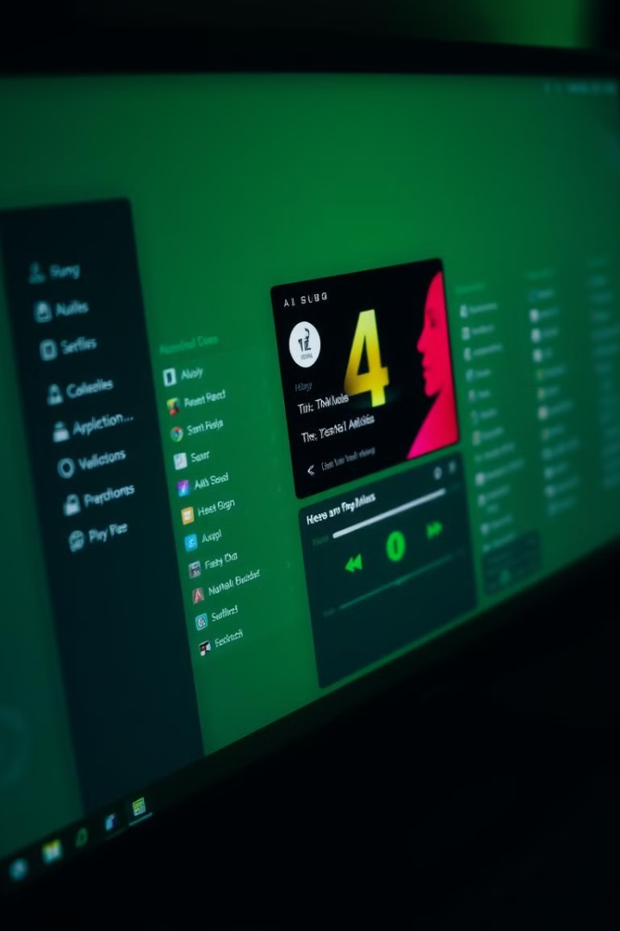

MUSIC PLAYER: A Doubly Linked List Application
This presentation will explore the MUSIC PLAYER application, a Java-based desktop application built to simulate a music playlist manager. The application uses a doubly linked list to efficiently manage and interact with a playlist of songs, offering a practical example of data structures in action.

Slide 2
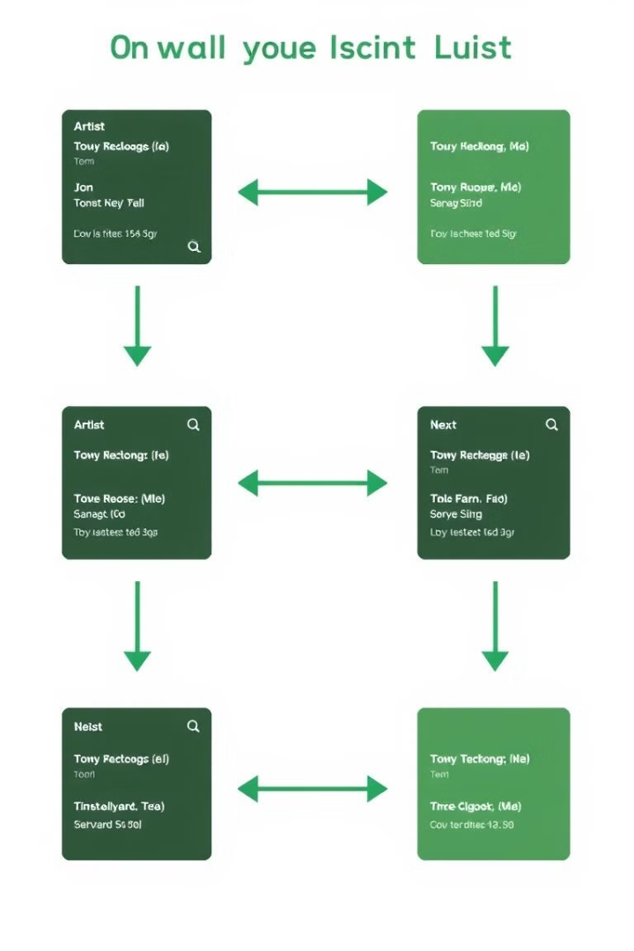
INTERACTION ON THE GO
Project Objectives
1
Data Structures in Practice
2
Playlist Management
Enable users to add, remove, navigate, and reorder songs within the playlist, offering a user-friendly experience.
Utilize a doubly linked list for efficient playlist management, demonstrating the practical application of data structures in software development.
3
Real-Time Interaction
4
User-Friendly GUI
Implement dynamic updates to the "Now Playing" display, ensuring seamless user feedback and interactivity.
Develop an intuitive and interactive graphical user interface (GUI) using Java Swing, providing a visually appealing and engaging user experience.

Slide 3

Code Overview: Song Class
Song Class
Doubly Linked List
Represents individual songs as objects with attributes like title, artist, and duration, and pointers for list navigation. This class forms the basis of the linked list data structure.
The core data structure used to manage the playlist, enabling efficient forward and backward traversal, song addition, removal, and reordering. This approach allows dynamic playlist manipulation.
Song

Slide 4
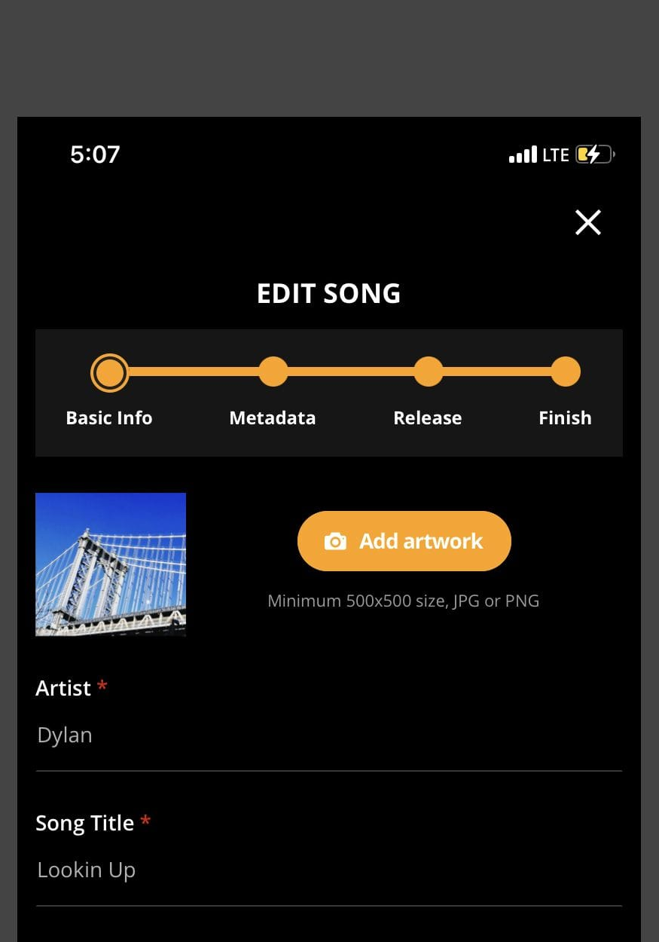




Key Code Functions: Adding Songs
Prompt User
Prompts the user to enter song details (title, artist, duration) through input dialogs.
Create Song Node
Creates a new Song node using the input details, initializing pointers to null.
Append to List
Appends the new node to the end of the doubly linked list, updating the tail pointer, ensuring list integrity.
Update GUI
Refreshes the playlist display and "Now Playing" label, ensuring visual representation of the updated playlist.

Slide 5

Key Code Functions: Removing Songs
Update Pointers
Prompt User
Adjusts the pointers (next, prev) of the neighboring nodes to maintain list integrity, removing the specified song node.
Prompts the user to enter the title of the song to be removed.
1
2
3
4
Find Song
Update GUI
Traverses the linked list to locate the song node matching the user input.
Refreshes the playlist display and "Now Playing" label, ensuring visual representation of the updated playlist.

Slide 6
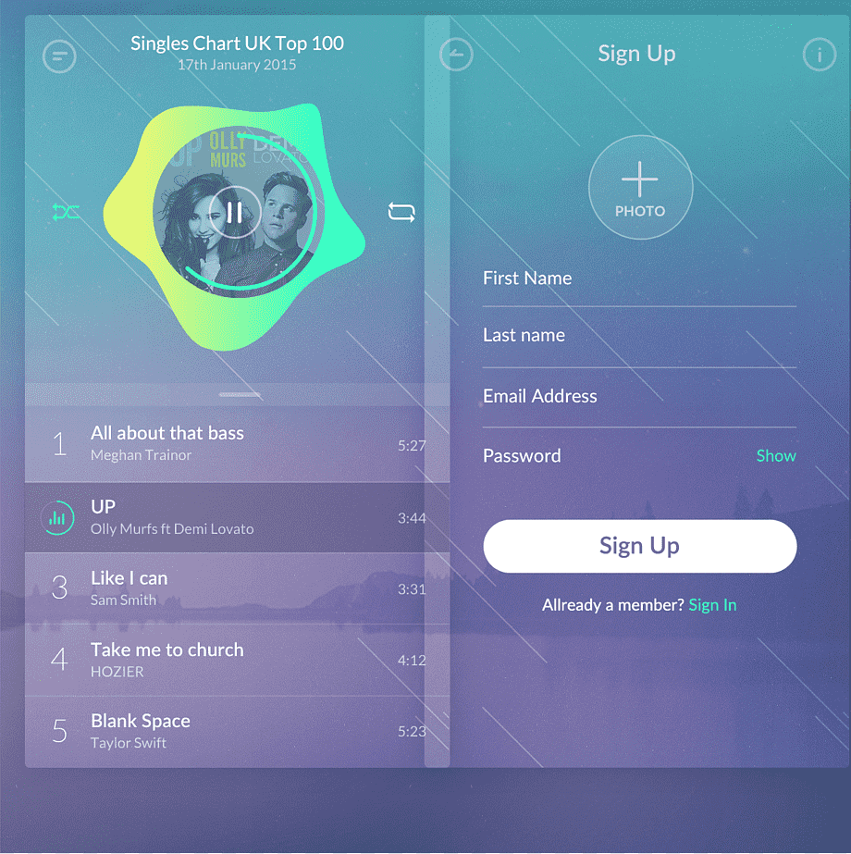



Key Code Functions: Navigating Songs
Play Next
Play Previous
Moves the current pointer to the next song in the playlist, ensuring smooth transitions between songs.
Moves the current pointer to the previous song in the playlist, providing backward navigation through the list.

Slide 7
Key Code Functions: Reordering Songs
Move Song Up
Move Song Down
Swaps the positions of the selected song and the one above it in the doubly linked list, adjusting pointers and updating the display.
Swaps the positions of the selected song and the one below it in the doubly linked list, ensuring smooth reordering of the playlist.

Slide 8




GUI: Swing Framework
1
JFrame
JList
2
Displays the playlist with the list of songs.
JButton
3
Provides buttons for control functions such as adding, removing, playing, and reordering songs.
JLabel
4
Displays information about the currently playing song.

Slide 9
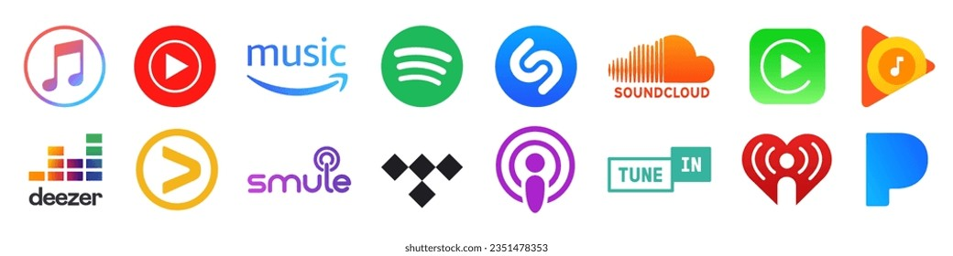
Summary and Takeaways
Practical Application
User-Friendly Interface
Effective Design
The MUSIC PLAYER project demonstrates how data structures, like doubly linked lists, can be effectively used to manage dynamic data in real-world applications.
The application provides an intuitive and interactive user interface, making playlist management a smooth and engaging experience.
The project showcases effective software design principles and Java programming concepts, ensuring robust application functionality and maintainability.

Slide 10
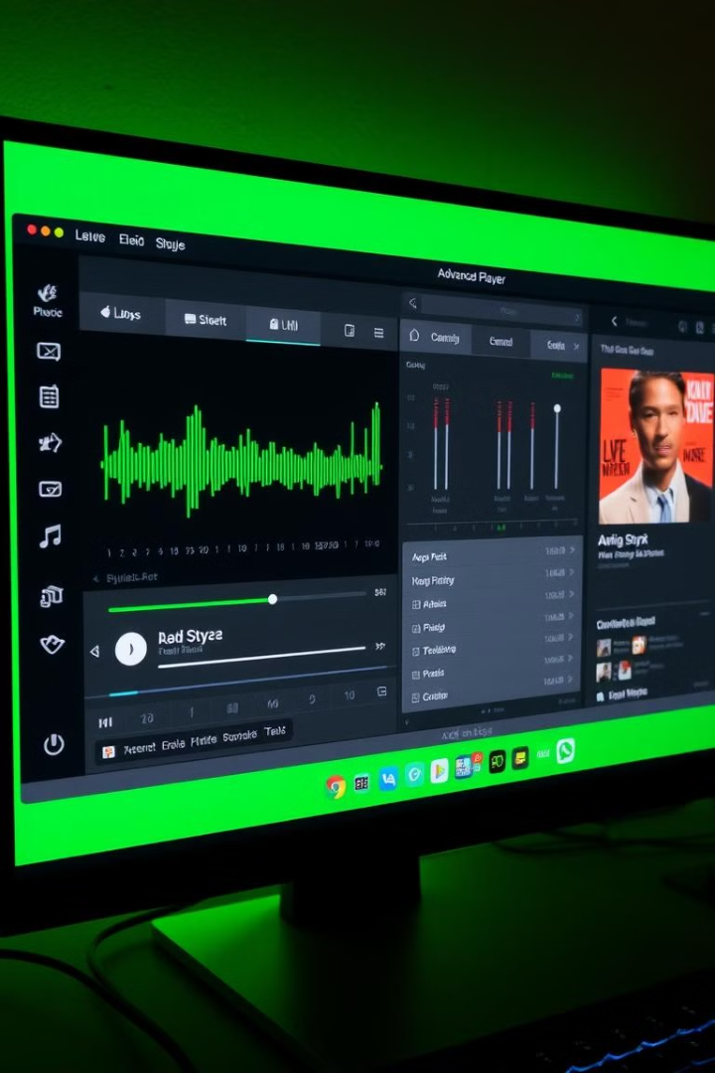
Next Steps
1
Enhance Features
Adding features like random play, shuffle, and loop functionality to enhance the user experience.
2
Integrate Audio
Implementing audio playback capabilities, allowing users to actually listen to songs within the application.
3
Advanced Functionality
Exploring the use of more complex data structures and algorithms for features like song sorting, search, and playlist sharing.

