Slide 1
MyPizza
David Boyle - 12521727
Rajit Patel - 17233634
Sujtih Daniel - 17232193
AMAR ICHANGMATH

Slide 2
Approach
1. Planning
2. Architecture
3. Design
5. Testing

Slide 3
Planning
1. Understanding requirements of the application to be created
2. Understand the sequence and flow of events.
3. Brainstorm on different approaches, DFD’s, Flowchart.
4. Determine different classes and Methods to be used.
5. Determine algorithm on Efficiency and different formulae.
6. Planning on a user friendly UI Design.

Slide 4
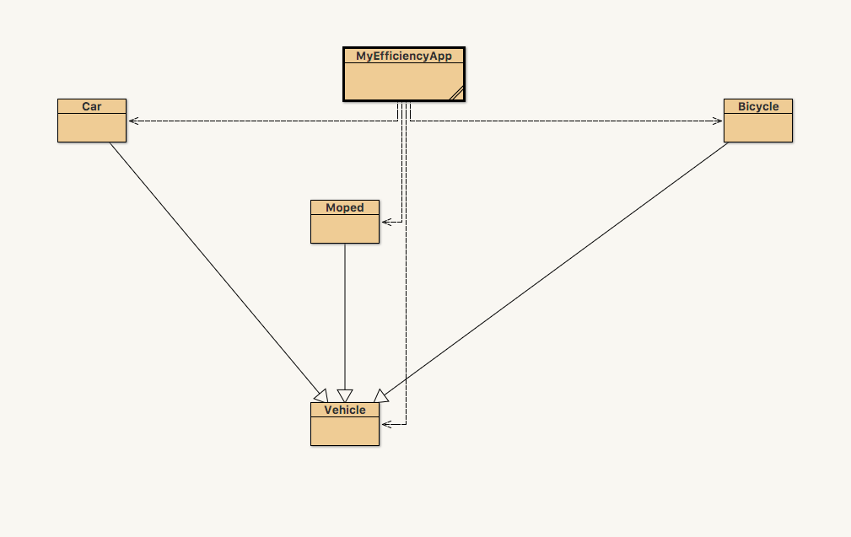
Architecture

Slide 5


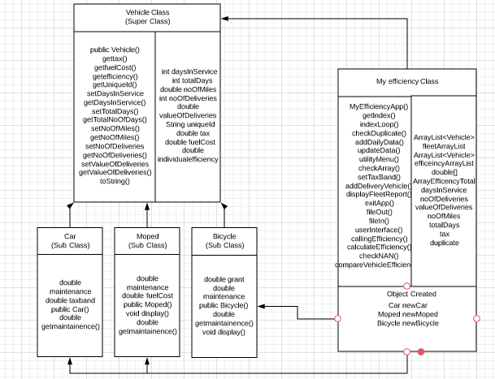



Design

Slide 6
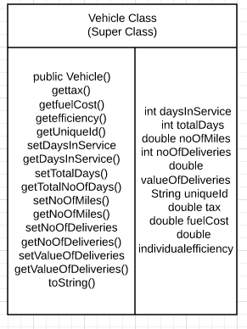
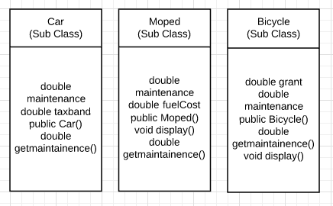
Creation of Classes

Slide 7
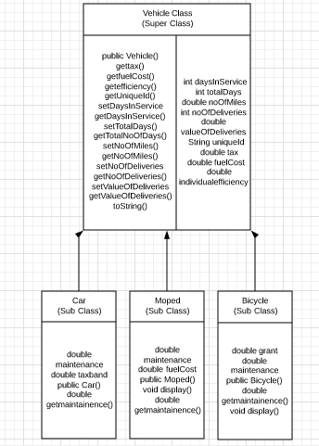
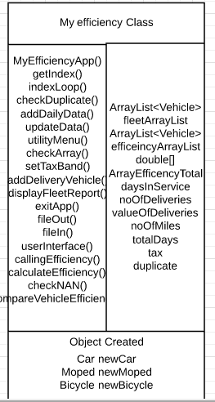

Slide 8
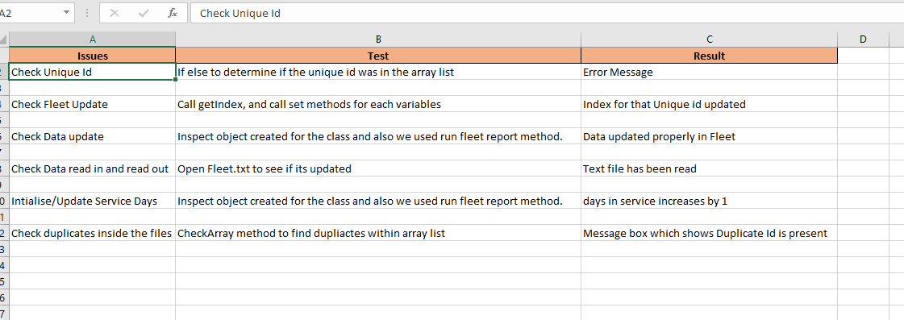
Testing

Slide 9
Object Orientation Concepts
1. Inheritance
2. Polymorphism
3. Coupling/Cohesion

Slide 10
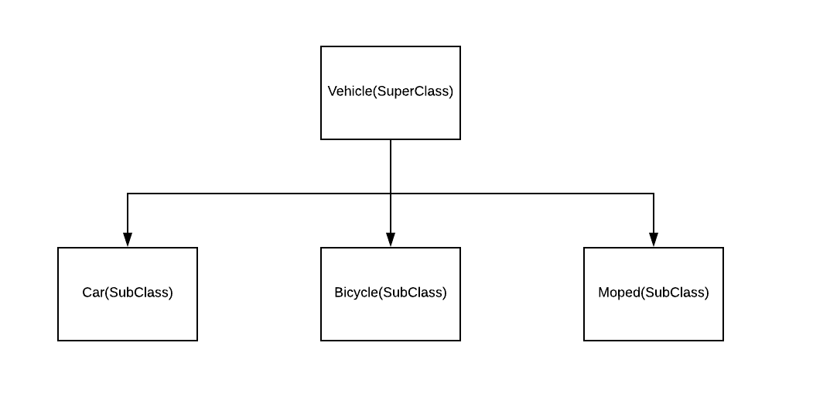
Inheritance
The idea is simple: instead of defining the Car, the Moped and Bicycle classes completely independently,
We first defined a class(Vehicle) that contains everything these three have in common. So now vehicle is SuperClass and the Car, Moped and Bicycle is Sub-class.
Thus, inheritance allows us to create the classes that are quite similar, while avoiding the need to write the identical part twice.

Slide 11
Polymorphism
Polymorphism is the capability of a method to do different things based on the object that it is acting upon. In other words, polymorphism allows you define one interface and have multiple implementations.
Created object of Class Vehicle of different form to achieve certain goals from Efficiency class.
while calculating individual efficiency for each instance of vehicle and created again different object form of Class vehicle

Slide 12
Coupling and Cohesion
Coupling refers to the interconnectedness of classes
Application, if we think from future prospectus if any new type of vehicle is been added there is no need to change much in any of the class
Cohesion refers to what the class can do
application we have methods such as calculateEfficiency() which just calculate efficiency and compareVehicleEfficiency() which just compare the efficiency and gives the best efficient vehicle

Slide 13
Understanding
1. Challenges Encountered
2. Lessons learned

Slide 14
Challenges
Working with BlueJ as compared to other Java application as Netbeans, Eclipse.
1
Handling exceptions
2
Coming with an efficiency algorithm that considers all variables and give justified solution
3

Slide 15
Lessons Learned
Proper planning is required before commencing the development/design
Test Cases should be run under both normal and extreme conditions to handle exceptions.
Determine complexity to effectively predict capacity and manage efficiency in different environment's.

Slide 16
Conclusion
This application can help the MyPizza client to help in deciding the most efficient Vehicle and thus helping them in making decisions for introducing new vehicles.
Also help in minimizing cost of the company.

Slide 17
Thank You

