Slide 1
Transactions

Slide 2
Transaction
A transaction is a unit of work that is either completed as a unit or undone as a unit.
We can use DISPLAY Transaction to check whether there is a transaction or not.

Slide 3
Transaction
If we press STOP key during a transaction or if a system crash occurs, Progress backs out the transaction, undoing all database changes made since the start of the transaction.
For more information on transaction activity we can use the LISTING option on the COMPILE statement.

Slide 4
Transactions and Blocks
Any block that uses the TRANSACTION keyword on the block statement starts a Transaction. (DO, FOR EACH, or REPEAT)
A procedure block, trigger block, and each iteration of a FOR EACH, or REPEAT block that directly updates the database or directly reads records with EXCLUSIVE–LOCK.

Slide 5
Transaction and Do Block
The TRANSACTION option on the block overrides the default transaction placement.
Do blocks do not automatically have the transaction property.

Slide 6
Subtransactions
A subtransaction is started when a transaction is already active and Progress encounters a subtransaction block.
If an error occurs during a subtransaction, all the work done since the beginning of the subtransaction is undone.
Subtransactions can be nested within other subtransactions.
The following are subtransaction blocks:
A procedure block that is run from a transaction block in another procedure.
Each iteration of a For Each block nested within a transaction block.
Each iteration of a REPEAT block nested within a transaction block
Each iteration of a DO TRANSACTION, DO ON ERROR, or DO ON ENDKEY block.

Slide 7
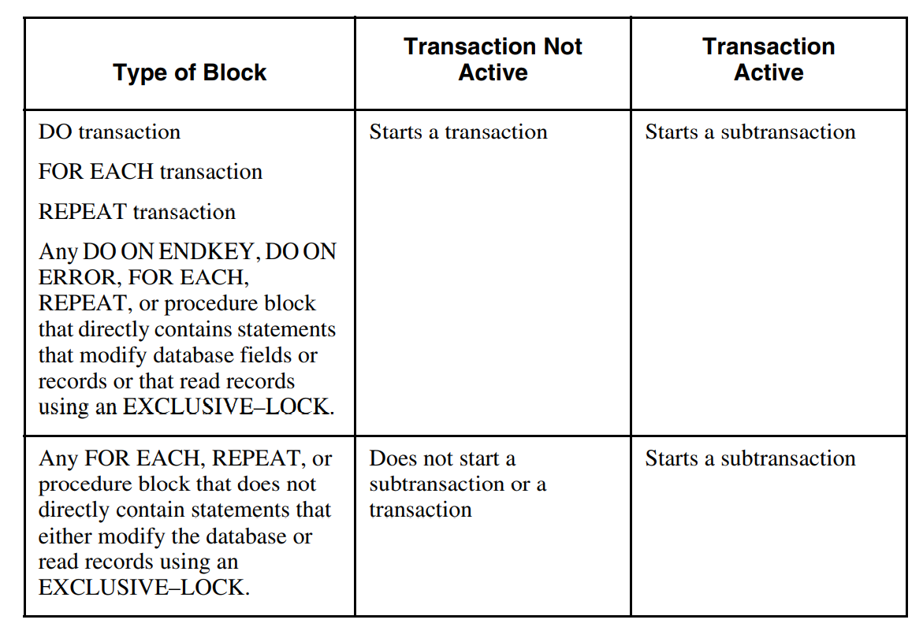

Slide 8
Transactions and Triggers
If a transaction begins with a trigger, it cannot extend beyond the end of the trigger.
If the transaction is scoped to a block within the trigger, the normal transaction scoping rules apply.
If the trigger is scoped to the trigger block itself, the transaction ends when the trigger ends.
We should design our application so that each transaction occurs within a single trigger. Otherwise, undoing one action might cause other unrelated actions to be undone also

Slide 9
Transactions and Subprocedures
If you start a transaction in a main procedure, that transaction remains active even while the main procedure runs called procedures.
When a requesting application with an active transaction runs a remote procedure, Progress does not propagate the transaction to the remote procedure. Rather, the remote procedure acts as if it is the first procedure of the application, and follows the normal 4GL rules for starting and terminating transactions. If a requesting application and a remote procedure connect to the same database, each database connection comprises a separate transaction.

Slide 10
Transactions and Program Variables
Any changes made to variables in a transaction or subtransaction block are undone whenever a transaction or subtransaction is backed out.
The variables are restored to the values they had at the beginning of the transaction or subtransaction that is undone.
Variables specifically defined as NO–UNDO are not undone in this case.
However, changes to variables made outside a transaction are never undone since only transaction and subtransaction blocks can be undone.

Slide 11
Transaction Mechanics
During a transaction, information on all database activity occurring during that transaction is written to a before-image (BI) file.
Progress maintains one BI file for each database.
The information written to the before-image file is carefully coordinated with the timing of the data written to the actual database table. That way, if an error occurs during the transaction, Progress uses this before-image file to restore the database to the condition it was in before the transaction started.
Information written to the before image file is not buffered. It is written to disk immediately

Slide 12
Subtransaction Mechanics
All database activity occurring during that subtransaction is written to a local-before-image (LBI) file.
Progress maintains one LBI file for each user.
If an error occurs during the subtransaction, Progress uses this local-before-image file to restore the database to the condition it was in before the subtransaction started.
Progress uses the local-before-image file to back out variables and to back out subtransactions in all cases when an entire transaction is not being backed out.
The local-before-image file is written using normal, buffered I/O.

Slide 13
Efficient Transaction processing
If we are doing extensive calculations with variables then use the NO–UNDO option when defining the variables.
If we are processing array elements, process them in a DO WHILE block rather than in a REPEAT WHILE block. That way, we will not start a separate transaction or subtransaction for each array element.
When the logic of our application permits, do as much processing as possible directly at the transaction level rather than creating subtransactions.

Slide 14
Thank you

