Slide 1
Block properties

Slide 2
outline
Block Types and Their Properties
External Procedure
Internal Procedure
Persistent and Non-persistent Procedures
User-Defined Functions
Procedure Overriding

Slide 3
Blocks types
Repeat Blocks
For Blocks
Do Blocks
Procedure Blocks
Trigger Blocks
Editing Blocks

Slide 4
Block properties
PROPERTY | REPEAT |  | FOR |  | DO |  | PROCEDURE OR TRIGGER
 | IMPLICIT | EXPLICIT | IMPLICIT | EXPLICIT | IMPLICIT | EXPLICIT | IMPLICIT | EXPLICIT
Looping | YES | WHILE TO/BY | YES | WHILE TO/BY | NO | WHILE TO/BY | NO | NO
Record reading | NO | NO | YES | Record Phrase | NO | NO | NO | NO
Frame scoping | YES | WITH FRAME | YES | WITH FRAME | NO | WITH FRAME | YES | NO
Record scoping | YES | FOR | YES | NO | NO | FOR | YES | NO
UNDO | YES | TRANS ACTION ON ERROR | YES | TRANS ACTION ON ERROR | NO | TRANS ACTION ON ERROR | YES | NO
ERROR processing | YES | ON ERROR | YES | ON ERROR | NO | ON ERROR | YES | NO

Slide 5
Block properties
Property | Repeat |  | For |  | Do |  | Procedures and Triggers
 | IMPLICIT | EXPLICIT | IMPLICIT | EXPLICIT | IMPLICIT | EXPLICIT | IMPLICIT | EXPLICIT
ENDKEY processing | YES | ON ENDKEY | YES | ON ENDKEY | NO | ON ENDKEY | YES | NO
STOP processing | YES | ON STOP | YES | ON STOP | NO | ON STOP | YES | NO
QUIT processing | YES | ON QUIT | YES | ON QUIT | NO | ON QUIT | YES | NO
System transaction | YES | TRANS ACTION | YES | TRANS ACTION | NO | TRANS ACTION | YES | NO
Parameter Passing | NO | NO | NO | NO | NO | NO | NO | YES

Slide 6
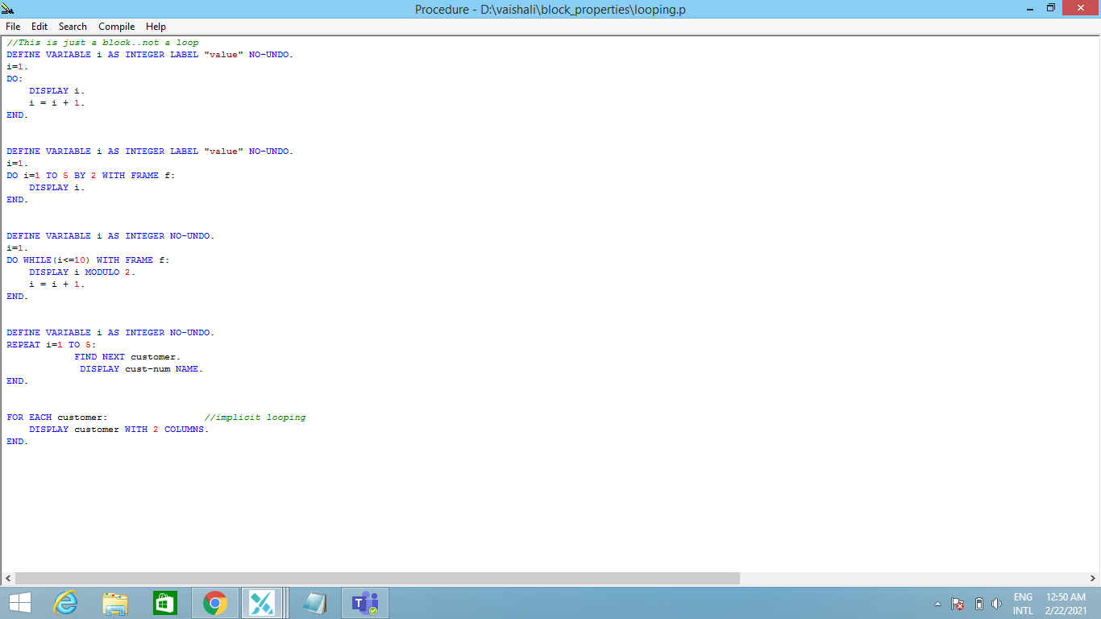
looping

Slide 7
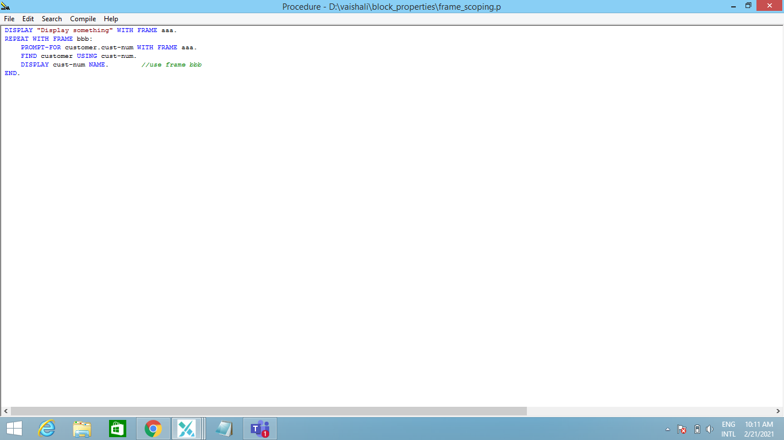
Frame scoping

Slide 8
Record scoping
Strong–Scoped Reference
Repeat for, Do for blocks
Buffer is scoped to the strong-scope block
Can have two sequential blocks of strong scope reference to same buffer.
Nesting not possible for same buffer reference.
Weak-Scoped Reference
FOR EACH, PRESELECT EACH
Can Reference same buffer outside the weak scope block
Can not contain any free reference to same buffer in weak scope block
Nesting not possible for same buffer reference.
Can have two sequential block.
Free Reference

Slide 9
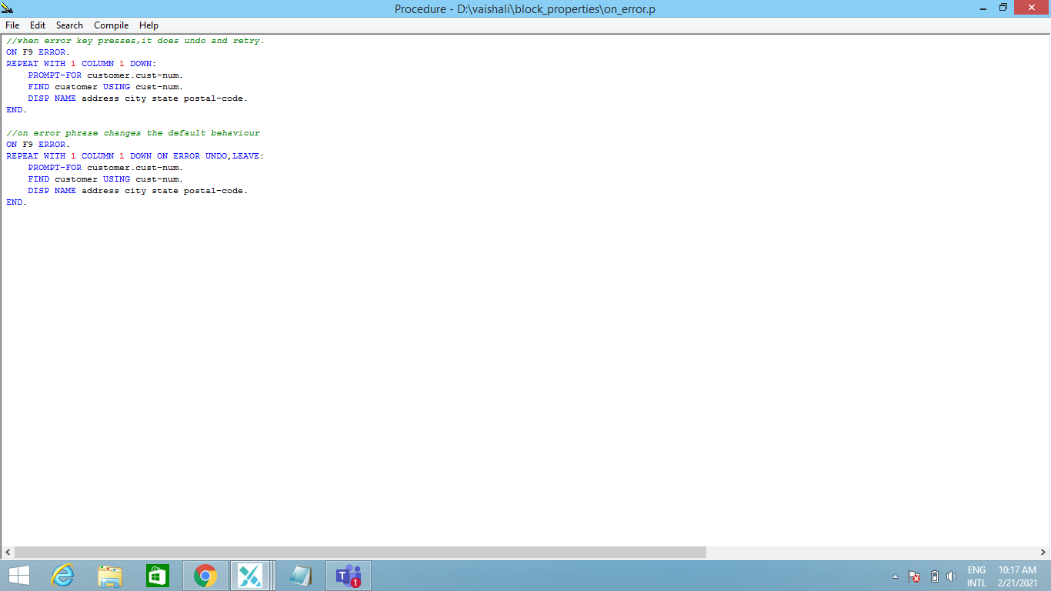
Error processing

Slide 10
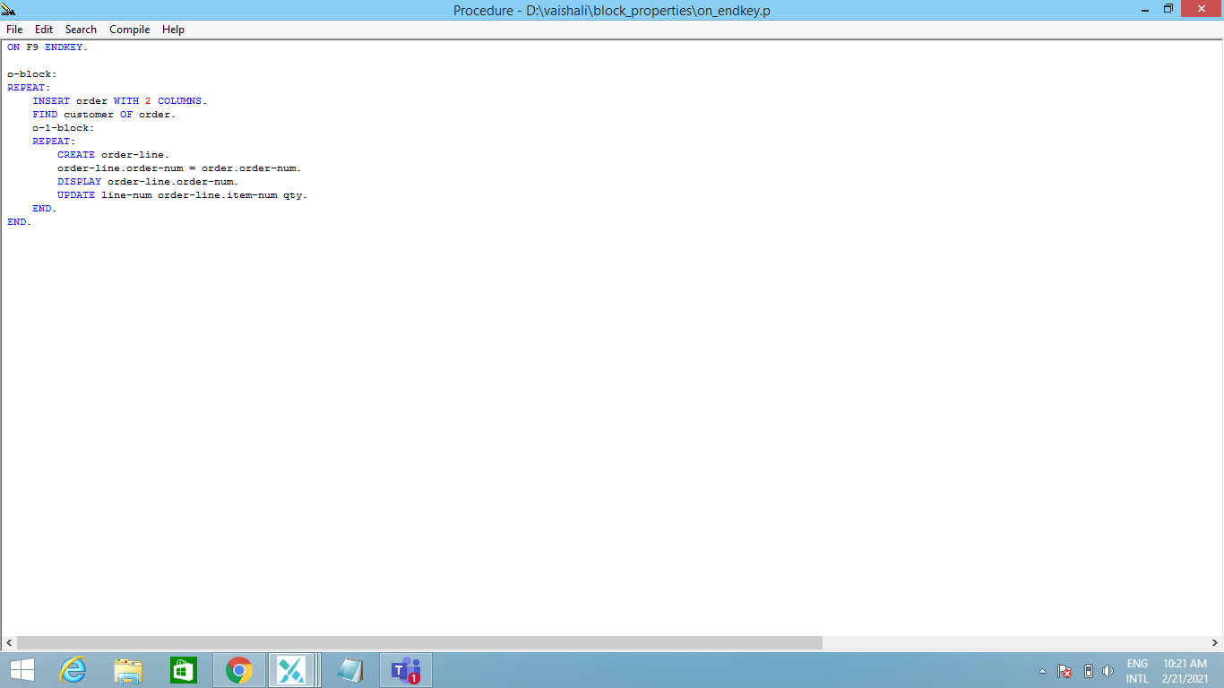
Endkey processing

Slide 11
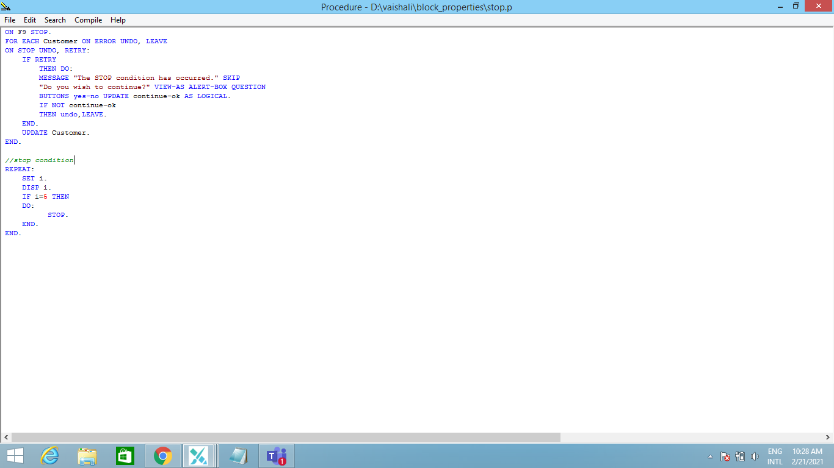
Stop processing

Slide 12
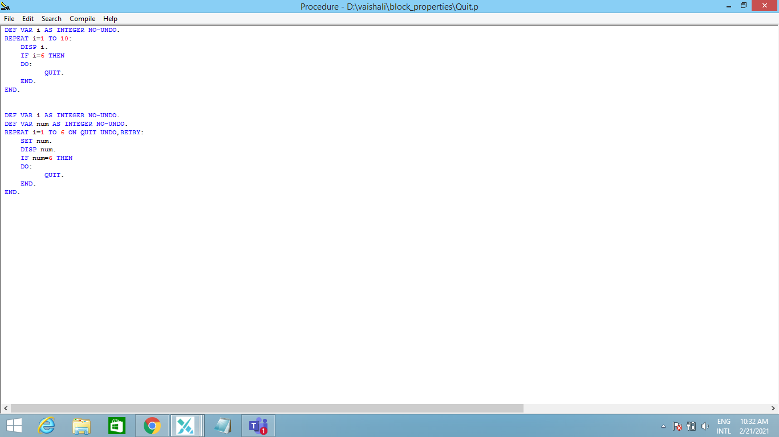
Quit processing

Slide 13
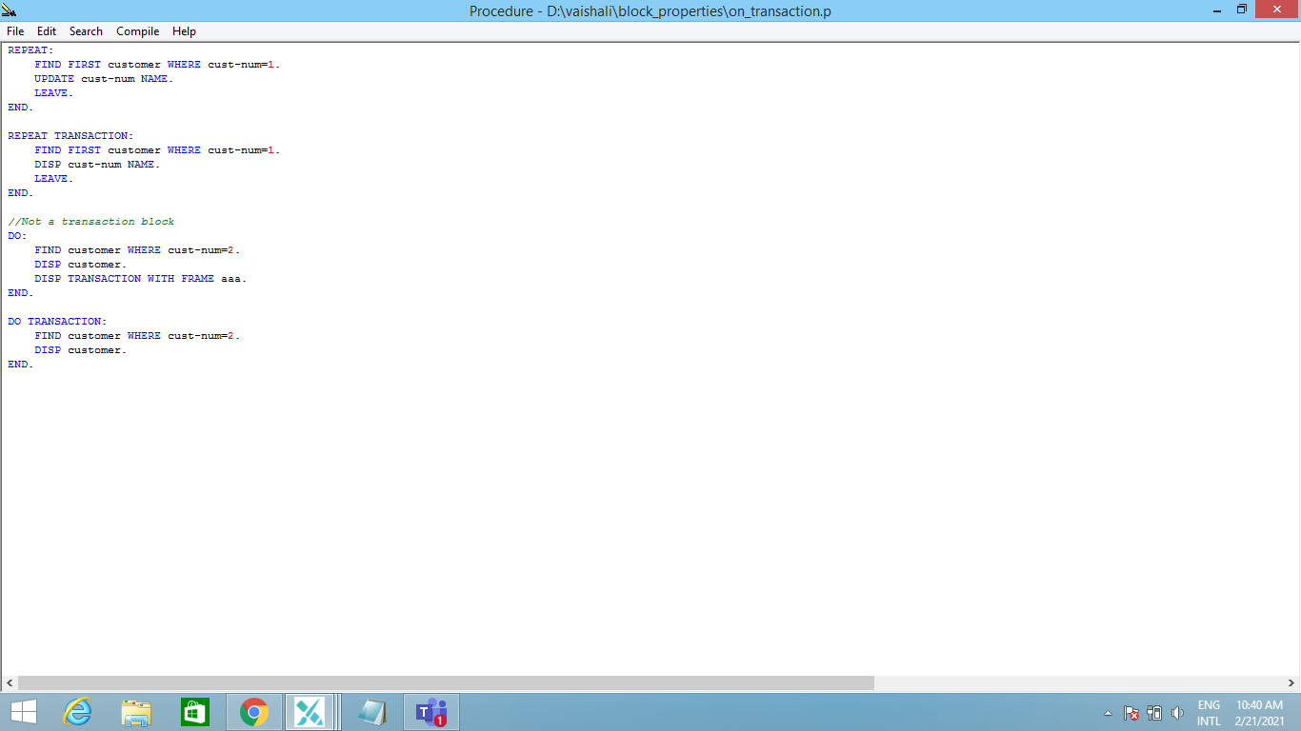
System transaction

Slide 14
Compiling
Listing
Syntax:- Compile programfile.p Listing program.out save.
Xref
Syntax:- Compile programfile.p Xref program.out save.
Debug-List
Syntax- Compile programfile.p Debug-List program.out save.

Slide 15
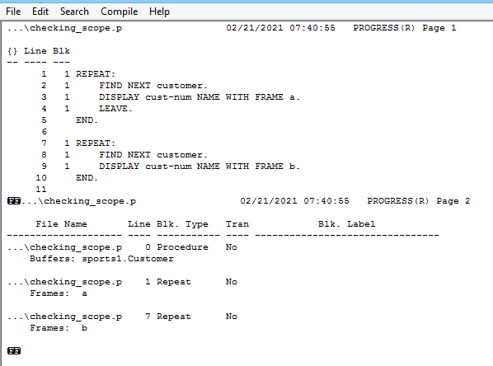
listing

Slide 16
Shared objects
Scoped
Accessible from the point of creation for the scope of the procedure that first defines it.
Global
Accessible from the point of creation until the end of the progress session.

Slide 17
Main Procedure
Create Scoped A
Subprocedure 1
Subprocedure 3
Create Global B
Reference A
Create Scoped C
Reference B
Reference A
Subprocedure 2
Reference A
Reference B
Reference C
Object Sharing Among External procedures

Slide 18
Procedure handles
A Procedure handle is a value that identifies the context of an external procedure.
Every External procedure has a procedure handle associated with it.
Procedure handle have attributes that can be used to store and retrieve information on the particular procedure.
A procedure handle value remains valid only as long as the specified procedure is in scope.
Procedure handle can be passed to other external procedures using parameters, shared variables and shared temporary table fields defined with the HANDLE data type.
This-Procedure System Handle returns the current procedure handle value as a HANDLE data type.

Slide 19
Internal procedures
Block of code defined within an external procedures
Complied as part of External Procedures.
Can not contain other internal procedure blocks.
Produces modularize code and reduce the number of external files in an application.
Syntax-
Procedure procedure-name:
Statements
End [procedure].
Procedure Execution using Run Statement Syntax-
Run proc-name [IN handle][run-options]

Slide 20
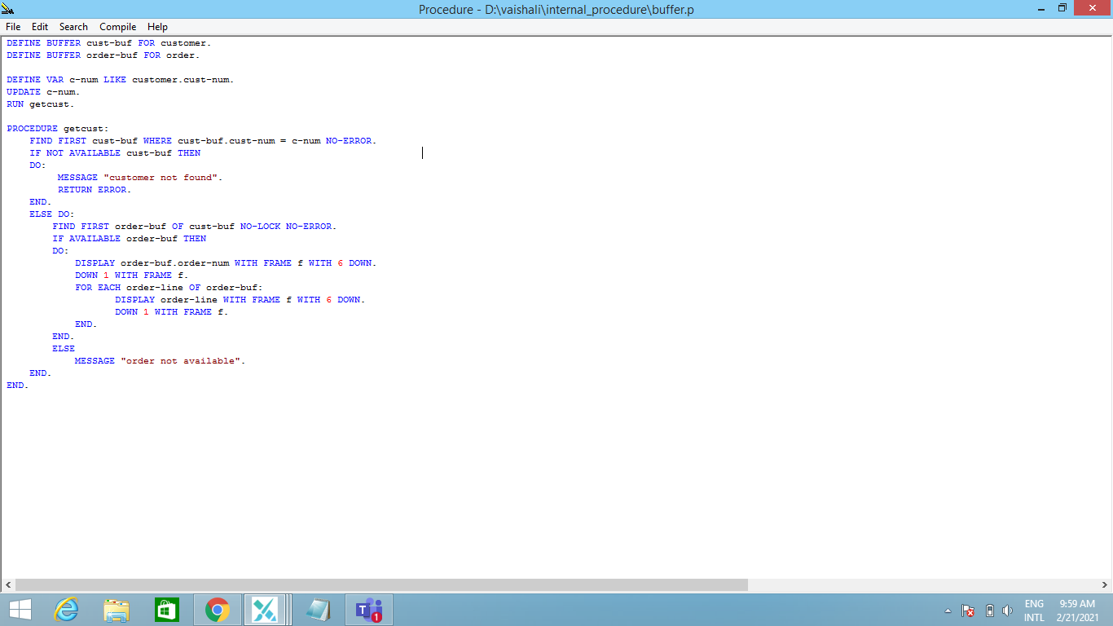
Internal procedure

Slide 21
External procedures
Persistent procedures
Non-persistent procedures
Creates its context when it executes and then maintains that context after it returns until the end of the progress session or until it is explicitly deleted.
Creates a persistent context using a RUN statement with the persistent option.
Syntax- RUN filename Persistent [SET handle] [run-options]
Delete persistent procedure using DELETE PROCEDURE statement.
Syntax- DELETE PROCEDURE handle [NO-ERROR]
Creates and maintains its context only until it returns from execution.
Context remains in scope only until the RUN statement and executes it completely.
External Procedure is Non-persistent by default.

Slide 22
Attributes of persistent procedure handle
INTERNAL-ENTRIES
GET-SIGNATURE
TYPE
VALID-HANDLE FUNCTION

Slide 23
User-defined Functions
Locally user defined Functions
Externally-defined user-defined Functions
Remotely-defined user-defined Functions
Syntax:-
FUNCTION function-name [ RETURNS ] data-type
[ ( param [ , param ] ... ) ]
{ FORWARD | [ MAP [ TO ] actual-name ] IN proc-handle }
Param Syntax:-
{ { [ INPUT ] | OUTPUT | INPUT-OUTPUT } param-name AS data-type
| { [ INPUT ] | OUTPUT | INPUT-OUTPUT } TABLE FOR temp-table-name [ APPEND ]
| BUFFER buffer-name FOR database-table-name }

Slide 24
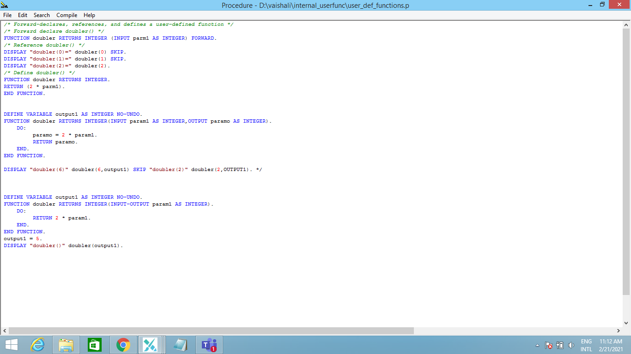
Locally user-defined function

Slide 25
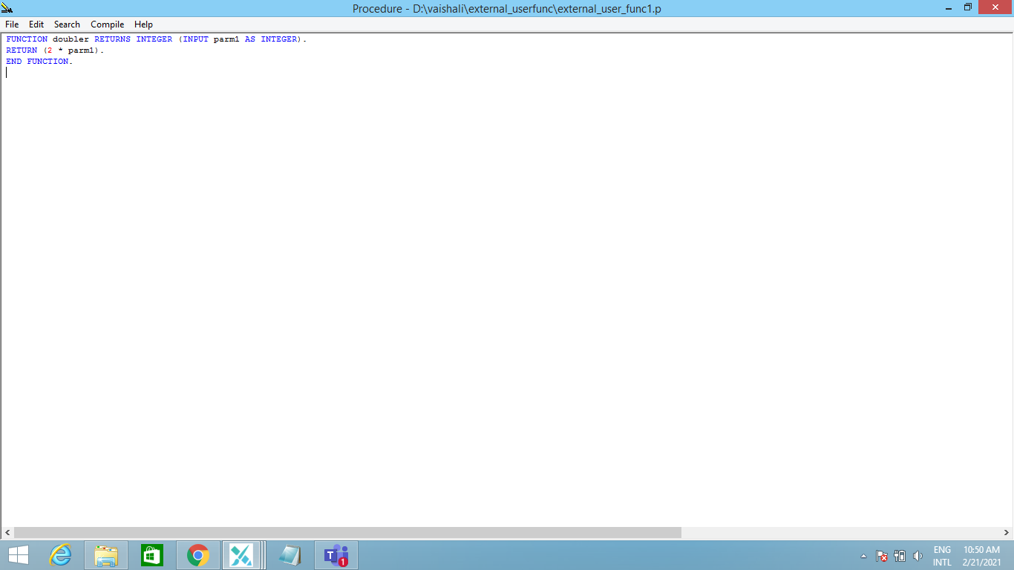
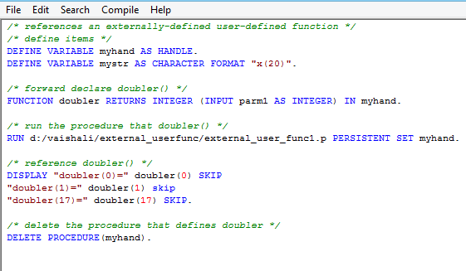
External user-defined function

Slide 26
Super procedures
Supports a mechanism for overriding progress internal procedures and user-defined functions.
Prototyping Internal Procedure -
Syntax – PROCEDURE proc-name IN SUPER
Internal Procedure can invoke the super version of itself by using the RUN SUPER statement.
User-defined functions can invoke its super version by using the SUPER function.

Slide 27
Thank you !

