Slide 1
Locks

Slide 2
Locks are used to Avoid Record Conflicts
In progress we have 3 types of LOCKS
SHARE-LOCK
EXCLUSIVE-LOCK
NO-LOCK

Slide 3
SHARE-LOCK
Whenever a person reads a record without specifying any lock then it will be in SHARE-LOCK.
An exception for this is the browse widget , For a browse widget NO–LOCK is the default mode.

Slide 4
SHARE-LOCK
When we read a record using SHARE-LOCK , other users can read that record but cannot update it .
Other users can update the record only after our procedure releases the SHARE–LOCK.

Slide 5
EXCLUSIVE-LOCK
It is used when we are updating a record.
Other users cannot read or update that record until the procedure releases EXCLUSIVE–LOCK.
If we want to delete a record then it must be in EXCLUSIVE–LOCK.

Slide 6
Waiting for lock release
If you try to read a record with a SHARE–LOCK when another user has that record EXCLUSIVE–LOCKed, Progress displays a message that the record is in use and you must wait to access it.
If you try to read a record with an EXCLUSIVE–LOCK, when another user has that record SHARE–LOCKed or EXCLUSIVE–LOCKed, you receive a message that the record is in use and you must wait to access it.

Slide 7
NO-LOCK
It is used to read a locked record.
If we are using NO-LOCK then other users can read and update the record.
Risk using NO-LOCK is that the data might not be up-to-date.

Slide 8
Transaction and Locks
If we read a record with NO–LOCK before a transaction starts and then read the same record with EXCLUSIVE–LOCK within the transaction, the EXCLUSIVE–LOCK is automatically downgraded to a SHARE–LOCK when the transaction ends. Progress does not automatically return you to NO–LOCK status. If we do not want to hold a lock beyond the end of the transaction, we must execute a RELEASE statement on the record within the transaction.

Slide 9
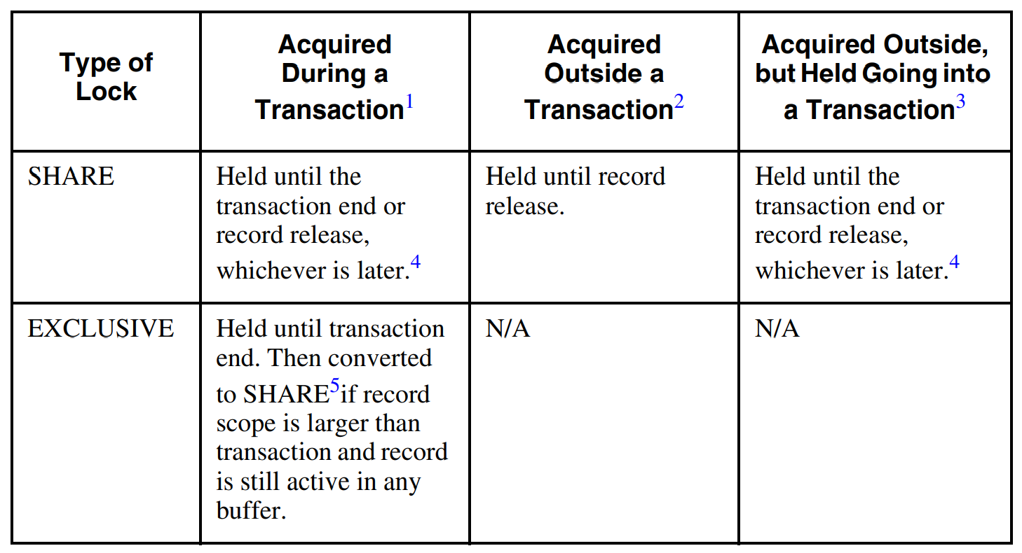

Slide 10
Lock Table
SHARE–LOCKs and EXCLUSIVE–LOCKs use up entries in the lock table.
The possible number of entries in the lock table by default is 500.
We can change this with the Lock Table Entries (–L) startup parameter.
Progress stops a user program if it attempts to access a record that overflows the lock table.

Slide 11
CAN-FIND
Returns a TRUE value if a record is found that meets the specified FIND criteria. Otherwise it returns FALSE.
CAN-FIND does not make the record available to the procedure.
The Default lock for CAN-FIND is NO-LOCK.
EXCLUSIVE lock is not allowed in a CAN-FIND because CAN-FIND does not return a record.

Slide 12
Deadly Embrace
User_1 reads a record in SHARE-LOCK.
User_2 reads the same record in SHARE-LOCK.
Now suppose that both users want to update the record. They both need an EXCLUSIVE–LOCK on the record. But User_1 cannot EXCLUSIVE–LOCK the record because the other user has the record SHARE–LOCKed. And User_2 cannot EXCLUSIVE–LOCK the record because the other user has it SHARE–LOCKed. This situation is known as deadly embrace.
One of the two users must press STOP to resolve the situation.

Slide 13
Deadly Embrace
Deadly embrace occurs when two users have the same record with SHARE–LOCK and both are waiting for the other to release the record. Although this problem can be avoided by good design, using the FIND CURRENT technique means that this will never be a problem.

Slide 14
Thank you

