Slide 1
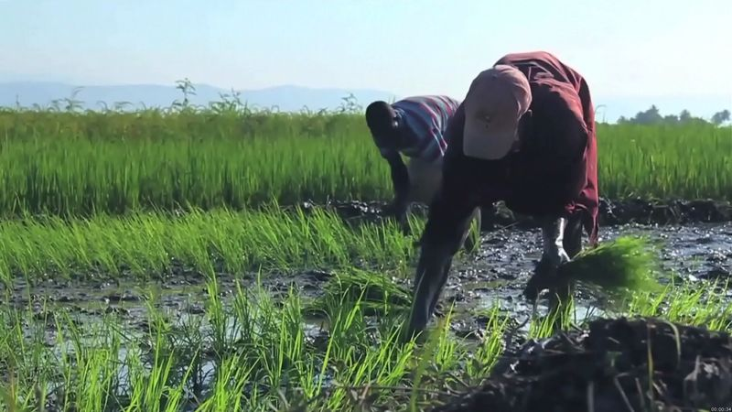
Plant Disease Detection
J005 Abhimanyu Gupta
J024 Muktesh Raghavan
J034 Sanchit Agarwal
J035 Aayush Wakmiki

Slide 2
Contents
Introduction
Datasets
Models
Advantages
Future Scope
Conclusion

Slide 3
Introduction
Diseases found in agriculture crop is a major threat that cause production and economic losses as well as reduction in both quality and quantity of agricultural products.
In India 70% of population depend on agriculture and contributes 17% towards the GDP of country.
Farmers experience great difficulties in switching from one disease control policy to another. The naked eye observation of experts is the traditional approach, this method can be time consuming, inaccurate and expensive.
The crop losses can be minimized by applying pesticides or its equivalent to combat the effect of specific pathogens, if disease are correctly diagnosed and identified early.

Slide 4
Datasets
The dataset is collected from open source website “Kaggle”.
We have taken samples of 12004 images of 2 crops with 5 classes.
The dataset consist of 5 classes corresponding to 3 disease and 2 healthy crops of 2 types
Crops are Potato and Bell Pepper with their diseases.

Slide 5
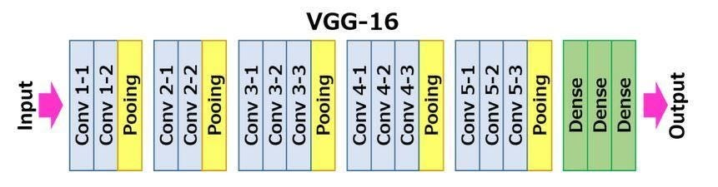
Models
VGG 16
A convolutional neural network is also known as a ConvNet, which is a kind of artificial neural network. A convolutional neural network has an input layer, an output layer, and various hidden layers. VGG16 is a type of CNN (Convolutional Neural Network) that is considered to be one of the best computer vision models to date. The creators of this model evaluated the networks and increased the depth using an architecture with very small (3 × 3) convolution filters, which showed a significant improvement on the prior-art configurations. They pushed the depth to 16–19 weight layers making it approx — 138 trainable parameters.

Slide 6
What we did
Dataset is imported from kaggle.
There were many classes in the dataset, so we took 5 classes from that and removed other classes.
Then we divided the data in three parts test, train and validate.
After that we performed trained test using data generator.
We have used VGG16 for image processing.
We added layers after that we trained our data using 10 epochs and hyperparameter tuning was done.
After doing this we tested our data, and we got the results as below:
loss: 0.2472 - accuracy: 0.9089 - val_loss: 0.1739 - val_accuracy: 0.9284

Slide 7
Advantages
The main advantage of automatic plant disease detection is to protect crop production from quantitative losses.
This system can work as a universal detector, reorganizing general abnormalities on the leaves such as schoring or mold etc.
It can be implemented to increase crop productivity by ensuring the quality and quantity of the food product.
This system is capable of distinguishing a large number of different disease in a less time.
It can recognize a plant disease which provides clues to identify and treat the disease in early stages.

Slide 8
Future Scope Of Project
The forecasting of disease in early stage, so that appropriate measures can be taken to minimize the loss in crops.
Recommendation of chemicals and their ratio to control the further spread of disease on the different part of plants after the proper identification of disease.
Other than plant and leaf disease identification, it can also be used for identification and classification of nutrients deficiency of plant leaves.
Creating and training a CNN model from scratch is a tedious process, this model can be used to detect and classify other pant disease too, by simply training the model using respected datasets.

Slide 9
Conclusion
The results show that the accuracy of the method is 77%, which is better than the traditional method, thus reducing the influence of disease on agricultural production and being favorable to sustainable development of agriculture.
With very less computational efforts the optimum results were obtained, which also shows the efficiency of proposed algorithm in recognition and classification of the leaf diseases. Another advantage of using this method is that the plant diseases can be identified at early stage or the initial stage.

