Slide 1
Business Report: Flight Delay Risk Analysis & Pricing Recommendations
Prepared by: Pooja Gupta
Objective: Identify key factors that influence flight delay claim risk and propose a simple, effective risk-based pricing model for the $800 flight-delay benefit.

Slide 2
1. Executive Summary
The analysis of flight delay claims between 2013–2016 shows that delay risk varies significantly across airlines, departure times, and seasons. These insights enable us to create a three-tier pricing model (Low, Medium, High risk) that aligns price with risk, improves profitability, and enhances competitiveness for low-risk flights.

Slide 3
2. Dataset Overview
Historical flight data included:
Airline
Departure & Arrival airports
Scheduled departure time
Month & day-of-week
Delay hours
Claim payout (0 or 800)
We created a binary indicator (is_claim_flag):
1 → Claim occurred
0 → No claim

Slide 4
3. Key Insights From Risk Analysis
We tested several hypotheses to understand which factors influence claim probability.
Below are the findings supported by visualizations.

Slide 5
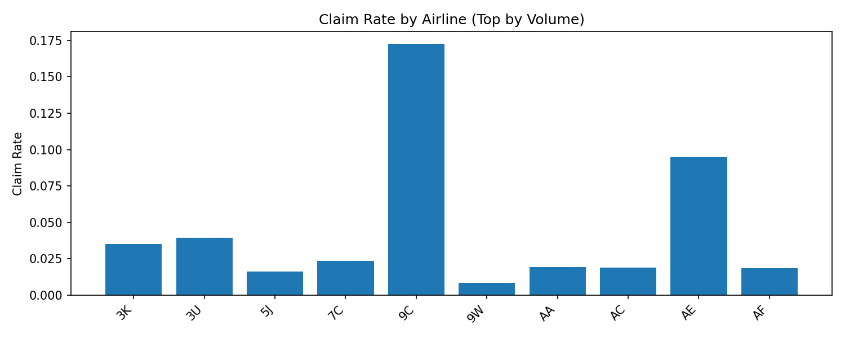
3.1 Airline Risk Analysis (Hypothesis 1)

Slide 6
3.1 Airline Risk Analysis (Hypothesis 1)
Insight
Claim rates vary significantly across airlines.
Some airlines (9C, AE) exhibit claim rates as high as 9%–17%, well above the dataset average.
Other airlines show consistently low risk (1–3%).
Conclusion
Airline is the strongest predictor of delay risk.
High-risk airlines should have higher premiums; low-risk carriers represent safe, low-cost pricing opportunities

Slide 7
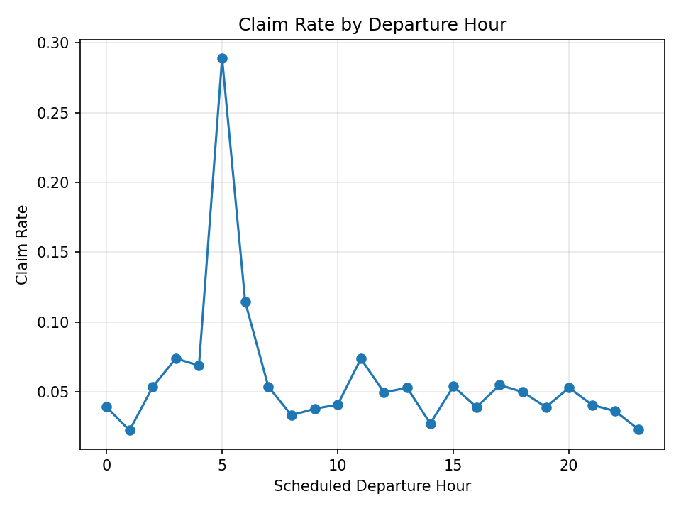
3.2 Departure Time Risk (Hypothesis 2)

Slide 8
3.2 Departure Time Risk (Hypothesis 2)
Insight
A dramatic spike in claims occurs at 05:00 AM, with a claim rate near 30%, far higher than any other hour.
Moderate risk observed at early morning (1–3 AM) and evening hours.
Most daytime flights show stable, lower risk.
Conclusion
Departure time strongly influences risk, particularly early morning departures.
Flights around 05:00 AM should be categorized as High Risk, even if other factors are low.

Slide 9
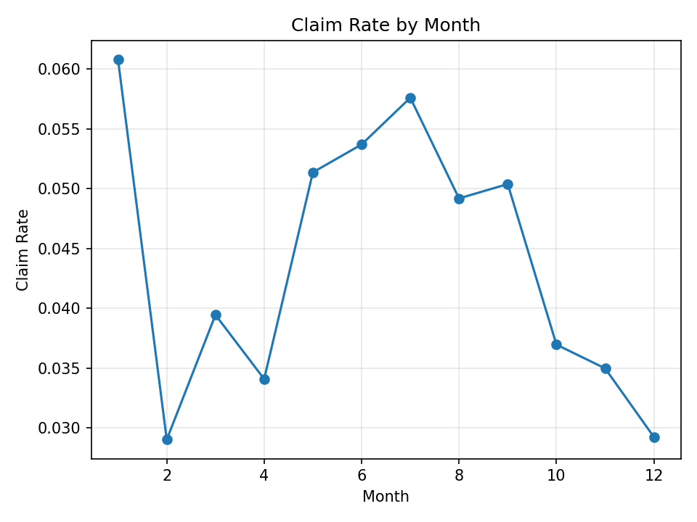
3.3 Seasonal Risk Analysis (Hypothesis 3)

Slide 10
3.3 Seasonal Risk Analysis (Hypothesis 3)
Insight
January has the highest risk (~6%), likely due to winter weather.
A second risk peak occurs from May to July, associated with heavy travel and congestion.
February and December show the lowest risk.
Conclusion
Delay risk exhibits clear seasonality.
Premiums can be seasonally adjusted to reflect known high-risk periods.

Slide 11
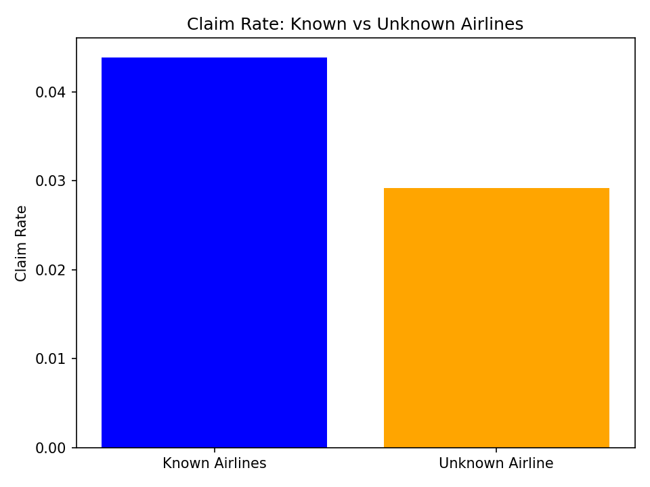
3.4 Known vs Unknown Airlines (Hypothesis4)

Slide 12
3.4 Known vs Unknown Airlines (Hypothesis4)
Insight
Known airlines claim rate ≈ 4.4%
Unknown airlines claim rate ≈ 2.9%
Conclusion
Missing airline information does not indicate higher risk.
In fact, Unknown Airline flights appear more reliable and should be priced as Low Risk, not penalized.

Slide 13
4 Synthesis: What Truly Drives Claim Risk?
Based on all hypotheses, the major risk drivers are:
Airline
Departure Hour
Season/Month
Data Category (Unknown Airline)
These variables should form the foundation of our pricing strategy.

Slide 14
5.Recommended Risk Bucketing Model
We can classify flights into three risk levels based on predicted claim probability:
RISK | Probability of claim
Low Risk | <3%
Medium Risk | 3%-8%
High Risk | >8%

Slide 15
6.Expected Loss per Risk Tier
Expected Loss = Claim Probability×800
Risk Tier | Typical Probability | Expected Loss
Low | 1-3% | $8-$24
Medium | 3-8% | $24-$64
High | 8-15% | $64-$120

Slide 16
Thank You
Questions & Discussion

