Slide 1

ALY6000 Introduction to Analytics
Project Report 4 Assignment: Independent Data Analysis Submission Date: 7th February 2024, Wednesday Submitted by Shraddha P Gupte

Slide 2
English Education in England - Introduction
The data set focuses on the educational attainment of young people in English towns and is sourced from The UK Office for National Statistics.
It contains information on various attributes related to this theme, including town name, population, town size, job density, income, and education score that represents a composite measure that evaluates the educational environment and attainment levels of people in each town, encompassing factors such as educational resources, school performance, and academic achievement. It also includes several other attributes on education level at key stage 4 and above.
Overall, the dataset offers a comprehensive view of the educational landscape in English towns, incorporating demographic, economic, and educational dimensions. It provides valuable insights for analyzing educational trends, socioeconomic disparities, and policy implications related to the educational outcomes of people across different areas in England.
Descriptive Statistics for Interesting Variables –
Measures of Central Tendency -
Mean Education Score: -1
Median of Education Score: -1
Mode of Education Score: 1
Measures of variability –
Standard Deviation: 2.8
Variance: 7.4

Slide 3
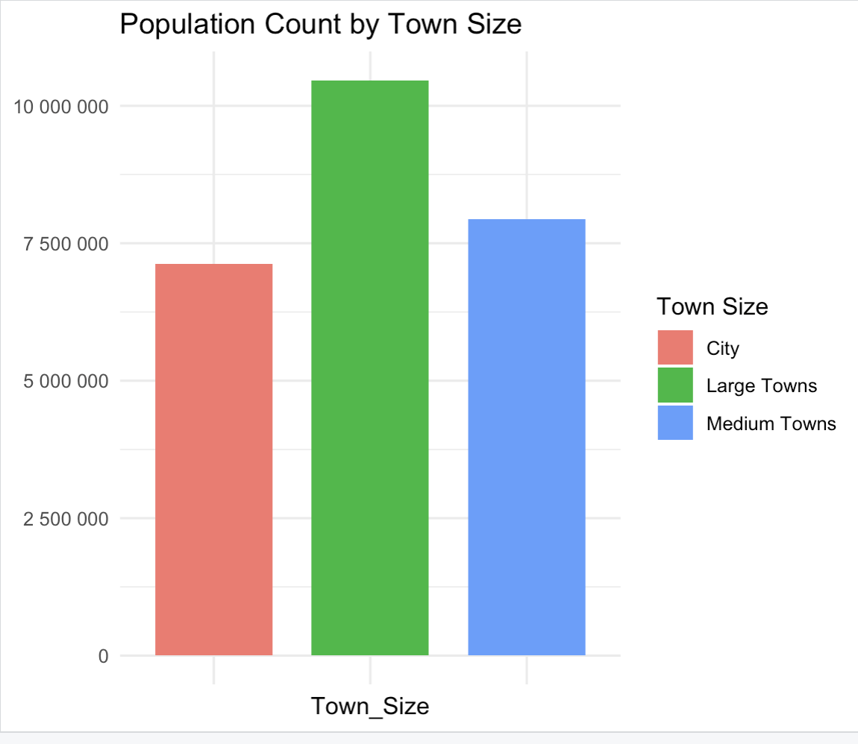
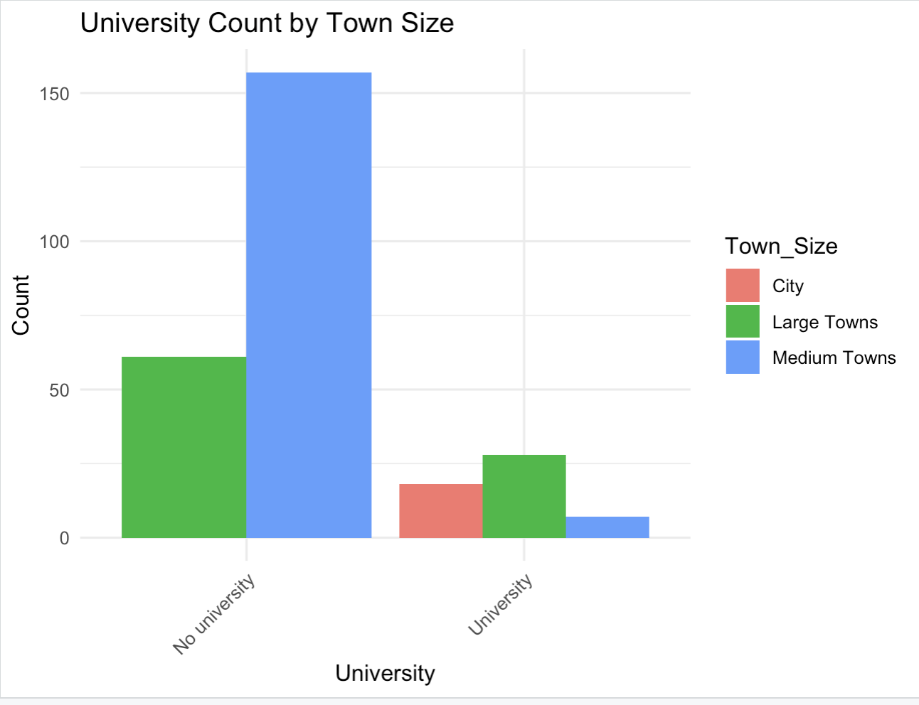
Visual Representation of the data (1/2)
A. Analysis based Population
B. Analysis based on University base
Notes:
Notes –
Highest population lies in large towns followed by medium towns.
Cities hold comparatively less population.
It is observed that maximum number of large and medium towns have no universities as compared to number of towns with universities.
Cities have less number of universities compared to large towns.
Medium Towns have lowest number of Universities
All cities have universities.

Slide 4
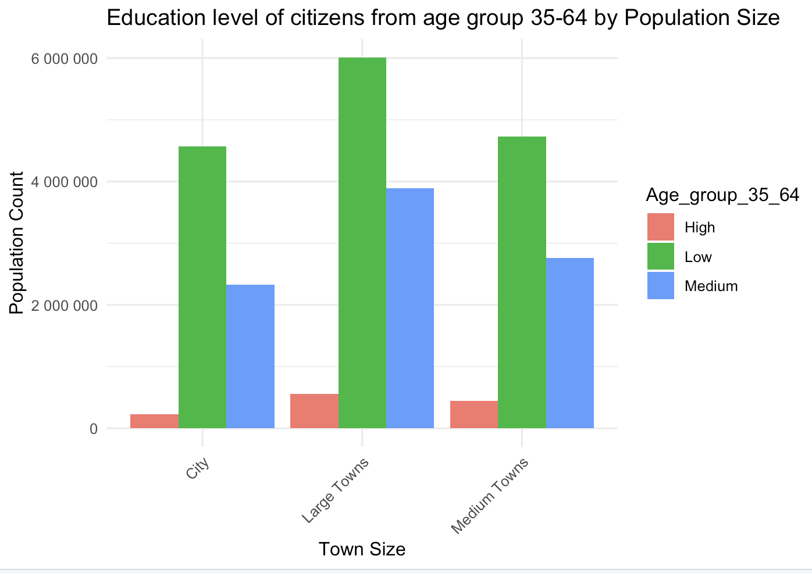
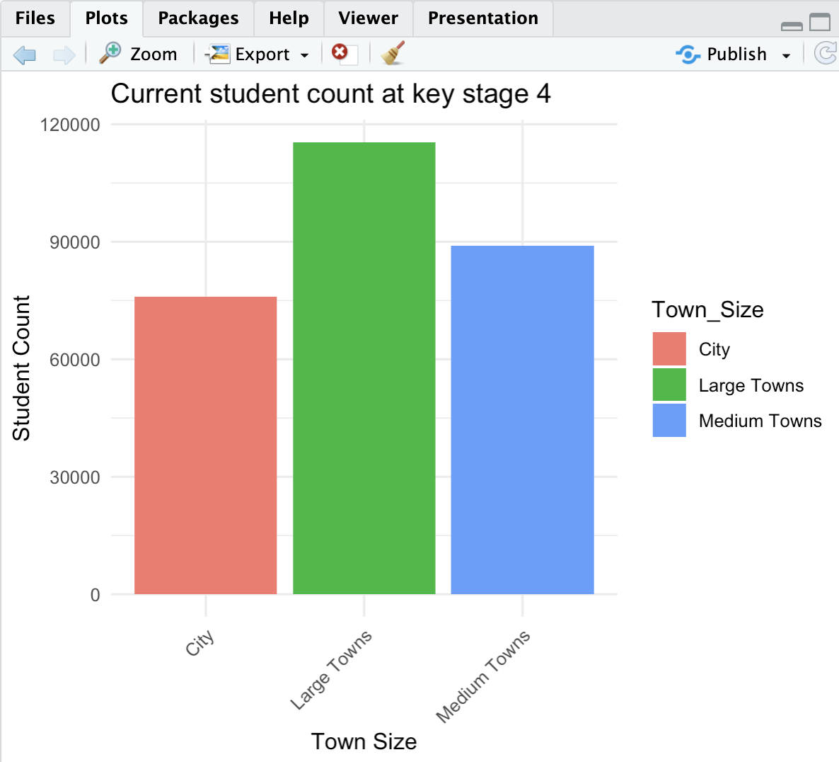
Visual Representation of the data (2/2
C. Analysis based on education level of Age group 35-64
D. Latest count of student at key stage 4
Notes:
Notes –
Cities and towns have highest number of population (35-64) with low level of education.
Large towns have highest population (35-64) with low level of education.
Cities have lowest population (35-64) with high level education compared to Large and Medium towns.
Large towns have highest count of student at key stage 4
Cities have the lowest count of students at key stage 4

Slide 5
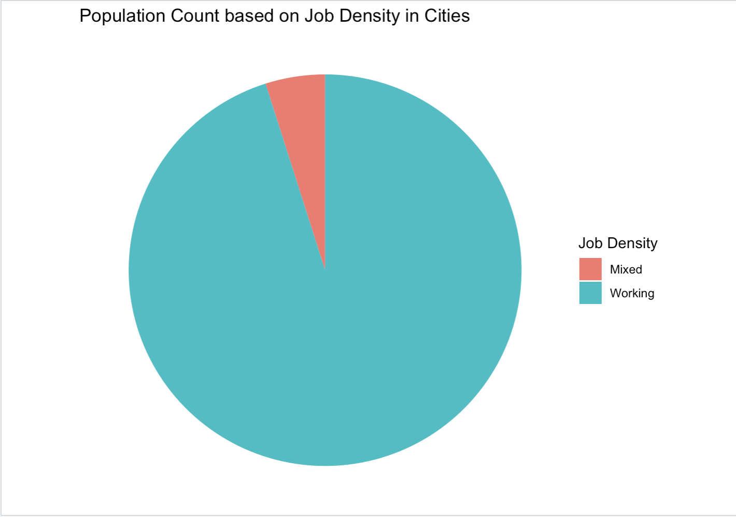
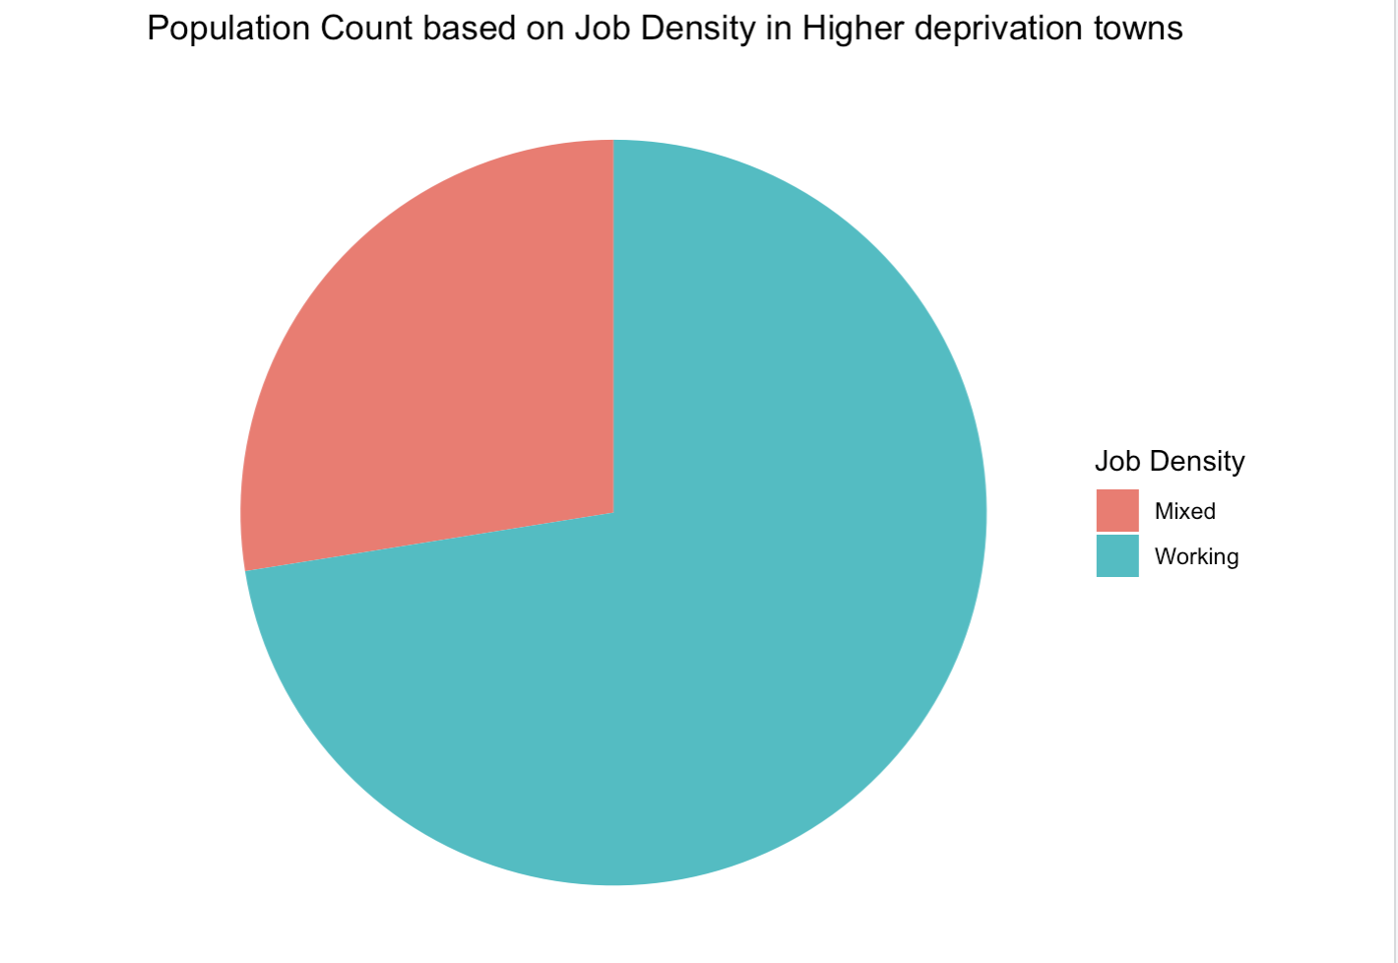
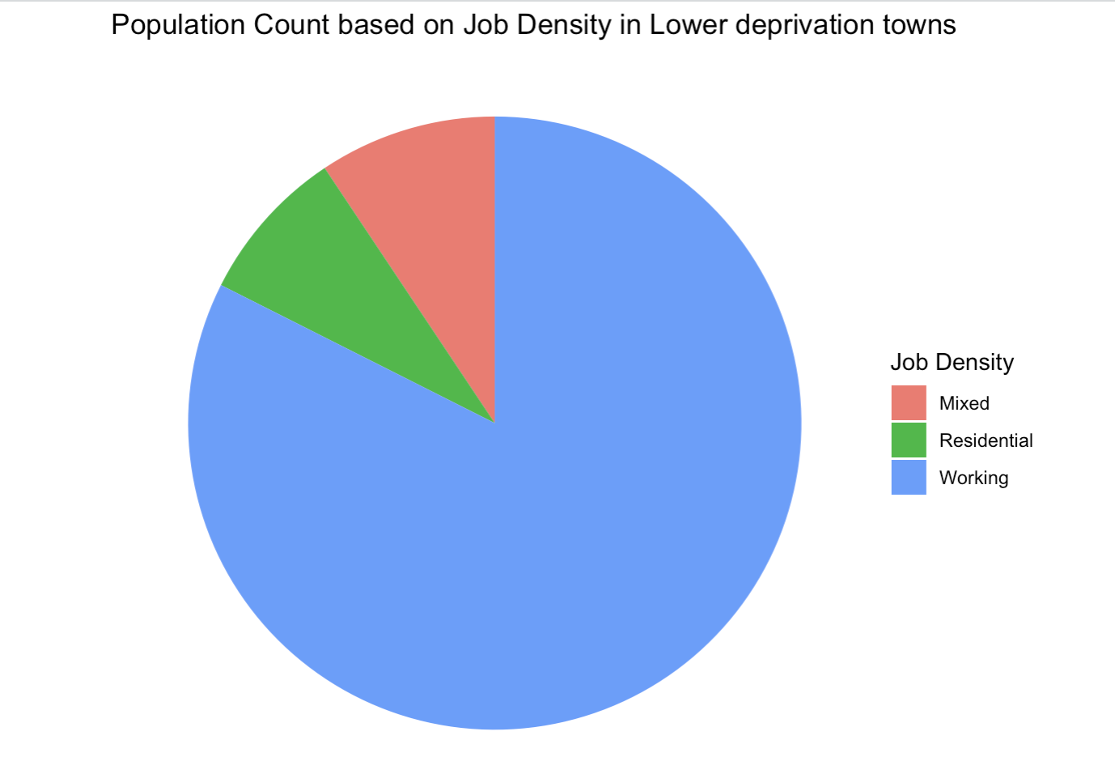
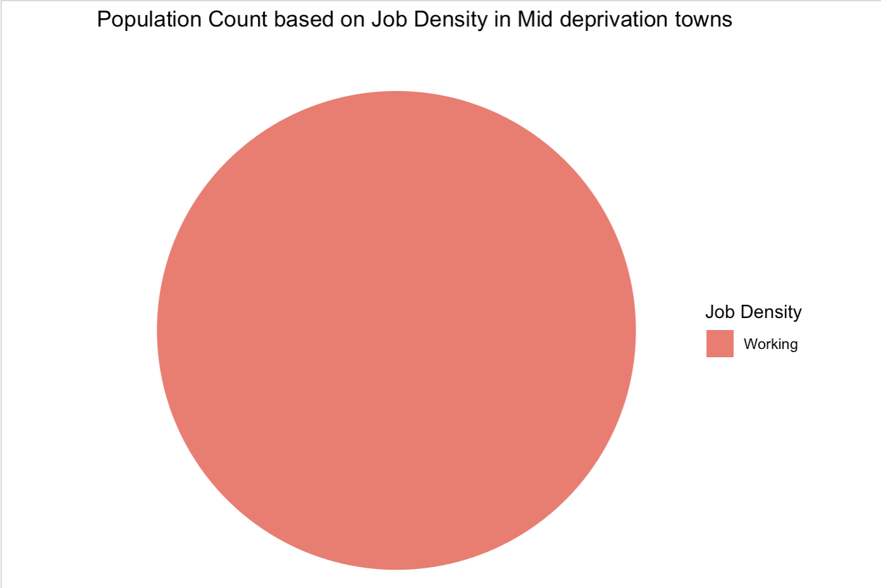
Analysis based on Job density and Income based on Working Population
A. Job Density of Population in Cities
B. Job Density of Population in Higher deprivation towns
C. Job Density of Population in Lower deprivation towns
D. Job Density in of Population Lower deprivation towns
Notes:
Notes –
Cities have highest count of working population.
Higher deprivation towns have more count of working population, and more mixed population compared to Cities.
Lower deprivation towns have more count of working population and almost same count of Residential and Mixed population
Mid Deprivation towns have only working population.
Residential population is only located in towns with income of lower deprivation.

Slide 6
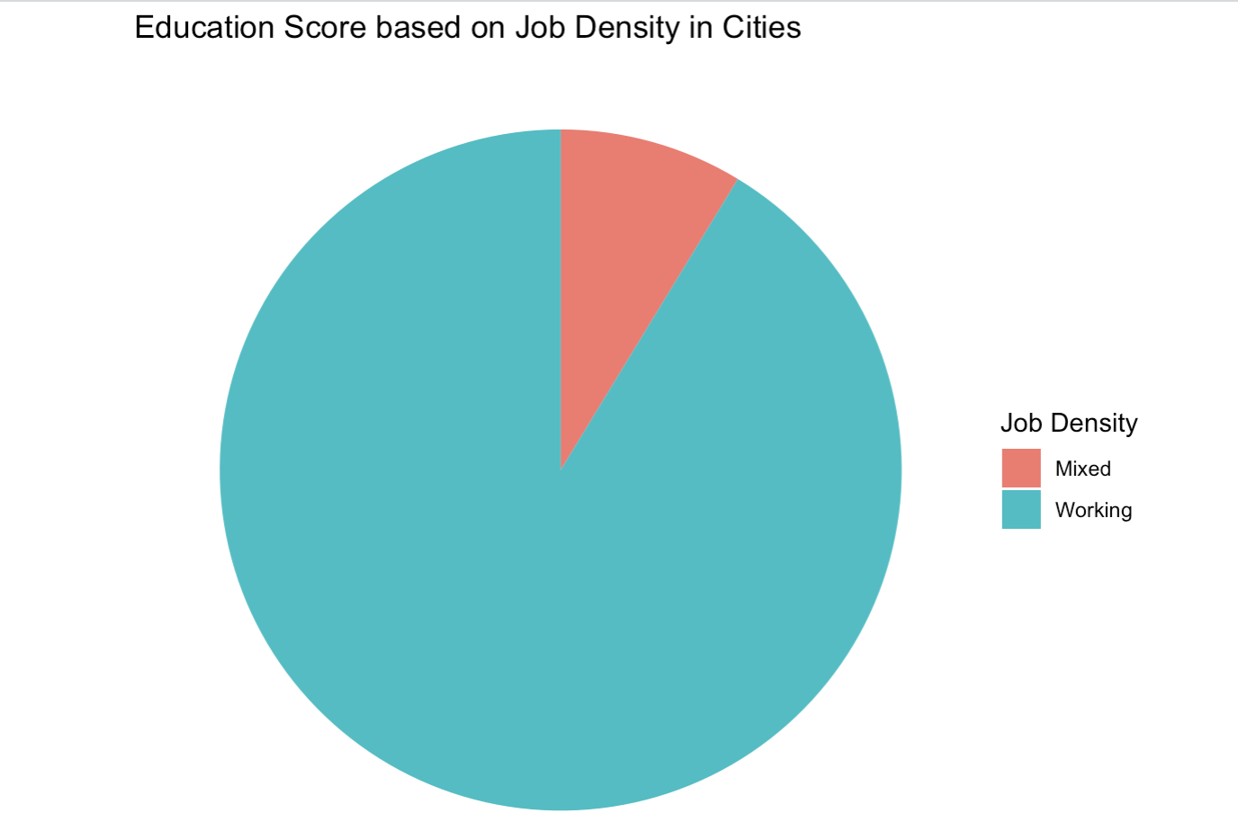
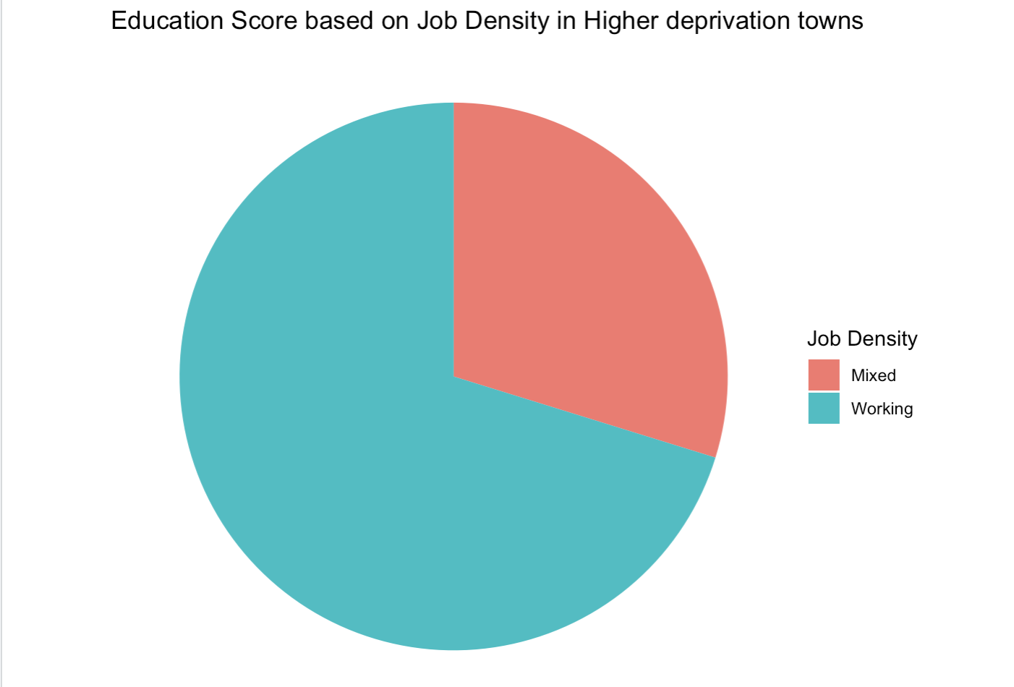
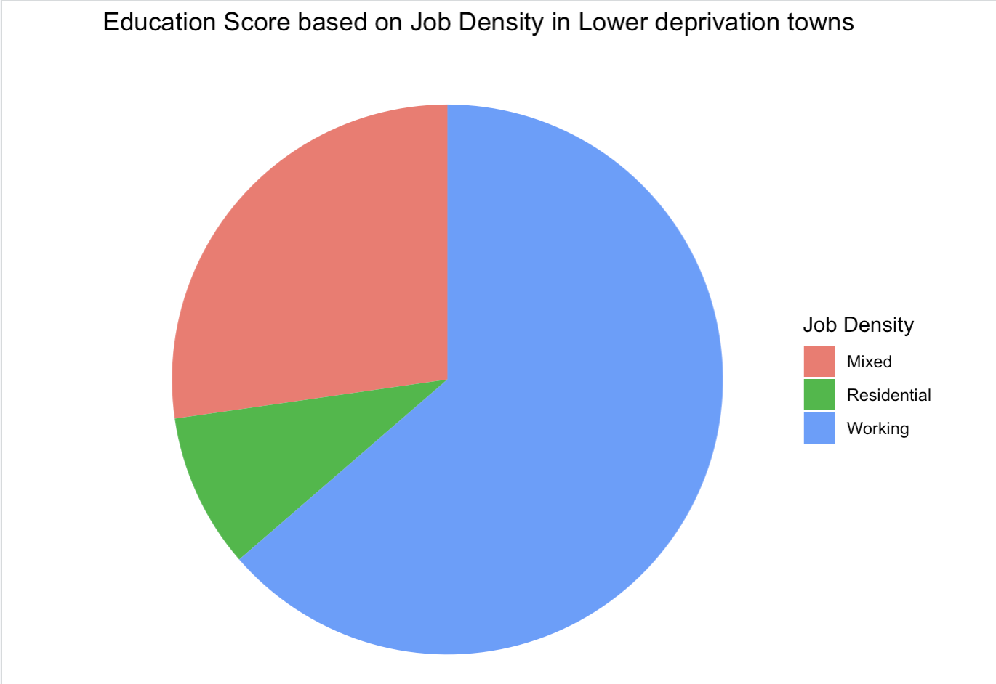
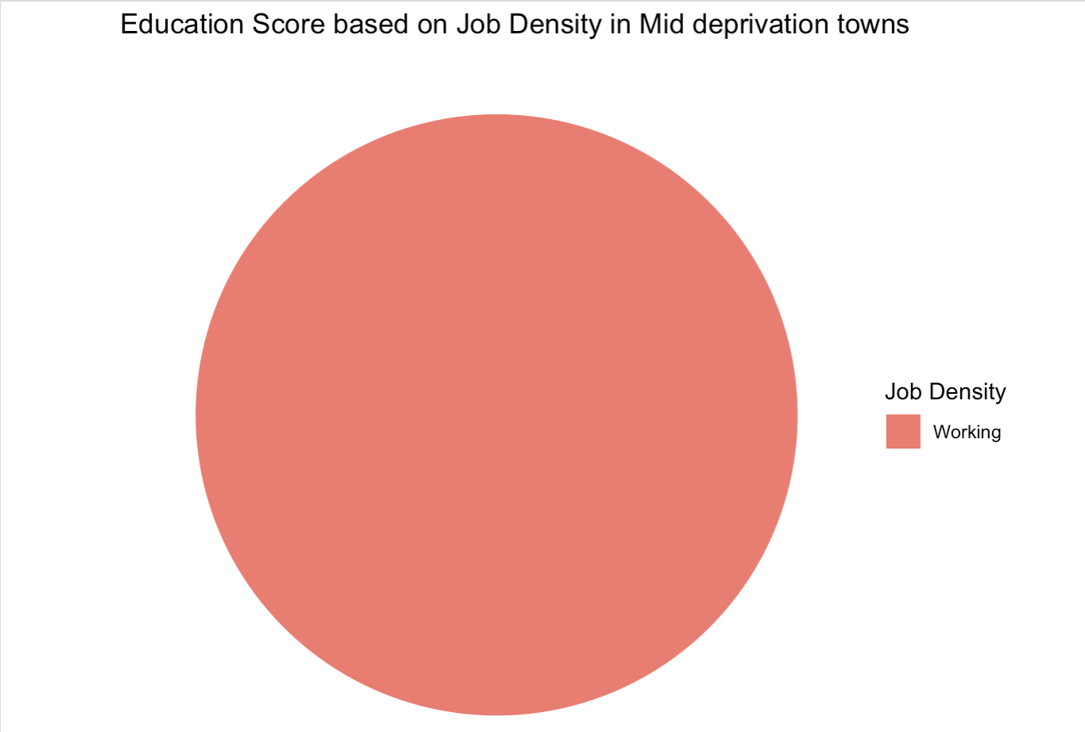
Analysis based on Job density and Income based on Education Score
A. Job Density of Education Score in Cities
B. Job Density of Education Score in Higher deprivation towns
C. Job Density of Education Score in Lower deprivation towns
D. Job Density of Education Score in Mid deprivation towns
Notes:
Notes –
Cities have highest education score of working population.
Higher deprivation towns have more education score of working population, and more education score of mixed population compared to Cities.
Lower deprivation towns have more education score of working population and lowest education score of Residential Population.
Mid Deprivation towns have highest education score with only working population.
Residential population is only located in towns with income of lower deprivation.

Slide 7
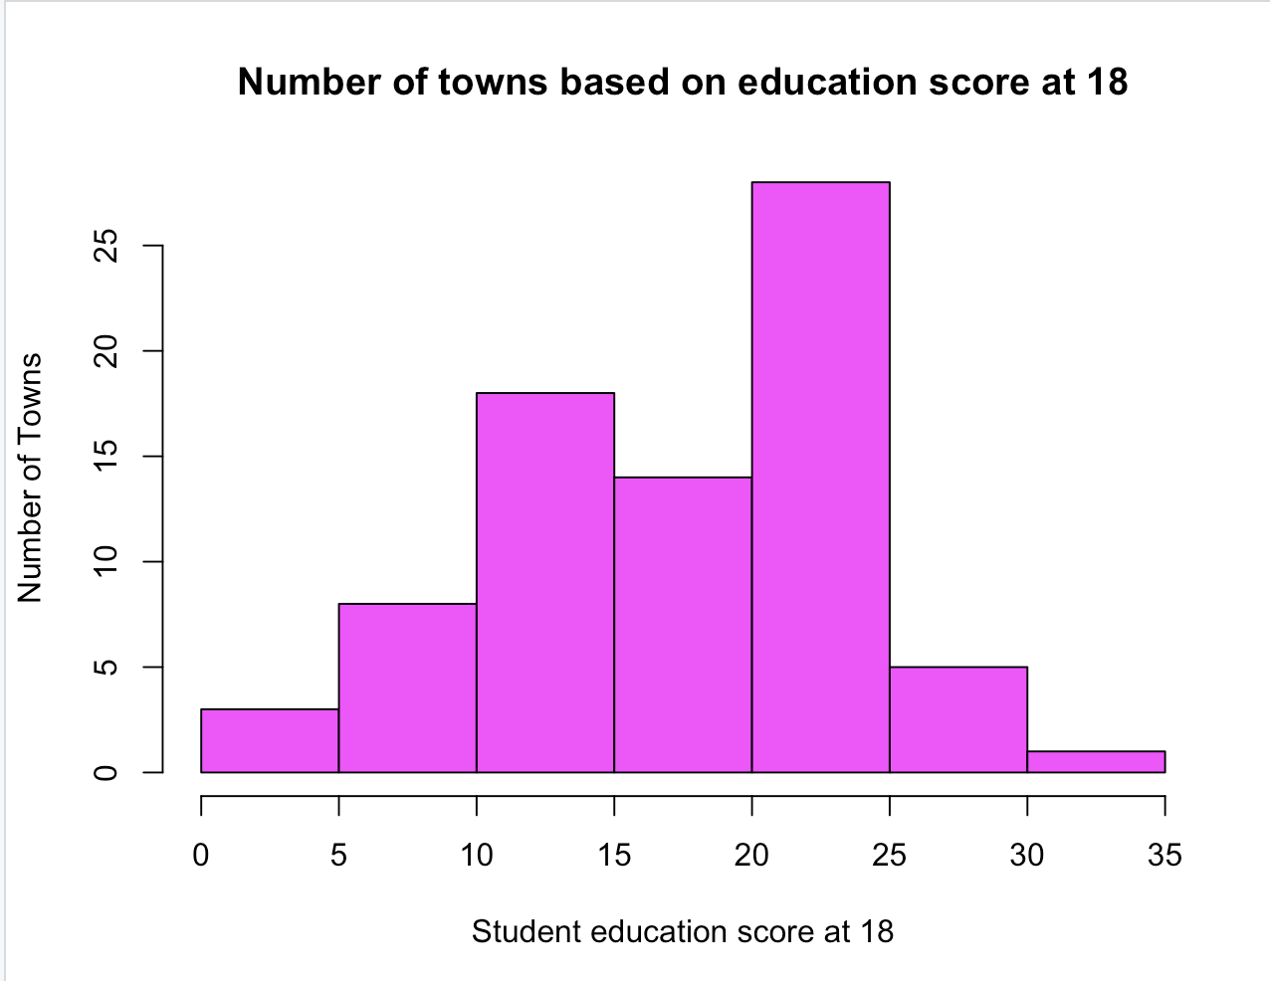
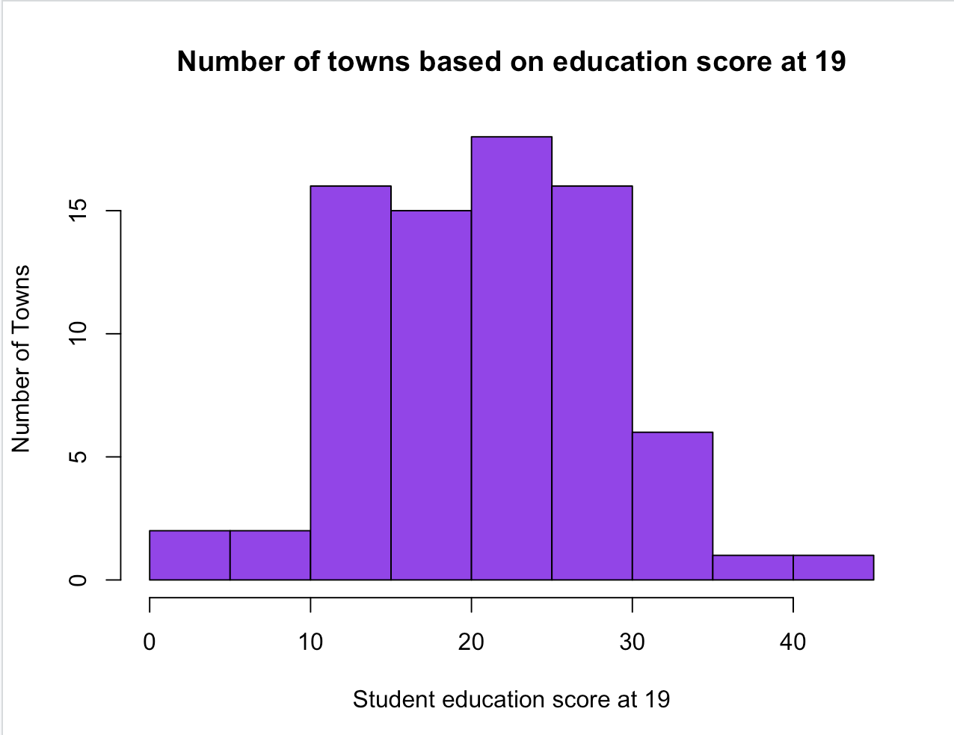
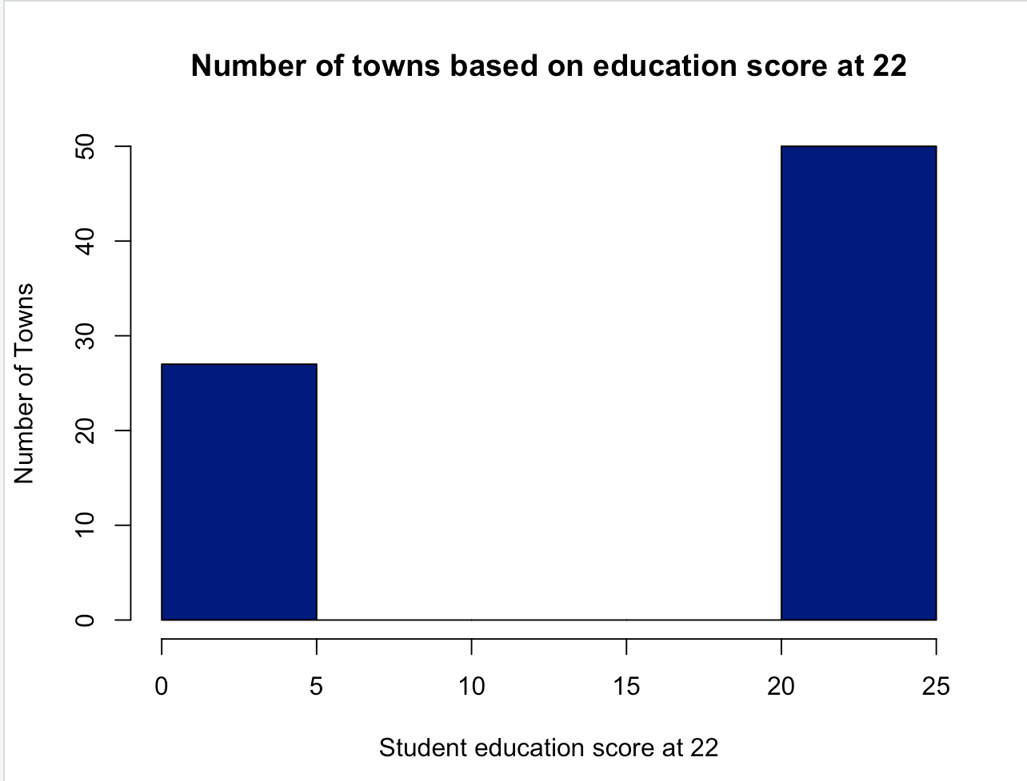
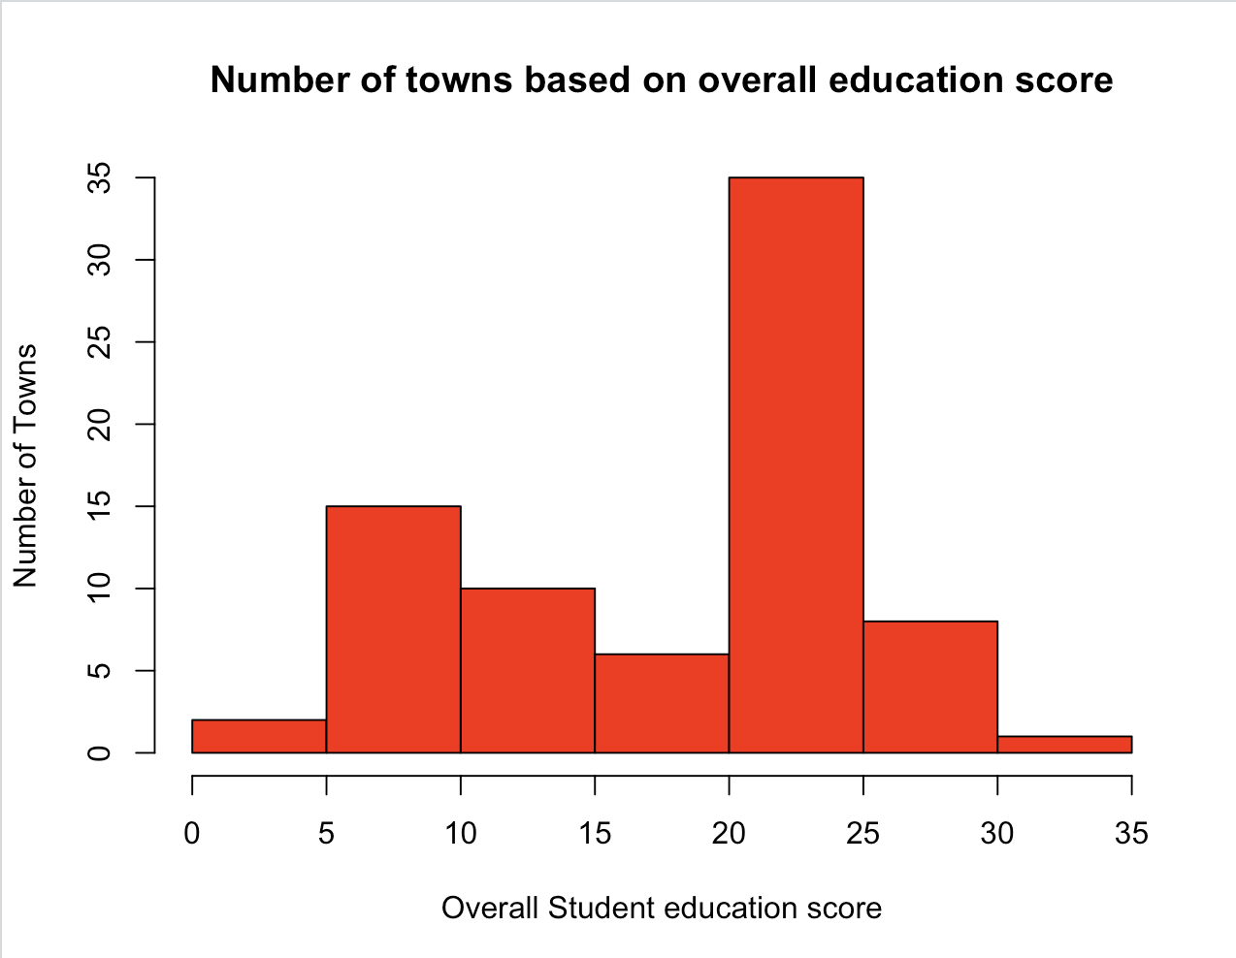
Representation of current student education based on age group
A. Number of towns with student education score at 18
B. Number of town with student education score at 19
C. Number of town with student education score at 22
D. Number of town with Overall student education score
Notes:
Notes –
The above graph A determines the highest number of town have student education score at 20-25
The above graph B determines the highest number of town have student education score at 20-30
The above graph C determines the highest number of town have student education score at 20-25 and score from 5 - 20. This indicates at students in these towns of either low education or highest level of education.
The above graph D shows the overall student education score highlight that most number of towns have student education score at 20-25
Very few town have highest score of 30-35
However, only few number of towns also have lowest score below five. This indicates that major towns have students with education score of above 5.

Slide 8
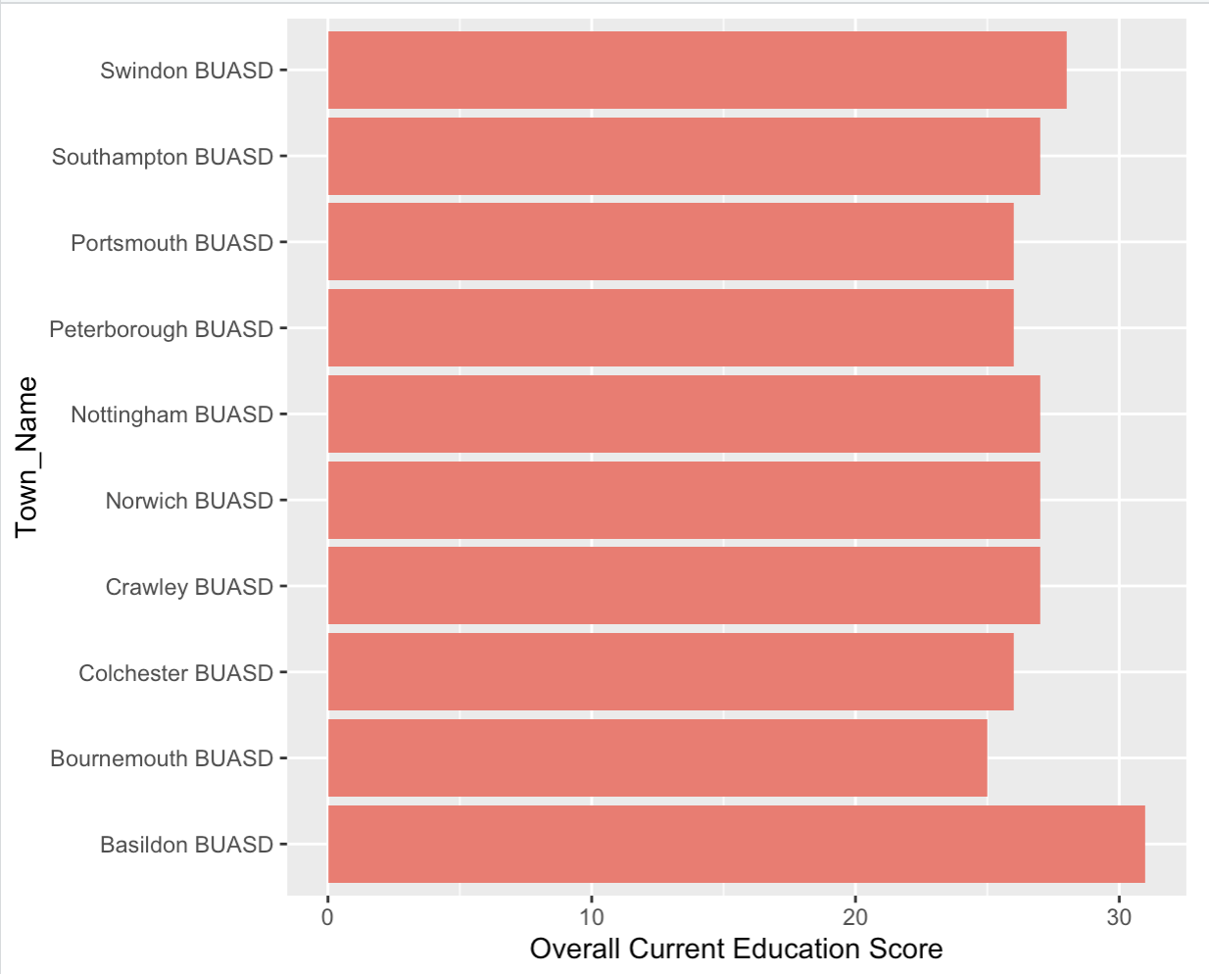
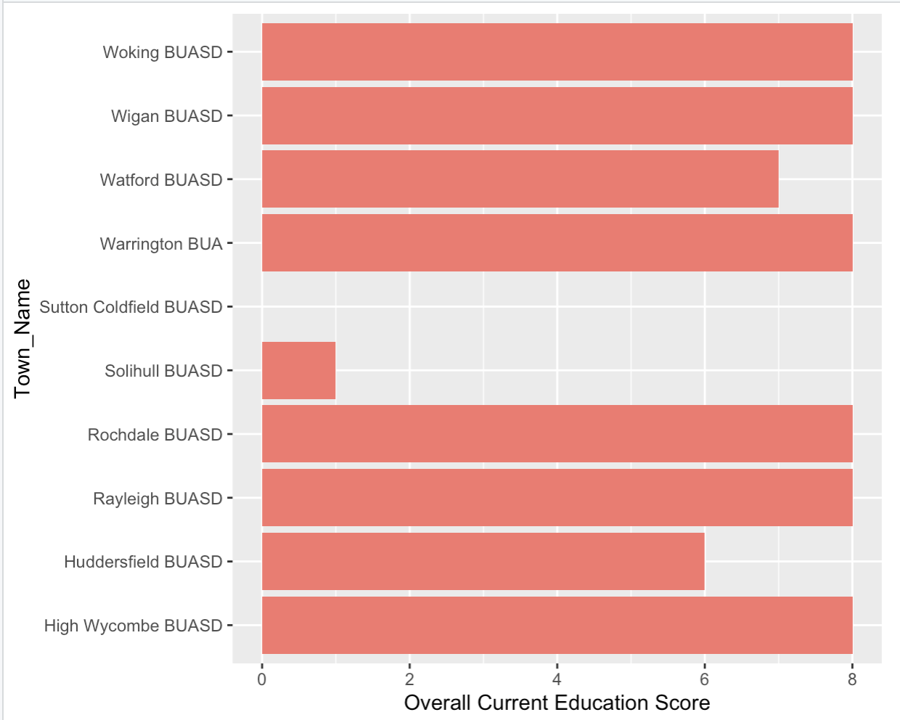
Education stats for the current student education
A. Top 10 towns with highest score on current student Education
B. Bottom 10 towns with lowest score on current student Education
Notes:
Notes –
The graph A provides list of top 10 town names with highest score of student education as per the latest year (2012-2013)
The town named Basildon has the highest score of 31
The graph B provides list of bottom 10 town names with lowest score of student population as per the latest year (2012-2013)
The town named Sutton Coldfield has the lowest score of 0
This may determine that further population of the town Basildon may have Lower deprivation and high density of working population.
Similarly the population of the town Sutton Coldfield may have Higher deprivation and low density of working population.

Slide 9
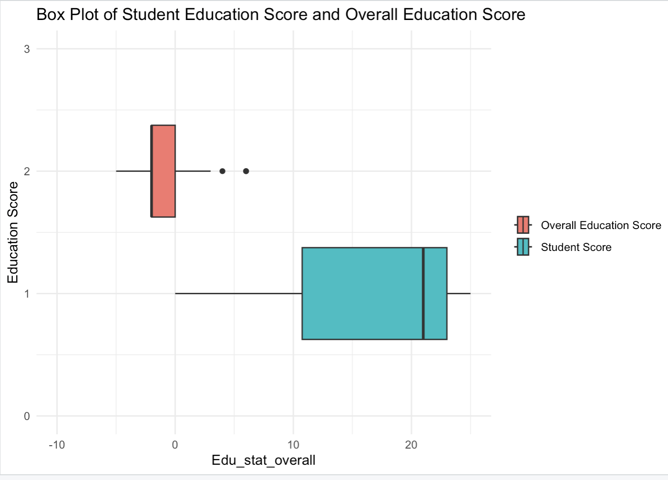
Comparison of Student Education Score and Overall Education Score
Notes:
Notes -
The above Boxplot defines the comparison of the current education score with the student education score also considered to be future working population.
For Student score the median is above 20, this indicates the score distribution is towards the positive side. students irrespective of town size or job density have high education score.
For Overall Education Score, the median is -1. This indicates that there is a high number of population irrespective of job density has less over education The number of universties are less in large towns and medium towns which contributes most to the overall population density

Slide 10
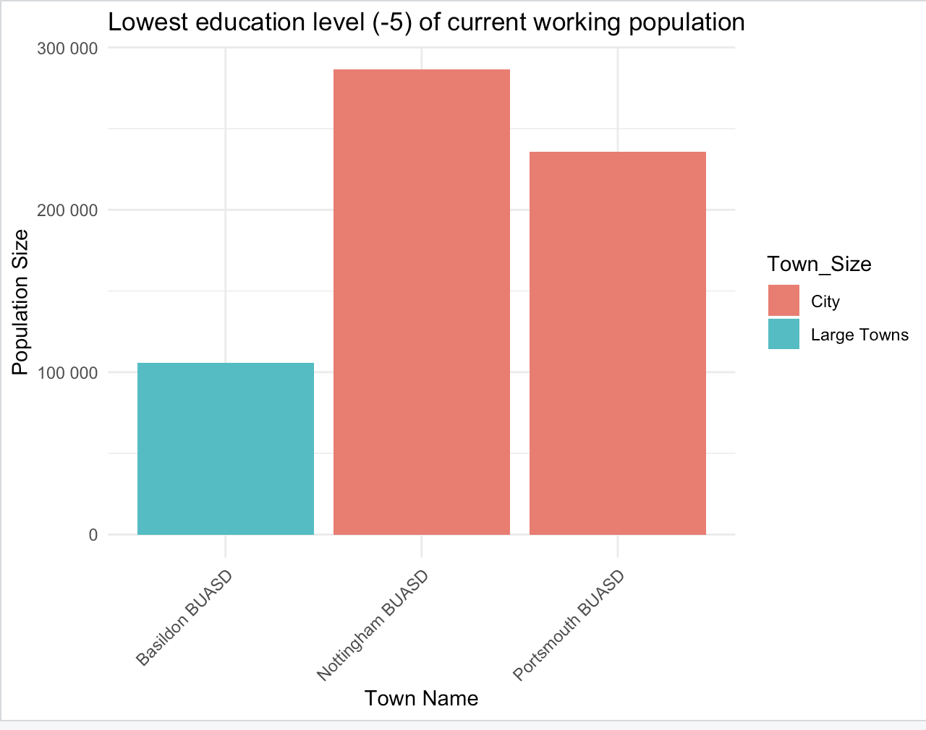
Population with lowest education score
Notes:
Notes –
The above graph indicates that inspite of being cities the Nottingham and Portsmouth have lowest education level.
Nottingham has the highest population with low education score.
This also indicates that the medium towns have significantly more education score.

Slide 11
Insights
The overall representation of the data determines that major population from large town size have high student and education level considering all age groups. This indicates that these towns are focused on developing future population by emphasizing the value of education.
The analysis also determines that in spite of the large towns having more educated population and student count, there is lack in the number of universities.
Cities and Higher Deprivation towns have no residential population and maximum working population which derivies that the income is less in these towns.
Lower deprivation towns have residential population and balance of mixed population, deriving that this population have high paying jobs.
In spite of the towns Basildon, Nottingham and Portsmouth having low education score of -5 the student education score of these towns is highest among top 10 determining the town is developing the student population.
Follow up questions -
Does education score involve all age groups?
What is the education score of the population between age group of 35-64?
Count of working, mixed and residential population would help to analyze the data more deeply.

Slide 12
References
Citation:
Book-
Kabacoff, R.I. (2022). R in action: Data analysis and graphics with R and tidyverse (3rd edition). Manning Publications.
Bluman, A. (2018). Elementary statistics: A step by step approach (10th ed.). McGraw Hill.
Website-
R Core Team.(2021). R: A Language and Environment for Statistical Computing https://www.R-project.org/
Data Carpentry : Data Analysis and Visualisation in R for Ecologists https://datacarpentry.org/
GeeksforGeeks : Data visualization with R and ggplot2 https://www.geeksforgeeks.org/

