Slide 1
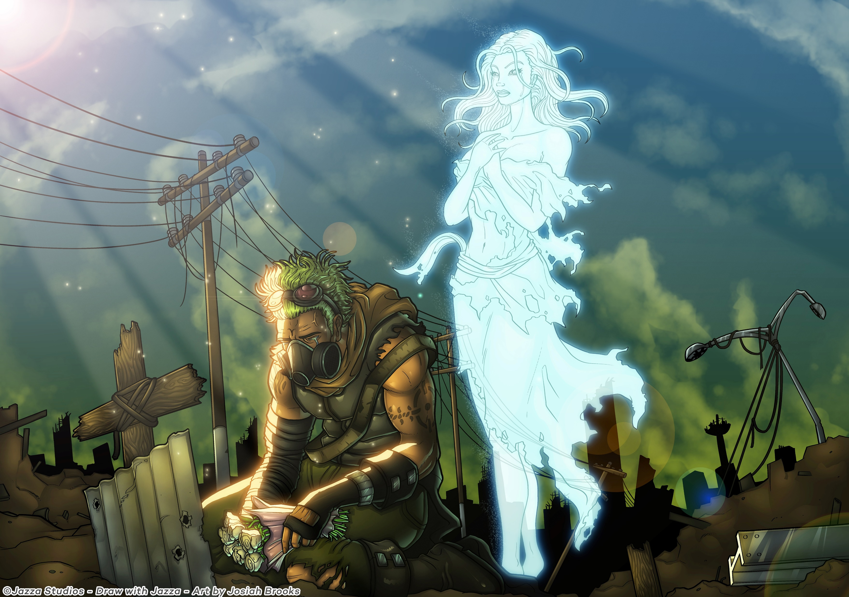
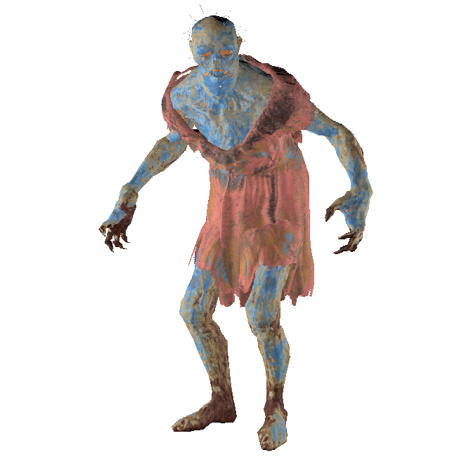

Are you a
INSAID –Creature recognition
based on features
This Photo by Unknown Author is licensed under CC BY-NC-ND
This Photo by Unknown Author is licensed under CC BY-SA-NC
This Photo by Unknown Author is licensed under CC BY-SA
Notes:
© Copyright PresentationGO.com – The free PowerPoint and Google Slides template library

Slide 2
Spooky Flow….
Introduction
Setup
Import
Read
Understand
Missing Values
Convert to Classification problem
Multinomial logistic, regularized logistic and random forest classifiers
Variables/ Data Visualization
Scatter Plot
Correlation Matrix
Conclusion
Actionable Insight
Notes:
© Copyright PresentationGO.com – The free PowerPoint and Google Slides template library

Slide 3
Where is my data….
Data was loaded using pandas read csv
Both train and test sets were loaded
## Load datasets from internet
data=pd.read_csv('C:\\Users\\shwet\\OneDrive\\Documents\\OnlineCourses\\insaid\\ghouls-goblins-and-ghosts-boo\\train.csv\\train.csv')
data_test=pd.read_csv('C:\\Users\\shwet\\OneDrive\\Documents\\OnlineCourses\\insaid\\ghouls-goblins-and-ghosts-boo\\test.csv\\test.csv')
Notes:
© Copyright PresentationGO.com – The free PowerPoint and Google Slides template library

Slide 4
Setting up the system
What you need to fight them…
Notes:
© Copyright PresentationGO.com – The free PowerPoint and Google Slides template library

Slide 5
Where is my data….
Null values were search using isnull function and no null values were found
Panda, numpy,
from sklearn.linear_model import LogisticRegression,
from sklearn.metrics import accuracy_score,
#Import Random Forest Model
from sklearn.ensemble import RandomForestClassifier,
import seaborn as sns
import matplotlib.pyplot as plt
Notes:
© Copyright PresentationGO.com – The free PowerPoint and Google Slides template library

Slide 6
Where is my data….
############################
#Finding missing values
#no missing values found
###########################3
print(data.isnull().sum())
print(data_test.isnull().sum())
The color of the creature is a categorical variable. There are 6 colors of creatures.
This requires one hot encoding which is also known as indicator variable creation.
Other types of encoding creates numerical order in the encoding which is wrong and it gives lower accuracy.
Notes:
© Copyright PresentationGO.com – The free PowerPoint and Google Slides template library

Slide 7
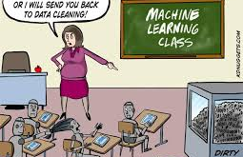
Convert to classification
Random forest
Multinomial logistic
Regularized logistic
Notes:
© Copyright PresentationGO.com – The free PowerPoint and Google Slides template library

Slide 8
Where is my data….
The first goal is to predict the type of ghost based on its features
So train and test sets were created
Multinomial logistic, regularized logistic and random forest classifiers were applied
Regularized logistic gives highest accuracy of 73%
So predictions using entire train set were made for train and orignal test set (provided by you) were done
Next goal is to see if there are correlations between features of creatures. So correlation matrix was created.
Next goal was to create scatter plots to visual see how features are correlated with class.
Notes:
© Copyright PresentationGO.com – The free PowerPoint and Google Slides template library

Slide 9
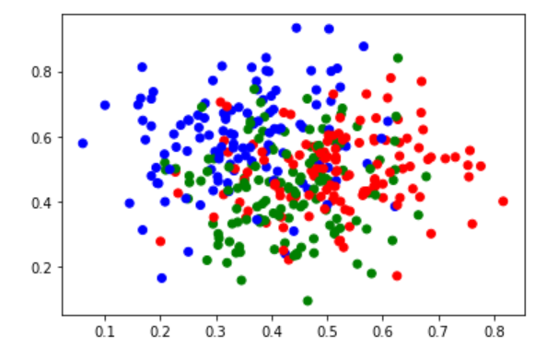
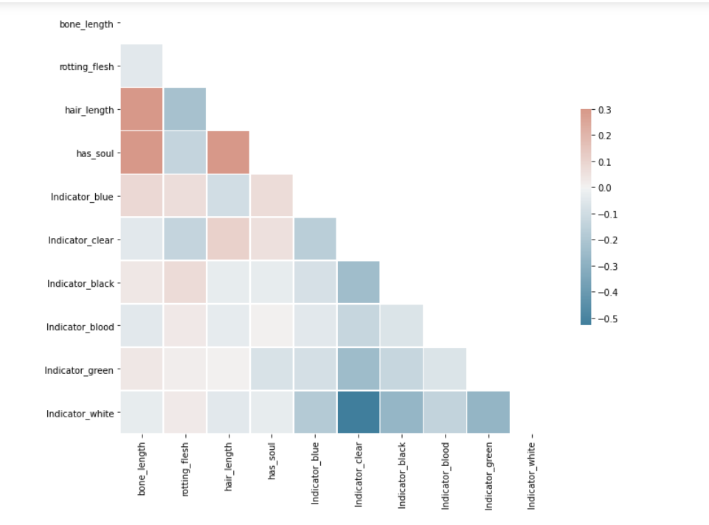
Data Visualizations
Notes:
© Copyright PresentationGO.com – The free PowerPoint and Google Slides template library

Slide 10
Actionable Insights
Data was analyzed as northwest direction, south direction, etc in scatter plot
Which is better?
There are mild correlations. Higher bone length means higher hair length. More soul has more hair. More bone length has more soul.
Regularized logistic gives highest accuracy of 73%
### When bone length is more, hair length is also more
### hair length and rotting flesh are negatively correlated
Notes:
© Copyright PresentationGO.com – The free PowerPoint and Google Slides template library

