Slide 1

Wine Data Analysis
Shweta Gupte@ INSAID

Slide 2

Introduction
Setup
Import
Read
Understand
Missing Values
Variables/ Data Visualization
Histogram
Correlation Matrix
Covert to Classification problem
Proportion of Good versus bad Wines
Preparing data for modelling
Split data
Modelling
Decision Tree
Conclusion
Actionable Insight

Slide 3



Wine data
Dataset link: https://raw.githubusercontent.com/insaid2018/Term-1/master/Data/Projects/winequality.csv
Problem Statement
It is very difficult to assess the quality of wine just by reading the label. Quality is assessed best by tasting. but as we have dataset which contains different ingredient of wine and also we have Quality of Wine column. So based on that we will try to find out what should be level of various ingredients to get the best quality of wine.

Slide 4
Setup Installs and libraries
import pandas as pd # Importing package pandas (For Panel Data Analysis)
from pandas_profiling import ProfileReport # Import Pandas Profiling (To generate Univariate Analysis)
import numpy as np # Importing package numpys (For Numerical Python)
#-------------------------------------------------------------------------------------------------------------------------------
import matplotlib.pyplot as plt # Importing pyplot interface to use matplotlib
import seaborn as sns # Importing seaborn library for interactive visualization
%matplotlib inline
#-------------------------------------------------------------------------------------------------------------------------------
import scipy as sp # Importing library for scientific calculations
#-------------------------------------------------------------------------------------------------------------------------------

Slide 5
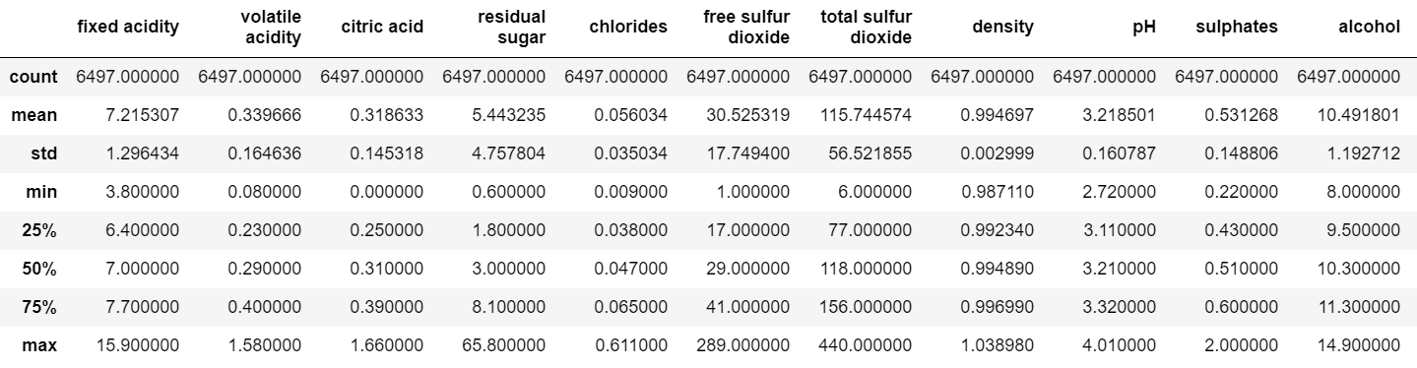
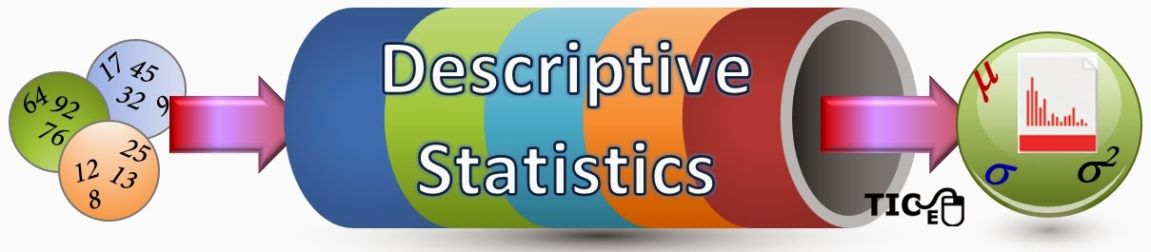

Slide 6
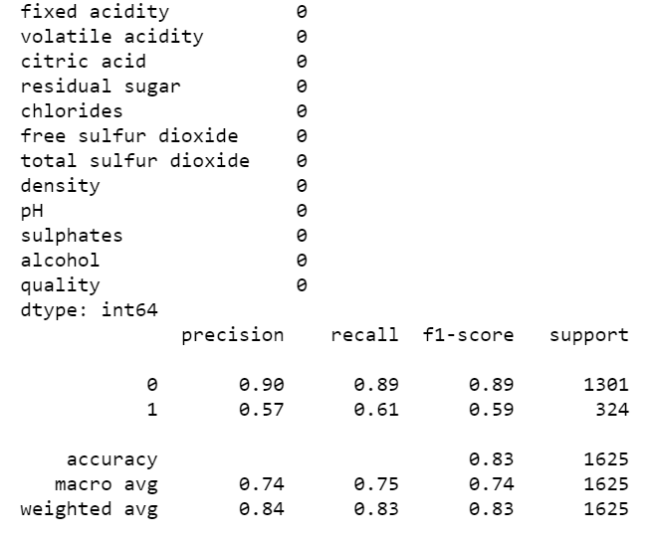
Missing value insight

Slide 7
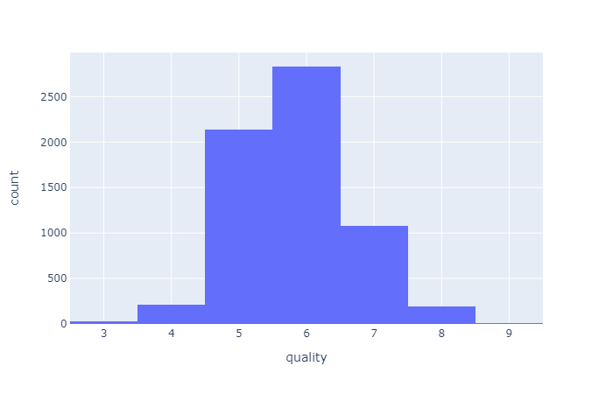
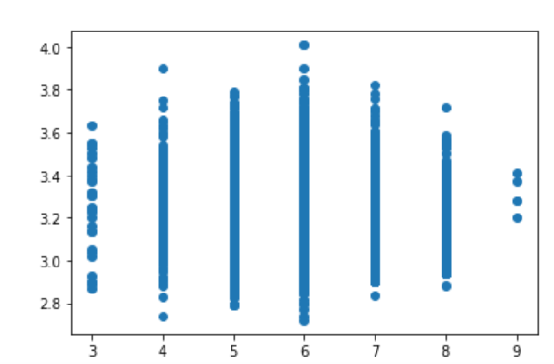
Scatter Plot
Histogram

Slide 8
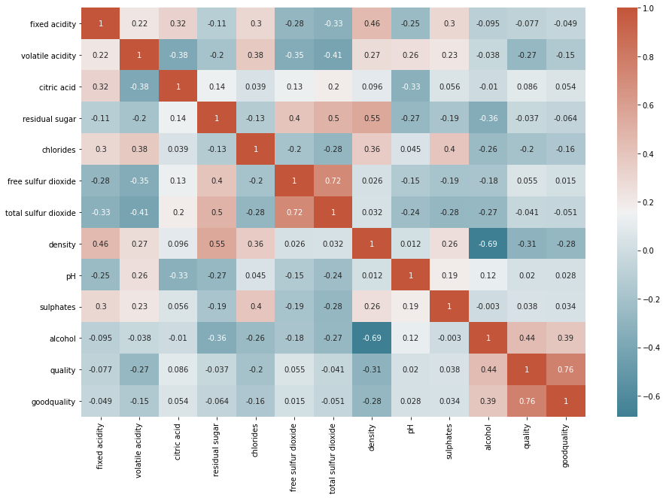
Correlation matrix

Slide 9
Logistic model
Based on correlation matrix | fixed acidity volatile acidity citric acid residual sugar chlorides free sulfur dioxide total sulfur dioxide density pH sulphates alcohol Logistic Model Values (array([[ 0.55060711, -0.55250758, -0.04509545, 0.81393336, -0.21771001, 0.22445839, -0.32719064, -0.87626643, 0.3733765 , 0.36500512, 0.70143703]]), array([-1.89957508])) | Q3 | Q4
alcohol n quality have positive correlation | fixed acidity more means more quality | citric acid more means lower quality | chlorides free means lower quality
density n quality have negative correlation | volatile acidity more means less quality | more residual sugar means more quality | more sulfur dioxide means more quality

Slide 10
Conclusion:
more total sulfur dioxide means lower quality
higher density means lower quality
higher pH means better quality
sulphates means better quality
higher alcohol means better quality
Actionable insight:
Sell the younger generation low density but high alcohol content wine as this gives a kick which is bearable to younger body and vise versa for older folks

