Slide 1
FLEXIPLE PRODUCT INTERN ASSIGNMENT · PRE-ALPHA PROTOTYPE
GCC Atlas — India’s GCC ecosystem, made searchable.
Provenance-first city, policy and company comparison for India capability-centre decisions:
every number carries its source, its date, and its counting denominator.
WORKING TITLE — name collision flagged (S38)
COMPOSITES FROM EVIDENCE — NO INTERVIEWS CONDUCTED
GCCS (PARENT-LEVEL)
GCC UNITS
OF 2025 OFFICE ABSORPTION
GCC REVENUE FY26
2,117
3,728
39%
$98.4B
FY2026 · S01/S02
FY2026 · S01
CBRE · S20
Nasscom–Zinnov · S02
Prototype runs from repo: `npm run setup && npm run seed && npm run dev:api` + `npm run dev:web` · Walkthrough: deployment/demo-walkthrough.md

Slide 2
PROBLEM CONTEXT & MARKET FRICTION
The problem: fragmented intelligence, costly decisions
India’s GCC ecosystem is large, fast and definitionally messy — the decision layer above company directories is nowhere assembled.
GCCS PARENT-LEVEL FY2026
FY2026 REVENUE
OF 2025 OFFICE-ABSORPTION IS GCCS
2,117
$98.4B
39%
Nasscom–Zinnov · S01/S02
same series · S02; 3 adds independent confirm
CBRE leasing records · S20/S22
▪ 8+ state policies in 8+ formats. Karnataka, TN, UP, Gujarat, Kerala… each publish subsidy tables in different shapes (payroll %, land subsidy, stamp duty, OPEX caps) — normalizing them is manual analyst work (S05–S19).
▪ Counting regimes conflict. 2,117 GCCs / $98.4B (Nasscom–Zinnov, S02) vs "$164B / 4.2M jobs" (Wizmatic via Statesman, S04 — low-confidence definitional outlier, registered as a conflict, never averaged).
▪ The comparison is done by consultants on 3–6-week cycles. A build-vs-lease decision uses brokerage PDFs + press releases + Excel (S01, S24); a defensible shortlist with citations takes weeks of analyst hours.
▪ Source quality varies wildly across DIY databases. DIY city directories contain row-level coding mistakes (GCC Village: ~473 Hyderabad vs ~100 Bengaluru rows, S35) that can severely misinform a location business case.
Everything above is cited; no market-size figure on this slide is our own estimate. All source IDs refer to research/source-register.csv.
GCC Atlas (working title) — Flexiple Product Intern assignment · pre-alpha prototype · sources: research/source-register.csv (S##)
02 / 13

Slide 3
STAKEHOLDERS (composite personas, evidence-based)
Who feels the information asymmetry
PRIMARY — designed for
secondary — served
secondary — served
Priya Raman
Rakesh
Maya
Location-strategy lead, MNC expansion desk
State investment-promotion (IPA) officer
Provider / enabler BD lead (RE, legal, staffing)
– Translates global headcount mandate → Indian city criteria
– Needs ranked candidate cities with talent, cost & subsidy facts
– Must defend shortlists to CFO, tax team & external consultants
– Fears "why does your slide contradict the broker report?" in review
– Competes vs peer states with hard numbers, not policy slogans
– Wants a shareable, credible neutral link for prospective investors
– Fears third-party commercial tables painting the state unfairly
– Wants verified, ready-to-engage corporate demand signals
– Currently pays $3.5K–$10K/year for commercial lead surfaces (S30)
– v1 gives her nothing to pay for — credibility & trust cultivated first
Basis: 64% of GCC space take-up by her class of buyer (S20,S21); UK/US firms drive 37–45% of India office absorption (S24). Composites; no interviews conducted.
Basis: 8+ states run active GCC-acquisition playbooks with published targets (S05,S10,S13,S16). Secondary persona — distribution catalyst in v1.
Basis: GCC Explorer monetizes exactly this class (S30); AIM watchlists purchased by this class (S32). Provider neutrality is an enforced rule.
Anti-personas by design: job-seekers (no JTBD) and competitor scrapers. Everything persona-labelled as [inference] through Phase-3 validation gates.
GCC Atlas (working title) — Flexiple Product Intern assignment · pre-alpha prototype · sources: research/source-register.csv (S##)
03 / 13

Slide 4
COMPETITIVE LANDSCAPE (verified, S30–S38)
Current workarounds and where they stop
GCC Explorer (AIM Research)
Consultancies (CBRE/JLL/Zinnov)
1,680+ GCC directory, daily analyst updates, contacts, watchlists. $3,500–$10,000 per seat cycle; free tier = 15 companies (S30/S31/S32).
Authoritative bespoke decks; mandates; deep local nuance (S01, S20–S24).
Their gap: Not a city-DECISION tool: no policy-incentive normalization, no side-by-side compare with counting denominators (S30 pages reviewed).
Their gap: Time + high fees; 3–6 week project cycles; not self-serve at session speed.
State portals + PIB PDFs
DIY directories (GCC Village et al.)
Primary-source truth; free access (S05–S19).
Free coverage slices; open directory tables (S35–S37).
Their gap: 8+ formats; conflicting denominators; normalizing incentives is analyst hours.
Their gap: Row-level coding inconsistencies (S35); unverified data; zero provenance links.
White space we occupy: a free, provenance-linked city-vs-city comparison layer with explicit counting denominators — no verified analog exists across the scanned landscape.
GCC Atlas (working title) — Flexiple Product Intern assignment · pre-alpha prototype · sources: research/source-register.csv (S##)
04 / 13

Slide 5
SCORING (research/opportunity-prioritization.md)
Opportunity map and prioritization
WINNER: O2 — the decision layer
4.40
▪ City atlas + location-comparison is the most underserved, most buildable surface (O2 score 4.40).
▪ O1 directory and O3 policy tracker ship as supporting modules inside it.
▪ Deliberately excluded: contact-data resale (O6: name/legal risk, S38), watchlists/O4 (needs live crawler infrastructure), comp-band library (O5: licensing cost, Phase-3 candidate).
▪ Falsification path: if a real expansion desk says an ad-hoc spreadsheet already solves their need, we pivot to O4 (documented in research §6).
4.30
4.15
3.60
3.30
3.10
1.40
O2 City atlas
O1 Directory
O3 Policy tracker
O5 Comp bands
O4 Watchlist
O7 AI report
O6 Contacts resale
Scores = weighted TAM / underservedness / public-data feasibility / prototype fit / risk (weights 20/30/25/15/10). Method + rubric documented in research/opportunity-prioritization.md.
GCC Atlas (working title) — Flexiple Product Intern assignment · pre-alpha prototype · sources: research/source-register.csv (S##)
05 / 13

Slide 6
PRIMARY SEGMENT (evidence-based composite)
Initial target customer and the job to be done
Job statement (from primary persona)
Why this segment first
“Compare candidate cities for a new GCC — talent, policies, real-estate cost and sector peers — for a specific function, with every number carrying its counting denominator and its source.”
▪ Documented demand density: US/global firms drove 37–45% of recent office absorption; this class routinely pays for location advisory (CBRE/JLL advisory hours S20–S24; GCC Explorer $3.5K–$10K S30).
▪ Severe workflow friction: 8+ state policy formats + conflicting market counts = exactly the information asymmetry documented in market-research §2–3.
▪ Reachable without paid ads: via state IPA relationships + public expansion-team leadership desks [inference].
▪ Measurable acceptance gate: M1 time-to-answer metric (<10 min) is instrumentable end-to-end.
▪ JTBD 1 — Frame: translate parent company mandate → objective city criteria (function, tier, cost ceiling).
▪ JTBD 2 — Shortlist: generate ranked candidate cities with verified facts (talent pool, Grade-A rents, subsidies).
▪ JTBD 3 — Defend: ensure shortlists survive CFO, tax desk, and consultant scrutiny with explicit citations.
▪ JTBD 4 — Act: identify exact IPA contacts and eligible subsidy bands (TN 30/20/10% payroll bands S06; UP ₹20k/fresher S10).
[inference] items bound for Phase-3 validation interviews
GCC Atlas (working title) — Flexiple Product Intern assignment · pre-alpha prototype · sources: research/source-register.csv (S##)
06 / 13

Slide 7
PRODUCT WORKFLOW · RAW DATA TO BOARD-READY OUTCOMES
From Fragmented Data to Defensible Decisions
STAGE 1
STAGE 2
STAGE 3
STAGE 4
1. SCATTERED PUBLIC DATA
2. NORMALIZATION & PROVENANCE
3. EXPLORATION & CITATION
4. DEFENSIBLE DECISION
Unstructured Raw Input
GCC Atlas Data Engine
Interactive Decision Surface
Intended Outcome [Hypothesis]
▪ Disparate PDF formats: 8+ state Government Orders (G.O.s) with incompatible subsidy structures (S05–S19).
▪ Brokerage PDF reports: Fragmented real estate asking rents and vacancy rates across CBRE, JLL, Colliers (S20–S24).
▪ Conflicting counts: Nasscom 2,117 GCCs vs Wizmatic $164B/4.2M outlier (S02 vs S04).
▪ Friction: Analysts waste 3–6 weeks hunting, copying, and reconciling unformatted sources.
▪ Unit standardization: Grade-A rents normalized to INR/sqft/mo; talent pools to headcount; subsidies to uniform schemas.
▪ Definitional labeling: Every metric explicitly tagged with counting denominator (e.g. parent entities vs units).
▪ Source hashing: Immutable link to publisher, publication date, verification date, and confidence level.
▪ Seed linter: Hard code invariant halts builds if any displayed figure lacks provenance (F6).
▪ Side-by-side matrix: Compare 2–4 cities with explicit EST flags, metric definitions, and state policy clauses.
▪ Bounded AI assistant: RAG engine strictly constrained to retrieved evidence packs; hallucinated citation IDs stripped.
▪ Recommendation split: Factual evidence cleanly separated from strategic guidance; declines if data is thin.
▪ Shareable sessions: URL state (?ids=) and server-scoped persistence for cross-stakeholder collaboration.
▪ 3–6 weeks → 1 session: Target: condense initial location shortlisting from weeks to <10 minutes (M1 instrumented).
▪ Board-ready audit trail: Every cell, subsidy band, and quote carries clickable primary-source backing.
▪ Zero broker bias: Neutral comparator free of pay-to-play rankings or sponsored placements.
▪ Credibility boundary: [INTENDED OUTCOME — UNVALIDATED IN PHASE 2; scheduled for Phase-3 MNC desk trials].
Workflow maps research/market-research.md to product architecture. Stage 4 outcomes are explicitly tagged as intended targets awaiting Phase-3 validation.
GCC Atlas (working title) — Flexiple Product Intern assignment · pre-alpha prototype · sources: research/source-register.csv (S##)
07 / 13

Slide 8
WHAT IS BUILT (running pre-alpha prototype)
The product and its differentiated value proposition
One line: evidence-first India GCC location intelligence — the decision layer above directories, below bespoke consulting ("free to look, defensible to reuse").
City Intelligence
Policy matrix
Provenance everywhere
12 tracked cities × 6+ metrics; side-by-side compare of 2–4 cities w/ metric definitions, units and EST flags.
State incentives normalized vs source G.O.s; draft/final states distinct; "not yet tracked" ≠ 0 (Kerala dual targets co-labelled, S16 vs S18).
46 GCC records, 36 sources; every figure → source chip → publisher, URL, pub date, verification date, confidence.
dataset: tracked records only (scope-labelled)
seed linter fails build on sourceless values
Cited AI assistant
Saved research + share
Event instrumentation
Retrieval-pack answers; only retrieved evidence may be cited; hallucinated IDs stripped (tested); recommendations separated; declines when thin.
Session-scoped server-side persistence (cross-session isolation tested); shareable deep links; CSV export.
PRD §3.5 catalog (search, detail_view, compare_create, source_click, export, saved_create…) — hashed session keys; aggregate admin.
demo mode composes deterministically without key
All coverage claims are dataset-scope-labelled; the app never claims the 2,117 national count as its own data.
GCC Atlas (working title) — Flexiple Product Intern assignment · pre-alpha prototype · sources: research/source-register.csv (S##)
08 / 13

Slide 9
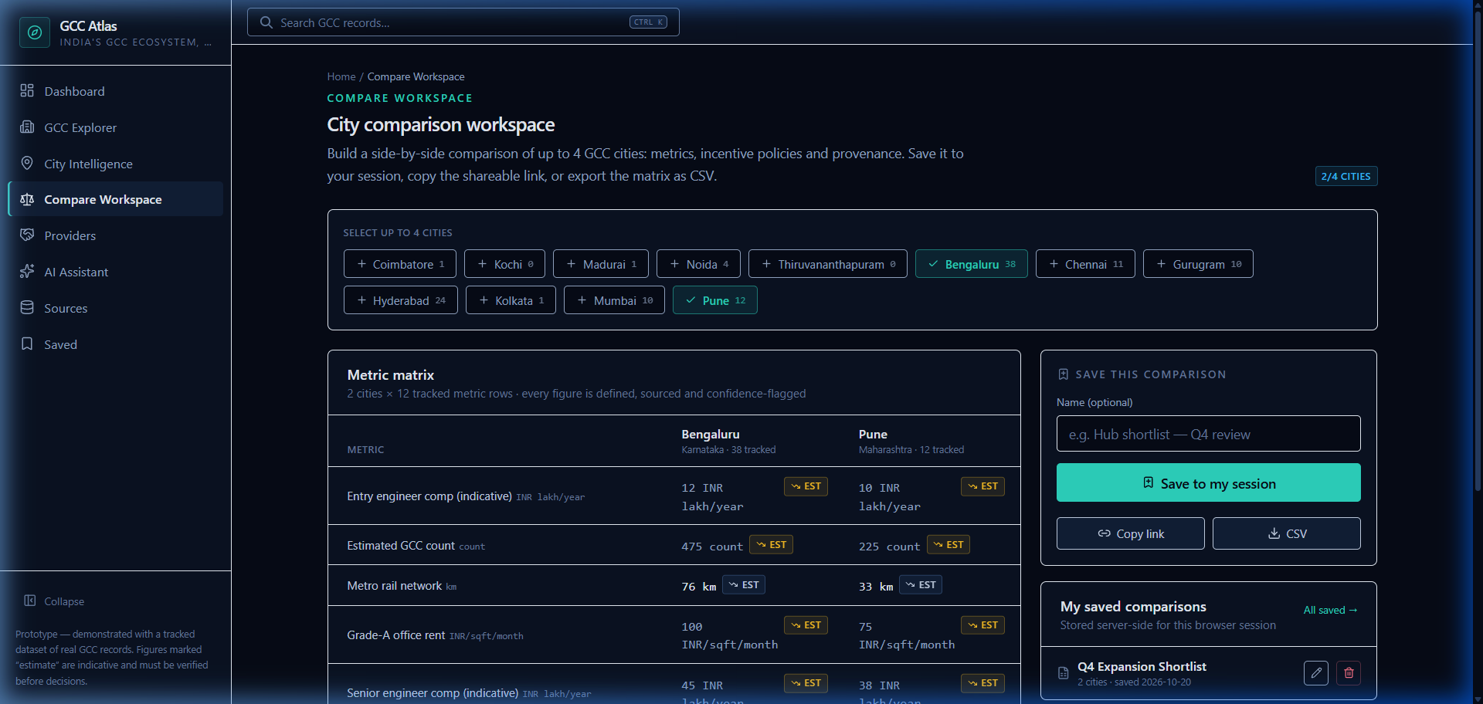
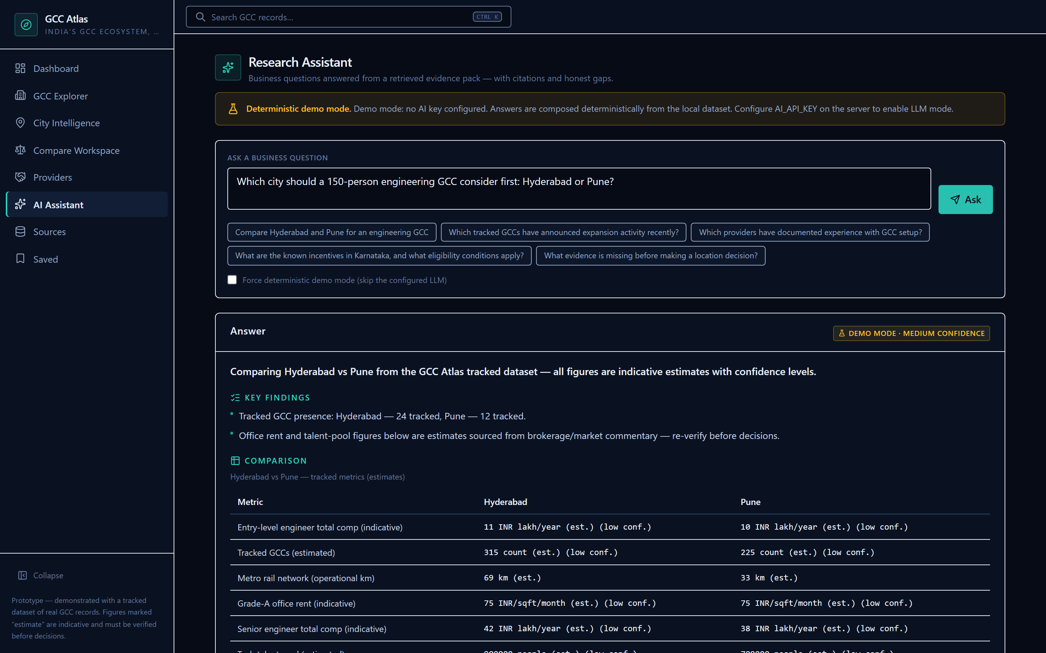
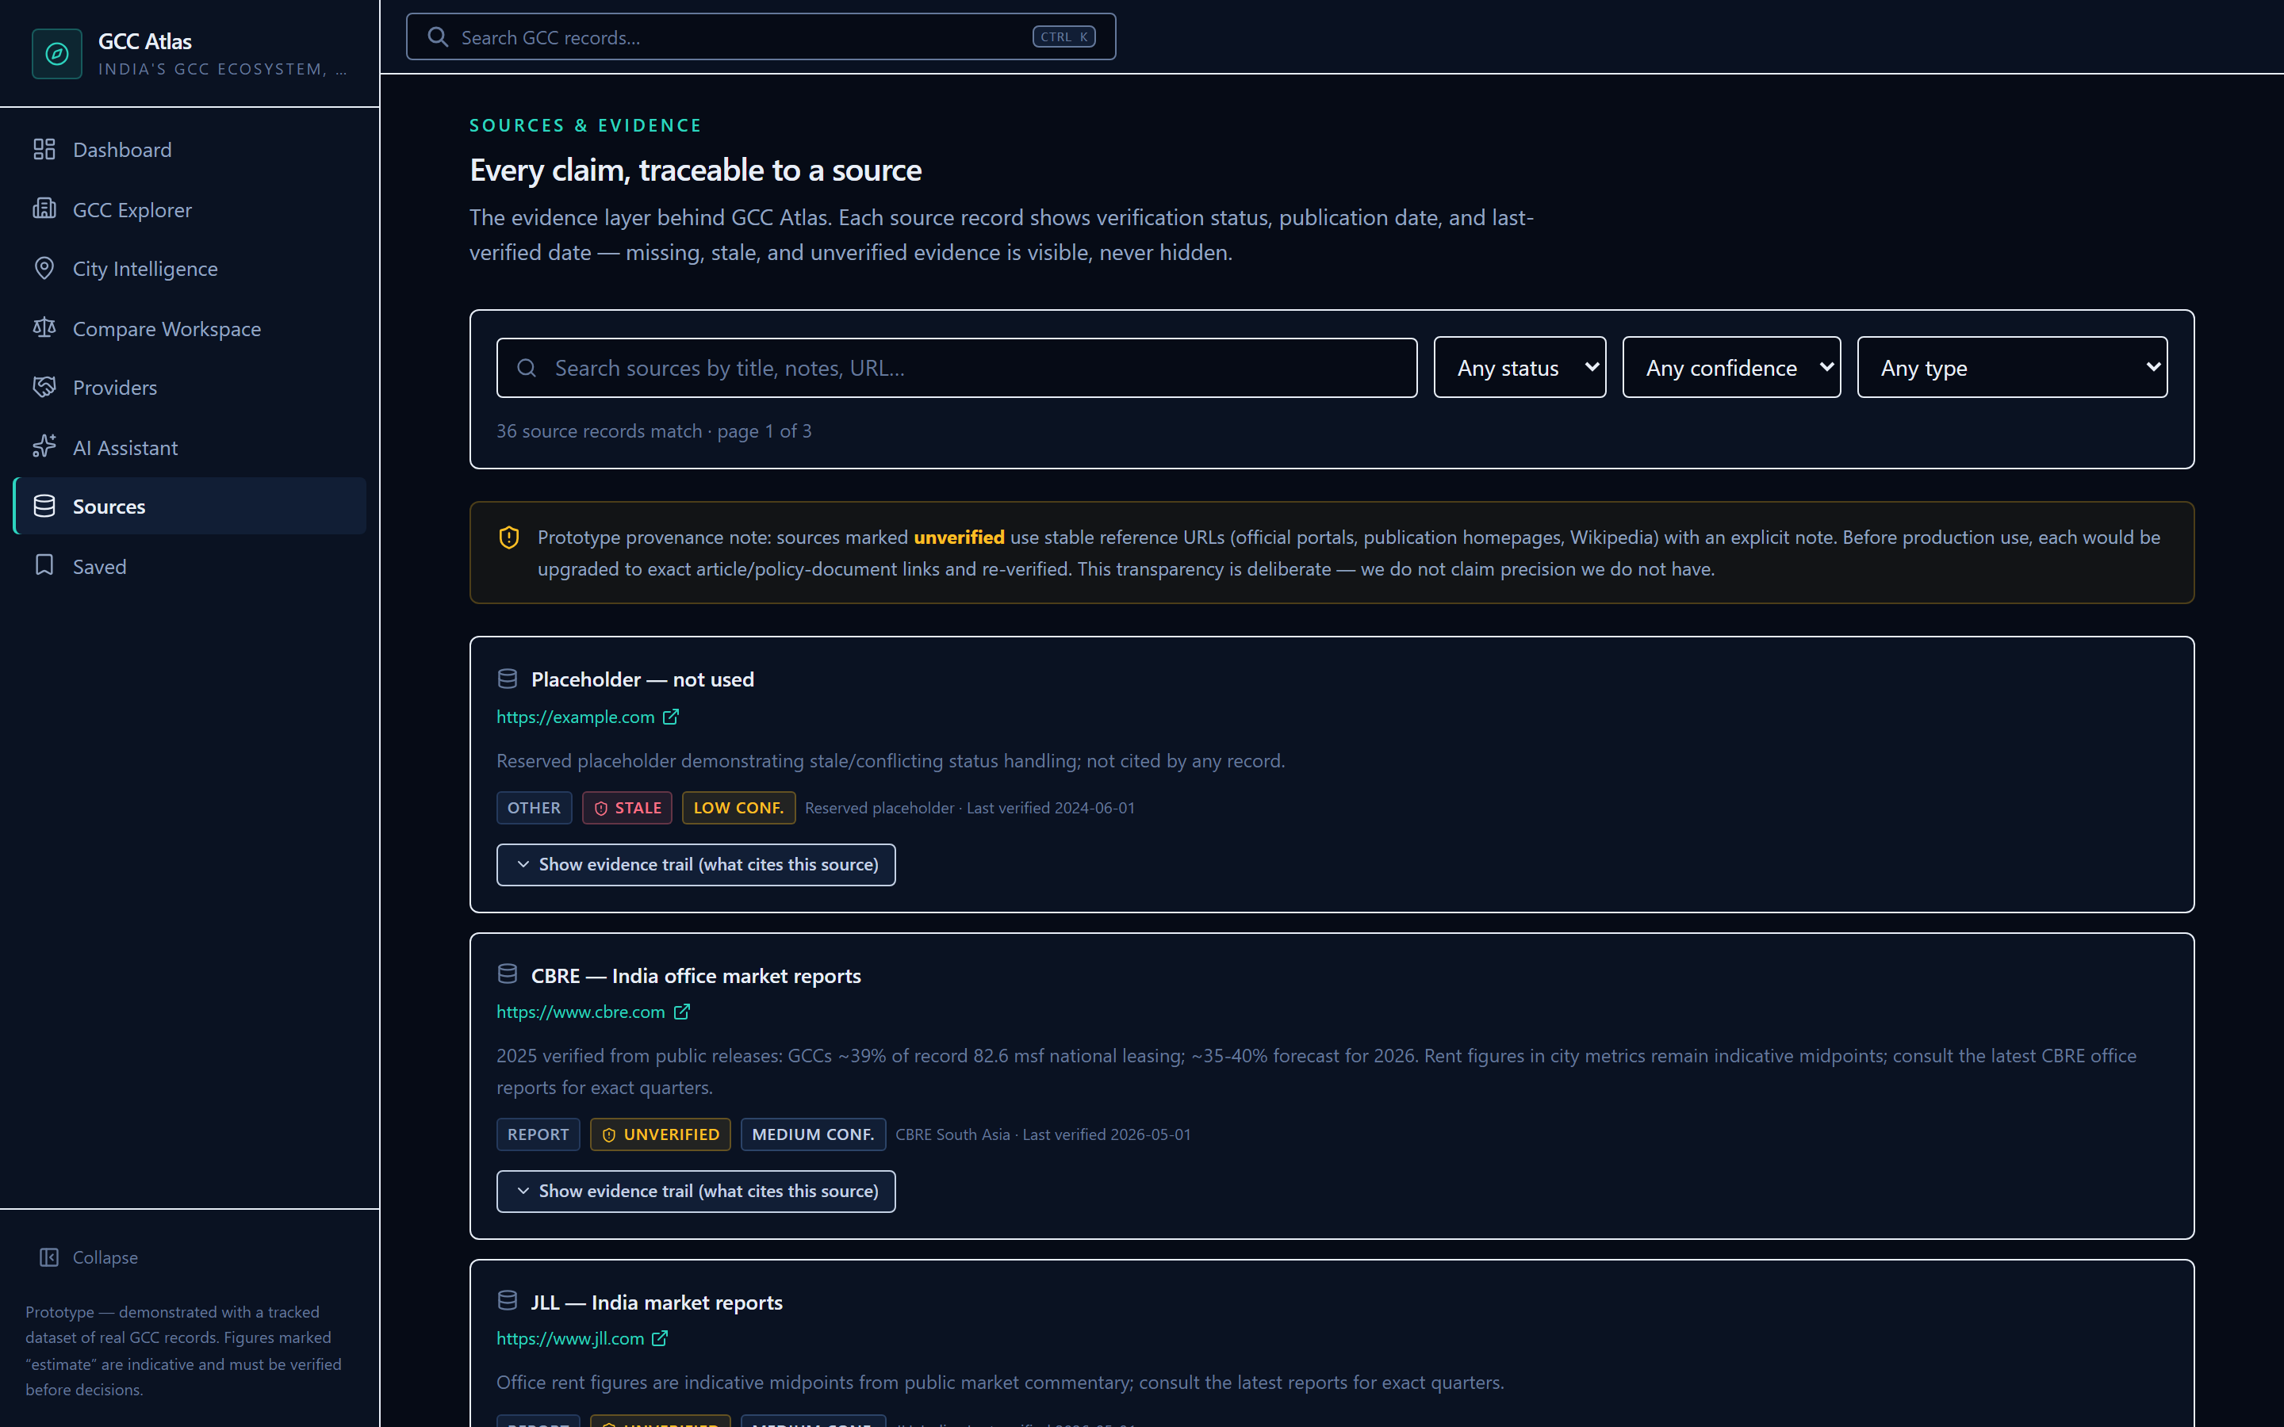
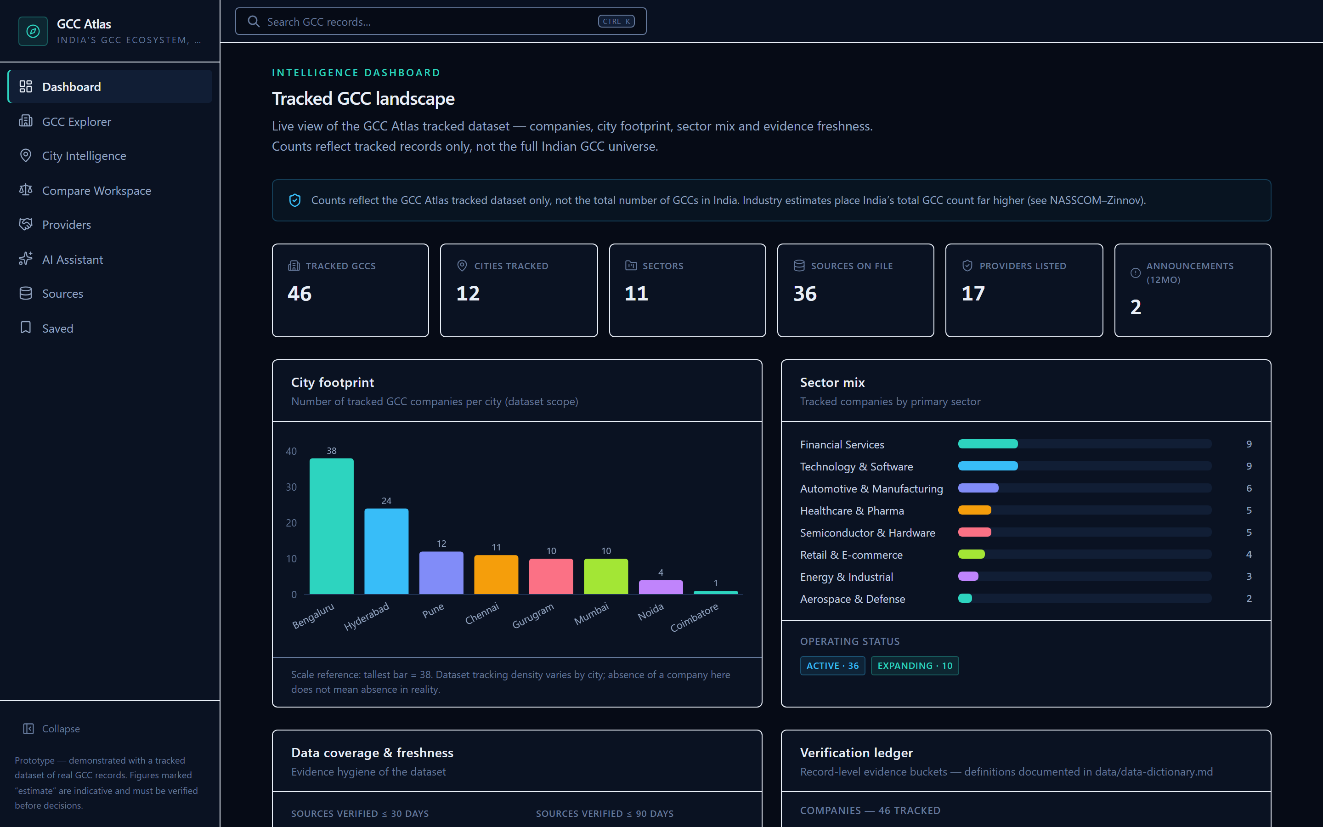
SCREENSHOTS & MODULE RATIONALE (running pre-alpha build captures)
Product walkthrough — genuine prototype captures
1. City Comparison Workspace
DECISION MATRIX
2. AI Research Assistant
BOUNDED RAG
▪ What it does: Side-by-side metric matrix (talent pool, Grade-A rents, comp, infra) and normalized state incentive policies across 2–4 selected cities with shareable URL parameters and CSV export.
▪ Problem: Manual multi-week reconciliation across 8+ incompatible state government orders (G.O.s), brokerage PDFs, and ad-hoc analyst spreadsheets.
▪ Why built this way: Explicit EST flags, hoverable counting definitions, and transparent source citations ensure shortlists survive CFO and consultant scrutiny without hidden broker bias.
▪ What it does: Retrieval-augmented query engine answering multi-city and expansion questions using strict local evidence packs with verified citation chips and separated recommendations.
▪ Problem: Generic LLM hallucinations, fabricated policy figures, and untraceable advisory recommendations in executive decision memos.
▪ Why built this way: Hard code invariant strips non-retrieved citation IDs, separates recommendations from factual basis, and features a deterministic demo fallback ensuring 100% auditability without third-party API keys.
3. Sources & Evidence
AUDIT REGISTER
4. GCC Intelligence Dashboard
ECOSYSTEM OVERVIEW
▪ What it does: Comprehensive provenance registry detailing publisher, publication date, verification status, confidence rating (high/med/low), and reverse "where cited" cross-links.
▪ Problem: Opaque market figures, zombie statistics, and conflicting definitions (e.g. 2,117 GCC parents vs 3,728 units) with zero provenance.
▪ Why built this way: Establishes defensibility and user trust before monetization; automated seed linter halts builds on sourceless numeric claims.
▪ What it does: High-level ecosystem overview tracking 46 verified GCCs across 12 cities and 11 sectors, paired with an active data freshness ledger and policy status tracker.
▪ Problem: Conflation of sampled directory records with national market census figures, leading to misleading location business cases.
▪ Why built this way: Prominent dataset-scope banner and verification ledger distinguish tracked sample data from the national 2,117 universe.
Screenshots captured from live prototype build (Compare verified with Bengaluru 38 tracked / Karnataka policy). Module cards communicate core functional JTBD & design rationale.
GCC Atlas (working title) — Flexiple Product Intern assignment · pre-alpha prototype · sources: research/source-register.csv (S##)
09 / 13

Slide 10
GO-TO-MARKET SEQUENCING [most steps are hypotheses]
Positioning and stakeholder adoption strategy
Category we aim to create: "evidence-first India GCC location intelligence" — decision layer above directories, below bespoke consulting. We never out-claim Nasscom–Zinnov/CBRE; their data is our source of record (competitive-landscape §4).
1. IPAs share
2. Providers inspect
3. Expansion desks adopt
Free, cited compare links let state IPAs position themselves fairly vs peer states — they become our distribution catalysts (no ad spend needed, S05–S19; S12 shows IPAs actively pitch at NASSCOM events).
Provider/BD leads verify market claims pre-meeting (this class already pays $3.5K–$10K for similar surfaces, S30 — organic awareness follows the free tier).
Priya-style desks self-serve pre-work, arrive at consultant conversations evidence-armed; conversion to paid only AFTER free-tier trust (M1/M3 instrumented).
What we deliberately DON’T do: no paid ranking anywhere facts are shown (trust contract), no bulk contact-data resale (O6, name/legal risk S38), no interviews implied in any deck claim (Phase-3 validates all [inference] tags).
GCC Atlas (working title) — Flexiple Product Intern assignment · pre-alpha prototype · sources: research/source-register.csv (S##)
10 / 13

Slide 11
ALL PRICING = [proposal], UNVALIDATED
Business-model hypotheses and go-to-market
H1 · Free core (now)
H2 · Pro seats [proposal]
City compare + policy matrix + source register stay free. Reputation density is the wedge; paying for data pre-trust kills it (business-model §1).
$99–$199/yr individual; $500–$2,000/yr teams of 3–5 — anchored at 3–6% of market comparables’ $3.5K–$10K cycles (S30). Gate: free-tier traction first.
H4 · Reports [proposal]
H5 · Provider verified [proposal]
Free quarterly standard; $299–$499 thematic deep-dives once publishing muscle exists (market precedent: free quarterly exists S31; historic $9,999 static lists S33).
$199–$499/yr verified-profile attributes only — zero influence on rankings/answers; banned-paid-ranking is an immutable product rule (business-model §4).
GTM hypotheses [proposal, no spend]: content-catalyst loop (share links) + expansion-desk outreach + token funnel metrics (M3 search→detail ≥40%; M1 median <10 min — BOTH are unvalidated targets until Phase 3 instrumentation reports).
GCC Atlas (working title) — Flexiple Product Intern assignment · pre-alpha prototype · sources: research/source-register.csv (S##)
11 / 13

Slide 12
GUARDRAILS THE BUILD ACTUALLY ENFORCES
Data trust, AI reliability, risks and success metrics
Trust contract (enforced in code, not just values)
Risks + metrics (targets are [proposals])
▪ Every figure sourced: seed linter FAILS the build on a sourceless value (F6); provenance chips on all numeric surfaces.
▪ Denominators labelled: "GCCs, parent vs units" named at every count (S01/S02-style conflict rendered, never averaged).
▪ Conflicts co-shown: $98.4B (S02) vs $164B (S04) both visible, flagged as contested.
▪ Missing ≠ zero: "not yet tracked", draft policies flagged; placeholder sources labelled "stale".
▪ AI cites or declines: only retrieved evidence citable; unknown citation IDs stripped in tests; insufficiency is an honest low-confidence path; recommendations never blended into facts.
▪ Coverage honesty: 46-company tracked subset; never billed as "all 2,117 GCCs" (S02/S30 context).
▪ Name collision: gcc-atlas.com exists (S38) — working-title label everywhere; trademark check is a Phase-3 gate.
▪ Data freshness: verify-by dates shown; manual re-verification pass scheduled at submission.
M1
Time-to-answer < 10 min [proposal]
M2
100% of displayed figures carry sources (hard invariant); assistant ≥95% answered w/ ≥1 citation [proposal]
M3
Search→detail ≥40% [proposal]
M4-M6
compare/assistant/provider engagement + no-paid-ranking guardrail countermetrics
GCC Atlas (working title) — Flexiple Product Intern assignment · pre-alpha prototype · sources: research/source-register.csv (S##)
12 / 13

Slide 13
PHASE GATES (product/roadmap.md)
Roadmap, prototype and next steps
Phase 2 — DONE: working prototype
Phase 3 — validation loop
Phase 4 — paid options (gated)
▪ Research → strategy → full build (Phases 1–8)
▪ Retrieval→citation pipeline + demo fallback
▪ Rate limits, events, session ACL, QA report (108/108 tests green)
▪ Deployment guide + render.yaml + this deck
▪ 0→1 interviews to replace [inference] tags (5+ expansion desks, 2+ IPAs)
▪ Re-calibrate M1/M3 targets from real funnel data
▪ Trademark check (S38) → rename-or-keep decision
▪ H2 seats only after free-traction gate; H3 workspaces; H5 provider profiles under neutrality rules
▪ Monitoring layer F17 if O2 survives falsification tests
The bet, honestly framed: the market is undeniably real and growing; the intelligence layer above it is fragmented and expensive; a discipline-first free comparator is buildable and differentiated. What we have NOT proven: demand (no interviews), willingness-to-pay (proposals only), and defensibility against a fast follower. Every one of those is instrumented to be falsifiable in Phase 3 — which is the point.
Prototype + demo script: deployment/demo-walkthrough.md · QA evidence: qa/quality-report.md · Full evidence register: research/source-register.csv · Deck sources: product/deck-evidence-sources.md
GCC Atlas (working title) — Flexiple Product Intern assignment · pre-alpha prototype · sources: research/source-register.csv (S##)
13 / 13

