Slide 1
FLEXIPLE PRODUCT INTERN ASSIGNMENT · PRE-ALPHA PROTOTYPE
GCC Atlas — India’s GCC ecosystem, made searchable.
Provenance-first city, policy and company comparison for India capability-centre decisions:
every number carries its source, its date, and its counting denominator.
WORKING TITLE — name collision flagged (S38)
COMPOSITES FROM EVIDENCE — NO INTERVIEWS CONDUCTED
GCCS (PARENT-LEVEL)
GCC UNITS
OF 2025 OFFICE ABSORPTION
GCC REVENUE FY26
2,117
3,728
39%
$98.4B
FY2026 · S01/S02
FY2026 · S01
CBRE · S20
Nasscom–Zinnov · S02
Prototype runs from the repo: `npm run setup && npm run seed && npm run dev:api` + `npm run dev:web` (full walkthrough: deployment/demo-walkthrough.md)

Slide 2
PROBLEM
The problem: fragmented intelligence, costly decisions
India’s GCC ecosystem is large, fast and definitionally messy — the decision layer above company directories is nowhere assembled.
GCCS PARENT-LEVEL FY2026
FY2026 REVENUE
OF 2025 OFFICE-ABSORPTION IS GCCS
2,117
$98.4B
39%
Nasscom–Zinnov · S01/S02
same series · S02; 3 adds independent confirm
CBRE leasing records · S20/S22
▪ 8+ state policies in 8+ formats. Karnataka, TN, UP, Gujarat, Kerala… each publish subsidy tables in different shapes (payroll %, land subsidy, stamp duty, OPEX caps) — normalizing them is manual analyst work (S05–S19).
▪ Counting regimes conflict. 2,117 GCCs / $98.4B (Nasscom–Zinnov, S02) vs "$164B / 4.2M jobs" (Wizmatic via Statesman, S04 — low-confidence definitional outlier, registered as a conflict, never averaged).
▪ The comparison is done by consultants on 3–6-week cycles.A build-vs-lease decision uses brokerage PDFs + press releases + Excel (S01, S24); a defensible shortlist with citations can take weeks to assemble.
▪ Source quality varies wildly. DIY city directories contain row-level coding mistakes (GCC Village: ~473 Hyderabad vs ~100 Bengaluru rows, S35) that can misinform a location case.
Everything above is cited; no market-size figure on this slide is our own estimate.
GCC Atlas (working title) — Flexiple Product Intern assignment · pre-alpha prototype · sources: research/source-register.csv (S##)
02 / 12

Slide 3
STAKEHOLDERS (composite personas, evidence-based)
Who feels the information asymmetry
PRIMARY — designed for
secondary — served
secondary — served
Priya Raman
Rakesh
Maya
Location-strategy lead, MNC expansion desk
State investment-promotion (IPA) officer
Provider / enabler BD lead (RE, legal, staffing)
▪ Translates headcount mandate → city criteria
▪ Needs ranked prospects w/ talent + cost + subsidy facts
▪ Must defend the shortlist to CFO + consultants
▪ Fears "why is this number different?" in review
▪ Competes vs peer states with numbers, not slogans
▪ Wants a shareable neutral page for prospects
▪ Fears third-party tables painting the state unfairly
▪ Wants ready-to-engage demand signals
▪ Currently pays $3.5K–$10K for lead surfaces (S30)
▪ v1 gives her nothing to pay for — trust cultivated first
Basis: 64% of GCC space take-up by her class of buyer (S20,S21); UK/US firms drive 37–45% of India office absorption (S24). Composites; no interviews.
Basis: 8+ states run GCC-acquisition playbooks with published targets (S05,S10,S13,S16). Secondary persona — distribution catalyst in v1.
Basis: GCC Explorer monetizes exactly this class (S30); AIM watchlists purchased by this class (S32).
Anti-personas by design: job-seekers (no JTBD) and competitor scrapers. Everything persona-labelled as [inference] through Phase-3 validation gates.
GCC Atlas (working title) — Flexiple Product Intern assignment · pre-alpha prototype · sources: research/source-register.csv (S##)
03 / 12

Slide 4
COMPETITIVE LANDSCAPE (verified, S30–S38)
Current workarounds and where they stop
GCC Explorer (AIM Research)
Consultancies (CBRE/JLL/Zinnov)
1,680+ GCC directory, daily analyst updates, contacts, watchlists. $3,500–$10,000 per seat cycle; free tier = 15 companies (S30/S31/S32).
Authoritative bespoke decks; mandates; human nuance (S01, S20–S24).
Their gap: Not a city-DECISION tool: no policy-incentive normalization, no side-by-side compare with counting denominators (S30 pages reviewed).
Their gap: Time + fees; 3–6 week cycles; not self-serve at session speed.
State portals + PIB PDFs
DIY directories (GCC Village et al.)
Primary-source truth; free (S05–S19).
Free coverage slices (S35–S37).
Their gap: 8+ formats; conflicting denominators; normalization is analyst hours.
Their gap: Row-level coding inconsistencies (S35); unverified; no provenance.
White space we occupy: a free, provenance-linked city-vs-city comparison layer with explicit counting denominators — no verified analog exists across the scanned landscape.
GCC Atlas (working title) — Flexiple Product Intern assignment · pre-alpha prototype · sources: research/source-register.csv (S##)
04 / 12

Slide 5
SCORING (research/opportunity-prioritization.md)
Opportunity map and prioritization
WINNER: O2 — the decision layer
4.40
▪ City atlas + location-comparison is the most underserved, most buildable surface (O2 score 4.40).
▪ O1 directory and O3 policy tracker ship as supporting modules inside it.
▪ Deliberately excluded: contact-data resale (O6: name/legal risk, S38), watchlists/O4 (needs live ingestion infrastructure), comp-band library (O5: licensing cost, Phase-3 candidate).
▪ Falsification path: if a real expansion desk says a one-week spreadsheet solves it, we pivot to O4 (documented in research §6).
4.30
4.15
3.60
3.30
3.10
1.40
O2 City atlas
O1 Directory
O3 Policy tracker
O5 Comp bands
O4 Watchlist
O7 AI report
O6 Contacts resale
Scores = weighted TAM / underservedness / public-data feasibility / prototype fit / risk (weights 20/30/25/15/10). Method + rubric documented in research/opportunity-prioritization.md.
GCC Atlas (working title) — Flexiple Product Intern assignment · pre-alpha prototype · sources: research/source-register.csv (S##)
05 / 12

Slide 6
PRIMARY SEGMENT
Initial target customer and the job to be done
Job statement (from primary persona)
Why this segment first
“Compare candidate cities for a new GCC — talent, policies, real-estate cost and sector peers — for a specific function, with every number carrying its counting denominator and its source.”
▪ Documented demand density: US/global firms drove 37–45% of recent office absorption; this class pays for location intelligence (CBRE/JLL advisory hours, S20–S24; GCC Explorer $3.5K–$10K, S30).
▪ Worst information-workflow fit: 8+ policy formats + conflicting market counts = exactly the asymmetry documented in market-research §2–3.
▪ Reachable for validation via IPA relationships + expansion-team desks (both self-identify publicly) [inference].
▪ Acceptance is measurable: M1 time-to-answer metric is instrumentable end-to-end.
▪ JTBD 1 — Frame: mandate → city criteria (function, tier, cost ceiling).
▪ JTBD 2 — Shortlist: ranked candidates with facts (talent, rent, subsidy).
▪ JTBD 3 — Defend: comparison survives CFO + consultant scrutiny, cited.
▪ JTBD 4 — Act: know exactly which IPA contact / subsidy applies (TN 30/20/10% payroll bands S06; UP ₹20,000/fresher S10).
[inference] items bound for Phase-3 interviews
GCC Atlas (working title) — Flexiple Product Intern assignment · pre-alpha prototype · sources: research/source-register.csv (S##)
06 / 12

Slide 7
WHAT IS BUILT (running prototype)
The product and its differentiated value proposition
One line: evidence-first India GCC location intelligence — the decision layer above directories, below bespoke consulting ("free to look, defensible to reuse").
City Intelligence
Policy matrix
Provenance everywhere
12 tracked cities × 6+ metrics; side-by-side compare of 2–4 cities w/ metric definitions, units and EST flags.
State incentives normalized vs source G.O.s; draft/final states distinct; "not yet tracked" ≠ 0 (Kerala dual targets co-labelled, S16 vs S18).
46 GCC records, 36 sources; every figure → source chip → publisher, URL, pub date, verification date, confidence.
dataset: tracked records only (scope-labelled)
seed linter fails a build on sourceless values
Cited AI assistant
Saved research + share
Event instrumentation
Retrieval-pack answers; only retrieved evidence may be cited; hallucinated ids stripped (tested); recommendations separated, basis-labelled; declines when evidence is thin.
Session-scoped server-side persistence (cross-session isolation tested); share links; CSV export.
PRD §3.5 catalog (search, detail_view, compare_create, source_click, export, saved_create…) — hashed session keys; aggregate admin.
demo mode composes deterministically without a key
All coverage claims are dataset-scope-labelled; the app never claims the 2,117 national count as its own data.
GCC Atlas (working title) — Flexiple Product Intern assignment · pre-alpha prototype · sources: research/source-register.csv (S##)
07 / 12

Slide 8
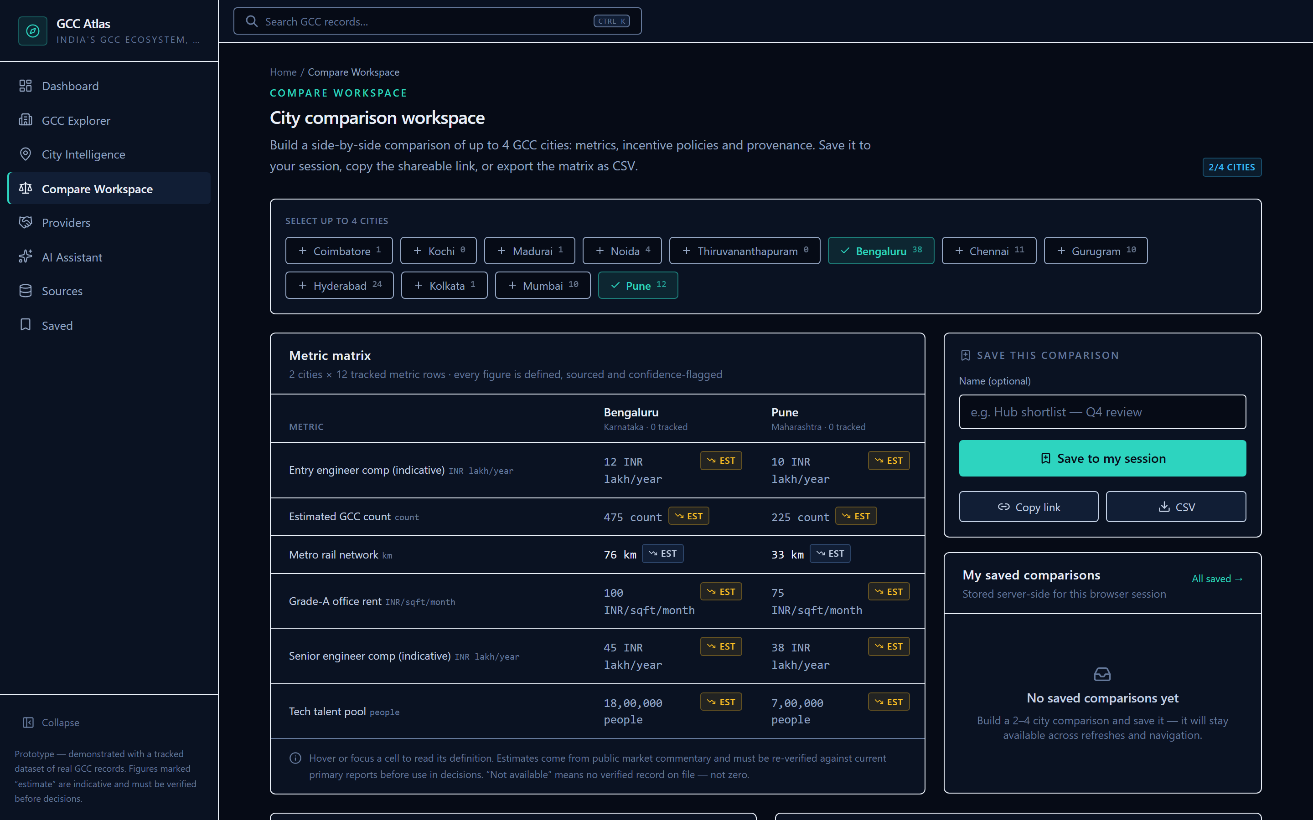
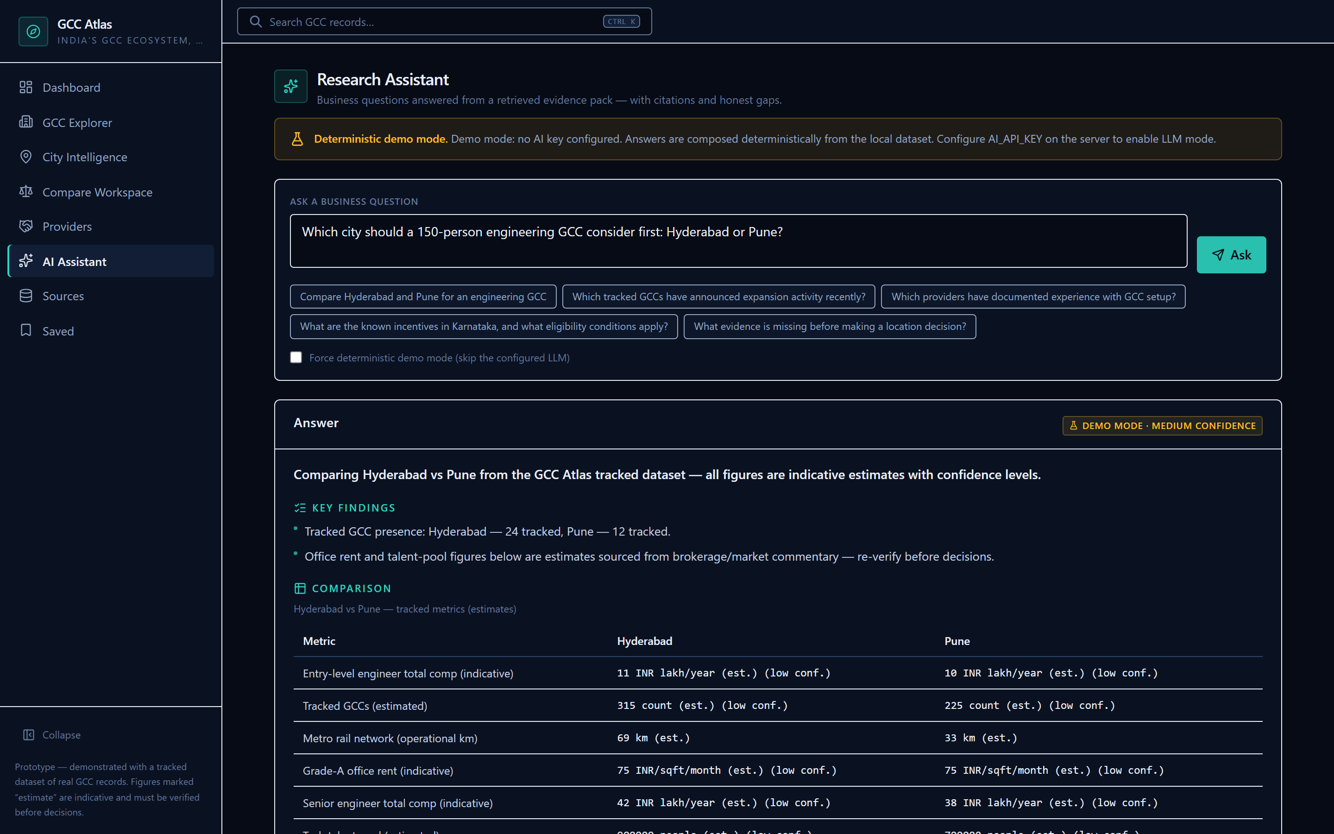
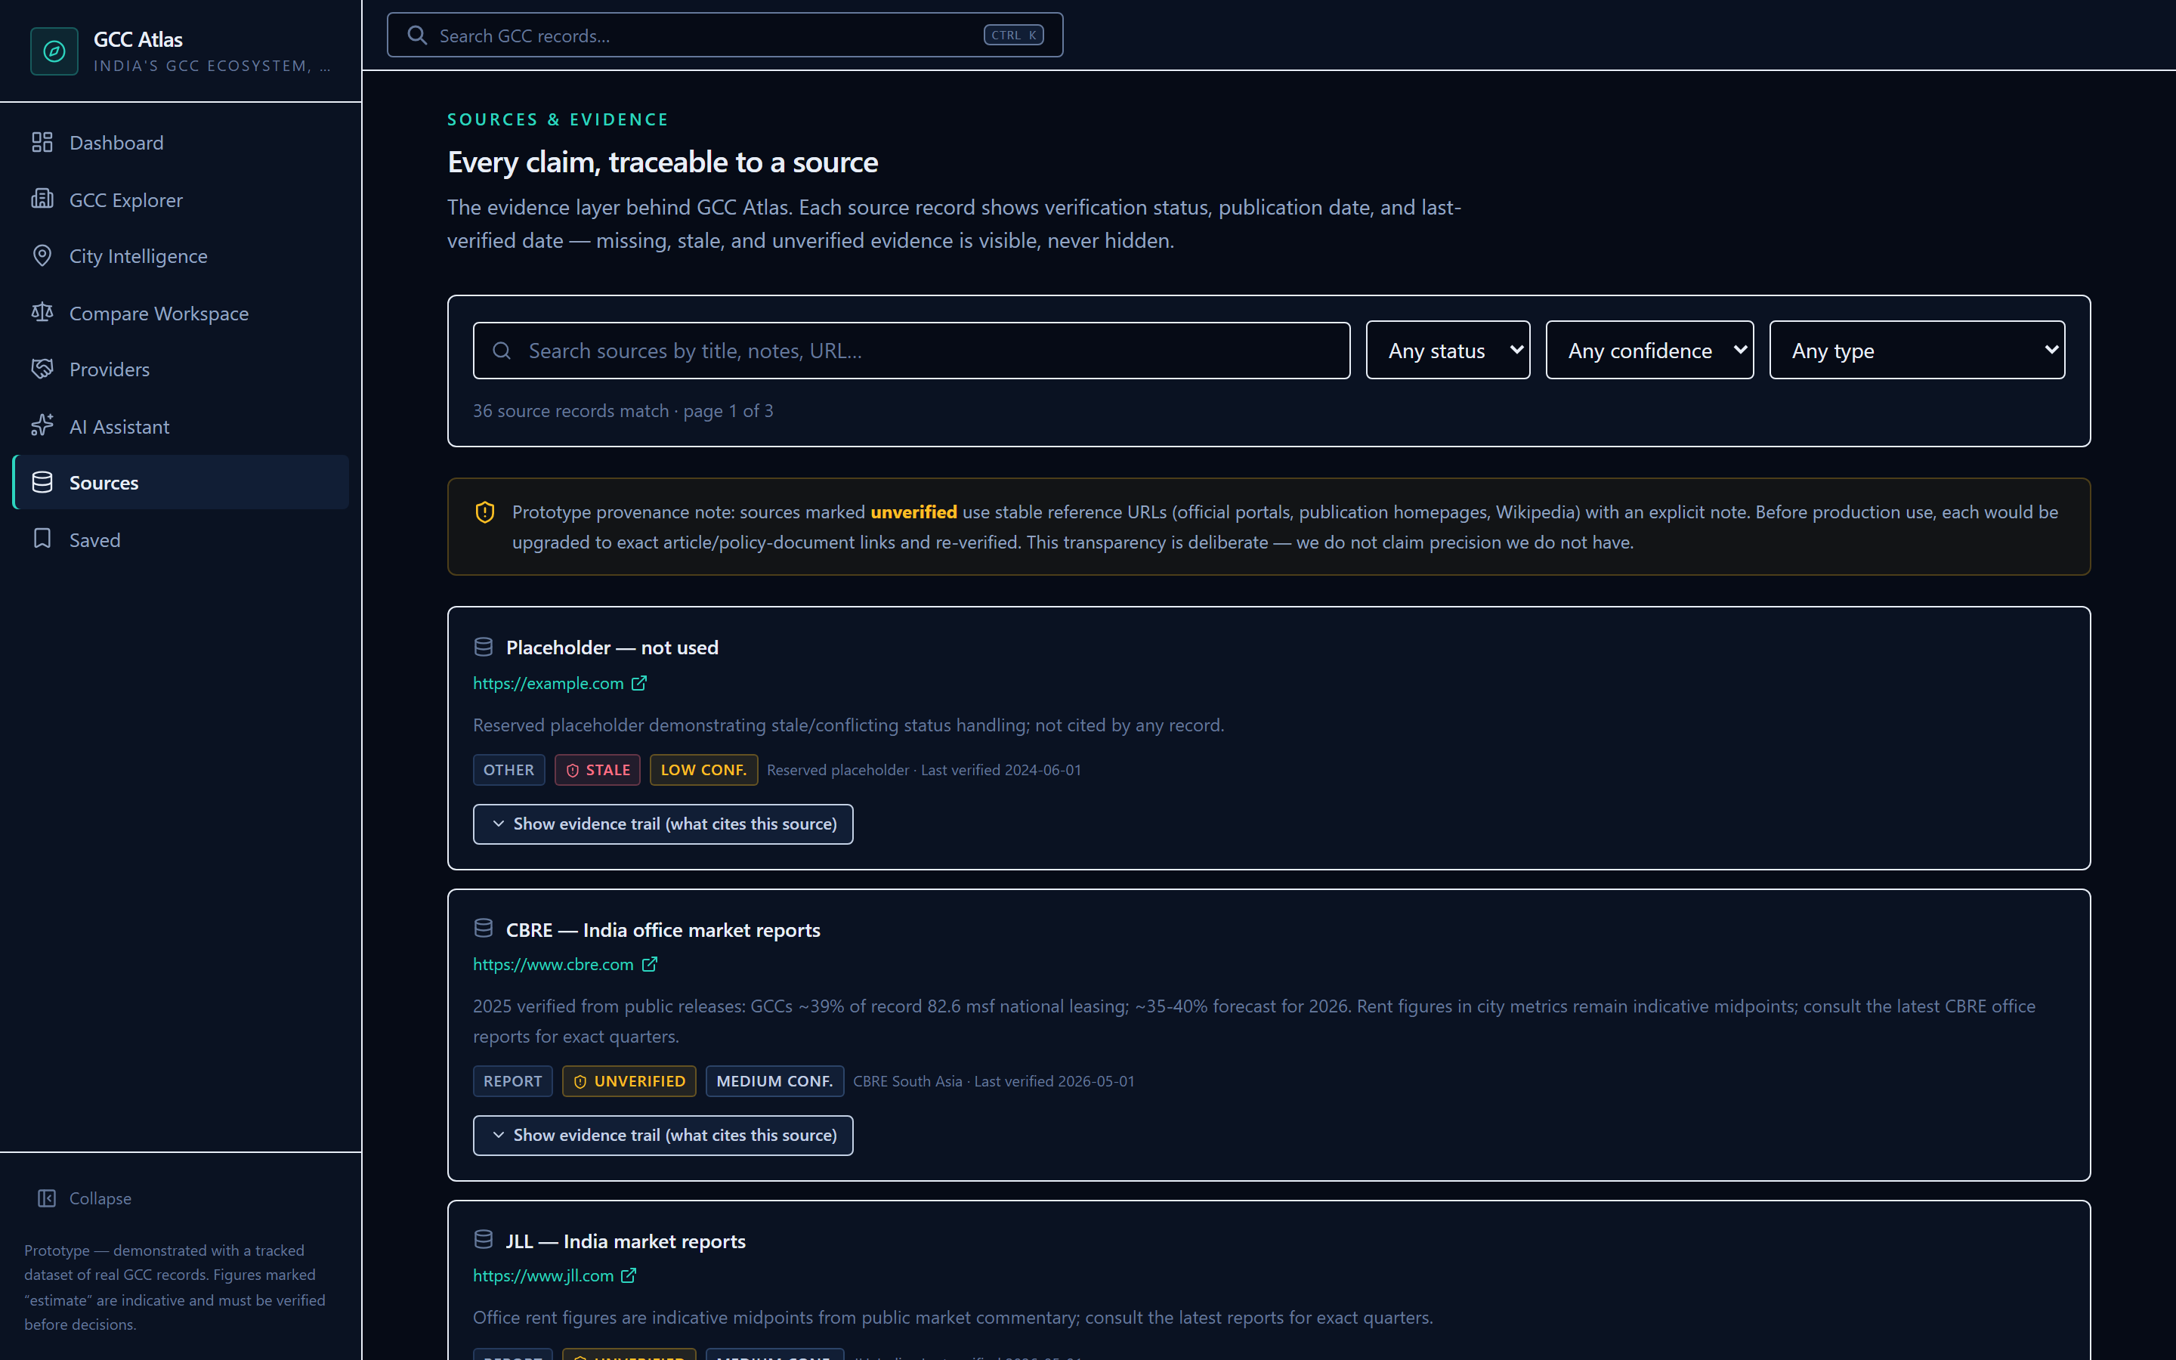
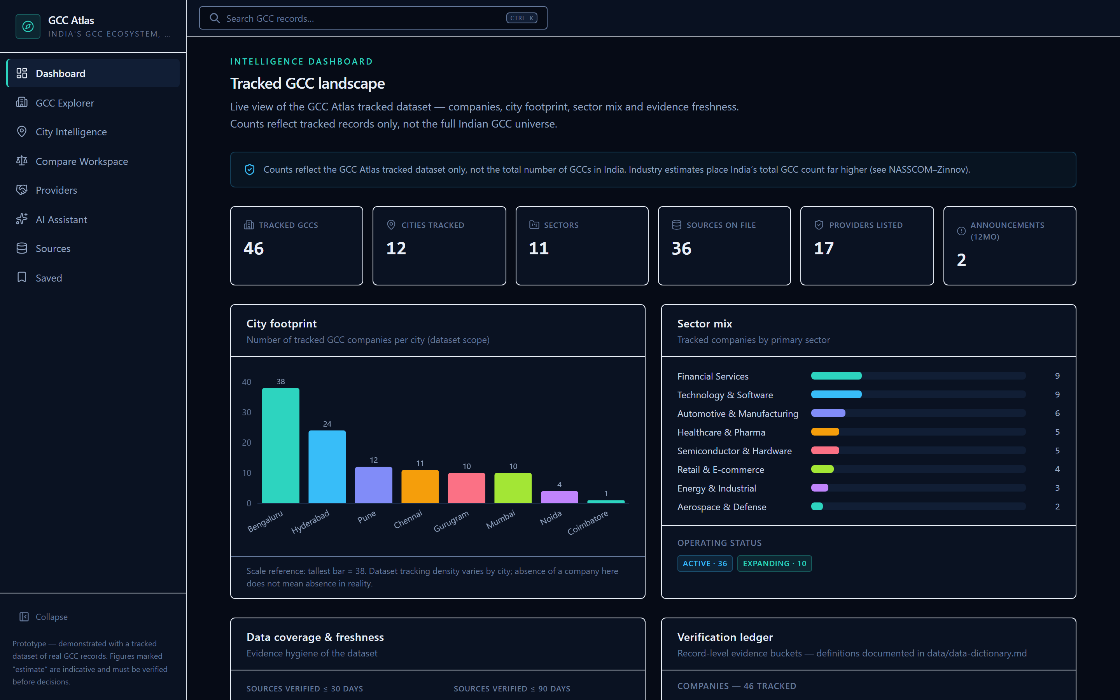
SCREENSHOTS (headless-browser captures of the running build)
Product walkthrough — genuine prototype captures
Compare Workspace: Bengaluru vs Pune — EST flags, metric definitions, provenance chips, save/copy-link.
Assistant: structured, cited answer (demo mode).
Sources: publisher, confidence, verification date + reverse "where used" per source.
Dashboard: dataset-scope counters + verification ledger.
GCC Atlas (working title) — Flexiple Product Intern assignment · pre-alpha prototype · sources: research/source-register.csv (S##)
08 / 12

Slide 9
GO-TO-MARKET SEQUENCING [most steps are hypotheses]
Positioning and stakeholder adoption strategy
Category we aim to create: "evidence-first India GCC location intelligence" — decision layer above directories, below bespoke consulting. We never out-claim Nasscom–Zinnov/CBRE; their data is our source of record (competitive-landscape §4).
1. IPAs share
2. Providers inspect
3. Expansion desks adopt
Free, cited compare links let state IPAs position themselves fairly vs peer states — they become our distribution catalysts (no engine gas needed, S05–S19; S12 shows IPAs actively pitch at NASSCOM events).
Provider/BD leads verify claims pre-meeting (this class already pays $3.5K–$10K for similar surfaces, S30 — awareness follows the free tier).
Priya-style desks self-serve pre-work, arrive at consultant conversations evidence-armed; conversion to paid only AFTER free-tier trust (M1/M3 instrumented).
What we deliberately DON’T do: no paid ranking anywhere facts are shown (trust contract), no bulk contact-data resale (O6, name/legal risk S38), no interviews implied in any deck claim (Phase-3 validates all [inference] tags).
GCC Atlas (working title) — Flexiple Product Intern assignment · pre-alpha prototype · sources: research/source-register.csv (S##)
09 / 12

Slide 10
ALL PRICING = [proposal], UNVALIDATED
Business-model hypotheses and go-to-market
H1 · Free core (now)
H2 · Pro seats [proposal]
City compare + policy matrix + source register stay free. Reputation density is the wedge; paying for data pre-trust kills it (business-model §1).
$99–$199/yr individual; $500–$2,000/yr teams of 3–5 — anchored at 3–6% of the market compar’s $3.5K–$10K cycles (S30). Gate: free-tier traction first.
H4 · Reports [proposal]
H5 · Provider verified [proposal]
Free quarterly standard; $299–$499 thematic deep-dives once publishing muscle exists (market precedent: free quarterly exists S31; historic $9,999 static lists S33).
$199–$499/yr verified-profile attributes only — zero influence on rankings/answers; banned-paid-ranking is a standing product rule (business-model §4).
GTM hypotheses [proposal, no spend]: content-catalyst loop (share links) + expansion-desk outreach + token funnel metrics (M3 search→detail ≥40%; M1 median <10 min — BOTH are unvalidated targets until Phase 3 instrumentation reports).
GCC Atlas (working title) — Flexiple Product Intern assignment · pre-alpha prototype · sources: research/source-register.csv (S##)
10 / 12

Slide 11
GUARDRAILS THE BUILD ACTUALLY ENFORCES
Data trust, AI reliability, risks and success metrics
Trust contract (enforced in code, not just values)
Risks + metrics (targets are [proposals])
▪ Every figure sourced: seed linter FAILS the build on a sourceless value (F6); provenance chips on all numeric surfaces.
▪ Denominators labelled: "GCCs, parent vs units" named at every count (S01/S02-style conflict rendered, never averaged).
▪ Conflicts co-shown: $98.4B (S02) vs $164B (S04) both visible, flagged as contested.
▪ Missing ≠ zero: "not yet tracked", draft policies flagged; placeholder sources labelled "stale".
▪ AI cites or declines: only retrieved evidence citable; unknown citation ids stripped in tests; insufficiency is an honest low-confidence path; recommendations never blended into facts.
▪ Coverage honesty: 46-company tracked subset; never billed as "all 2,117 GCCs" (S02/S30 context).
▪ Name collision: gcc-atlas.com exists (S38) — working-title label everywhere; trademark check is a Phase-3 gate.
▪ Data freshness: verify-by dates shown; manual re-verification pass scheduled at submission.
M1
Time-to-answer < 10 min [proposal]
M2
100% of displayed figures carry sources (hard invariant); assistant ≥95% answered w/ ≥1 citation [proposal]
M3
Search→detail ≥40% [proposal]
M4-M6
compare/assistant/provider engagement + no-paid-ranking guardrail countermetrics
GCC Atlas (working title) — Flexiple Product Intern assignment · pre-alpha prototype · sources: research/source-register.csv (S##)
11 / 12

Slide 12
PHASE GATES (product/roadmap.md)
Roadmap, prototype and next steps
Phase 2 — DONE: working prototype
Phase 3 — validation loop
Phase 4 — paid options (gated)
▪ Research → strategy → full build (Phases 1–8)
▪ Retrieval→citation pipeline + demo fallback
▪ Rate limits, events, session ACL, QA report (94+14 tests green)
▪ Deployment guide + render.yaml + this deck
▪ 0→1 interviews to replace [inference] tags (5+ expansion desks, 2+ IPAs)
▪ Re-calibrate M1/M3 targets from real funnel data
▪ Trademark check (S38) → rename-or-keep decision
▪ H2 seats only after free-traction gate; H3 workspaces; H5 provider profiles under neutrality rules
▪ Monitoring layer F17 if O2 survives falsification tests
The bet, honestly framed: the market is undeniably real and growing; the intelligence layer above it is fragmented and expensive; a discipline-first free comparator is buildable and differentiated. What we have NOT proven: demand (no interviews), willingness-to-pay (proposals only), and defensibility against a fast follower. Every one of those is instrumented to be falsifiable in Phase 3 — which is the point.
Prototype + demo script: deployment/demo-walkthrough.md · QA evidence: qa/quality-report.md · Full evidence register: research/source-register.csv · Deck sources: product/deck-evidence-sources.md
GCC Atlas (working title) — Flexiple Product Intern assignment · pre-alpha prototype · sources: research/source-register.csv (S##)
12 / 12

