Slide 1




Working on
Exploits
Giorgi Akhalaia
Tbilisi, 2022

Slide 2

Overview
exploitdb search
python code validation
Machines: elastic
SSH
Machine: libssh

Slide 3

Terms & Conditions
For Educational Purposes Only
In either case,
hacking without a customer’s explicit permission and direction
is a crime.

Slide 4

Exploits
An exploit is a program, or piece of code, designed to find and take advantage of a security flaw or vulnerability in an application or computer system, typically for malicious purposes such as installing malware.
An exploit is not malware itself, but rather it is a method used by cybercriminals to deliver malware.
Based on popular usage of exploit terms, an exploit is referred to as a zero-day exploit when it is used to attack a vulnerability that has been identified but not yet patched, also known as a zero-day vulnerability.

Slide 5
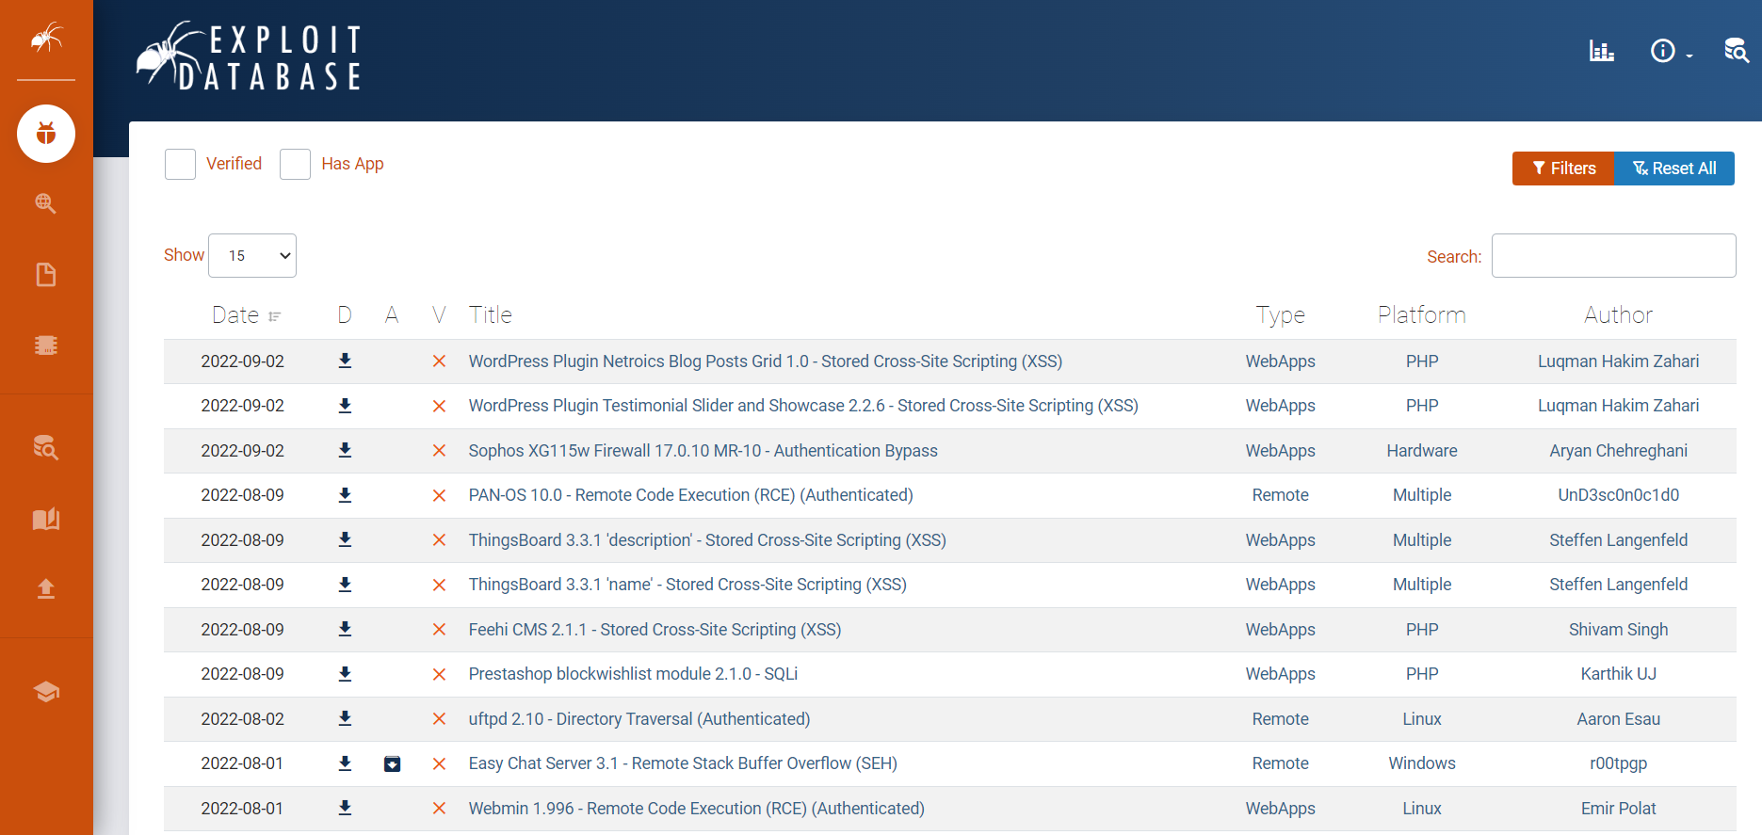
Exploit Database
https://www.exploit-db.com/

Slide 6
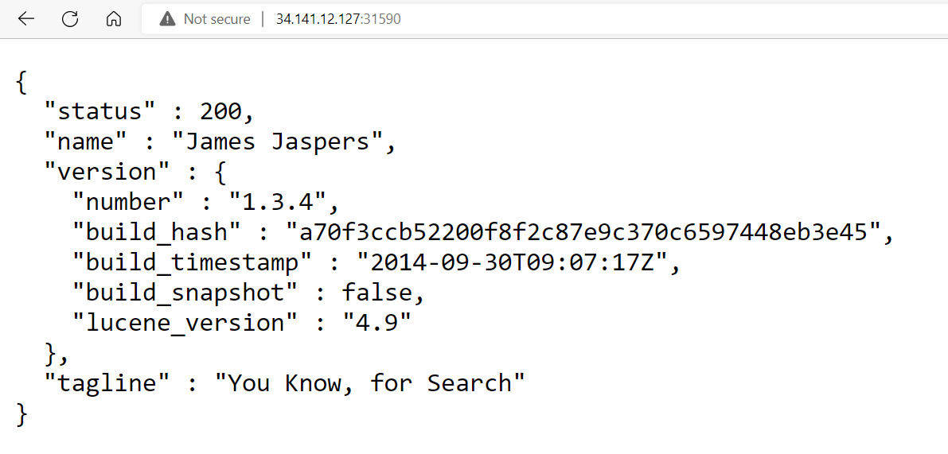
Laboratory: elastic
Description:
Directory traversal vulnerability in Elasticsearch allows remote attackers to read arbitrary files via unspecified vectors related to snapshot API calls.
Flag format: CTF{sha256}
Level: Medium
Server: 34.141.12.127:31590
Hints:
Hint 1: no hints ^^

Slide 7
Laboratory: elastic
? ? ?

Slide 8
Laboratory: elastic
Hints:
Hint 1: Elasticsearch < 1.6.1 Arbitrary file read CVE
The main web page exposure the sensitive information about the version of Elasticsearch
application.
The main of this scenario is to identify the vulnerability like in the real scenario.

Slide 9

Laboratory: elastic
Try to Find an Exploit

Slide 10

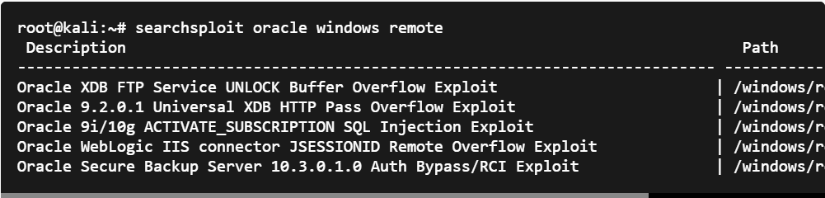
Laboratory: elastic
Exploitdb
Search for remote oracle exploits for windows:
Installation:
Searchable archive from The Exploit Database. https://www.exploit-db.com/
$sudo apt install exploitdb
$sudo apt install libxml2-utils
Dependencies:
libxml2-utils

Slide 11
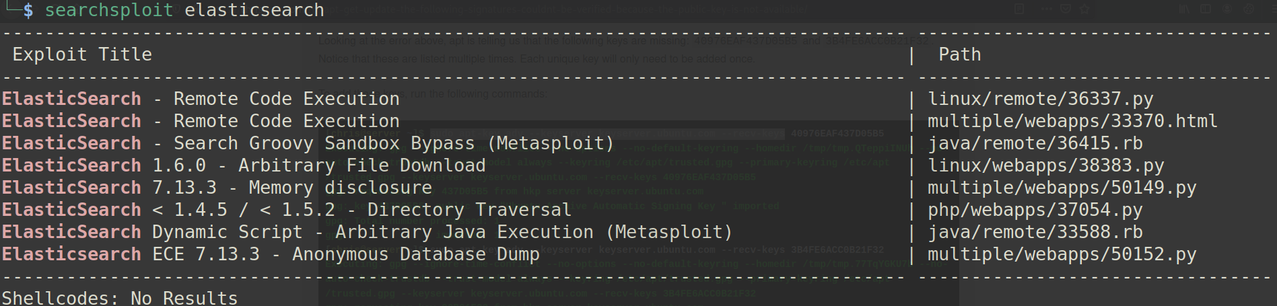
Laboratory: elastic
$searchsploit elasticsearch
Exploitdb

Slide 12
Laboratory: elastic
The vulnerability present in the current scenario, offers more details about
CVE-2015-5531- Arbitrary file Vulnerability.
Exploit can be found here:
https://github.com/nixawk/labs/blob/master/CVE-2015-5531/exploit.py
Exploitdb

Slide 13
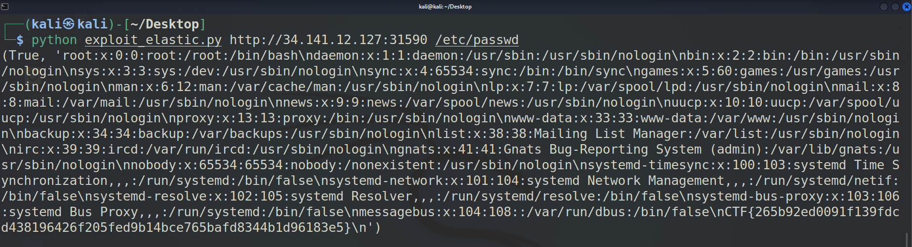
Laboratory: elastic
CTF{265b92ed0091f139fdcd438196426f205fed9b14bce765bafd8344b1d96183e5}
Notes:
CTF{265b92ed0091f139fdcd438196426f205fed9b14bce765bafd8344b1d96183e5}

Slide 14
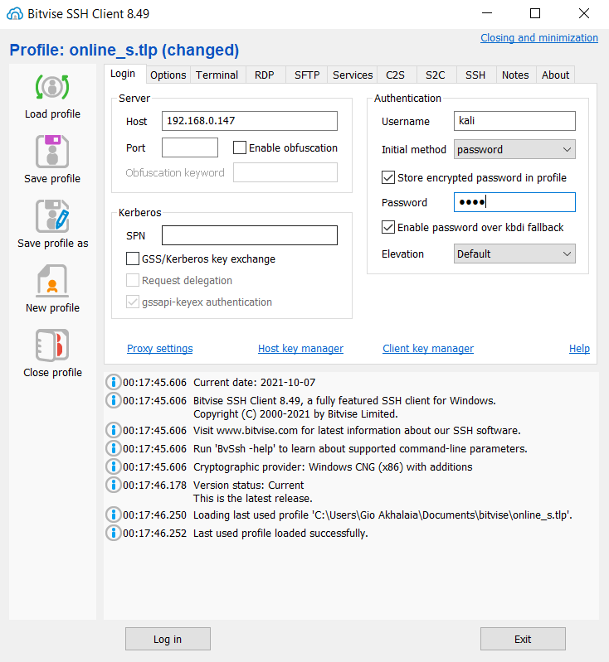
SSH
$sudo apt install ssh #install ssh server on Kali OS
$sudo service ssh start #startup ssh server on Kali OS
$ssh kali@192.168.1.15 #connect as user kali to the host 192.168.1.15
$scp [OPTION] [user@]SRC_HOST:]file1 [user@]DEST_HOST:]file2 #coping files from remote host using encrypted channel
Download Link

Slide 15

File Transfer Using Terminal
SCP Syntax
$scp [OPTION] [user@]SRC_HOST:]file1 [user@]DEST_HOST:]file2 #coping files from remote host using encrypted channel
Copy a Local File to a Remote System with the SCP Command
$scp file.txt remote_username@192.168.0.147:/remote/directory
Copy a File Between Two Remote Systems using the SCP Command
$scp user1@host1.com:/files/file.txt user2@host2.com:/files
#data will be transferred directly from one remote host to another. You should use -3 option to route traffic from the machine where the command is issued

Slide 16
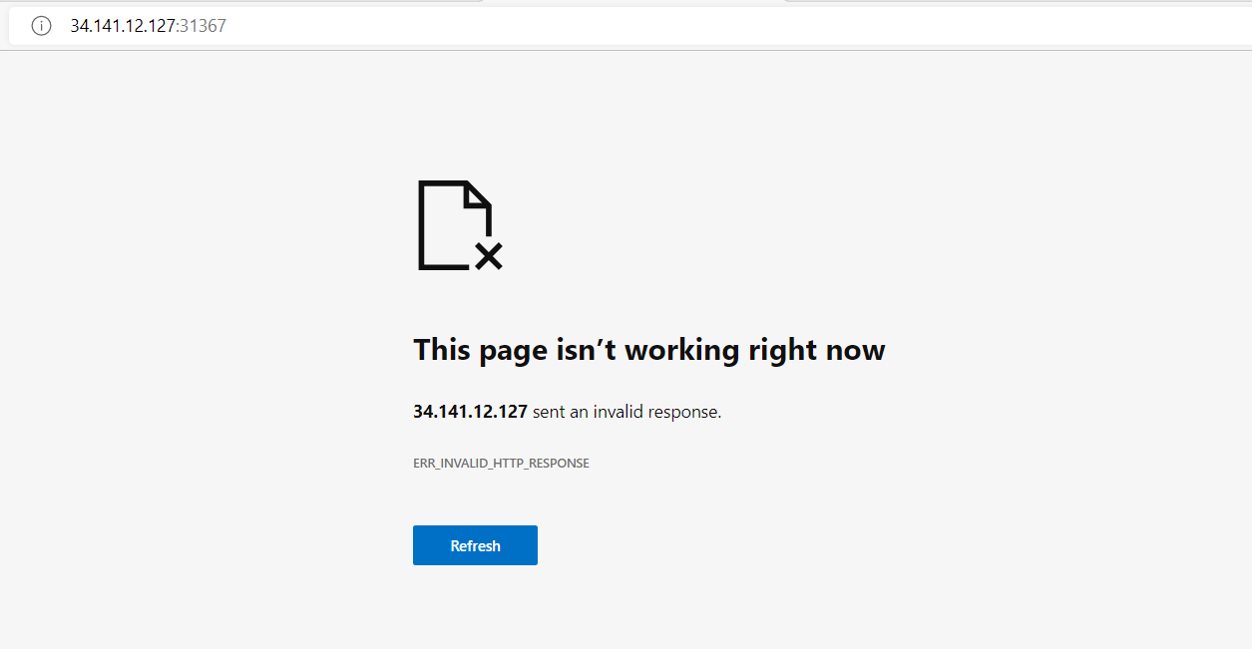
Laboratory: libssh
Description:
Welcome to the magical world of Adventure of CVE. Explore as much as you can this land of services.
Flag format: CTF{sha256}
Level: Easy
Server: 34.141.12.127:31367
Hints:
Hint 1: SSH is not so secure
libssh is a multiplatform C library implementing the SSHv2 protocol on client and server side. With libssh, you can remotely execute programs, transfer files, use a secure and transparent tunnel, manage public keys and much more ...

Slide 17
Laboratory: libssh
? ? ?

Slide 18
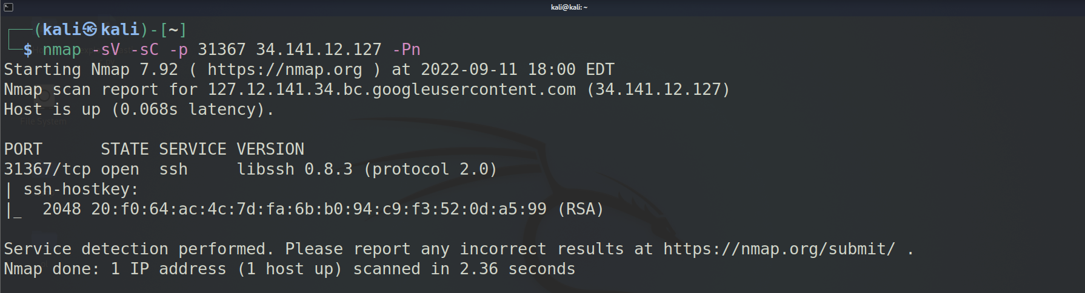
Laboratory: libssh
Try Port Scanning using Nmap
$nmap –sV –sC –p 31367 34.141.12.127 -Pn

Slide 19
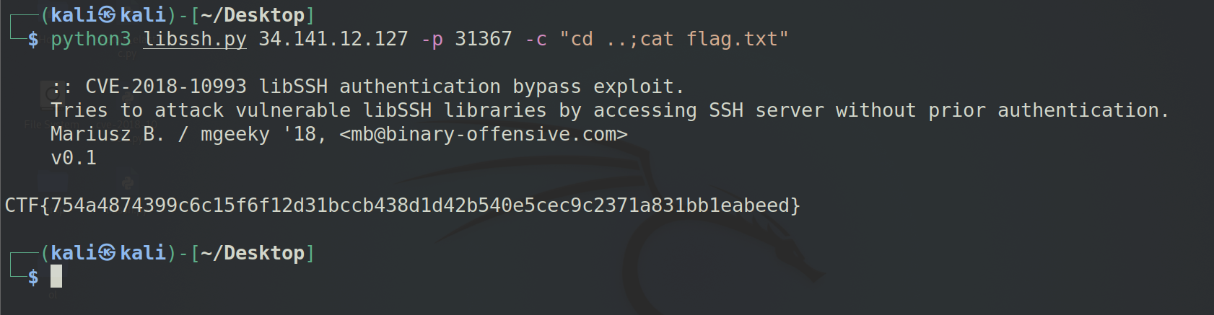
Laboratory: libssh
You can use CVE-2018-10993 libSSH authentication bypass exploit
Exploit: https://gist.github.com/mgeeky/a7271536b1d815acfb8060fd8b65bd5d
Notes:
CTF{754a4874399c6c15f6f12d31bccb438d1d42b540e5cec9c2371a831bb1eabeed}

Slide 20
Thank you for Attention!
contact: email: gakhalaia@cu.edu.ge
mob: 598 590158

