Slide 1




Server-Side Template Injection
Shark

Slide 2

Overview
Server-Side Template Injection
2 Types of SSTI
How to test on SSTI
Machine: shark

Slide 3

Web Penetration Testing 2
For Educational Purposes Only
In either case,
hacking without a customer’s explicit permission and direction
is a crime.

Slide 4

7*7= ???

Slide 5
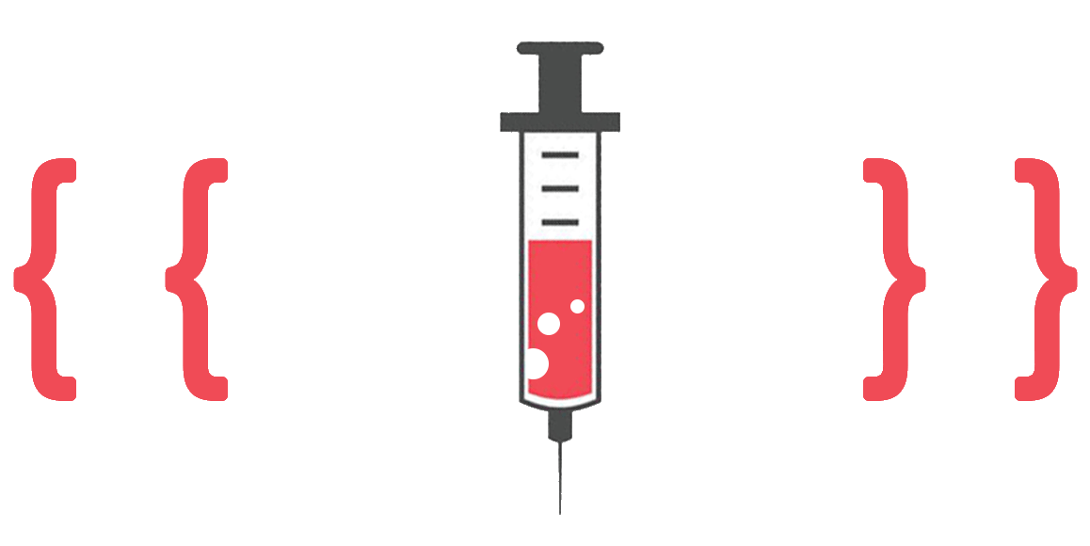
Server-Side Template Injection
Server-side template injection is when an attacker is able to use native template syntax to inject a malicious payload into a template, which is then executed server-side.
Template engines are designed to generate web pages by combining fixed templates with volatile data.
Server-side template injection attacks can occur when user input is concatenated directly into a template, rather than passed in as data.
As the name suggests, server-side template injection payloads are delivered and evaluated server-side

Slide 6
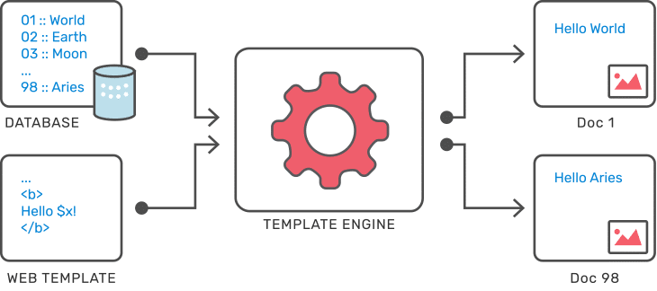
Server-Side Template Injection
Web applications use template engines to separate the visual presentation (HTML, CSS…) from the application logic (PHP, Python…). These engines allow the creation of template files in the application.
These engines allow the creation of template files in the application. Templates are a mixture of fixed data (layout) and dynamic data (variables).
When the application is used, the template engine will replace the variables contained in a template with values and will transform the template into a web page (HTML) and then send it to the client.

Slide 7
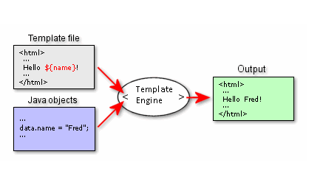
Server-Side Template Injection
Template engines are widely used by web applications to present dynamic data via web pages and emails. Unsafely embedding user input in templates enables Server-Side Template Injection
Unlike XSS, Template Injection can be used to directly attack web servers' internals and often obtain Remote Code Execution (RCE), turning every vulnerable application into a potential pivot point.
Template Injection can arise both through developer error, and through the intentional exposure of templates in an attempt to offer rich functionality, as commonly done by wikis, blogs, marketing applications and content management systems.

Slide 8
How do server-side template injection vulnerabilities arise?
A server-side template injection (SSTI) vulnerability occurs when user data is embedded directly in a template and then interpreted by the template engine.
Server-side template injection vulnerabilities arise when user input is concatenated into templates rather than being passed in as data.
The source of the problem is that the data transmitted by users is interpreted directly by the template engine (as dynamic data), instead of being integrated as fixed data.
Static templates that simply provide placeholders into which dynamic content is rendered are generally not vulnerable to server-side template injection.
This type of vulnerability is most often found on sites that want to offer advanced customisation features such as wikis, blogs, marketing applications or CMS.
Notes:
Vulnerabilities like this are sometimes caused by accident due to poor template design by people unfamiliar with the security implications.
However, sometimes this behavior is actually implemented intentionally. For example, some websites deliberately allow certain privileged users, such as content editors, to edit or submit custom templates by design. This clearly poses a huge security risk if an attacker is able to compromise an account with such privileges.

Slide 9
How do server-side template injection vulnerabilities arise?
The classic example is an email that greets each user by their name, such as the following extract from a Twig template:
$output = $twig->render("Dear {first_name},", array("first_name" => $user.first_name) );
This is not vulnerable to server-side template injection because the user's first name is merely passed into the template as data.

Slide 10
How do server-side template injection vulnerabilities arise?
However, as templates are simply strings, web developers sometimes directly concatenate user input into templates prior to rendering.
Let's take a similar example to the one above, but this time, users are able to customize parts of the email before it is sent.
For example, they might be able to choose the name that is used:
$output = $twig->render("Dear " . $_GET['name']);
In this example, instead of a static value being passed into the template, part of the template itself is being dynamically generated using the GET parameter name. As template syntax is evaluated server-side, this potentially allows an attacker to place a server-side template injection payload inside the name parameter as follows:
http://vulnerable-website.com/?name={{bad-stuff-here}}

Slide 11
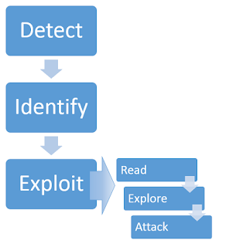
Constructing a server-side template injection attack
Identifying server-side template injection vulnerabilities and crafting a successful attack typically involves the following high-level process.

Slide 12
How to find an SSTI vulnerability?
Identification takes place in two parts
A first phase of detection of the vulnerability.
A second phase to identify the template engine used.
${{<%[%'"}}%\

Slide 13
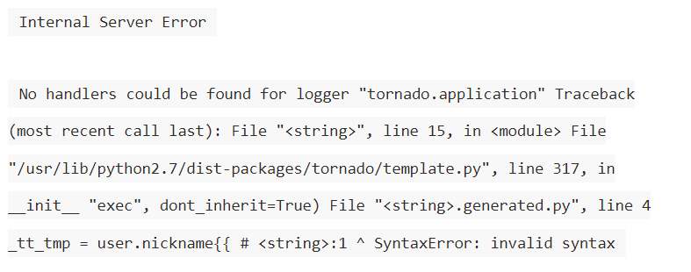
Detecting the vulnerability
If you are able to detect that a vulnerability is present, it can be surprisingly easy to exploit it. This is especially true in unsandboxed environments.
An effective approach is to fuzz the target in all data fields with a payload containing special characters often used by template engines.
For example:
${{<%[%'"}}@{%\.#{<%=
${{<%[%'"}}%\
If an error message is returned in the server responses, this indicates that the application is potentially vulnerable. Analyzing the error message could help determine which template engine is being used.

Slide 14
Detecting the vulnerability
Template injections can occur in two different contexts:
Plaintext context:
Many template engines allow content to be entered directly into HTML tags or using the template engine syntax. This content will be interpreted on the server side before the server returns an HTTP response. In this case, it is recommended to send mathematical formulas in the tested fields (depending on the template engine, the syntax may change).
{{7*7}}
${7*7}
${{7*7}}
<%= 7*7 %>
#{7*7}
Context code:
When user inputs are directly inserted into an expression evaluated by the template engine. In this case, the idea is to modify the relevant parameter while trying to generate an error.
Notes:
If one of these formulas is interpreted, the server response will contain “49”. This means that the mathematical operation was interpreted in a “Plaintext” context and that an SSTI vulnerability is present.

Slide 15
Detecting the vulnerability
For example, consider a template that contains the following vulnerable code:
During auditing, we might test for server-side template injection by requesting a URL such as:
Hello 49
If the resulting output contains Hello 49, this shows that the mathematical operation is being evaluated server-side. This is a good proof of concept for a server-side template injection vulnerability.

Slide 16
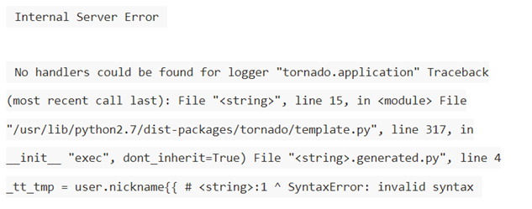
Identify
Once you have detected the template injection potential, the next step is to identify the template engine.
Although there are a huge number of templating languages, many of them use very similar syntax that is specifically chosen not to clash with HTML characters. As a result, it can be relatively simple to create probing payloads to test which template engine is being used.
Simply submitting invalid syntax is often enough because the resulting error message will tell you exactly what the template engine is, and sometimes even which version.

Slide 17
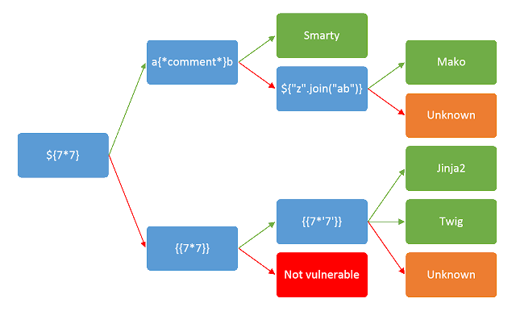
Identify
Otherwise, you'll need to manually test different language-specific payloads and study how they are interpreted by the template engine.
Using a process of elimination based on which syntax appears to be valid or invalid, you can narrow down the options quicker than you might think.
A common way of doing this is to inject arbitrary mathematical operations using syntax from different template engines. You can then observe whether they are successfully evaluated.
To help with this process, you can use a decision tree similar to the following:
For example, the payload {{7*'7'}} returns 49 in Twig and 7777777 in Jinja2. Therefore, it is important not to jump to conclusions based on a single successful response.

Slide 18
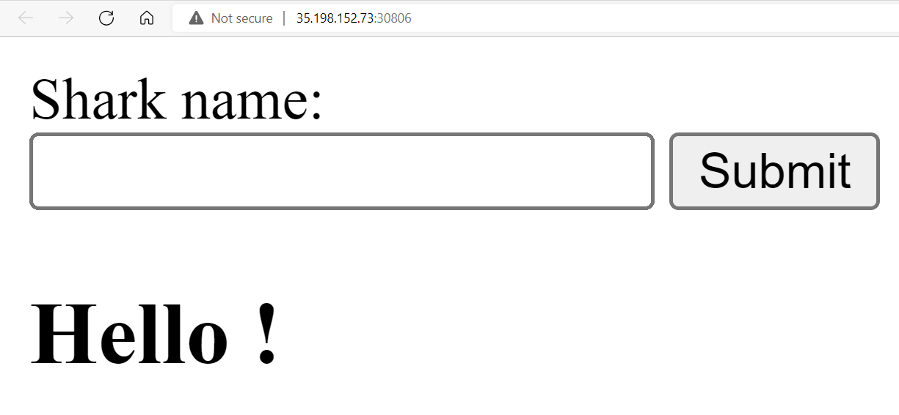
Laboratory: shark
Description:
Exploit the shark and get the flag!
Flag format: CTF{sha256}
Level: Easy
Server: 35.198.152.73:30806
Hints:
Hint 1: Server Site Template Injection

Slide 20
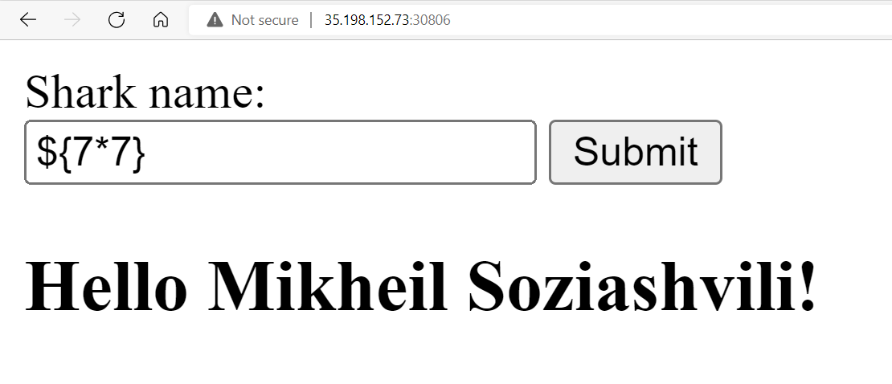
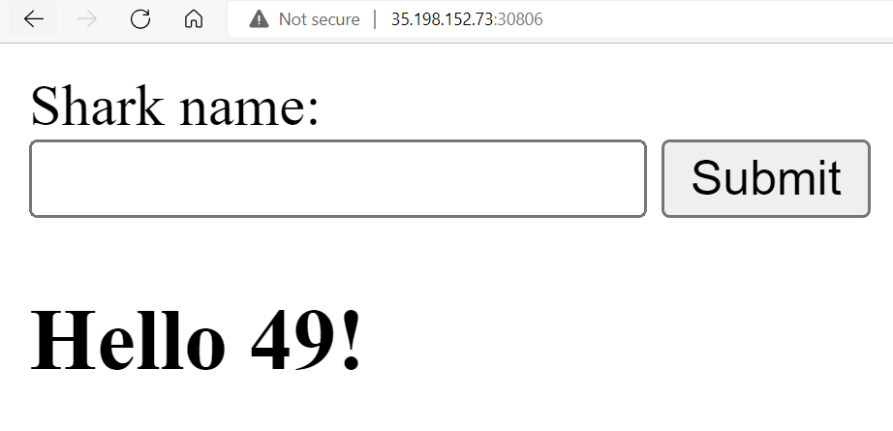
Laboratory: shark
Payload
Result:
{{7*7}}
${7*7}
${{7*7}}
<%= 7*7 %>
#{7*7}

Slide 22
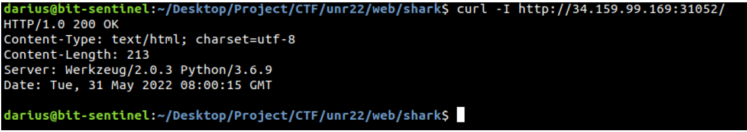
Laboratory: shark
After this observation, we can use the cURL utility into Terminal to find more information about the server
From curl output we can conclude the following:
the web application is based on the Werkzeug Python Server
this server is vulnerable to SSTI injection

Slide 23
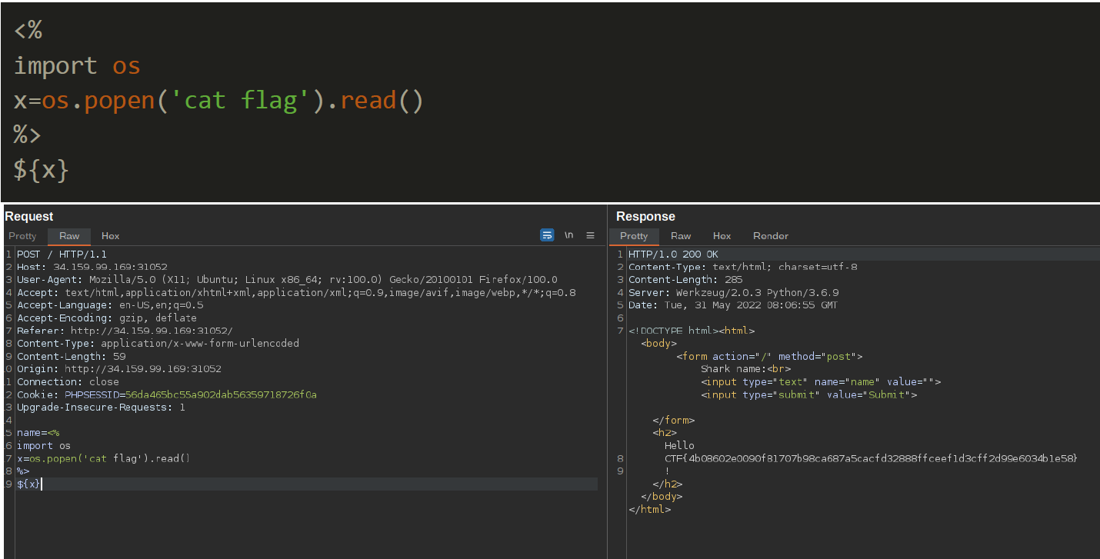
Laboratory: shark
Upon searching on the Internet, we learn that if the "MAKO" payload is used will lead to reading sensitive information on the server.
Open the Burp Suite and use the next payload on the name parameter:
https://0x1.gitlab.io/web-security/Server-Side-Template-Injection/#mako

Slide 24
Thank you for Attention!

