Slide 1
Full Stack Engineering
Project
Team Details:
Gracy Gulati(2210990331)
Gunn Arora(22210990333)
Guransh Singh(2210990335)
Prachi Malik (2210990661)
Faculty Coordinator: Shaffu
:
Chitkara University Institute of Engineering and Technology,
Chitkara University, Punjab

Slide 2
Table of Contents
Introduction
Problem Statement
Technical Details
Key Features
Project Highlights
Conclusion
References/Links used

Slide 3
Introduction
E-commerce has revolutionized the footwear industry, offering customers convenience, variety, and seamless shopping experiences. Online stores provide a vast selection of shoes, from casual sneakers to luxury footwear, catering to diverse styles and budgets. Advanced features like virtual try-ons, size guides, and customer reviews help buyers make informed decisions. Businesses use AI-driven recommendations, personalized marketing, and efficient return policies to enhance customer satisfaction. With fast deliveries and secure payment options, online footwear shopping continues to grow, making it easier than ever to find the perfect pair. The future of footwear e-commerce is driven by innovation, accessibility, and customer-centric solutions.

Slide 4
Problem Statement
The footwear industry faces challenges in providing a seamless online shopping experience due to issues like inaccurate size selection, limited personalization, and high return rates. Customers often struggle with finding the right fit, leading to dissatisfaction and product returns. Additionally, a lack of detailed product descriptions, virtual try-ons, and customer support affects user confidence. Businesses also face difficulties in managing inventory, optimizing logistics, and ensuring a smooth checkout process. To address these challenges, an e-commerce footwear platform needs to offer an intuitive interface, AI-driven recommendations, virtual try-ons, and efficient order management to enhance user experience and increase conversions.

Slide 5
Technical Details
Frontend: React.js – Dynamic and responsive user interface
Backend: Node.js with Express.js – Scalable and efficient server-side logic
Database: MySQL – Secure and structured data management
State Management: Context API/Redux – Smooth data flow and management
API: RESTful APIs – Seamless communication between frontend and backend
Hosting & Deployment: Vercel/Netlify for frontend, AWS/DigitalOcean for backend
Payment Integration: Razorpay/Stripe – Secure online transactions

Slide 6
Technical Details
Version Control: Git & GitHub – Code management and collaboration
Authentication: JWT or OAuth – User authentication and security

Slide 7
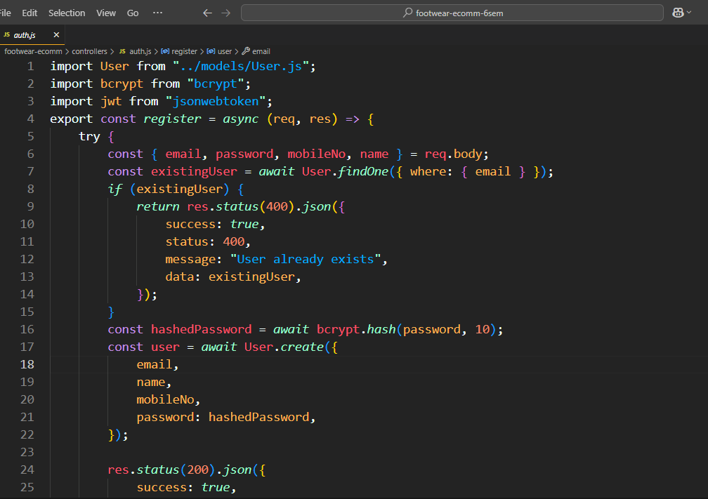
Screenshots

Slide 8
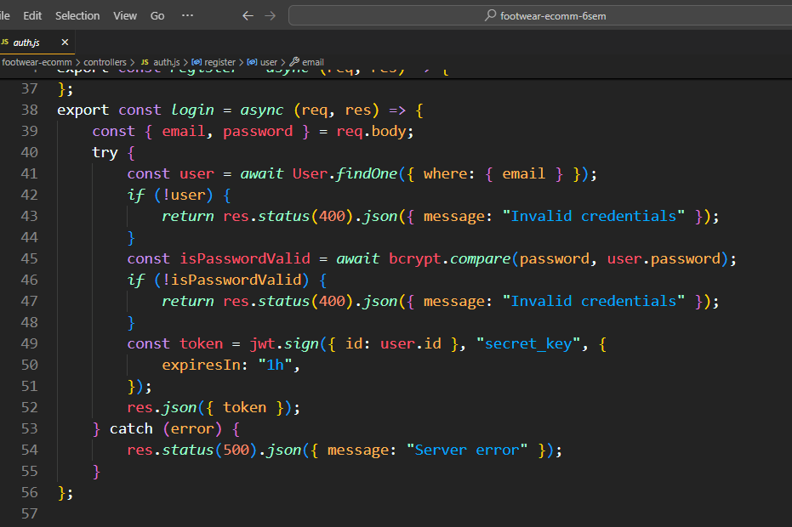
Screenshots

Slide 9
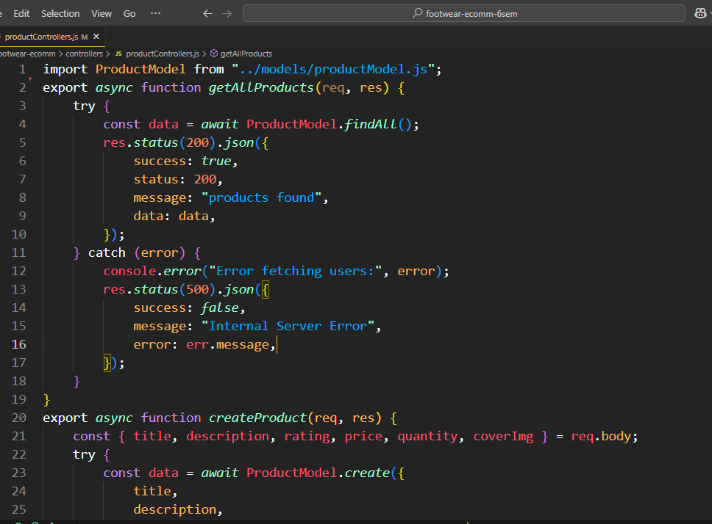
Screenshots

Slide 10
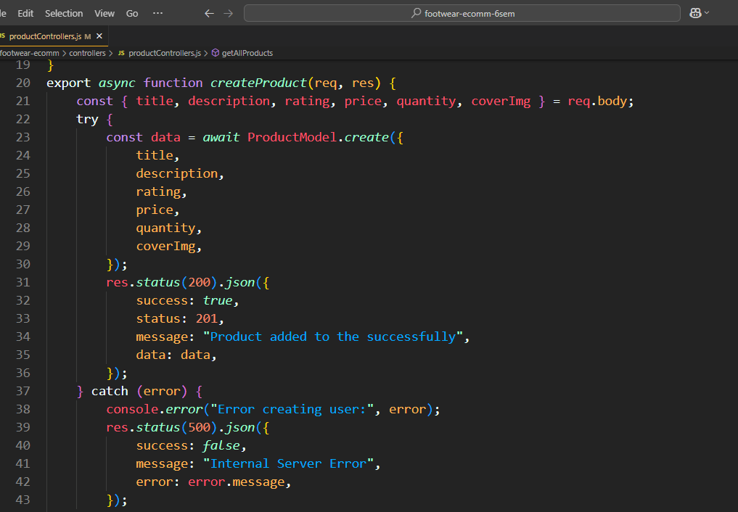
Screenshots

Slide 11
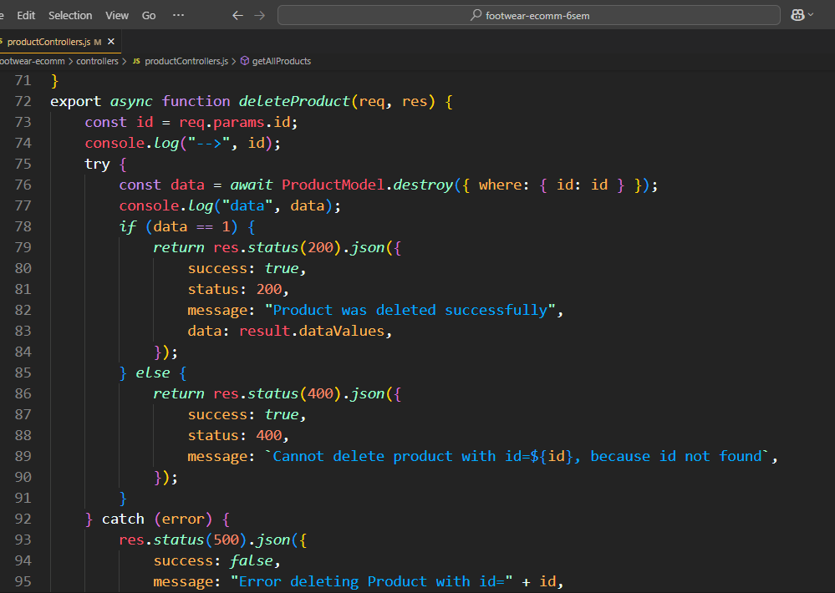
Screenshots

Slide 12
Key Features
Wide Collection: Various styles and brands.
Secure Checkout: Multiple payment options.
Customer Reviews: Ratings and feedback
Easy Navigation: Smooth browsing and filtering.
Fast Delivery: Reliable shipping services
Easy Returns: Hassle-free exchanges and refunds.
Personalized Recommendations: AI-driven suggestions.
Exclusive Deals: Discounts and offers.

Slide 13
Project Highlights
User-Friendly Interface: Simple and intuitive experience.
Privacy & Security: Robust data protection and encryption.
Secure Digital Vault: Safely store and manage digital assets.
Time Capsule Feature: Schedule memories for future release.
Storytelling: Preserve family history through text and audio.
Recipe & Post Management: Organize and share cherished content.
Public Gallery: Showcase shared moments in one place.
Seamless Sharing: Pass down digital heirlooms effortlessly.

Slide 14
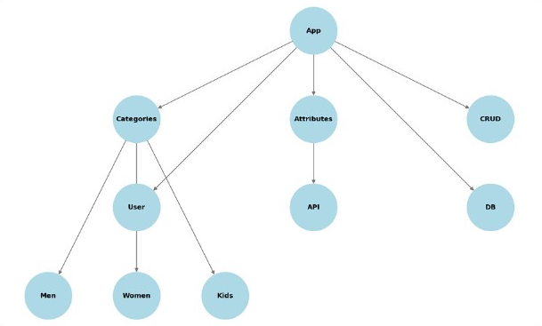
Project Hierarchy

Slide 15
Conclusion
Our eCommerce footwear platform offers a seamless shopping experience with a wide collection of styles, secure transactions, and fast delivery. With user-friendly navigation, customer reviews, and easy returns, we ensure convenience and satisfaction. By combining quality, affordability, and exclusive deals, we aim to be the go-to destination for all footwear needs.

Slide 16
References/Links used
React js: https://react.dev
Node js: https://nodejs.org/en
MySQL: https://dev.mysql.com/doc/
W3schools: https://www.w3schools.com
Geek for geeks: https://www.geeksforgeeks.org

Slide 17


