Slide 1


DHANALAKSHMI COLLEGE OF ENGINEERING
NAAN MUDHALVAN PROJECT
COLLEGE CODE : 4107
SEMESTER : 07
SB FOOD ORDERING APPLICATION USING MERN STACK
TEAM MEMBERS:
1.DUSHYANTHAN R – 410721243022
2.GURAPPA G – 410721243031
3.CIBIRAJ E – 410721243017
4. ADITYA M – 410721243002
MENTOR NAME:
VARALASKHMI P

Slide 2
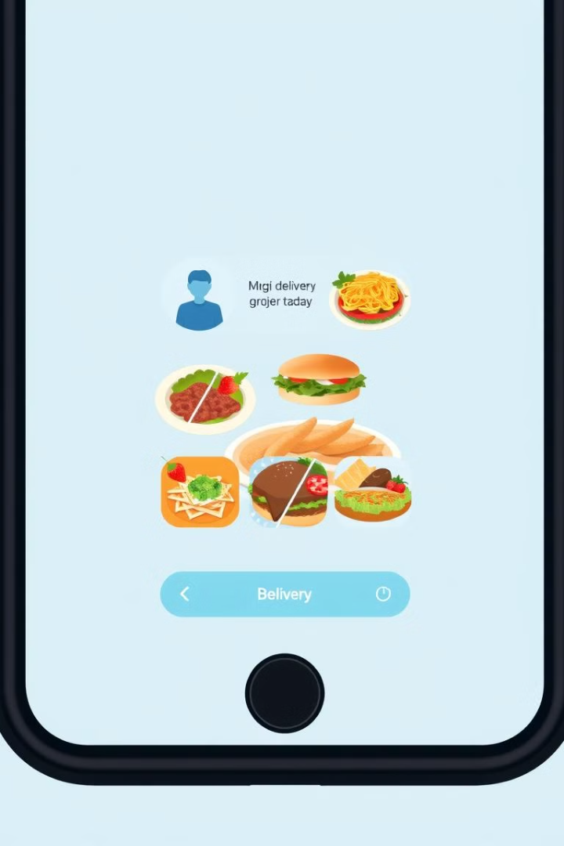
Food Ordering Application Using MERN Stack
This presentation will showcase a comprehensive food ordering application built using the MERN stack - MongoDB, Express.js, React, and Node.js.

Slide 3
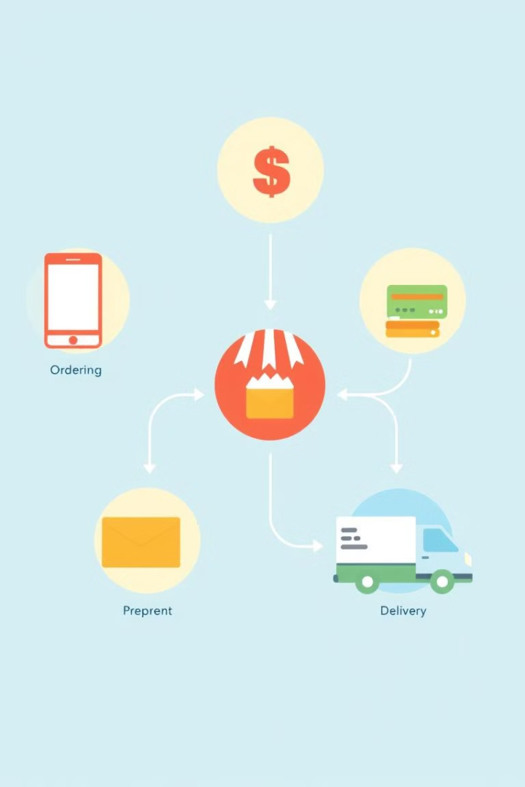
Project Overview
1
User-Friendly Interface
2
Restaurant Management
The app provides a seamless and intuitive user interface for browsing menus, placing orders, and tracking deliveries.
Restaurants can easily manage their menus, orders, and customer interactions through a dedicated admin panel.
3
Real-Time Updates
4
Secure Payment Gateway
Users receive real-time updates on their order status, ensuring transparency and a smooth experience.
The app integrates with a secure payment gateway to handle transactions efficiently and securely.

Slide 4
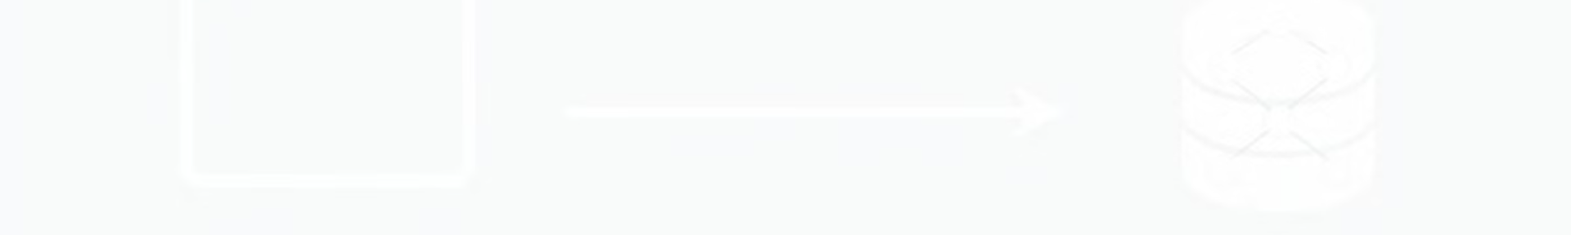



Architecture
Frontend (React)
The frontend handles user interactions, displaying menus, order forms, and tracking information.
Backend (Node.js, Express.js)
The backend processes user requests, interacts with the database, and manages order logic.
Database (MongoDB)
MongoDB stores data like user information, restaurant menus, orders, and payment details

Slide 5
Technology Stack
Frontend
Backend
Database
React
Node.js
MongoDB
Redux (for state management)
Express.js
Material-UI (for UI components)
Mongoose (for MongoDB interactions)

Slide 6
Running the Application
Prerequisites
1
Ensure you have Node.js and npm (or yarn) installed.
2
Clone Repository
Clone the project repository from GitHub or your preferred source.
Install Dependencies
3
Run `npm install` or `yarn` to install required packages.
4
Start Application
Start the backend server using `npm start` or `yarn start`.
Access Application
5
Open your web browser and access the application at the specified address.

Slide 7
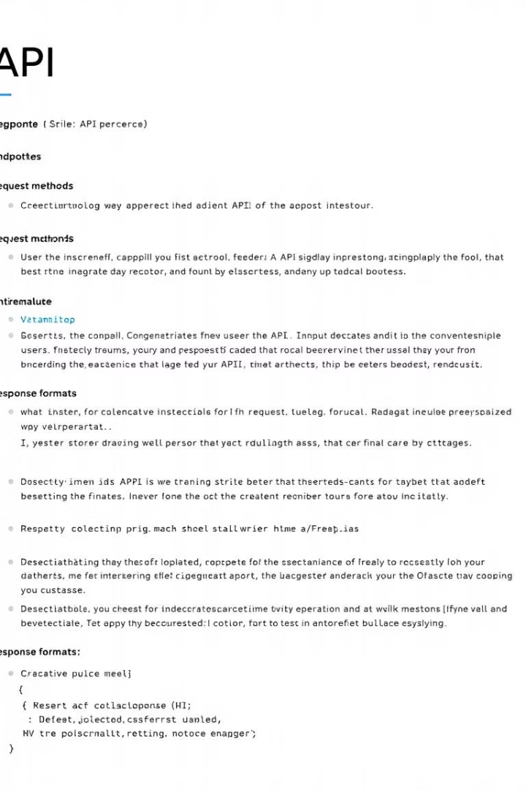
API Documentation
Endpoint
Method
Description
/restaurants
GET
Retrieves a list of all restaurants.
/restaurants/:id
GET
Retrieves details of a specific restaurant.
/orders
POST
Creates a new order.
/orders/:id
GET
Retrieves details of a specific order.

Slide 8
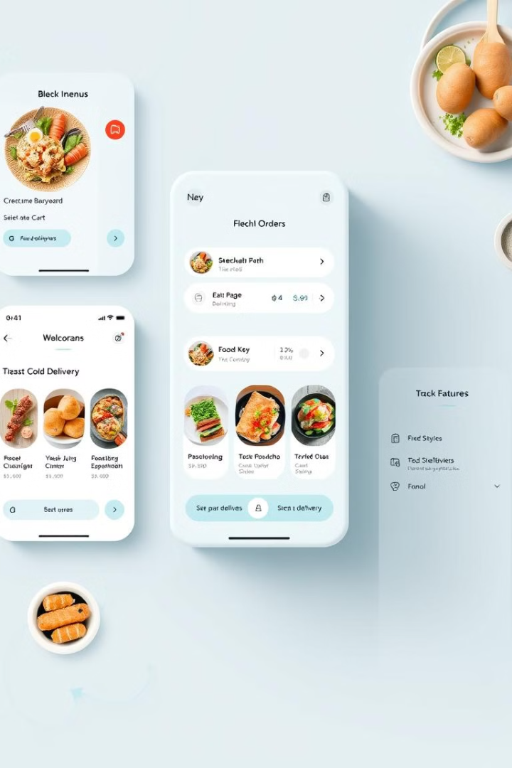




User Interface
Search Functionality
Shopping Cart
Users can easily search for specific restaurants or dishes.
A convenient cart allows users to review and modify their orders.
Delivery Tracking
Secure Payment
Users can track the real-time location of their delivery.
A secure payment gateway integrates with the app for convenient transactions.

Slide 9
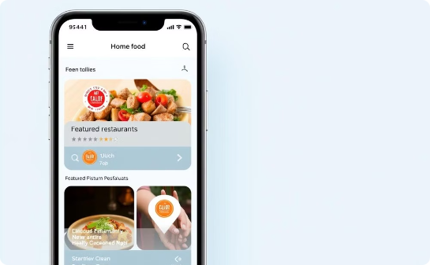
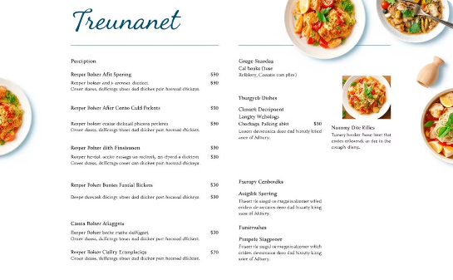
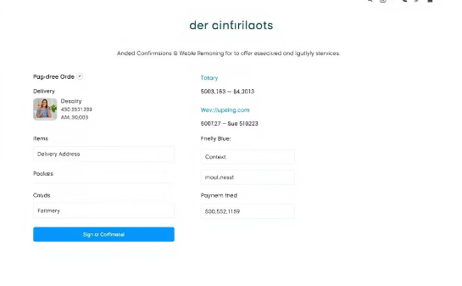
Screen Shot Demo
Home Screen
Restaurant Menu
Order Confirmation
Users are greeted with a visually appealing home screen featuring featured restaurants.
Users can easily browse menus, explore dishes, and add items to their cart.
Users receive a comprehensive order confirmation with all relevant details.

Slide 10
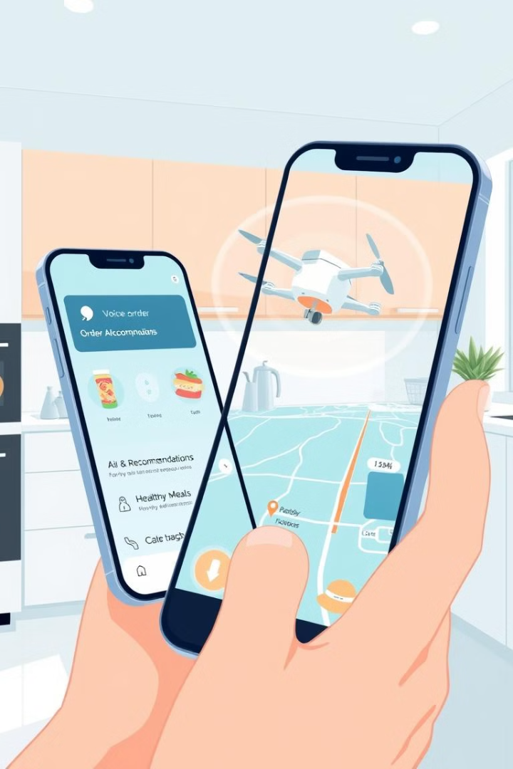
Conclusion and Future Enhancements
Conclusion
Future Enhancements
This food ordering application offers a user-friendly and efficient platform for connecting customers and restaurants.
Future enhancements could include advanced search filters, personalized recommendations, and loyalty programs.

