Slide 1
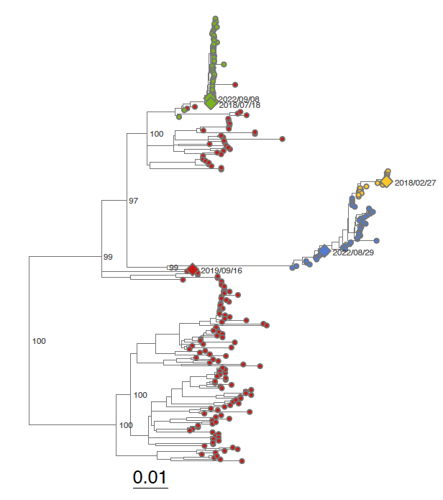
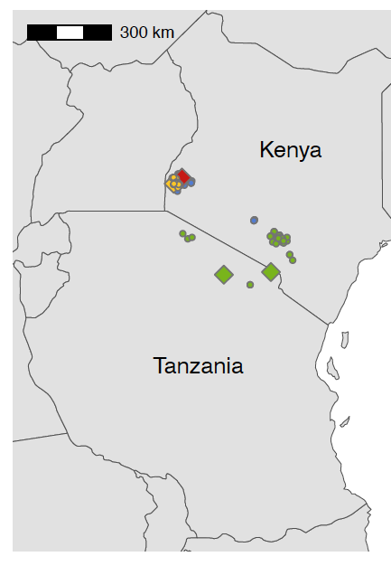
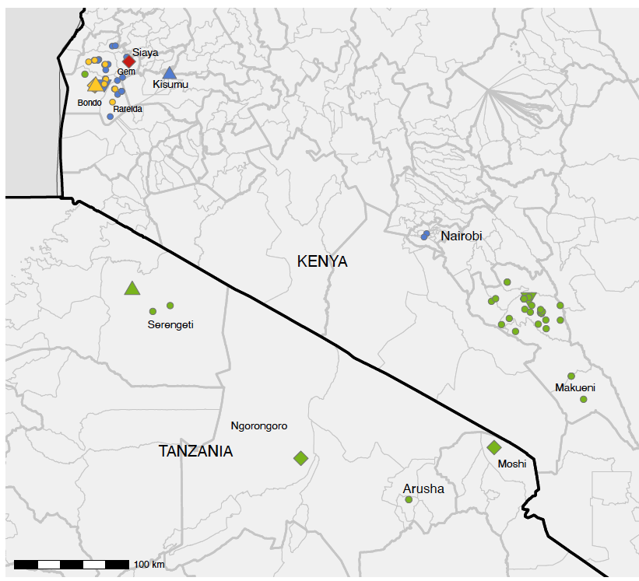

AIM: Investigate 5 human rabies deaths in East Africa 2018-2022
Lineages:
CONCLUSIONS & RECOMMENDATIONS:
Train medical staff on bite management
Improve access to free PEP
Increase rabies awareness
Enhance diagnosis with rapid tests and genomics
Coordinate regional efforts for the 'Zero by 30' goal through better PEP access and mass dog vaccination.
PHYLOGENETIC INVESTIGATION
All cases due to dog-mediated rabies
Transboundary circulation evident
Multiple co-circulating lineages
EPIDEMIOLOGICAL INVESTIGATION
3 had no post-exposure vaccination
1 had only 1 vaccine dose only
1 had all doses but incorrect timeline

Slide 2




Investigation of 5 human rabies deaths in Tanzania & Kenya
EPIDEMIOLOGICAL INVESTIGATION
3/5 had no post-exposure vaccination
1 had only 1 vaccine dose only
1 had all doses but incorrect timeline
CONCLUSIONS and RECOMMENDATION
All the cases due to Dog-mediated rabies
Co-circulating viral lineages
Endemic transboundary spread
Coordinate regional efforts for the 'Zero by 30' goal through better PEP access and mass dog vaccination.
Train medical staff on bite management
Improve access to free PEP
Increase rabies awareness
Enhance diagnosis with rapid tests and genomics
Rapid diagnostic testing
Immunohistochemistry
Whole genome sequencing
Phylogenetic analysis

