Slide 1
Small Sample Size Effects
Maksym Shevchenko, AI-2

Slide 2
Agenda
Introduction
Classification algorithms
Sensitivity of Classifiers to design sample size
Performance estimation
Feature selection
Sample size determination
Conclusion

Slide 3
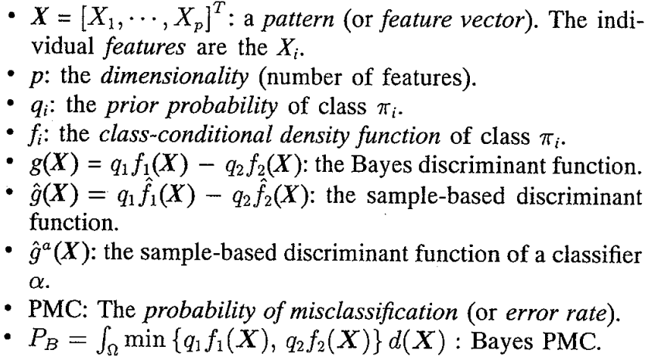
1. Introduction. Notation

Slide 4



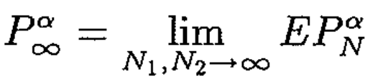
2. Classification algorithms. PMC types
Bayes PMC
Conditional PMC
Expected PMC
Asymptotic PMC

Slide 5
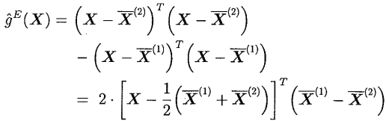
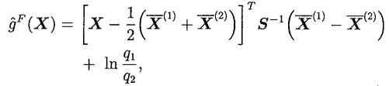
2. Classification algorithms. Classifiers
Euclidean Distance Classifier
Fisher’s Linear Discriminant

Slide 6
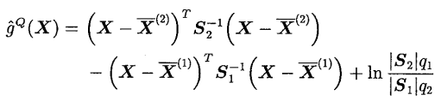



2. Classification algorithms. Classifiers
Quadratic Discriminant Function
Parzen Window Classifier

Slide 7
2. Classification algorithms. Classifiers
K-Nearest-Neighbor Classifier
class of the input pattern X is chosen as the class of the majority of its K nearest neighbors
Multinomial Classifier

Slide 8
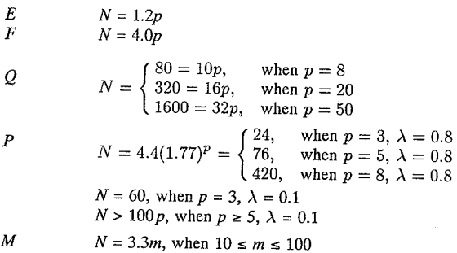
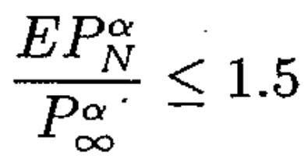
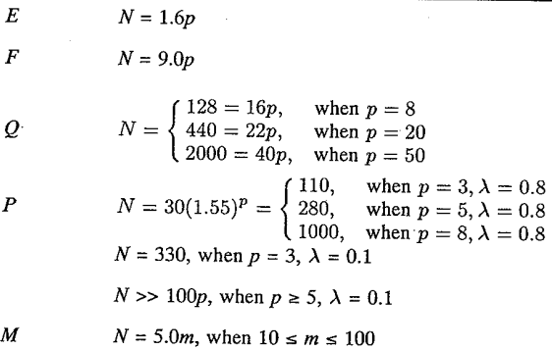
3. Sensitivity of Classifiers to design sample size

Slide 9
4. Performance estimation. Train/Test split
R. Resubstitution Method
H. Hold-Out Method
L. Cross-Validation Method
B. Bootstrap Method

Slide 10
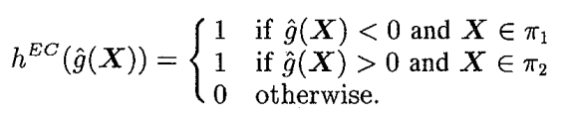
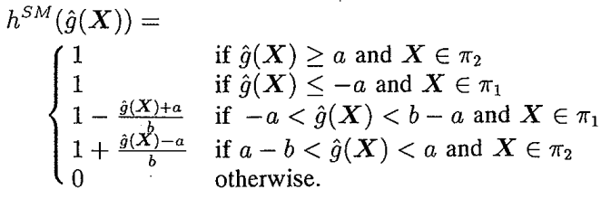
4. Performance estimation. Error Function
EC. Error Counting
SM. Smooth Modification of EC

Slide 11

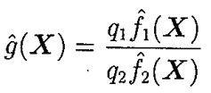


4. Performance estimation. Error Function
Posterior probability estimate
QP. Quasiparametric estimate
PMC is found analytically from sample means and variances of the values

Slide 12
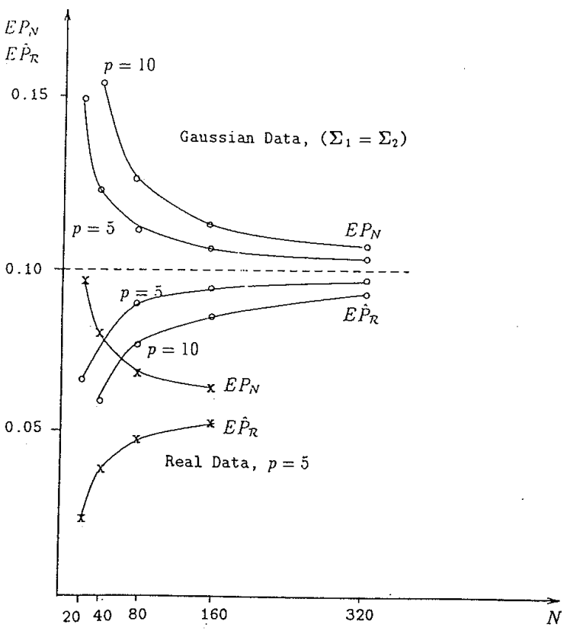
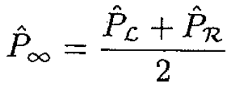
4. Performance estimation

Slide 13
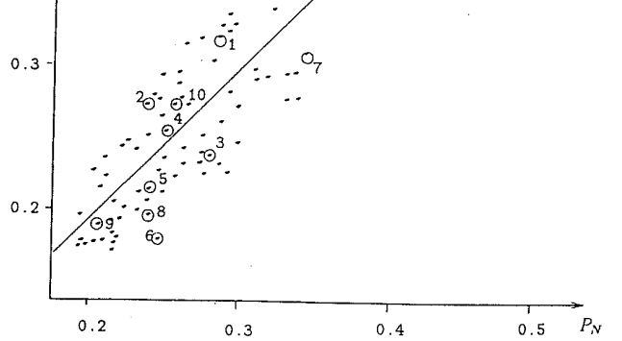
5. Feature selection
A. Optimal Number of Features
Accuracy of Feature Selection
Classification error types:
Apparent error
Ideal PMC
True PMC

Slide 14





6. Sample size determination

Slide 15




6. Sample size determination

Slide 16
7. Conclusion
Pay careful attention in selecting design parameters
Do experiments
Pay attention to test samples
Chose best features subset
Be attentive to performance

Slide 17
Thanks for your attention!

