Slide 1
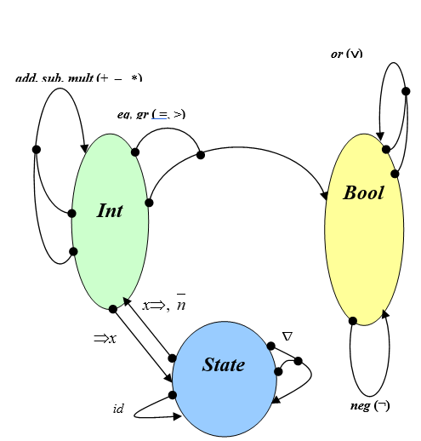
pl, pr
emp
Deque
al, ar

