Slide 1


SurroudSound
Improving music sharing at events and public venues
Joshua Guinness, Ming Huang, Daksh Patel, Bill Sun

Slide 2
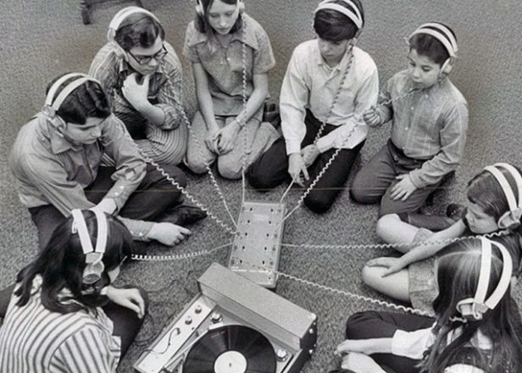
Motivation
Improve music / playlist sharing through a platform so more people can hear their favourite songs in public places or at events
Can be used at events such as dance parties, formals, weddings, and proms
Can be used at public spaces such as malls, supermarkets, and gyms

Slide 3

Functionality Highlight
Client Side:
Connected to Spotify and allows our app to collect users’ tokens, userIDs, emails, and top played songs
Common songs have a higher chance of being played
Host Side:
The host can see the list of popular songs in the vicinity
Ability to adjust radius of detection
They can ultimately decide what song to play next

Slide 4





Structural Overview
React Native and Node.js front-end
Spotify API for retrieving user info and getting top songs from each user
Built-in libraries for location services
API wrapper to integrate back-end into front-end
MongoDB database connected to the app via Postman API

Slide 5
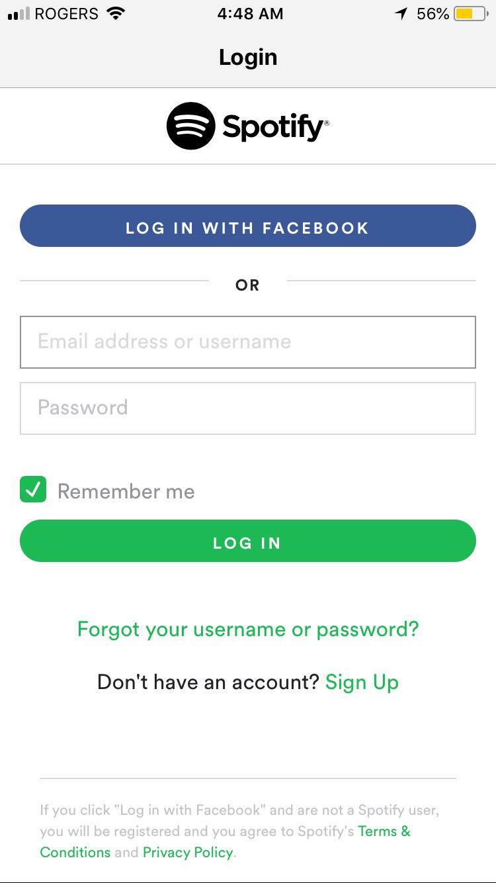
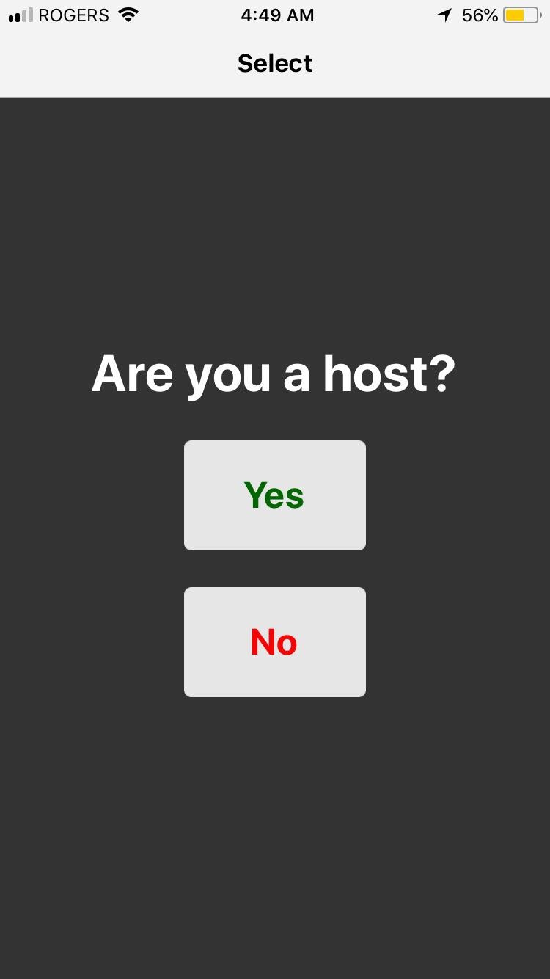
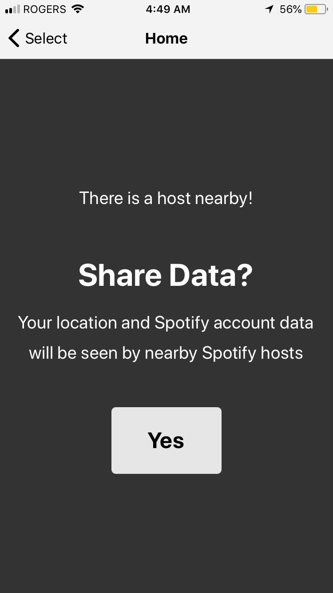

Slide 6
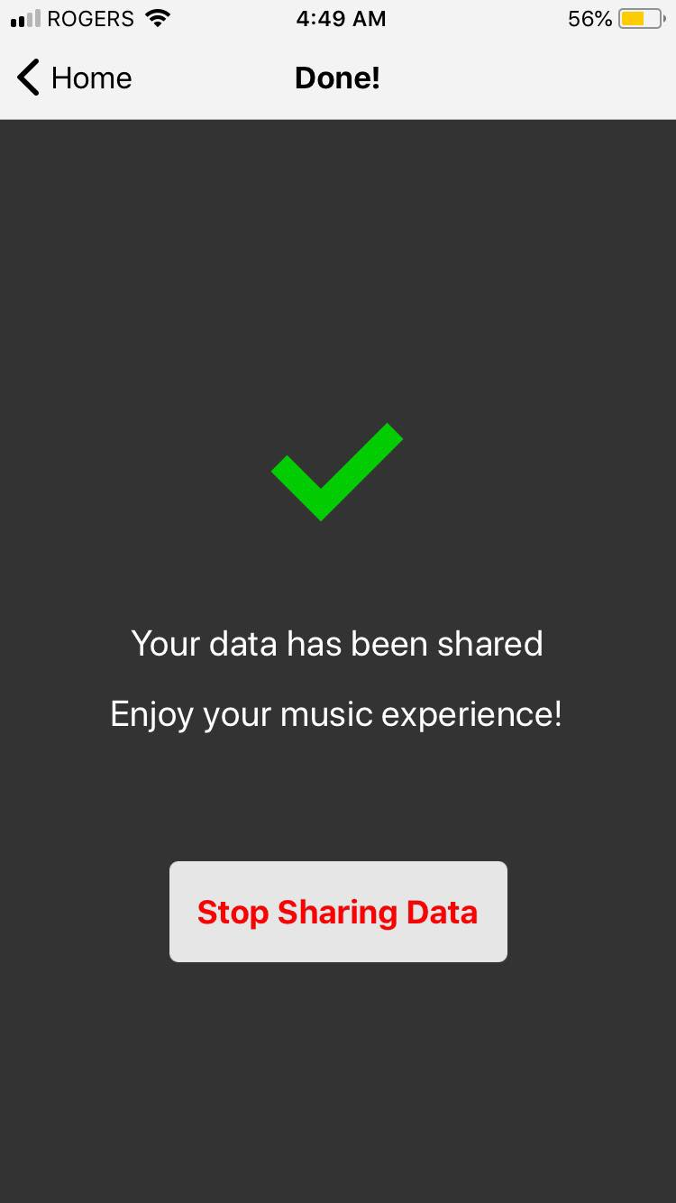
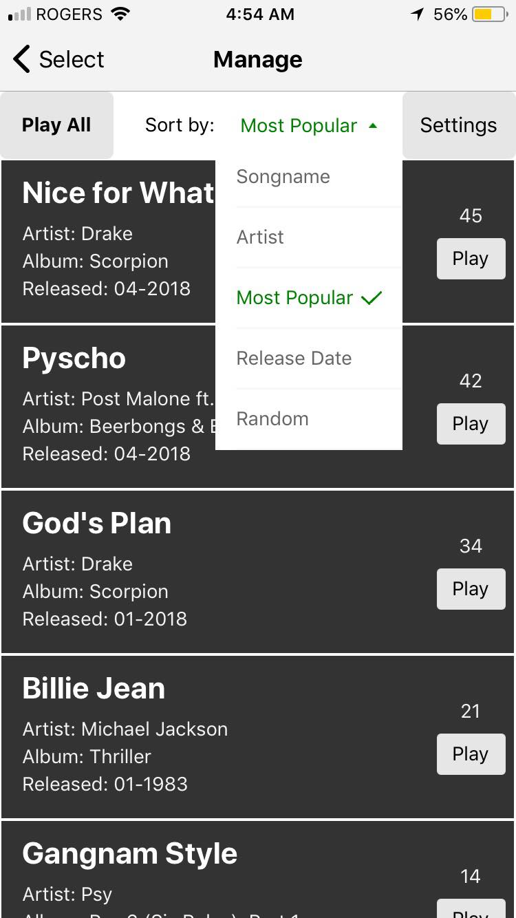
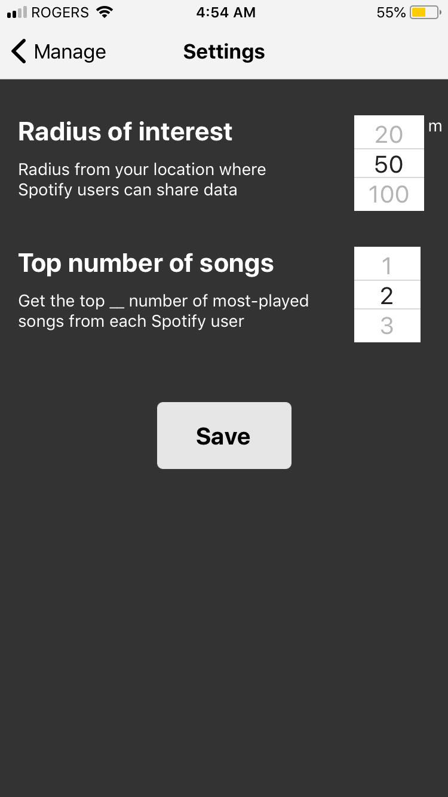

Slide 7
Demo
Spotify API: https://limitless-basin-60883.herokuapp.com
App: On Expo

Slide 8
How It was Built
Planning: Narrowed down the functionalities and APIs needed
Divide and conquer: Front-end, APIs, location, and back-end database
Integration and debugging: Staged between different subtasks

Slide 9
Challenges
All of us were new to the technologies used
Idea turned out to be a lot more challenging than initially thought
Many hours spent reading tutorials, understanding syntax, and fixing bugs
Compatibility concerns between APIs and libraries
Immense number of random errors
Single update pushing back development for many hours

Slide 10
What we accomplished and learned
Proud of creating something while utilising technology we have never seen before
Learning how to interface with APIs
Deeper understanding of Javascript and React
Do not underestimate time and tasks!

Slide 11
Next Steps
Seamless location based switching and database logging
Voting for the next song
Host would be able to decide what songs to omit
Both the host and client to see the playlist

Slide 12
Thank You!

