Slide 1



RNS INSTITUTE OF TECHNOLOGY
Channasandra, Bengaluru-560061
Dept. of ELECTRONICS AND COMMUNICATION ENGINEERING
2020-2021
Internship Presentation on
Smart suggestion of Top selling books of amazon store
Using unsupervised ML.
Internship Carried out at: Agimus technology ,322, #121, 1st Floor, Hosur Road, Madiwala, Bangalore - 560068
Under the Guidance of, By,
Prof.Sreenivasa Babu Ramakrishna hegde
USN: 1RN17EC120 Dept. of ECE, RNSIT Dep:ECE,RNSIT
Notes:
<number>
Roshni U Singh

Slide 2
Contents
About company
Introduction
Company overview
Company services
Domain
Company product
Work carried out
Mini Project

Slide 3
Introduction
Agimus Technologies
"Agimus" is a latin word meaning WE DRIVE, WE ACT, WE DO
“AGIMUS Technologies Private Limited” is a technology company formed by veteran technology researchers who has more than two decade of experience in the area of IOT / Autosar / VLSI / Embedded / RF / PCB verticals and Technology Training / Machine Learning / AI . Innovation is the life of enterprise and AGIMUS is in pursuit of sustainable team, especially focus on R&D innovation.
The company is located in hosur road,madival banglore.Company head and our internship guide is a well known resourceful person I have ever seen.To be mention some of the main product developped by the company are oasis,nvedia,fpga etc

Slide 4
Company Overview:
The company’s Product & solutions are contains wide range of In-house Developed Boards,
Evaluation Kits and Modules
Testing & Measurement equipment,
PCB Prototyping Machines, robotic Kits for the Academic Segment and
Customized Real Time IOT & Embedded solutions targeting mega-trend industries.
The company also give the service of custom designing embeded boards and fpga based on the requirements.
Agimus is also imparting knowledge through “agimus academy” where various courses on evolving technologies like machine learning,data science and matlab etc.

Slide 5
Company Services
Company offers a wide range of electronics and mechanical products, solutions and services in the area of IOT / Autosar / VLSI / Embedded / RF / PCB verticals and
Technology Training / Machine Learning / AI .
It always look for innovating ideas and brings product into market by applying trendy topics like AI,ML and many various. When covid pademic happened the company developped a product which was implemented using AI to maintain social distance in offices.
It also encouraging students to takeup internship programs virtually from there “agimus academy”.

Slide 6
Company product
OASIS:OASIS is able to compute the full range of design possibilities and
uses intelligent sampling which pinpoints the focus areas that contain the most promising options;regardless of design complexity.
The application of OASIS’ techniques yield best designs found in less time,
while users generate meaningful data to understand their models better
NVIDIA Jetson systems provide the performance and power efficiency to run autonomous machines software, faster and with less power. Each is a complete System-on-Module (SOM), with CPU, GPU, PMIC, DRAM, and flash storage saving development time and money. Jetson is also extensible. Just select the SOM that’s right for the application, and build the custom system around it to meet its specific needs.
Agimus IOT Starter Platform is a unique platform with combination of Arduino,ESP8266 and Node MCU.The user can design and develop algorithms pertaining to IOT based on his application.

Slide 7
Rigol premium line of products includes Digital and Mixed Signal Oscilloscopes, Spectrum Analyzers and RF Signal Generators, Arbitrary waveform Generators, Sensitive Measurement Products, and Data Acquisition Systems
rtix 7 FPGA Development board is upgraded version of Spartan 6 board. It is exclusively designed for the latest Vivado Design Suite. The Artix 7 board includes most of the interfaces present on Spartan 6 board plus external memory SRAM, HDMI Out and Micro SD interface. Microblaze soft-core processor design can be easily implemented with SRAM using Vivado SDK.

Slide 8
Work Carried out
Before starting the internship we were well informed about the things what we are going to learn and What are the works and project we should able to build with the help of there guidence.
The internship summary is shown in next slide.
Week 1: Mentor tought us about various basic commands in matlab and also advanced topics Like MATLAB deep learing API’s. How to use various machine learing API’s of matlab
Week 2: This week they tought us how transfer learing works by showing real world projects,using “Alexnet”. Some of those project to name are, classifying fruits in a
fruit shop,identifying faces etc
Week 3:One of the trending topic, data science was tought in this week.
Various python packages of python was introduced
Week4:Python code implementation using pynq and zync boards was shown
Week5: Hardware items used for AI related projects was given inroduction. Ex:Nvedia j jetson nano(gpu)
Week6: Given a task to build a project “movie recommendation system”
Successfully finished project and completed internship.

Slide 9
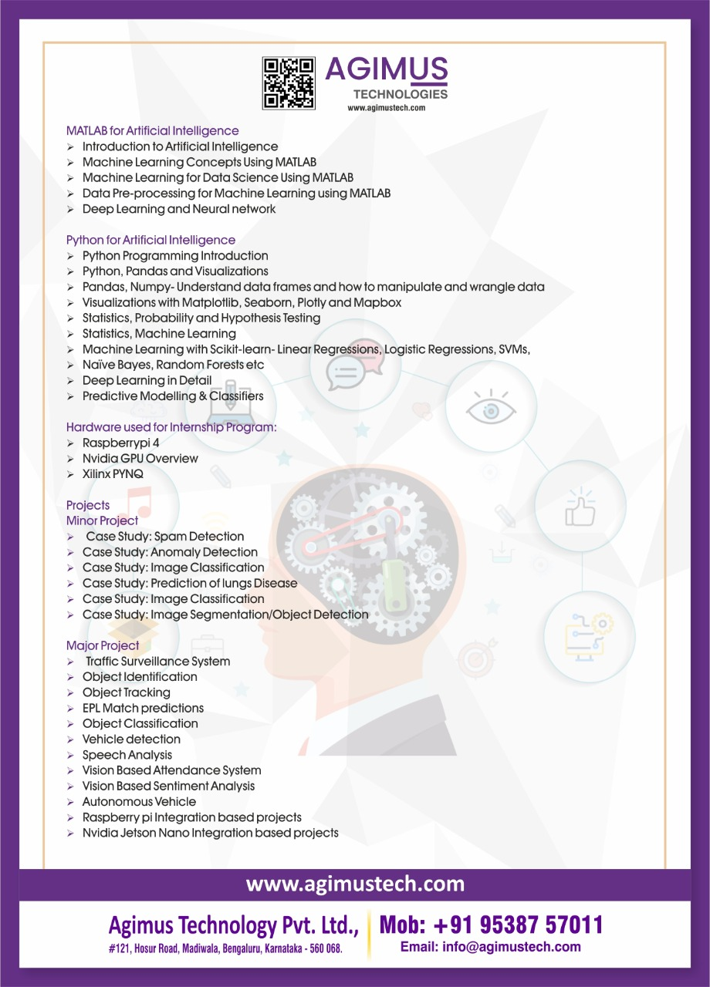

Slide 10
Mini project
Smart suggestion of Top selling books of amazon store
Using unsupervised ML.
Aim: To suggest a reader top 5 selling books in amazon online book store using machine learing technique
Tools used are: Python sklearn,tkinter,pandas libraries and spyder ide
The project starts with collecting/ to be specific in ML word data mining is the first and fore most step.I have collected the neccessory data for training my machine learing model from the website Kaggle.com.
The data includes 550 different book names with published year, user rating, type of book(fication or non fiction),
Price, author.

Slide 11
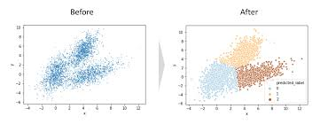
Machine learing model:
The model which can be trainable using collected data is then created
using python sklearn library
Sklearn module of python comes with predefined k-means clustering class
Using this class i have created the model and trained using data.
K-means clostering technique:

Slide 12
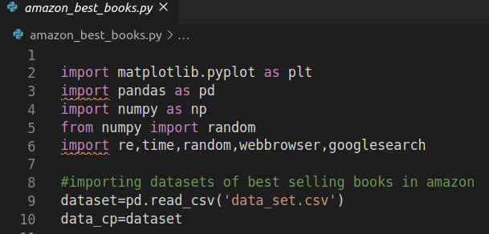
Randomly spread data is categorised into definite classes using k-means clustoring based on the Similarity.
The first 6 lines of code importing data and then reading data from csv file format

Slide 13
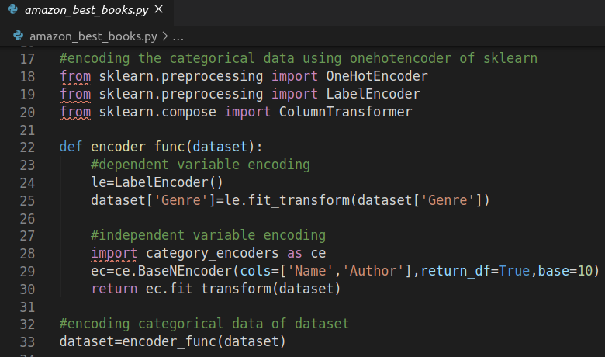
Encoding:
Before training its important to convert all categorical data like book name,author name etc into Digit since we all know machine cannot understand our human language, it knows only binary 1’s and 0’s .I am using here sklearn Onehot encoder.

Slide 14
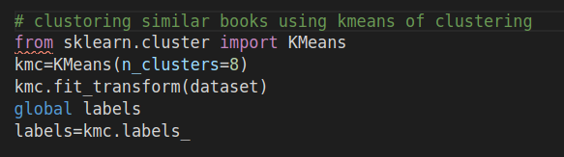
Training Model:
When all data is ready in machine readable format we use k-means clustor model and train with Our dataset for costom output.Now our model is trainded it will assign each of book into one of the 8 clusters as we mentioned.
Now this trained model can take input from reader and will suggest him best 5 books randomly from that cluster.
To give a nice user interface i have used python tkinter GUI kit.

Slide 15
Block Diagram
Raw data
input
imputing
scaling
encoding
Trained ML model
Output 5 books
Reader’s input
Fig : Block Diagram

Slide 16
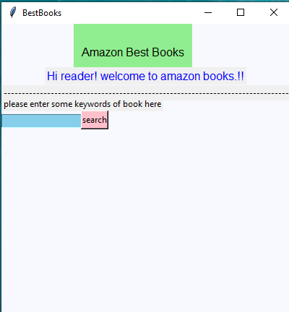
Results of project
The user is promted tkinter window as shown below.

Slide 17
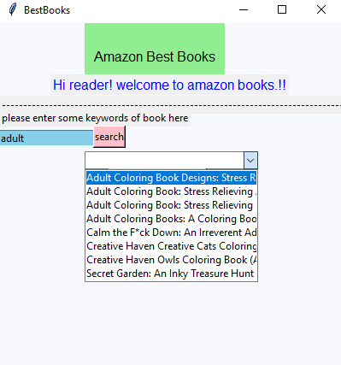
The user is asked to put some keyword of book he have read recently. Since i have enabled smart search Using python regular expression , he need not to give full name of the book. He can just put some key words of the book and press search he will get all list of books that contains those keywords.
Eg: if he enter world
It can suggest him 1) seven wonders of world 2) world war 2 like that
He can then select any of those books and press select.

Slide 18
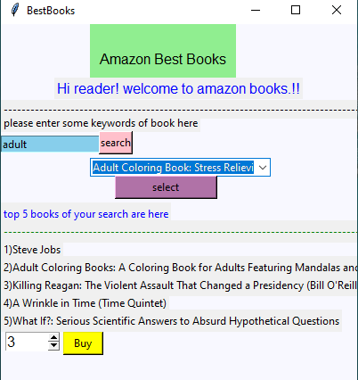
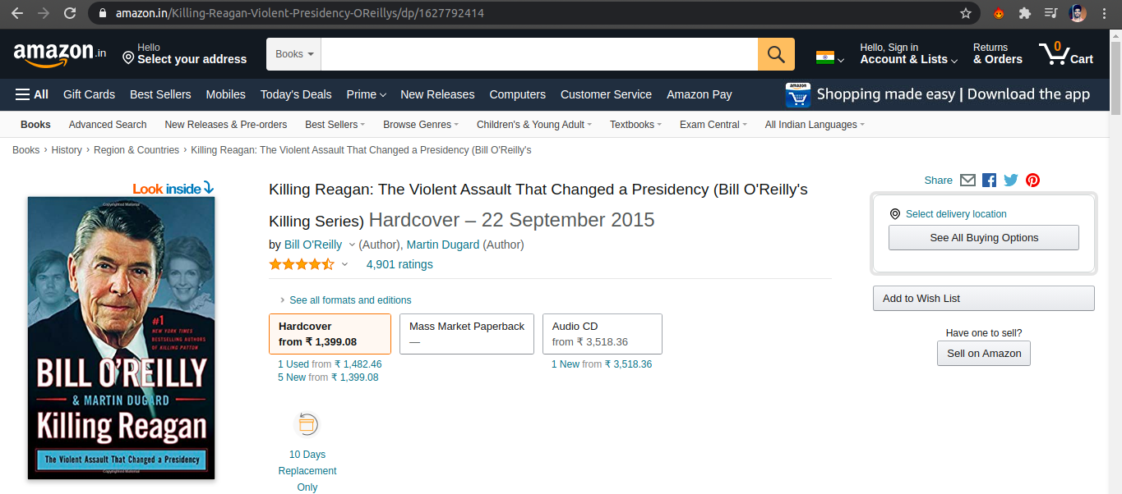

After he press select from those smart searched book list he will be suggested top 5 books related to his search with the help of our machine learning model. He can select those books using the index number and then i have given him to buy that book option also. He can select the book in spin box and hit buy that will take him directly to amazon book store

Slide 19
Outcomes of Internship
The internship helped me to understand various AI and ML techniques and how to apply them to solve
real world existing problems.
It also gave a good understanding about available hardware items to implement models that i have created
in AI and optimization, speeding options.
A well introduction of python and its useful packages for data science and machine learning filled a confidence
in me to start my career in those domains.
MATLAB features and API’s introduction in this internship made me to build small individual project
eg: face detection, bounding box on vechicles etc
In addition to all of these many additional tools which are helpful to build real world projects like rasberry pi,
Nvedia jetson nano , pynq platforms were helped me to think out of box.
The project “movie recommendation” with the help of mentors guidence was really helped me understand
all the aspects of data mining,data handling, model creation,encoding and many more data science
terminologies.
This 45 days of intership made me to understand all the things related to AI,ML ,DATA SCIENCE
and helped me to build some cool real world projects.

Slide 20
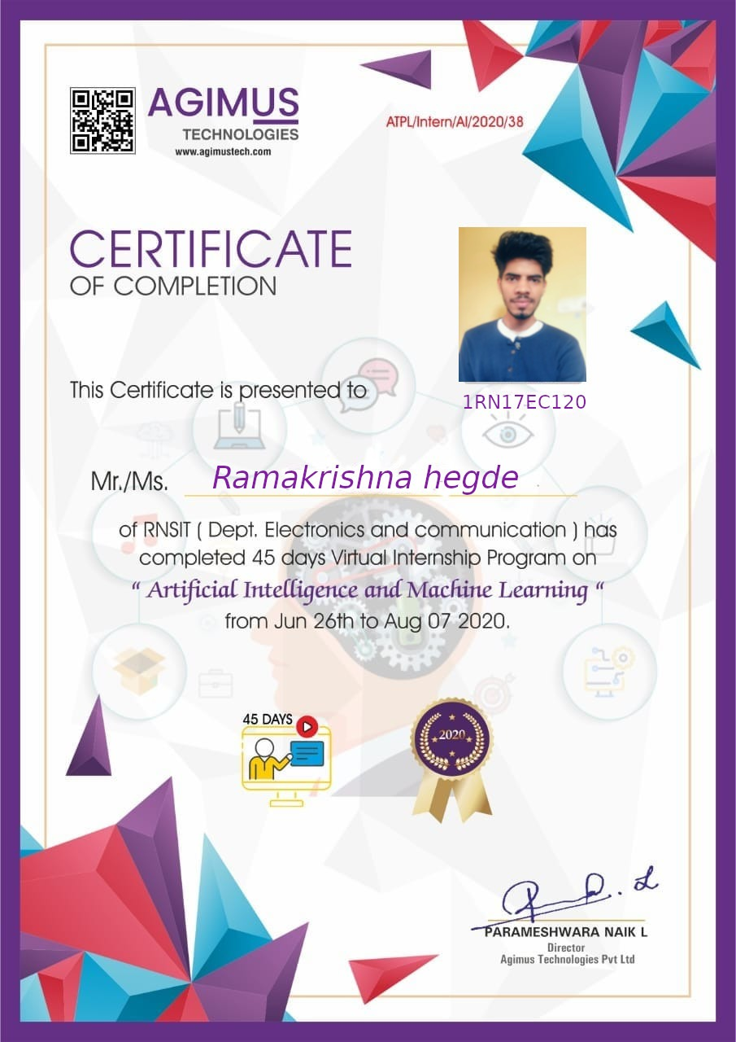

Slide 21
THANK YOU

