Slide 1
24S AI Infrastructure and Arch. - 02 #4 Sentiment Analysis // Azure
Gurinder Singh Sandhu
Student ID: 200553737

Slide 2
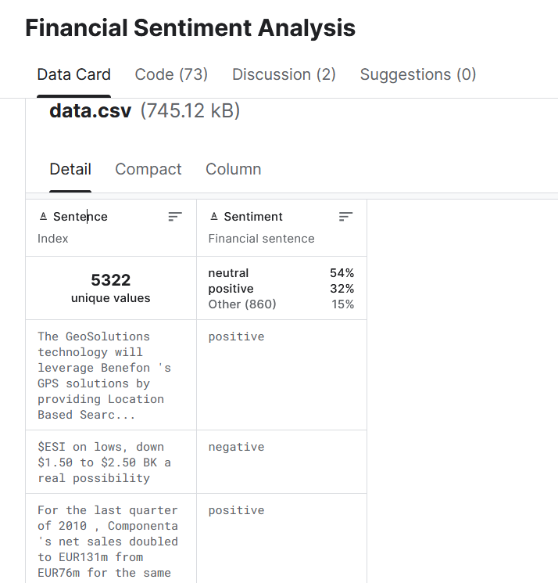
Data collection Phase
Link of dataset used:
https://www.kaggle.com/datasets/sbhatti/financial-sentiment-analysis

Slide 3
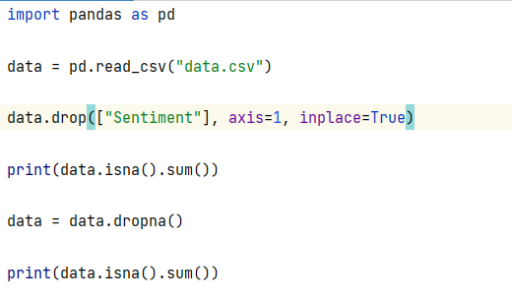
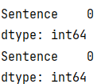
We removed the “Sentiment” column as that is what we will be predicting in our Sentiment analysis assignment.
Then we checked for any null/na values and tried to remove them.
Output

Slide 4
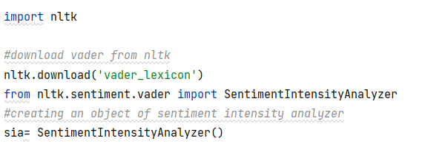
Sentiment Analysis Library
VADER( Valence Aware Dictionary for Sentiment Reasoning) is an NLTK module that provides sentiment scores based on the words used. It is a rule-based sentiment analyzer in which the terms are generally labeled as per their semantic orientation as either positive or negative.
First, we will create a sentiment intensity analyzer to categorize our dataset. Then, we use the polarity scores method to determine the sentiment.

Slide 5
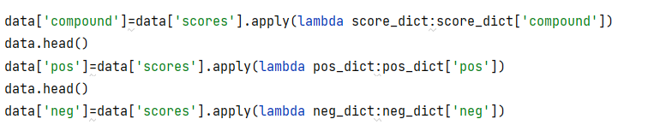
Polarity_scores: This function returns the sentiment strength based on the given input statement/text.
For example:
text= "Bobby is an amazing guy" sia.polarity_scores(text)
{‘compound’: 0.5859, ‘neg’: 0.0, ‘neu’: 0.513, ‘pos’: 0.487}
You can observe that the above statement is neutral
text= "The food delivered was really very bad" sia.polarity_scores(text)
{‘compound’: -0.6214, ‘neg’: 0.404, ‘neu’: 0.596, ‘pos’: 0.0}
This example statement is a negative one.
Let us now create a new column in our CSV file that stores the polarity scores of each review.
Similarly, we then create three different columns each for compound scores, positive scores, and negative scores.

Slide 6
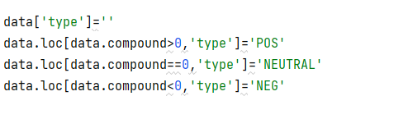
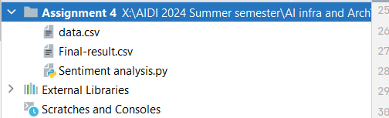

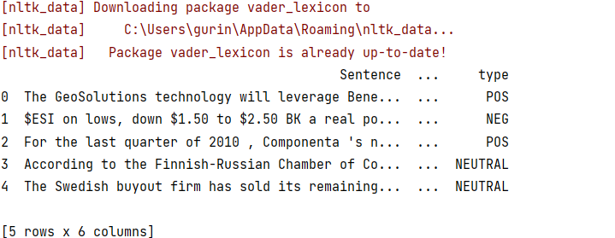
We then create a new column named type, which indicates whether the review is pos, neg, or neutral.
Output

Slide 7
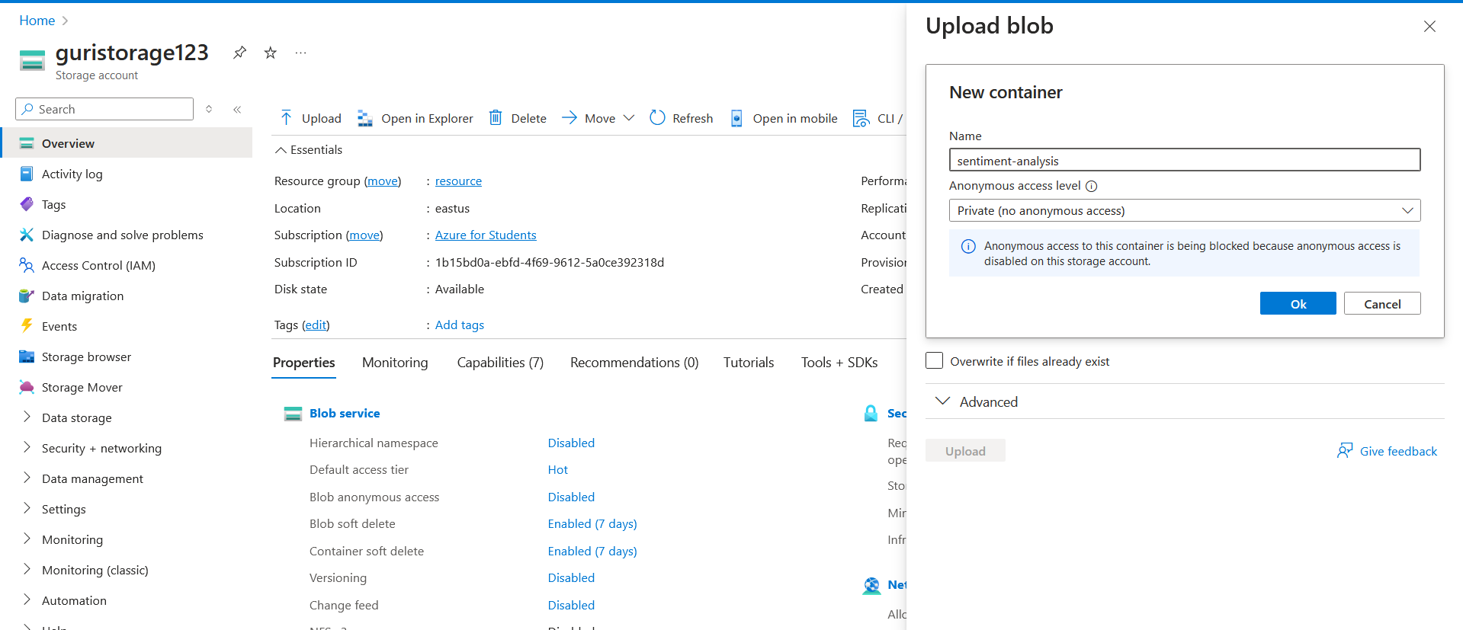
Uploading the Final CSV File to Azure Blob Storage

Slide 8
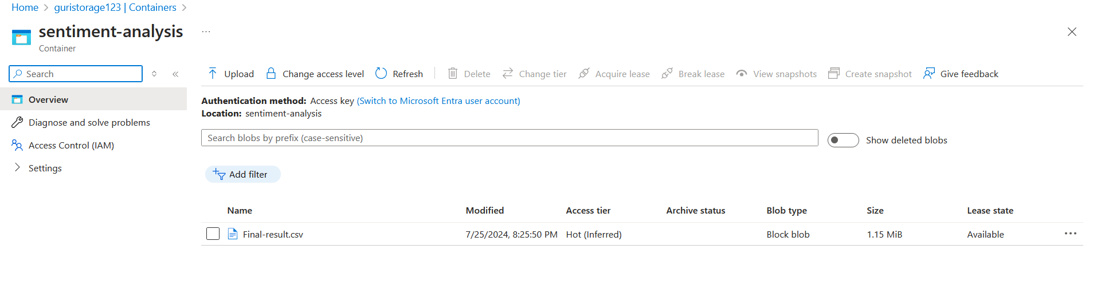
The CSV file is stored in sentiment-analysis container

Slide 9
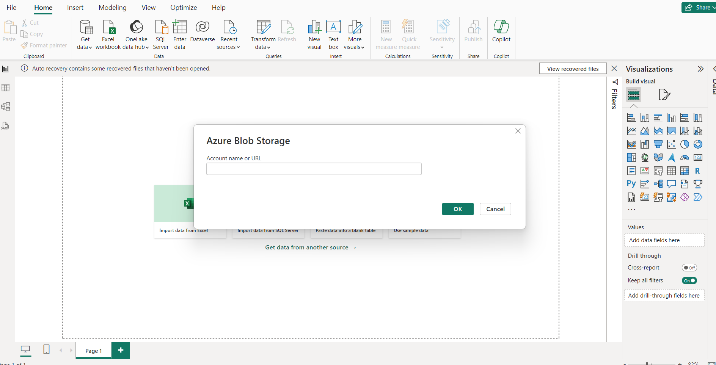
Connecting Azure Blob Storage to Power BI

Slide 10
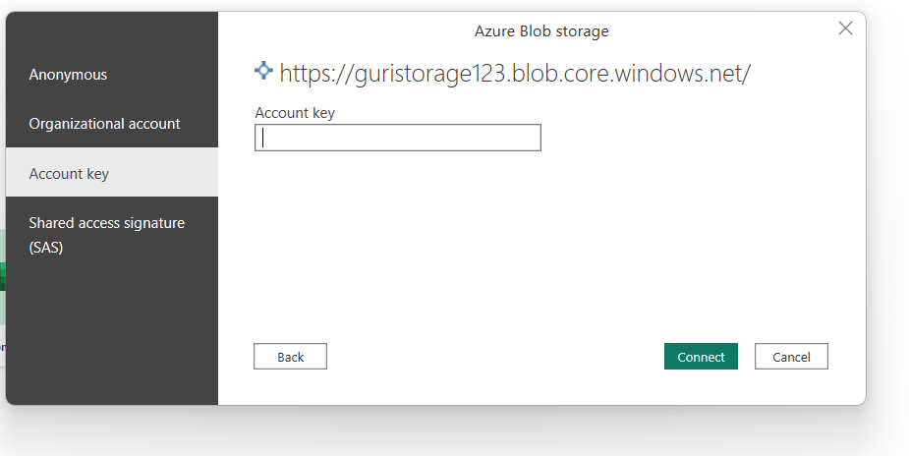
Entering Access key from Azure blob

Slide 11
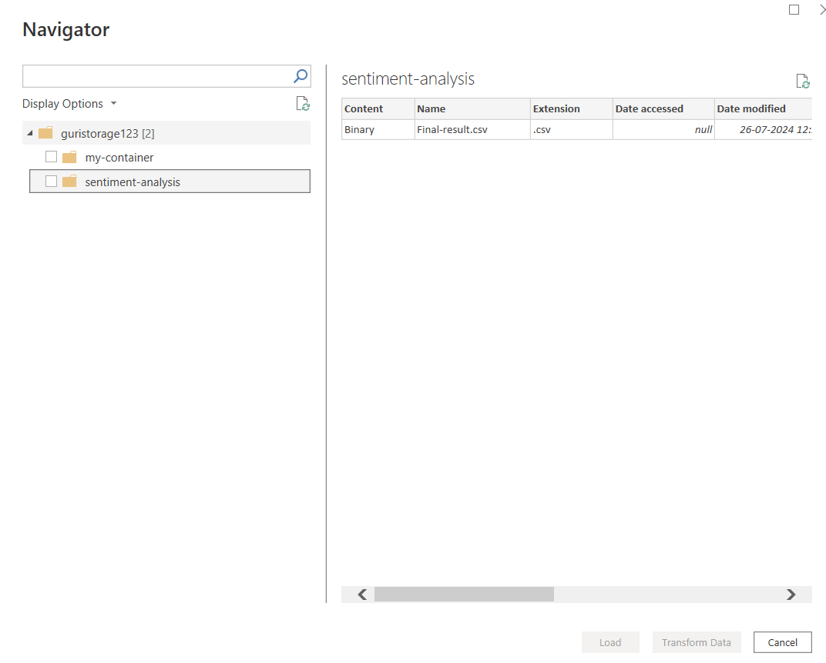
Select the blob required, in our case it is sentiment-analysis

Slide 12
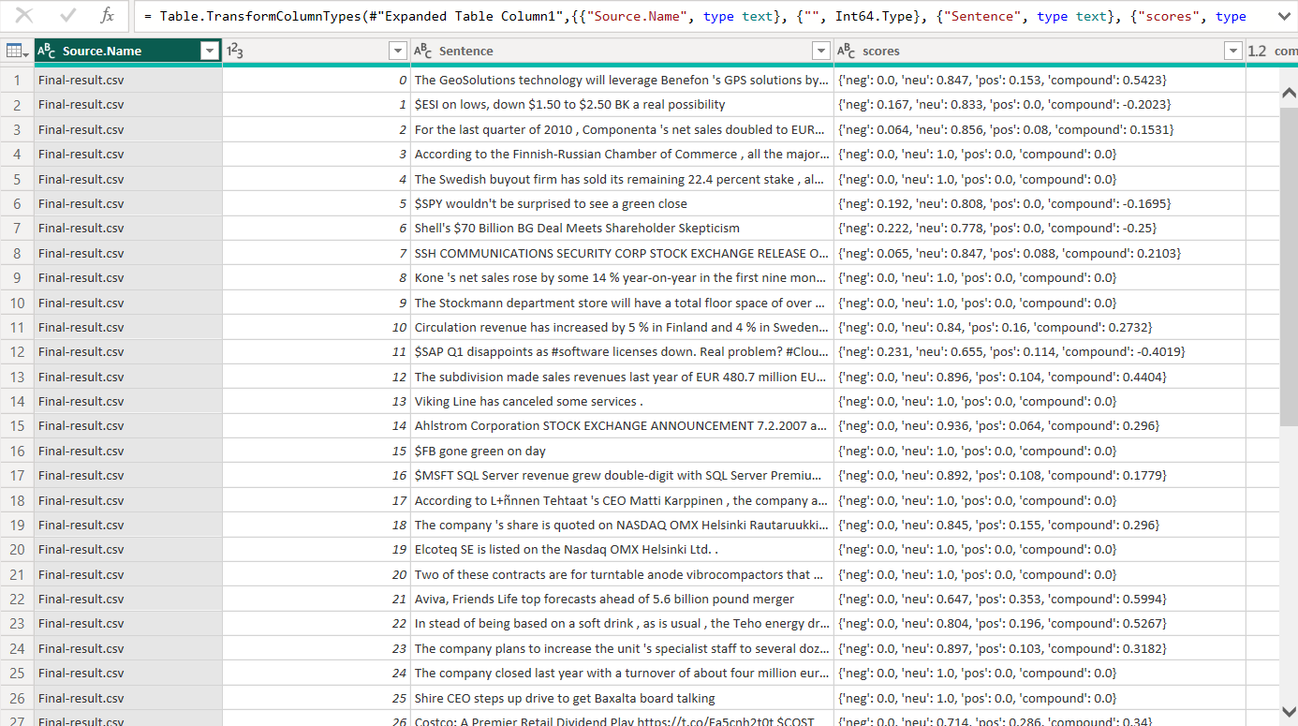
The csv file is imported in Power BI, finally.

Slide 13
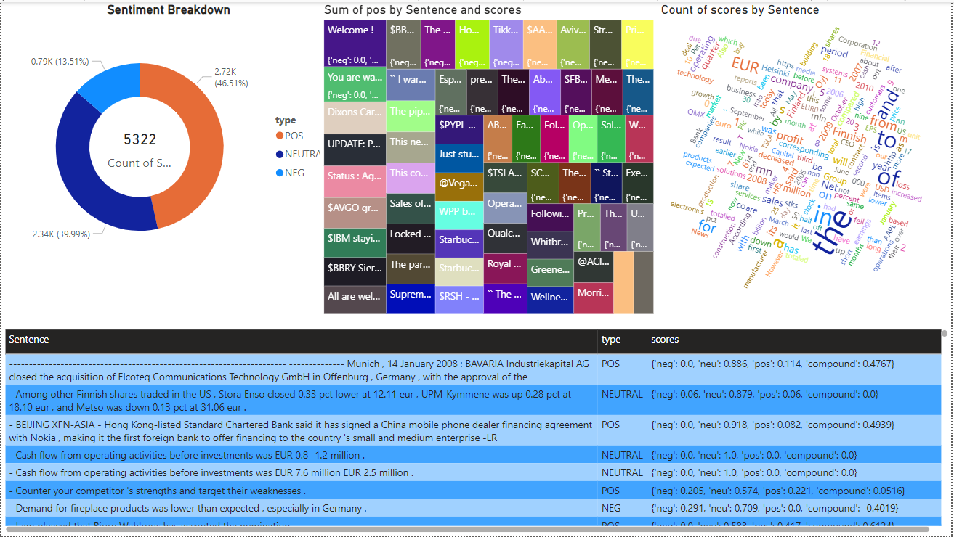
Creating Visualizations in Power BI

Slide 14
Thank you
Gurinder Singh Sandhu

