Slide 1
Hello, everyone!
My name is Brandon

Slide 2
I’m From…
Where am I from?

Slide 3

AMERICA

Slide 4
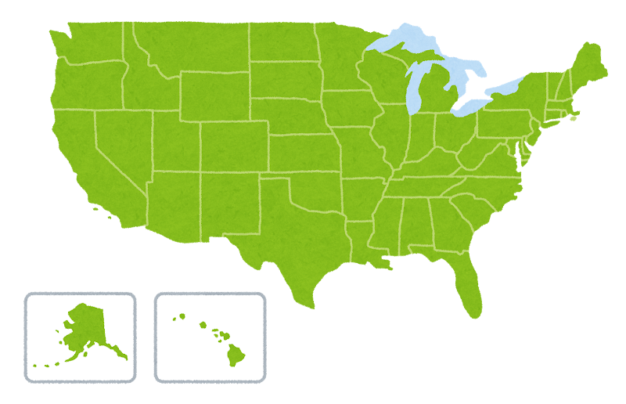
AMERICA

Slide 5

LOS ANGELES, CALIFORNIA

Slide 6
🐾
My Pets 🐾
2 cats and 4 dogs!

Slide 7
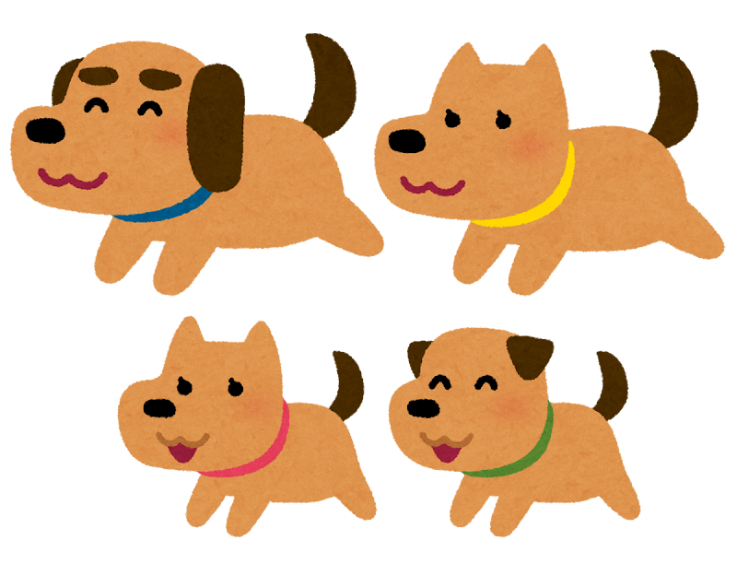
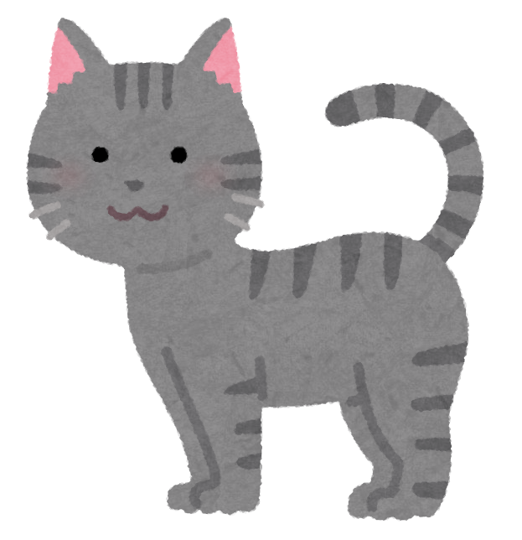
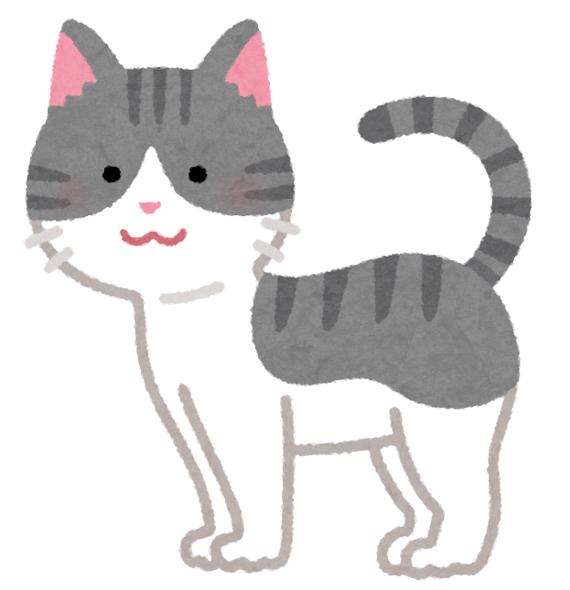
Meet my animals! 🐾
2 cats
They are calm and fluffy!
4 dogs
Loud and very energetic!

Slide 8
My Favorite Color
What is Brandon’s favorite color?

Slide 9

My favorite color is…
Black

Slide 10
True or False?
⭕ for TRUE · ❌ for FALSE

Slide 11
TRUE or FALSE? 🧐
"Brandon speaks Spanish."
⭕ TRUE
❌ FALSE

Slide 12
⭕ TRUE!

Slide 13
TRUE or FALSE? 🧐
"Brandon likes cold weather."
⭕ TRUE
❌ FALSE

Slide 14
❌ FALSE!

Slide 15
TRUE or FALSE? 🧐
"Brandon has more cats than dogs."
⭕ TRUE
❌ FALSE

Slide 16
❌ FALSE!

Slide 17
TRUE or FALSE?
"Brandon is from Los Angeles."
⭕ TRUE
❌ FALSE

Slide 18
⭕ TRUE!

Slide 19
Food
Likes & Dislikes

Slide 20

I LIKE…
PIZZA
Cheesy and delicious!

Slide 21
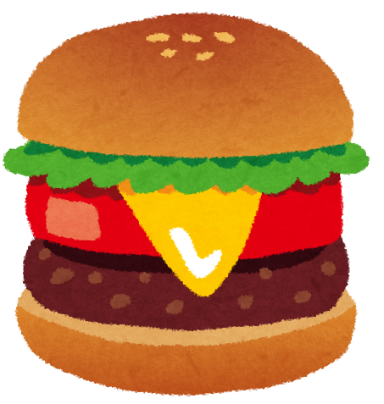
I LIKE…
HAMBURGER
An American classic!

Slide 22

I don't like... 🙅
EGGPLANT
I don’t like the taste!

Slide 23
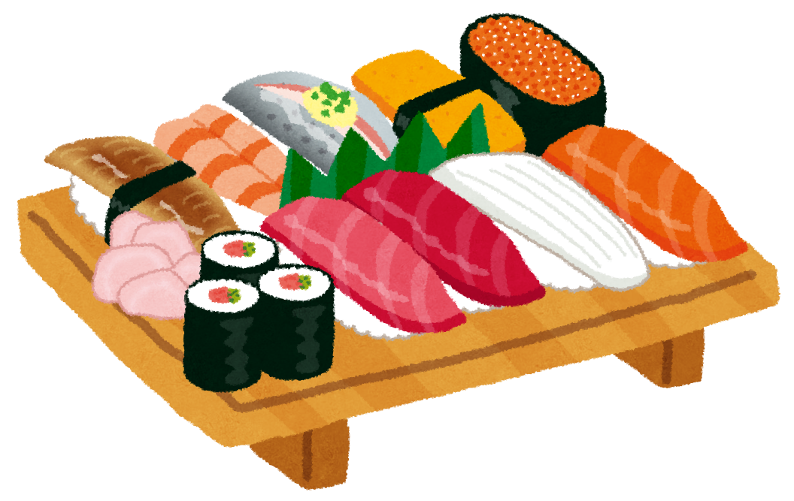
I LIKE…
SUSHI
Many types of fish!

Slide 24
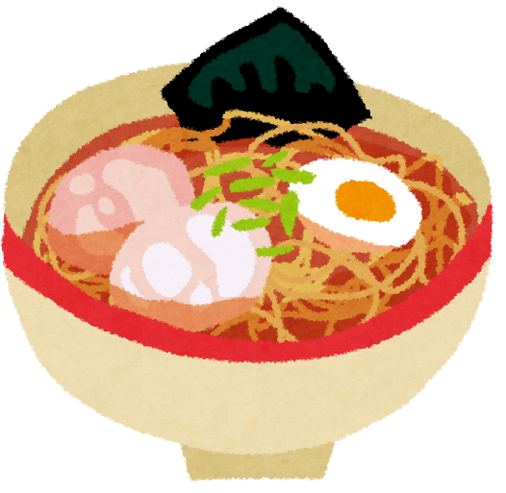
I LIKE…
RAMEN
One Tonkatsu Ramen, please!

Slide 25
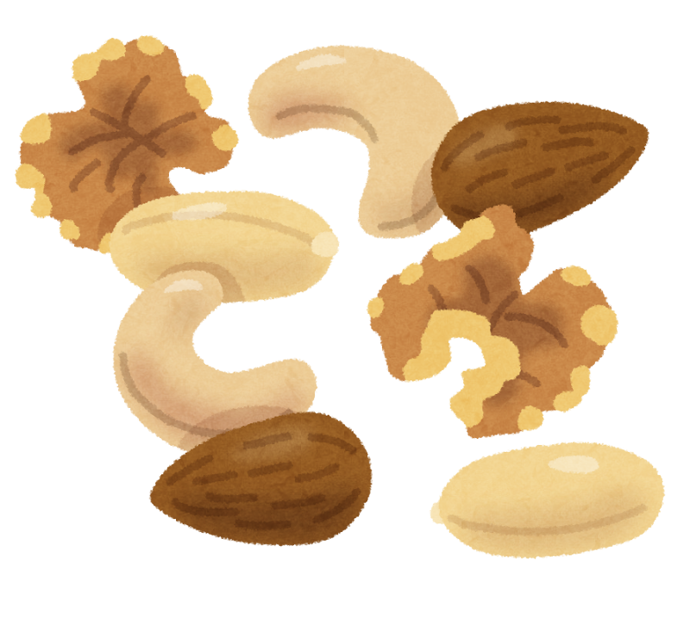
I don't like...
NUTS
No, thank you!

Slide 26
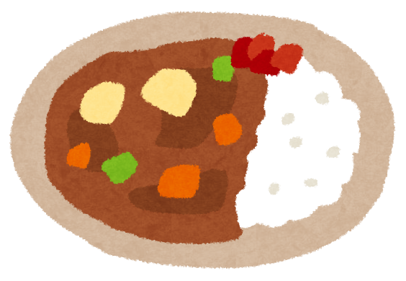
I LIKE…
CURRY
Spicy curry is the best!

Slide 27

I LIKE…
STRAWBERRIES
Fresh and sweet!

Slide 28
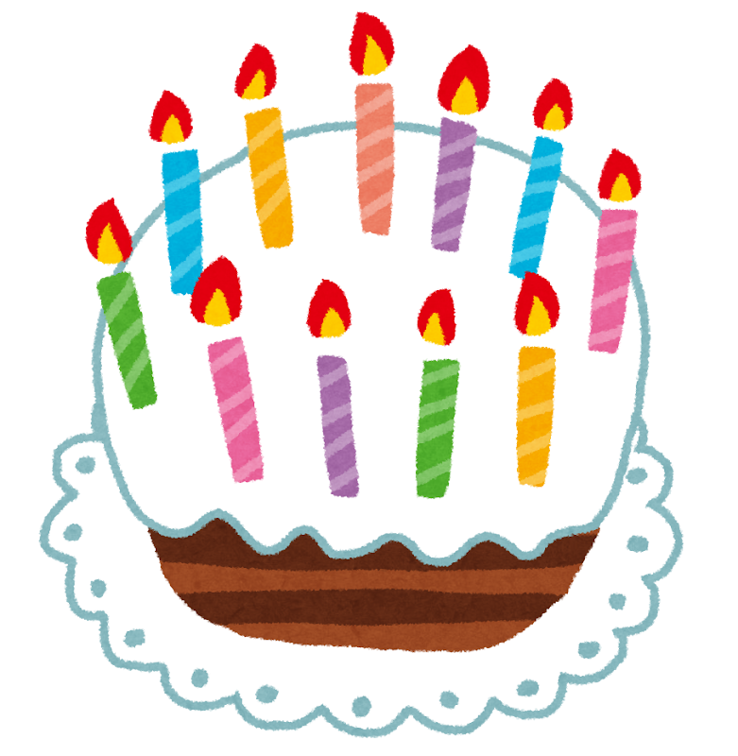
I don't like...
CAKE
It is way too sweet!

Slide 29

I like...
SPICY FOOD
The spicier the better!

Slide 30
I don't like...
CAKE
It is way too sweet!

Slide 31
QUIZ!
Brandon does not like?
A. Pizza
B. Sushi
C. Nuts
D. Spicy food

Slide 32
Answer!
Nuts!

Slide 33
QUIZ!
Where is Brandon from?
A. Japan
B. Russia
C. Mexico
D. America
Answer: C — Spanish! 🇪🇸
[irasutoya: search "quiz teacher" on irasutoya.com and paste image here]

Slide 34
Answer!
America!
Brandon lived in California!

Slide 35
QUIZ!
Brandon has __ cats and __ dogs.
A. 1 cat, 3 dogs
B. 2 cats, 4 dogs
C. 3 cats, 4 dogs
D. 3 cats, 4 dogs

Slide 36
Answer!
2 cats + 4 dogs!
That's 6 animals in total! Brandon's house is very busy!

Slide 37
3 Hints Quiz!
Can you figure it out before Hint 3?

Slide 38
3 Hints Quiz!
What is it?
Hint 1: It is in the United States 🇺🇸
Hint 2: ? ? ?
Hint 3: ? ? ?

Slide 39
3 Hints Quiz!
What is it?
Hint 1: It is in the United States 🇺🇸
Hint 2: It is famous for movies and sunshine
Hint 3: ? ? ?

Slide 40
3 Hints Quiz!
What is it?
Hint 1: It is in the United States 🇺🇸
Hint 2: It is famous for movies and sunshine
Hint 3: A city Brandon lived in!

Slide 41
Answer!
LOS ANGELES!

Slide 42
3 Hints Quiz!
What is it?
Hint 1: You can paint.
Hint 2: ? ? ?
Hint 3: ? ? ?

Slide 43
3 Hints Quiz!
What is it?
Hint 1: You can paint.
Hint 2: You can craft.
Hint 3: ? ? ?

Slide 44
3 Hints Quiz!
What is it?
Hint 1: You can paint.
Hint 2: You can craft.
Hint 3: Brandon likes to draw!

Slide 45
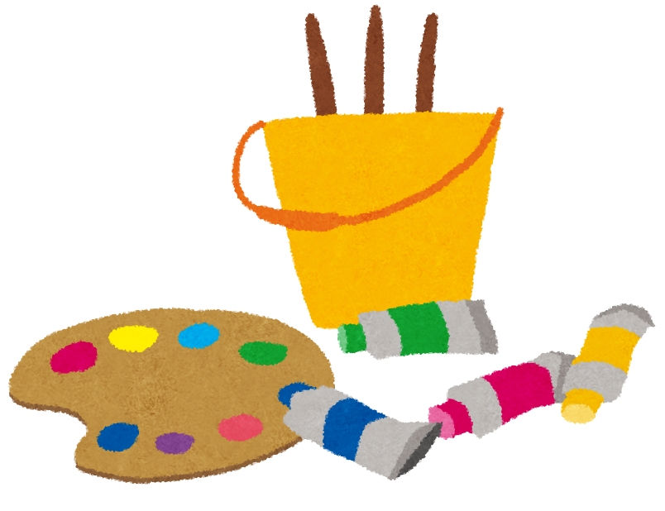
Answer!
ART AND CRAFTS!

Slide 46
3 Hints Quiz!
What is it?
Hint 1: You need water
Hint 2: ? ? ?
Hint 3: ? ? ?

Slide 47
3 Hints Quiz!
What is it?
Hint 1: You need water
Hint 2: You use your whole body
Hint 3: ? ? ?

Slide 48
3 Hints Quiz!
What is it?
Hint 1: You need water
Hint 2: You use your whole body
Hint 3: Brandon can do this well. It's also a great exercise!

Slide 49
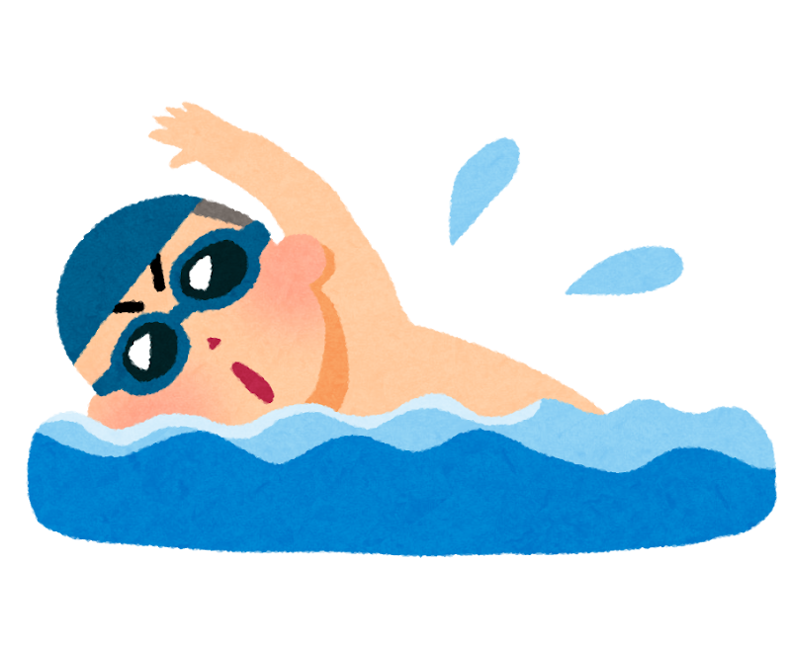
Answer!
SWIMMING

Slide 50
3 Hints Quiz!
What is it?
Hint 1: It comes from Japan
Hint 2: ? ? ?
Hint 3: ? ? ?

Slide 51
3 Hints Quiz!
What is it?
Hint 1: It comes from Japan
Hint 2: It has noodles
Hint 3: ? ? ?

Slide 52
3 Hints Quiz!
What is it?
Hint 1: It comes from Japan
Hint 2: It has noodles
Hint 3: Brandon likes to eat it!

Slide 53
Answer!
Ramen!

Slide 54
⭕ Like or Dislike!

Slide 55
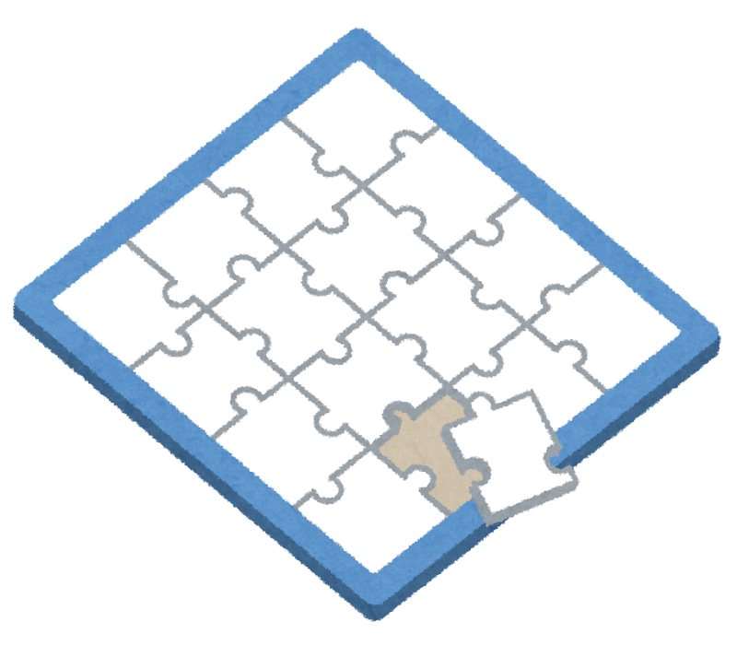
Like or Dislike!
PUZZLES

Slide 56
⭕ LIKE!

Slide 57
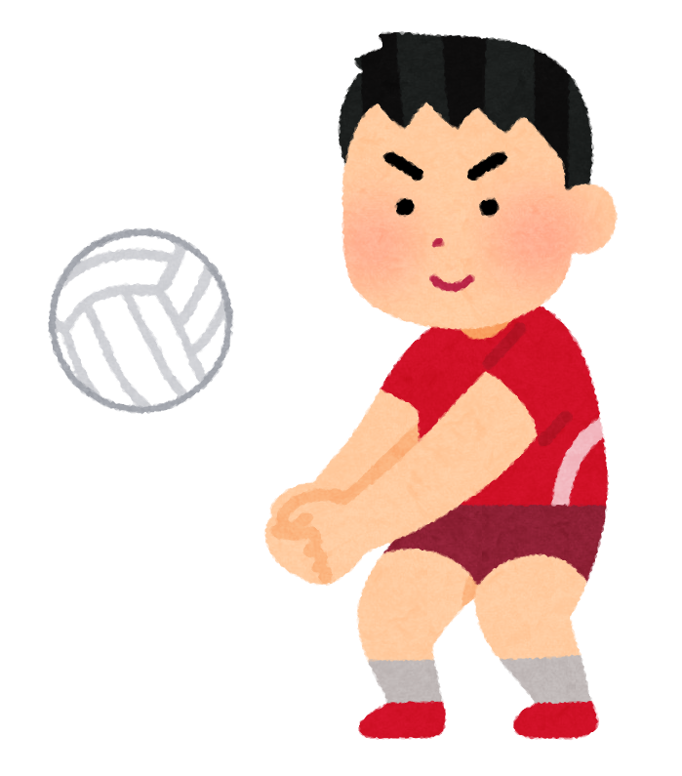
Like or Dislike!
VOLLEYBALL

Slide 58
❌ DISLIKE!

Slide 59
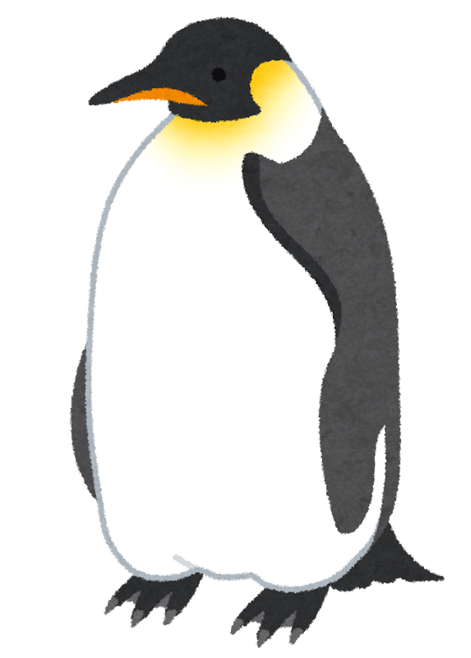
Like or Dislike!
PENGUINS

Slide 60
⭕ LIKE!

Slide 61
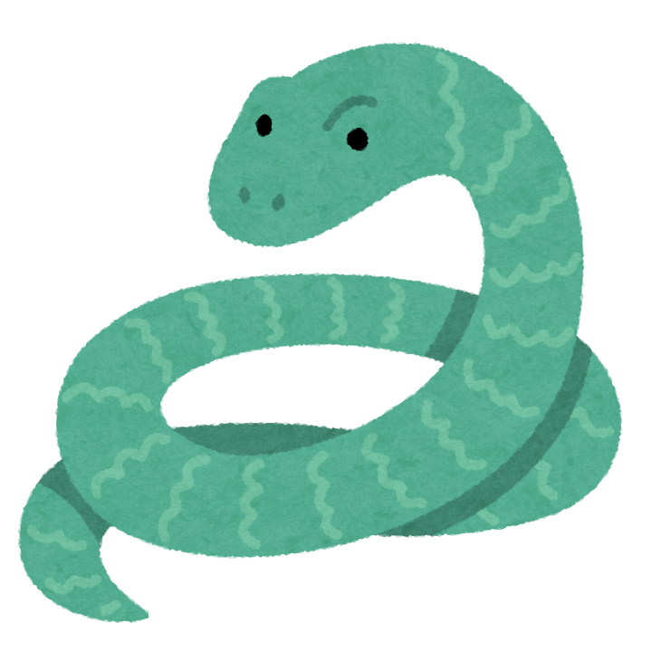
Like or Dislike!
SNAKES

Slide 62
⭕ LIKE!

Slide 63
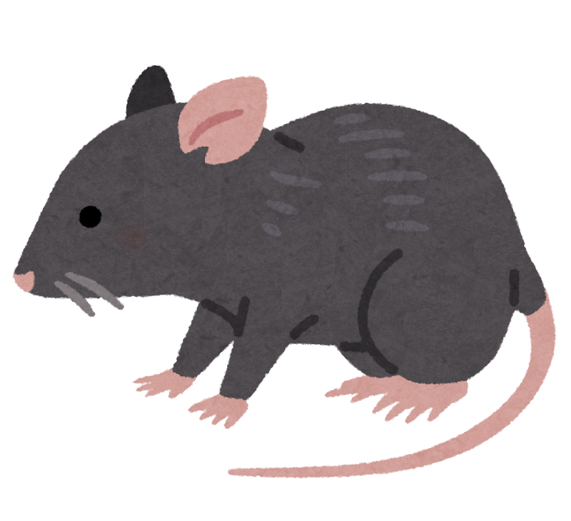
Like or Dislike!
MOUSE

Slide 64
❌ DISLIKE!

Slide 65
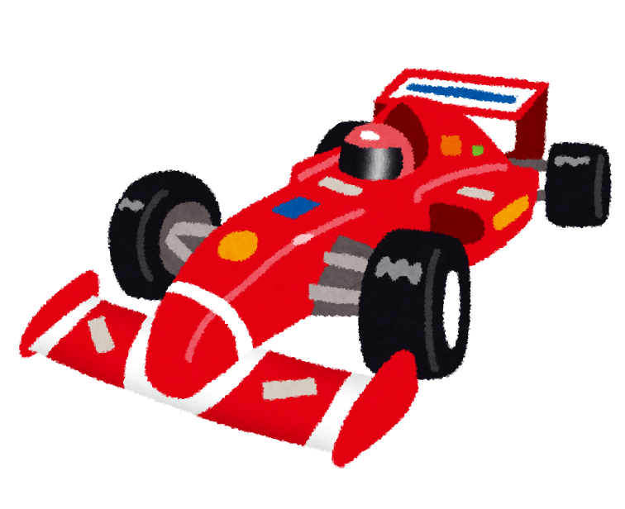
Like or Dislike!
F1 RACE

Slide 66
⭕ LIKE!

Slide 67

Like or Dislike!
SKY DIVING

Slide 68
❌ DISLIKE!

Slide 69
What Would Brandon Choose?

Slide 70
What would Brandon choose? 🤔
What weather does Brandon like?
A
B
☀️ A hot day
❄️ A cold day
VS

Slide 71
Brandon chooses...
A: ☀️ A hot day
Brandon hates cold weather — beach all the way! ☀️

Slide 72
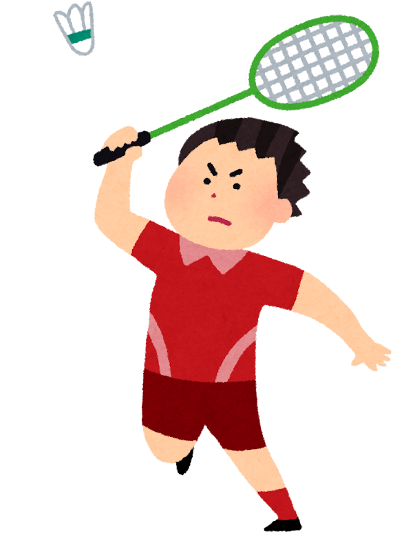
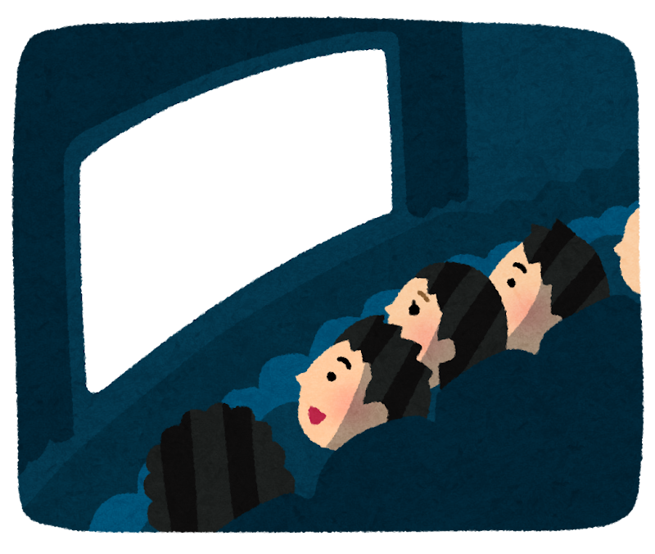
What would Brandon choose? 🤔
Friday night — what does Brandon do?
A
B
Play badminton
Watch a movie
VS

Slide 73
Brandon chooses...
B: Watch a movie
Brandon likes movies! He dislikes badminton. 🎬

Slide 74
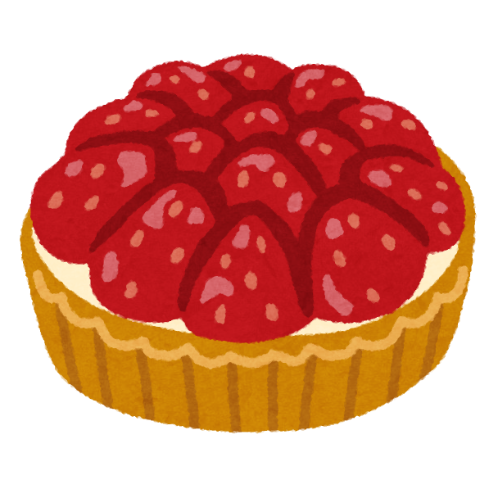
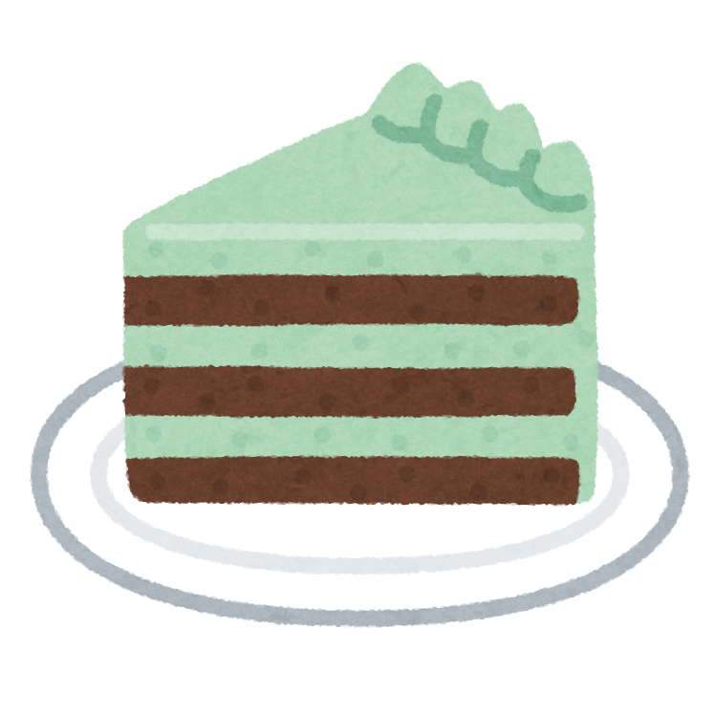
What would Brandon choose?
Brandon's dessert...
A
B
Strawberry tart
A big slice of cake
VS

Slide 75
Brandon chooses...
A: Strawberry Tart
Brandon loves strawberries but really dislikes cake! 🍓

Slide 76
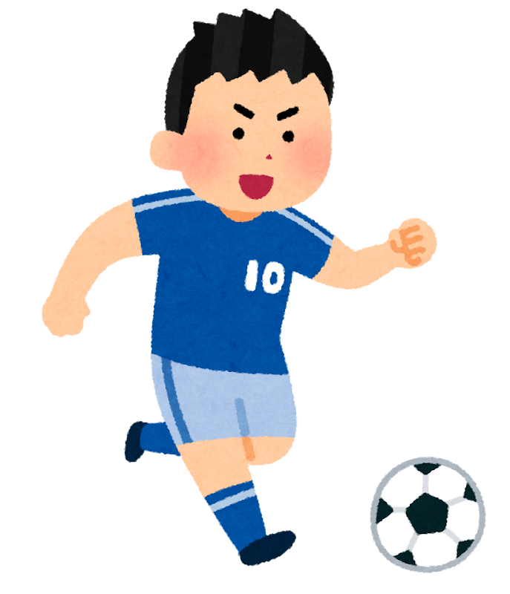
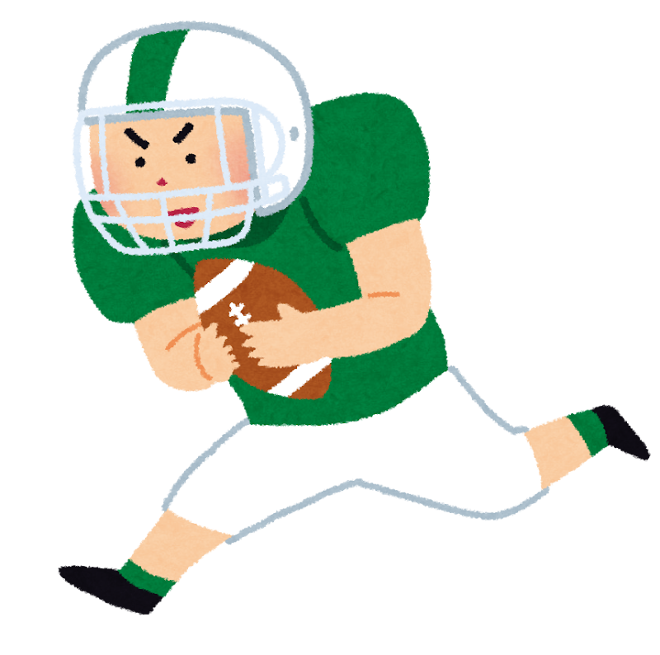
What would Brandon choose?
Brandon’s favorite sport...
A
B
Soccer
American Football
VS

Slide 77
Brandon chooses...
B: American Football
Brandon used to play American Football!

Slide 78

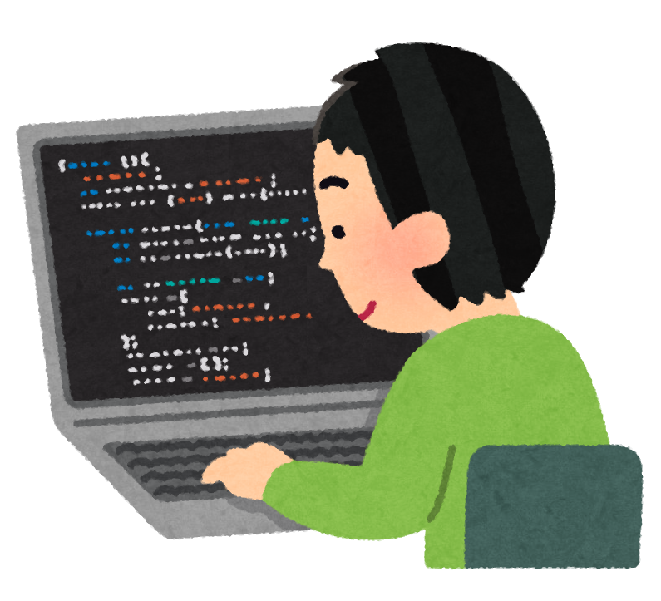
What would Brandon choose?
Brandon’s hobby is...
A
B
Fishing
Programmer
VS

Slide 79
Brandon chooses...
B: Programmer
Brandon studied to program!

Slide 80

Ask Brandon a Question!
Use these starters:
Do you like ___? · What is your favorite ___? · Can you ___?
How many ___? · Where do you ___?

Slide 81
See you next time!
Thank you for listening!
I look forward to our next class together! 🌟
See you next time, Brandon!

