Slide 1

Start Game

Slide 2
Greeting
Food
Drinks
Sports
Time
Places
¥ 200
¥ 200
¥ 200
¥ 200
¥ 200
¥ 200
¥ 400
¥ 400
¥ 400
¥ 400
¥ 400
¥ 400
¥ 600
¥ 600
¥ 600
¥ 600
¥ 600
¥ 600
¥ 800
¥ 800
¥ 800
¥ 800
¥ 800
¥ 800
¥ 1000
¥ 1000
¥ 1000
¥ 1000
¥ 1000
¥ 1000

Slide 3
⤵
Greeting
Where are you from?
¥ 200
Show Answer

Slide 4
⤵
Greeting
Japan
¥ 200

Slide 5
⤵
Greeting
Can you say 2 things you like?
¥ 400
Show Answer

Slide 6
⤵
Greeting
I like ___ and ___.
¥ 400

Slide 7
⤵
Greeting
Can you say all the weathers?
¥ 600
Show Answer

Slide 8
⤵
Greeting
Sunny, Cloudy, Snowy, Rainy
¥ 600

Slide 9
⤵
Greeting
Can you say all the days in the week?
¥ 800
Show Answer

Slide 10
⤵
Greeting
Monday, Tuesday, Wednesday, Thrusday, Friday, Saturday, Sunday
¥ 800

Slide 11
⤵
Greeting
Can you say all the greetings?
¥ 1000
Show Answer

Slide 12
⤵
Greeting
Hello. Hi. Good Morning. Goodbye. See you.
¥ 1000

Slide 13

⤵
Food
¥ 200
Show Answer

Slide 14
⤵
Food
Hot Dog
¥ 200

Slide 15

⤵
Food
Food
¥ 400
Show Answer

Slide 16
⤵
Food
Shrimp
¥ 400

Slide 17
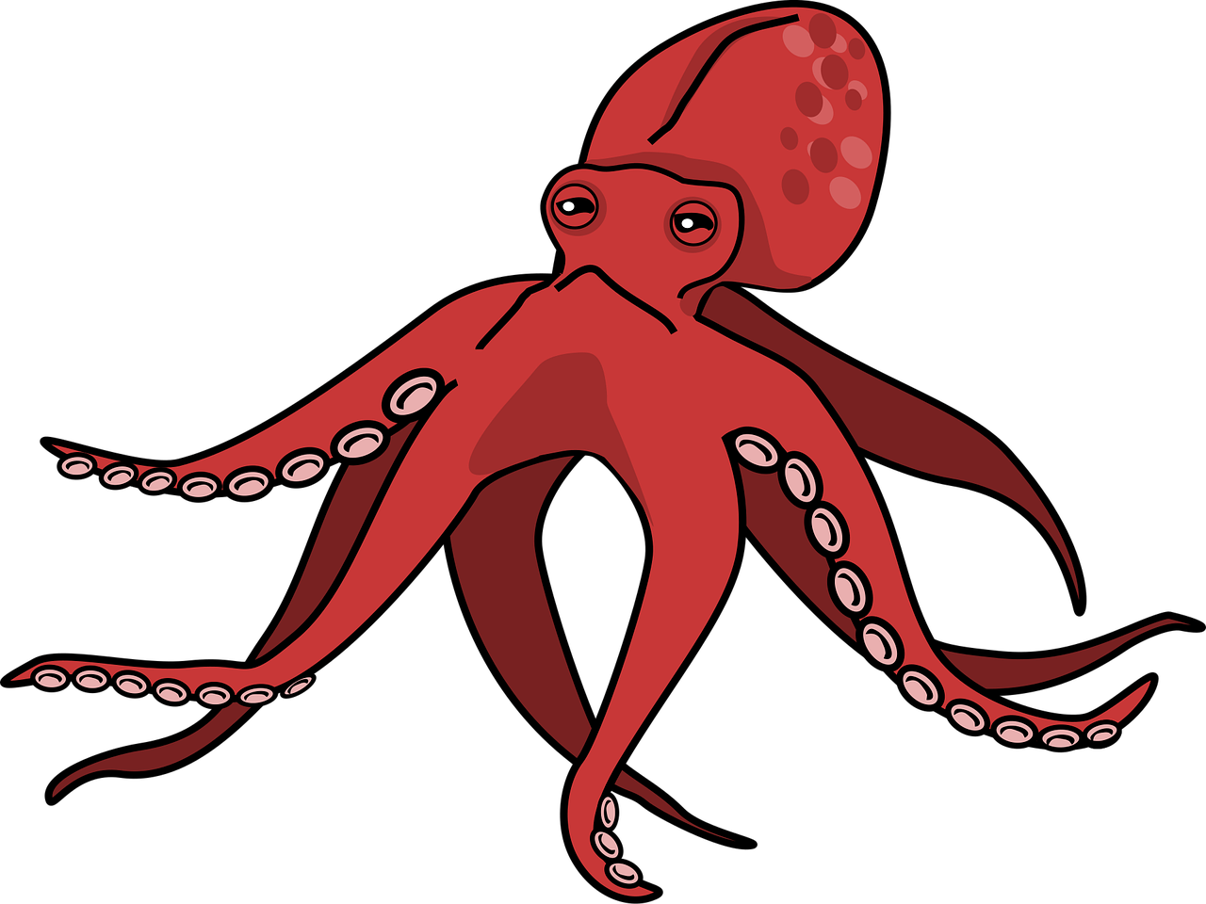
⤵
Food
¥ 600
Show Answer

Slide 18
⤵
Food
Octopus
¥ 600

Slide 19
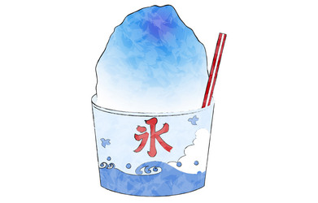
⤵
Food
¥ 800
Show Answer

Slide 20
⤵
Food
Shaved Ice
¥ 800

Slide 21
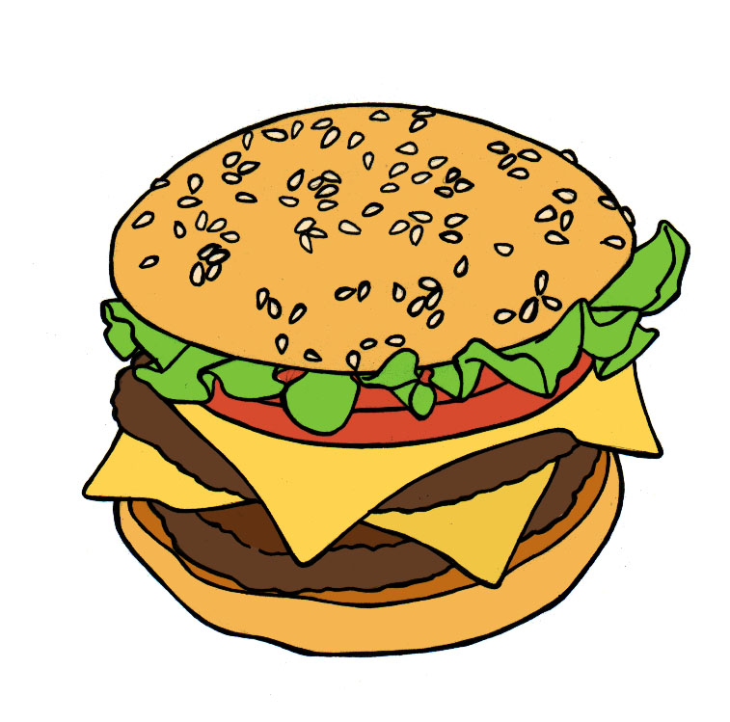
⤵
Food
¥ 1000
Show Answer

Slide 22
⤵
Food
Cheeseburger
¥ 1000

Slide 23

⤵
Drinks
¥ 200
Show Answer

Slide 24
⤵
Drinks
Tea
¥ 200

Slide 25

⤵
Drinks
Drinks
¥ 400
Show Answer

Slide 26
⤵
Drinks
Juice
¥ 400

Slide 27

⤵
Drinks
¥ 600
Show Answer

Slide 28
⤵
Drinks
Green Tea
¥ 600

Slide 29
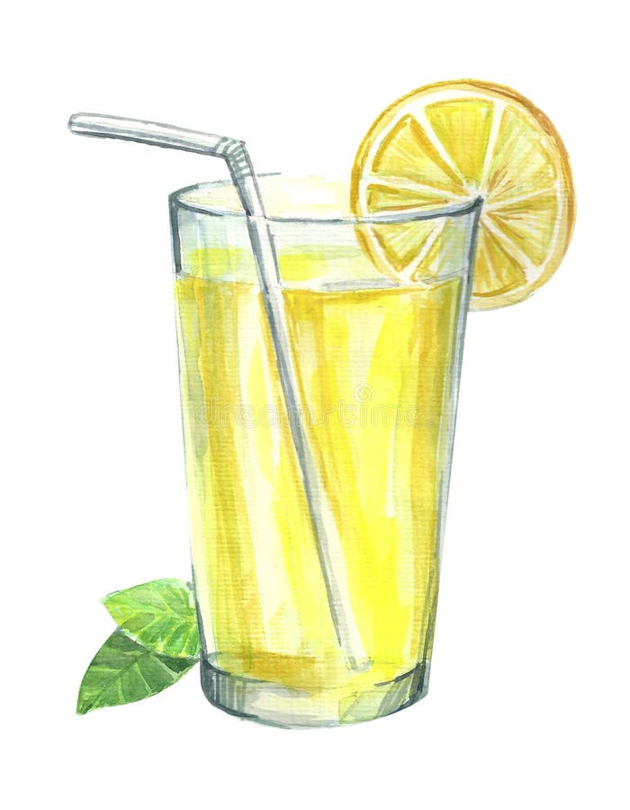
⤵
Drinks
¥ 800
Show Answer

Slide 30
⤵
Drinks
Lemonade
¥ 800

Slide 31

⤵
Drinks
¥ 1000
Show Answer

Slide 32
⤵
Drinks
Hot Chocolate
¥ 1000

Slide 33
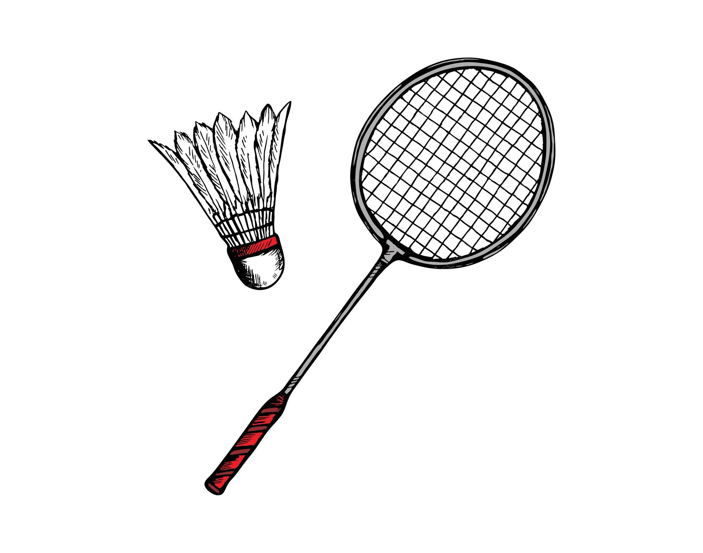
⤵
Sports
¥ 200
Show Answer

Slide 34
⤵
Sports
Badminton
¥ 200

Slide 35
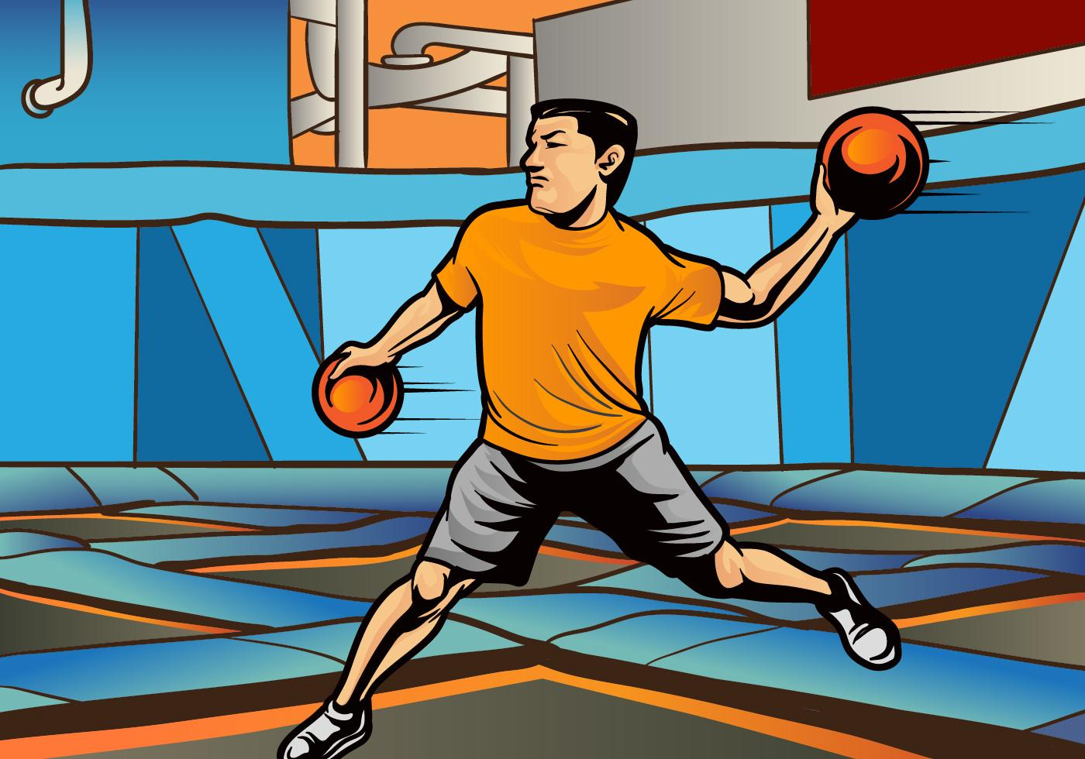
⤵
Sports
Sports
¥ 400
Show Answer

Slide 36
⤵
Sports
Dodgeball
¥ 400

Slide 37
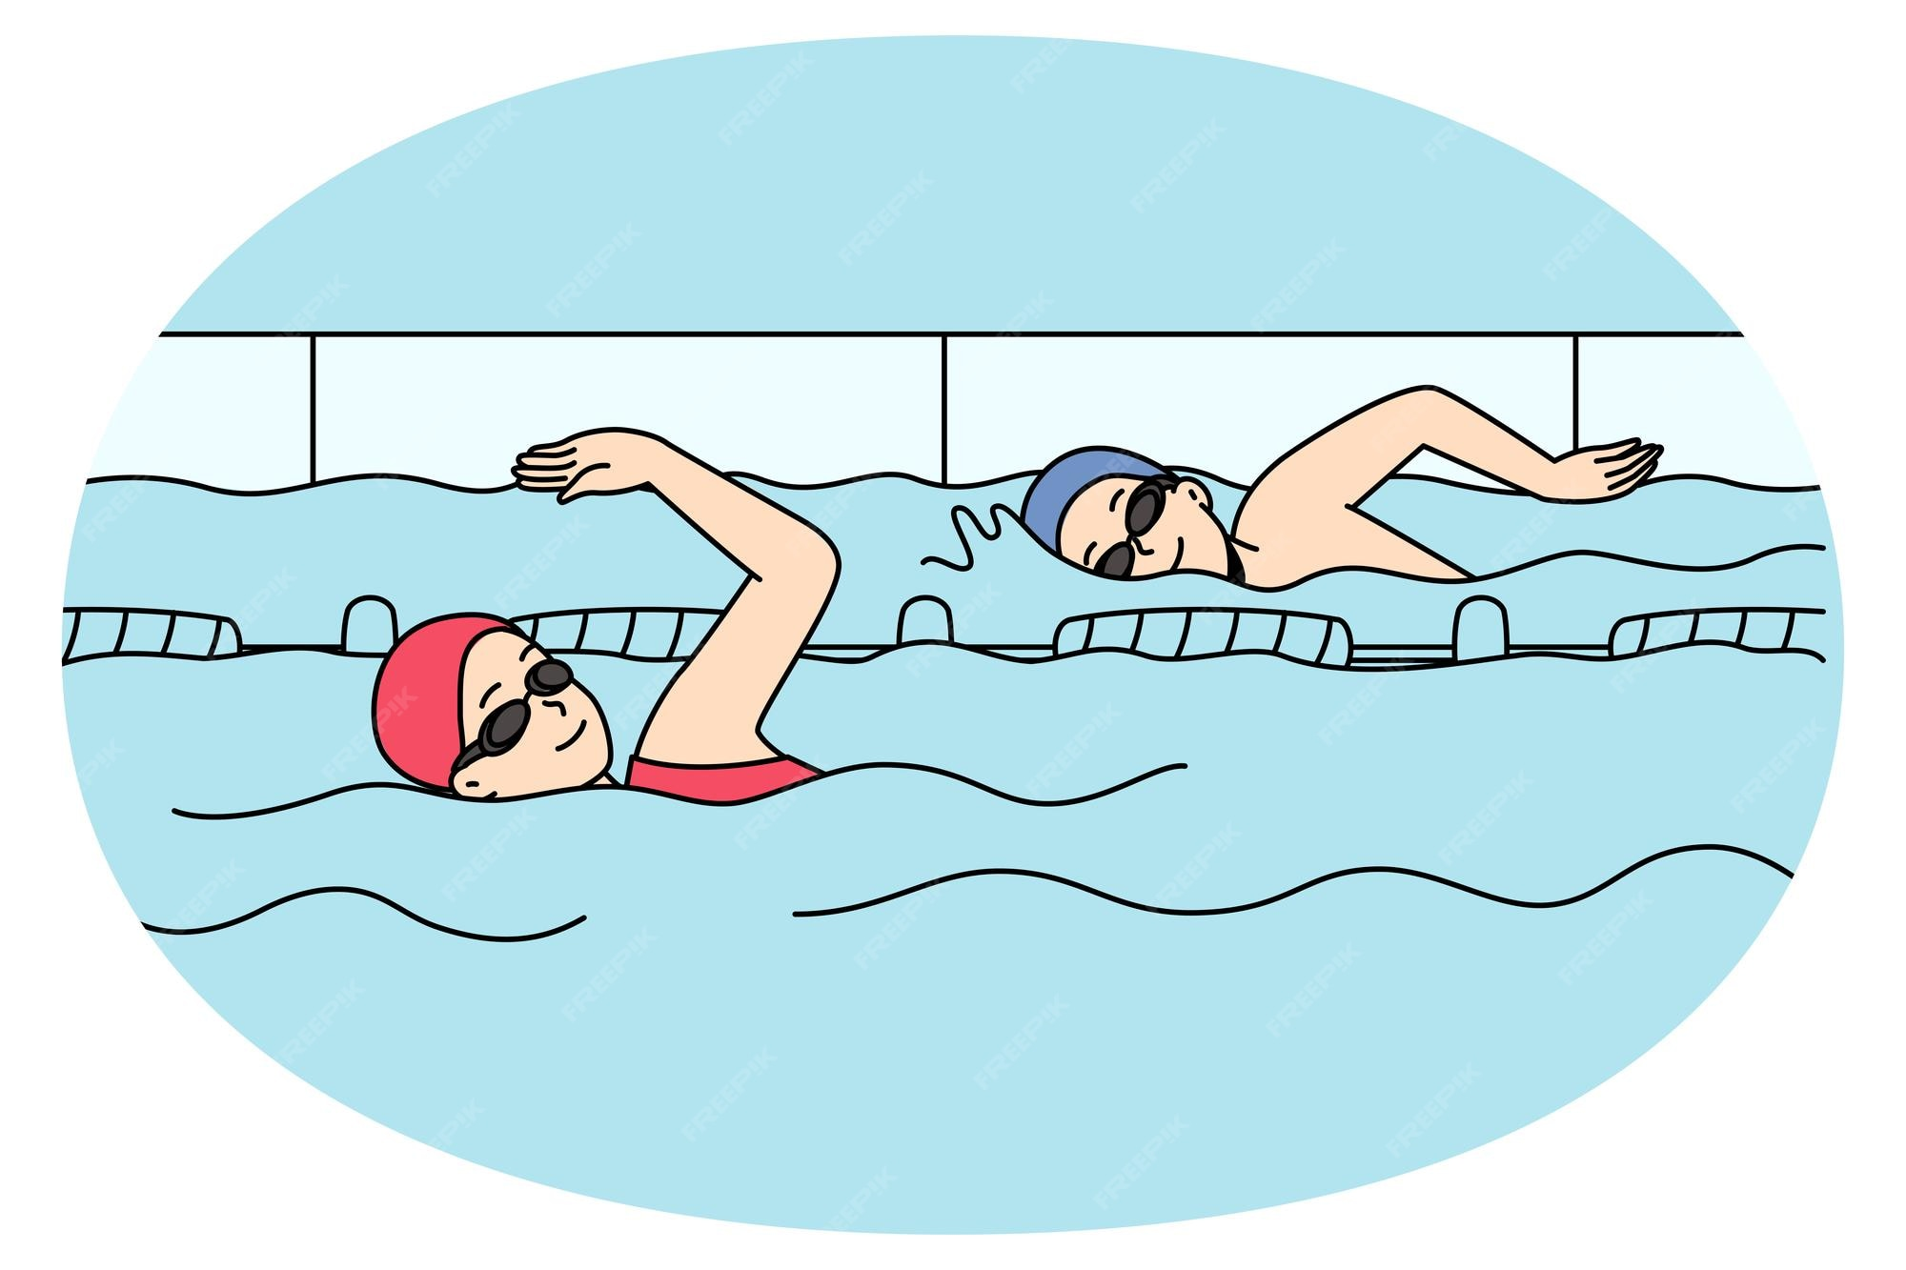
⤵
Sports
¥ 600
Show Answer

Slide 38
⤵
Sports
Swimming
¥ 600

Slide 39
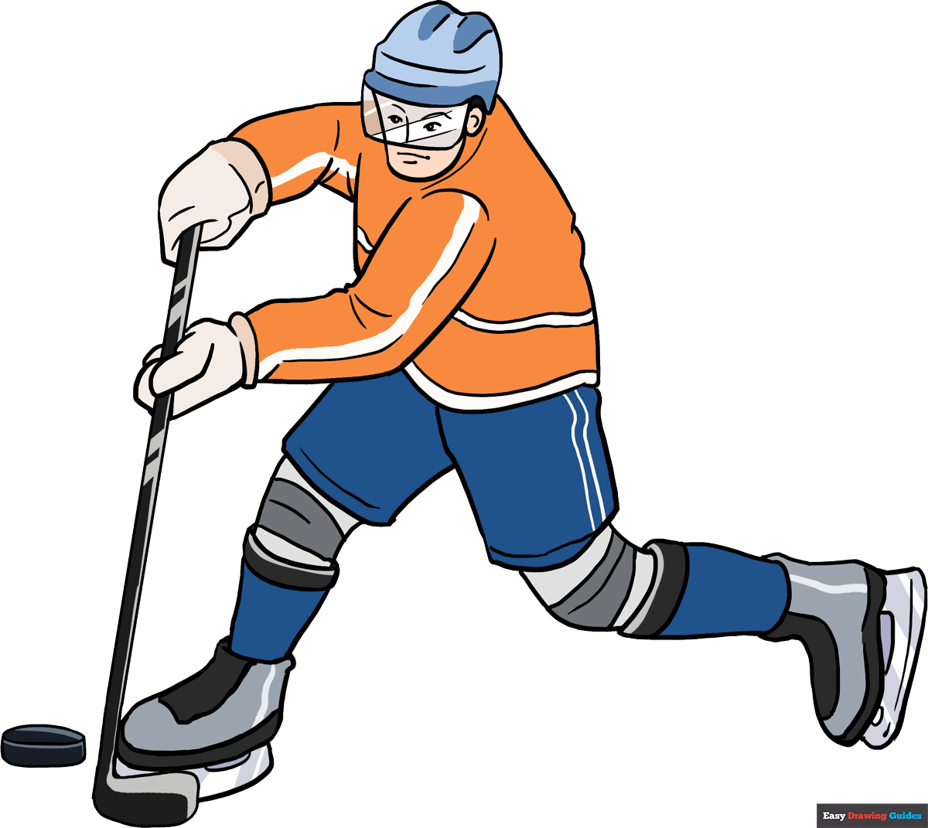
⤵
Sports
¥ 800
Show Answer

Slide 40
⤵
Sports
Ice Hockey
¥ 800

Slide 41
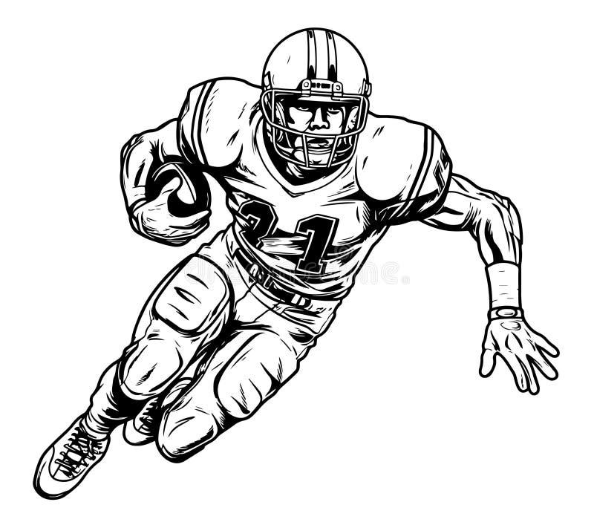
⤵
Sports
¥ 1000
Show Answer

Slide 42
⤵
Sports
American Football
¥ 1000

Slide 43
⤵
Time
What time is this? 6:00
¥ 200
Show Answer

Slide 44
⤵
Time
Six o’ Clock
¥ 200

Slide 45
⤵
Time
What month is this?
7月
Time
¥ 400
Show Answer

Slide 46
⤵
Time
July
¥ 400

Slide 47

⤵
Time
What season is this?
¥ 600
Show Answer

Slide 48
⤵
Time
Autumn/Fall
¥ 600

Slide 49
⤵
Time
How do you say this date? 十月二十日
¥ 800
Show Answer

Slide 50
⤵
Time
October Twentieth
¥ 800

Slide 51
⤵
Time
What time is this?
19:48
¥ 1000
Show Answer

Slide 52
⤵
Time
It’s seven forty-eight P.M.
¥ 1000

Slide 53

⤵
Places
¥ 200
Show Answer

Slide 54
⤵
Places
School
¥ 200

Slide 55

⤵
Places
Places
¥ 400
Show Answer

Slide 56
⤵
Places
Germany
¥ 400

Slide 57
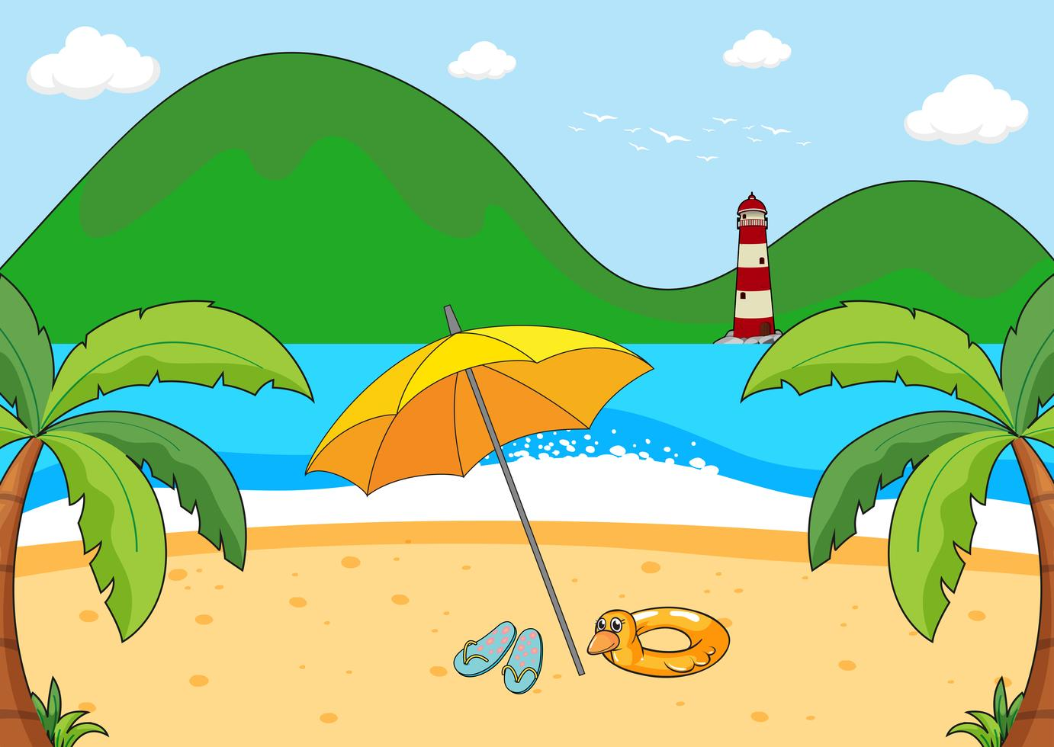
⤵
Places
¥ 600
Show Answer

Slide 58
⤵
Places
Beach
¥ 600

Slide 59
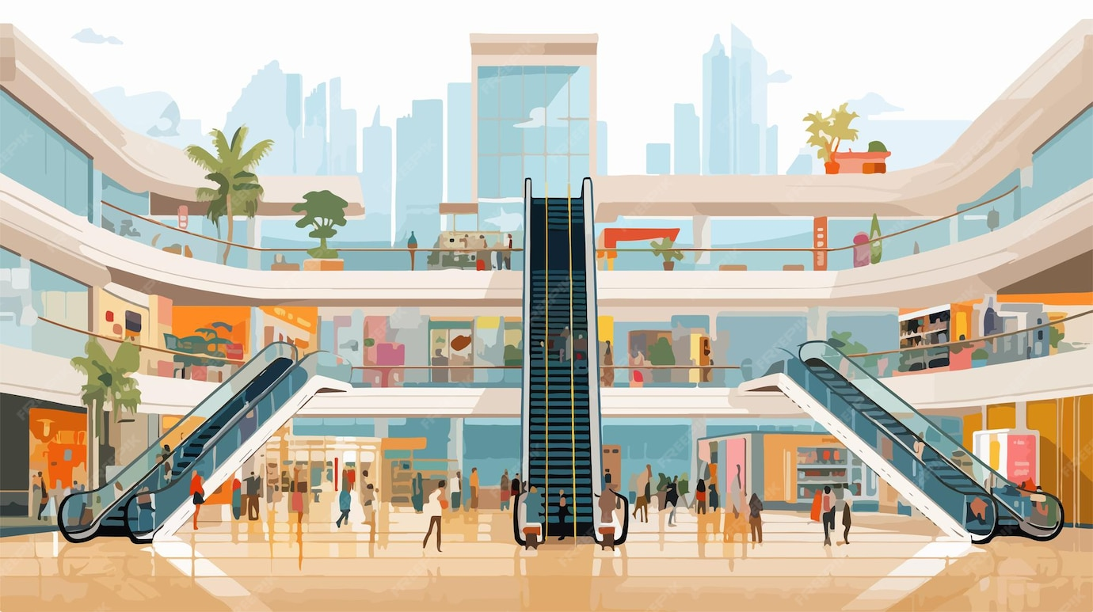
⤵
Places
¥ 800
Show Answer

Slide 60
⤵
Places
Shopping Mall
¥ 800

Slide 61
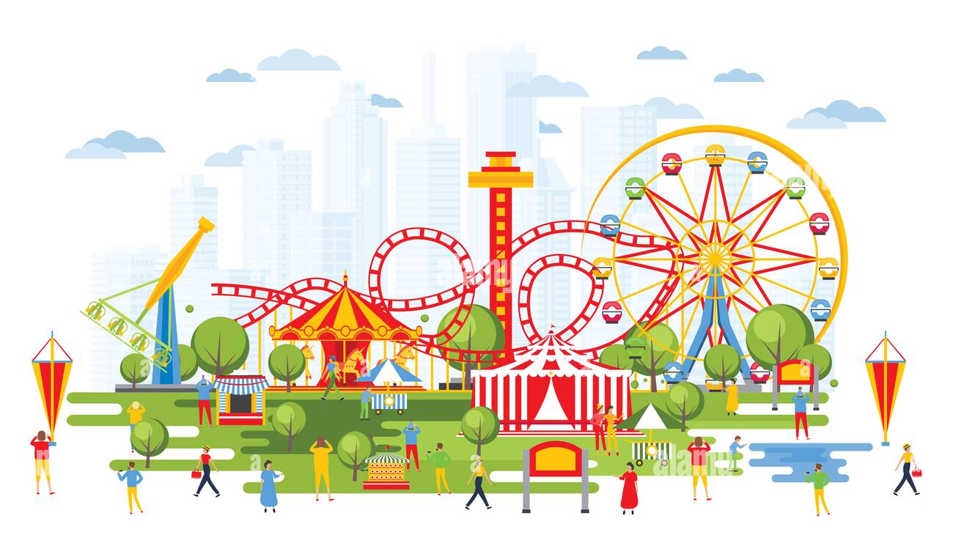
⤵
Places
¥ 1000
Show Answer

Slide 62
⤵
Places
Amusement Park
¥ 1000

