Slide 1
HELLO, EVERYONE!
MY NAME IS BRANDON

Slide 2
I’M FROM

Slide 3

AMERICA

Slide 4
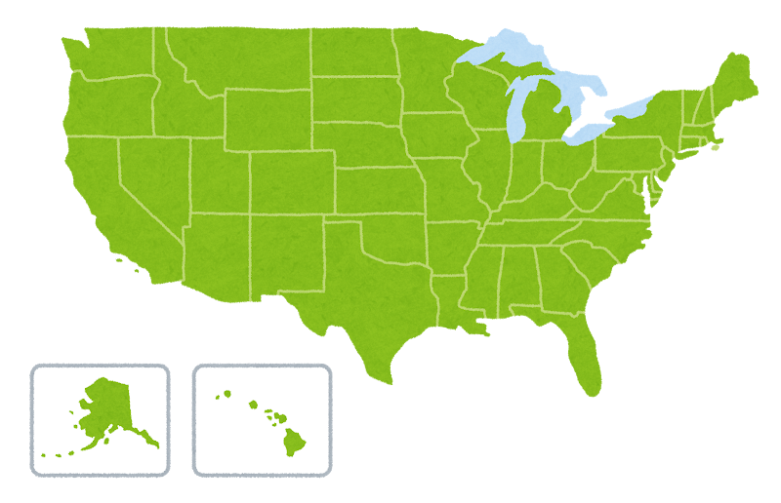
AMERICA

Slide 5
🐾
MY PETS

Slide 6
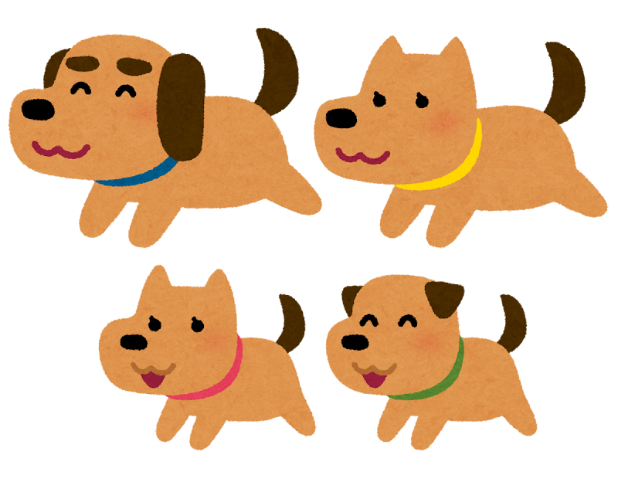


2 CATS
4 DOGS

Slide 7
MY FAVORITE COLOR

Slide 8

BLACK

Slide 9
FOOD

Slide 10

I LIKE
PIZZA

Slide 11

I LIKE
HAMBURGER

Slide 12

I DON’T LIKE
EGGPLANT

Slide 13

I LIKE
SUSHI

Slide 14

I LIKE
RAMEN

Slide 15
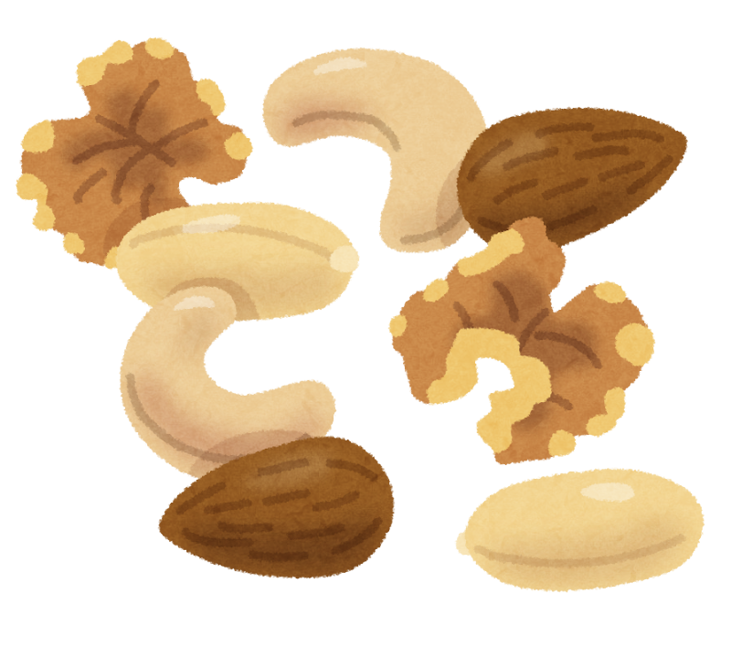
I DON’T LIKE
NUTS

Slide 16
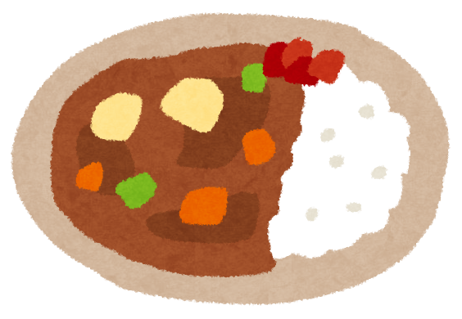
I LIKE
CURRY

Slide 17

I LIKE
STRAWBERRIES

Slide 18

I DON’T LIKE
CAKE

Slide 19

I LIKE
SPICY

Slide 20
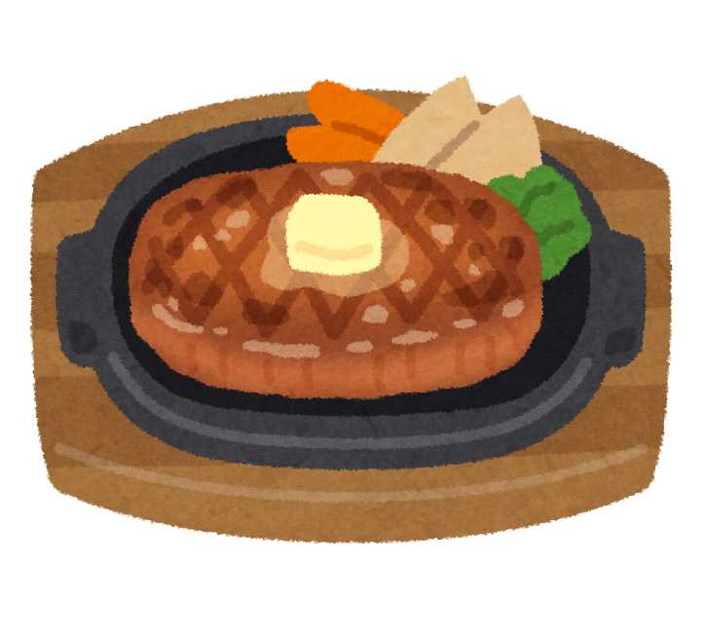
I LIKE
STEAK

Slide 21
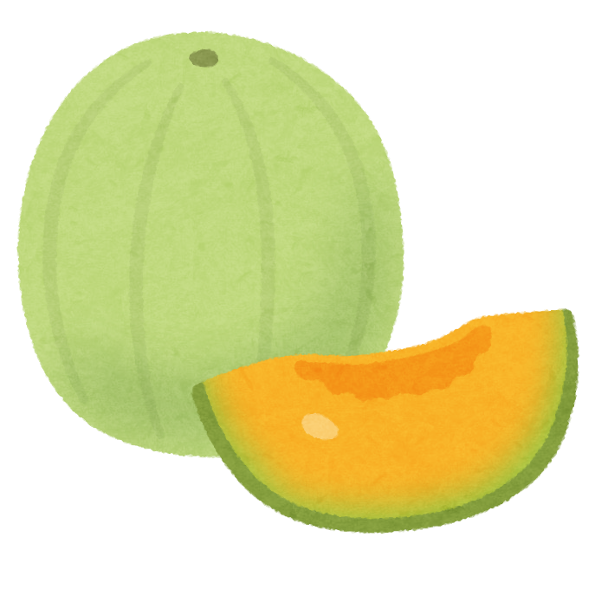
I DON’T LIKE
MELON

Slide 22

I DON’T LIKE
BOBA

Slide 23
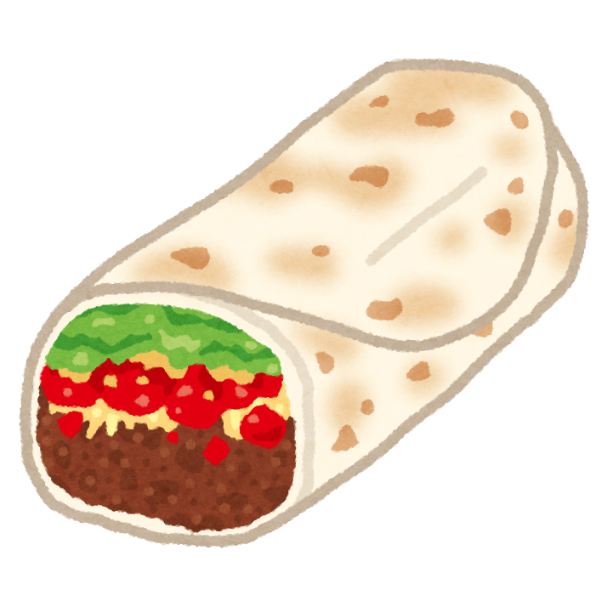
I LIKE
BURRITO

Slide 24
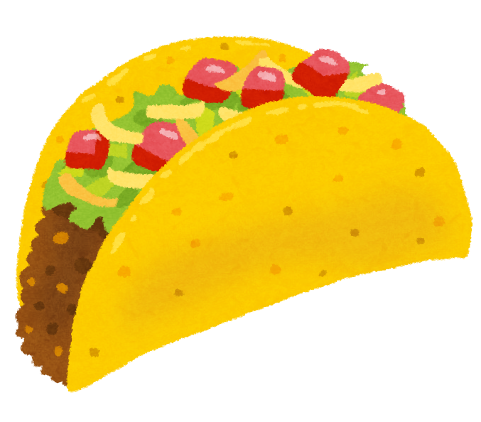
I LIKE
TACOS

Slide 25
QUIZ!
I DON’T LIKE
A. PIZZA
B. SUSHI
C. NUTS
D. SPICY

Slide 26
ANSWER!
NUTS

Slide 27
QUIZ!
I AM FROM?
A. Japan
B. Russia
C. Mexico
D. America
Answer: C — Spanish! 🇪🇸
[irasutoya: search "quiz teacher" on irasutoya.com and paste image here]

Slide 28
ANSWER!
AMERICA

Slide 29
QUIZ!
I HAVE _ CATS, _ DOGS.
A. 1 CAT, 3 DOGS
B. 2 CATS, 4 DOGS
C. 3 CATS, 4 DOGS
D. 3 CATS, 4 DOGS

Slide 30
ANSWER!
2 CATS & 4 DOGS!

Slide 31
QUIZ!
I LIKE THE COLOR
A. BLACK
B. WHITE
C. GREEN
D. YELLOW

Slide 32
ANSWER!
BLACK

Slide 33
MY HOBBIES

Slide 34
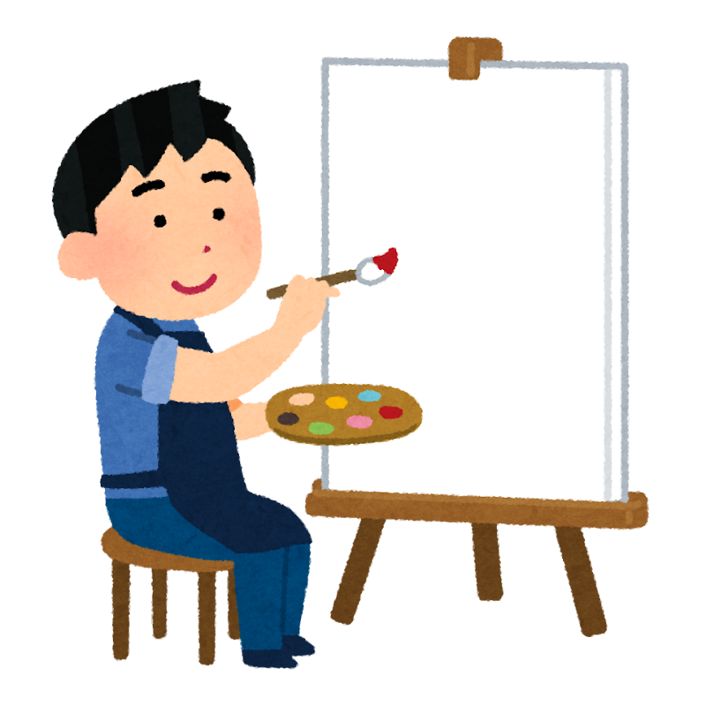
I ENJOY
PAINTING/DRAWING

Slide 35
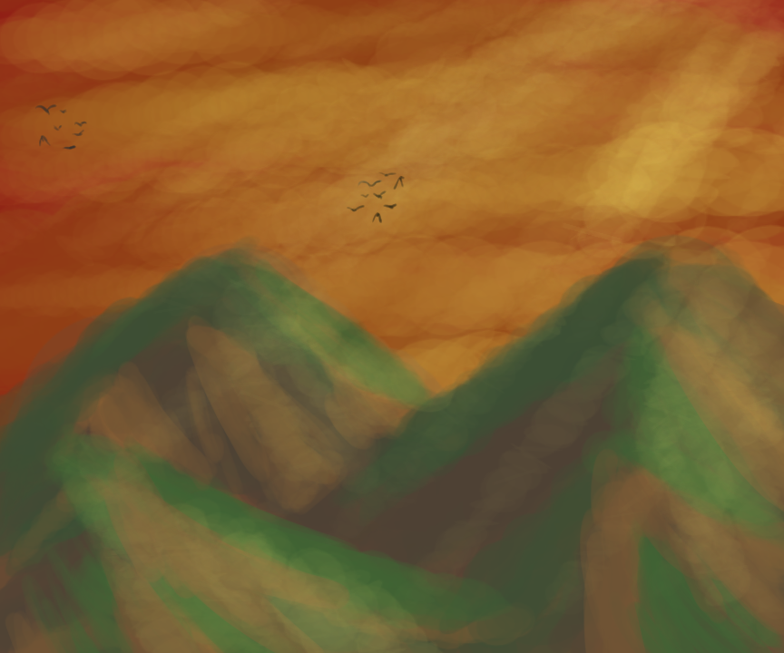
MY DRAWING

Slide 36
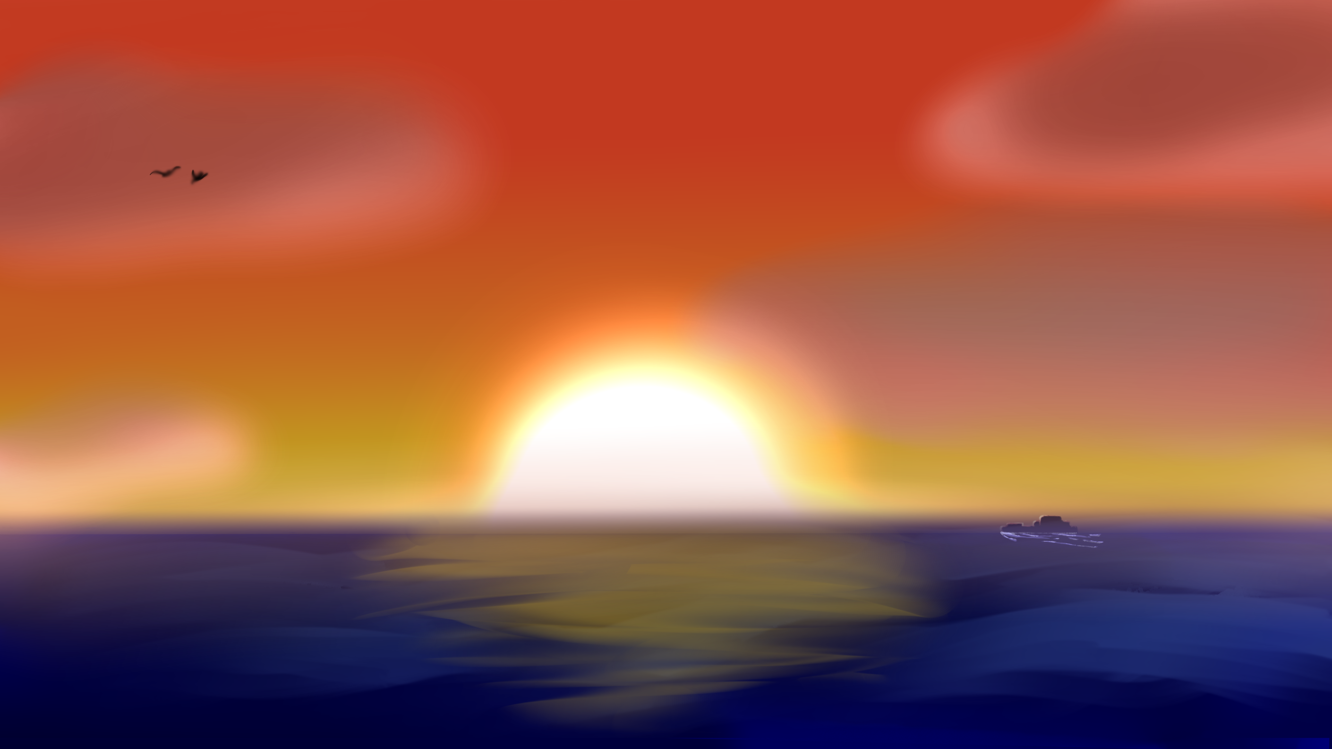
MY DRAWING

Slide 37


MY DRAWING

Slide 38

I ENJOY
SWIMMING

Slide 39

I ENJOY
TECHNOLOGY

Slide 40
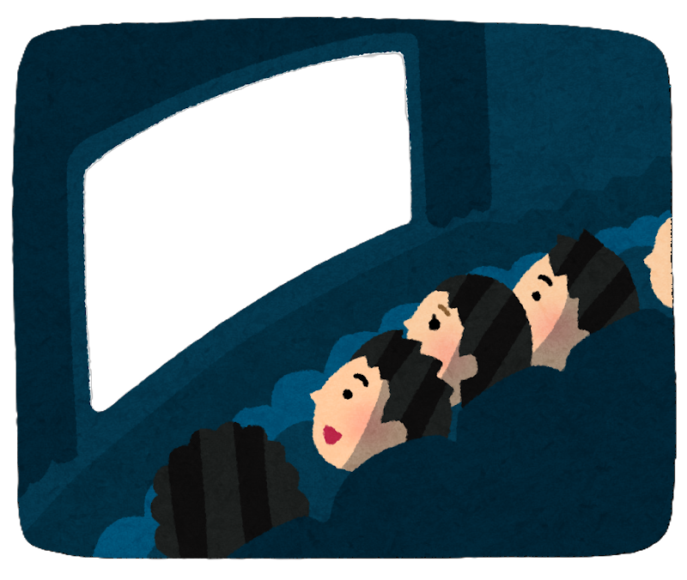
I ENJOY
MOVIES

Slide 41
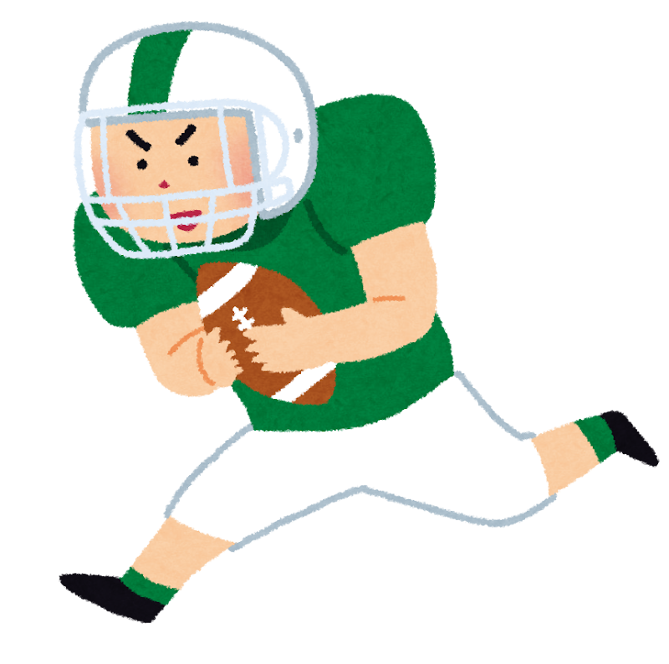
I ENJOY
AMERICAN FOOTBALL

Slide 42
⭕ LIKE
OR
❌ DISLIKE

Slide 43

Like or Dislike!
PUZZLES

Slide 44
⭕ LIKE!

Slide 45
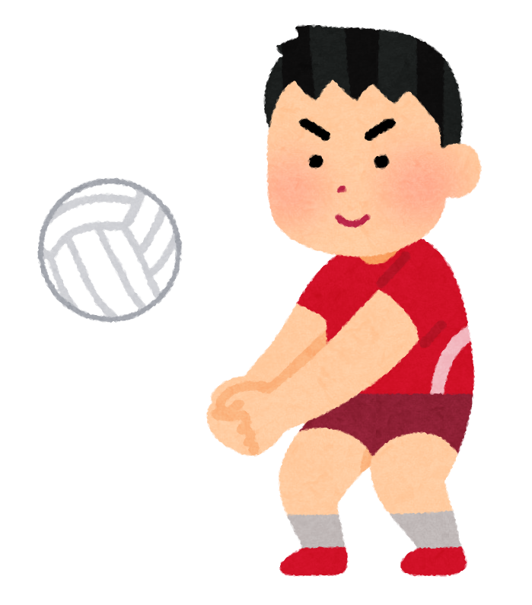
Like or Dislike!
VOLLEYBALL

Slide 46
❌ DISLIKE!

Slide 47

Like or Dislike!
PENGUINS

Slide 48
⭕ LIKE!

Slide 49

Like or Dislike!
SNAKES

Slide 50
⭕ LIKE!

Slide 51
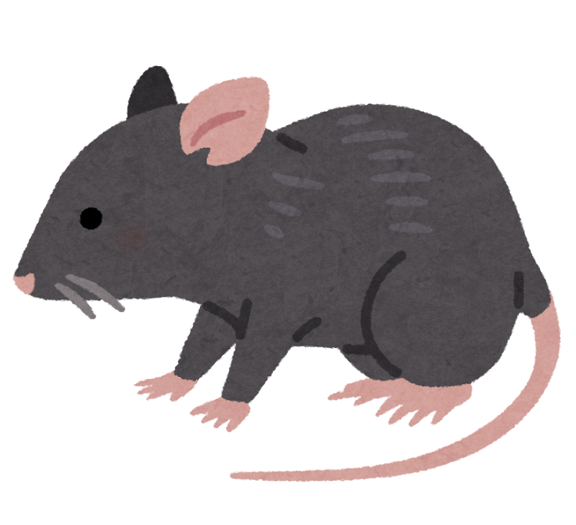
Like or Dislike!
MOUSE

Slide 52
❌ DISLIKE!

Slide 53

Like or Dislike!
F1 RACE

Slide 54
⭕ LIKE!

Slide 55

Like or Dislike!
SKY DIVING

Slide 56
❌ DISLIKE!

Slide 57

Like or Dislike!
COCONUT

Slide 58
❌ DISLIKE!

Slide 59

Like or Dislike!
MAHJONG

Slide 60
⭕ LIKE!

Slide 61
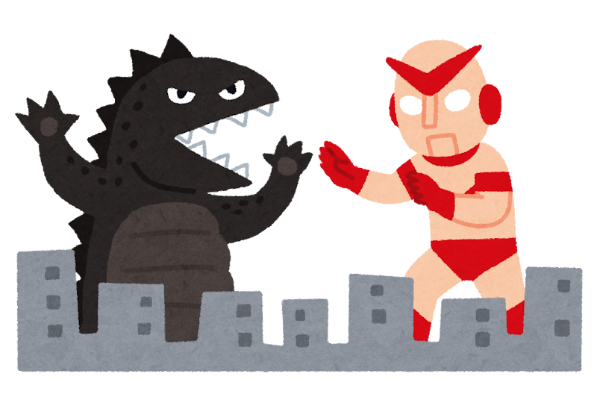
Like or Dislike!
KAIJU

Slide 62
⭕ LIKE!

Slide 63
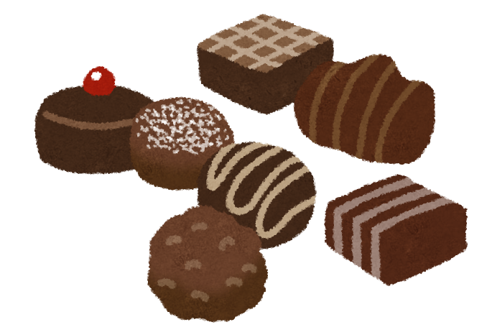
Like or Dislike!
CHOCOLATE

Slide 64
❌ DISLIKE!

Slide 65

Like or Dislike!
FISHING

Slide 66
⭕ LIKE!

Slide 67
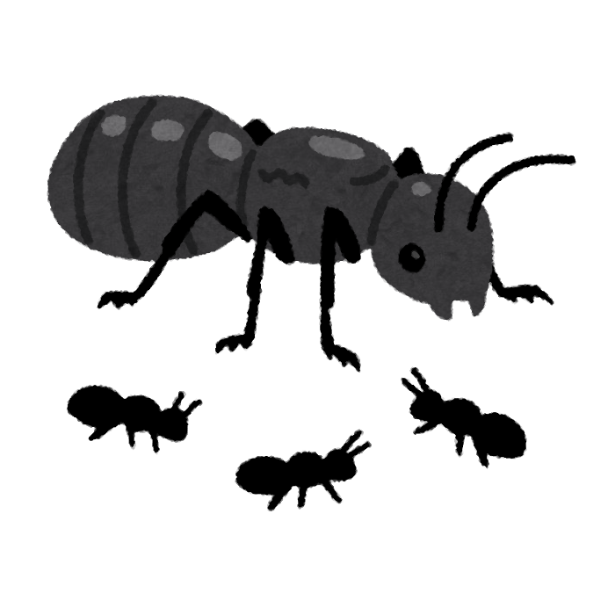
Like or Dislike!
ANTS

Slide 68
❌ DISLIKE!

Slide 69
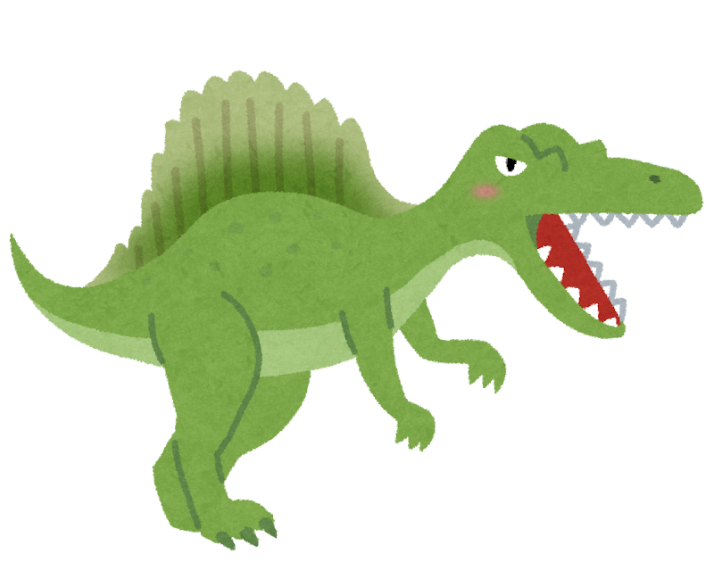
Like or Dislike!
DINOSAUR

Slide 70
⭕ LIKE!

Slide 71


DO YOU HAVE ANY QUESTIONS?
FOR EXAMPLE:
DO YOU LIKE __?· WHAT IS YOUR FAVORITE___? · CAN YOU___?
HOW MANY___? · WHERE DO YOU___?

Slide 72

See you next time!
Thank you for listening!

