Slide 1
IMPROVED SOURCE OF DRINKING WATER
CAPSTONE PROJECT
Presented By:
1. GURIJALA TEJ KUMAR-SREENIVASA INSTITUTE OF TECHNOLOGY AND MANAGEMENT STUDIES-COMPUTER SCIENCE AND ENGINEERING

Slide 2
OUTLINE
Problem Statement
Proposed System/Solution
System Development Approach
Algorithm & Deployment
Result
Conclusion
Future Scope
References

Slide 3
Problem Statement
The Challenge: Access to safe and improved sources of drinking water remains a critical issue in India, especially in rural and underdeveloped regions. Despite ongoing efforts under the Sustainable Development Goals (SDGs), inequalities persist in water accessibility across states and socio-economic groups. This project aims to analyze data from the 78th Round of the Multiple Indicator Survey (MIS) to assess the percentage of the population with access to improved drinking water sources. It will also explore related indicators such as use of clean cooking fuel and migration trends. By identifying patterns and disparities, the study will generate actionable insights to support evidence-based policymaking. The ultimate goal is to help ensure equitable access to clean water and contribute to India's progress on SDG targets.

Slide 4
Proposed Solution
The proposed system addresses disparities in access to improved sources of drinking water by combining data analytics, IBM Cloud services, and visual storytelling to uncover actionable insights. The solution includes:
🔹 1. Data Collection & Storage
Obtain and manage the 78th Round MIS dataset using IBM Cloud Object Storage.
Handle CSV and structured data in a scalable and secure manner.
🔹 2. Data Preprocessing
Clean and normalize the dataset using Python (pandas, NumPy) in Watson Studio Jupyter Notebooks.
Handle missing data, convert categorical variables, and standardize geographical/state-level entries.
🔹 3. Exploratory Data Analysis (EDA)
Analyze state-wise and socio-economic group-wise access to improved drinking water.
Compare rural vs urban access and overlay insights with other indicators like:
Use of clean cooking fuel.
Internal migration trends.
🔹 4. Visualization and Insight Generation
Use Seaborn, Plotly, or Watson Studio visualizations to create:
Heatmaps of water access.
Bar charts comparing states.
Correlation graphs showing linkages with migration and fuel use.

Slide 5
System Approach
Technology Stack:
IBM Watson Studio
IBM Cloud Object Storage
Python (pandas, matplotlib, seaborn)
Jupyter Notebook on IBM Cloud
Optional: IBM Cognos Dashboard Embedded
Steps:
Data upload and preprocessing
Exploratory analysis and visualization
Insight extraction and reporting
Optional: Model deployment

Slide 6
Algorithm & Deployment
While this is primarily an analysis-based project, optional predictive modeling (e.g., Logistic Regression or Decision Trees) can be implemented to predict access to water.
Algorithm (Optional):
Inputs: Region, socio-economic factors, cooking fuel type, migration status
Output: Probability of improved water access
Deployment: Via IBM Watson Machine Learning or within Watson Studio Notebooks

Slide 7
Result
Visuals: Bar charts and heatmaps showing disparities in water access across states.
Key Insight: Rural areas in specific states showed lower access compared to national averages.
Correlations: Areas with poor water access often use unclean cooking fuel and show higher migration.

Slide 8
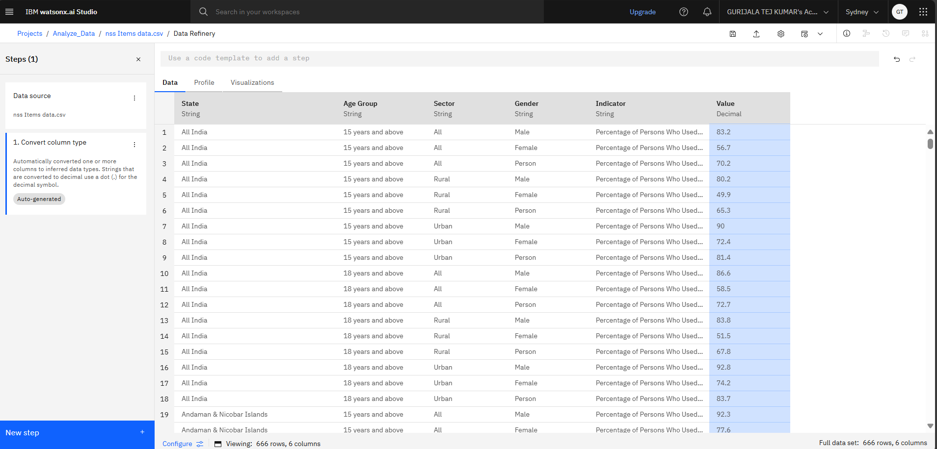
DATASET

Slide 9
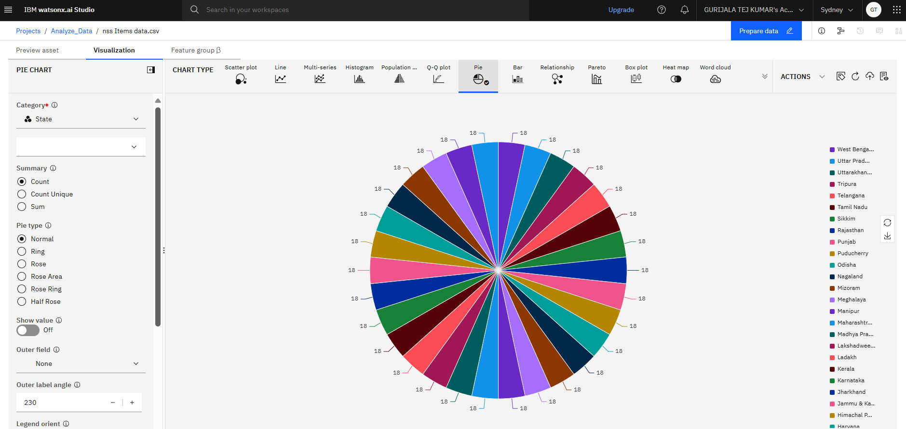
ANALUZED PIE CHART

Slide 10
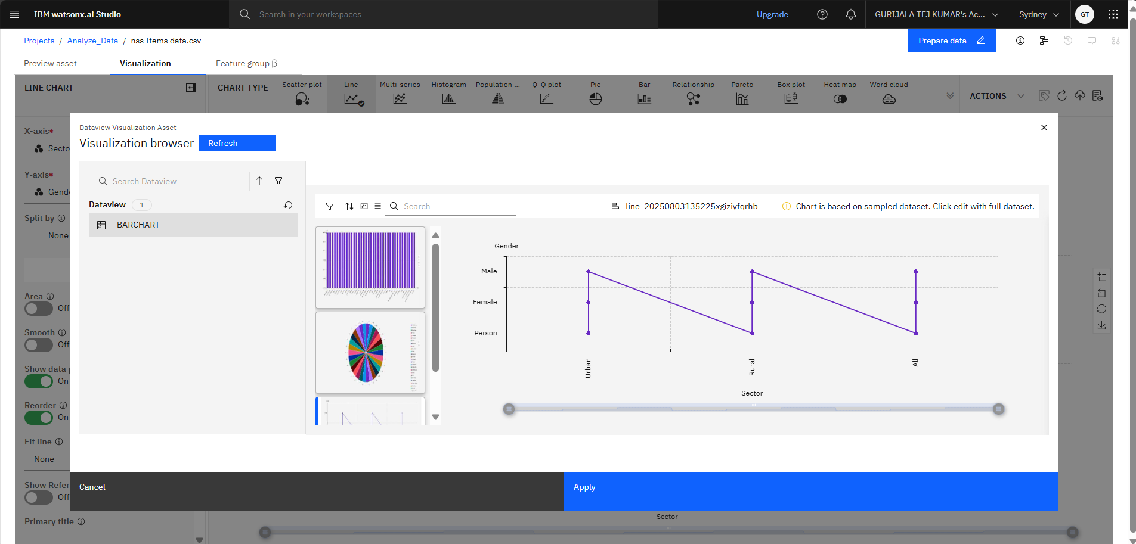
ANALUZED LINE CHART

Slide 11
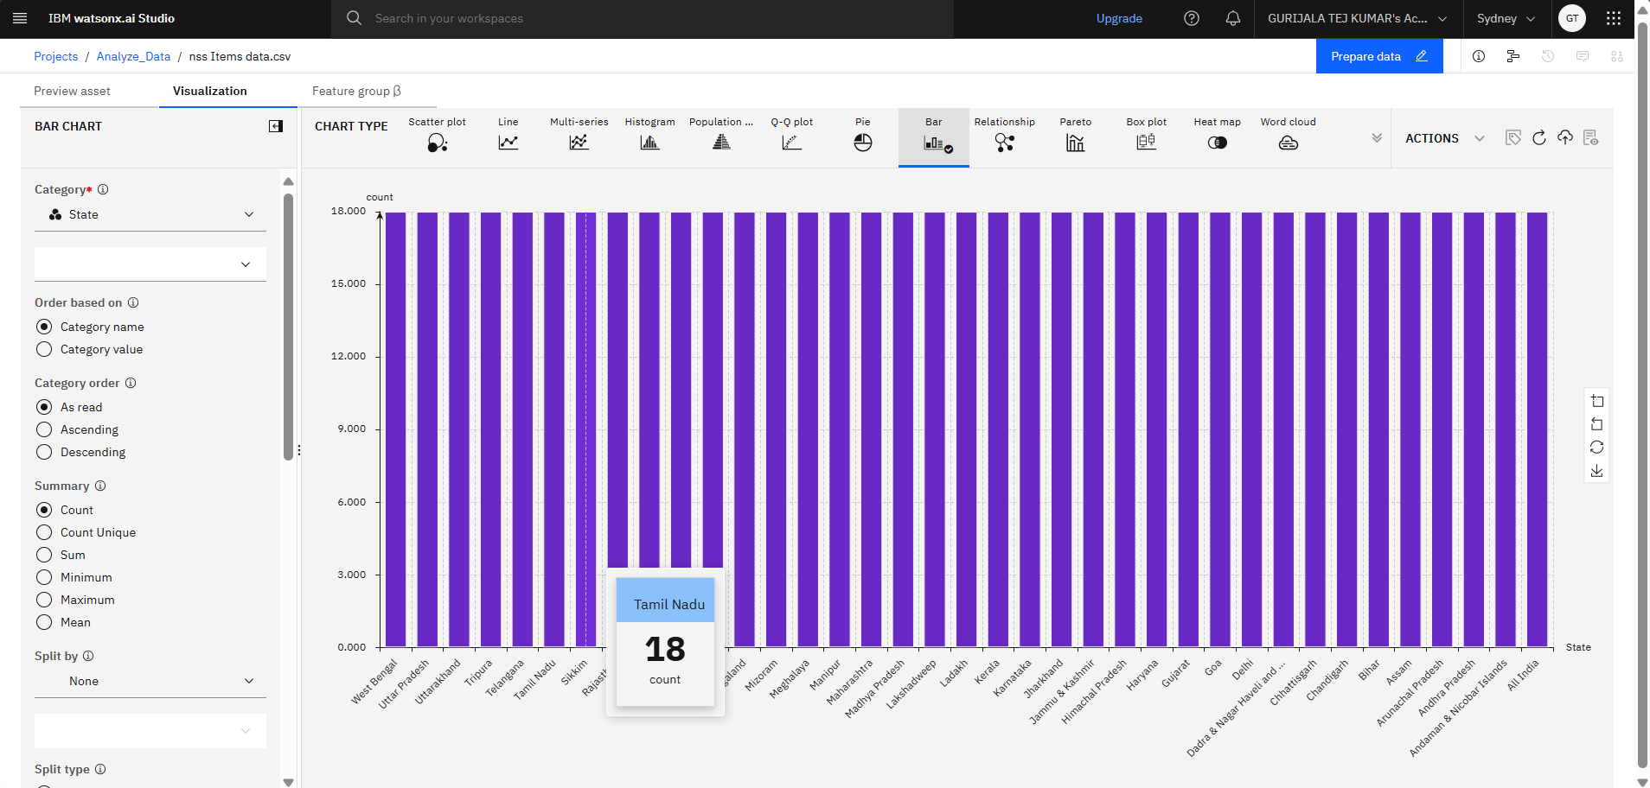
ANALYZED BAR CHART

Slide 12
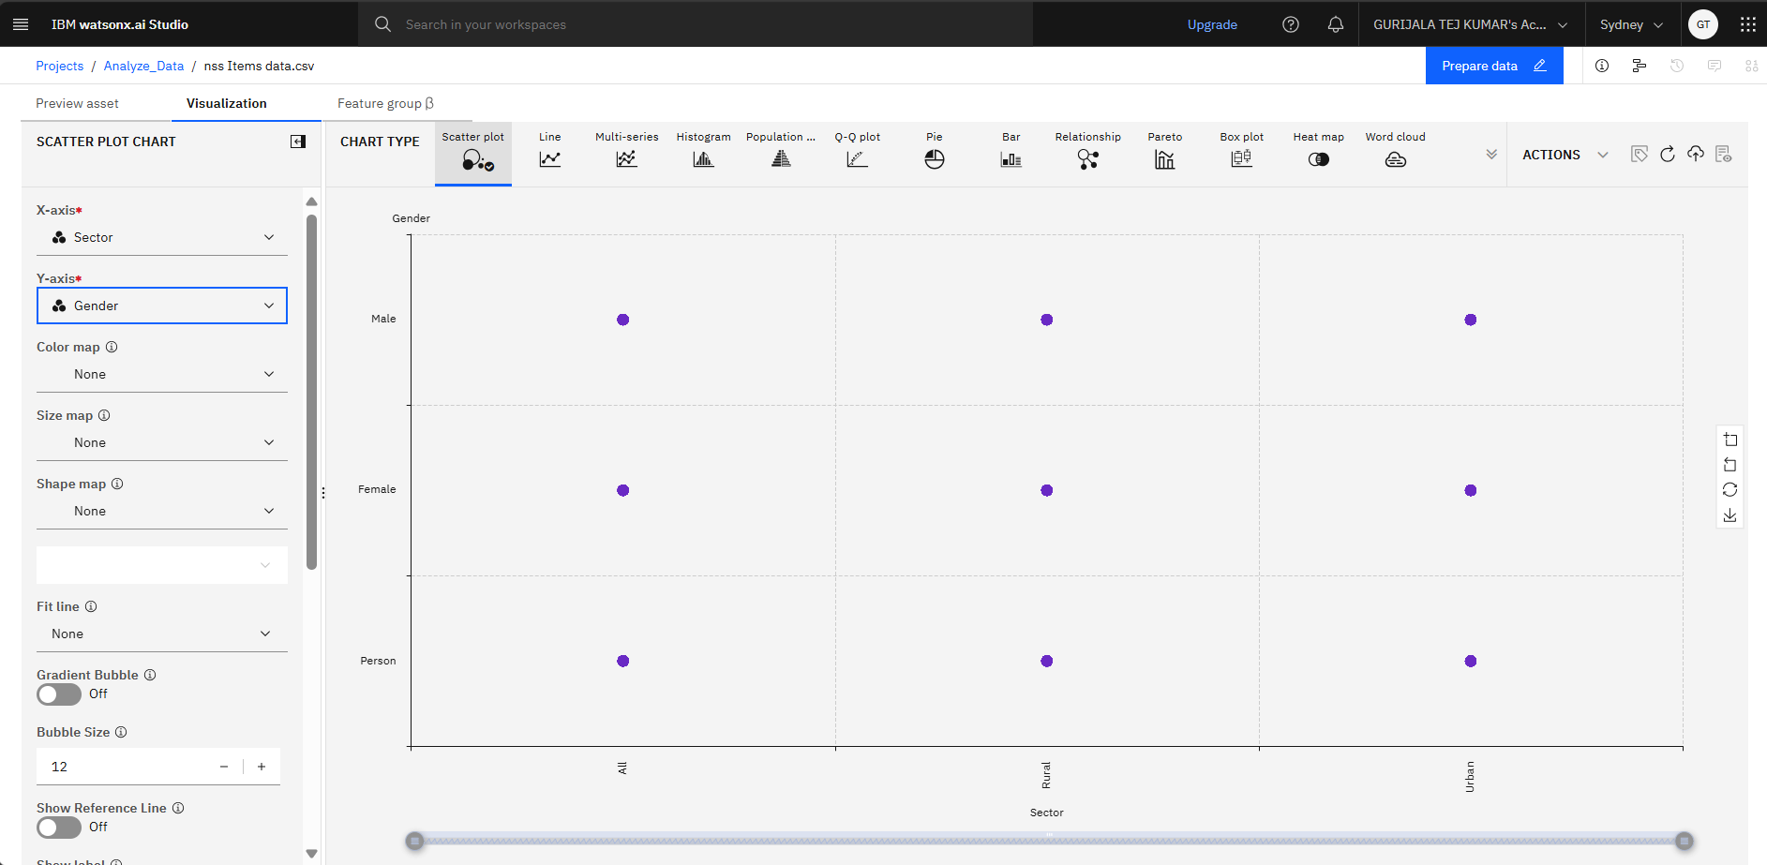
SCATTER PLOT CHART

Slide 13
Conclusion
The study successfully identified regional and socio-economic disparities in access to improved drinking water using data from the MIS 78th round. The integration of IBM Cloud services enabled scalable and collaborative data analysis. The insights generated can guide targeted interventions to support India’s SDG targets, especially SDG 6: Clean Water and Sanitation.

Slide 14
Future scope
Expand analysis to multiple rounds of MIS/NSSO surveys for time-based trends.
Use machine learning for predictive analytics.
Incorporate GIS data for spatial mapping.
Build a mobile-friendly public dashboard with real-time updates.

Slide 15
References
78th Round Multiple Indicator Survey Dataset – AI Kosh
SDG Goals – United Nations
IBM Cloud Documentation
Research Papers on Water Accessibility in India
Tutorials: IBM Watson Studio and Object Storage

Slide 16
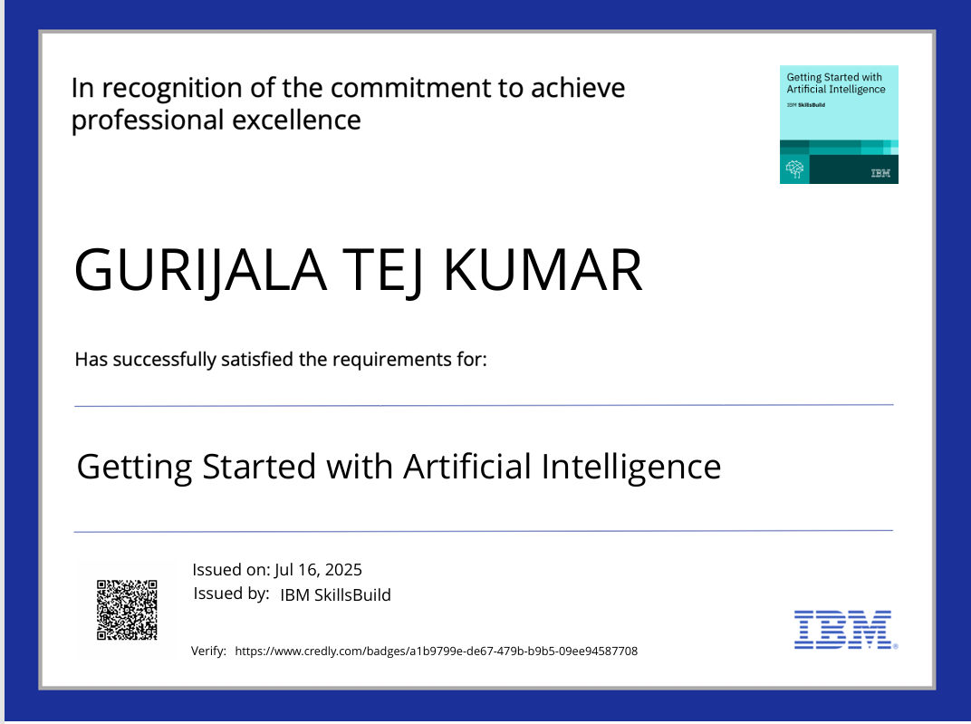
IBM Certifications [Getting Started with AI]

Slide 17
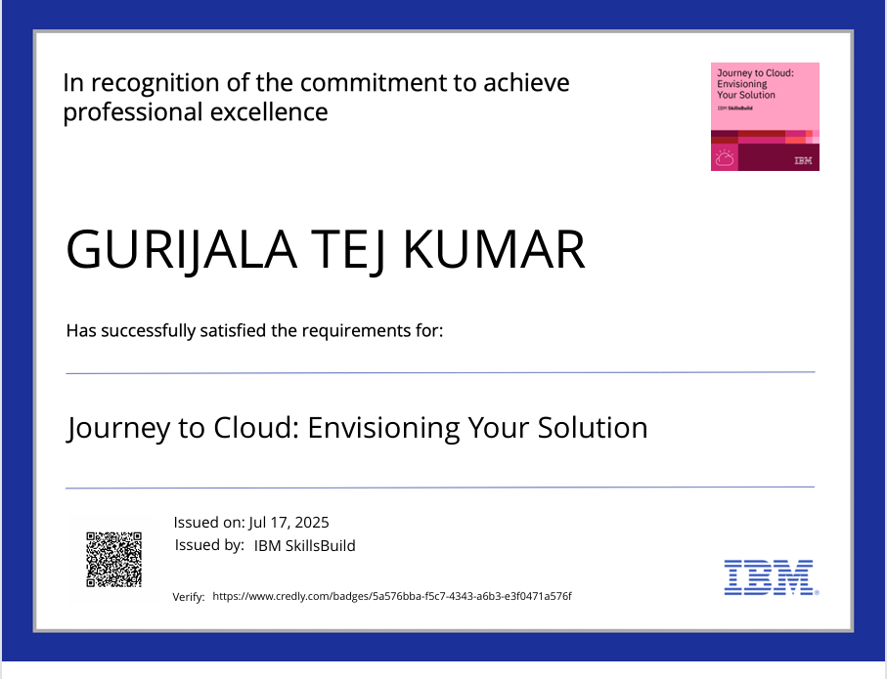
IBM Certifications[Journey to Cloud]

Slide 18
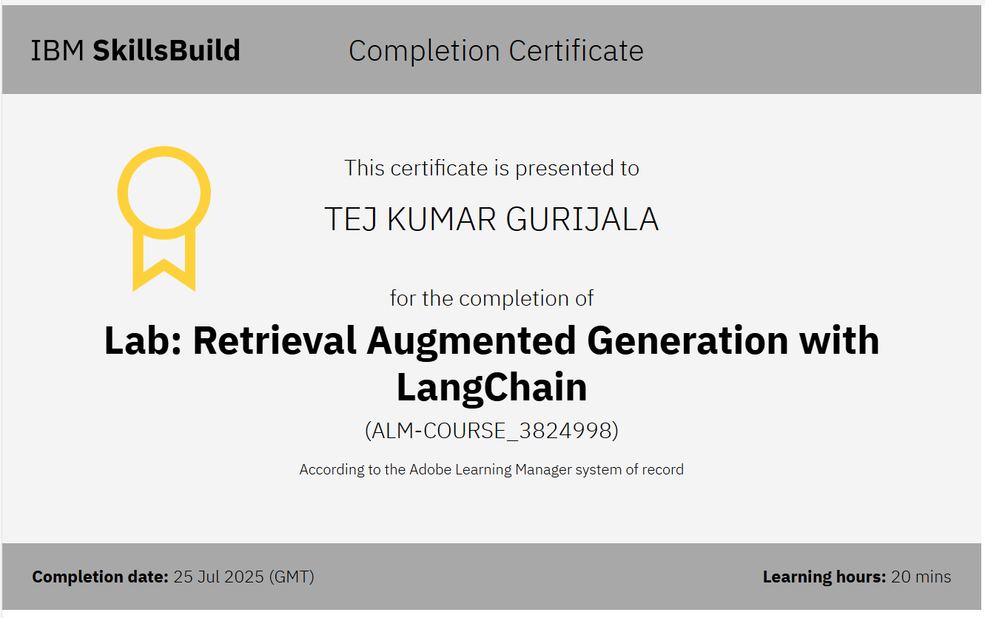
IBM Certifications[rag lab]

Slide 19
THANK YOU

