Slide 1

SREENIVASA INSTITUTE OF TECHNOLOGY AND MANAGEMENT STUDIES (Approved by AICTE, New Delhi; Affiliated to JNTUA, Ananthapuramu) Chittoor, A.P-517127.
DEPARTMENT OF COMPUTER SCIENCE AND ENGINEERING
(2025-26)
An INTERNSHIP REVIEW
ON
POWER SYSTEM FAULT DETECTION AND CLASSIFICATION USING IBM AUTOAI
GURIJALA TEJ KUMAR 22751A0546
Under the Guidance of
Mr.E.Purushotham,M.Tech,( Ph.D.,)
Associate Professor
Department of CSE,
SITAMS,Chittoor,A.P.

Slide 2
ABSTRACT
Power system faults cause instability & blackouts.
Objective: detect and classify faults automatically.
Dataset: Voltage & Current phasors from Kaggle.
Tool: IBM AutoAI automates ML pipeline.
Outcome: Ensemble model achieved high accuracy.

Slide 3
INTRODUCTION
Power grids = critical infrastructure.
Faults → equipment damage, outages, instability.
Fast detection = improved reliability.
ML can automate fault classification.

Slide 4
PROBLEM STATEMENT
Challenge: Detect & classify faults in a power distribution system.
Why important?
Faults → blackouts, equipment damage, instability.
Rapid classification = faster recovery + reliability.
Types of faults to classify:
Line-to-ground
Line-to-line
Double line-to-ground
Three-phase fault
Normal condition

Slide 5
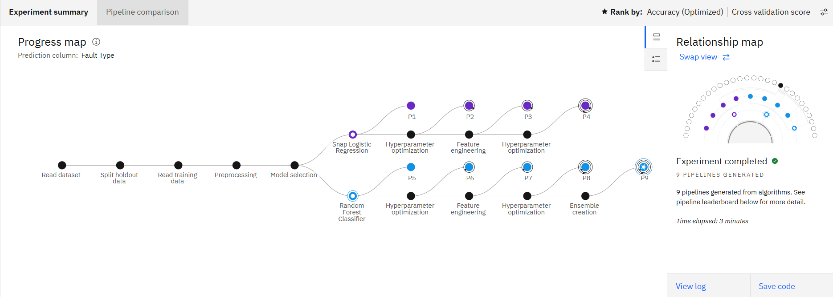
OBJECTIVES
Develop ML model for power fault classification.
Ensure high accuracy & reliability.
Automate pipeline using IBM Auto AI..
Deploy model for real-time predictions.

Slide 6
LITERATURE SURVEY
Singh, M., & Vittal, V. (2011). “Wide Area Protection and Emergency Control of Power Systems.” IEEE Transactions on Power Systems, 26(4), 2194–2205. . Discusses traditional relay and protection systems, their limitations in handling dynamic faults.
Samantaray, S. R. (2013). “Decision Tree-Based Fault Classification and Location in Transmission Lines.” IEEE Transactions on Power Delivery, 28(3), 1830–1838. .Uses Decision Trees for fault detection/classification, shows ML application but still needs manual feature extraction.

Slide 7
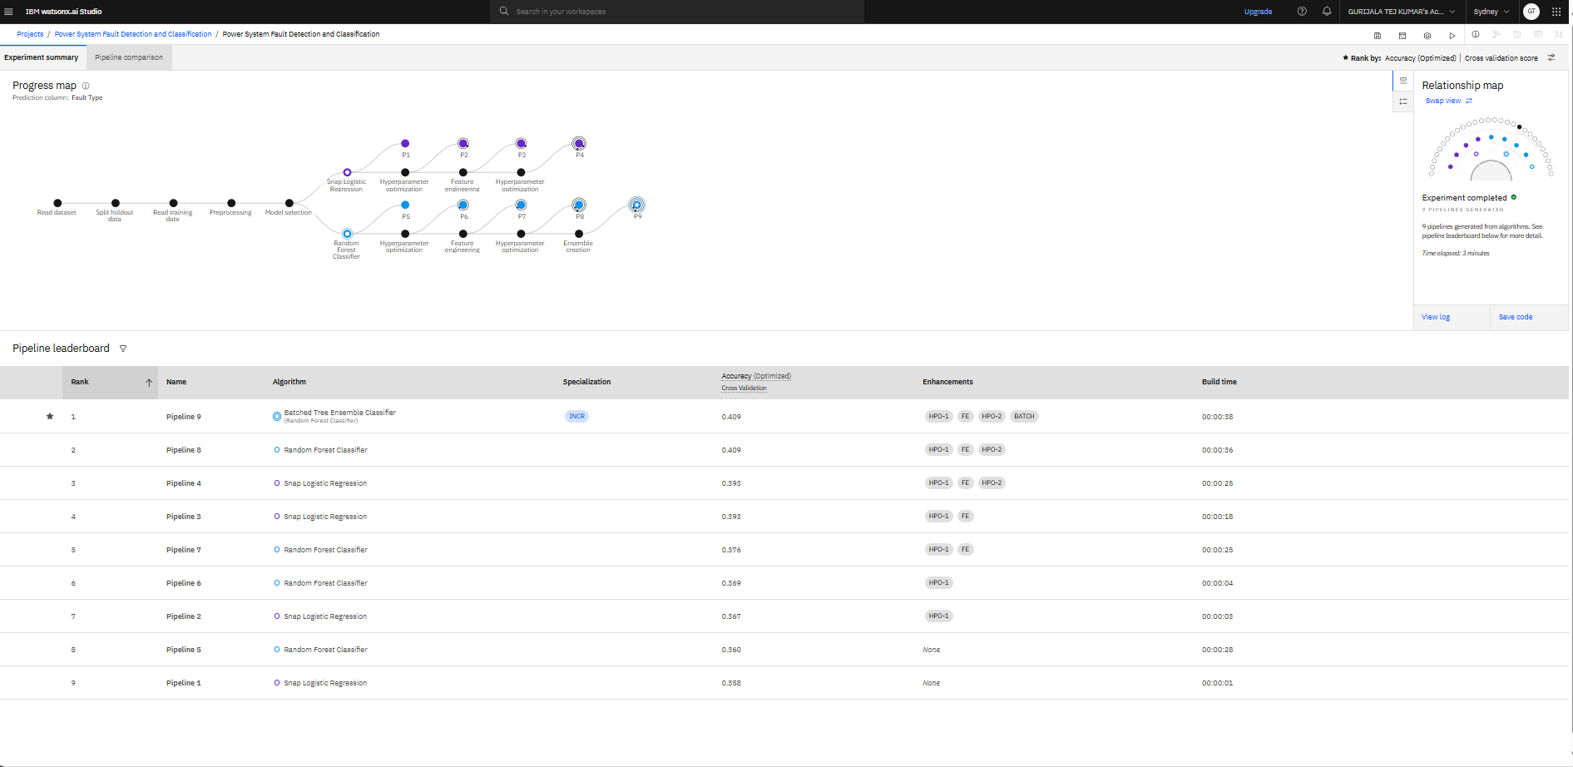
LITERATURE SURVEY
Traditional methods → relay protection, manual analysis.
ML techniques (SVM, ANN, Decision Trees) used in research.
Limitations: require manual feature engineering, time-consuming.
Auto AI addresses these gaps.

Slide 8
EXISTING SYSTEM
Relays and conventional protection schemes.
Manual threshold-based fault detection.
Time-consuming, less adaptable to new data.

Slide 9
PROPOSED SYSTEM
Use IBM Auto AI for automated model building.
Steps: Preprocessing → Model selection → Hyperparameter tuning → Ensemble.
9 pipelines generated, best ensemble chosen.
Deploy model in Watson Machine Learning as API.
Real-time phasor data → model → fault type classification.

Slide 11
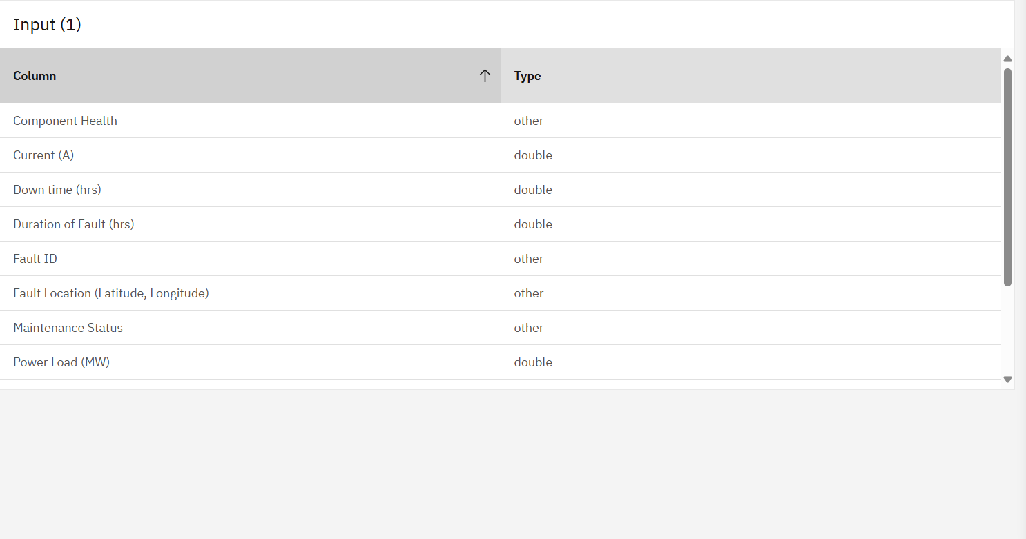

Slide 12
THANK YOU

