Slide 1
Probation Confirmation Guide
October 2015
www.xebiaindia.com

Slide 2
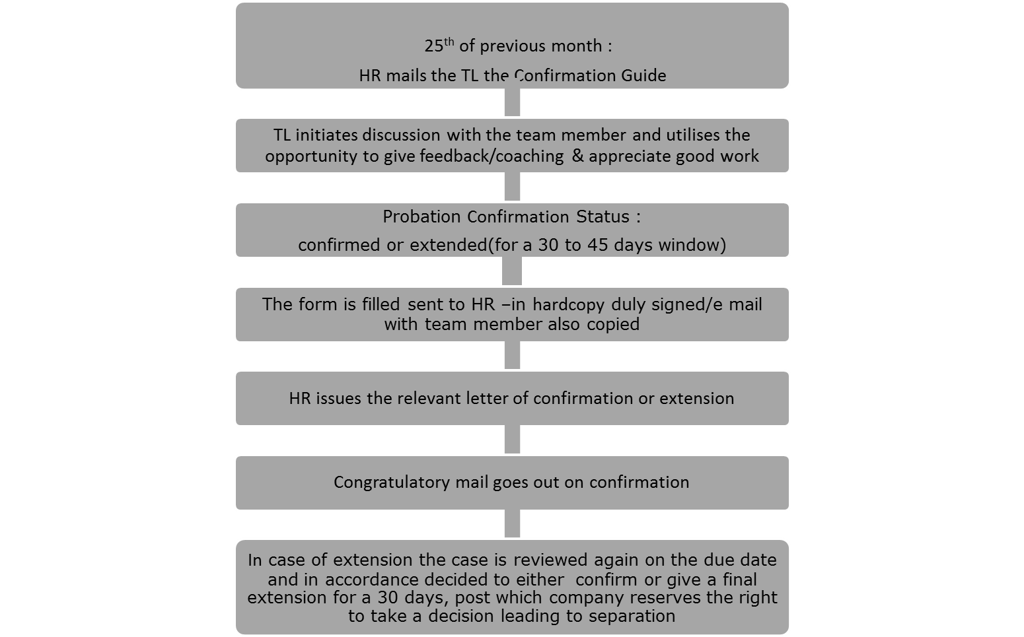
Probation Confirmation Process

Slide 3
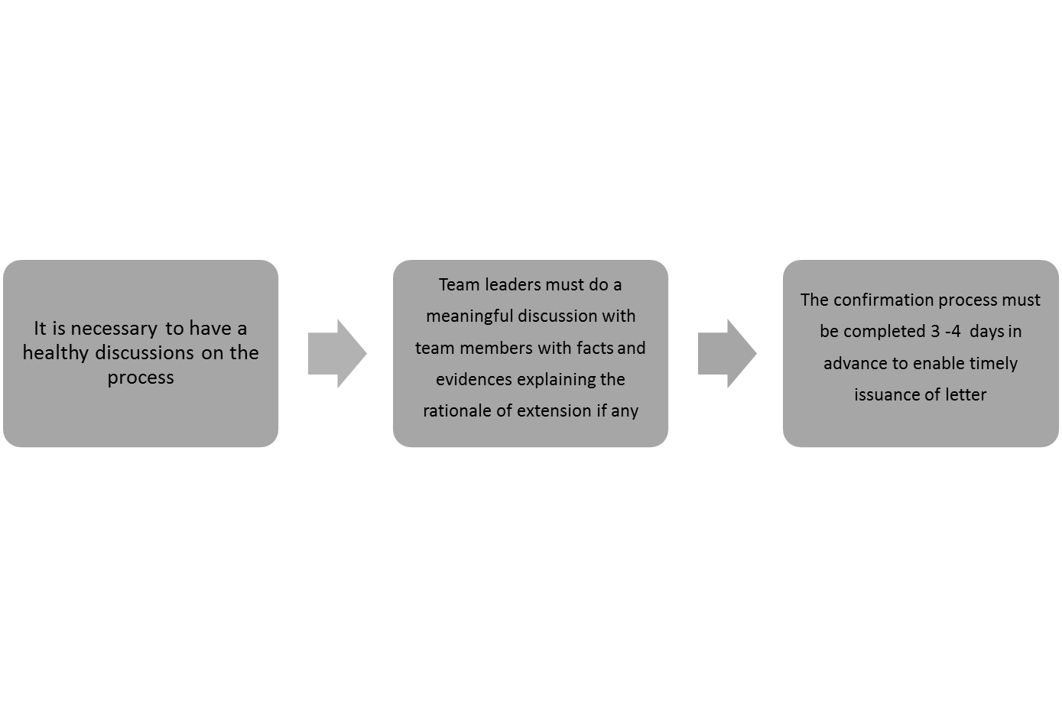
Key Considerations

Slide 4

Probation Confirmation Form

