Slide 1



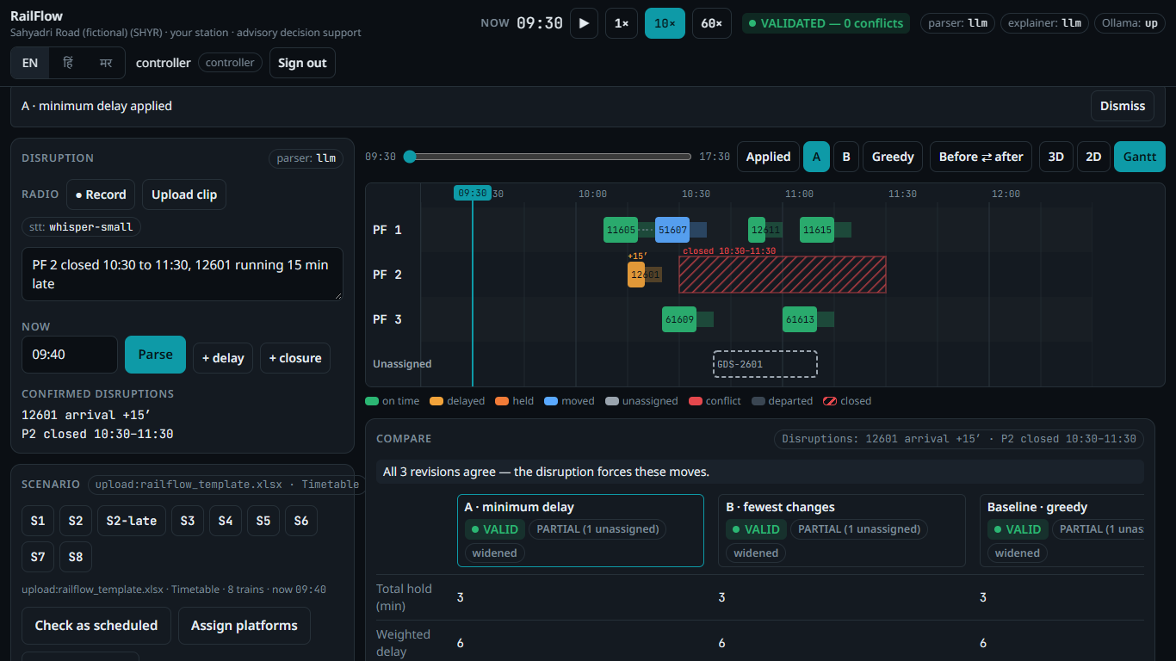





VORTEXA 3.0
12-HOUR HACKATHON · POWERED BY A.I.R.S · DR. D. Y. PATIL INSTITUTE OF TECHNOLOGY, PIMPRI
DOMAIN & PS NO.
6 · Public Systems & Civic Technology · P-03
PROBLEM STATEMENT
RailFlow: Railway Disruption & Platform Conflict Simulator
TEAM NAME
Runtime Renegades
TEAM ID
VTX26-92646
TEAM
Gurjas Singh Gandhi (Leader) · Aaditi Choramle
MCA, P.E.S. Modern College of Engineering, Pune
The planner may be wrong. The validator cannot be fooled.
The AI never touches a platform.

Slide 2


PROBLEM STATEMENT
At an Indian junction, one late train rarely stays one late train — and it is replanned by hand.
1
One delay becomes many
2
Replanned by phone and memory
A train running 30 min late holds its platform; the trains due there next are blocked and the delay spreads down the timetable.
Station masters and section controllers rework platforms over radio and phone, with registers, while the clock keeps running.
3
Too many rules to juggle
4
A missed clash reaches the platform
Minimum clearance between trains, 24–26-coach rakes vs short platforms, MEMU-only bays, goods loops, maintenance blocks.
Manual checks miss a 2-minute gap; late platform switches send crowds across foot-over-bridges.
WHAT P-03 ASKS FOR — AND WHAT RAILFLOW DELIVERS, ALL FIVE
✓ ASSIGN
✓ DETECT
✓ REPLAN
✓ VALIDATE
✓ AI
No platform double-booked; every gap kept
Each conflict reported by train & platform
Delays & closures, with a reason per change
Independent check; never 'valid' when not
Text → delays & closures; explains trade-offs; never assigns

Slide 3
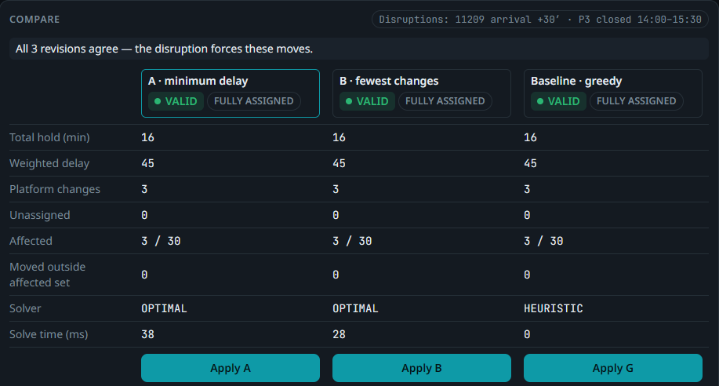
PROPOSED SOLUTION: RAILFLOW
Speak or type the disruption. Get a replan that is proven conflict-free — in seconds.
1
REPORT
2
AI PROPOSES
3
HUMAN CONFIRMS
4
OPTIMISE
5
PROVE & APPLY
Radio clip, typing or the + delay / + closure forms · EN · हिं · मर
Local LLM turns words into delays & closures, each linked to its source words
Unknown trains are rejected, never guessed; the controller signs off
OR-Tools CP-SAT: A = least delay, B = fewest platform changes, plus a greedy baseline
Independent validator (V1–V10) → hash-checked apply → audit chain
OUR DESIGN RULE
The planner may be wrong.
The validator cannot be fooled.
The AI never touches a platform.
BUILT FOR
Station master / Dy. SS
Section controller
Divisional control
Admin / audit
Live, S2: 11209 runs 30 min late + PF 3 shut → 3 of 30 trains move; all 3 revisions independently VALID.

Slide 4
TECHNICAL APPROACH
OPERATOR UI · React 19 + TypeScript
HOW IT DECIDES
Gantt truth view · 3D / 2D station · compare & apply · reason cards · EN · हिं · मर · phone / tablet / desktop
One occupancy rule
A train holds its platform for [arrival, departure + min gap).
API · FastAPI + Pydantic v2
Roles & Argon2id sessions · CSP + Origin checks · every action and refusal written to the audit chain
Strict priorities
First: no train left unplaced. Then the controller's goal: least delay or fewest changes.
AI BRANCH (advisory)
PLANNER
VALIDATOR (independent)
Ollama qwen2.5:3b, local
Whisper small for radio
Regex + template fallback
Numbers must appear in the source
OR-Tools CP-SAT
Lexicographic objective
Replans the affected set only
Greedy baseline to compare
Sweep line, V1–V10
Imports only the data models
Reports every violating pair
Sole source of VALID
Touch only what broke
Replan the affected trains; widen the set only when forced.
proposals → human confirm → plan → prove → apply (AI output can never express a platform assignment)
Nothing unproven ships
A plan that fails validation cannot be applied — the button is locked.
STORAGE · SQLite (WAL)
Immutable revisions · SHA-256 hash-chained audit log · apply = hash match + re-validate + one transaction
Python 3.12
FastAPI
OR-Tools
SQLite
React 19
Three.js
Ollama
faster-whisper
pytest + Hypothesis

Slide 5
HOW THE VALIDATOR WORKS
A separate checker re-proves every plan from scratch — with a different algorithm from the planner.
THE SWEEP LINE, ON THE REAL S3 CONFLICTS
TEN RULES, CHECKED ON EVERY PLAN
13:40
14:00
14:20
14:40
V1
Every timetable train exactly once
V6
Hold within the 45-min limit
PF 1
11214
GAP_VIOLATION
clearance short by 2 min (55 + 5 − 58)
11216
V2
The platform exists
V7
Departed or berthed trains stay put
PF 4
OVERLAP
both at the platform 5 min · 10 min of reserved time
51214
V3
Required / allowed platform kept
V8
No overlap, clearance kept (sweep)
51215
V4
Stay = dwell + departure delay
V9
No train inside a closure
occupied [arr, dep)
5-min clearance → reserved [arr, dep + gap)
Same answers as the station's own Excel answer key — found automatically.
V5
Never earlier than the delay allows
V10
Coaches / wagons fit the platform
THE ALGORITHM, PER PLATFORM
WHY IT CANNOT BE FOOLED
1
Turn every assigned train into an interval [arr, dep + gap).
▸ Imports only the data models and Python's standard library — a test fails the build if that changes.
▸ Different algorithm from the planner: a sweep line, not CP-SAT constraints.
▸ The only source of the VALID badge; re-run on the hashed plan at Apply.
▸ Proven: 400 / 400 random plans checked; every injected planner fault caught (S5).
2
Sort by arrival — O(n log n).
3
Sweep: compare each train with the ones after it; stop at the first arrival ≥ dep + gap. Every clashing pair is reported, not just neighbours.
4
Measure in minutes: stay = min(dep A, dep B) − arr B; reserved = min(dep A, dep B) + gap − arr B; shortfall = dep A + gap − arr B.

Slide 6
FEASIBILITY AND VIABILITY
137
400 / 400
OPTIMISER vs GREEDY · 20 seeded peak-hour scenarios
automated backend tests,
all passing
random disruption cases —
every plan proven valid
9 / 9
₹0
wrong AI readings caught
before reaching 'ready'
cloud cost · runs offline on
one laptop, no GPU
Deployable today
Fits how stations work
Honest next steps
One laptop, fully offline. Judges' and staff phones join over the hotspot — no cloud, no GPU.
Imports the working-timetable Excel; any station via template, JSON or typed in by hand.
Route conflicts in the station throat (designed, measured), past-midnight trains, multi-station.
AI parser accuracy: LLM 44/52 exact vs regex 36/52 on labelled messages; when Ollama is off, RailFlow falls back to regex + templates and still plans.

Slide 7
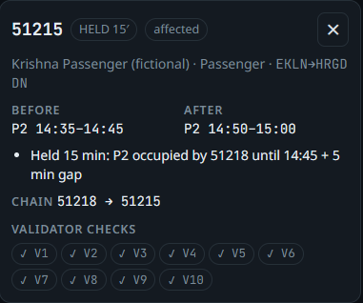
IMPACT AND BENEFITS
C
Controllers
From minutes of phone calls to a checked replan in seconds — every move arrives with its reason, ready to announce.
P
Passengers
Option B keeps platform changes to a minimum: fewer last-minute dashes across foot-over-bridges.
R
Railway management
Every confirm, plan, apply and refusal sits in a tamper-evident audit chain; admins audit, controllers act.
Every change explains itself: cause, chain and checks.
S
Safety & trust
S8 · THE CONTROLLER CHOOSES, INFORMED
No plan reaches a platform unless an independent validator proved it conflict-free.
A
2 moves
weighted delay 76
B
1 move
weighted delay 136
Beyond the demo: any station via Excel / JSON template or manual entry · 3 languages · works on phone, tablet and desktop.

Slide 8
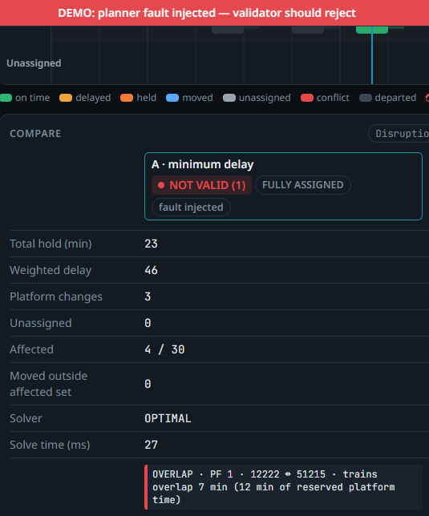
DIFFERENTIATOR
Phone + register
Optimiser / chatbot
RailFlow
Finds every clash, with minutes
No
Partly
Yes
Moves only the affected trains
Partly
No
Yes
Independent proof each plan is valid
No
No
Yes
AI can never assign a platform
—
No
Yes
Explains why each train moved
Partly
Partly
Yes
Our boldest demo: we break our own planner, live.
The validator catches the overlap — NOT VALID, Apply locked. Trust is proven, not promised.
Voice · EN · हिं · मर · offline
Yes
No
Yes
Tamper-evident audit trail
No
No
Yes
We don't ask anyone to trust the AI or the optimiser. Every plan is proven before it touches a platform — and the AI only listens and explains.

Slide 9










Team Runtime Renegades · VTX26-92646 · P-03 RailFlow
github.com/Gurjas2112/RailFlow
THANK YOU!
Game’s
Still On
VORTEXA 3.0 · AIRS

