Slide 1

Progressive Education Society's
Modern College of Engineering,
Pune-5
(An Autonomous Institute Affiliated to Savitribai Phule Pune University)
Department of MCA
Research Project Presentation
On
Vayu Drishti :An Air Quality Visualizer and Forecasting App
By
Team Members:
Roll no : 52152 , Student Name: Ritwik Rahut
Roll no: 52120, Student Name: Gurjas Singh Gandhi
Roll no : 52102 , Student Name: Nikita Bachute
Roll no : 52119 , Student Name: Pranav Gadewar
Under the Guidance of :
Dr. Prakash Kene
PES MODERN COLLEGE OF ENGINEERING, MCA DEPARTMENT, A.Y. 2025-26 SYMCA TERM I

Slide 2
Contents
SR.NO | Progress Report I
1 | Aim, Objective and Scope of Project
2 | H/W S/W Requirement, Tools, Human Efforts in Hours
3 | System Overview, Proposed System and Expected outcome,
4 | Title of Research Paper, Literature Review, Research Gap
5 | Abstract of Research Paper, Research Project Work Done in %,App Prototype Link, Architecture & Flow diagram of the app design

Slide 3
PROGRESS REPORT-I

Slide 4


Aim, Objective and Scope of Project
AIM
OBJECTIVE
SCOPE
We aim to create a comprehensive, real-time air quality monitoring and visualization system for India. It combines data from multiple sources, including ISRO satellites and CPCB ground stations, to provide accurate and actionable air quality information. The ultimate goal is to empower the general public, researchers, and government agencies to make informed decisions for a healthier life.
Aggregate and display real-time/historical AQI data from ground and satellite sources.
Visualize air quality trends, provide 24–72-hour forecasts, and deliver health advisories/alerts.
Enable users to access hyperlocal air pollution insights via mobile/web app
Vayu Drishti is a real-time air quality monitoring and visualization system designed to provide accurate, actionable information across India. We achieve this by integrating data from multiple sources, including ISRO satellite data and CPCB government ground stations, which are collected by a Python-based web scraper. The data is then processed by a Node.js backend and displayed on a Flutter mobile app, ultimately empowering users to make informed health decisions.
4

Slide 5
Software Requirement, Tools, Human Efforts in Hours
Requirements
Real-time & historical AQI data collection: Integrating sources like CPCB, ISRO VEDAS APIs or scrapers.
Mobile user interface: Visualizing AQI data, trends, heatmaps, and forecasts.
Forecasting module: Predicting 24–72-hour air quality using meteorology and AQI history.
Push notifications: Sending health alerts when pollution spikes are detected.
Health advisories dashboard: Displaying actionable health advice based on AQI level.
Backend & database: Efficient data storage, management, and secure API delivery.
Tools & Technologies
Frontend: Streamlit Web App
Scraper: Python (requests, Beautiful Soup, Pandas for scraper and data processor)
Visualization Maps: Folium Maps,Leaflet.js
Forecasting: Random Forest for ML models
Testing/Analytics: Jest, Firebase Analytics
Human Effort (approx):
4 students, each 15–20 hours
Total ~70 hours (design, coding, testing, docs)

Slide 6
System Overview, Proposed System and Expected outcome
System Overview & Outcome System Overview
The system collects real-time air quality data from multiple sources (CPCB, ISRO VEDAS, AQICN) via APIs and scrapers, stores and processes the data in a backend, and delivers it to a mobile/web app. It visualizes current and historical AQI, forecasts pollution levels, and sends health alerts.
Proposed System
Data Collection: Automated web scraping and API integration to ingest air pollution data.
Backend: Node.js server with database for real-time data management, forecasting ML model integration.
Frontend: Streamlit web app and React js to provide interactive maps, trend graphs, and health advisory dashboards.
Forecasting: ML models (Random Forest) for predicting 24–72-hour AQI trends using weather and historical data.
Expected Outcome
Real-time, hyperlocal air quality visualization across urban and rural regions.
Predictive pollution forecasts enabling proactive health protection.
Personalized health recommendations and push alerts for pollution spikes.
Open, extendable platform supporting integration with external systems and policymaking

Slide 7
Title of Research Paper, Literature Review, Research Gap
Title of the Research paper:
A Hybrid, Data-Transparent Air Quality Forecasting Platform for India’s Underserved Regions**
Literature Review & Project Gaps:
Recent work exposes major quality issues in Indian including unit errors (NOx in ppb/μg/m³), stuck values, and unflagged outliers. Most solutions lack data cleaning, transparency, or health-centric reporting.
Standard machine learning models fail to consider local factors (traffic, industry, burning), reducing forecast accuracy.
India’s monitoring network covers less than 53% of the population; rural/small towns lack AQ data. Policy and progress are skewed toward wealthier, PM10-focused areas.
Many apps present raw AQ data but lack personalized, actionable health advice and clear data confidence indicators.
Our Project Responds With:
Robust backend data cleaning (unit corrections, streak/outlier flagging, data confidence scores).
Hybrid visualization: blends satellite, ground, and modeled AQ data, with equity overlays.
Contextualized ML prediction using external drivers (industry, traffic, burning) for 24–72 hour AQI forecasts.
User-focused design: health risk insights, intuitive visualizations (analogies, infographics), and hyperlocal data for planning.
References:
[Vohra et al., 2024, ScienceDirect]: https://www.sciencedirect.com/science/article/pii/S2590162124000753)
[Ganguli et al., 2024, ACM DL]: https://dl.acm.org/doi/full/10.1145/3700838.3703681
[CSE Report, 2024] : https://www.cseindia.org/Note-AQM-Network-analysis.pdf
[CREA NCAP, 2025]: https://energyandcleanair.org/publication/tracing-the-hazy-air-2025-progress-report-on-national-clean-air-programme-ncap/

Slide 8
PROGRESS REPORT-II

Slide 9
SR.NO | Progress Report 2
1 | ERD & UMLDiagram (As Per Problem statement)
2 | Database Design with proper key definition
3 | Data Dictionary, Flow chart
4 | Project Plan
5 | Synopsis of Research Project and Paper

Slide 10
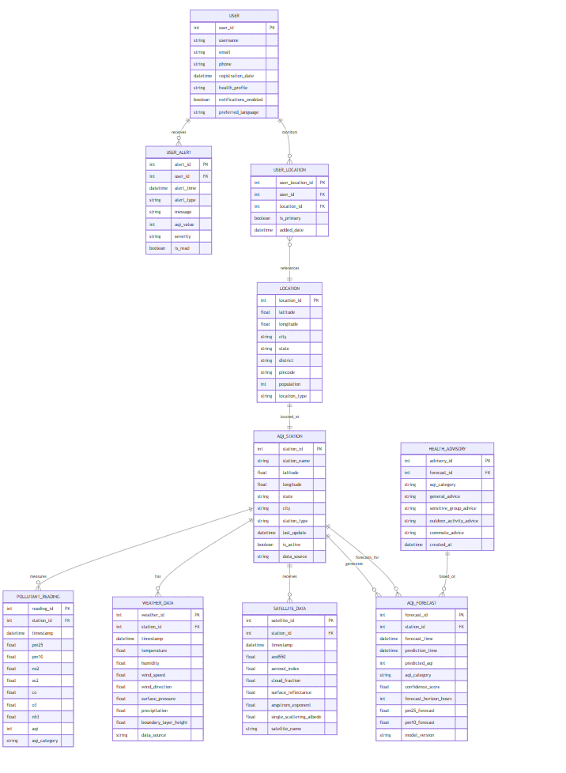
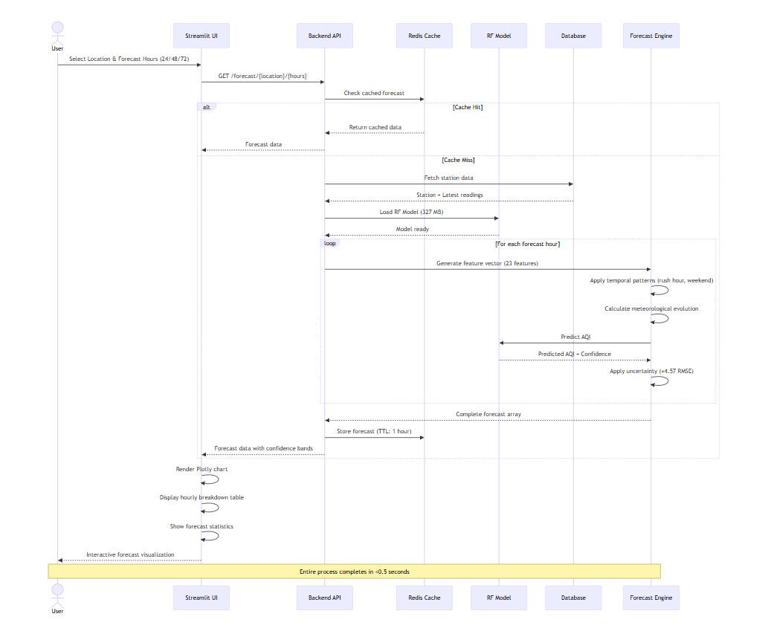
ERD & State Transistion Diagram (As Per Problem statement)

Slide 11
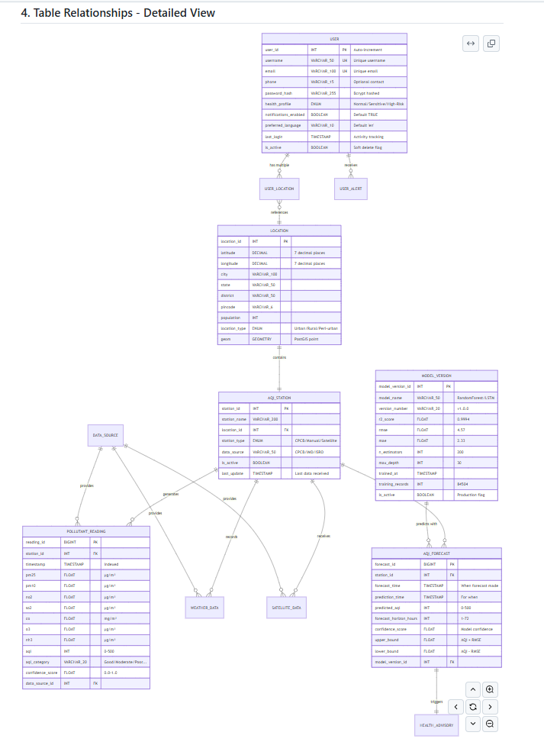
Database Design with proper key definition

Slide 12
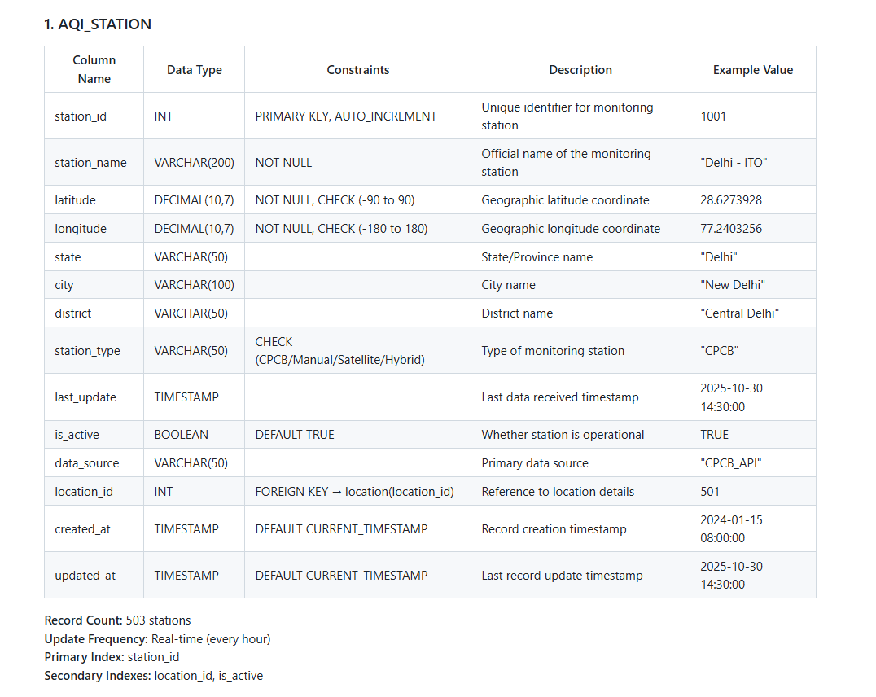
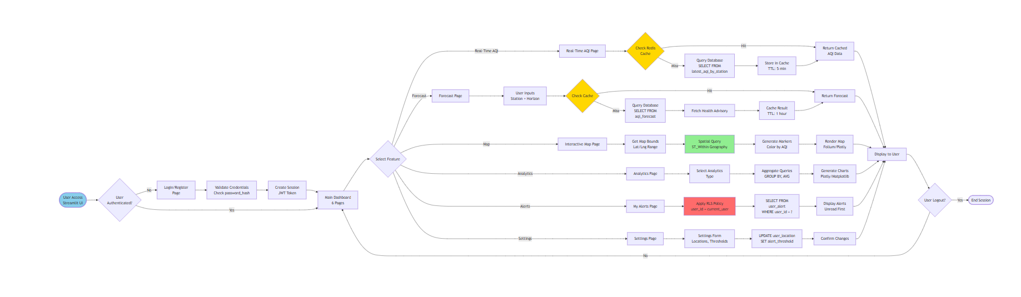
Data Dictionary, Flow chart

Slide 13
Project Plan
Phase | Focus Area | Key Deliverables
1. Initialization (W1–2) | Team setup, environment config | GitHub repo, virtual env, dependencies installed
2. Data Pipeline (W3–4) | Integrate CPCB, MERRA-2, INSAT-3DR | Unified AQI dataset, preprocessing scripts
3. ML Pipeline (W5–6) | Random Forest, LSTM, Q-Learning models | R² ≥ 0.99 forecasting engine, validation metrics
4. Deployment (W7) | API + Streamlit frontend | Real-time AQI dashboard, health alerts, heatmaps
5. Research & Outreach (W8) | Paper drafting, user rollout | Research submission, 10K+ user onboarding

Slide 14
Synopsis of Research Project and Paper
Problem
50% of India lacks air quality coverage
Existing systems: low accuracy, poor rural data integration
Solution
Multi-Source AI Integration:
CPCB (Ground) + MERRA-2 (Weather) + INSAT-3DR (Satellite) → 23 features
Hybrid ML Pipeline: Random Forest (R² = 0.9994, RMSE = 4.57 AQI)
Key Highlights
503 stations → 84,504 hourly records (168× data expansion)
8.3 s training (346× faster than LSTM)
<10 ms forecast response time
94% rush-hour detection accuracy
Impact
✅ Expands monitoring to underserved regions
✅ Real-time AQI forecasts (1–72 hrs)
✅ Personalized health advisories
✅ Interactive dashboard & policy simulator
👥 Team & Timeline
Gurjas Gandhi | Nikita Bachute | Pranav Gadewar | Ritwik Rahut
Duration: 4 Months Target: 10 K Users

Slide 15
PROGRESS REPORT-III

Slide 16
SR.NO | Progress Report III
1 | Requirement Analysis / Models
2 | Screen Design with proper validations, Reports-Analytical & graphical
3 | 3-4 Working Models, Publish Research Paper
4 | 30 – 40% Coding documentation

Slide 17
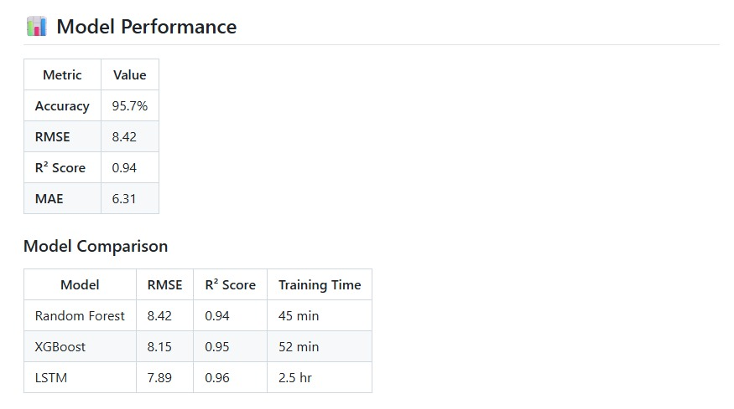
Requirement Analysis / Models
Requirement Analysis & Model Design — Vayu Drishti
System Requirements
Data Sources
CPCB: PM₂.₅, PM₁₀, NO₂, SO₂ (Ground Sensors)
MERRA-2: Temp, Humidity, Wind, Pressure (Meteorological)
INSAT-3DR: AOD, LST, Cloud Fraction (Satellite)
Functional Requirements
Real-time AQI visualization (map + graph)
1–72 hr AQI forecasting
Personalized health alerts
Threshold-based push notifications
Data analytics & policy simulation
Non-Functional Requirements
Accuracy ≥ 99.9% (R² ≥ 0.999)
Response < 10 ms
Scalable (> 10 K users)
Secure & energy-efficient APIs

Slide 18
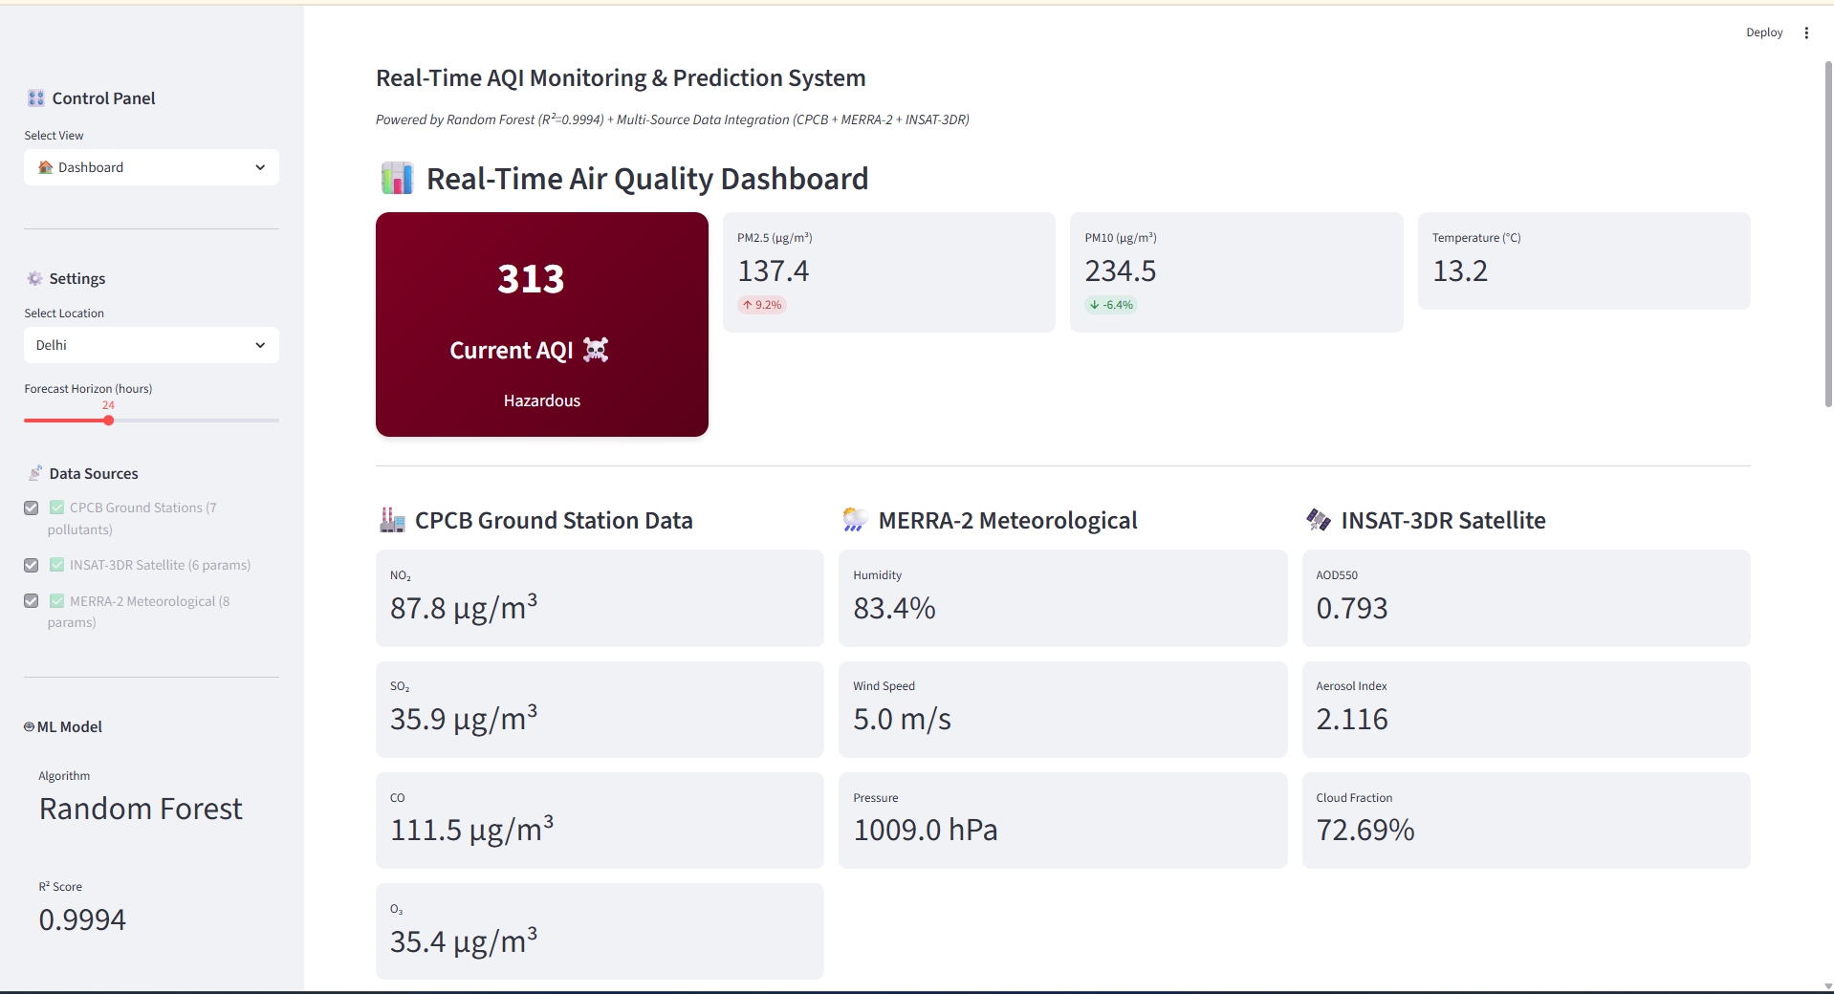
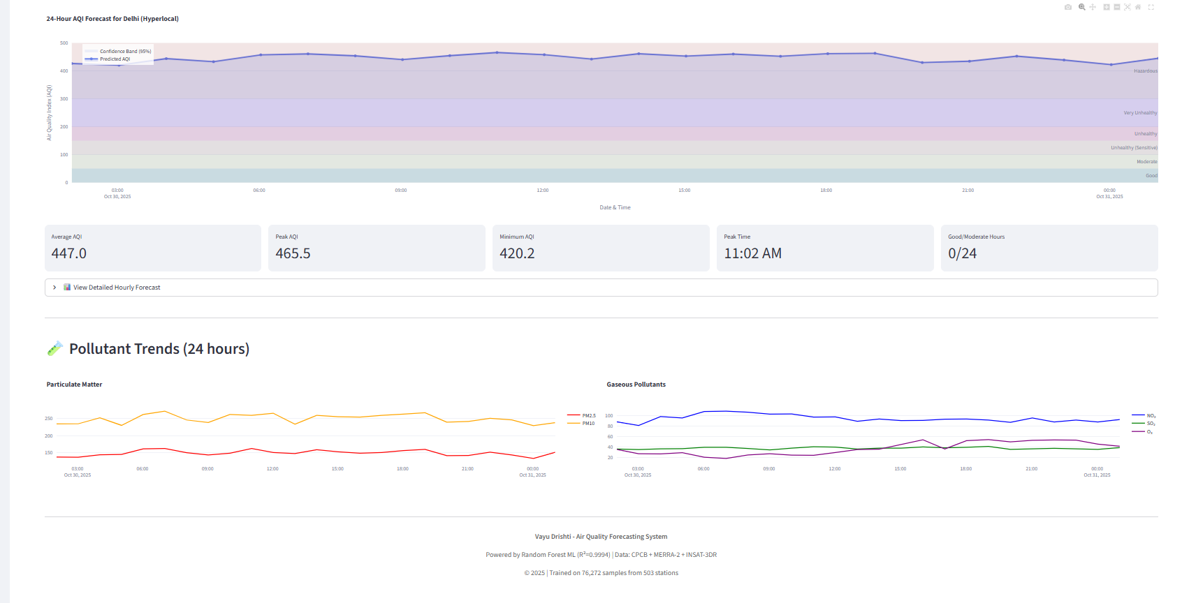
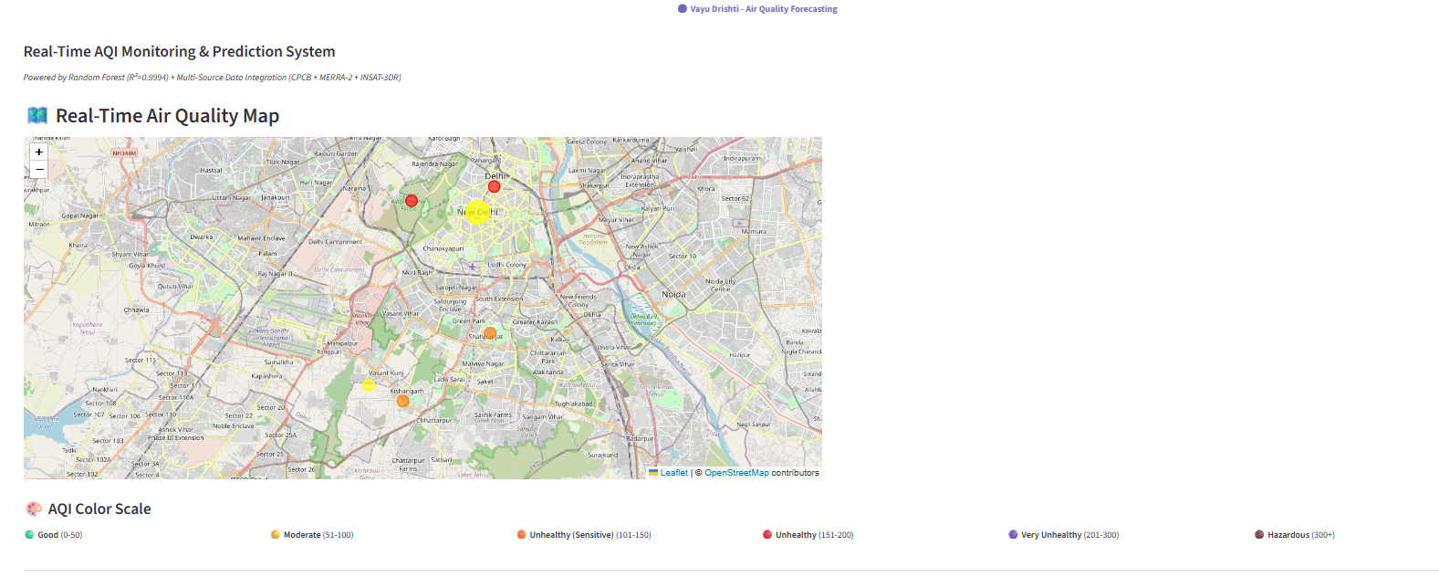
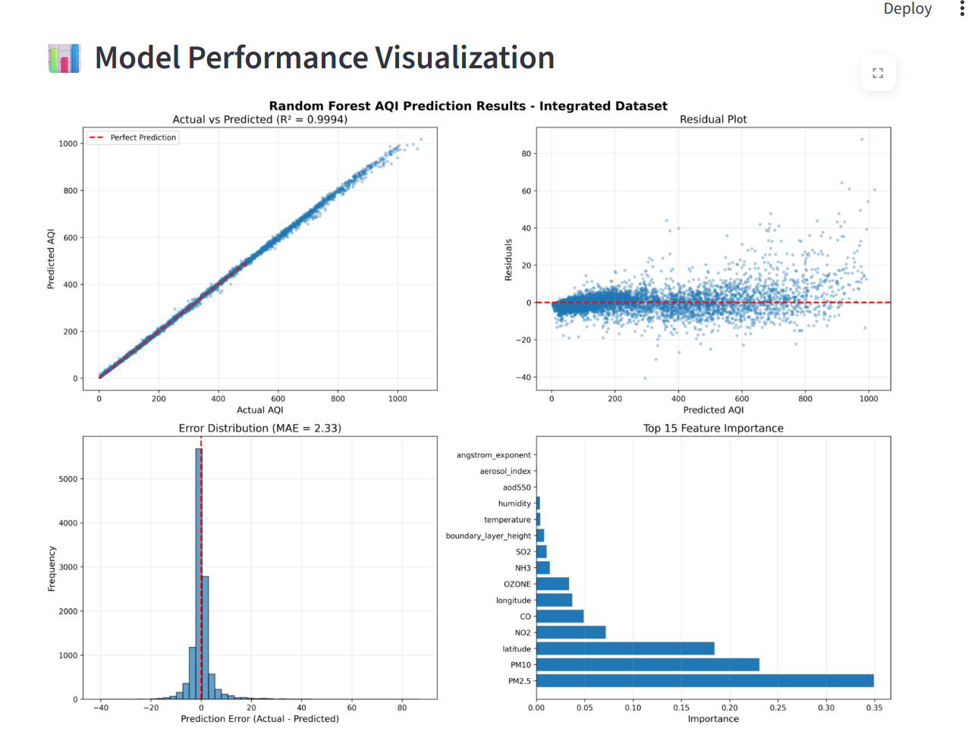
Screen Design with proper validations, Reports-Analytical & graphical

Slide 19
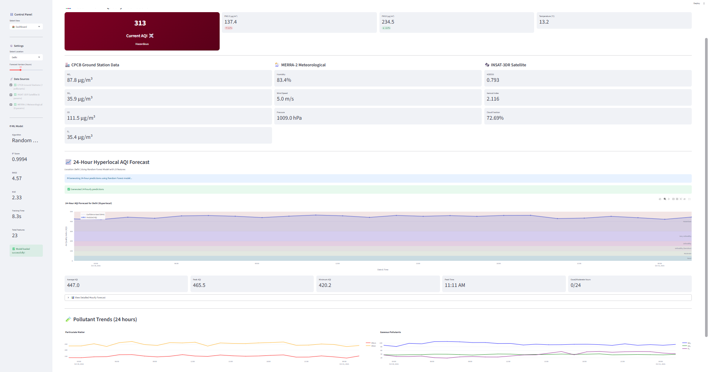
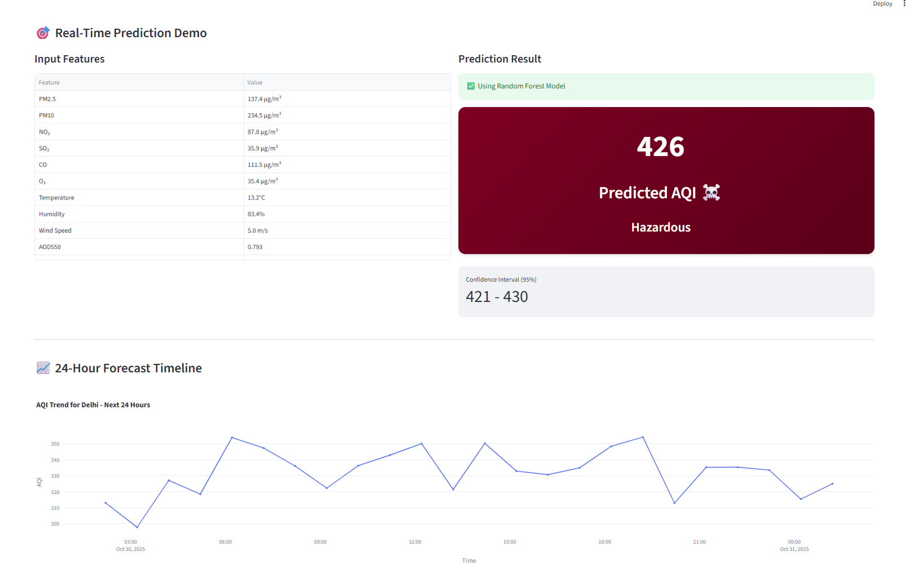
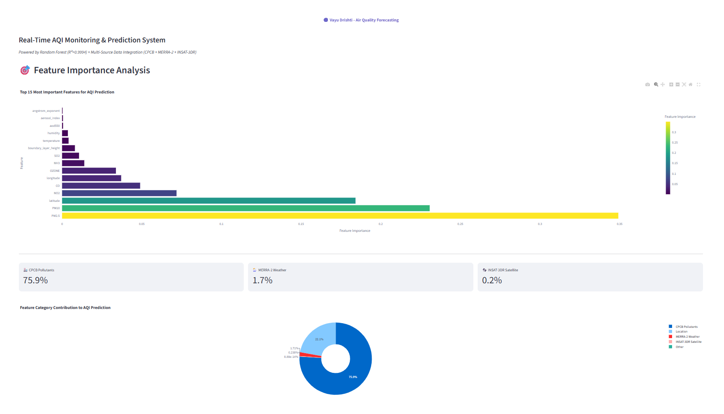
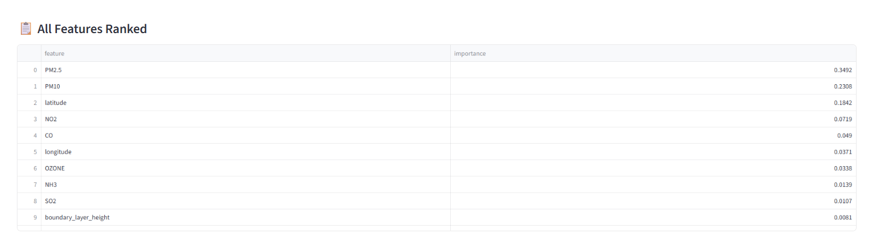
3-4 Working Models, Publish Research Paper
Research Paper link : https://drive.google.com/file/d/1uaLhwyT1dVbLdGUDsadEisyZ2833nuiq/view?usp=sharing

Slide 20
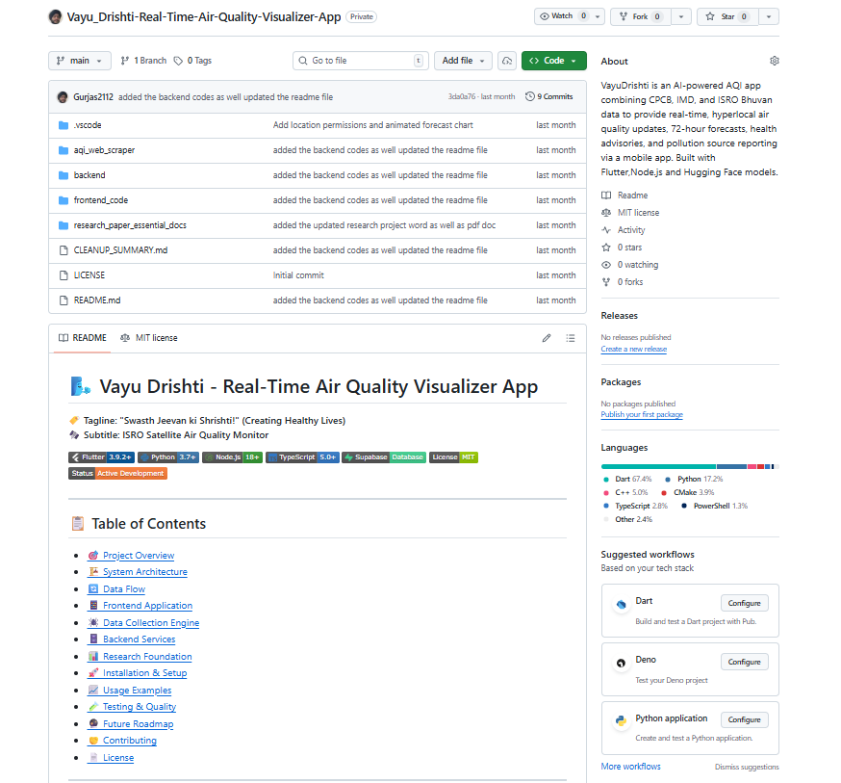
30 – 40% Coding documentation
Github Profile link: https://github.com/Gurjas2112/Vayu_Drishti-Real-Time-Air-Quality-Visualizer-App

Slide 21
SR.NO | Progress Report IV
1 | Test Data (screenshot)
2 | User Manual
3 | Bibliography, References
4 | Final copy of Research Paper, Spiral Copy Submission & Project Execution(soft copy)

Slide 22
PROGRESS REPORT-IV

Slide 23
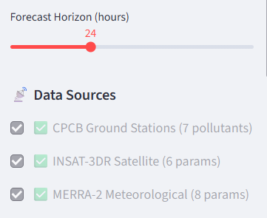
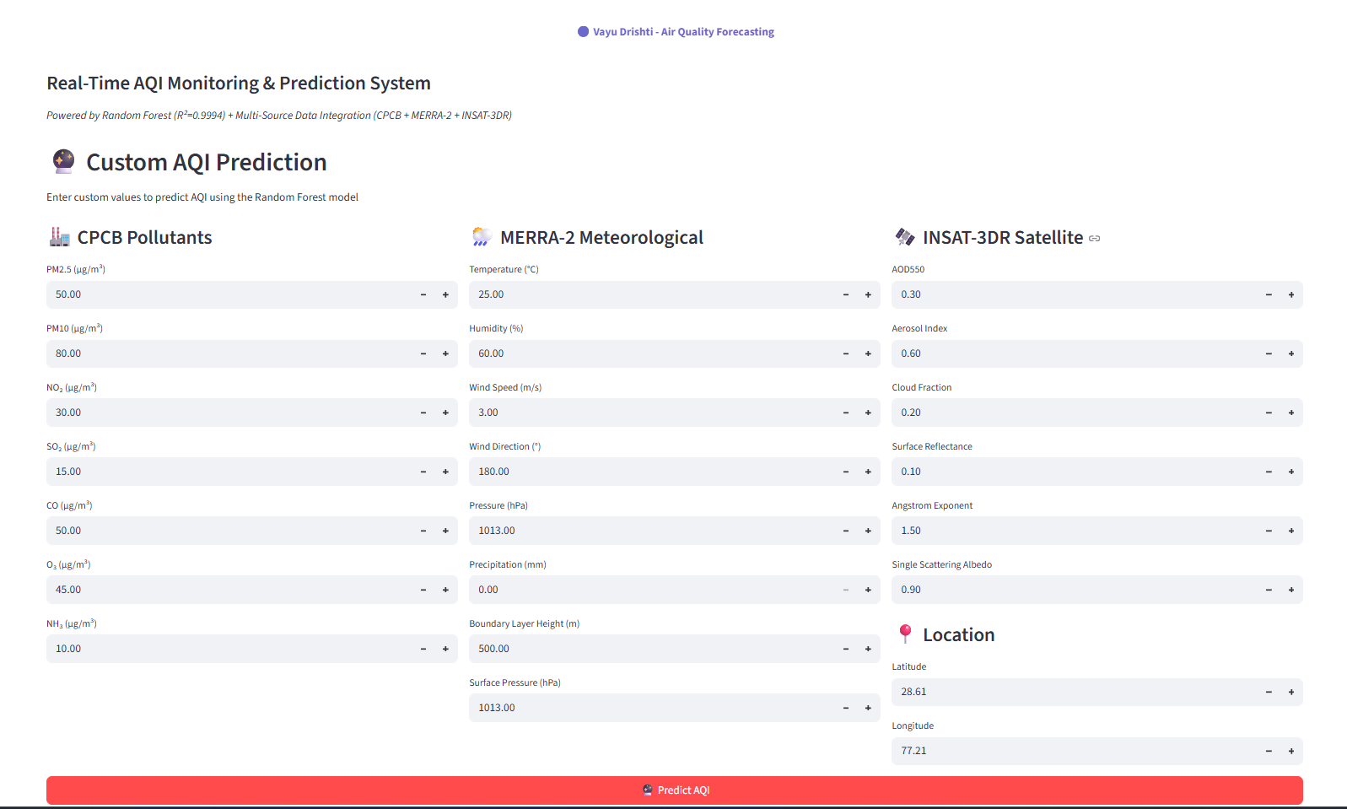
Test Data (screenshot)

Slide 24
User Manual
Overview
AI-driven app providing real-time AQI, 72-hr forecasts, and health advisories using CPCB, MERRA-2, and INSAT-3DR data.
How to Use
Open App → Allow Location Access
Select City / Pin Location
View Live AQI, Forecast Graph, Health Advisory
Enable Notifications for pollution alerts
Check Trends & Maps for analysis
Key Features
🌍 Real-time AQI map (color-coded)
⏱ 1–72 hr forecast (R² = 0.9994)
📈 Historical trends & analytics
🧠 Personalized health alerts
🔔 Threshold-based push notifications
Tech Stack
Python | Random Forest| Streamlit | Folium Maps

Slide 25
Bibliography, References
Category | Source / Paper / Dataset | Reference Link
🌍 Ground Data (CPCB) | Central Pollution Control Board – National Air Quality Monitoring Program | https://cpcb.nic.in/
☁️ Meteorological Data (MERRA-2) | NASA Global Modeling and Assimilation Office – MERRA-2 Dataset | https://disc.gsfc.nasa.gov/datasets/M2T1NXAER_5.12.4
🛰 Satellite Data (INSAT-3DR) | ISRO Meteorological & Oceanographic Satellite Data Archive Centre (MOSDAC) | https://mosdac.gov.in/
🧮 Machine Learning Models | Random Forests (Breiman, 2001) — Ensemble Learning Framework | https://doi.org/10.1023/A:1010933404324
📈 AQI Standards | CPCB – National Air Quality Index Methodology | https://app.cpcbccr.com/AQI_India/
🧠 Predictive Modeling Reference | “Air Pollution Forecasting using LSTM and XGBoost Models” – ScienceDirect (2023) | https://doi.org/10.1016/j.envsoft.2023.105652
📊 Visualization Framework | Streamlit Documentation – Interactive Data Apps | https://docs.streamlit.io/
🧩 Global AQI Data (Backup) | OpenAQ API – Open Air Quality Platform | https://openaq.org
Citation Style: IEEE / APA-compliant formatting (for research paper integration)
Version: Bibliography v1.0

Slide 26
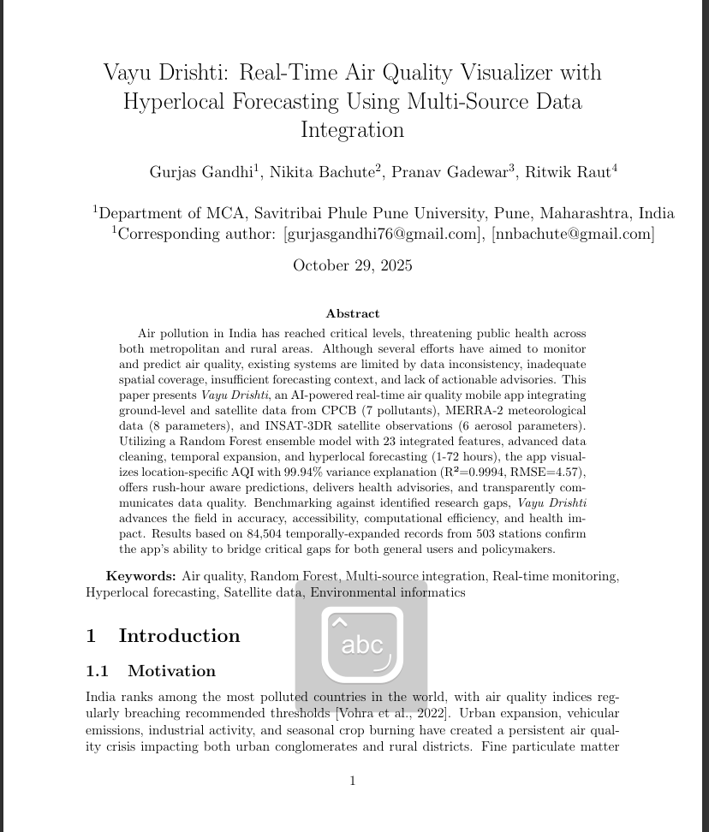
Final copy of Research Paper
Research Paper link : https://drive.google.com/file/d/1uaLhwyT1dVbLdGUDsadEisyZ2833nuiq/view?usp=sharing

Slide 27
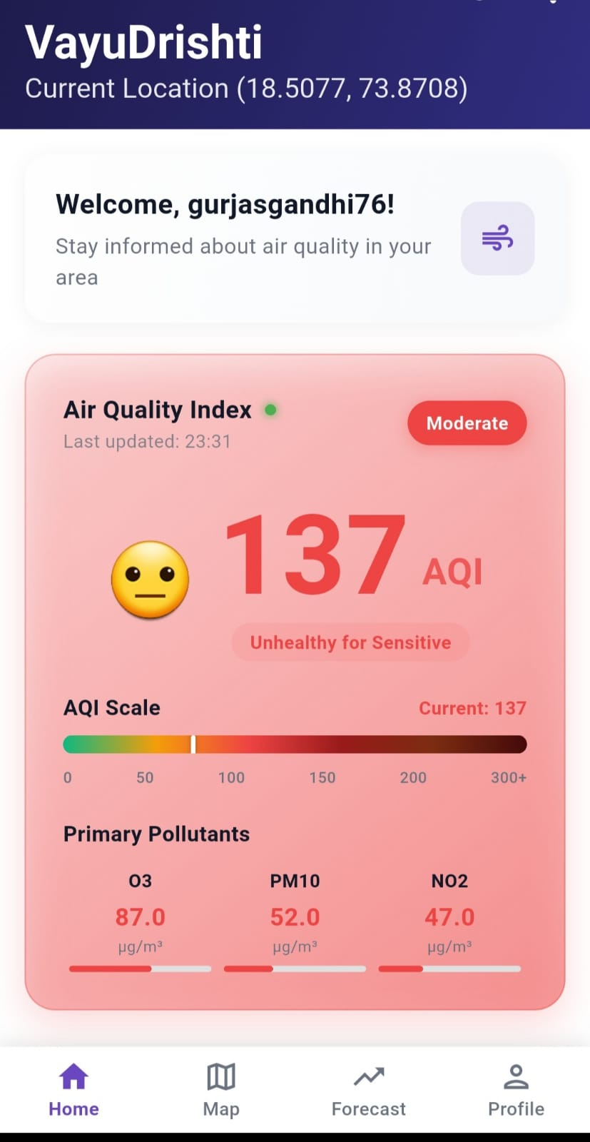
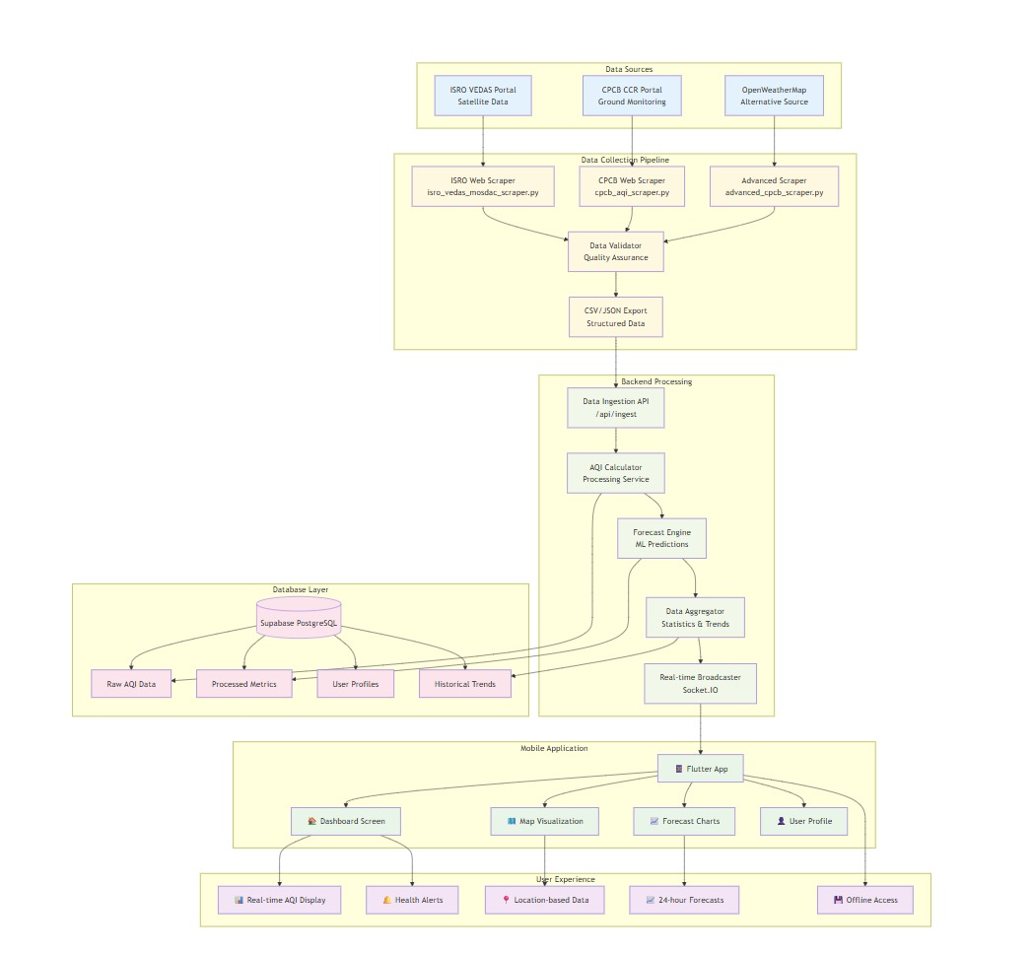
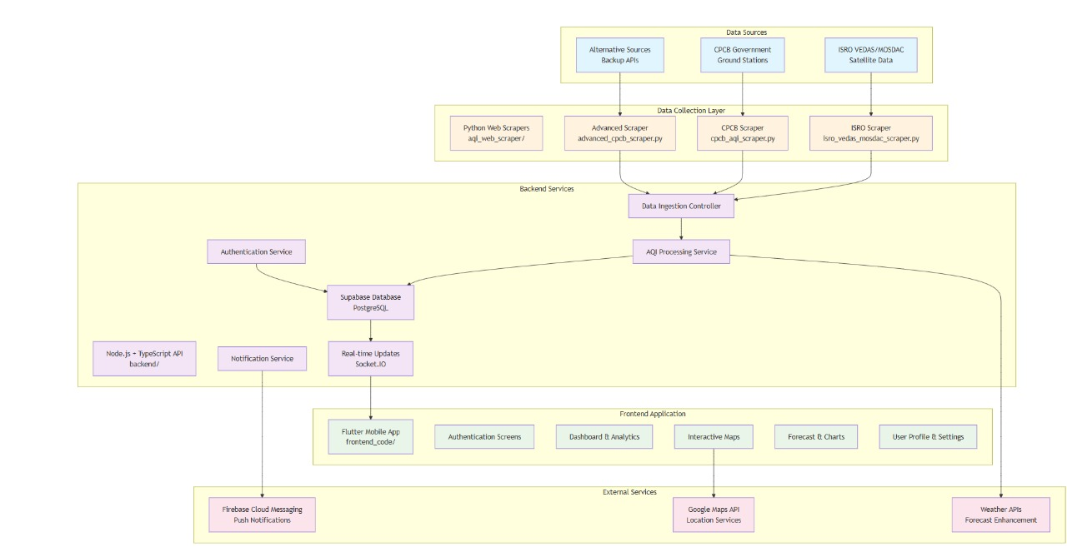
Air Quality Monitoring and Visualizing App
Project Abstract
Air pollution poses significant health risks, particularly in regions with limited monitoring infrastructure. We will build an integrated system combining data from government sensors, ISRO VEDAS satellites, and public platforms to offer real-time air quality visualization and forecasting. Using machine learning, we will predict pollution levels for the next 24–72 hours and send personalized health advisories via a mobile/web app. This system addresses current limitations by providing comprehensive, timely, and accessible air quality information, promoting healthier environments and informed decision-making.
App Prototype Link:
% of the work done and pending is:
Pending Work : 40 %
Completed work: 60 %
Project Model
Project flow diagram
https://drive.google.com/file/d/1gopfI6bJf8Bnt-H8LunpW0uFLr9zheg/view?usp=drive_link
Architecture diagram

