Slide 1

EXOPHCA
Exoplanet Habitability Compatibility Analysis
Scoring and predicting exoplanet habitability from NASA archive data
GURJOT SINGH| ROLL NO: 24BCS003 | RIMT University | Industrial Training at Meander Software Pvt. Ltd.

Slide 2






OVERVIEW
What We'll Cover
The Problem
The Data & Pipeline
Why habitability scoring matters, and the data gap it addresses
NASA archive data, cleaning, and system architecture
The Method
The Discovery
Earth Similarity Index, superhabitability, and machine learning
Finding and fixing data leakage — the project's key turning point
The Results
The Application & What's Next
Real predictions on unconfirmed TESS candidates
EXOPHCA in action, and future directions
2

Slide 3
THE PROBLEM
Most Exoplanets Are Discovered Before They're Understood
Over 6,000 confirmed exoplanets. Thousands more unconfirmed candidates.
Detailed measurements — precise radius, stellar flux — often aren't available until much later, if ever. Yet limited telescope time means we must decide which candidates deserve costly follow-up observation.
}
6,319
confirmed planets analyzed
8,064
TESS candidates screened
Can we estimate habitability using only the limited, early-available data we have at the point of detection?
0.37%
meet strict habitability criteria
3

Slide 4




OBJECTIVES
Project Objectives
Analyze real NASA archive data and understand its structure and biases
Design a scientifically grounded habitability scoring system
Build a leakage-free ML model for early-stage, indirect data
Validate against real, currently unconfirmed TESS candidates
Deliver an interactive, non-technical-friendly application
4

Slide 5

DATA
Two NASA Data Sources, Two Roles
PSCompPars
TOI Table
Planetary Systems Composite Parameters
TESS Objects of Interest
6,319
8,064
confirmed exoplanets · 325 attributes
unconfirmed candidates · active mission
PSCompPars trains and scores; TOI validates against genuinely new, unconfirmed data.
5

Slide 6
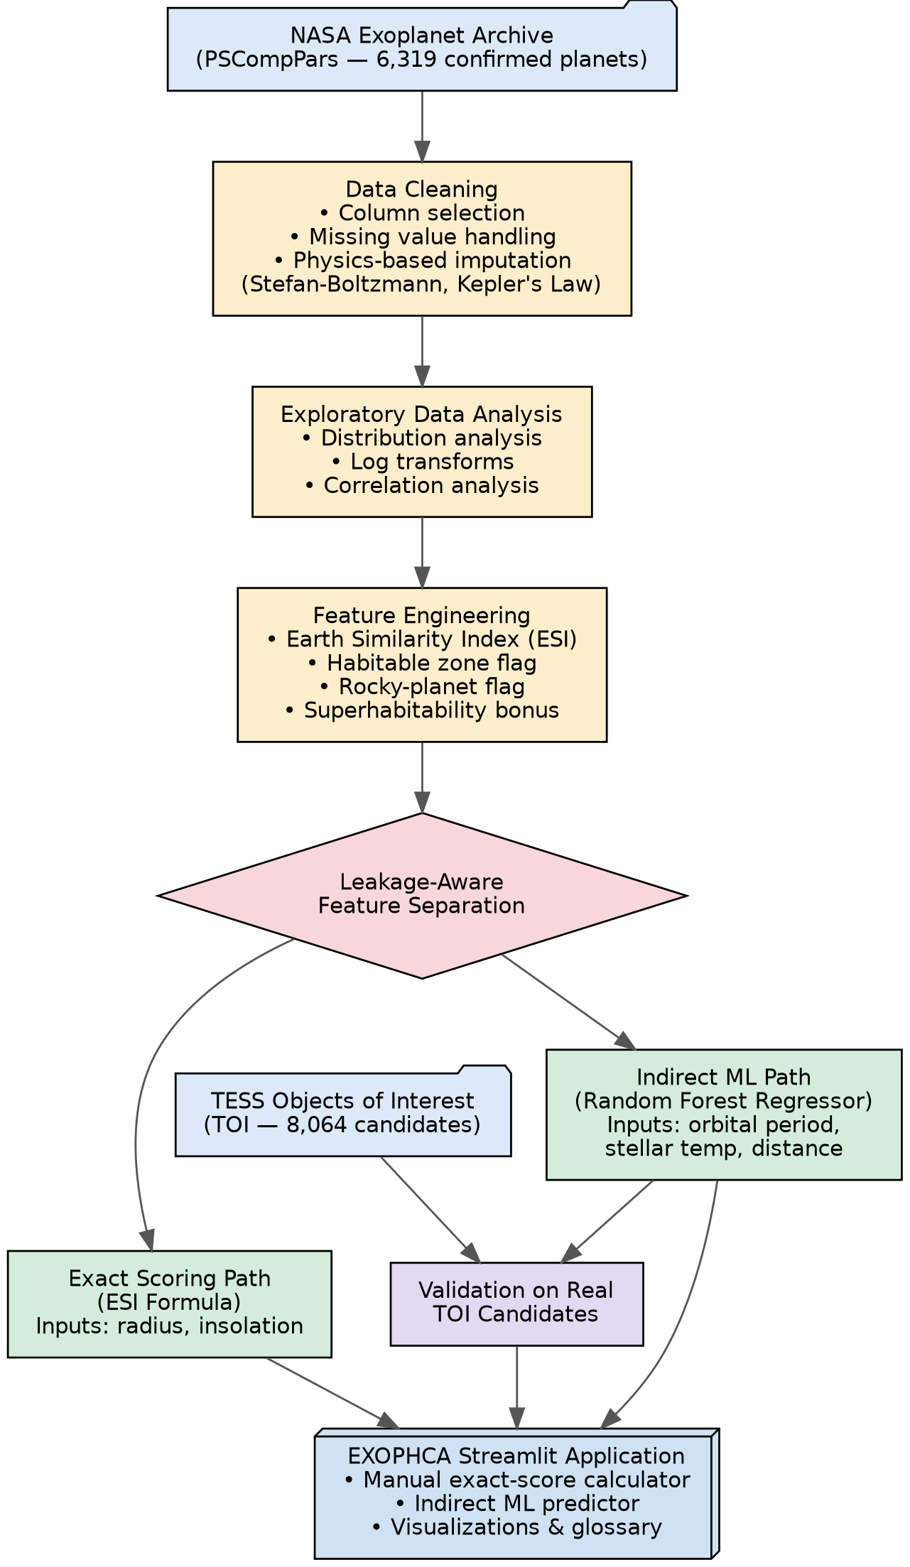
SYSTEM DESIGN
Pipeline Architecture
6

Slide 7
DATA CLEANING
Physics, Not Guesswork, Fills the Gaps
Rather than dropping every incomplete row, missing values were recovered using exact physical relationships wherever possible:
Stefan–Boltzmann Relation
Kepler's Third Law
insol = (eqt / 255)^4
a³ = P² × M_star
Recovered missing insolation flux from equilibrium temperature for planets missing only one of the two.
Recovered missing orbital semi-major axis from orbital period and stellar mass.
Result: 5,613 of 6,319 rows preserved (~89%) — vs. a much larger loss with naive dropping.
7

Slide 8
EXPLORATORY ANALYSIS
The Data Itself Is Biased
Transit and radial-velocity detection methods favor large, close-in planets — the confirmed-planet population is not a random sample of the galaxy.
Astronomical relationships follow power laws, not straight lines — log transforms reveal correlations raw analysis missed.
8

Slide 9
METHODOLOGY
Scoring Habitability: The Earth Similarity Index
Adapted from Schulze-Makuch et al. (2011) — Earth scores exactly 1.0 by construction; similarity decreases from there.
ESI = ( ESI_radius × ESI_insolation )^0.5
Superhabitability Bonus (Heller & Armstrong, 2014)
+0.05
Host star is K-class
Longer stellar lifetime, greater long-term stability
+0.05
Radius between 1.0–1.5 R⊕
Larger planets may retain atmosphere & activity longer
Score intentionally left uncapped — planets can exceed Earth's own baseline of 1.0.
9

Slide 10
THE TURNING POINT
When the Model Was
Too Good to Be True
An early model scored an almost perfect R² of 0.9956 — because it was given the same variables used to build its own target score.
10

Slide 11



MODELING
Why Random Forest?
Non-linear by design
Built-in feature importance
Handles the ESI formula's absolute-value and exponent terms; Linear Regression scored R² = -142.5 on the same data.
Directly revealed the leakage problem, and later confirmed the corrected model's predictors made physical sense.
No feature scaling needed
Robust at this data scale
Threshold-split trees are unaffected by wildly different feature scales (e.g., planet mass spans orders of magnitude).
~5,600 training rows, 3–9 features — well suited to Random Forest without deep-learning-scale data needs.
11

Slide 12
MODELING RESULTS
What Drives the Indirect Model
Orbital period and stellar temperature dominate — not because of a direct formula, but because of detection bias favoring short-period planets. R² = 0.9171.
12

Slide 13
A STRIKING FINDING
Even Earth Doesn't Score Perfectly
Earth's True ESI
Published Precedent
1.000
82%
Exact score — Earth compared to itself
Barnes et al. (2015) — Earth's score under a transit-based habitability index
Indirect Model's Prediction
~0.55
Both results reveal the same effect: detection-biased training data can underrate even a confirmed habitable planet.
13

Slide 14

REAL-WORLD VALIDATION
Ranking Real, Unconfirmed TESS Candidates
The candidate-compatible model (R² = 0.811) was applied to 5,039 open TESS candidates — planets nobody has fully characterized yet.
TOI Designation | Orbital Period | Stellar Temp. | Distance | Predicted Score
TOI-7347.01 | 60.83 days | 3,736 K | 227.3 pc | 0.882
TOI-6714.01 | 4.77 days | 2,824 K | 26.7 pc | 0.814
TOI-2094.01 | 18.79 days | 3,457 K | 50.0 pc | —
TOI-450.01 | 10.71 days | 3,054 K | 53.5 pc | —
Nearly all top-ranked candidates orbit cool K/M-dwarf stars (2,800–4,300K) — physically coherent, since even short orbits stay temperate around dimmer stars.
TOI-6714.01 sits just 26.7 parsecs away — the closest candidate, and a strong real-world follow-up target.
14

Slide 15

DELIVERABLE
EXOPHCA: The Interactive Application
Exact Score Calculator
Indirect ML Predictor
ESI-based scoring for planets with complete radius & insolation data, with preset solar-system and known-exoplanet values.
Habitability estimation for candidates with only period, temperature, and distance — the real TOI use case.
Interactive Visualizations
Glossary & Methodology Notes
Size comparisons, star/planet color previews, and population scatter plots showing where each planet lands.
Plain-language explanations and an honest account of the leakage-correction process, built into the app itself.
15

Slide 16
SUMMARY
Key Findings
A leakage-free indirect model estimates habitability (R² ≈ 0.81–0.92) using only early-available, indirect data.
Detection bias in confirmed-exoplanet data measurably affects models — even underrating Earth itself, echoing published research.
Real, currently unconfirmed TESS candidates were ranked, proving practical use beyond the training set.
Hard habitable-zone cutoffs exclude meaningful near-miss planets that continuous scoring correctly identifies.
16

Slide 17



WHAT'S NEXT
Future Scope
Kopparapu-based boundaries
Deeper superhabitability modeling
Combine TESS + Kepler candidates
Stellar-temperature-dependent habitable zone limits, replacing the current flat cutoff.
Incorporate atmospheric data as it becomes available for more exoplanets.
Broaden validation once schema differences are reconciled.
Live re-validation pipeline
Per-prediction explanations
Public deployment
Auto-query the NASA TAP API to keep predictions current as TESS finds more candidates.
SHAP-based feature contributions — explain why, not just what.
Host EXOPHCA online, beyond local/academic use.
17

Slide 18
Thank You
Questions & Discussion
EXOPHCA — Exoplanet Habitability Compatibility Analysis

