Slide 1

LOOK LOCK
SUBMITTED TO:
Mr. SAKKARVARTHI RAMANATHAN
Mrs. SAKSHI SHARMA
Ms. SILVIYA PASKALEVA
Mr. GILLES-PHILIPPE GRÉGOIRE
Mr. HARSHKUMAR DAVE
SUBMITTED BY:
Ms. ARSHDEEP KAUR
Ms. GURJOT KAUR
Mr. MANPREET SINGH JAWANDHA
Mr. DALWINDER SINGH
Mr. MANJINDER SINGH
Ms. SIMRANJEET KAUR

Slide 2
CONTENTS
INTRODUCTION
AIM
SCOPE
BRAIN STORMING
FUNCTIONAL/ NON-FUNCTIONAL REQUIREMENTS
PROTOTYPE

Slide 3
INTRODUCTION
Quality jobs are not easy to come by, especially if you are looking for a job change. There are various reasons behind that. Sometimes, the companies outsource the hiring process to third-party companies and sometimes, it ends up with internal hiring.
Whatever it may be, the whole process can be quite tiring. Fortunately, with the influx of apps, now you can do the job search while you are on the go. You can find apps for job searches on multiple platforms like Play Store and App Store.
Job-hunting apps make it easy to hunt for your next opportunity from anywhere, day or night.
"LookLock" app is also based on finding part-time jobs, anywhere and anytime. This especially designed for finding part-time jobs only.This app is going to help all students and those who are looking to earn extra with valuable tips, which can come handy when applying for a job.
So, to stay on the top of your job hunt and stay connected with this app.

Slide 4
AIM
At LookLock, our mission is to help people get part-time jobs. This app will connect millions of people to new opportunities. With the pretty simple interface of app will help user to explore more oppurtunity related to their interests.
The whole experience is designed to be pleasant, and there are numerous mechanisms for making sure everyone operates with confidence, transparency, and accountability.
People who want to stay close to home can use this app to find jobs in cities near by. Also, job seekers can prioritize jobs based on their first, second, and third choice, as well as track the positions they have applied to, the interviews they’ve been on, and the offers they have received.
The foremost motive this app to make user happy by helping them to introduce with new oppurtunities, which will enhace their work experience and raise up their allowances.

Slide 5
SCOPE
Job hunting can be time consuming and lengthy, so it’s imperative for people to use their search time wisely. There are an endless amount of resources that job seekers can use as they look for a position, but incorporating apps into a job search can allow people to work smarter, not harder, when looking for a job.
The "LookLock" application is a part-time job finder app which will target students and those who already have full-time job and want to earn more.
This app will increase the transparency between job seekers and companies.This initiative brake the barriers of job seekers and skip the process of going to employment agencies. Job seeker can direcly interact with the recruiters.
Job seeker can search for by factors such as location, job title, industry, and salary range.
Having hundreds of benefits of this application it will become first choice of job seekers. This may boost up the usage of this application.

Slide 6
BRAIN-STORMING
User App requirements and ideas:
1. Do you Like to Register ?
2. Do you Like to include Profile settings - Your gender, Name, Picture, Mail id ,contact, location and so on ?
3. Go for login and add forget password feature if forget ?
4. Do you Like to Search by job type, keywords ,company and by location?
5. Do you like to add my Jobs(saved one) Option ?
6. Would you like to invite friends to apply for job ?
7. Do you want to delete your browser history( recent searches)?
8. Do you want to upload your resume?
9. Do you like to send message and personal information to employer?
10. Do you like to add help section or Contact Us section ?

Slide 7
11. Do you like to add your own location and get alerts about nearby jobs?
12. Do you want to add updates?
13. Do you want app has different languages?
Admin App requirements and ideas:
1. Do you want to add new jobs and remove old ones?
2.Do you want to see Job seeker’s Profile?
3.Do you like to sent messages to job finders?

Slide 8
FUNCTIONAL REQUIREMENTS
Sr. No. | Name | Description | Must or Could
FR-1 | Sign Up | An Application must allow job seekers to register themselves. It requires applicant’s full name, age, gender, address, e-mail, phone number, password and confirm password. | Must
FR-2 | Sign In | App must have Sign In feature that takes user’s e-mail and password. | Must
FR-3 | View Available Jobs | Users can view all available jobs according to their search. | Must
FR-4 | Apply | An Applicant can apply more than one job | Must
FR-5 | Search | Application must allow applicants to search jobs | Must
FR-6 | Search by Category | Application must allow applicants to search jobs by different category such as Title, location, salary, job type. | Must
FR-7 | Update | Applicants can Update their Profile information. | Must
FR-8 | Password Recovery | Applicants can retrieve their password if forgot | Must
FR-9 | An update by Admin | Admin can update the Terms and Conditions of the app in future and add new job and delete previous one | Must
FR-10 | Security and Confidentiality | Users should have security in different forms like password encryption and validation | Must

Slide 9
NON-FUNCTIONAL REQUIREMENTS
Sr. No. | Name | Description | Must or Could
NFR-1 | Performance | User should get better performance at peak time. | Could
NFR-2 | Required Platform and User Interface | The platform must be Android with API level 17 and there should be version 4.1 And the user interface should be compatible with both iOS and Android mobile phones. | Could
NFR-3 | System Processing | Users should be able to navigate quickly between screens (maximum time is 2 seconds) | Could
NFR-4 | Language | The language used in the first version is English. Later, we will add more language options (Punjabi, Hindi, English, French). | Could
NFR-5 | Reliability | Application must be reliable to users to maintain integrity issues such as errors as well as user’s access control | Could
NFR-6 | Required Memory Space | The application must have enough memory space to store large information because less space causes the frequent app crash. | Could
NFR-7 | Application Portability | The App should be portable. So, moving from one OS to another OS should not create any problem | Could
NFR-8 | Recovery of user data | The user data must be saved for a specific period like one year whether the user deleted their profile permanently. | Could

Slide 10
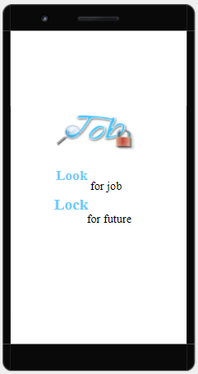
PROTOTYPE
1. SPLASH SCREEN

Slide 11
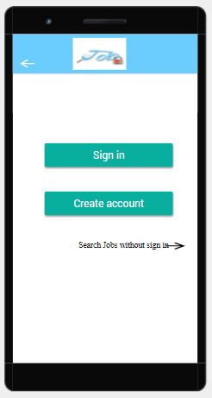
2. USER

Slide 12
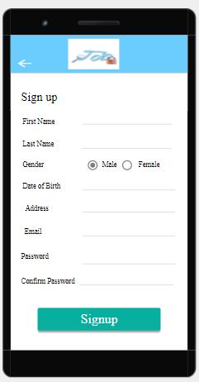
3. SIGN UP

Slide 13
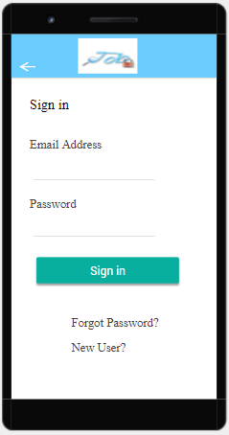
4. LOGIN

Slide 14
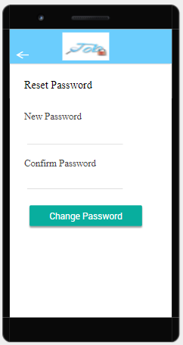
5. FORGET PASSWORD

Slide 15
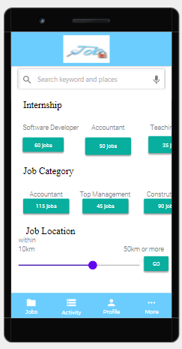
6. HOME

Slide 16
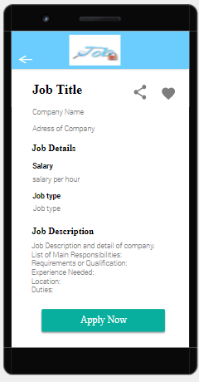
7. JOB DETAILS

Slide 17
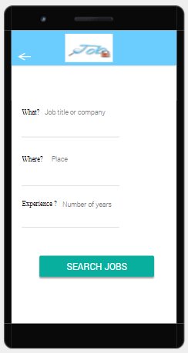
8. SEARCH

Slide 18
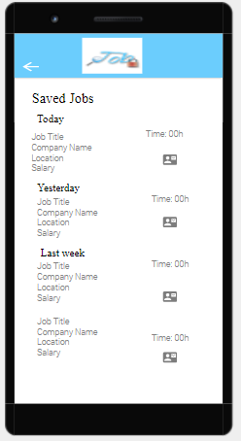
9. FAVOURITES

Slide 19
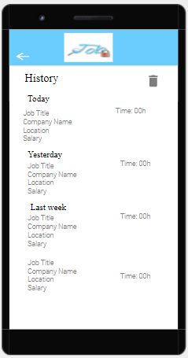
10. HISTORY

Slide 20
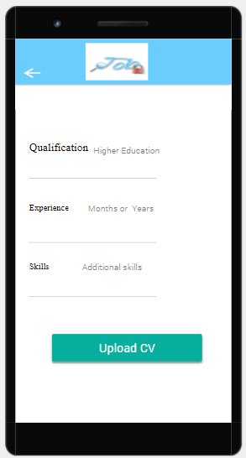
11. CV

Slide 21
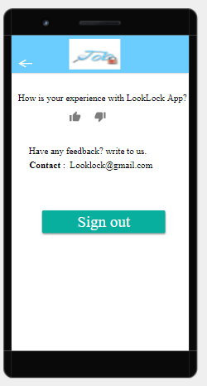
12. MORE INFO

Slide 22
THANKS

