Slide 1

Customer Support Ticketing System
Streamlining customer support with automation. Integrates Microsoft Forms, Azure Logic Apps, Outlook, Power Automate, and SharePoint.
by GURJYOT SINGH

Slide 2
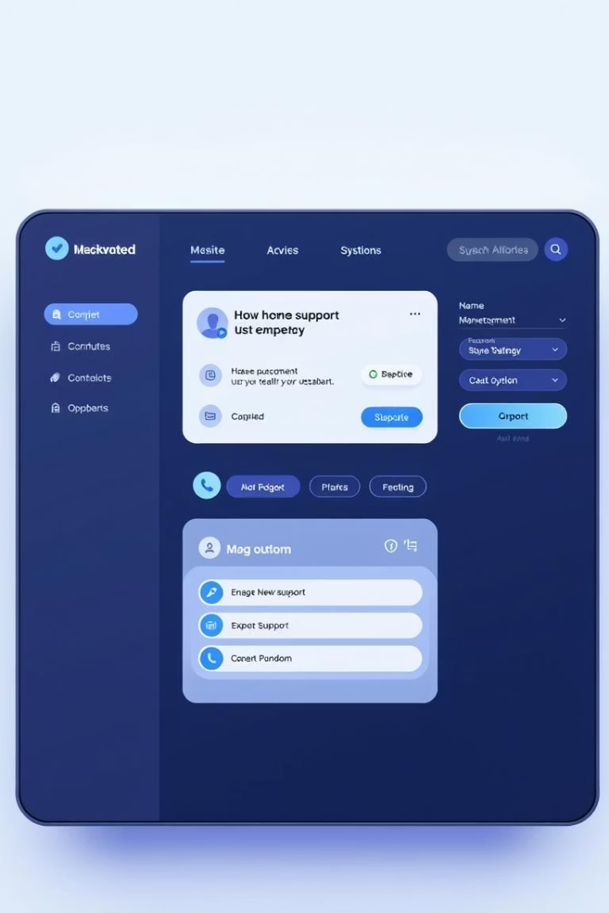
Objective and Key Features
1
Automated Ticketing
2
Timely Communication
Streamline handling of customer complaints and support requests.
Ensure organized and efficient communication.
3
Improved Satisfaction
Reduce manual workload and improve response time.

Slide 3
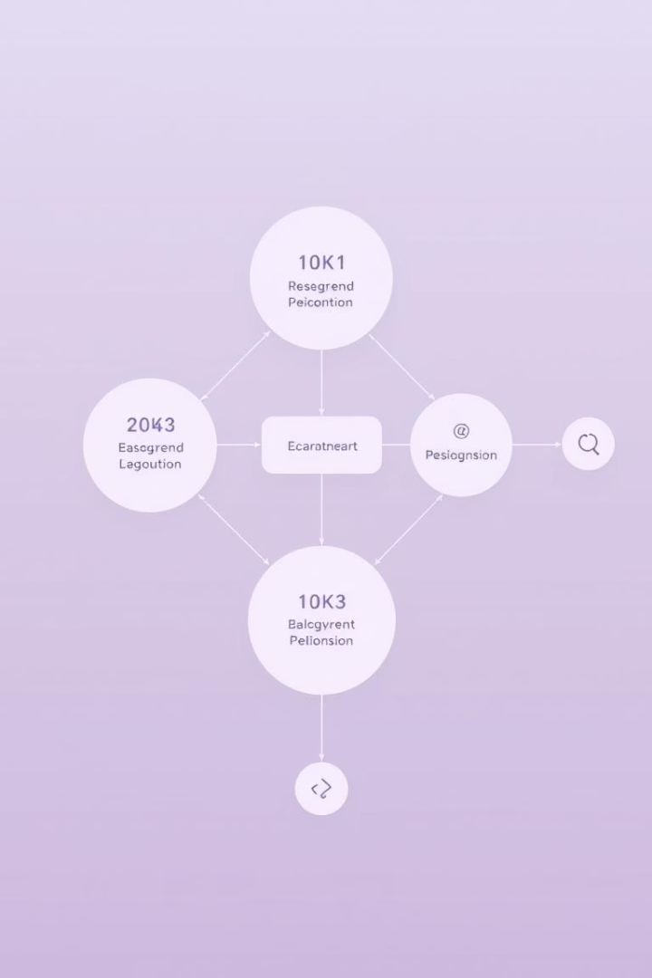


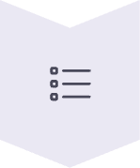

System Design
Microsoft Form
Collect structured ticket request details.
Logic Apps
Generate ticket IDs and assign tasks.
SharePoint List
Store form responses and ticket metadata.
Power Automate
Send status updates to customers.

Slide 4
Development and Deployment
Microsoft Form
Logic Apps
SharePoint List
Power Automate
Integrated with Logic App trigger.
Used Compose and Switch Case actions.
Built with columns to store ticket data.
Set up to monitor SharePoint List.

Slide 5

Testing and Validation
End-to-End Testing
Switch-Case Logic
Form submission to email delivery.
Ensured correct priority-based assignment.
SharePoint Integration
Verified data storage and retrieval.

Slide 6



Refinement and Finalization
Performance Optimization
Condition checks and redundant steps.
Feedback Collection
Data Validation
Form usability and email clarity.
Within Forms (number fields, inputs).
2
1
3

