Slide 1






MEDICAL COMPANY
HR Department
Notes:
Good day this is Gurkeet Singh from Cohort 36
This is our report for Group Project 2 Batch 3 titled…
HR Attendance Report for Medical Company

Slide 2

The HR department was tasked to make a report based on the attendance of the employees of the medical company. The CEO has asked for the following:
Identify the most disciplined and undisciplined employees and divisions;
Create a visualization with analysis of weekdays and months when the most employees were late/absent(either vacation leave or sick leave);
Which heads of department tend to forgive employees for lack of discipline? Are there any favorites for any heads of departments?
Notes:
A report based on the attendance of the medical company's personnel was required from the HR department. The following is what the CEO has requested:
Who is most likely to be late or absent
What days and months employees tend to take a leave
Are there favorite employes who usually get away with lack of discipline
AND WE will tackle all of that right now, but first let’s have a look at our methodology

Slide 3
Investigated the data set for data cleaning. Used Power Bi commands.
Removed unnecessary columns and columns with blank data.
Merge queries to join the tables based on the user id and date to calculate the statistics of tardiness based on personnel schedule and actual attendance.
Data Analysis using Power BI query and DAX measures.
Created a visualization using Power BI dashboards.
Methodology
Notes:
As for our METHODOLOGY
We first identified the problem and gathered the data available, the team proceeded as follows:
Loaded each csv file and transformed the attendance file first; then
Duplicated the attendance file TWICE to filter out the case-OUT apart from case-IN using PowerBI commands
We then removed unnecessary columns like first name and last name since it has blank data throughout
AFTER the cleaning part the team then;
MERGED queries to combine the filters, to perform calculation by use of conditional column and the M language to input the 10 minutes safe spots AND the above 2 hours late outliers. PAUSE
All the calculation made resulted to the identification of on-time log-in and log-out, late, and finally under time.
FINALLY; the team applied all queries and switched to Power BI desktop for visualization.

Slide 4

10 Minute Grace period
Notes:
Discipline
GREAT our first dashboard, in here we can clearly point out who among the employees punch in and out both on time as well as late
HAVE FUN!!
10 MIN SAFE SPOT
The dashboard is split into three parts, the top side contains the data for the employees themselves, then the bottom right is their corresponding gander, in which we can see is it mostly women, in terms of being late and working undertime, finally in the bottom left corner are the departments, in here we can see that though the support center has late log ins than the medical department BUT in relation to the employees who punch in on time is way less in comparison to the other viable departments, but generally the medical department has the most late employees and pharmacy has the most punctual ones. Upon time out it is pretty straight forward, the more the employees in general the more under timers, in this case the pharmacy department.
Now for the most disciplined employees, we can look up here on top were in it is listed who are the employees who come to work on time, namesssssssssssssss. Then on the contrary these are the employees who have the most late punch ins. Surprisingly we can clearly say who is the most disciplined when we look at the employees who log out on time, because thre of them are also employees who log in on time, and on the right there are the employees who leave early which are both men and women equally.
FINDINGS: the company gives short time parameters in terms of late comers.
RECOMMENDATION: the company should be tolerant or… lenient enough to set the PARAMETERS of late in minutes, to AN HOUR, to give… ample time for employees to log in.

Slide 5
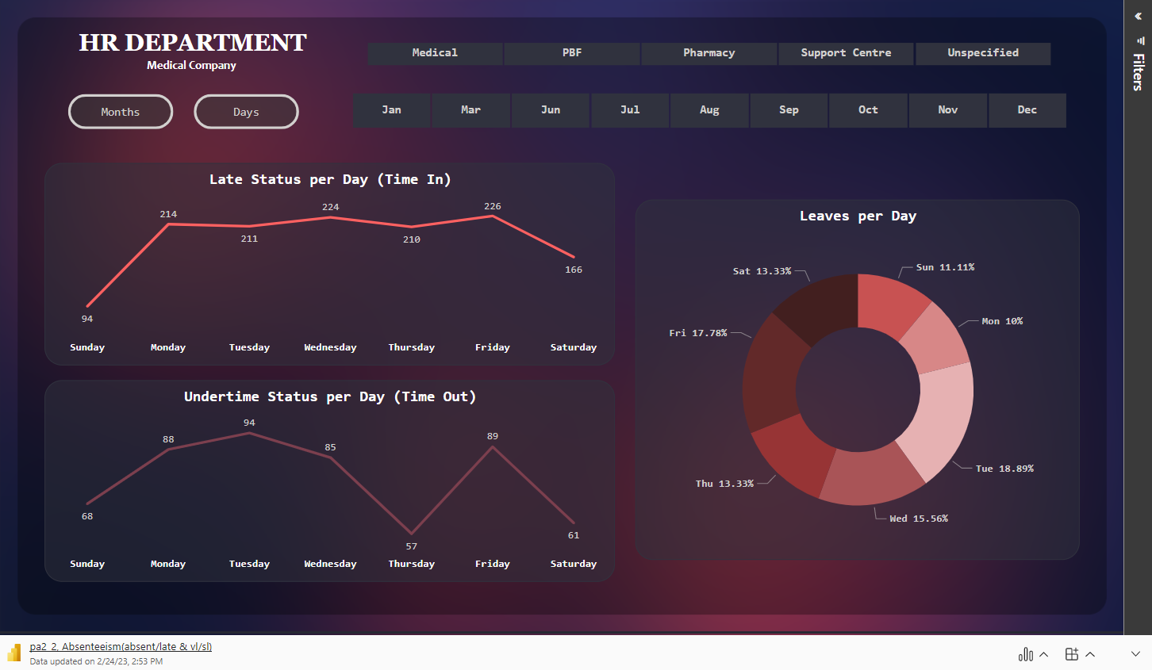
Notes:
Absenteeism
This dashboard visualizes all late, undertime and, leave statuses by month as well as weeks
Okay let’s start with months first.
HAVE FUNNNN!!!!!!!!!
Most leaves occur in JUNE and JANUARY, right after Christmas times and on summer days, OPPOSINGLY March has only one leave in a whole MONTH
Nurses bad but pharmacist weird
Correlation between leaves and undertimes on THURSDAYS

Slide 6
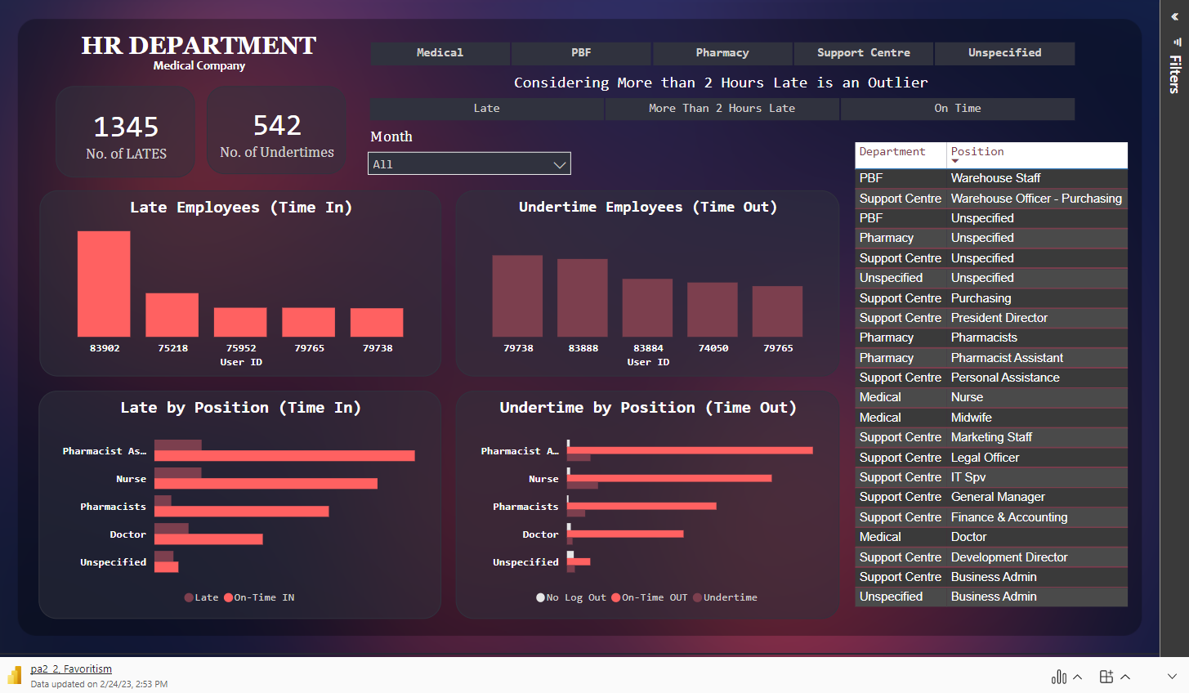
Notes:
Favoritism
Finally we have this dashboard visualizing if there are some departments that receive special treatment in terms of being late and/or working undertime
EXPLOREEEEEE!!!!!!!!!!!!!!!

Slide 7
We can implement stricter policies with regards to absenteeism, tardiness and undertime.
The HR drafts a memo regarding the attendance policy so that every employee is aware of the sanctions if they commit an attendance violation.
The HR department should reprimand the head of the Medical dept. They should monitor the tardiness/undertime of employees. Nurses in particular.
Same goes with the head of the Pharmacy department. They are responsible to deliver effective, safe, quality medicines, and services to achieve optimal health outcomes.
Recommendations
Notes:
NOW, as for our recommendations
We CAN implement stricter policies with regards to absenteeism, tardiness and undertime. Ex. Only 3 incidents of late is allowed per month or 1 absence per month. If an employee exceeds, disciplinary action will be issued. It will be progressive if an employee has the same violation in the following month.
The HR can draft a memo regarding the attendance policy to be signed by all employees so that they will be aware of the sanctions if they commit an attendance violation.
The HR department should reprimand the head of the Medical dept. They should monitor the tardiness/undertime of employees, especially the nurses. They play an important role in the medical company so it may affect the quality of service given to the patients if they don’t have enough nurses on duty.
Same goes with the head of the Pharmacy department. They bear a great responsibility to deliver effective, safe, and quality medicines and services.

Slide 8
Annual performance evaluation to employees focusing on attendance and punctuality.
During the hiring/recruitment process, HR must conduct an orientation seminar informing new employees about company policies on attendance and leave.
Implement a system to track the leave requests. Requests should be submitted at least a week in advance to avoid last-minute absences.
Allow employees to swap schedules provided that they’re in the same department and have the same position. That’s applicable if they can’t report to work on their original schedule or if their leave request was denied/rejected.
Recommendations
Notes:
We would also suggest an
Annual performance evaluation to employees focusing on attendance and punctuality. It can be the basis of their salary increase. This can motivate the employees to aim for a perfect attendance or minimal attendance violation.
During the hiring/recruitment process, HR must conduct an orientation seminar informing new employees about company policies both on attendance and leave.
Implement a system to track the leave requests. They should limit the number of employees that can be on leave per day per department. Requests should be submitted at least a week in advance to avoid last-minute absences.
Allow employees to swap schedules if they’re in the same department and have the same position. Only if they can’t report to work on their original schedule or if their leave request was denied/rejected. That can lower down the absenteeism/tardiness quite significantly in our opinions.

Slide 9
GROUP 2
- Acosta, Jillian Rechelle
- Clarito, Raquel
- Dela Cruz, Antonio III
- Ruiz, Rowena
- Singh, Gurkeet
Notes:
That I all for out report, we hope that added to the ever-growing success of the company.
This has been Gurkeet Singh representing group 2, have a GREAT day!

