Slide 1
Data Visualization and Dashboards with Tableau

Slide 2
Goals
The aim is to learn how to convert data into easily consumable visual insights using Tableau
Creating dashboards that help stakeholders make decisions based on a business questions
Communicating insights with the correct visualizations

Slide 3
Process
Chose the dataset FAA Wildlife Strikes, 2015
This is a cleaned table of wildlife strikes from 2000-2015 in the United States.
Data was connected and different data types were probed in the data
Different visualizations were built to understand more about the dataset
The main categorical features in the table are Effect, when and wildlife
Categorical features were analysed using appropriate numerical features
Tried identifying different trends, patterns and key insights in this dataset

Slide 4
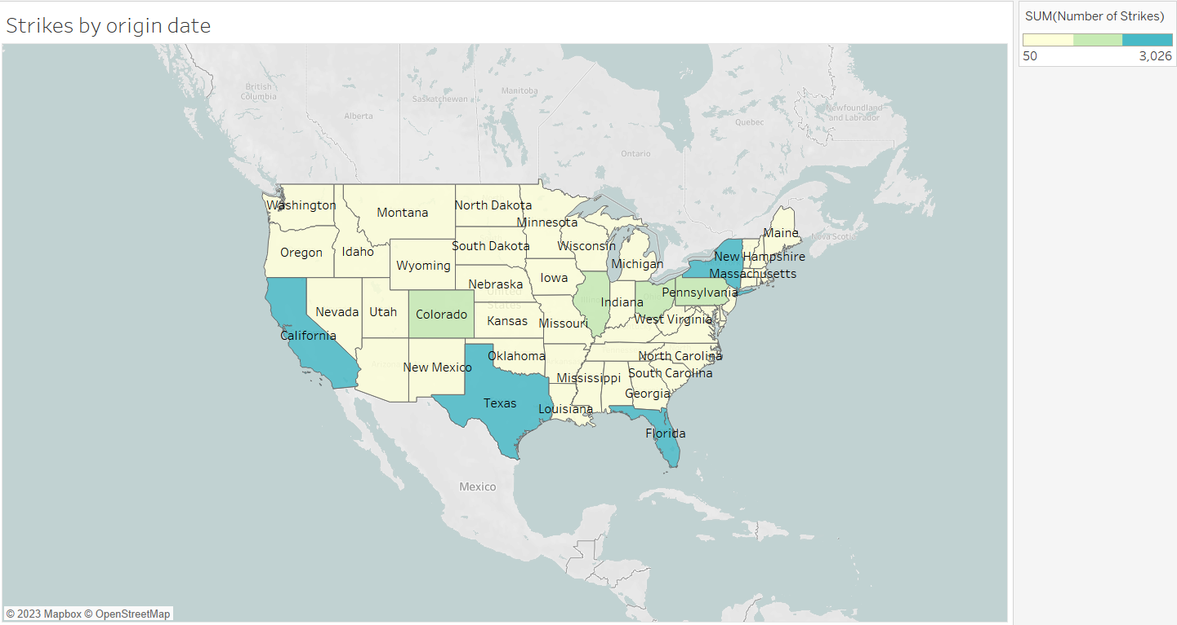
Geospatial occurrences of the strikes were visualized and it was found that state of California has highest number of strikes

Slide 6
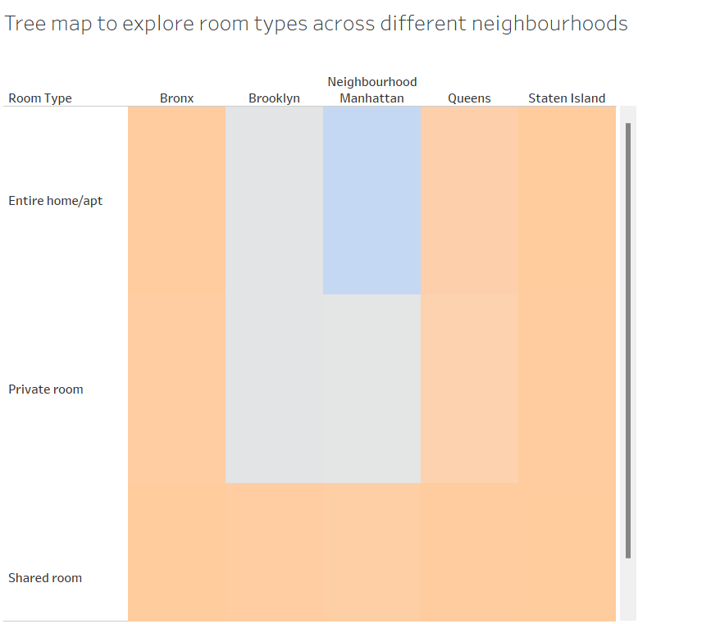

Slide 7
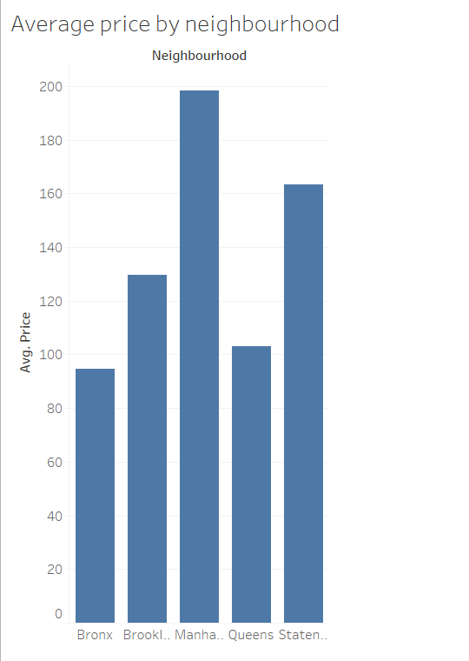

Slide 8
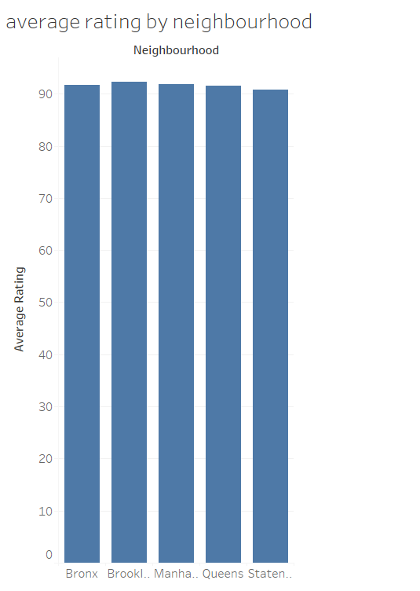

Slide 9
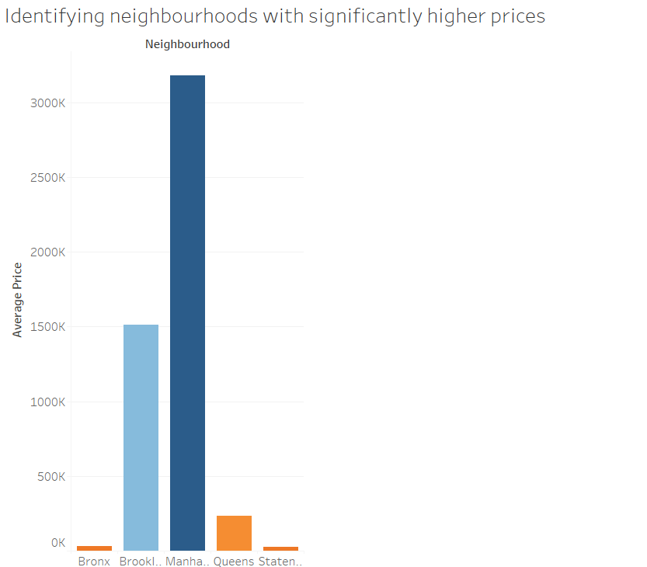

Slide 10
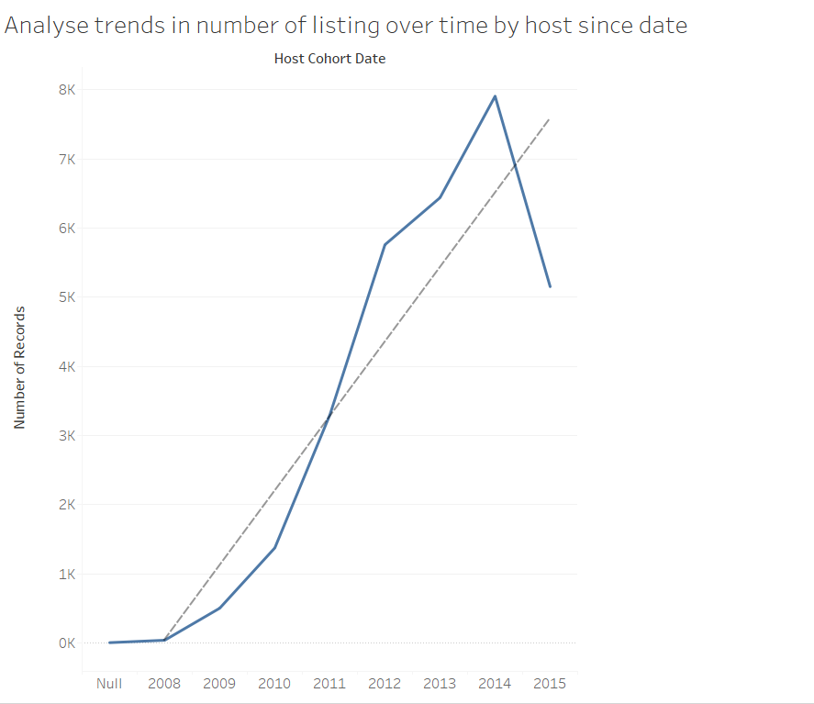

Slide 11
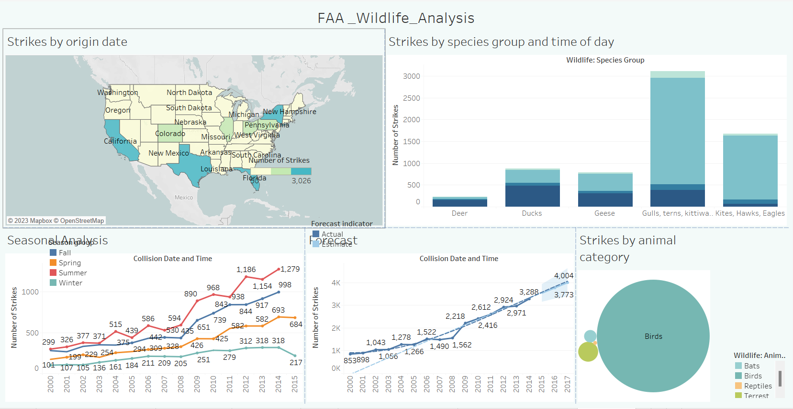

Slide 12
Challenges
Data inconsistency
Inconsistent formats for location lead to mapping errors
Complex data
There were diverse features related to aircraft type, phase of flight and damage effect which made task of clustering complex
Outlier detection
Ensuring that numerical data such as cost related variables are interpreted correctly
Time was biggest challenge

Slide 13
Future Goals
Explore in detail and practice Tableau
Implement clustering algorithms to identify strike clusters based on aircraft type, phase of flight and damage effect
Probe dataset further and answer more questions related to cost analysis, relation between effect of damage and phase of flight etc
Create a more comprehensive and interactive Dashboard

