Slide 1

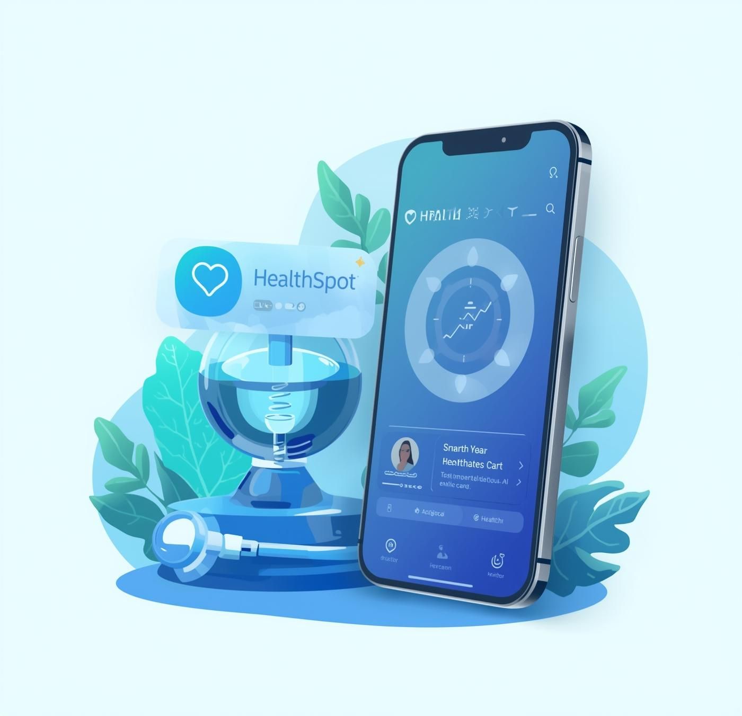
HealthSpot Solutions
PRESENTED TO
PRESENTED BY
Healthcare Professionals
Quan Devs

Slide 2
HealthSpot
Smart Healthcare Identity Solutions
HealthSpot Solutions
PRESENTED TO
PRESENTED BY
Healthcare Professionals
Quan Devs

Slide 3
Key Challenges in Healthcare Today
01
CENTRALIZED MEDICAL HISTORY
02
TRACKING PRESCRIPTIONS
Patients often struggle with fragmented medical records, leading to incomplete health information during treatment.
Difficulty in managing prescriptions causes confusion and medication errors, impacting patient safety and adherence.
03
FINDING THE RIGHT DOCTOR
04
EARLY DISEASE DETECTION
Patients frequently experience delays and frustrations when searching for specialists suited to their specific conditions.
The absence of AI-driven solutions limits proactive health management, resulting in late diagnosis and treatment of diseases.

Slide 4
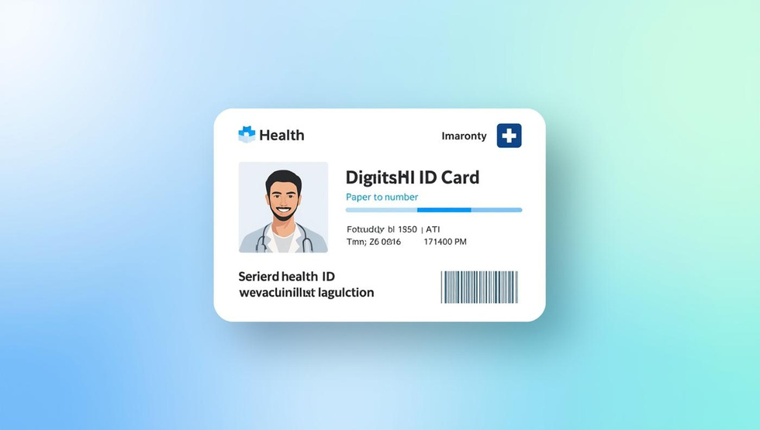

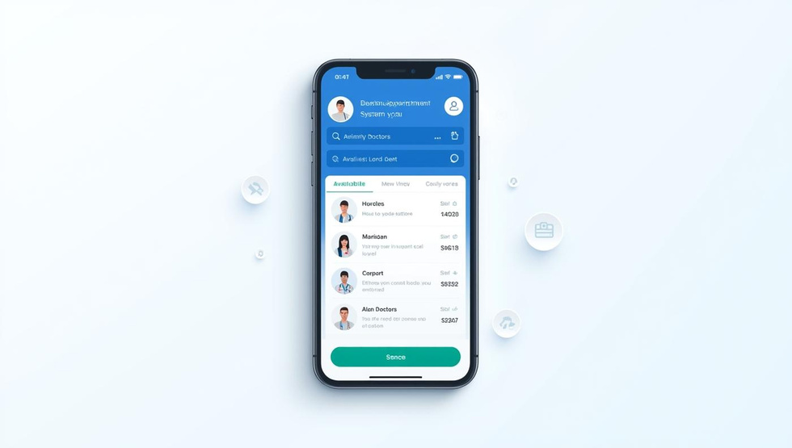
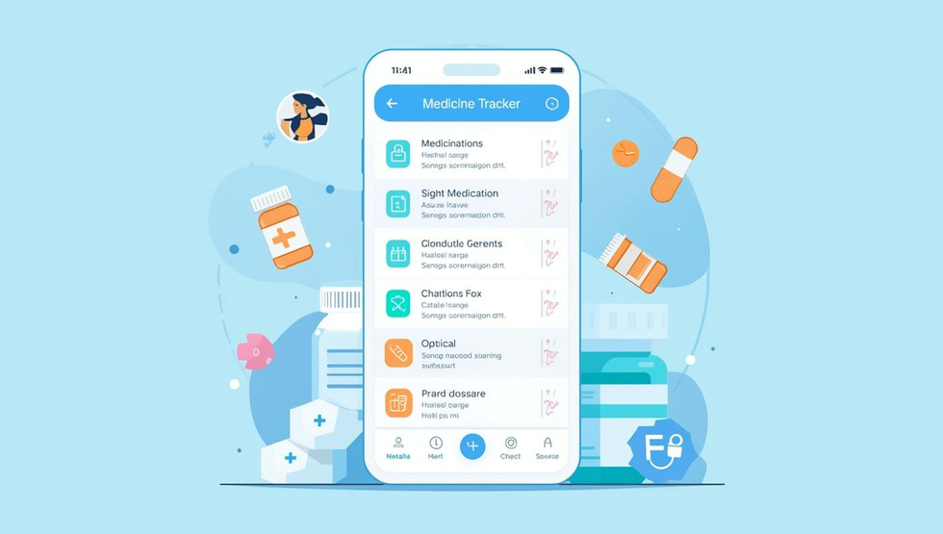

DIGITAL HEALTH ID CARD
SECURE MEDICAL DATA STORAGE
DOCTOR APPOINTMENT SYSTEM
A unique identifier ensuring seamless access to medical records.
Encrypted storage for confidential patient information and medical history.
AI-driven matching for finding the right doctors based on conditions.
MEDICINE AND PRESCRIPTION TRACKER
AI-POWERED DISEASE DETECTION
A user-friendly tool for managing medications and dosage schedules.
Analyzes data for early diagnosis and improved patient outcomes.

Slide 5
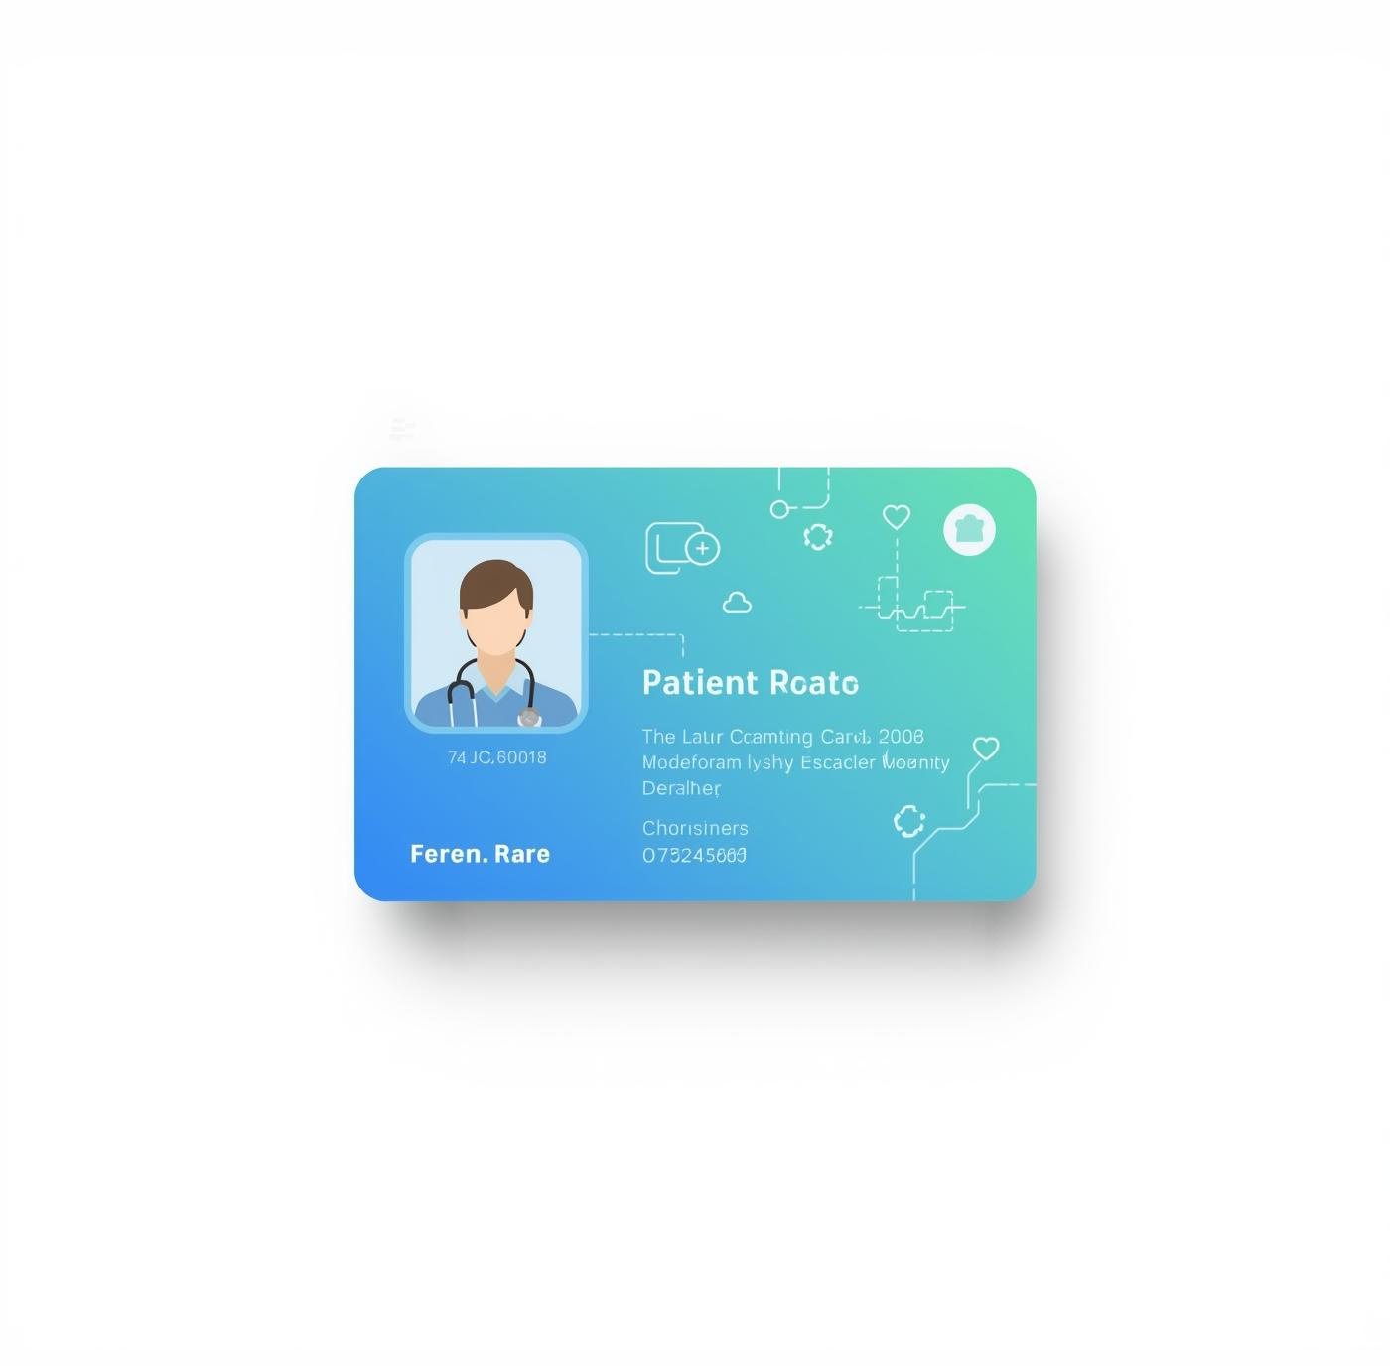
Digital Health ID Card: Universal Health Identity
The Digital Health ID Card simplifies patient identification by generating a unique ID. This universal identity facilitates seamless access to medical records across various hospitals, ensuring patients’ information is secure and easily retrievable.

Slide 6
Medical Data Storage & Security
PROTECTING PATIENT INFORMATION
Utilizing advanced encryption techniques, HealthSpot guarantees that sensitive patient information remains secure. Access is strictly controlled, ensuring that only authorized personnel can view or modify data. This robust security framework fosters trust between patients and healthcare providers, making health data management seamless and secure.
ENSURING SECURE, ENCRYPTED ACCESS FOR DOCTORS AND PATIENTS
COMPLIANCE WITH HEALTHCARE REGULATIONS
HealthSpot adheres to stringent regulations such as HIPAA and GDPR, ensuring compliance in all aspects of medical data storage. This commitment to regulatory standards reinforces our dedication to patient privacy and security, providing peace of mind to users regarding their medical information management and storage.

Slide 7
Doctor Appointment & Prescription Tracker
DIRECT APPOINTMENT BOOKING
The HealthSpot app allows patients to book appointments directly through the platform. With an AI-driven matching system, patients are connected to specialists suited to their specific health conditions, ensuring they receive timely care and reducing the hassle of finding the right doctor.
IMPROVED ACCESS, ADHERENCE, AND REDUCED MISUSE OF MEDICATIONS
DOSAGE REMINDERS FOR MEDICINES
Patients are provided with personalized reminders for their prescribed medications, improving adherence to treatment plans. This feature helps minimize the risk of medication misuse and missed doses, promoting better health outcomes and enhancing the overall patient experience in managing their healthcare.

Slide 8
AI-Powered Disease Detection
TRANSFORMING HEALTHCARE WITH AI
Integrating AI technology into healthcare can revolutionize disease detection. By analyzing patient data from blood tests and medical reports, AI can identify potential health risks early. This allows for timely interventions and personalized care, significantly improving patient outcomes and enhancing overall health awareness in the population.
AI IMPROVES EARLY DETECTION AND PATIENT AWARENESS.

Slide 9
Tech Stack Behind HealthSpot's Success
01
FRONTEND DEVELOPMENT
02
BACKEND TECHNOLOGIES
Built using HTML, CSS, and JavaScript for a responsive and interactive user experience.
Utilizes Python, JSON, APIs, and ML models for robust processing and data management.
03
SECURE DATABASE STORAGE
04
AUTHENTICATION MECHANISMS
Incorporates encrypted storage ensuring patients' medical data remains confidential and secure.
Employs a unique ID and QR code for secure patient identification and access control.
05
SCALABLE ARCHITECTURE
Designed for seamless integration with existing healthcare systems and future scalability.

Slide 10
Revenue Model: Freemium + Subscription Approach
01
BENEFITS FOR PATIENTS
02
BENEFITS FOR PROVIDERS
Patients can access essential features for free, promoting broader usage and improving healthcare accessibility.
Hospitals and clinics gain enhanced integration with HealthSpot, generating steady revenue through subscription fees while providing better services.

Slide 11
Premium Features Driving Revenue Growth
01
AI DISEASE ANALYZER
02
AUTOMATED HEALTH REPORTS
Access to the AI disease analyzer ensures early detection and improved patient outcomes, enhancing the user experience.
Patients receive automated health reports, providing insights into their conditions and progress, fostering proactive healthcare.
03
PRIORITY DOCTOR BOOKING
Priority booking offers patients expedited access to specialists, reducing wait times and improving overall satisfaction.

Slide 12
Advantages of HealthSpot's Smart Healthcare Solutions
01
CENTRALIZED DIGITAL HEALTH RECORDS
02
AI-DRIVEN EARLY DISEASE PREDICTION
HealthSpot offers a comprehensive view of patient data, ensuring seamless access and improved coordination among healthcare providers.
Utilizing AI technology, HealthSpot enhances early detection, leading to better health outcomes and timely intervention for patients.
03
FASTER DOCTOR MATCHING
04
PAPERLESS HEALTHCARE
The app's intelligent matching system connects patients with the right specialists, improving diagnosis accuracy and treatment efficiency.
By digitizing records, HealthSpot eliminates paperwork, reducing administrative burdens and the risks of lost or misplaced documents.
05
ENHANCED DOCTOR-PATIENT COMMUNICATION
HealthSpot fosters open dialogue between doctors and patients, leading to increased engagement and a better understanding of health issues.

